Slide 1
Project on: Typing Master Software
Group Members:
Aniket. V. Warade
Subodh. V. Deshmukh
Sandesh. N. Bhoir
Piyesh. K. Patil

Slide 2
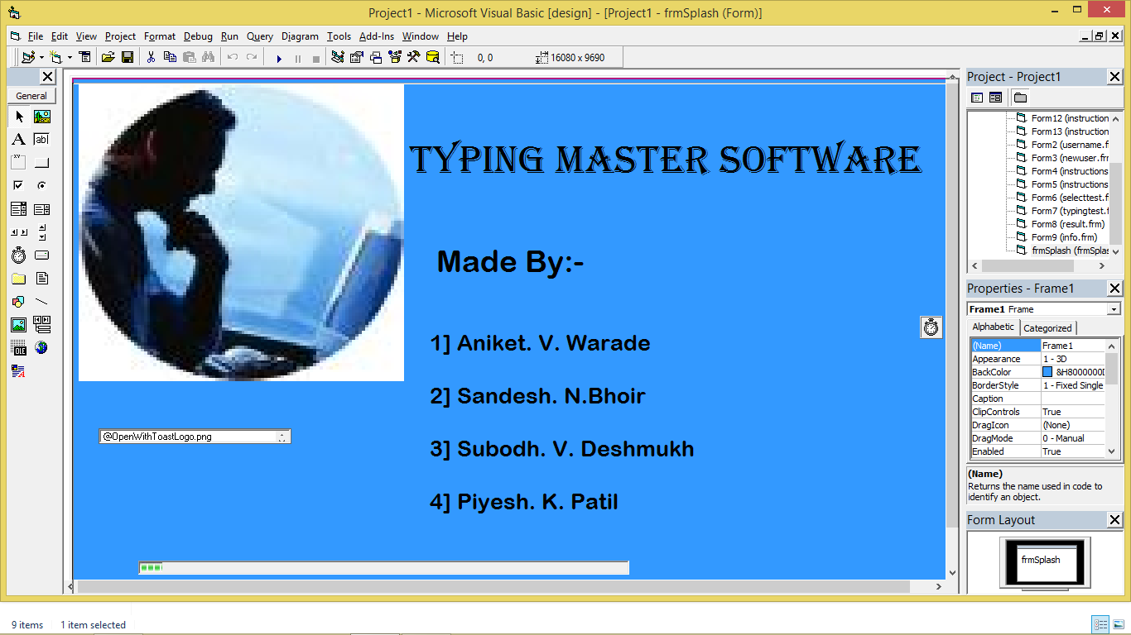
Load Form

Slide 3
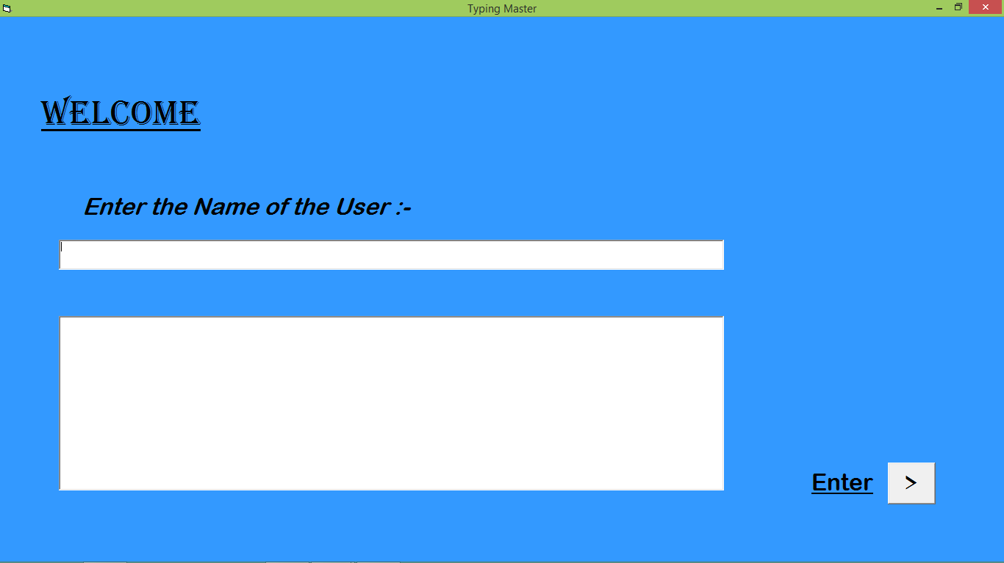
User Name Form

Slide 4
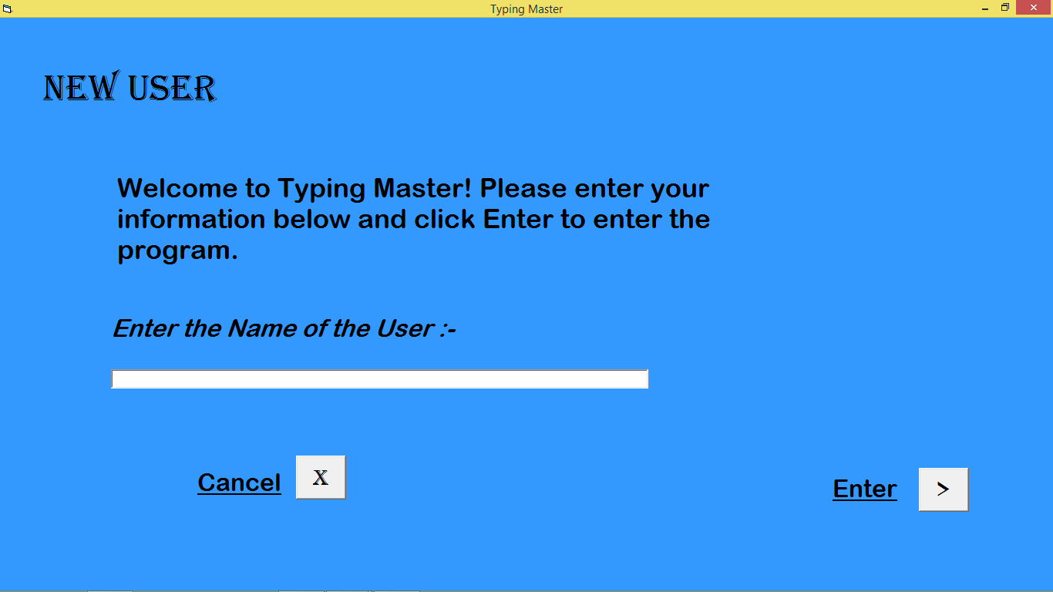
New User Form

Slide 5
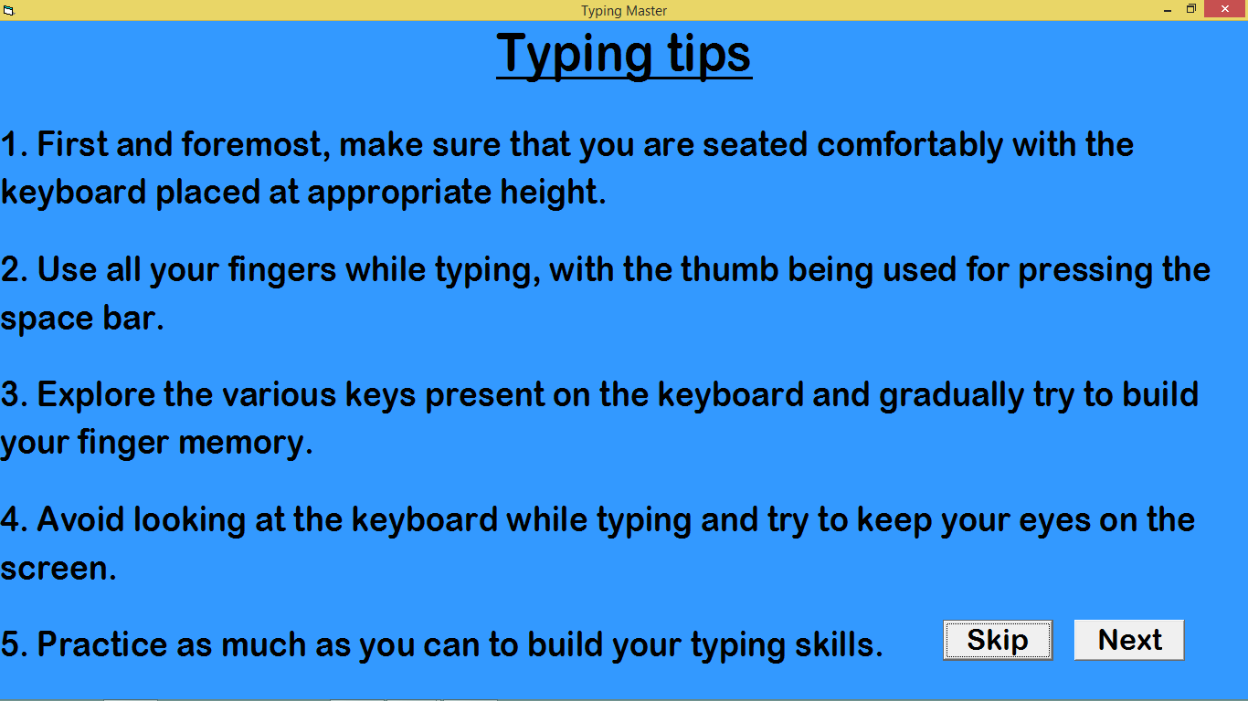
Typing Tips Form

Slide 6
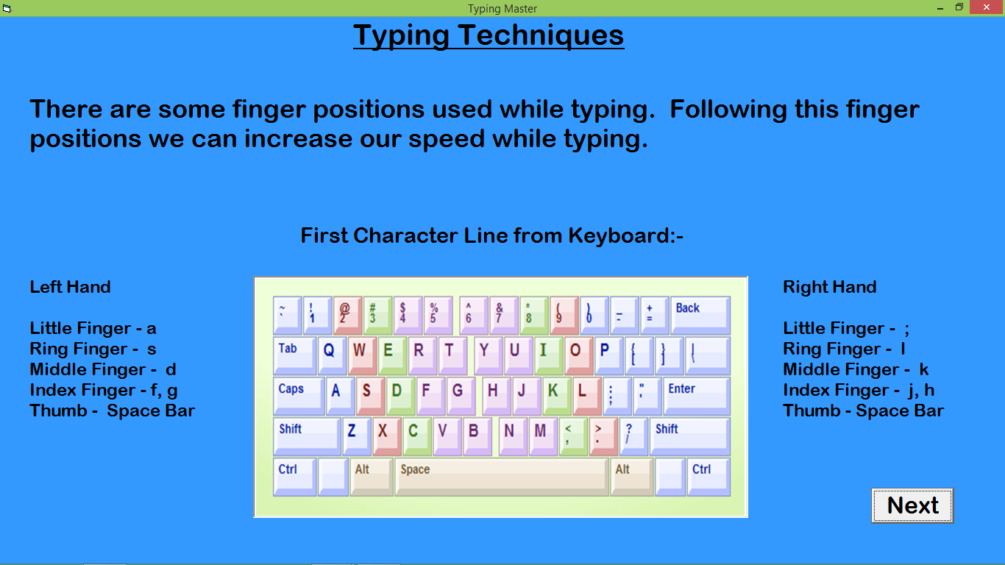
Typing Instructions1 Form

Slide 7
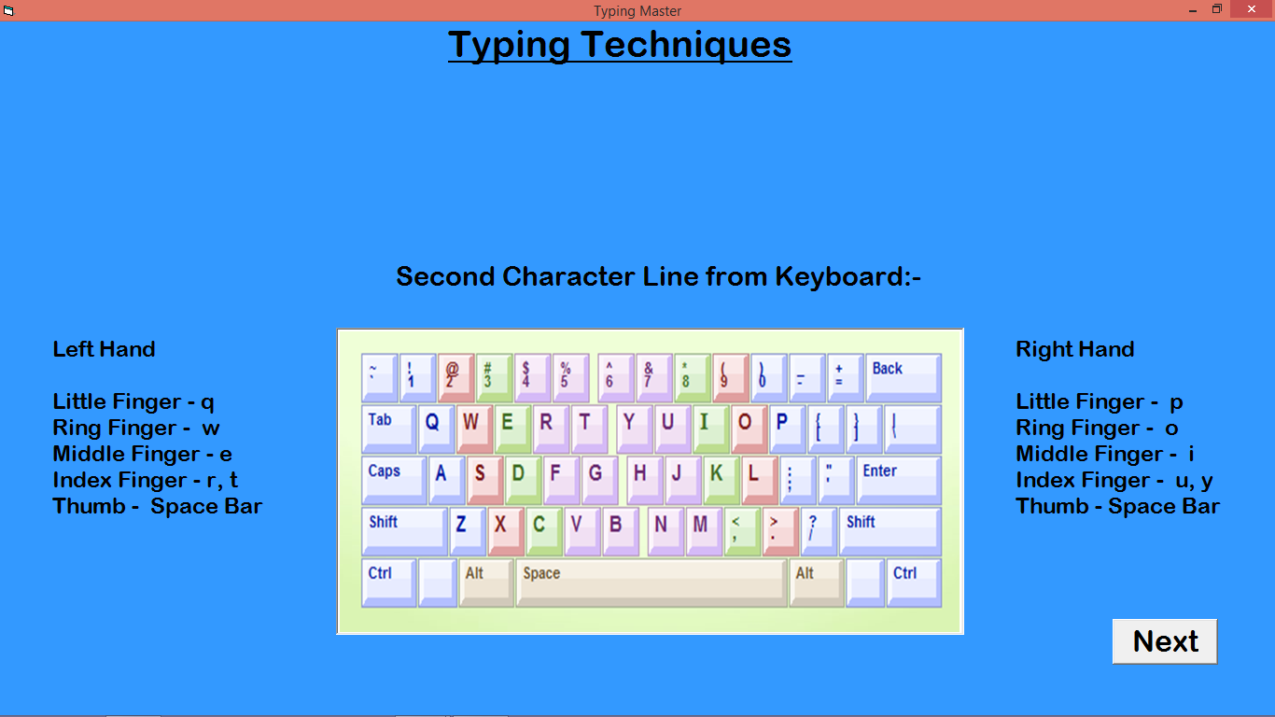
Typing Instructions2 Form

Slide 8
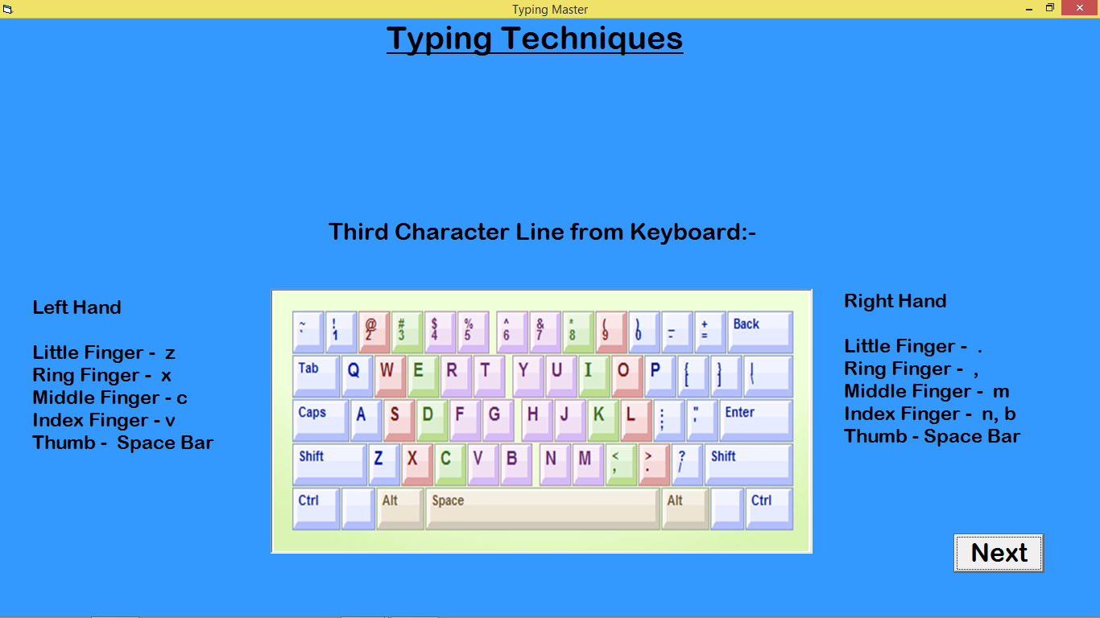
Typing Instructions3 Form

Slide 9
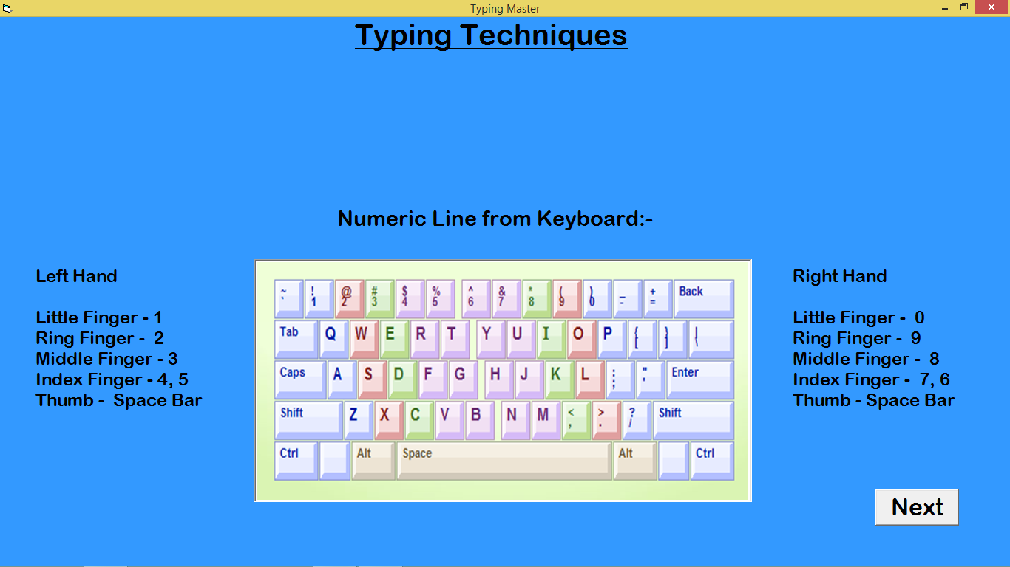
Typing Instructions4 Form

Slide 10
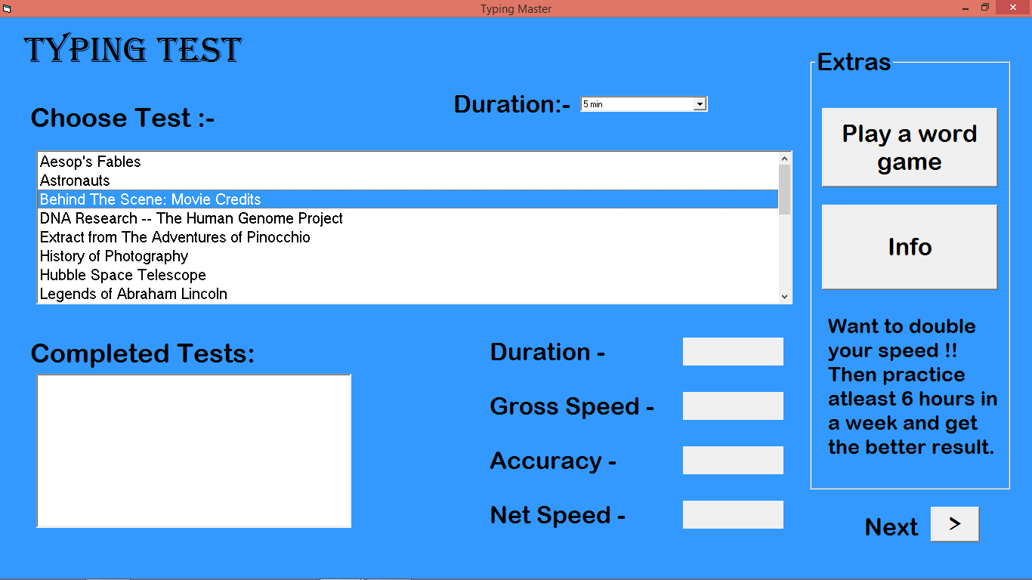
Select Test Form

Slide 11
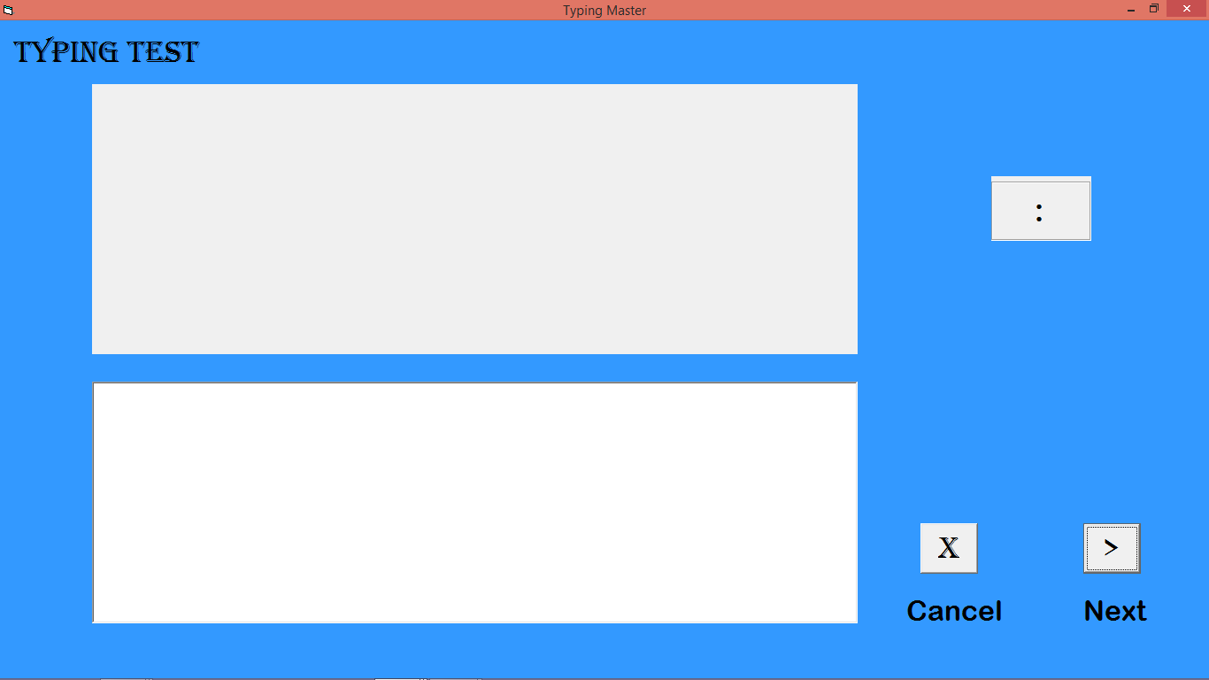
Typing Test Form

Slide 12
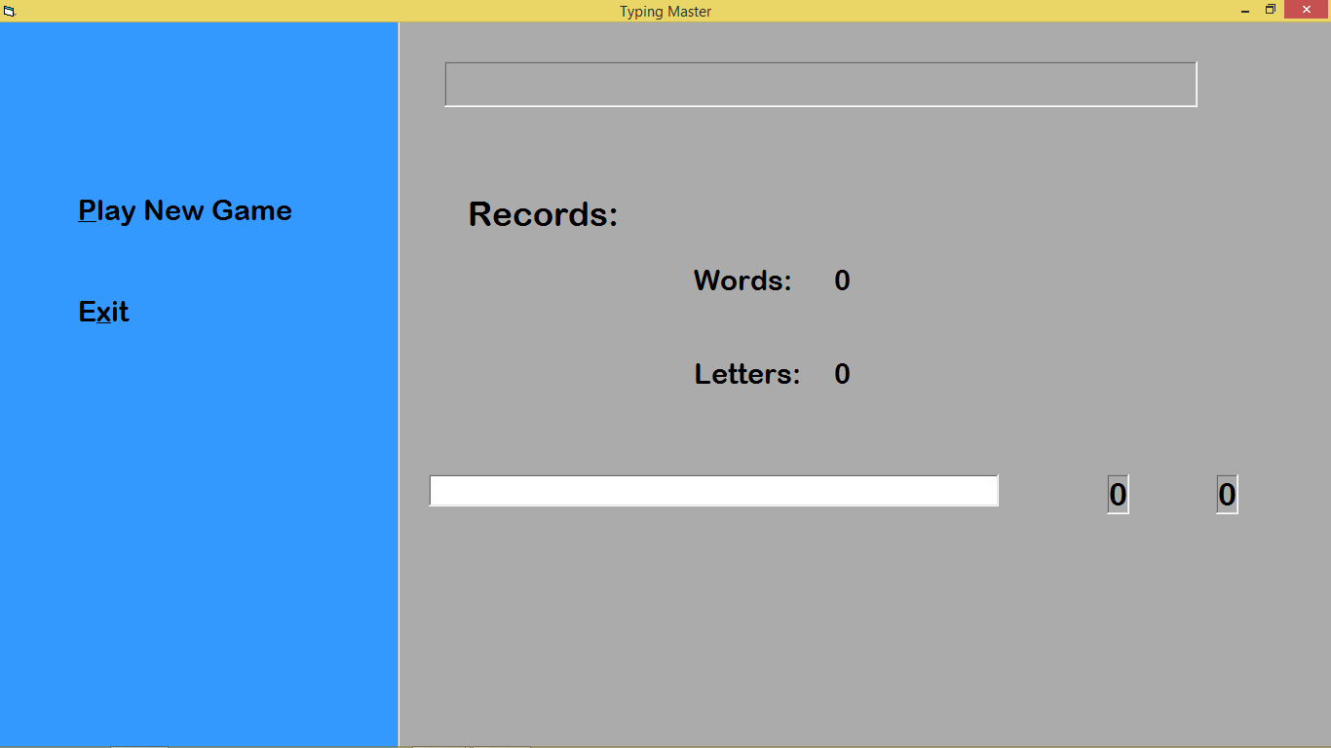
Word Game Form

Slide 13
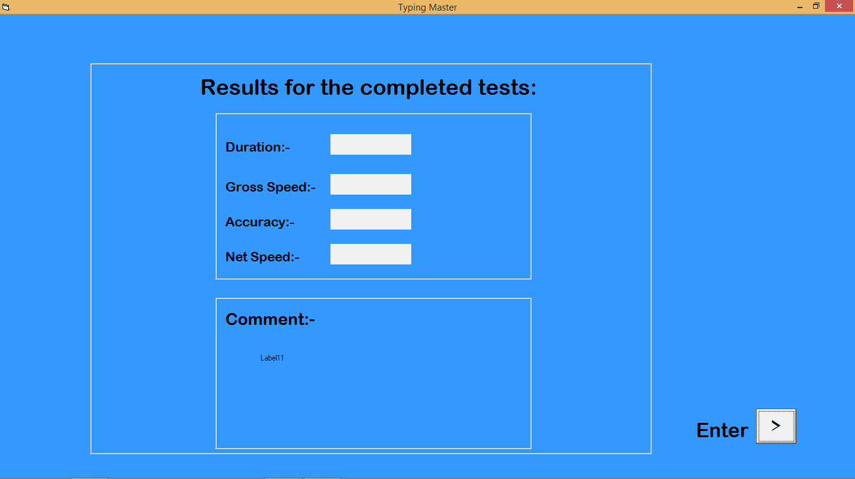
Display Result Form

