Slide 1

Exploring CO2 Emissions Around the World
Global carbon emissions are at an all-time high, resulting in dire consequences for our planet. Let's explore a machine learning project focused on understanding and mitigating CO2 emissions worldwide.
by Aniket Chavan

Slide 2

Today, we embark on an exciting journey at the intersection of
environmental science and cutting-edge technology.
Climate change, driven by the increase in greenhouse gases,
especially carbon dioxide (CO2), is one of the most pressing challenges of our time.
In this presentation, we will explore how machine learning algorithms
can be harnessed to predict, analyze, and eventually mitigate CO2 emissions
across the globe. By leveraging the vast troves of data available to us,
we aim not only to understand the patterns in CO2 emissions but also to foresee
potential trends, enabling us to make informed decisions and formulate proactive
policies.

Slide 3
Objective :
The objective of this project is to analyse CO2 Emission around the world by using the
Machine Learning models / Algorithmns like :
LINEAR REGRESSION.
& classification with
LOGISTIC REGRESSION.
SUPPORT VECTOR MACHINE ( SVM ).
NAÏVE BAYES.
K NEAREST NEIGHBOUR KNN ( KNN ).

Slide 4

METHODOLOGY :
PROBLEM DEFINATION
DAA COLLECTION
DATA PREPROCESSING
CHECKING NULL VALUES,
FILLING NULL VALUES,
CHECKING FOR OUTLIERS.
EXPLORATORY DATA ANALYSIS.
PLOTTING THE REQUIRED PLOTS
FOR VISULIZATION OF DATA.
FEATURE ENGIONEERING.
ENCODING AND STANDARD SCALING.
MODEL DEVELOPMENT
TUNNING
WITH GRID SEARCH & RANDOM SEARCH.

Slide 5
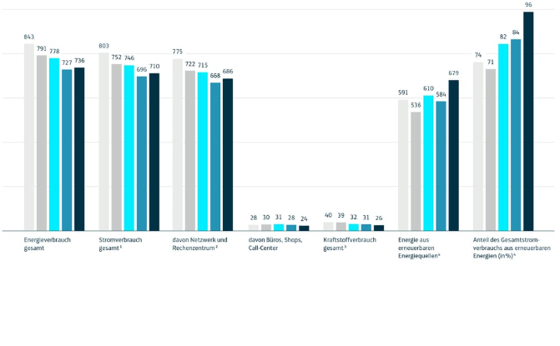
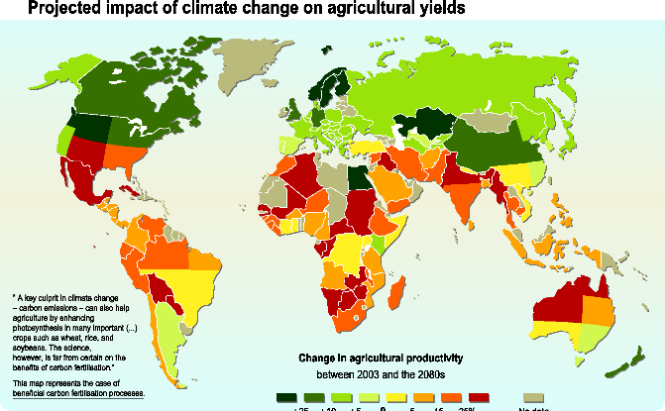
Model Selection and Training
Algorithms
Training Process
We tested multiple machine learning algorithms, including linear regression, logistic regression, svm, naïve bayes and knn to identify the best ones for our project.
We used a random subset of the data to train our models, using techniques such as cross-validation and hyper-parameter tuning to ensure high accuracy and avoid overfitting.

Slide 6
Result :
FOR LINEAR REGRESSION.
Accuracy : 80%
RESULTS | LR | L1 ( LASSO ) | L2 ( RIDGE )
MAE | 4.34 | 3.38 | 4.29
MSE | 134.44 | 145.52 | 132.51
R2 | 0.80 | 0.79 | 0.80

Slide 7
Result : Before Tunning
RESULT | LOGISTIC REGRESSION | SVM | NAÏVE BAYES | KNN
ACCURACY | 99% | 76% | 97% | 70%
PRECISION | 99% | 79% | 96% | 78%
RECALL | 99% | 86% | 99% | 74%
F1-SCORE | 99% | 83% | 98% | 76%

Slide 8
Result : After Tunning
RESULT | LOGISTIC REGRESSION | SVM | NAÏVE BAYES | KNN
ACCURACY | 99% | 80% | 94% | 73%
PRECISION | 99% | 82% | 99% | 80%
RECALL | 94% | 76% | 99% | 78%
F1-SCORE | 96% | 78% | 90% | 79%

Slide 9

Conclusion:
After performing different types of algorithm on the co2 Emission dataset we could see that each algorithm's model perform differently in order to classify the data and providing accuracy of doing the same.
from the table above we can clearly conclude that the linear regression model is performing well on the dataset giving us accuracy of 80% which shows how good it gives the relation between dependent and independent variables.
In classification models however the accuracies of all the models i.e. logistic,SVM,naive bayes,knn have accuracy of LOS = 99% , SVM = 80% , Naive Bayes = 90% and KNN = 73% showing that their ability to classify the data is well, but if we want to choose one model out of these we would go for Linear Regression as its accuracy is Best.

Slide 10

FUTURE STEPS:
Let's Take Action Together
As individuals and as a community, we can take action now to reduce our carbon footprint and help protect our planet. Let's work together to create a cleaner, more sustainable future.
Aniket chavan

