Slide 1

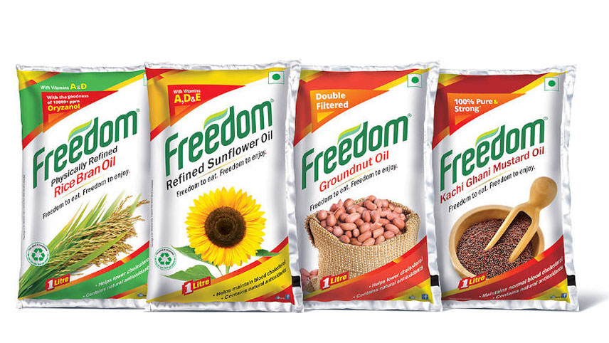

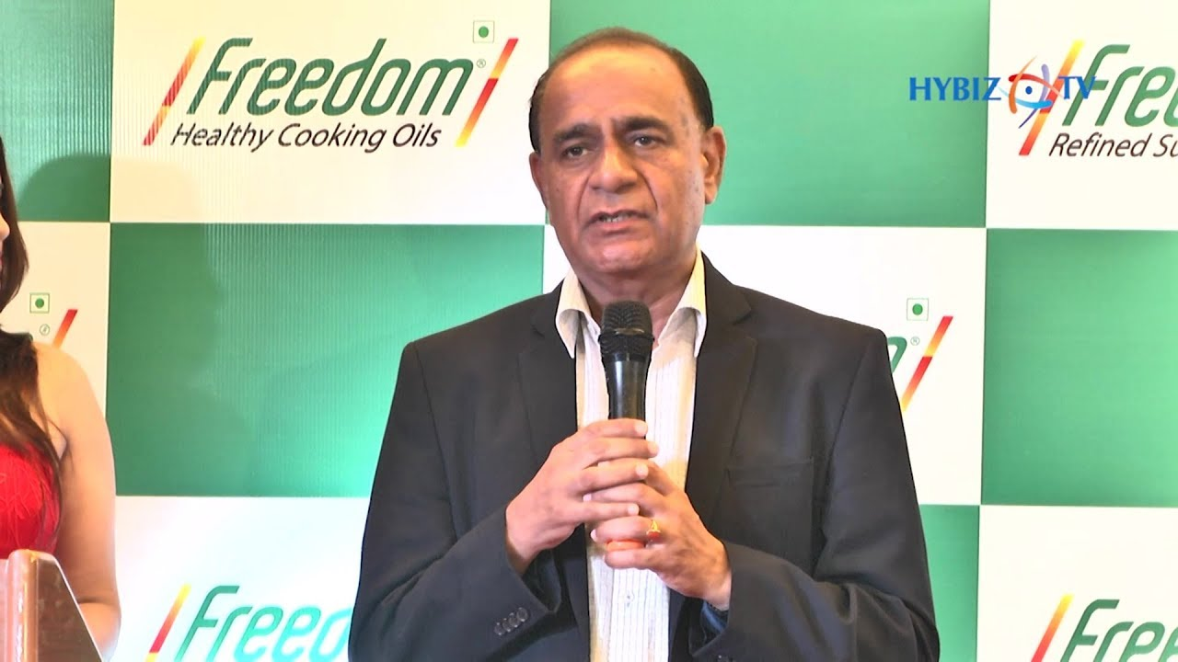

Case Study
MBA631A
Group 10
Gemini Edibles and Fats India Ltd. (GEF)
INSTRUCTOR : Mr. AMIT SHUKLA

Slide 2
BACKGROUND
Gemini Edibles & Fats India Private Limited (GEF) was founded in 2009 in Andhra Pradesh by Mr. Pradeep Chowdhury.
Mr. Pradeep Chowdhury, first generation professional turned entrepreneur, had years of experience with a edible oil company in India.
GEF’s business strategy consists of import, processing, trading and marketing of edible oils and speciality fats.
Introduced it’s oil brand, Freedom, in AP in February 2010.
GEF planned to set up two new refineries in Krishnapatnam and Kakinada, both in AP.
GEF invested INR 150 crores at it’s initial stage.

Slide 3
MARKET CONDITION (BEFORE FEB’10)
The edible oil market was like a commodity market with low margin.
Almost 99.8% household penetrate edible oil in AP.
Loose oil penetration was significantly high but that was declining fast in recent past times. It also captured around 45% of market share.
Purchase Particulars | Household Penetration
Loose oil | 44.9%
Pre-packed | 34.6%
Both | 20.3%
Did not purchase oil | 0.2%

Slide 4
MARKET CONDITION (BEFORE FEB’10)
The oil market was quite complex. The below table shows the market share (by volume) of existing share at the time of launch of Freedom.
Brand | Level | Market share
Gold Drop | State level | 29%
Naturralle | State level | 15%
Crystal | State level | 12%
Vijaya | State level | 8%
Fortune | National level | 7%
Priya | State level | 4%
Others |  | 25%

Slide 5
CHALLENGES AHEAD
Making high quality oil.
Taking right position in market and right marketing decision.
Acquiring market shares from existing players.

Slide 6

Product
Freedom is a brand that maufactures and market refined oils and fats of best quality.
Price
=> PTD was kept INR 2 below the brand leader.
=> PTR of Freedom gives INR 1.25 – 1.80 more profit to the retailer than Brand leader.
Place
=> Regional Market of AP was chosen for the launch campaign
=>
Promotion
=> Top TV programs selected based on price and TRP (Sponsor “Maa Voori Vanta”)
=> Sales Promotion like TBTL was used for trade push

Slide 7
SWOT ANALYSIS

Slide 8
Results (Performance till Dec 2010)
Exceeded all targets and expectations with good launch campaign
Retail focused distribution, excellent packaging, superior communication, aggressive media presence and excellent quality were the main success drivers
Achieved distribution targets and far exceeded sales targets
Key Takeaway: The market was growing and consumers were not reluctant to try a new brand with overall superior offering than the already established brands.

Slide 9
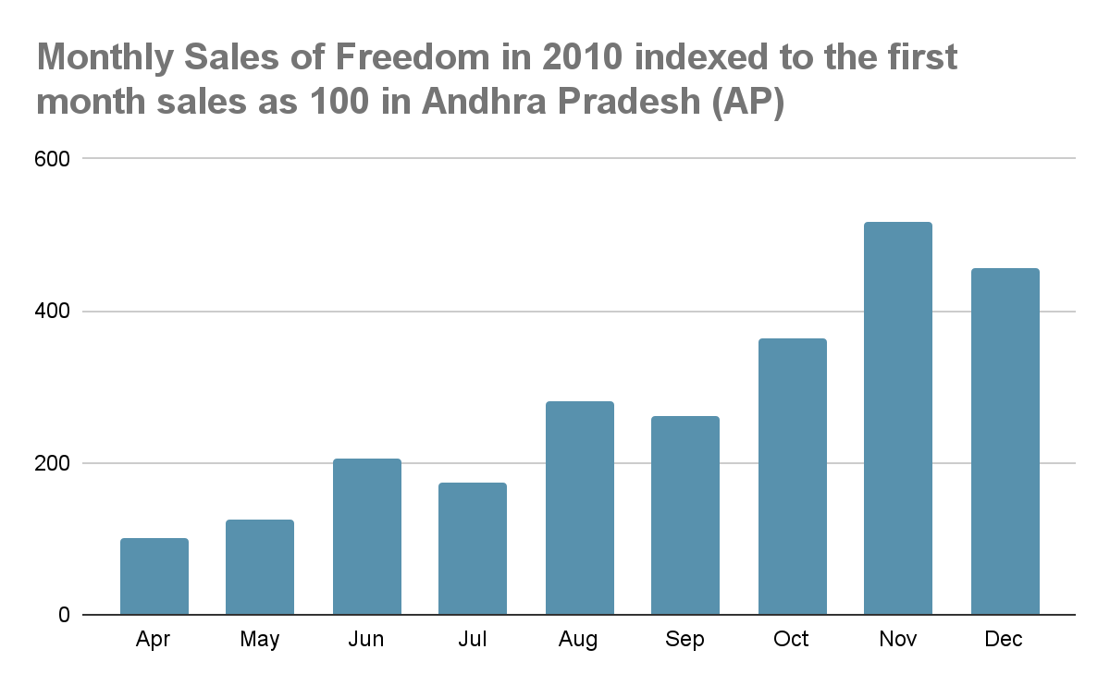
Market Shares of Brands: Last Quarter 2010
Brand | Market Share by Volume
Gold Drop | 29%
Naturalle | 14%
Crystal | 11%
Vijaya | 8%
Fortune | 7%
Priya | 4%
Freedom | 3%
Others | 24%
Sources: Internal sources
Sources: Internal estimate

Slide 10
ROAD AHEAD
The Freedom Brand had done well and this led to management setting aggressive targets for the upcoming year.
The Brand Manager, Kapil, was looking beyond just sales numbers and wanted to get a Brand Health check done.
He prepared a brief for the research agencies to get input regarding profile of Freedom Consumers.
Perception of the Brand, Effectiveness of the message and efficiency of media(as they had spent a lot of money on TV advertisement).

Slide 11
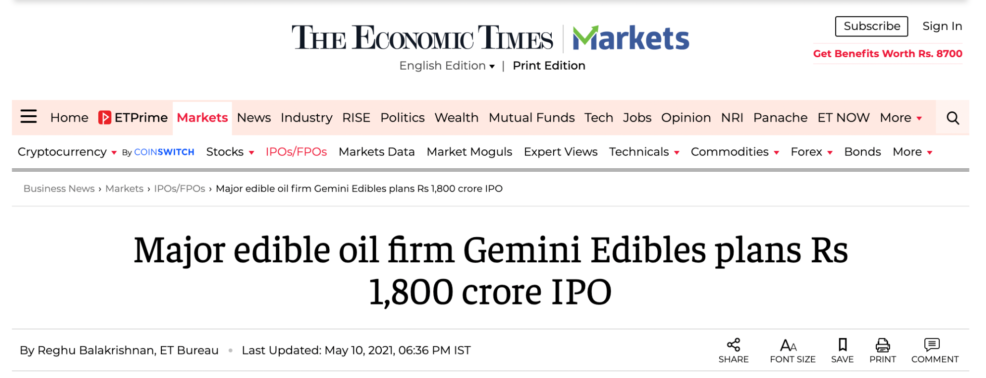
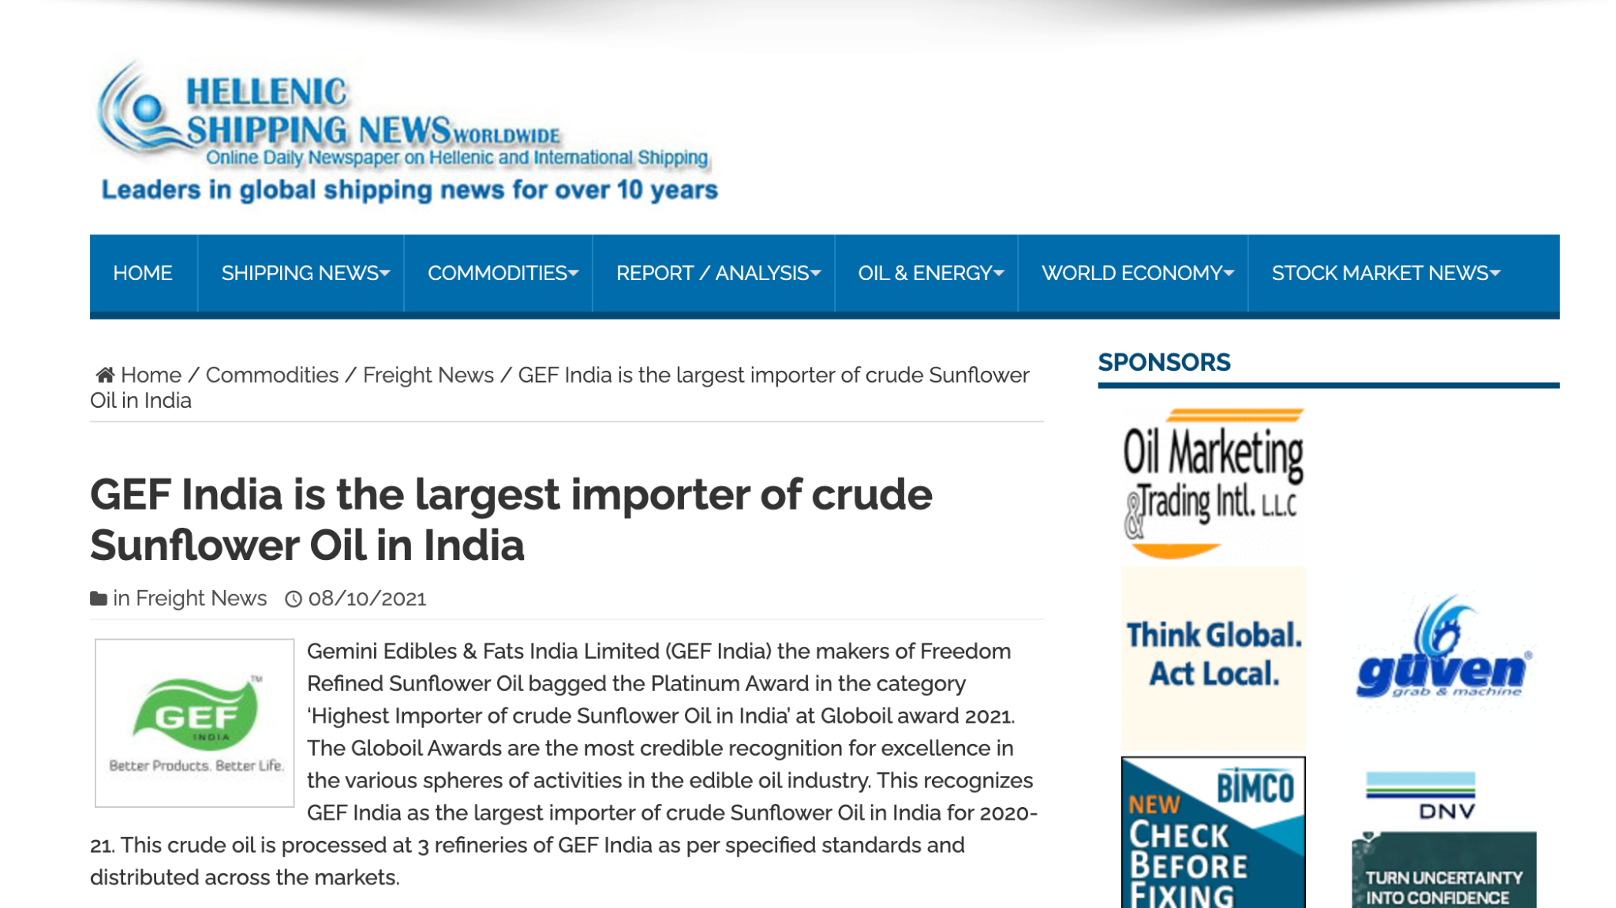
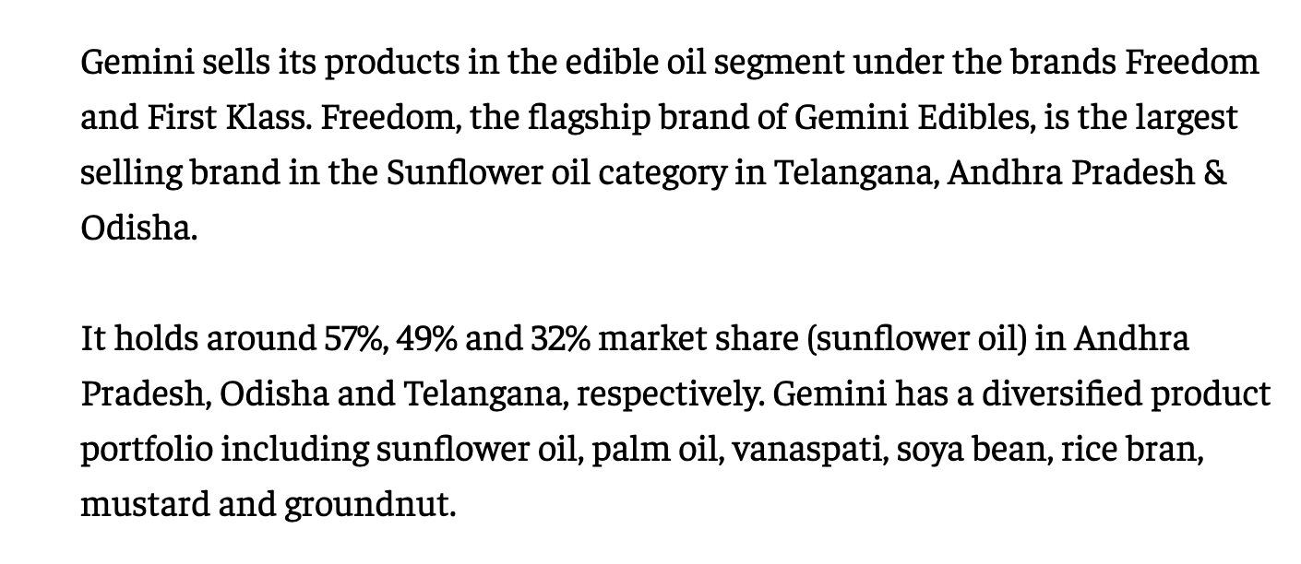
Recent Developments (2021)
Sources: https://www.hellenicshippingnews.com/gef-india-is-the-largest-importer-of-crude-sunflower-oil-in-india/
Sources: https://economictimes.indiatimes.com

Slide 12
.
.
Thank you!

