Slide 1




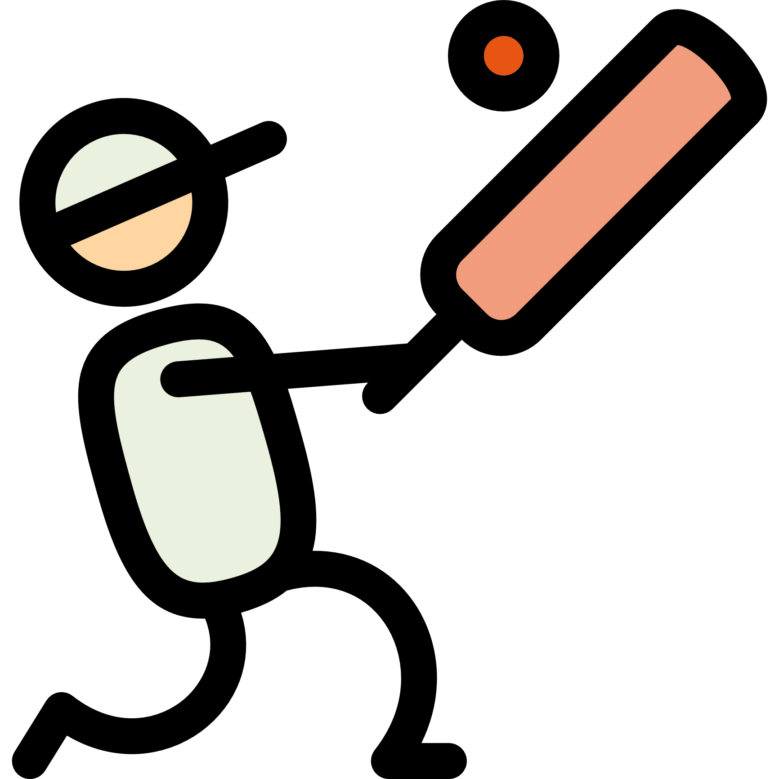





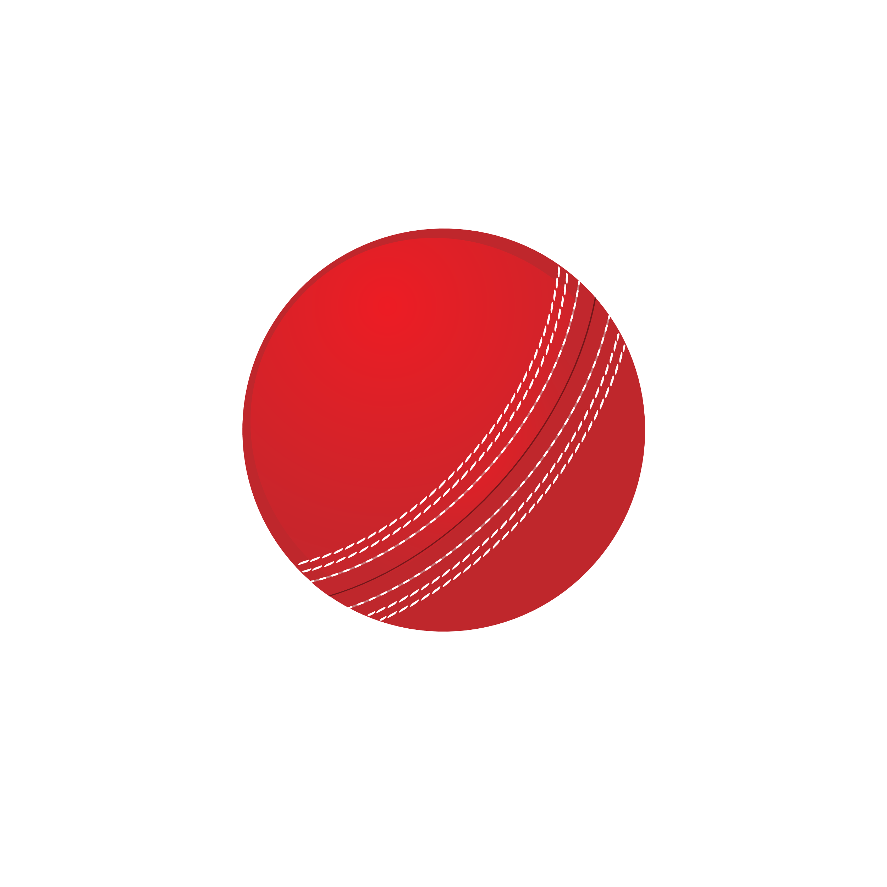





Meetings
Here you can add
some brief texts
9
Crictual
The desktop application
Birthday
Here you can add
some brief texts
17
Presentation
Here you can add
some brief texts
21
Report
Here you can add
some brief texts
26

Slide 2

Concept :
This is a desktop application game which is a replica of the famous hand cricket game played for entertainment by school students, children etc.

Slide 3

Team :
Name : Kajjam Aniketh

Slide 4


Introduction:
Cricket is a bat-and-ball game played between two teams of eleven players on a field at the centre of which is a 22-yard (20-metre) pitch with a wicket at each end, each comprising two bails balanced on three stumps

Slide 5
Our version:
Here in our game the user will play with the computer. This game consists of zero to six numbers. The target will automatically get assigned, you just have to beat the total set by the computer. So, we have used pyqttsx3 for the voice over whenever you get into the game, get out or beat the target. A message box will also be generated when the player either surpass the score or gets out.

Slide 6
Requirements:
Python
1
Tkinter
2
Pyttsx3 module
3
Vs Code
4

Slide 7
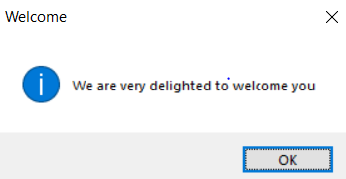
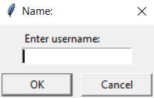
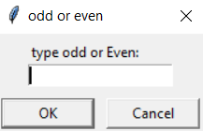
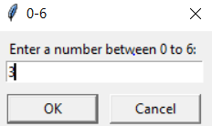



OUTPUT:

Slide 8
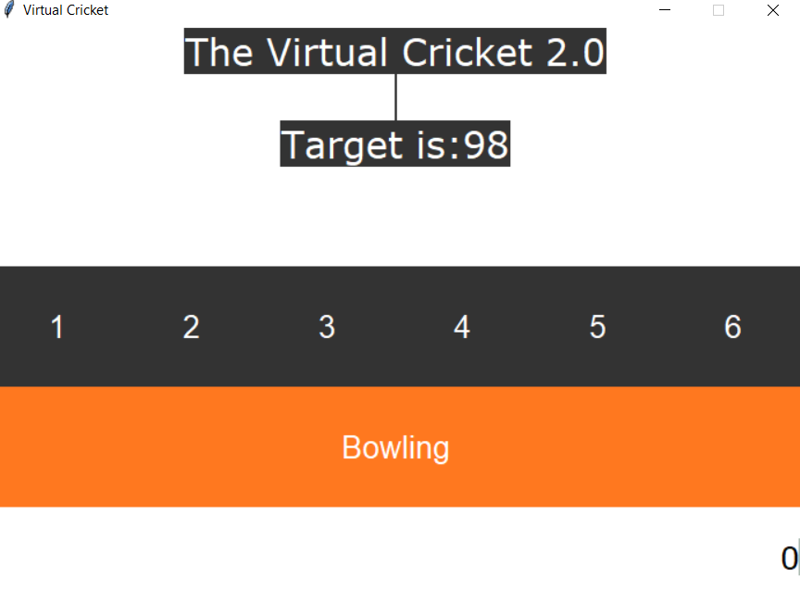

Slide 9
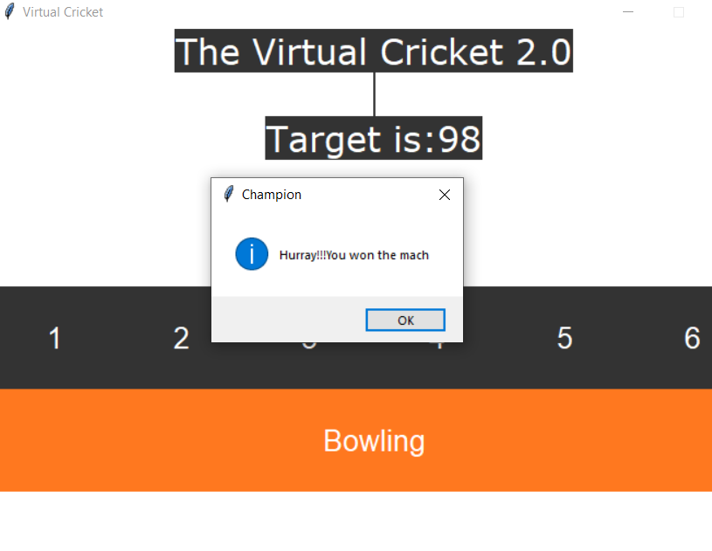

Slide 10
