Slide 1

Sentiment Analysis in Stock market
Aniketh Bhargav - 1RVU23CSE056
Ahaan R - 1RVU23CSE031
Akshata Athreya - 1RVU23CSE035
Amar H Vaid - 1RVU23CSE040
RV University, Bangalore India

Slide 2
Problem Statement
Develop a machine learning model for stock market price prediction using sentiment analysis of tweets.
Input: An index containing the following fields: Date, Tweet, Stock Name, Company Name.
Output: Predicting Closing Price of a given stock using sentiment analysis of tweets on that date.

Slide 3
Datasets detail
The stock_tweets.csv dataset consists of 80,000 samples consisting of 4 features- Date, tweet, Stock name, company name.
Training: 64,000 Testing: 16,000
Number of classes: 0
The stock_yfinance_date.csv 6,300 consisting of 8 features - Date,Open,High,Low,Close,Adj Close,Volume,Stock and Name.
Training: 5,040 Testing: 1,260
Number of classes: 0
These datasets help us infer the market sentiment and give us a comprehensive overview of the comparison between the market sentiment and the closing price of the stock.

Slide 4
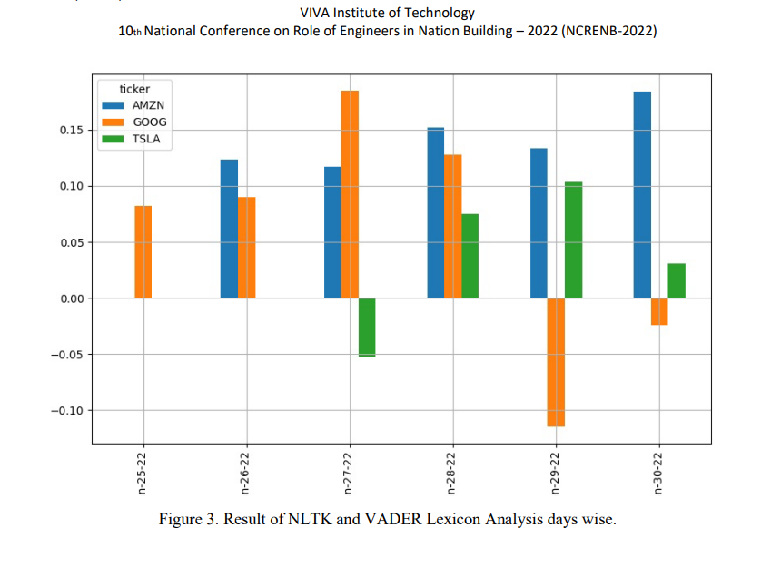
Literature Survey
1. "Sentiment Analysis in Stock Market Using NLTK." (2022).
Models: NLTK, VADER LEXICON, BERT
Datasets: Financial news articles, Stock market data
Paper link: https://www.viva-technology.org/New/IJRI/2022/232.pdf:

Slide 5
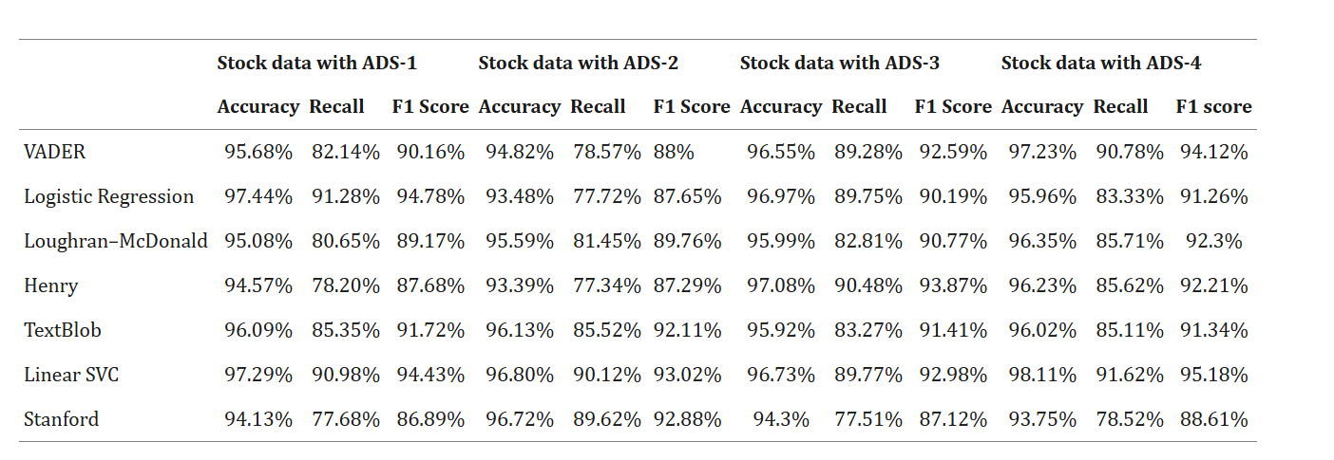
Literature Survey Contd.
2. "Stock Market Movement Prediction Using Sentiment Analysis and LSTM During COVID-19." (2022). Models: LSTM, VADER, Logistic Regression, TextBlob, Linear SVC, Stanford NLP Datasets: Web-scraped data from stock-related articles, tweets, financial news from Economic Times, and Facebook comments.
Paper link: https://pmc.ncbi.nlm.nih.gov/articles/PMC9325657/

Slide 6
Literature Survey Contd.
3. Sentiment Analysis for Effective Stock Market Prediction
(PDF) Sentiment Analysis for Effective Stock Market Prediction
4.Sentiment Analysis for Indian Stock Market Prediction using Sensex and Nifty
Sentiment Analysis for Indian Stock Market Prediction Using Sensex and Nifty - ScienceDirect
5. Stock Market Price Prediction using Sentiment Analysis
Stock Market Price Prediction using Sentiment Analysis.pdf

Slide 7
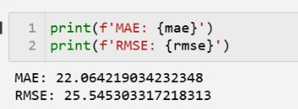
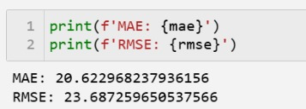
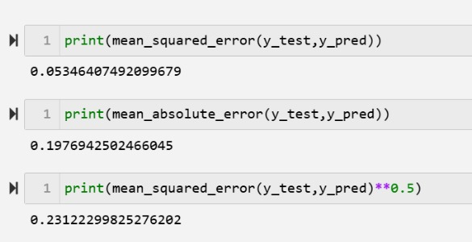
Preliminary Results
Random Forest
Regressor:
Linear Regression:
LSTM:

Slide 8
Further Plan
Hyperparameter tuning.
Identifying the best duration where there is a clear correlation between the moving average and the overall market sentiment in that duration.
Improving the LSTM RNN model.
Real-time analysis using news and tweets (APIs).
Improving the training vs validation loss.

Slide 9
Thank you

