Slide 1
Billing & Inventory Management System
Submitted in the partial fulfillment for the award of the degree of
BACHELOR OF ENGINEERING
in
CSE – Cloud Computing
Submitted by:
Pranav Goel-20BCS4116
Aniket Khajanchi-20BCS4098
Under the Supervision of:
Harmandeep Kaur Jhajj
Department of AIT-CSE
DISCOVER . LEARN . EMPOWER

Slide 2
Outline
Introduction to Project
Problem Formulation
Objectives of the work
Methodology used
Results and Outputs
Conclusion
Future Scope
References

Slide 3
Introduction to Project
This project seeks to make the Billing System and Inventory Management easy and stress-free for both the customer and the owner. A computer system like this can assist in managing a big collection of data without the element of human inaccuracy. The project's goal is to create software that is quick in processing while also having a clutter-free user interface so that users can readily adjust to it and it can be used for a long period without failure or maintenance. The security of the manager's access has also been addressed to prevent unauthorized access

Slide 4
Problem Formulation
The existing system requires large personnel to operate it. The system does not make good use of its resources.
The suggested solution is designed to give the capability of automating the supermarket's billing system. There is a need to build a new system to eliminate the bottlenecks of the present system. The new system should address the needs of both customers and merchants. The objective of this project is to make the present system more instructive, dependable, quick, and simple. There are several causes for the project's inception, including the fact that selling ten goods through the manual method of a salesman encounters numerous inefficiencies. It necessitates the handling of enormous record books that include both irrelevant and vital information, making it difficult to discover the necessary information. Object-Oriented Programming principles made it easy for me to construct project modules.

Slide 5
Objectives
• To decrease the amount of time spent on management
• To improve the system's efficiency and accuracy
• To relieve labor strain by relieving workers of dull and monotonous tasks.
• To speed up the recovery of information
• To improve the system's viability
• To remove a significant quantity of paperwork
• To improve system reliability and eliminate the uncertainty
• To lower the system's cost factor
• To increase the system's flexibility
• It offers an easy billing pattern solution
• It keeps track of newly added categories or goods

Slide 6
Methodology
Segregated portals for customers and admin control: This module segregates two different portals for the customer as well as the Inventory Manager. The inventory manager can create/modify/delete products according to the stock. The customer can buy the required products from their portal.
Secure access to Inventory Management: The Inventory manager gets secure access to their portal and they can manage their inventory however required by creating/modifying/deleting products.
Self-checkout system for the customer: The customer gets a user-friendly interface to order all the required products with the specified quantity and can checkout themselves without the need for any supervision
Digital Invoice generated for the customer: Keeping in mind the digital revolution as well as the save paper initiative, we generated a service of generating a digital invoice for all the customers in order reduce the demand for printing a bill, when not necessary.

Slide 7
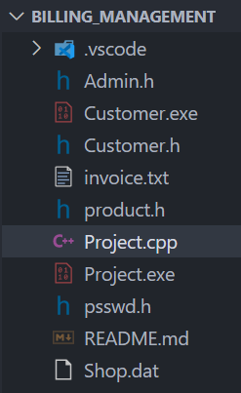
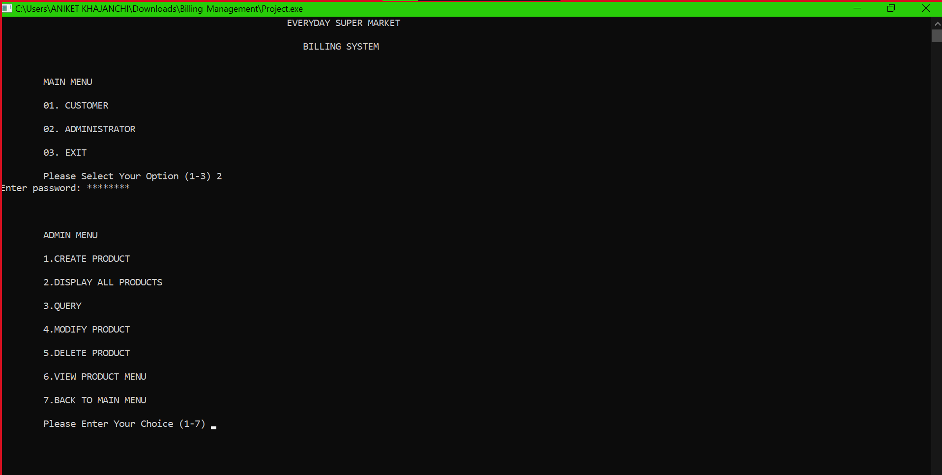
Results and Outputs

Slide 8
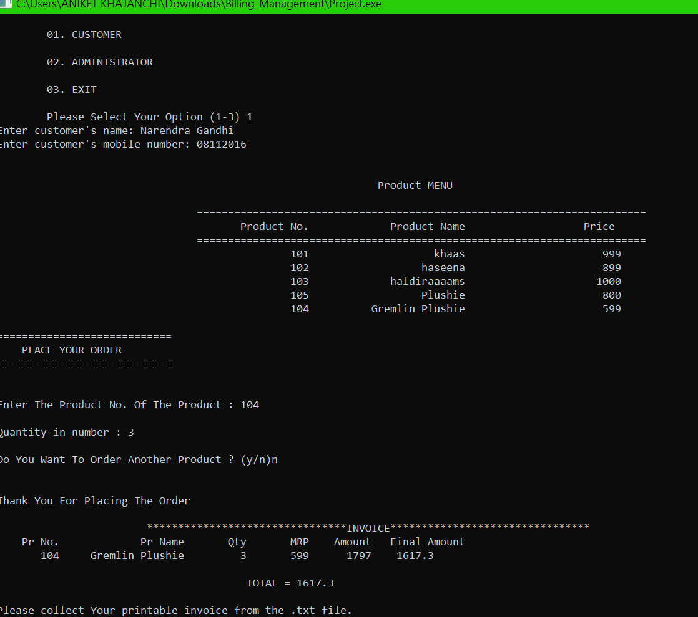
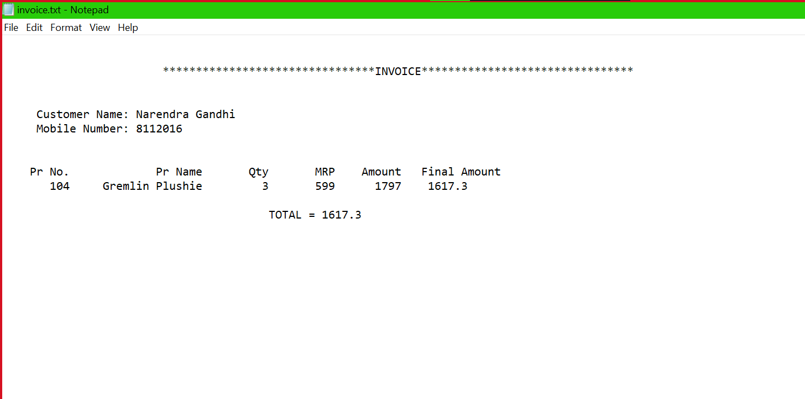
Results and Outputs

Slide 9
Conclusion
This software has been designed to reduce the time taken to handle the sales activity. It is designed to replace an existing manual record system for reducing the time taken for calculations and for storing data. This system has been developed with the Concept of OOPs and File Handling. This system has been developed with OOPs concepts. The system is strong to handle daily operations where the database is cleared over a certain time. This system will reduce manual work, calculations and will also provide periodic reports at any time. Let’s Discuss how else can the concept of the Billing and Inventory management system be improved over time.

Slide 10
Future Scope
For a Digital World we plan on going completely paperless, by implementing digital transcripts of the items purchased, sent directly to your email/phone, with no requirement of a printable invoice.
We further plan on a better data management system with modern GUI tools for remote Database Updates making it easier for the Manager to control the Inventory.

Slide 11
References
https://www.cplusplus.com/reference/iomanip/setw/?kw=setw
https://www.tutorialspoint.com/cplusplus/cpp_files_streams.htm
https://stackoverflow.com/questions/41652182/how-to-display-asteriskfor-input-password-in-c-usingclion#:~:text=%23include%20%23include,%5D%3B%2F%2Fto%20store%20password
http://www.cplusplus.com/forum/beginner/84082
https://codereview.stackexchange.com/questions/37235/basic-passwordauthentication-system-app
https://docs.cyberark.com/Product-Doc/OnlineHelp/AAMCP/Latest/en/Content/CP%20and%20ASCP/C-Application-PasswordSDK.htm
https://stackoverflow.com/questions/22088133/how-do-you-write-to-adat-file-in-c/22088178
http://www.java2s.com/Tutorial/Cpp/0240__FileStream/Openfileexampledatforreadingandwriting.htm

