Slide 1
SS ZG653 : Software Architecture Assignment :1
Name: Muskan Agarwal
Email: 2022MT93662@wilp.bits-pilani.ac.in
ID Number: 2022TM93662

Slide 2
PURPOSE OF THE AUTOMATED BACKUP MANAGEMENT SYSTEM (ABMS)
The following are the goals of the ABMS:
Automate the backup of critical data and resources through a UI/command line to assist IT administrators, developers, and operations teams.
Provide the ability to schedule backups for servers, databases, and applications.
To verify the integrity of backups and ensure they can be restored successfully.
Integrate with other IT management tools to enhance data protection strategies.

Slide 3
Functional Requirements
FR No. | FR Description
FR 1 | System must allow scheduling of backup jobs that can be written in languages such as Python or Shell scripts.
FR 2 | System must have a UI that can be used by administrators and operations teams to initiate, monitor backup jobs, and view results
FR3 | System must also have a command line tool to allow other IT management tools such as Ansible and Puppet to interact with it.
FR4 | System must allow users to schedule and manage backups only if they are authenticated.
FR 5 | System must have the capability to notify stakeholders (through email) about the status of backup jobs.

Slide 4
Non - Functional Requirements
Quality | FR Description
Performance | System shall run backup jobs parallelly (At least 4 jobs at a time). Maintain CPU usage as low as 50% in standard workloads.
Security | The system must not allow certain operations based on permissions given to the user logged in
Availability | MTTR of Less than 60 seconds shall be needed.
Portability | Should be able to deploy system in both Windows and Linux platforms
Usability | System shall be easy to pick up and be used by new hires in less than two weeks of training.
Interoperability | System shall abstract common services such as logging, remote communication to ease backup job development

Slide 5
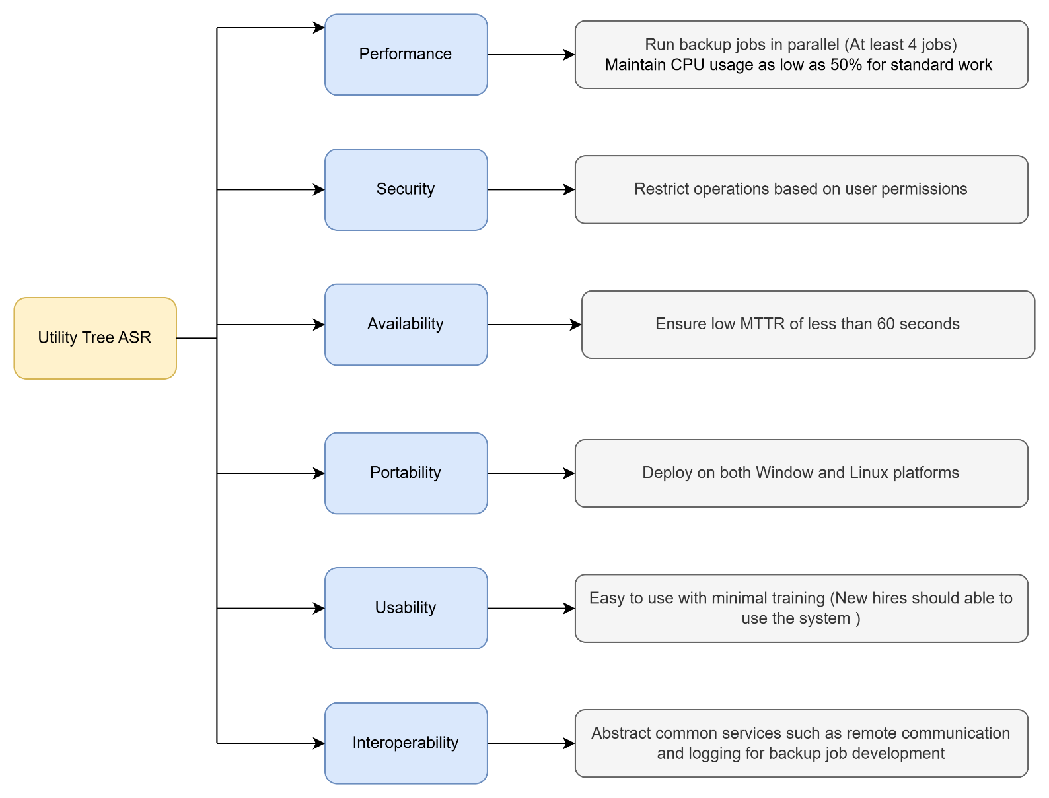
Utility Tree of ASR

Slide 6
Tactics to Achieve TOP 5 ASRs
Quality Attribute | Scenario (Attribute Refinement) | Tactics
Performance | On standard operation of 4 test flows the CPU usage must be as low as 50% to let the other services to use. (System Load) | Caching: Cache data of older backup results so that requests for them are handled quickly and do not affect other backup execution requests. Resource Arbitration: Ensure resource arbitration by placing backup execution requests on a FIFO queue, as all backup requests are of equal priority. Implement mechanisms such as timeouts and exception handling to avoid other backup requests from getting stuck in the queue.
Security | Authorized ABMS users are assigned to groups that determine which backups the user can execute and which they cannot (Authorization). | SSO Integration: The controller handling requests to the ABMS must be able to authenticate the requests by integrating with the organization’s SSO (Single Sign-On). Role-Based Permissions: Assign role permissions when backups are configured. Users can be put into roles and groups, helping segregate the kinds of backups they can execute.

Slide 7
Tactics to Achieve TOP 5 ASRs – CONT.
Quality Attribute | Scenario (Attribute Refinement) | Tactics
Availability | When core ABMS services are down, the system must come back up within 60 seconds. | Fast Storage: Deploy the core ABMS system modules responsible for backup execution in fast, readable SSD-based storage. State Caching: Cache application state data so that service restart is faster.
Portability | ABMS services can be deployed on both Windows and Linux servers, and the GUI is accessible on popular platforms. | Cross-Platform Frameworks: Implement the ABMS core services with cross-platform frameworks such as Spring in the case of Java, so it can be deployed on both Windows and Linux servers. Web-Based GUI: Develop the front-end GUI as a web-based interface, making it accessible on any device with a web browser.

Slide 8
Tactics to Achieve TOP 5 ASRs – CONT.
Quality Attribute | Scenario (Attribute Refinement) | Tactics
Interoperability | When developers create automated backup flows that behave similarly across platforms, the flow must work on all these platforms (Unified Experience) | Utility Abstraction: Abstract utilities for logging, remote command execution, process management, and file management. This ensures that backup flows can use these functions without worrying about the target platform on which they will run.

Slide 9
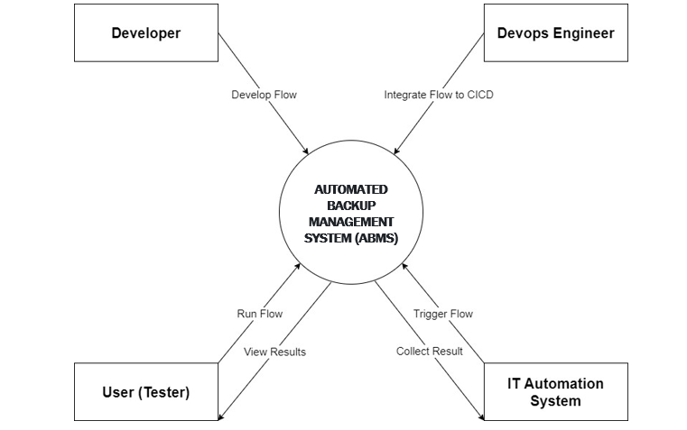
Context Diagram

Slide 10
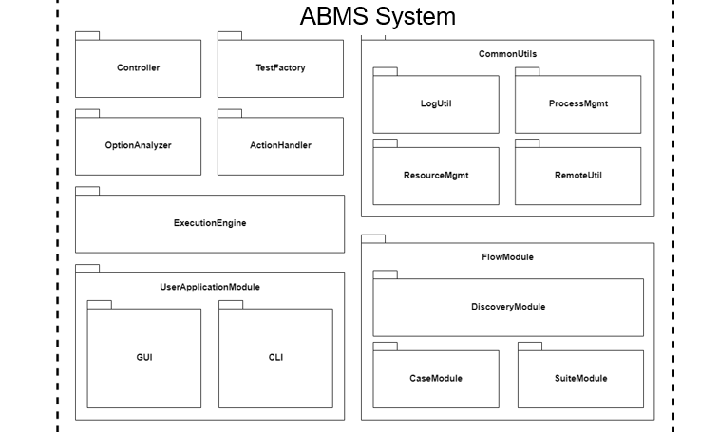
Model Decomposition

Slide 11
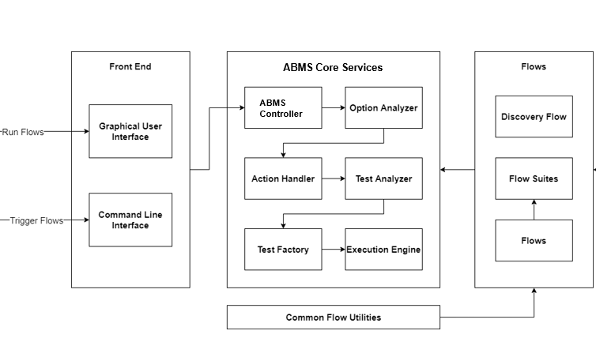
Component Connect Diagram

Slide 12
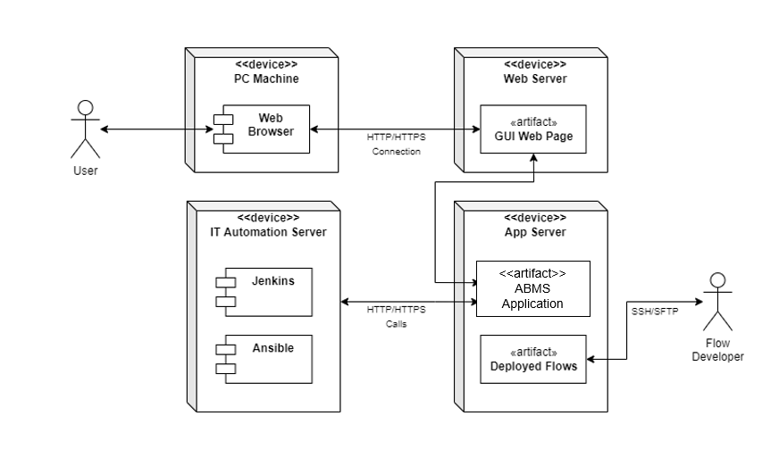
Deployment Diagram

Slide 13
How the Automated Backup Management System (ABMS) Operates
The Automated Backup Management System (ABMS) operates by automating the backup processes for critical data and resources. This is achieved through the interactions of the following components:
Developers:
Developers create backup scripts (written in Python/Shell) and group related scripts into backup suites, which can be triggered by the users of the ABMS. These scripts are packaged and deployed on the backup server.
ABMS Controller:
The ABMS Controller exposes endpoints that accept requests from the GUI/CLI tools and sends the parameters of the backup execution request to the Configuration Validator.
Configuration Validator:
The Configuration Validator checks all the configuration options provided by the user through the GUI/CLI to ensure they are valid, and the user has the necessary permissions to run the requested backup. If the options are valid, they are sent to the Pre-Backup Handler; otherwise, an error is sent back to the controller to notify the users.
Pre-Backup Handler:
The Pre-Backup Handler is responsible for pre-backup tasks such as verifying that the resources to be backed up exist and ensuring that the ABMS is functioning properly by checking the logs. After these checks, control is handed over to the Backup Analyzer.

Slide 14
How the Automated Backup Management System (ABMS) Operates CONT.
Backup Analyzer:
The Backup Analyzer checks for issues with the backup scripts that are deployed on the ABMS. If there are issues with the backup scripts, the backups are not initiated, and a notification is sent to the teams responsible for script deployment. If there are no issues, the request is sent to the Backup Factory.
Backup Factory:
The Backup Factory builds the execution queue, analyzes the dependencies between backup scripts and suites to be executed, and constructs the optimal sequence for executing the backups. Control is then handed over to the Execution Engine.
Execution Engine:
The Execution Engine is the core component of the ABMS. It manages the scheduling of backup jobs, parallelism, resource reservation, updating relevant log files with status, and handling failures. The status of the backups can be checked via the GUI/CLI through the exposed controller endpoints.
Common Utilities:
In addition to these core components, common utilities are developed to abstract functionalities such as logging, process management, remote command execution, etc., ensuring that the same backup scripts can be run on multiple platforms. This enhances code maintenance and reliability.
This structured approach ensures that backups are handled efficiently, securely, and reliably across various environments.

Slide 15
Key Learnings
Nonfunctional Requirements:
Performance, security, and availability requirements can significantly influence ABMS design. Identifying these early ensures the system meets its goals efficiently.
Context Diagrams:
Context diagrams help stakeholders understand the system's boundaries and interactions, clarifying what belongs in the system and what does not.
Reusable Analysis Templates:
Templates for system analysis (e.g., module decomposition, utility trees, component connections) can be reused for similar systems, aiding in future designs and cost-benefit analysis.
Developer Visualization:
Module view and component connection diagrams provide a visual representation of implementation strategies, improving planning and execution in Agile environments.
Deployment Clarity:
Deployment views offer a clear picture of module deployment, aiding operations teams in cost estimation and resource planning, ensuring smoother transitions to production.

Slide 16
Thank You
Name: Muskan Agarwal
ID Number:2024TM93662

