Slide 1
Statestics
Mean mode & median

Slide 2
Mean
Mean is defined as the sum of all the observations divided by the total number of observations.
We have a set of observations-x=1,3,5,7,91,3,5,7,9. The Arithmetic Mean is computed as (x/n) where n is the number of observations which is equal to 5 in this case. Thus x=25 in this case and n=5 so the mean comes out to be 5

Slide 3
Median
The median is defined as the middle point in any dataset of observations. Half of the observations are greater than this number and half of them are smaller. Median is also called the 50th percentile. In many cases, the Median is the better measure of Central tendency than Mean because the outliers(data points which have extreme values) have less effect on the Median.

Slide 4
Steps in Calculating Median
Step 1- Arrange the observations in ascending or descending order.
Step 2- If the number of observations is odd, then the median is the middle observation and if the number of observations is even, then the median is the average of the 2 middle observations.
Example- We have a dataset x=10,40,30,20
Step 1- Arranging the data in ascending order- x=10,20,30,40
Step 2- Since the number of observations is even, the median is (30+20)/2 which equals 25.

Slide 5
Mode
Mode is defined as the most frequent or common observation occurring in a dataset. A dataset can have 0,1 or more than 1 modes. The advantage of Mode is that it can be applied to any type of dataset, unlike Mean and Median which can not be applied to nominal data. It is also not affected by outliers. Its disadvantage is that it cannot be used for more detailed analysis.

Slide 6
Mode example
{2,2,1,5,6,2}- In this dataset, the mode is 2 since it is the most occurring observation.
{21,34,43,21,34,56,7,9,0}- This dataset has 2 modes, 34 and 21 because they both occur twice.

Slide 7
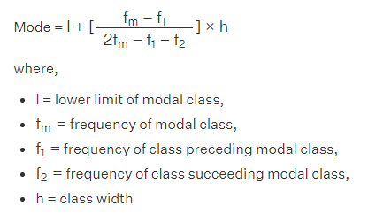
Mode Ex.2 Grouped Data

Slide 8
Example
Example: Find the mode of the given data:
Marks Obtained | 0-20 | 20-40 | 40-60 | 60-80 | 80-100
Number of students | 5 | 10 | 12 | 6 | 3
The highest frequency = 12, so the modal class is 40-60.
l = lower limit of modal class = 40
fm = frequency of modal class = 12
F1 = frequency of class preceding modal class = 10
F2 = frequency of class succeeding modal class = 6
h = class width = 20

Slide 9
