Slide 1
PAYTHON
INTRODUCTOIN OF LISTS

Slide 2
LISTS
Can store different data types
Same values are allowed
Indexing and slicing is possible
Mutable

Slide 3
Syntax of lists
Variable= [Different data separated by comma]
Examples
A= [1, 2, 3.5]
B= [“python”, “java”, “c”]
C=[1, 2, 3.5, “python”, “java”, “c”]

Slide 4
Indexing
to get the first element
Indexing starts from 0(zero).
Example
A= [5, 7, 10, 18, 14]
to get the first element
A[0] output is 5
A=[1] output is 7

Slide 5
mutable
We can change the data in variables.
Before
A= [5, 7, 10, 18, 14]
A[0]= 2
After
A= [2, 7, 10, 18, 14]

Slide 6
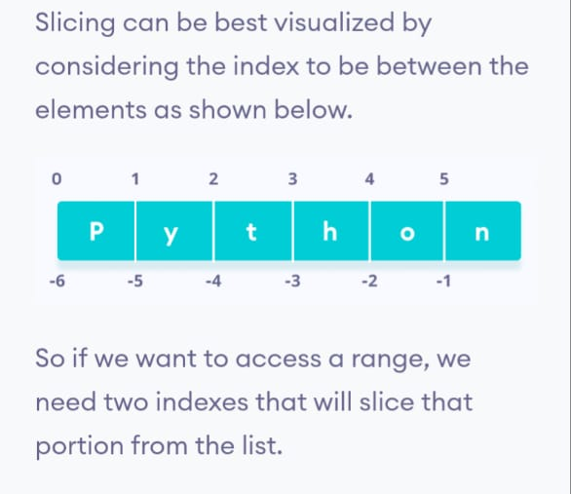
Slicing of Lists
A= [“P”, “y”, “t”, “h”, “o”, “n”]

Slide 7
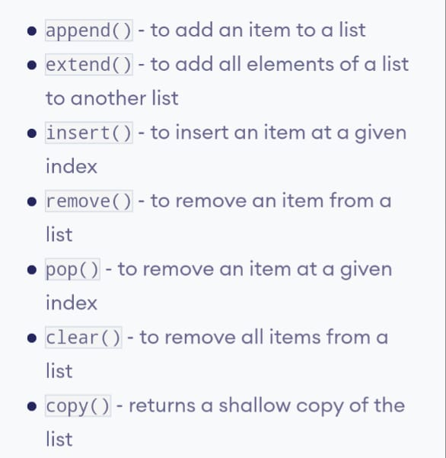
Python lists method

