Slide 1
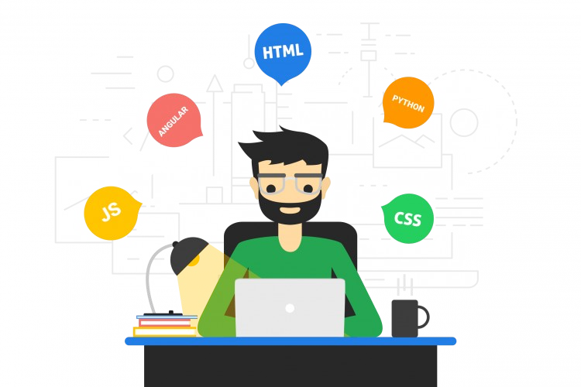
What is Full Stack...?
●
Full Stack developer is someone who is familier with all layers of software development.
These developers aren't expert in everything but simply have the functional knowledge to finsh and develop the entire product.
●

Slide 2
Full Stack Development
Front End Technology
Back End Technology
Database
HTTP & REST
Web Application Architecture
Algorithms & Data Structure
Git Version Control

Slide 3
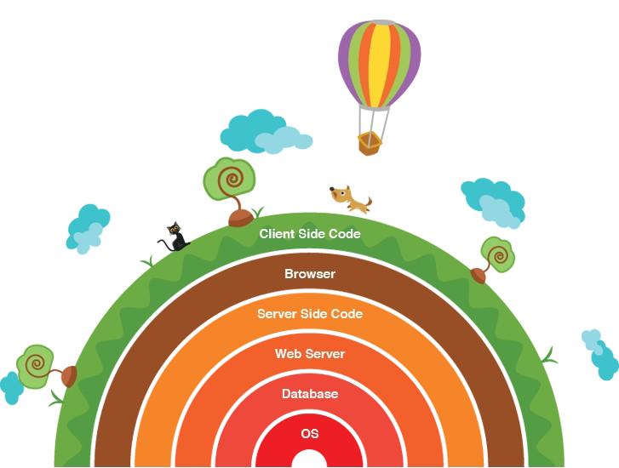
Layers in Full Stack Development

Slide 4
Front End Technologies
Front-End Technologies in Full Stack Includes:
HTML CSS
Javascript Libraries such as jQuery, ReactJS, ZeptoJS Frameworks such as Angular, Vue, Backbone, Ember Bootstrap
●
●
●
●

Slide 5
Back End Technologies
Back-End Technologies in Full Stack Includes:
Ruby (Ruby on Rails)
Python (Django, Flask, Pylons) PHP (Laravel)
Java (Spring) Scala (Play) NodeJS
●
●
●
●
●

Slide 6
Interesting, right?
This is just a sneak preview of the full presentation. We hope you like it! To see the rest of it, just click here to view it in full on PowerShow.com. Then, if you’d like, you can also log in to PowerShow.com to download the entire presentation for free.

