Slide 1

Problem Theme 3
Beneficiary Management System
Team-19
Presenters:
Harsh Nayan , Comp
Chetan Singh, Comp

Slide 2
Problem Statement brief:
1.Beneficiary Tracking and Management: Develop a system that allows NGOs to efficiently track and manage their beneficiaries, including personal information, needs, and engagement history.
2.Project Management and Impact Measurement: Implement tools to manage ongoing projects and measure the impact of these projects on the beneficiaries.
3.Automation and Efficiency: Automate manual tasks to reduce the administrative workload for NGOs, enhancing efficiency and minimizing errors.
4.User-Friendly and Scalable: Ensure the system is user-friendly and can scale to accommodate the growth of both the NGO and the number of beneficiaries they serve.

Slide 3
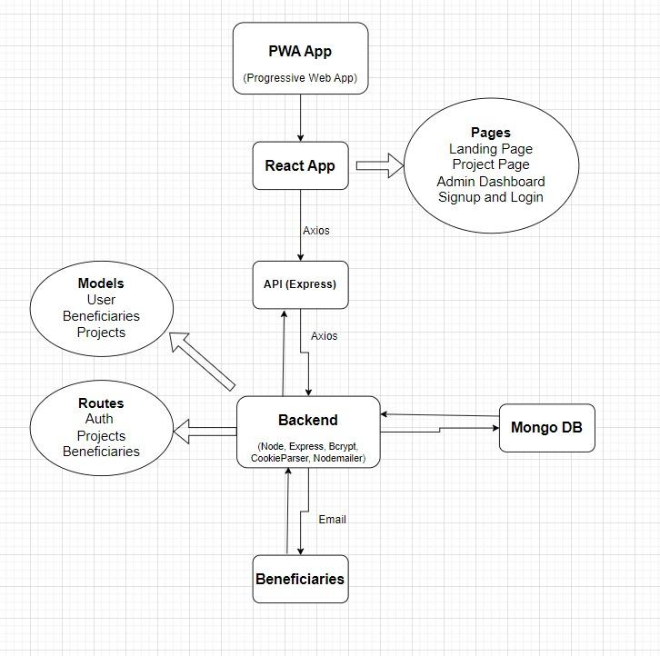
Solution Overview:

Slide 4
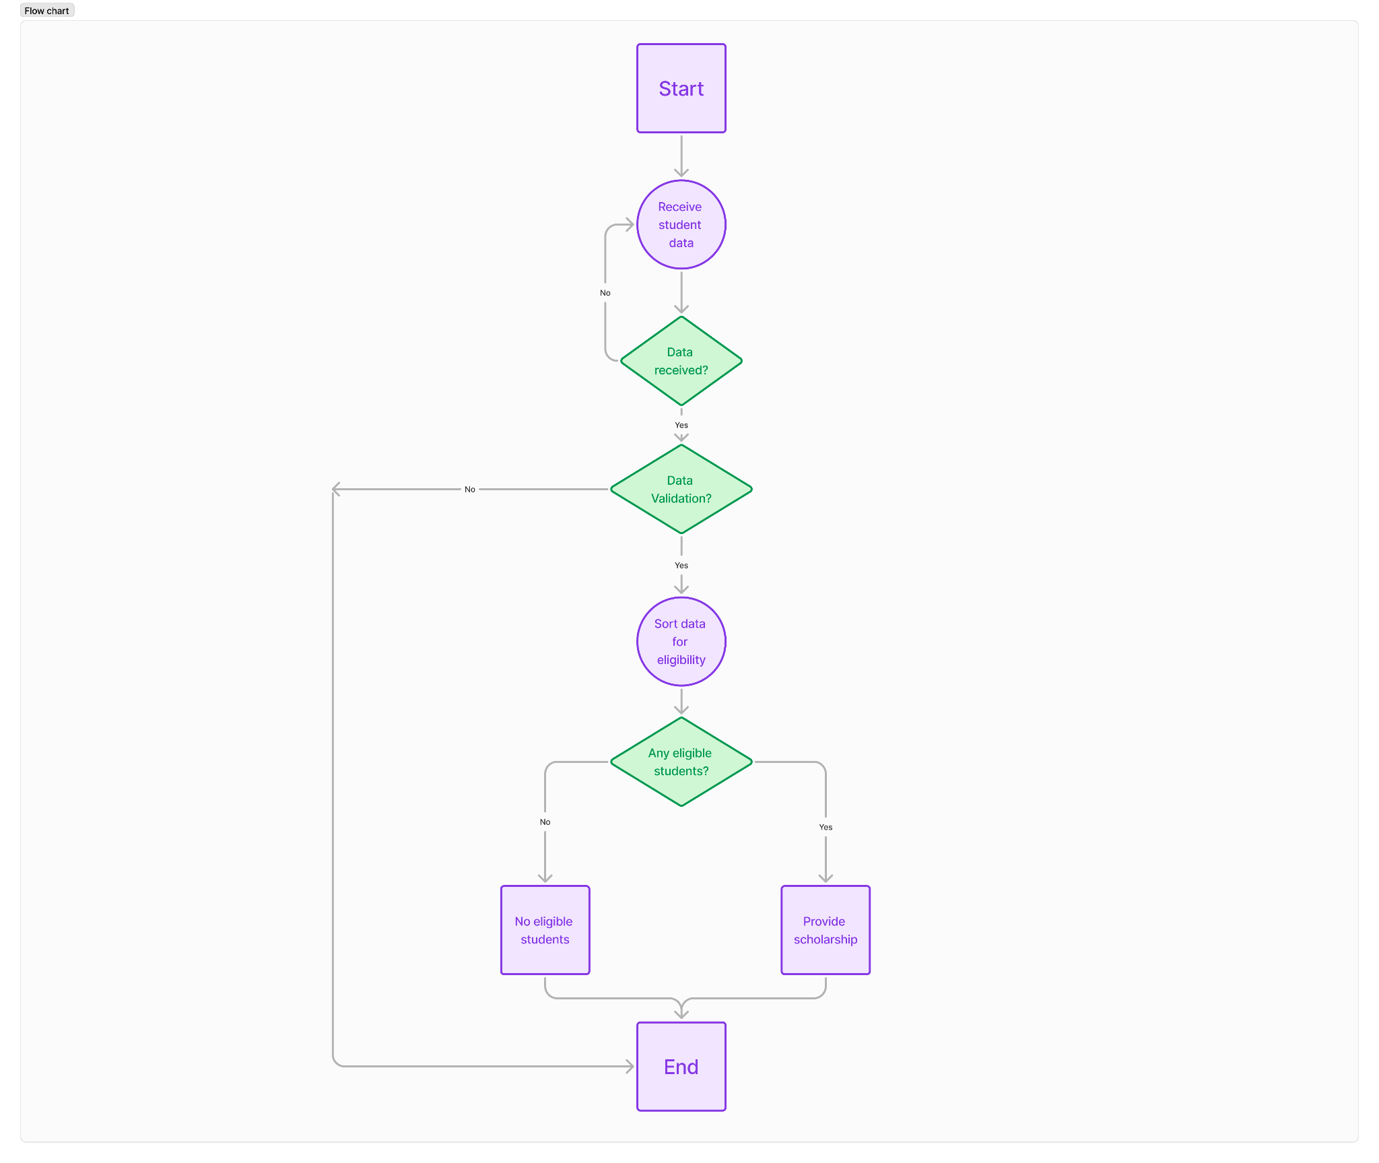
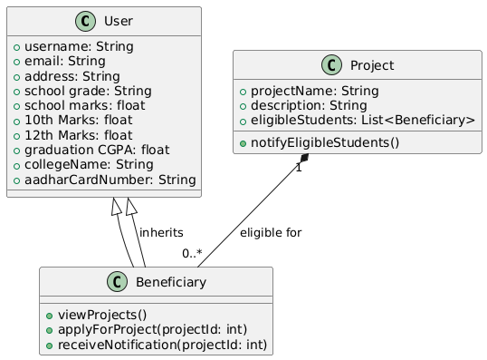

Slide 5
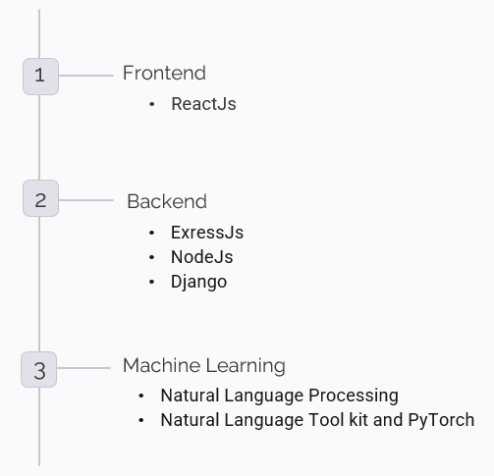
Technology Stack

Slide 6
Impact/Future scope
1.Beneficiary Registration and Management
Family and Group Linkage: Ability to link beneficiaries to their families or groups for better tracking.
2. Project Tracking and Management*
Milestone Tracking: Monitor progress towards project goals for each beneficiary.
Automated Reminders: Set up reminders for critical dates, such as follow-ups, meetings, and milestones.
3. Data Management and Analytics
Data Exporting: Enable exporting data into various formats (CSV, PDF) for external reporting or sharing.
4. Security and Privacy
Data Encryption: Ensure all beneficiary data is encrypted both in transit and at rest.

Slide 7
Q&A

