Slide 1
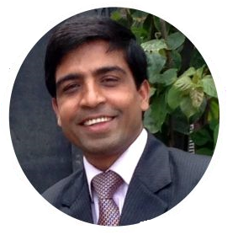
CT-351 Cloud Computing
Mr. Kamal Kant Hiran

Slide 2
Module 02
Cloud Delivery Models
“If someone asks me what cloud computing is, I try not to get bogged down with definitions. I tell them that, simply put, cloud computing is a better way to run your business.”
~ Marc Benioff, Founder, CEO and Chairman of Salesforce

Slide 34
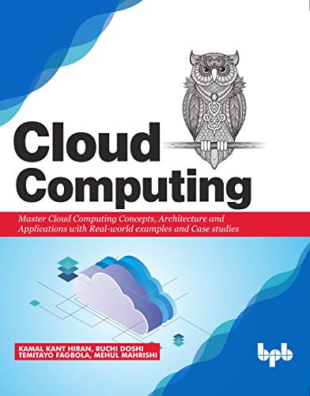
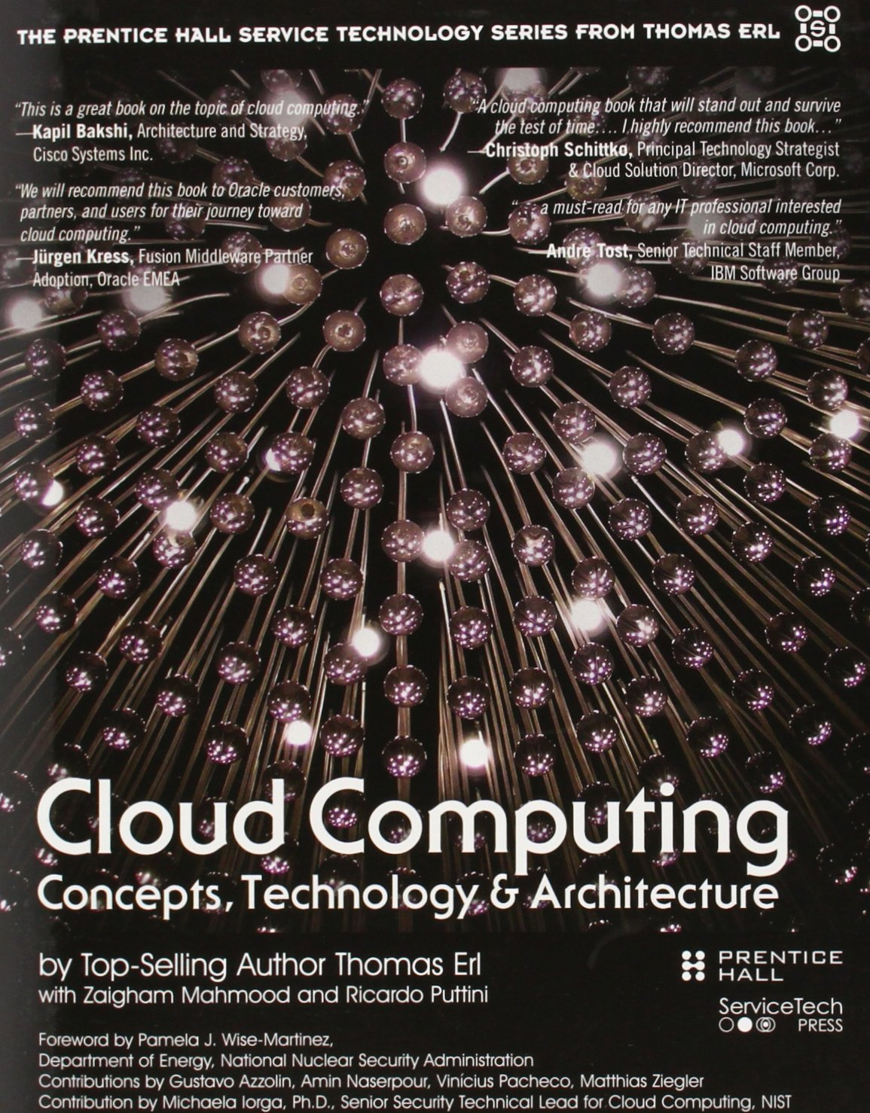
Suggested Readings
Hiran, K. K., Doshi, R., Fagbola, D. T., & Mahrishi, M. (2019). Cloud Computing: Concepts, Architecture and Applications with Real-world examples and Case studies . BPB Publications.
Erl, T., Puttini, R., & Mahmood, Z. (2013). Cloud computing: concepts, technology, & architecture. Pearson Education.

Slide 35

Any query?

