Slide 1

CT-2002 Cloud Computing
Mr. Kamal Kant Hiran

Slide 2
Module 01
Fundamentals of Cloud Computing
“Cloud computing is a spectrum of things complementing one another and building on a foundation of sharing.”
~ Chris Howard, Research Vice President at Gartner

Slide 3
Introduction to cloud computing
A dynamically scalable system that provides internet-based services often virtually.
Forrester defines cloud computing as “A pool of abstracted, highly scalable, and managed compute infrastructure capable of hosting end-customer applications and billed by consumption.”

Slide 4
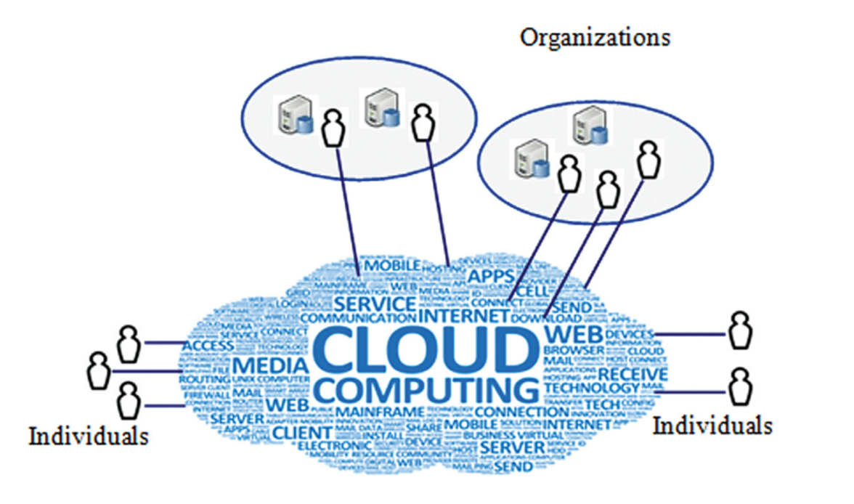
Basic operating mode of a cloud

Slide 5
Examples
Amazon Elastic Cloud.
Google Sites and Coghead.

Slide 6
Cloud computing Ecosystem
Cloud Computing Ecosystem (CCE) is a dynamic and complex community of the cloud computing system components and the stakeholders.

Slide 7
Cloud stakeholders
Cloud service providers
The Cloud users
The End users

Slide 8
Cloud computing Characteristics
Technical characteristics of cloud computing
Basic characteristics of cloud computing

Slide 9
Technical characteristics
Large-scale computing resources
Shared resource pooling
Dynamic resource scheduling
High Scalability
Rapid Elasticity

Slide 10
Basic Characteristics
On-demand self-service
Broad network access
Measured service
Multitenancy
Reliability
Cost-effectiveness
Customization

Slide 11
Basic Characteristics
Efficient resource utilization
Maintainability
Collaboration
Green Technology
High Performance
Shared infrastructure
Network Access

Slide 12
Advantages and disadvantages
The following are the advantages of cloud computing:
Economical
Abundant storage
Backup and recovery
Automatic software integration
Easy access to information
Quick deployment

Slide 13
Disadvantages
Technical issues
Prone to attack
Security and privacy
Compliance concerns
Service migration

Slide 14
Disadvantages
Technical issues
Prone to attack
Security and privacy
Compliance concerns
Service migration

Slide 15
Disadvantages
Technical issues
Prone to attack
Security and privacy
Compliance concerns
Service migration

Slide 16
Summary
NIST defines cloud computing as a model for enabling ubiquitous, convenient, on-demand network access to a shared pool of configurable computing resources that can be rapidly provisioned and released with minimal management effort or service provider interaction.
The CCE is a dynamic and complex community of the cloud computing system components and the stakeholders. The three primary stakeholders of the cloud include the end users, the cloud users and the cloud providers.

Slide 17
Summary
Cloud computing characteristics are typically the distinctive features and qualities that differentiate such systems from other seemingly-related systems.
There are basically five technical characteristics of cloud computing
Advantages of cloud computing
Disadvantages of cloud computing

Slide 18
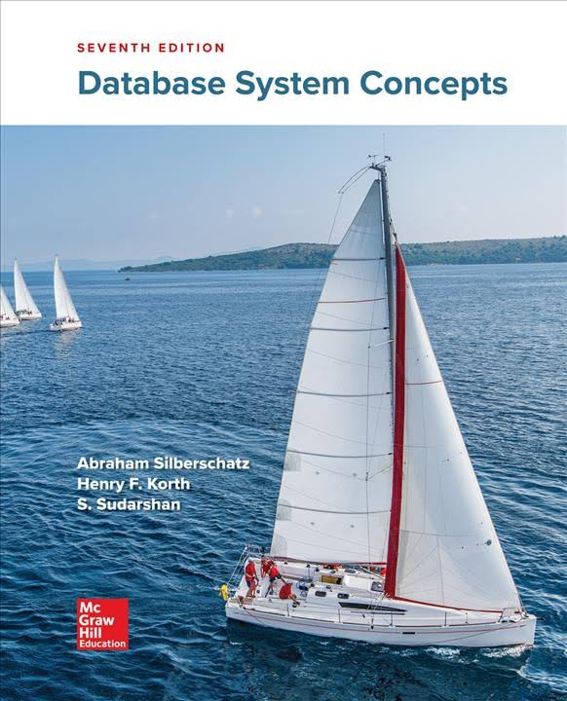
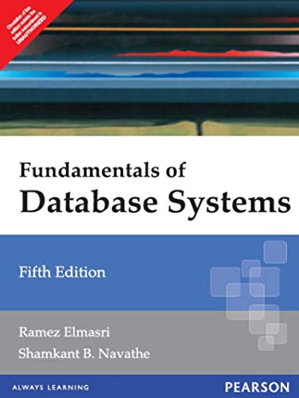
Suggested Readings
Silberschatz, A., Korth, H. F., & Sudarshan, S. (1997). Database system concepts (Vol. 5). New York: McGraw-Hill.
Elmasri, R. (2008). Fundamentals of database systems. Pearson Education India.

Slide 19

Any query?

