Slide 1

BANGLADESH ARMY UNIVERSITY OF SCINCE AND TECHNOLOGY DEPARTMENT OF COMPUTER SCINCE AND ENGINEERING
HOSPITAL MANAGEMENT SYSTEM
Presented by:
Shadekujjaman Anik Id:210201040
Sharifa Rahman Sweety Id:210201019
Tasnimuzzaman Tasin Id:210201015
Presented to:
Hasan Muhammad kafi
Assistant professor
(DEPT. of CSE)
Page:01

Slide 2
outline
INTRODUCTION
OBJECTIVES
PROBLEM DEFINITION
RELATED APPLICATIONS
METHODOLOGY
TOOLS AND TECHNOLOGY
CONCLUSIONS
REFERENCES
Page :02

Slide 3

Introduction
Patient Information Management
Electronic Health Records (EHR)
Telehealth Support
Improved Patient Care
Page :03

Slide 4
Objective
Patient can choose their desired doctor and their availability.
Patient can look up to their medical conditions
Doctors can too read up on their patients’ health details and can analyze.
Page :04

Slide 5
Problem Definition
PATIENT DATA DISORGANIZATION
APPOINTMENT BACKLOGS
DATA SECURITY AND PRIVACY
PATIENT ENGAGEMENT AND ACCESS
MAINTENANCE AND UPDATES
Page :05

Slide 6
Related application
There are a few websites and apps such as:
Nih.gov[1]
healthline.com[2]
Soft Clinic[3]
Although these websites are meant to be for medical purposes. They don’t give all the necessary facilities.
Their main problem is that they are only made and concentrated for certain regions of the world. Some are only for research purposes which is not very helpful for non-medical personals.
Page :06

Slide 7
System Architecture
Use id
Read
patient
report
Patient
Create
appointment
User type
User
Nurse
Admin
Update
payment
Doctor
Doctor
Delete
Page :07

Slide 8
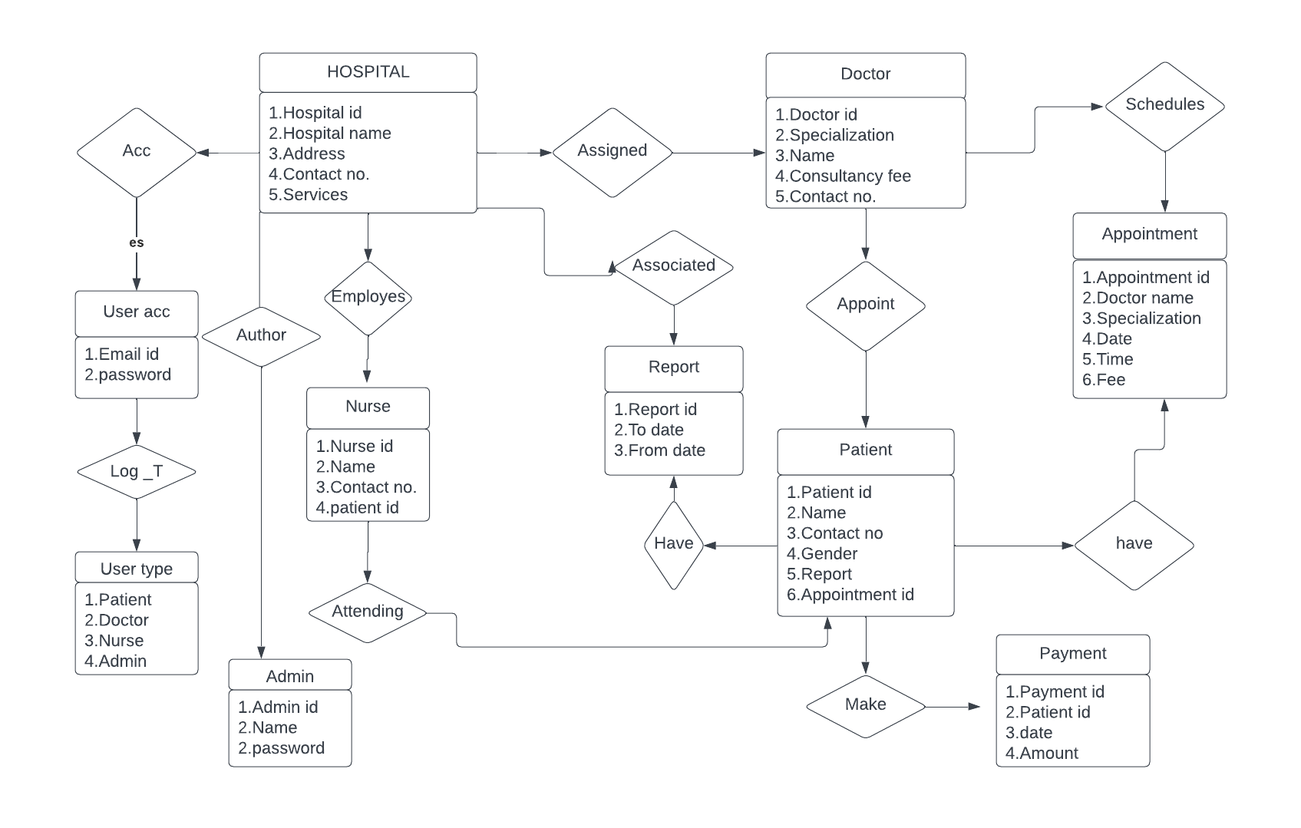
Database system
Page :08

Slide 9
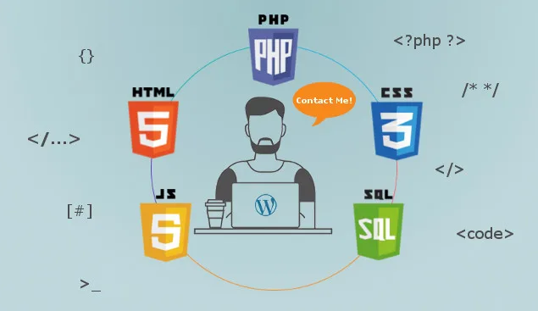
Tools and technology
HTML
CSS
BOOTSTRAP
MYSQL
PHP
Page :09

Slide 10
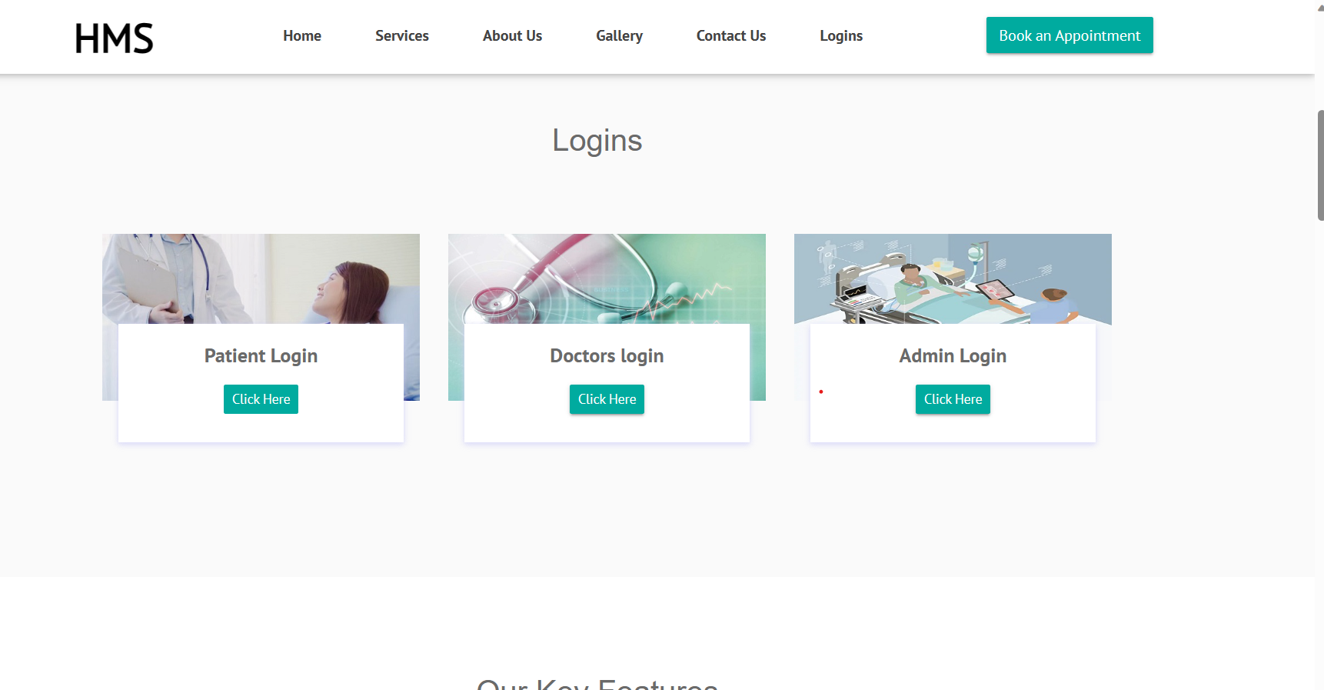
IMPLEMENTATION(HOMEPAGE)
Page:10

Slide 11
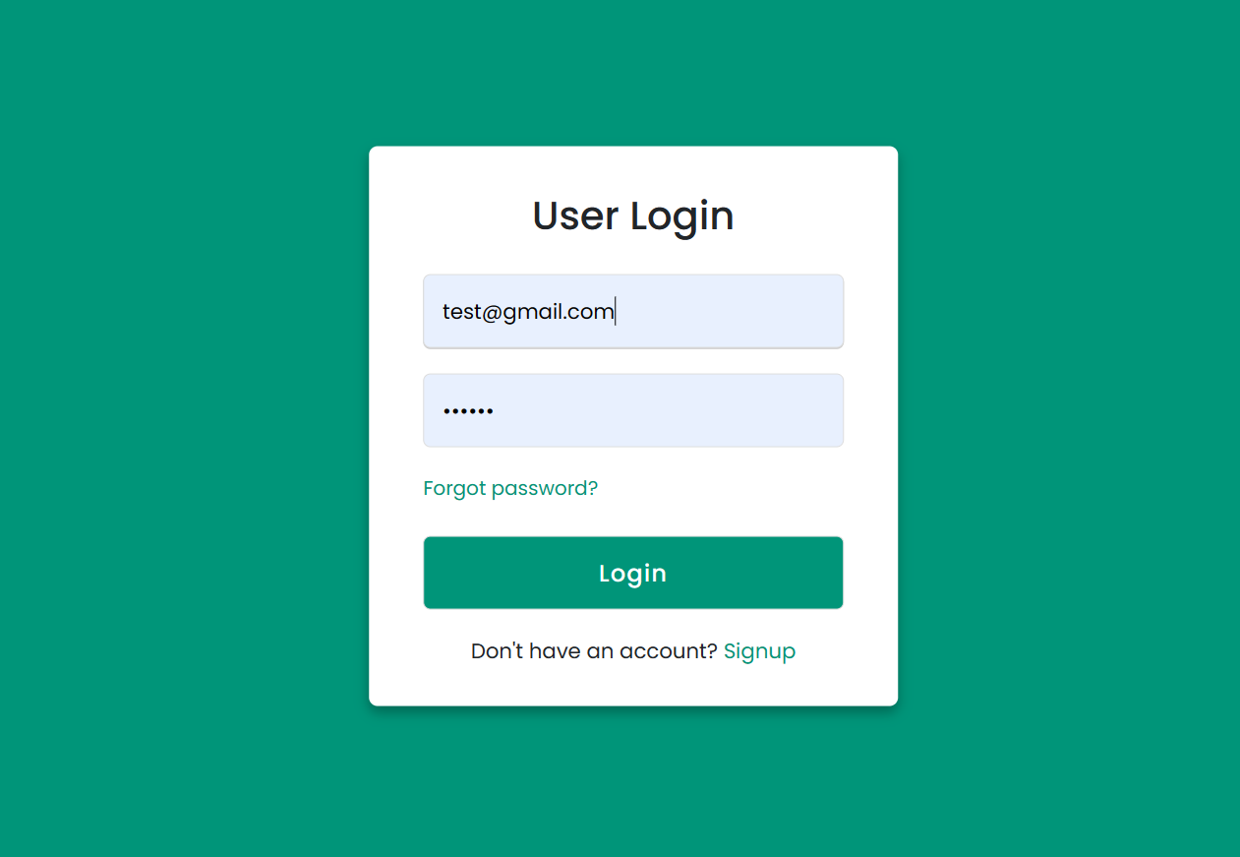
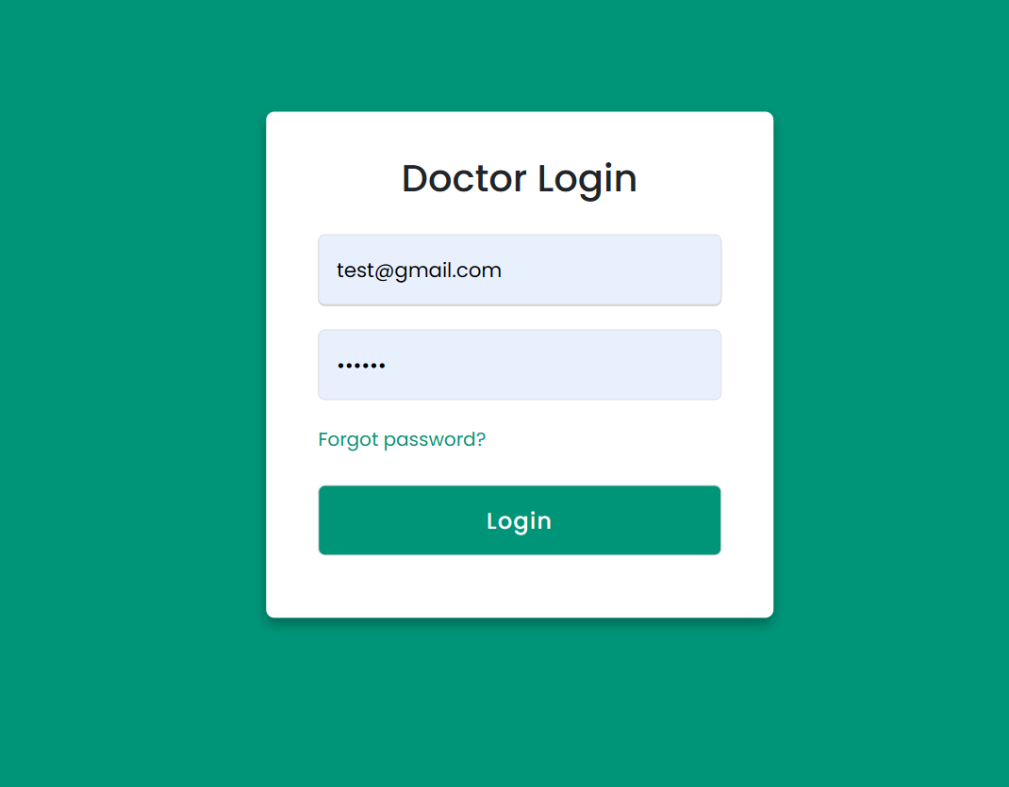
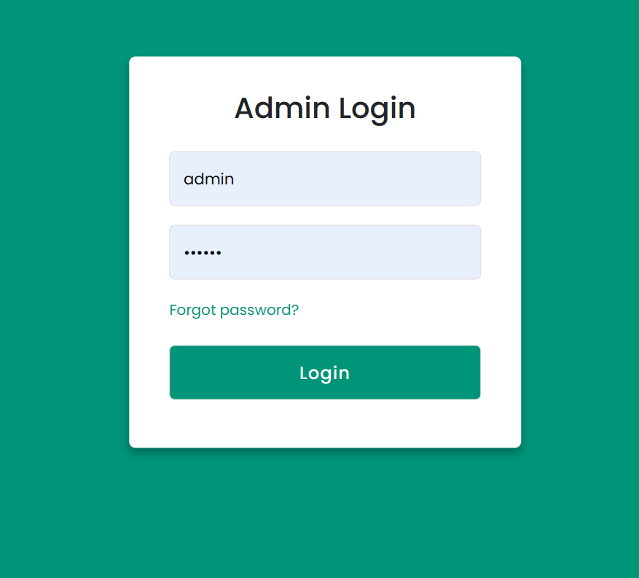
IMPLEMENTATION(LOGIN PAGE)
Page :11

Slide 12
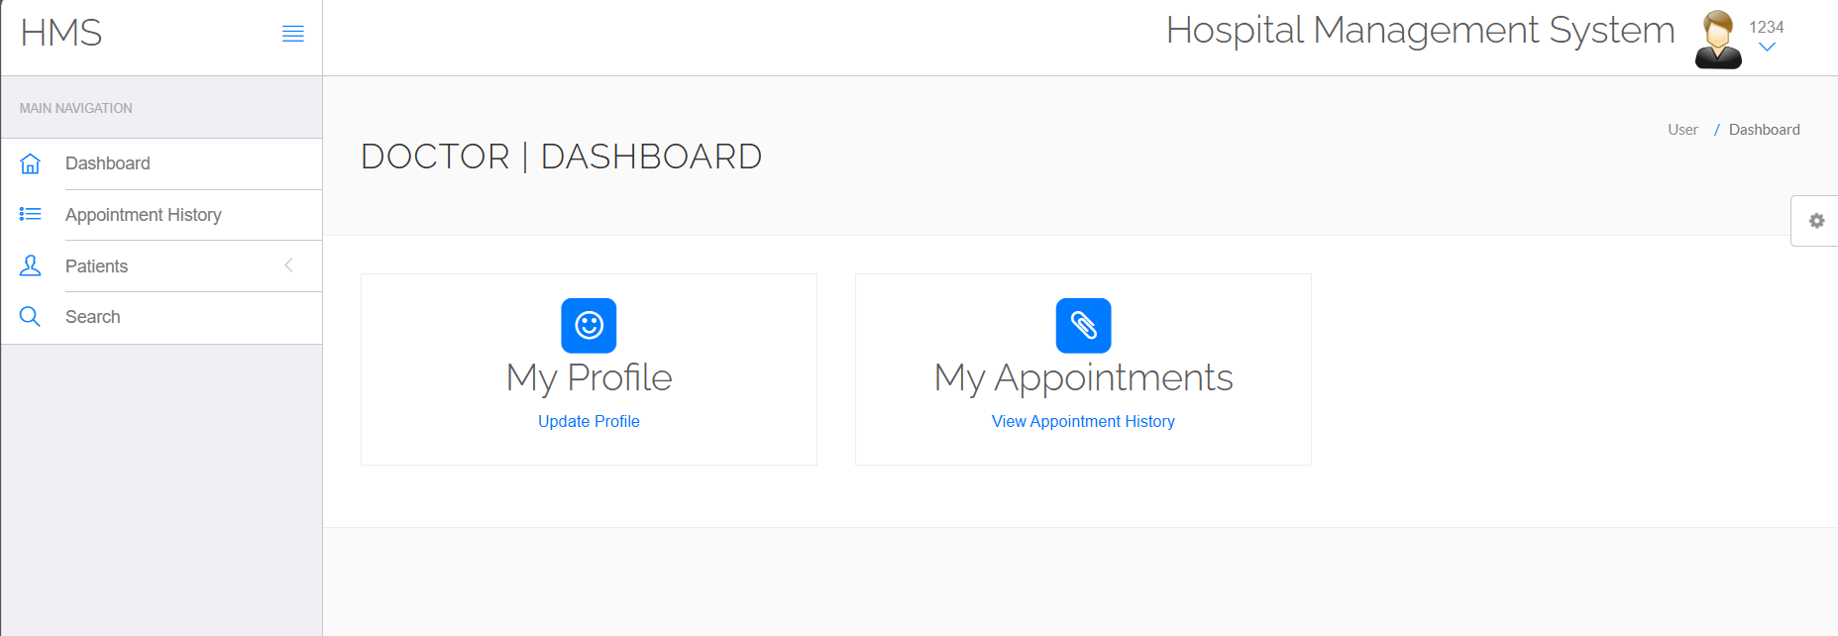
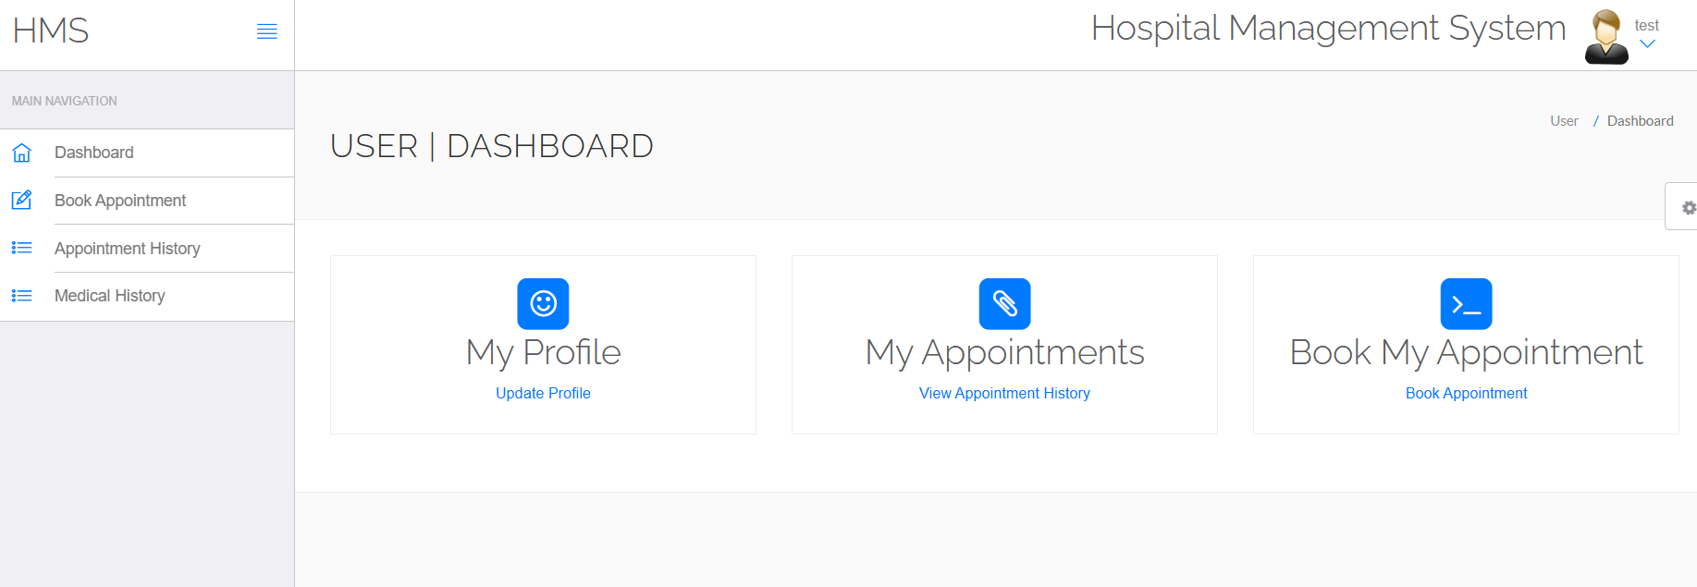
IMPLEMENTATION(DASHBORD)
Page :12

Slide 13
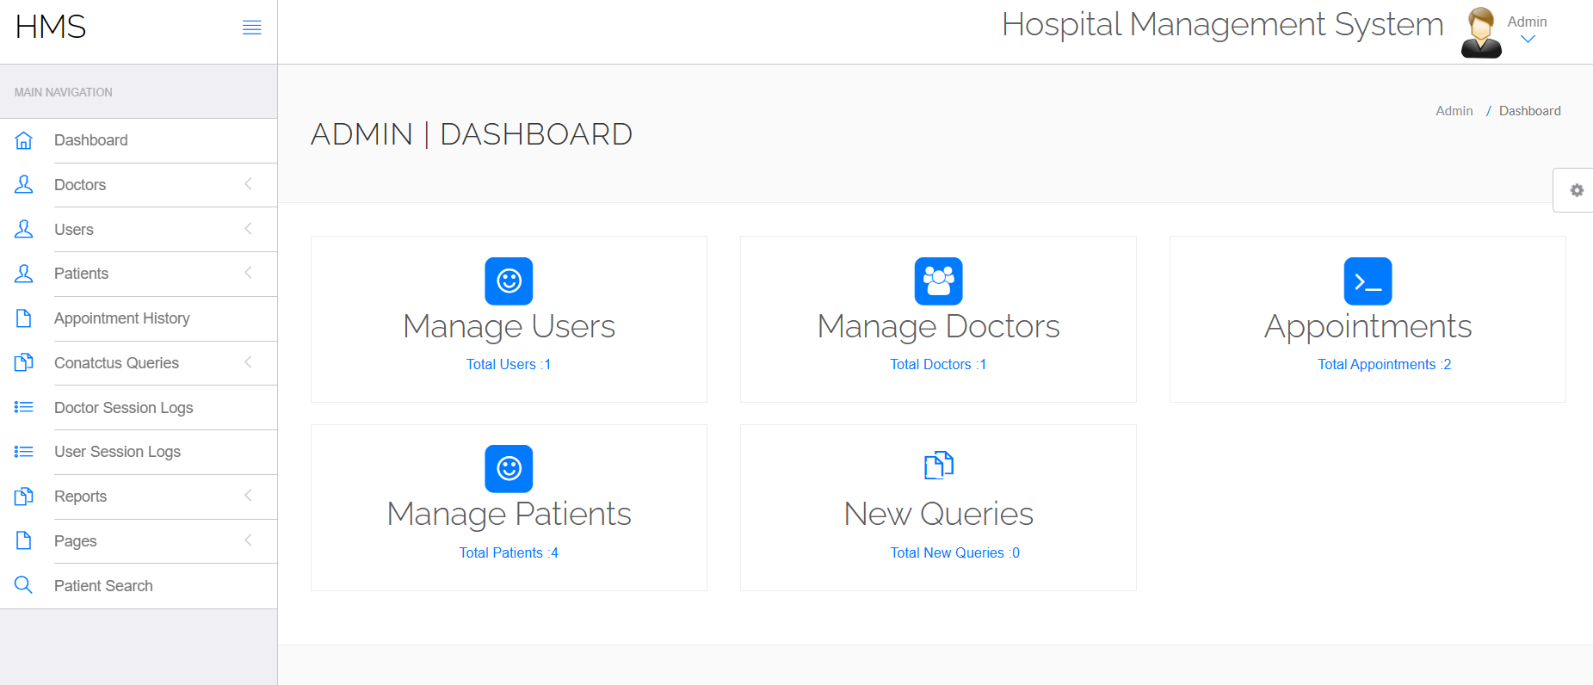
IMPLEMENTATION(DASHBORD)
Page:13

Slide 14
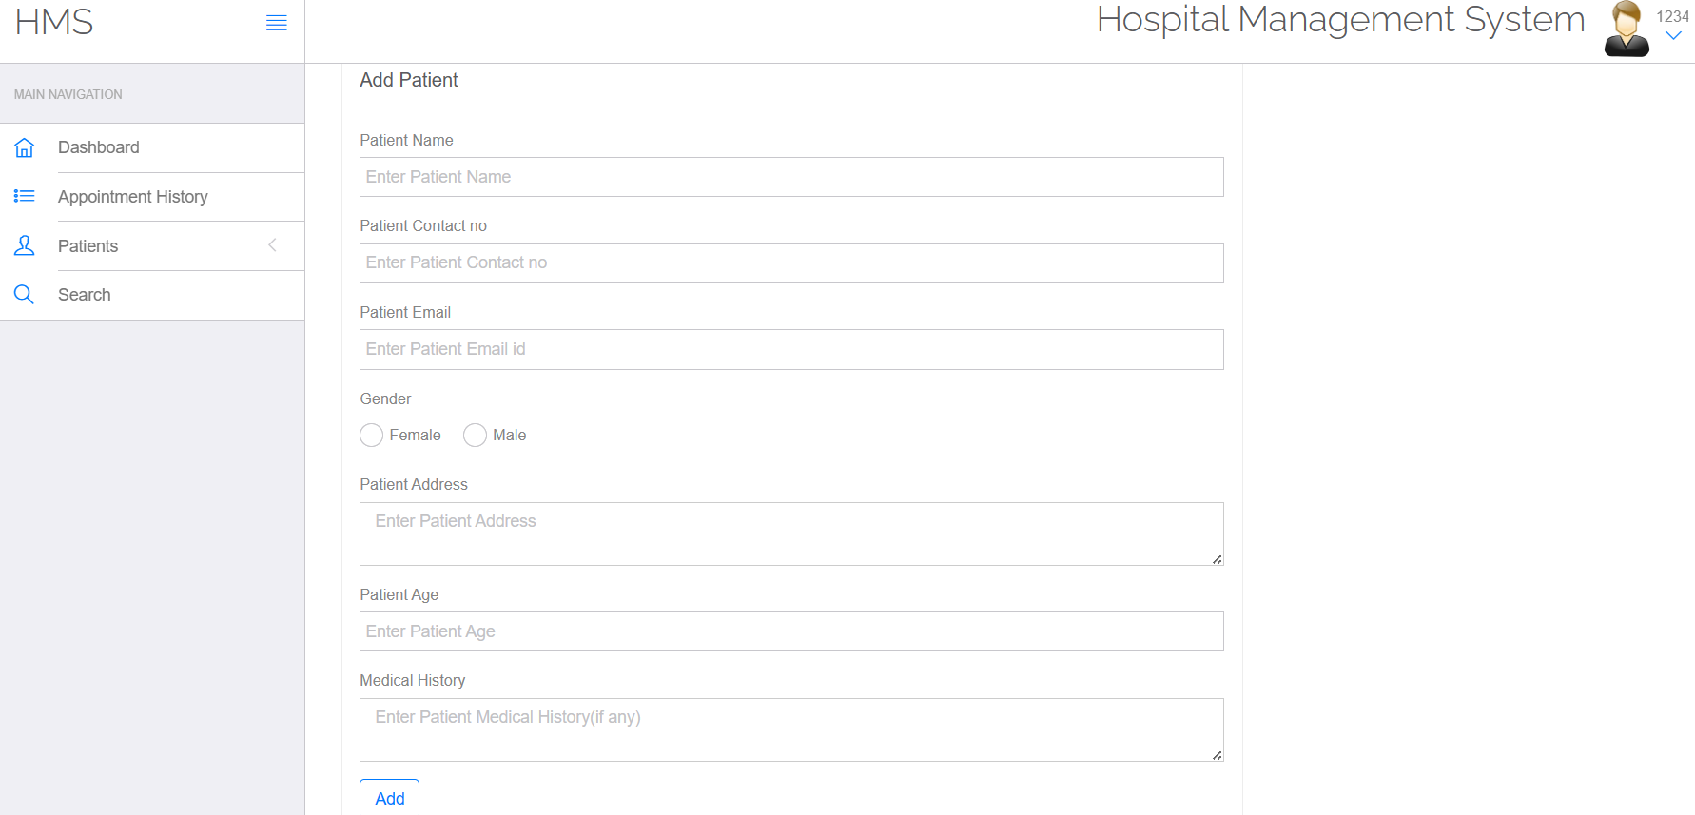
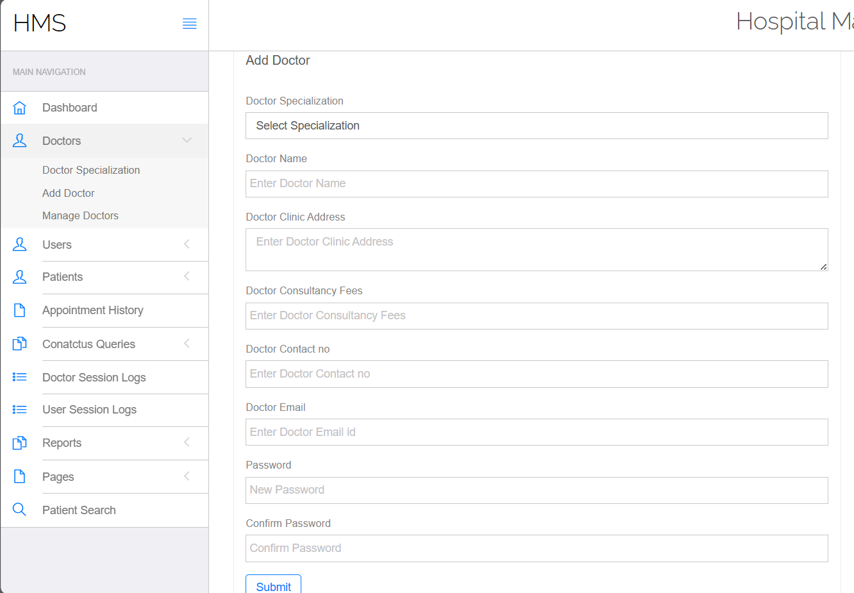
IMPLEMENTATION(ADD DOCTOR AND PATIENT)
Page:14

Slide 15
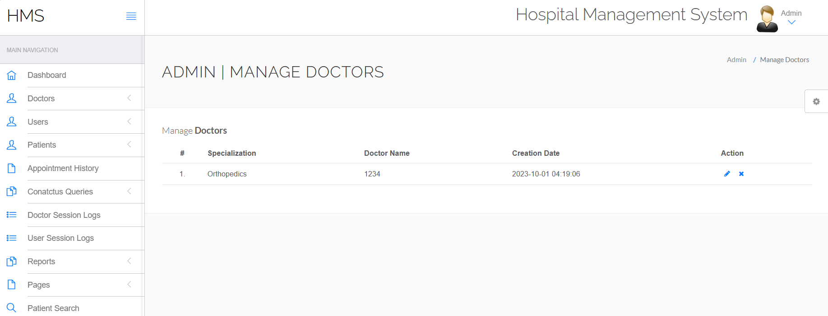
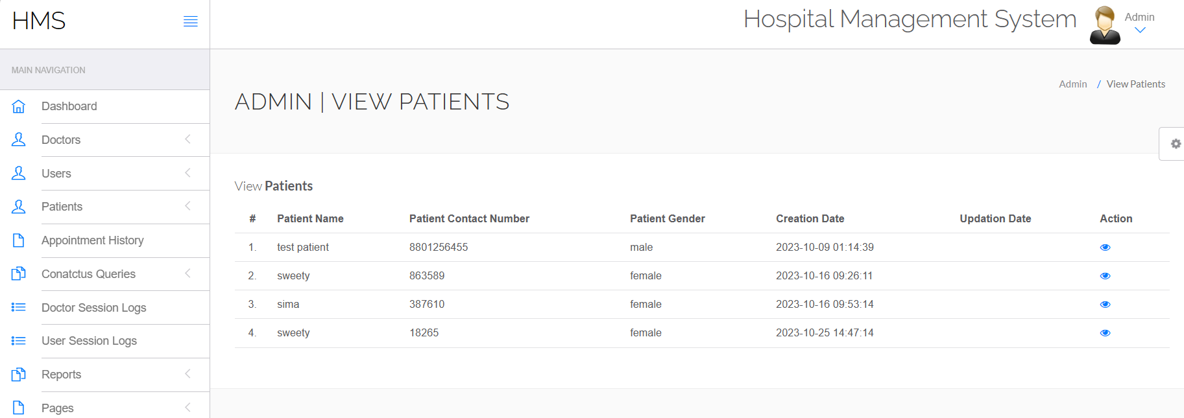
IMPLEMENTATION
Page:15

Slide 16
Conclusion
A hospital management system is a vital tool for modern healthcare facilities, streamlining administrative tasks and improving overall patient care. It enhances efficiency by digitizing patient records, appointment scheduling, and billing processes. Moreover, it facilitates data management and analysis, enabling better decision-making. Ultimately, a well-implemented hospital management system can lead to cost savings, improved patient satisfaction, and better healthcare outcomes.
Page :16

Slide 17
LIMITATIONS
High Implementation Costs: Setting up and customizing a Hospital Management System can be expensive, including the costs of software, hardware, training, and ongoing maintenance.
Complex Implementation: Implementing these systems in a healthcare facility can be a complex and time-consuming process, often requiring significant changes in workflow and staff training.
Scalability Challenges: Adapting the system to accommodate the needs of growing or changing healthcare facilities can be a challenge.
Page :17

Slide 18
references
https://www.nih.gov/
https://www.healthline.com
https://www.techpout.com/hospital-management-software/#1_Soft_Clinic
Page :18

Slide 19
THANK YOU
EVERYONE
Page :19

