Slide 1

Hospital Management System
Bangladesh Army University Of Science and Technology, Saidpur
Shadikujjaman Anik-210201040
Tasnimuzzaman Tasin- 210201015
Sharifa Rahman Sweety- 210201019
Department :Computer Scince And Engineering

Slide 2
Table of content
Introduction
Problem definition
Objective
RELATED PROJECT
Methodology
Tools
Conclusion
Reference

Slide 3
Introduction
Our project is about making hospital management system
easy,
Secured
computerizing
the manual works of the hospital.

Slide 4
Problem definition
Problem 1:Patient Feedback.
Problem 2:Telemedicine Platform.
Problem 3:Ambulance & Vehicle Management.
Problem 4:Online Appointment Book.
Problem 5:Web & Mobile App Access.

Slide 5
objective
Patient can choose their desired doctor and their availability.
Patient can look up to their medical conditions
Doctors can too read up on their patients’ health details and can analyze.

Slide 6
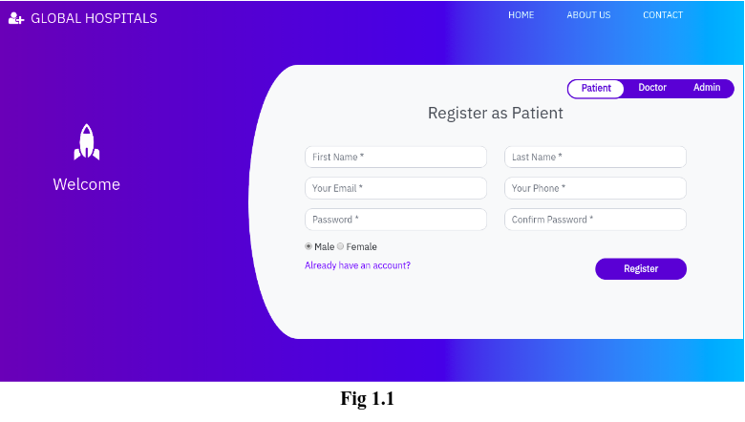
RELATED PROJECT
GLOBAL HOSPITAL MANAGEMENT SYSTEM

Slide 7
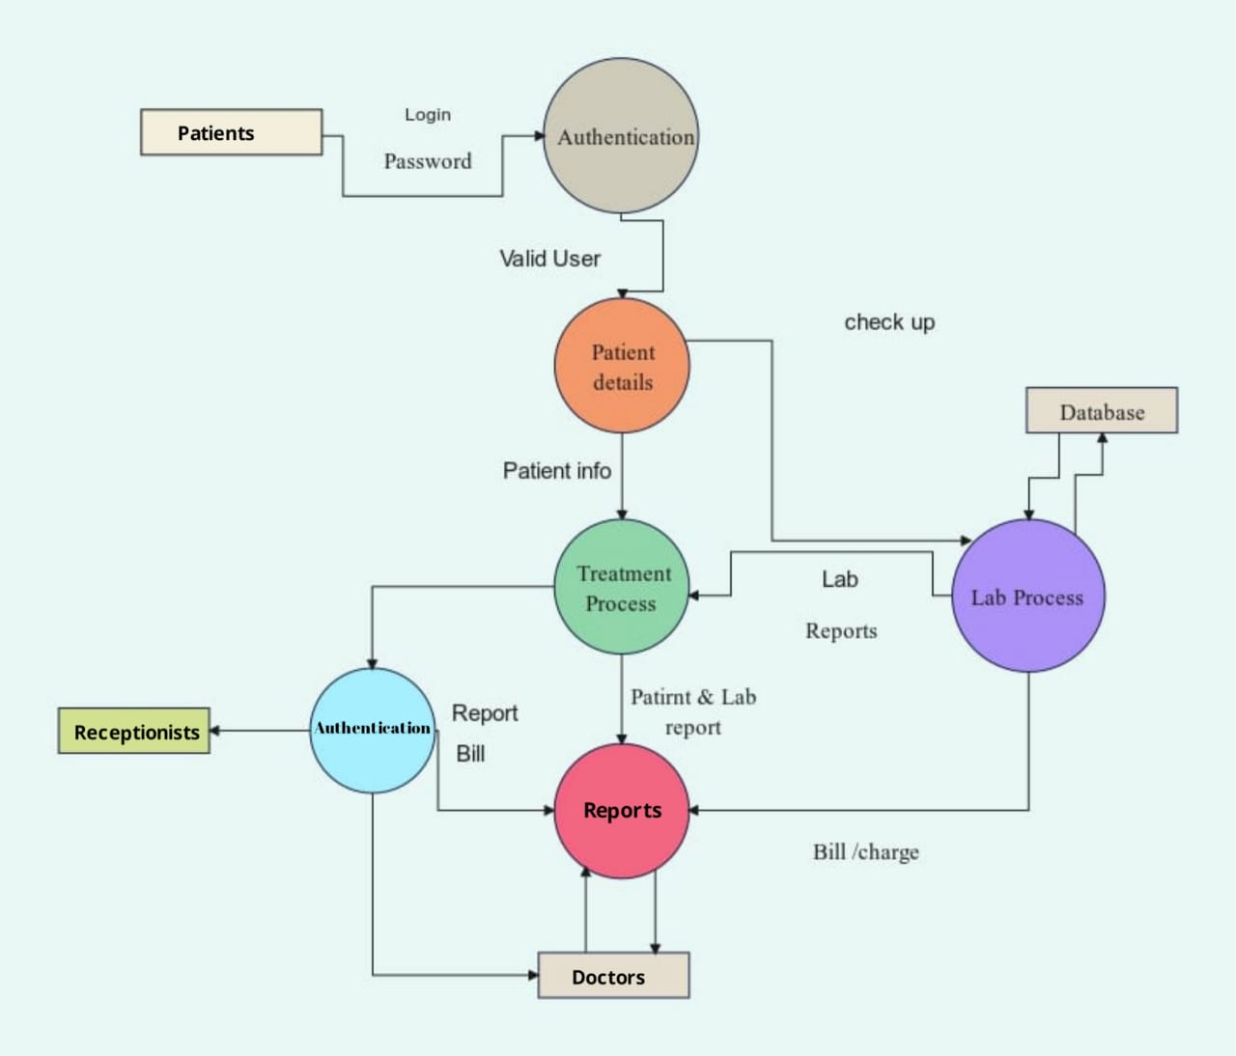
Methodology

Slide 8
Tools
HTML
CSS
JavaScript
PHP
Sql
Bootstrap

Slide 9
Conclusion
Our project “Hospital Management System(HMS)” is developed for making hospital works easy and accurate. It might consists of basic features but using some high level programming language, this project can be made more advanced.

Slide 10
Reference
PHP:https://www.php.net/manual/en/tutorial.php
HTML/CSS:https://www.w3schools.com/
JavaScript:https://www.w3schools.com/js/default.asp
Sql:https://www.mysqltutorial.org/

Slide 11
THANK YOU

