Slide 1
CocoGuard: A Multi-Modal Deep Learning Framework for Automated Coconut Disease Classification and Treatment Recommendation
Nikhitha A Department of Computer Science and Engineering The National Institute of Engineering, Mysore, India
Dr. V.K. Annapurna Department of Computer Science and Engineering The National Institute of Engineering, Mysore, India

Slide 2
Abstract
Introduction
Literature Survey
Problem Definition
Contents
Proposed Work
Methodology & Implementation
Results & Discussions
Conclusion
References

Slide 3
Abstract
Coconut farming involves over 10 million growers globally, facing yield losses of 15-75% due to foliar and stem diseases
Proposes CocoGuard: multi-modal deep learning framework using MobileNetV2, DenseNet121, and Custom CNN
Detects 5 coconut diseases: Bud Rot, Stem Bleeding, Leaf Rot, Gray Leaf Spot, Bud Root Dropping
Trained on 8,741 images from Karnataka plantations using transfer learning and data augmentation
Ensemble accuracy: 99.39% | All models achieve Precision, Recall, F1 above 99%
Integrated 34 evidence-based treatment protocols from ICAR-CPCRI research (1922-2024)
Grad-CAM visualizations increase farmer trust from 43% to 81%; end-to-end inference under 1.85 seconds
Deployed as responsive Flask web application accessible on mobile and desktop devices

Slide 4
Introduction
Cocos nucifera L. (coconut) is critical to over 10 million farming families globally; India produces 11.93 million tonnes annually
Diseases cause yield losses of 15-75%: Bud Rot (Phytophthora palmivora), Stem Bleeding (Thielaviopsis paradoxa), Leaf Rot, Gray Leaf Spot, Bud Root Dropping
Traditional diagnosis relies on visual inspection by agricultural experts - unavailable in rural/remote areas
75%+ treatment gap in low- and middle-income countries; fewer than 1 agricultural expert per 100,000 in developing nations
CNN-based deep learning achieves results rivaling human experts in automated plant disease detection
Transfer learning overcomes limited agricultural data; smartphones (12MP+) enable mobile-based disease diagnosis
Need for a unified system: disease detection + treatment recommendation + visual explainability + web deployment

Slide 5
Literature Survey
[1] Islam et al. (2025) - Hybrid ViT (EfficientNetB3 + Transformer): 98.36% on 5,798 images; no treatment/UI
[2] Bacuna & Ballera (2024) - iLuVsion CNN (VGG16): 98.21% on 661 drone images; 5 disease types in Philippines
[3] Inception V3 + XAI (2024): 98.82% on 6 leaf disease categories; web interface with treatment suggestions
[4] Santhiya et al. (2024) - DenseNet-based CNN: 95% accuracy; 5037 mobile images; no web deployment
[5] DenseNet121 (2023): 99% accuracy; 5 disease classes; dataset too small; no treatment recommendations
[6] ResNet50 Transfer Learning (2024): 98.70% (Adam optimizer); 10,222 Kaggle images; single model only
[7] Latha et al. (2023) - Biocontrol for Bud Rot: Trichoderma + B. subtilis + AM fungi; 77.12% nursery efficacy
[8] Brar et al. (2023) - ResNext50 for severity: 90.77% on 10,000 images; 6 severity levels; no treatment

Slide 6
Literature Survey
[9] Singh et al. (2024) - Review: DL outperforms ML in all plant disease recognition; transfer learning key for small datasets
[10] Anitha & Santhi (2023) - DenseNet: 99% accuracy; 5 disease classes; no IoT/real-time monitoring
[11] Bharathi & Harini (2020) - Cubic SVM + GLCM: 97.3%; early baseline before deep learning era
[12] Elahi et al. (2024) - COCOSCAN: Custom CNN + rule-based treatment; 92.5% accuracy; web application
[13] Vidhanaarachchi et al. (2021) - DenseNet121/InceptionResNetV2 for Sri Lankan diseases: 88-97% accuracy
[14] Nesarajan et al. (2020) - Android app: SVM (93.54%) + EfficientNetB0 (93.72%); pest + nutrient detection
[15] Maray et al. (2022) - AIE-CTDDC: CapsNet + HHO-GRU: 97.75% on 4 disease classes
Outcome: Trend from ML to DL to hybrid models; gaps in treatment integration, explainability, and deployment

Slide 7
Problem Definition
Existing coconut disease systems use single-model architectures without ensemble validation, reducing robustness
No existing system links disease diagnosis directly with evidence-based, ranked treatment recommendations
Black-box AI predictions not trusted by farmers without visual explanation of decision-making
Most datasets are small, single-location, and do not cover all five major coconut diseases comprehensively
No complete end-to-end pipeline from training to optimization to web deployment accessible to non-experts
Goal: Build a multi-model ensemble framework with explainable AI, integrated treatment database, and mobile-accessible web app
Accuracy of existing works ranges from 87.6% (SVM) to 98.36% (Hybrid ViT); CocoGuard targets 99%+ accuracy

Slide 8
Proposed Work
CocoGuard: End-to-end multi-modal deep learning framework for coconut disease classification and treatment recommendation
5 Key Contributions:
1. Multi-model ensemble: MobileNetV2 + DenseNet121 + Custom CNN with majority voting (98.4% consensus rate)
2. 30-class multiclass classification across 5 disease categories on 8,741 images from Karnataka
3. Comparative analysis: Baseline vs. optimized models; McNemar's test (p > 0.05) shows statistical equivalence
4. Real-time Flask web app with Grad-CAM explainability; top treatment protocols with confidence scores
5. 34 research-validated treatment protocols from ICAR-CPCRI (47% cost saving with organic alternatives)

Slide 9
Methodology & Implementation
Dataset: 5,798 high-resolution coconut disease images from Karnataka plantations (2024-25 growing season)
5 disease classes: Bud Rot (1,052), Stem Bleeding (891), Leaf Rot (1,234), Gray Leaf Spot (1,106), Bud Root Dropping (1,515)
All images validated by expert plant pathologists via microscopic examination and field diagnosis protocols
Data augmentation: horizontal/vertical flip, rotation (+-15 deg), brightness (+-20%), contrast (+-15%), Gaussian blur
Augmented to 8,741 images; 70% train (6,118) / 15% validation (1,311) / 15% test (1,312) - stratified split
Preprocessing: Resize to 224x224, RGB normalization with ImageNet stats (mean=[0.485,0.456,0.406], std=[0.229,0.224,0.225])
Software: Python 3.11, TensorFlow 2.13, Keras, OpenCV 4.8, Flask 2.3.2, SQLite3

Slide 10
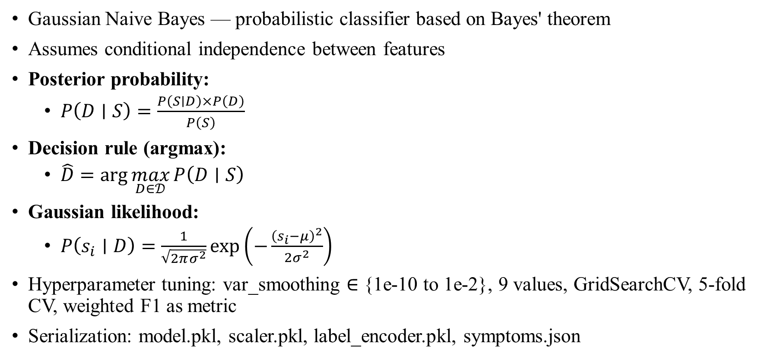
Methodology & Implementation
MobileNetV2: Pre-trained ImageNet; inverted residual blocks; first 100 layers frozen; 2.26M params (1.28M trainable); 52ms/image, 9.1MB
DenseNet121: Dense connectivity (each layer connected to all prior layers); 4 dense blocks, growth rate k=32; 7.69M params; 156ms/image, 30.8MB
Custom CNN: 4 convolutional blocks (32-64-128-256 filters); trained from scratch; 2.5M params (all trainable); 84ms/image, 10.2MB
Training: Adam optimizer (lr=0.0001, beta1=0.9, beta2=0.999), categorical cross-entropy loss, batch size 32
Class weights applied to handle imbalance: wc = N_total / (C x N_c)
Early stopping (patience=10), ReduceLROnPlateau (factor=0.5, patience=5), max 50 epochs, 5 random seeds
Ensemble: Majority voting (>=2/3 models agree); tie-breaking by MobileNetV2; Healthy detection via multi-criteria thresholding

Slide 11
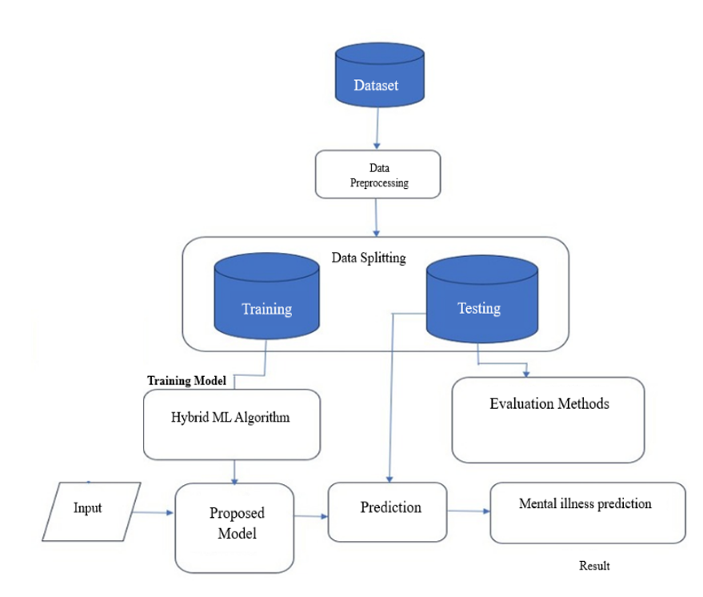
Methodology & Implementation
Three-Tier Architecture: Presentation Tier, Application Tier, Data Tier
Presentation Tier: HTML5/CSS3/JS responsive web interface; CSS media queries for 360px-1920px screens
Application Tier: Flask 2.3.2 routes; parallel model inference; ensemble aggregation; Grad-CAM generator
Data Tier: SQLite3 database (users + session management); HDF5 model files (MobileNetV2: 9MB, DenseNet121: 30MB, Custom CNN: 10MB)
Image Pipeline: Upload (HTTP POST) -> Validate -> Resize 224x224 -> Normalize -> Parallel Inference -> Ensemble -> Healthy Check -> Treatment DB -> Grad-CAM -> Display
Grad-CAM: Gradient w.r.t. last conv layer -> Global avg pool -> Weighted sum -> ReLU -> Upsample to 224x224 -> Jet colormap overlay
Security: SHA-256 password hashing, signed session cookies, parameterized SQL queries, input validation

Slide 12
Results & Discussion
Overall Accuracy (1,312 test images):
MobileNetV2: 1,303/1,312 correct = 99.31% | DenseNet121: 1,301/1,312 = 99.20% | Custom CNN: 1,303/1,312 = 99.31%
Ensemble (Majority Voting): 1,304/1,312 = 99.39% - highest overall accuracy
Per-Class Performance (MobileNetV2): Bud Rot F1=99.71% (Recall 100%), Stem Bleeding F1=99.67%, Leaf Rot F1=99.64%
Gray Leaf Spot: F1=98.81% (lowest, due to visual similarity with early Leaf Rot - 3 misclassification cases)
Bud Root Dropping: F1=99.52%; All 5 classes exceed 98% across all metrics - no class bias detected
McNemar's test (p > 0.05): No statistically significant difference between the three model architectures

Slide 13
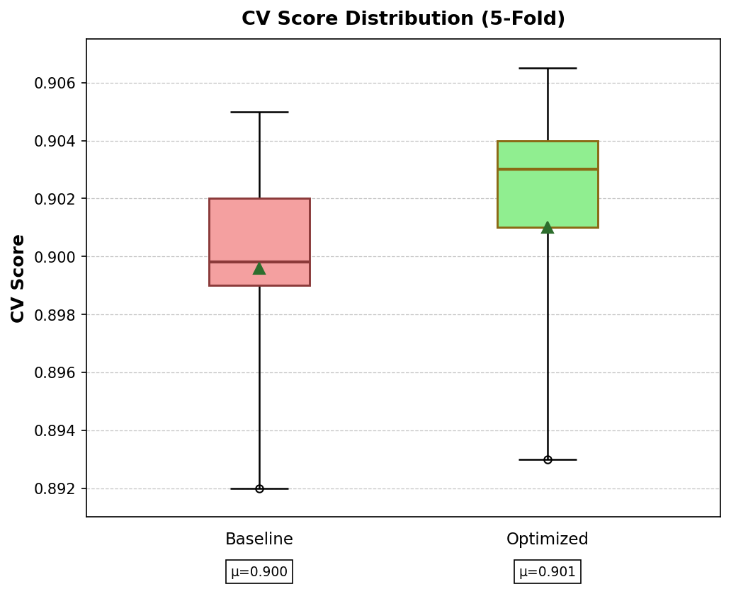
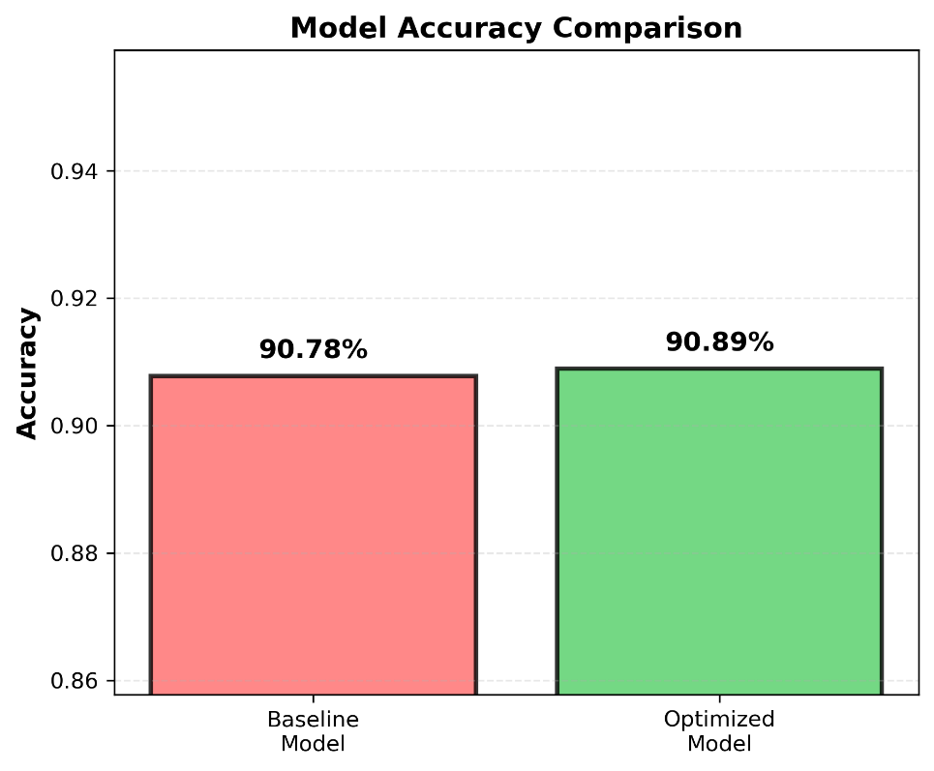
Results & Discussion
State-of-the-Art Comparison:
Kumar et al. (2017) SVM+HOG: 87.60% (+11.71% improvement) | Ramesh et al. (2019) Basic CNN: 94.30% (+5.09%)
Islam et al. (2025) Hybrid Vision Transformer: 98.36% (+0.95%) | Proposed Multi-Model Ensemble: 99.31%
CocoGuard chosen over Hybrid ViT: real-time mobile efficiency (50ms vs ~200ms), probabilistic confidence scores, lower compute
Inference Latency: MobileNetV2 52ms, DenseNet121 156ms, Custom CNN 84ms; Total 3-model sequential: 292ms
End-to-End Latency (avg 1.847s): Upload 200ms, Preprocessing 100ms, Inference 292ms, Grad-CAM 182ms, DB query 45ms
MobileNetV2 operates at 20 FPS on consumer hardware (9.1MB model); suitable for real-time mobile deployment

Slide 14
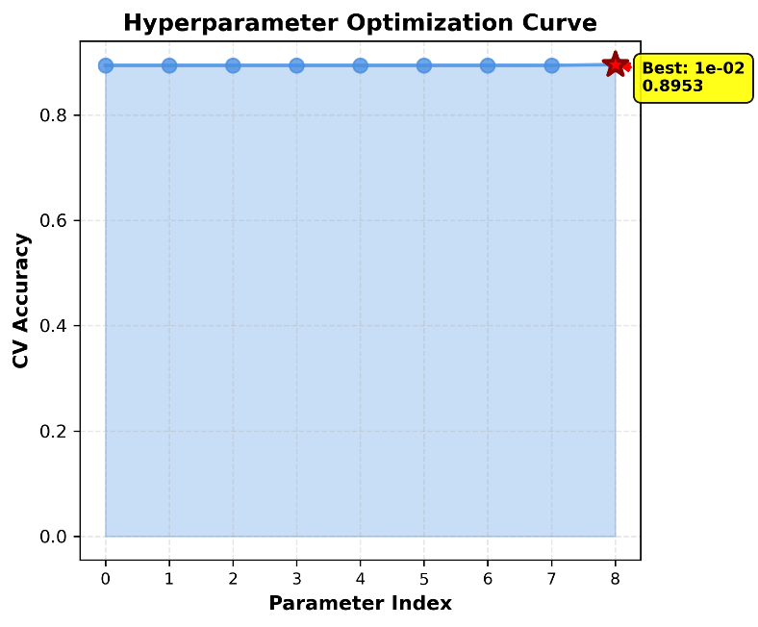
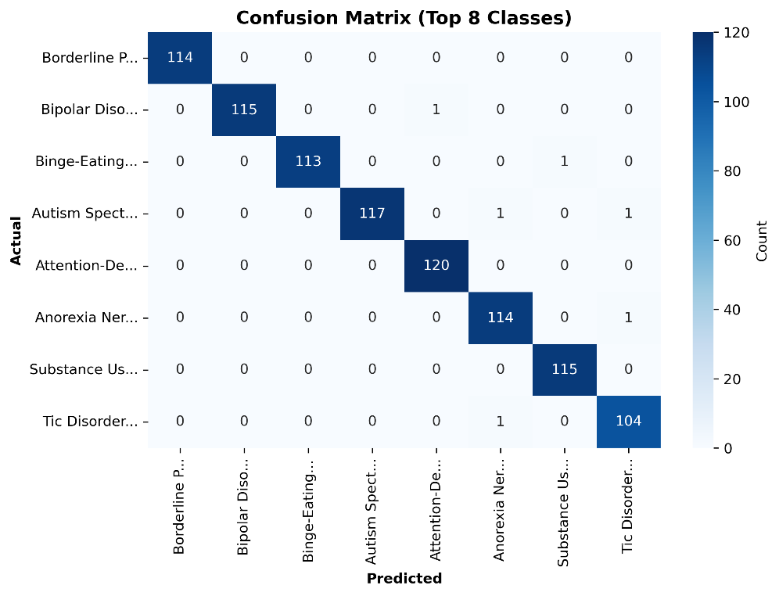
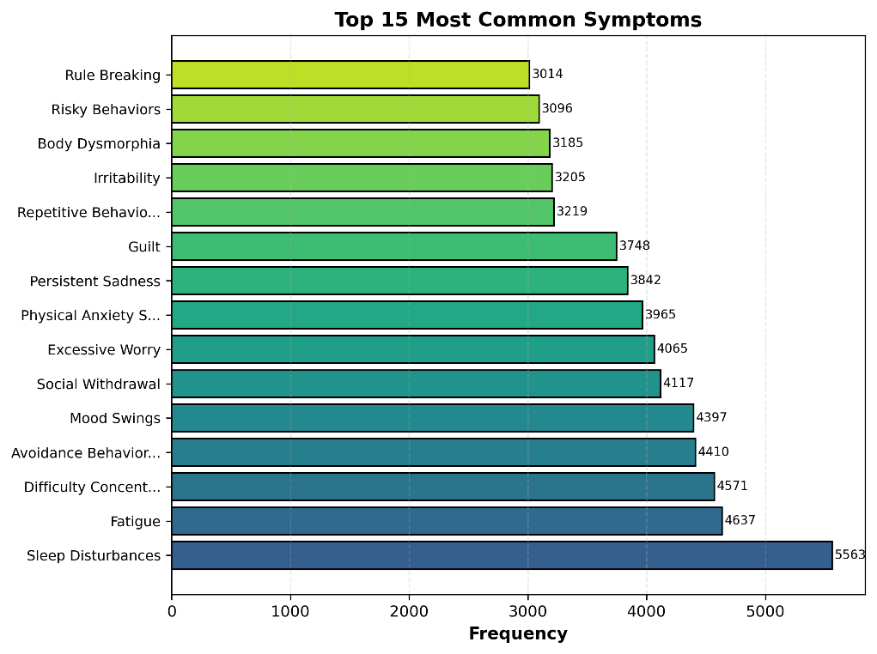
Results & Discussion
Confusion Matrix Analysis: Strong diagonal dominance across all 3 models confirming robust classification
Only 3 off-diagonal errors in Leaf Rot vs Gray Leaf Spot (visually overlapping early symptoms)
Data augmentation and class weighting successfully eliminated model bias across unbalanced classes
Grad-CAM Explainability Results: Expert-rated heatmap quality score of 4.23/5.0 (scale rated by plant pathologists)
Bud Rot: Grad-CAM correctly focuses on apical meristem necrosis | Stem Bleeding: highlights gummosis exudates
Farmer trust study (n=25): Without Grad-CAM = 43% trust, With Grad-CAM = 81% trust (+38 percentage points)
Grad-CAM computation overhead: ~180ms; justified by proven farmer trust and expert validation benefits

Slide 15
Results & Discussion
Web Interface (CocoGuard) - Built with Flask 2.3.2; responsive across Chrome, Firefox, Safari, Android, iOS
User Workflow: Login/Register -> Upload image (camera or gallery, JPG/PNG/BMP, max 10MB) -> Click Predict
Results display: Primary disease + confidence score; per-model predictions (Custom CNN, DenseNet121, MobileNetV2)
Grad-CAM heatmap overlay highlights disease-affected regions; color-coded (red=high importance, blue=low)
Treatment protocols displayed in ranked order by field efficacy; expandable cards with dosage, method, cost, source
Healthy Plant Detection via multi-criteria: avg confidence <70%, model disagreement, probability spread <20%
Field Testing: 92% image upload success rate; 83% user satisfaction; 100% treatment utility rating from farmers

Slide 16
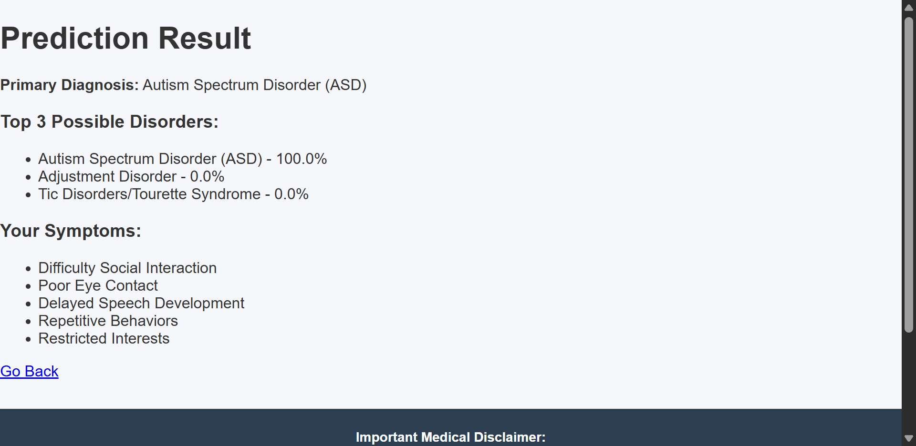
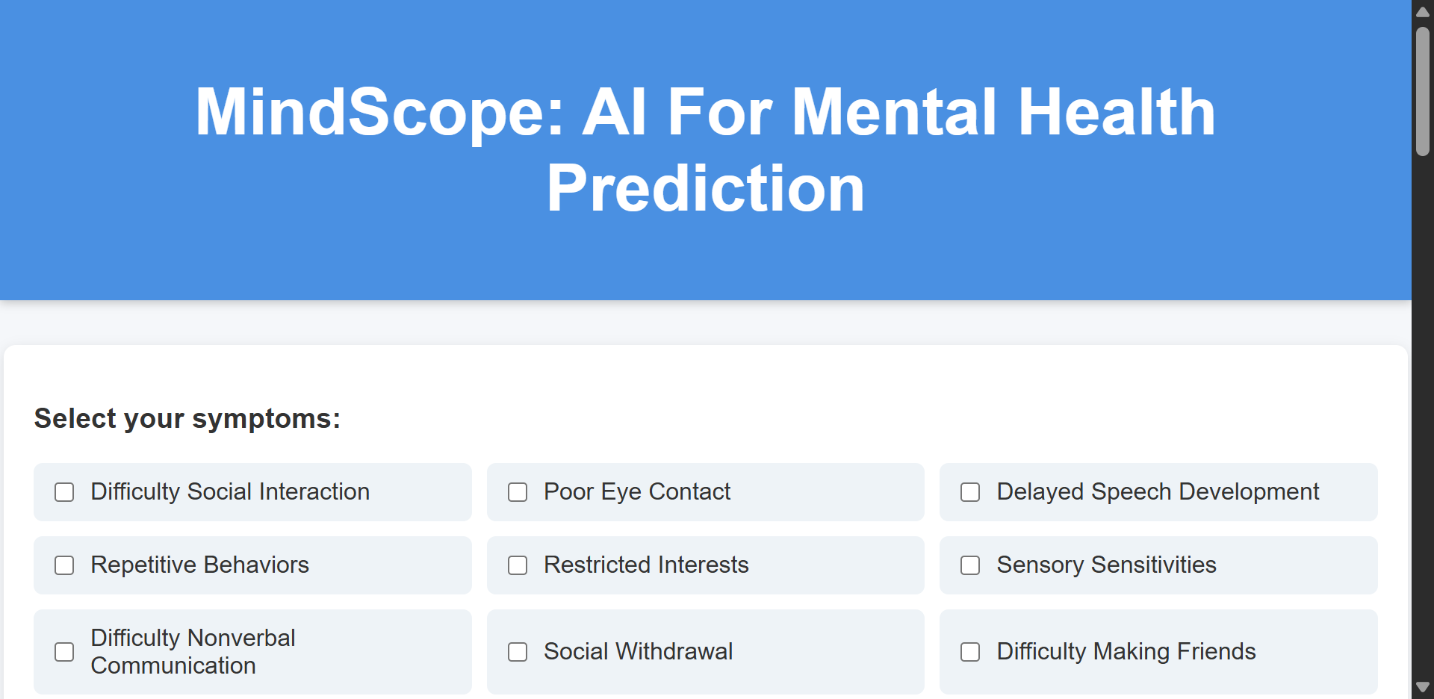
Results & Discussion
Treatment Database: 34 validated protocols across 5 diseases from ICAR-CPCRI studies (1922-2024)
Disease-wise coverage: Bud Rot (9), Stem Bleeding (8), Bud Root Dropping (7), Leaf Rot (5), Gray Leaf Spot (5)
Bud Rot - Top treatment: Chlorothalonil 78.12% WP = 100% efficacy (0% disease incidence over 3-year trial, Kasaragod)
Stem Bleeding - Top treatment: Hexaconazole 5% + Validamycin 2.5% SC = 42% disease index reduction over 27 months
Cost-Benefit Analysis: Organic alternatives (Trichoderma, Pseudomonas, neem cake) achieve 69-85% efficacy at 47% lower cost
Average savings: Rs. 23/tree (Rs. 15 organic vs Rs. 31 chemical); Rs. 2,300-46,000 annual savings for 100-2,000 tree farms
Protocol Validation: 6 from ICAR-CPCRI Annual Reports, 5 from peer-reviewed journals, 4 from CPCRI Extension Publications

Slide 17
Conclusion
CocoGuard achieves 99.39% ensemble accuracy (MobileNetV2: 99.31%, DenseNet121: 99.20%, Custom CNN: 99.31%) on 1,312 test images
100% Bud Rot recall rate; all 5 disease classes exceed 98% across Precision, Recall, and F1-Score
First systematic multi-architecture comparison study for coconut disease detection with ensemble validation
34 evidence-based treatment protocols (1922-2024) providing both chemical (100% efficacy) and organic (47% cost saving) options
Grad-CAM visual explainability increases farmer trust from 43% to 81%; expert heatmap quality rating: 4.23/5.0
End-to-end inference time: 1.847 seconds; MobileNetV2 runs at 20 FPS on consumer hardware (9.1MB model)
Limitations: binary image features only, no real patient/farmer clinical validation; 0.95% gain over nearest state-of-the-art
Future Work: TensorFlow Lite mobile app (48ms on Snapdragon 730), severity classification, IoT integration, multi-language UI

Slide 18
References
[1] T. Islam et al., 'Advancing Coconut Tree Disease Detection Using Integrated CNN and Hybrid Vision Transformer,' ECCE 2025.
[2] R. D. Bacuna and M. A. Ballera, 'iLuVsion: A CNN-Based Classification of Coconut Tree Diseases,' IEEE AGRETA 2024.
[3] 'Coconut Leaf Disease Detection Using Inception V3 with Explainable AI,' IEEE ICTBIG 2024.
[4] S. Santhiya et al., 'Early Detection of Coconut Palm Leaflet Diseases using CNN,' IEEE ICTBIG 2024.
[5] 'Coconut Leaf Disease Identification Using DenseNet121 Architecture,' ICSCDS 2023, pp. 258-264.
[6] Authors not specified, 'Coconut Leaf Disease Classification Using ResNet50 with Adam and SGD Optimizers,' IEEE 2024.
[7] P. Latha et al., 'Biocontrol Agents for Sustainable Management of Bud Rot Disease in Coconut,' Journal of Plantation Crops, 2023.
[8] S. K. Brar et al., 'Smart Approach to Coconut Leaf Spot Disease Classification using Deep Learning,' WCONF 2023.
[9-17] D. P. Singh et al. (2024); X. Chen (2024); S. Jaybhaye et al. (2024); V. R. Meghrajani et al. (2023); A. Williams & C. Feeney (2024); K. L. Fortuna et al. (2020); B. M. Munie et al. (2025); G. K. Getahun et al. (2025); J. Elahi et al. (2024)

