Slide 1
WP
WorkPulse
Team Standup & Blocker Management System
FSAD Assignment 2026 | N K Anil Kumar (2025TM93109) | github.com/Anil-2025tm93109/workpulse
React
Node.js
MongoDB
JWT
Tailwind CSS

Slide 2
Table of Contents
01
Problem Statement
Slide 3
07
Backend Startup
Slide 9
Challenge and WorkPulse solution
Node.js + MongoDB Connected proof
02
Tech Stack
Slide 4
08
Register & Login APIs
Slides 10-11
React, Node.js, MongoDB, JWT, Tailwind
Postman proof — 201 Created, 200 OK
03
System Architecture
Slide 5
09
Standup & Dashboard APIs
Slides 12-13
Frontend → Backend → Database
Postman proof — data in MongoDB
04
Database Schema
Slide 6
10
Frontend Setup
Slide 14-18
Users, Standups, Blockers collections
Vite + Tailwind CSS configured
05
REST API Endpoints
Slide 7
11
Key Features
Slide 19
12 endpoints with role based access
Auth, RBAC, Standup, Dashboard, Search
06
User Roles & Features
Slide 8
12
GitHub & AI Usage
Slides 20-21
Employee, Manager, Admin
Commits, tools, reflection

Slide 3
Problem Statement
The Challenge
In distributed and hybrid teams, daily standups are often forgotten, inconsistently logged, or lost in chat threads. Managers have no real-time visibility into team progress or recurring blockers until it is too late.
The Solution — WorkPulse
A centralized platform where employees log daily standups and managers track team progress and blockers in real time. Role-based dashboards provide instant visibility into who submitted, who hasn't, and what's blocking the team.
3
12
7
User Roles
API Endpoints
UI Pages

Slide 4
Tech Stack
Frontend
Backend
Database
Dev Tools
React 18
Node.js
MongoDB Atlas
Git + GitHub
Vite (Build Tool)
Express.js
Mongoose ODM
Postman
Tailwind CSS
JWT Auth
3 Collections
VS Code
React Router
bcryptjs
Cloud Hosted
nodemon
Axios
dotenv + cors
Free Tier
Claude AI

Slide 5
System Architecture
FRONTEND
BACKEND
DATABASE
• Login Page
• Express.js Server
• MongoDB Atlas
• Dashboard
• Auth Middleware
• Users Collection
• Standup Form
Axios / HTTP
• JWT Verification
Mongoose
• Standups Collection
• Blocker Board
• Role Based Access
• Blockers Collection
• Team Standups
• 12 REST APIs
• My History
• CRUD Operations
• Cloud Hosted
• My Blockers
• Error Handling
• Free M0 Cluster

Slide 6
Database Schema — MongoDB Collections
Users
Standups
Blockers
_id: ObjectId
_id: ObjectId
_id: ObjectId
name: String
userId: ObjectId → Users
userId: ObjectId → Users
email: String (unique)
yesterday: String
standupId: ObjectId → Standups
password: String (hashed)
today: String
description: String
role: employee|manager|admin
blockers: String
status: open|resolved
team: String
hasBlocker: Boolean
resolvedBy: ObjectId → Users
createdAt: Date
date: String (YYYY-MM-DD)
resolvedAt: Date

Slide 7
REST API Endpoints
Method
Endpoint
Access
Description
POST
/api/auth/register
Public
Register new user with role
POST
/api/auth/login
Public
Login and receive JWT token
GET
/api/auth/me
Logged In
Get current user profile
POST
/api/standups
Employee
Submit daily standup
GET
/api/standups/me
Employee
Get my standup history
GET
/api/standups/today
Manager
See today's team submissions
GET
/api/standups/team
Manager
All team standups with search
GET
/api/blockers/me
Employee
My personal blockers
GET
/api/blockers
Manager
All team blockers
GET
/api/blockers/open
Manager
Only open/unresolved blockers
PATCH
/api/blockers/:id/resolve
Manager
Mark a blocker as resolved
GET
/api/dashboard
Manager
Team overview and stats

Slide 8
User Roles & Features
👤 Employee
👔 Manager
🔑 Admin
✓ Submit daily standup
✓ View team dashboard
✓ All Manager permissions
✓ Yesterday / Today / Blockers
✓ See submitted vs not submitted
✓ Full system access
✓ One submission per day
✓ View all team standups
✓ Manage all users
✓ View personal history
✓ Search by name or date
✓ View all data
✓ Track own blockers
✓ View all open blockers
✓ Highest privilege level
✓ See blocker status
✓ Mark blockers as resolved
✓ System administration

Slide 9
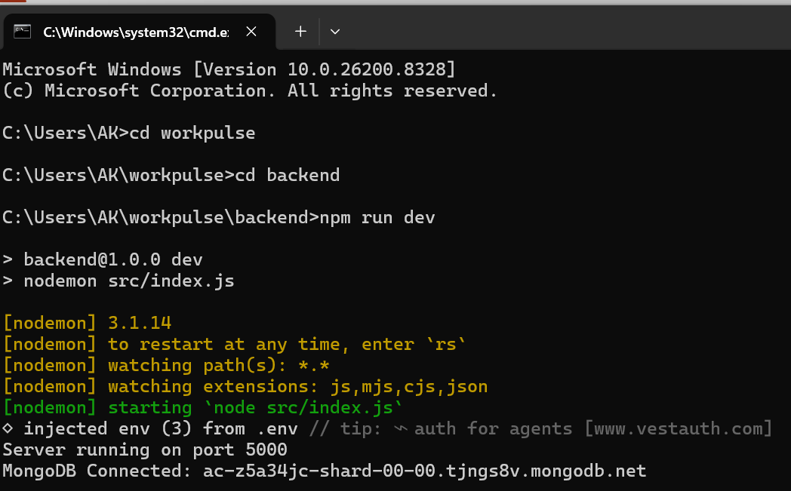
Implementation Proof — Backend Server Startup
What This Proves
Command
npm run dev
Tool
nodemon v3.1.14
Port
5000
DB
MongoDB Atlas
Status
✅ Connected
Host
ac-z5a34jc-shard
Env
3 vars from .env
Terminal — npm run dev → Server on port 5000 → MongoDB Connected ✅

Slide 10
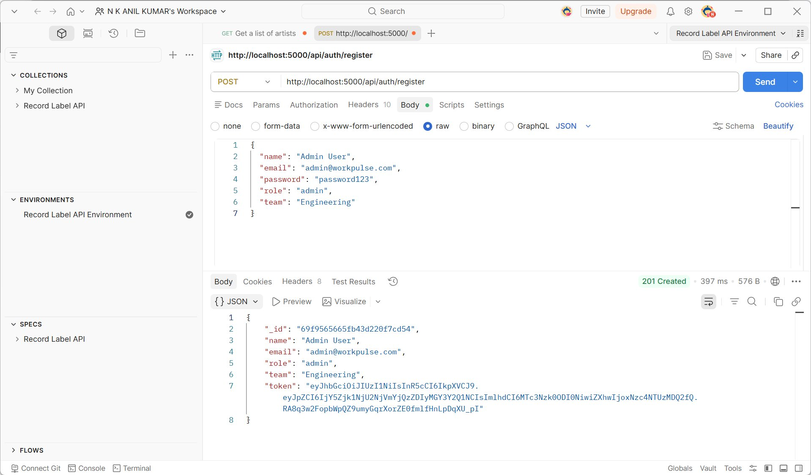
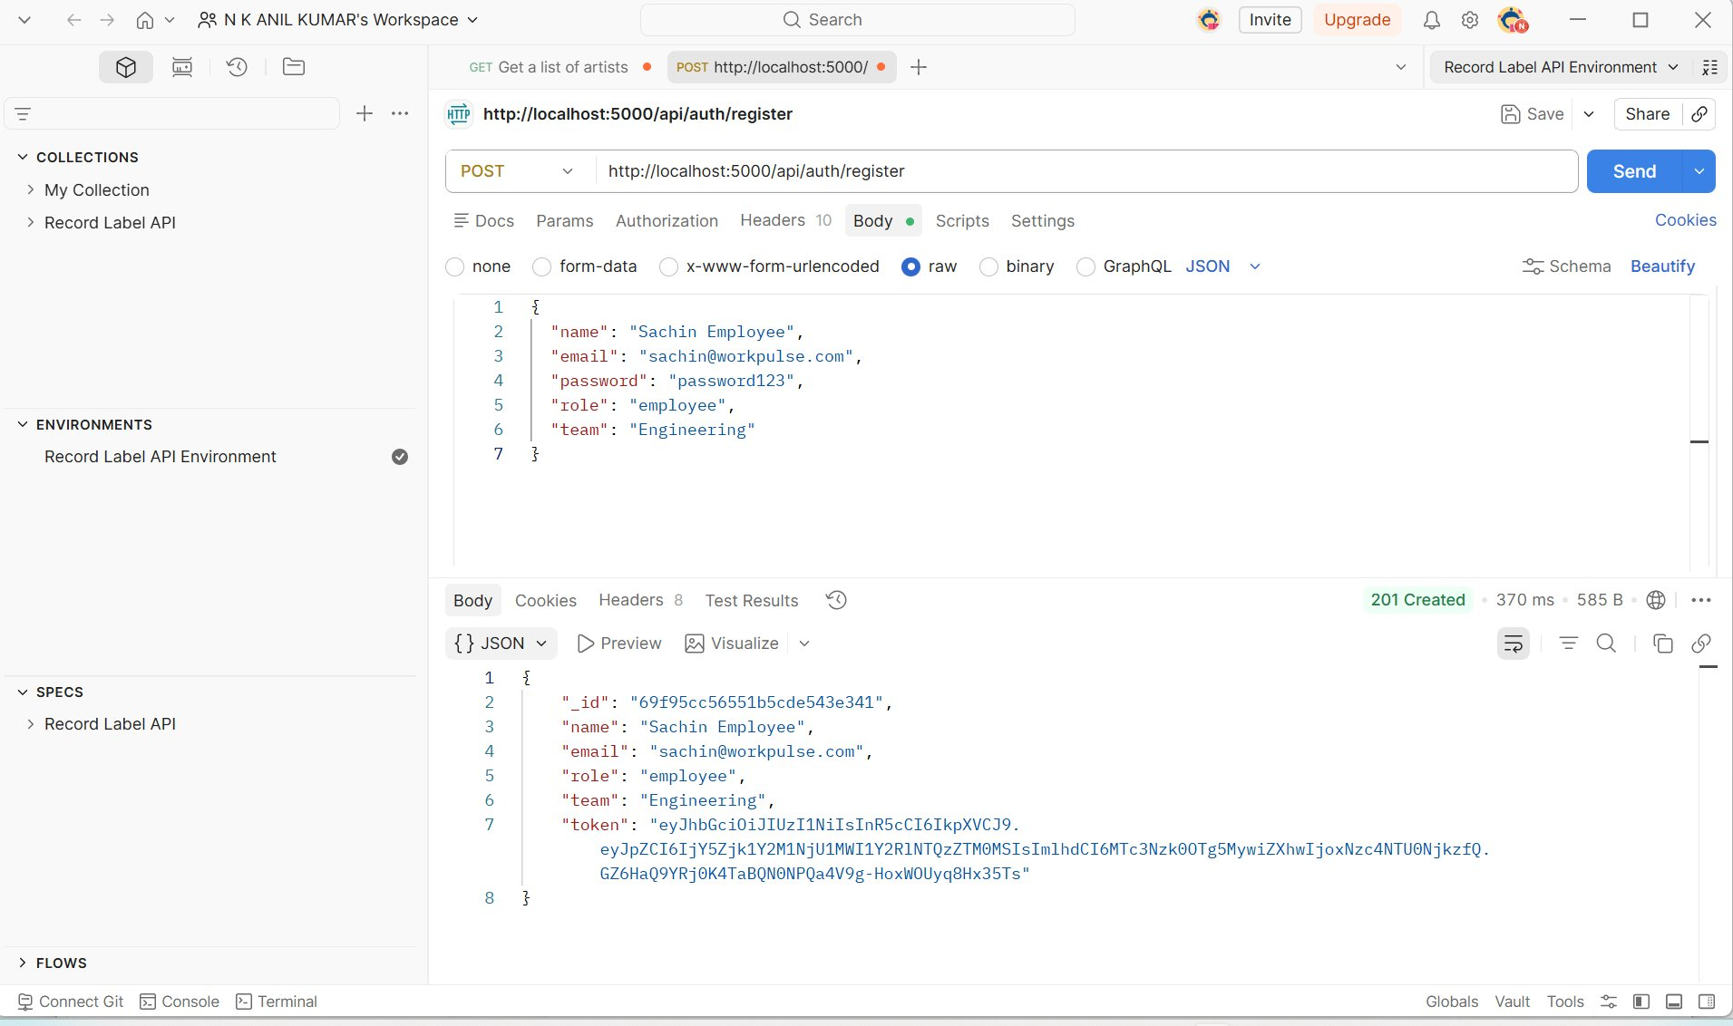
Implementation Proof — Register API (POST /api/auth/register)
Slide 10 of 17
Admin User — POST /api/auth/register — 201 Created
Sachin Employee — POST /api/auth/register — 201 Created
Body: name, email, password, role: admin, team: Engineering → Returns: _id, name, email, role, team, JWT token
Body: name, email, password, role: employee, team: Engineering → Returns: _id, email, role, JWT token
WorkPulse — FSAD Assignment 2026 | N K Anil Kumar (2025TM93109)

Slide 11
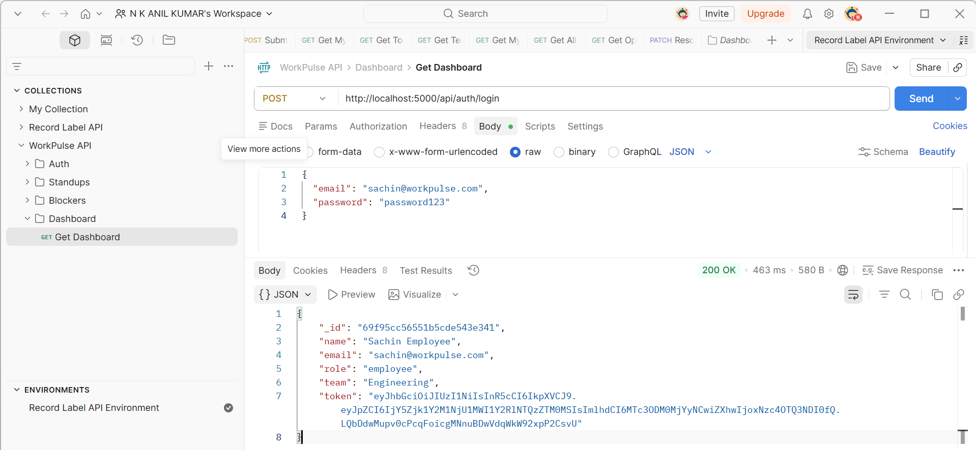
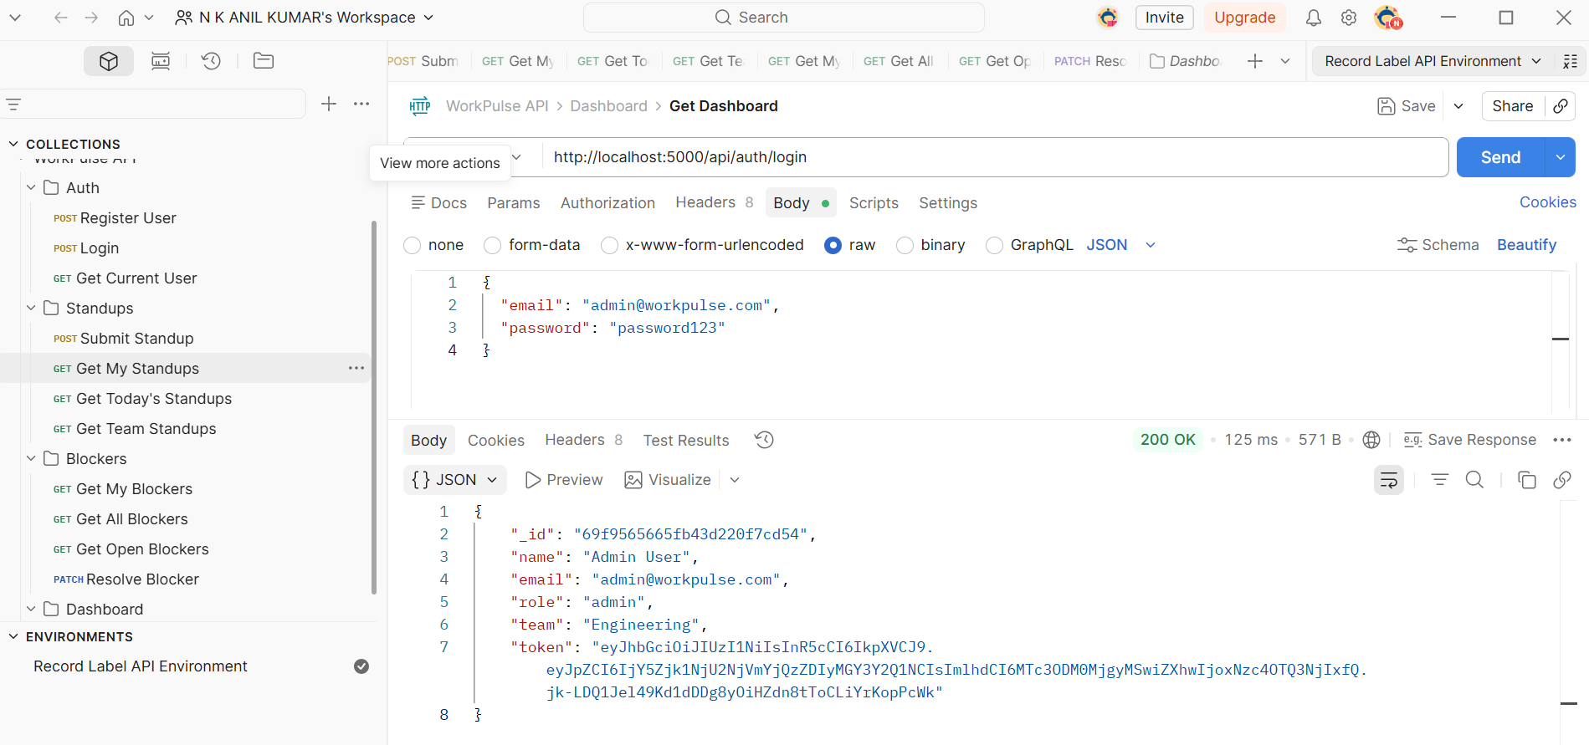
Implementation Proof — Login API (POST /api/auth/login)
Login API — 200 OK — JWT Token returned
Admin Login — role: admin — 200 OK
Body: email + password → Returns: user object + JWT token (used as Bearer token in all protected routes)
Role returned in response enables frontend to redirect Admin → Dashboard, Employee → Standup form

Slide 12
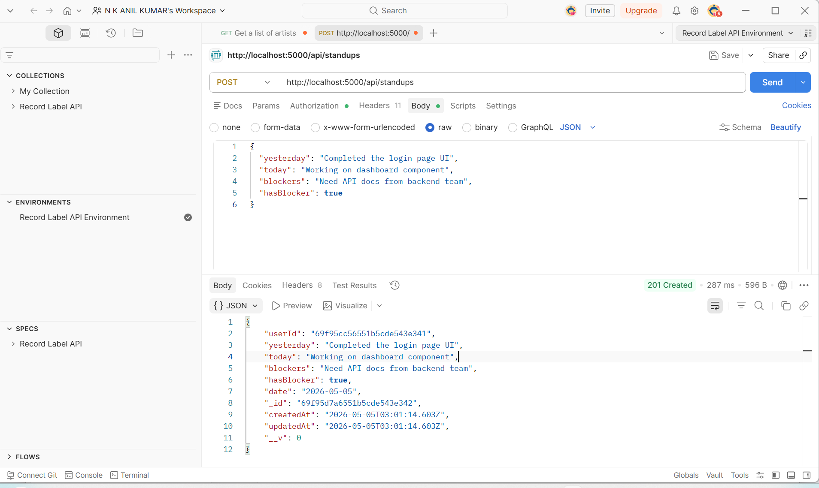
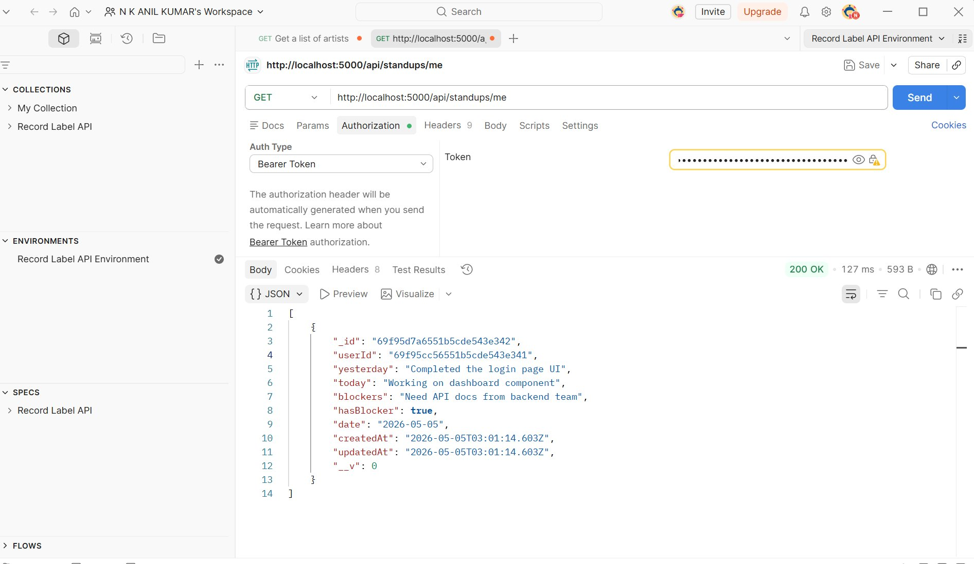
Implementation Proof — Standup APIs (POST & GET /api/standups)
Slide 12 of 17
POST /api/standups — 201 Created — Saved to MongoDB
GET /api/standups/me — 200 OK — Array returned
Fields: yesterday, today, blockers, hasBlocker: true → Auto sets date: 2026-05-05, userId linked
Bearer token in header → returns only that user's standups with all fields, userId, date, timestamps
WorkPulse — FSAD Assignment 2026 | N K Anil Kumar (2025TM93109)

Slide 13
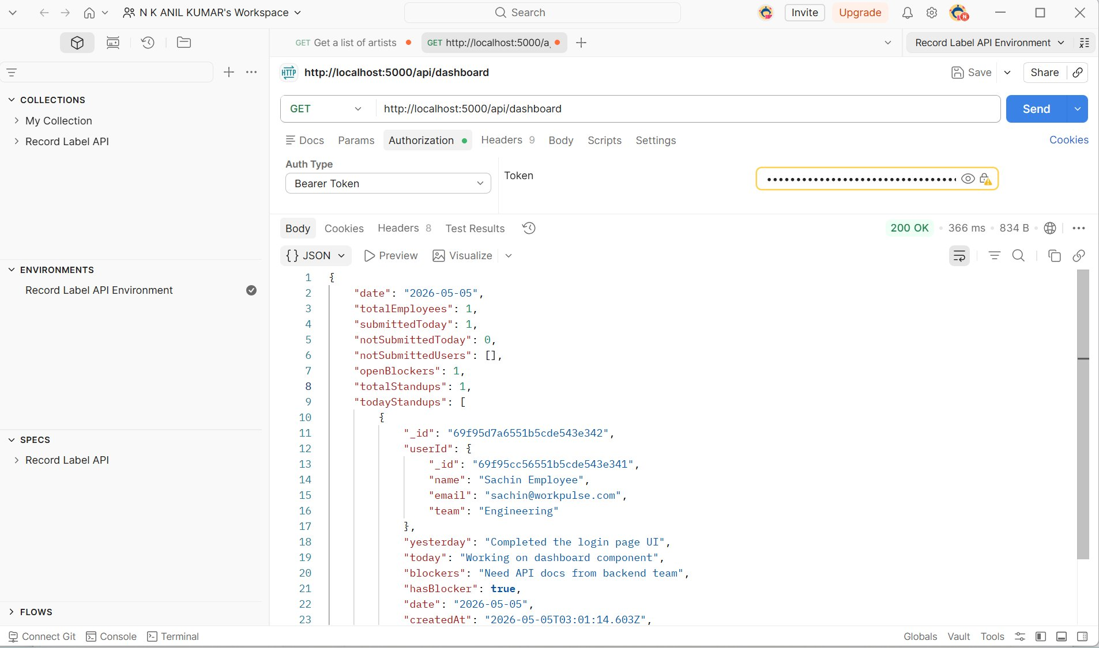
Implementation Proof — Dashboard API (GET /api/dashboard)
Slide 13 of 17
Response Fields
date
2026-05-05
totalEmployees
1
submittedToday
1
notSubmittedToday
0
openBlockers
1
totalStandups
1
todayStandups
[ array ]
GET /api/dashboard — Manager Bearer Token — 200 OK — 366ms — 834B

Slide 14
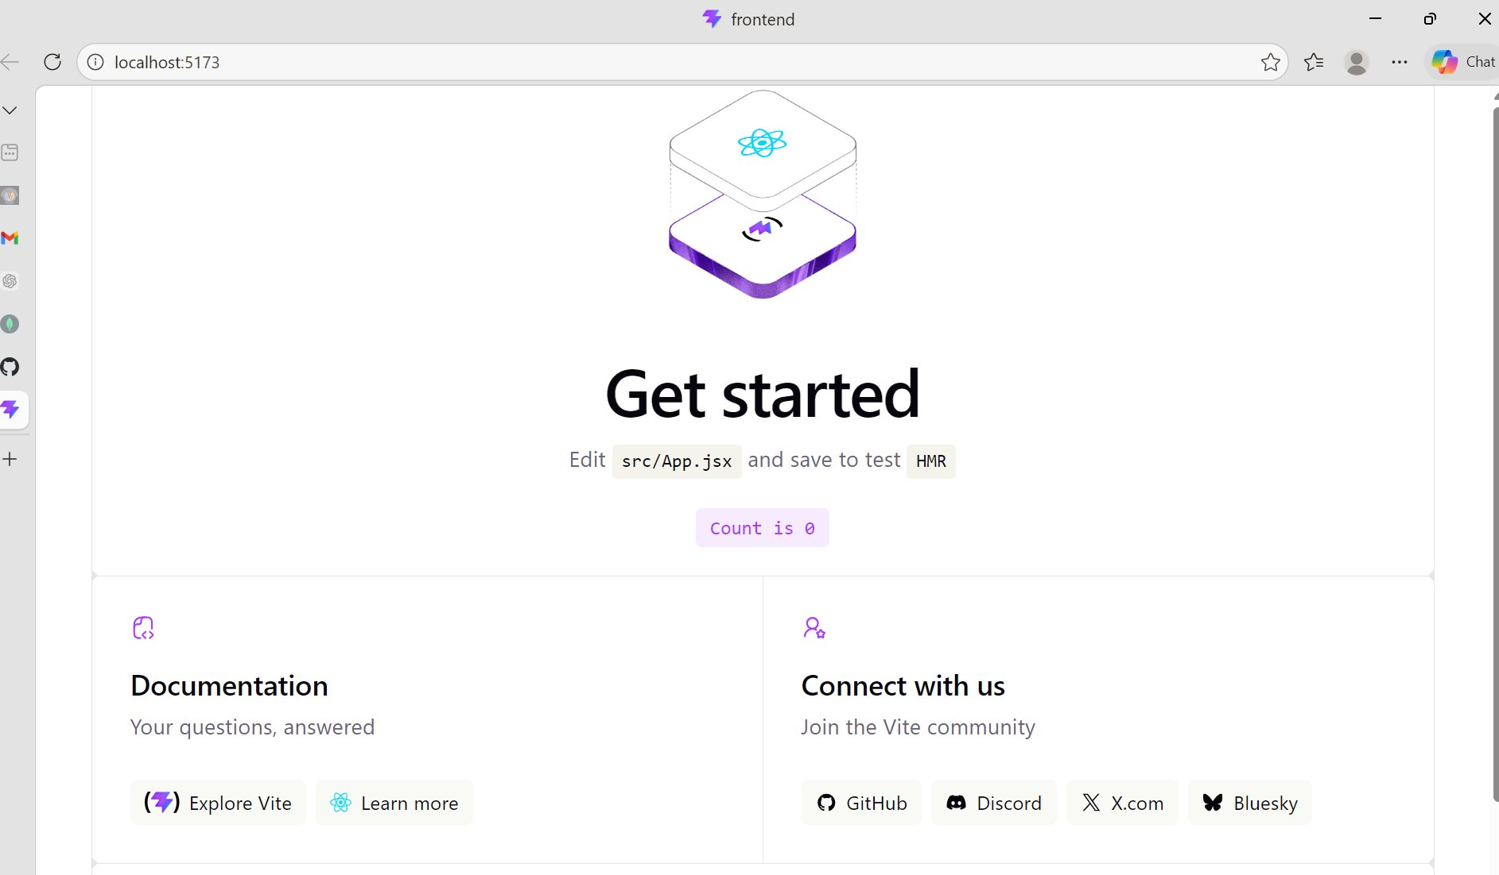
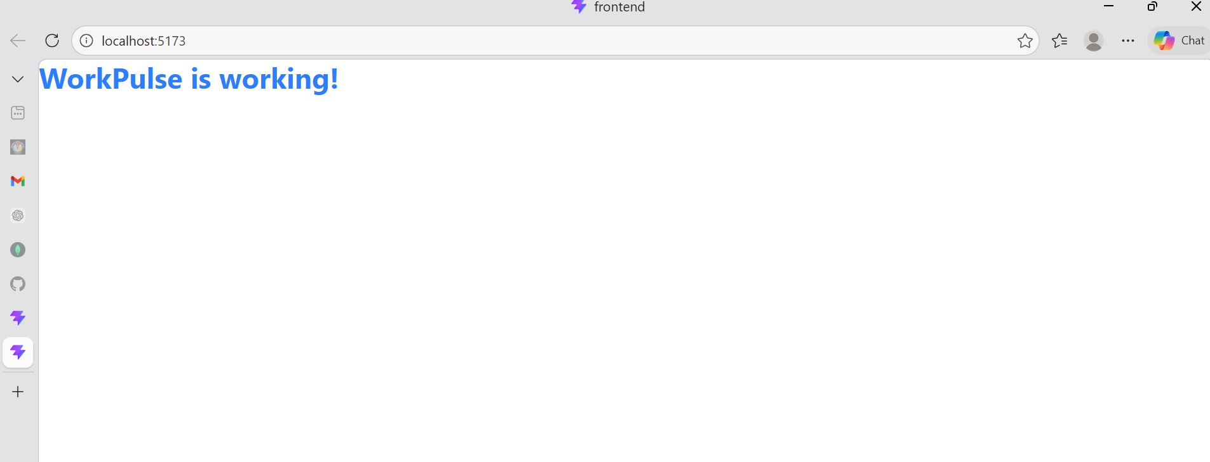
Implementation Proof — React + Vite + Tailwind CSS Setup
Slide 14 of 17
React + Vite Default Page — localhost:5173 — Project initialized ✅
Tailwind CSS Working — WorkPulse is working! — Blue bold text ✅
Command: npm create vite@latest frontend --template react → npm install → npm run dev
Config: vite.config.js updated, index.css @import tailwindcss, App.jsx with Tailwind classes
WorkPulse — FSAD Assignment 2026 | N K Anil Kumar (2025TM93109)

Slide 15
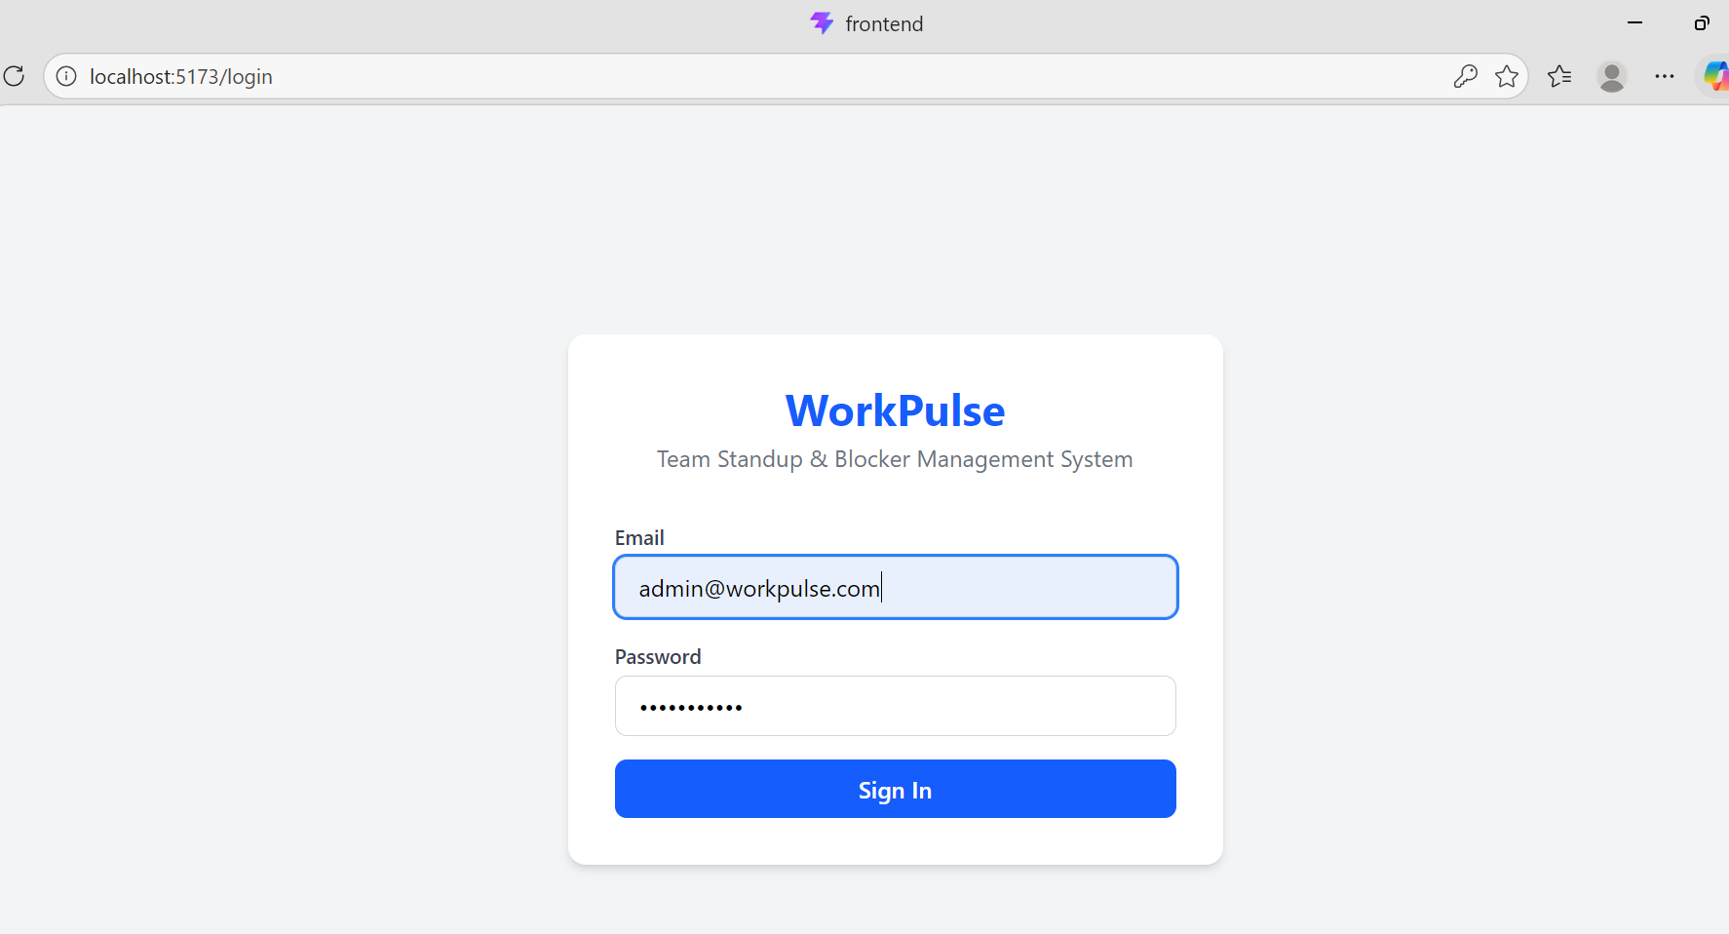
Application Screenshots
Login Page
Live Demo — WorkPulse in Action
[ Add screenshot here ]

Slide 16
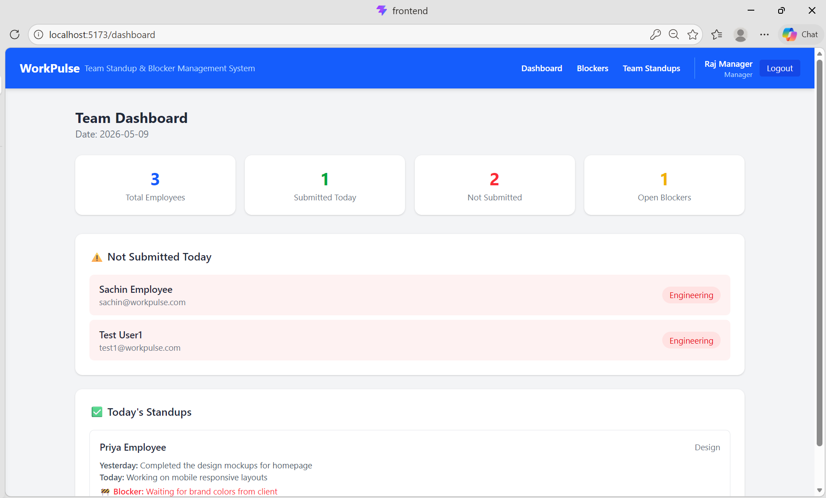
Application Screenshots
Manager Dashboard
Live Demo — WorkPulse in Action
[ Add screenshot here ]

Slide 17
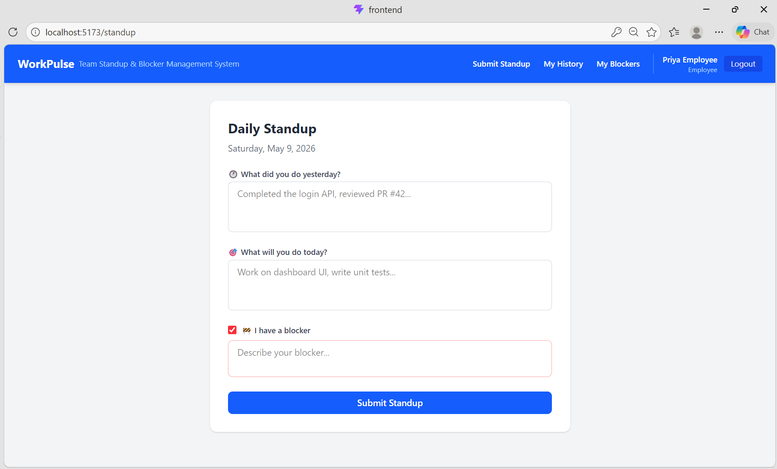
Application Screenshots
Stand up Form
Live Demo — WorkPulse in Action
[ Add screenshot here ]

Slide 18
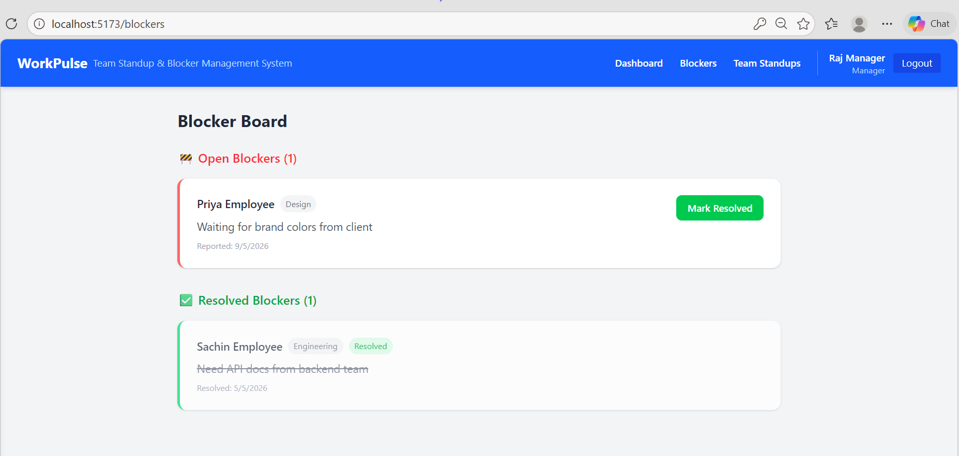
Application Screenshots
Blocker Board
Live Demo — WorkPulse in Action
[ Add screenshot here ]

Slide 19
Key Features Implemented
🔐 JWT Authentication
👥 Role Based Access
Secure token-based login with 7-day expiry. Passwords hashed with bcryptjs.
3 roles: Employee, Manager, Admin. Each sees different UI and API endpoints.
📝 Daily Standup
🚧 Blocker Tracking
One submission per user per day. Auto date detection prevents duplicates.
Auto-creates blocker record from standup. Manager resolves with timestamp.
📊 Live Dashboard
🔍 Search & Filter
Real-time stats: submitted today, not submitted, open blockers count.
Team standups searchable by employee name or date string.

Slide 20
GitHub Repository & Commit History
🔗 github.com/Anil-2025tm93109/workpulse | Public Repository | main branch
Day 6
a08522f
docs: add complete AI usage log with reflection
Day 5
c885ce2
docs: add README, Postman collection and AI usage log
Day 4
9b7a2df
feat: add all frontend pages - dashboard, standup, history, blockers
Day 3
b5a03b7
feat: add React frontend with login page and auth context
Day 2
2313e30
feat: add standup, blocker and dashboard APIs
Day 1
c3ced50
feat: initial backend setup with auth APIs
6 commits • 5 days of development • 20+ files • 2,500+ lines of code

Slide 21
AI Tools Usage — Claude (claude.ai)
Day
Area
AI Generated
Manually Modified
Day 1
Backend Setup
db.js, User.js, Standup.js, Blocker.js, authMiddleware.js, authController.js, authRoutes.js, index.js
MongoDB connection string (SRV → Standard)
Day 2
APIs
standupController.js, blockerController.js, dashboardController.js, all route files
Tested all APIs manually in Postman
Day 3
React Setup
api.js, AuthContext.jsx, Login.jsx, App.jsx, main.jsx
Fixed App.jsx syntax error, tested token flow
Day 4
UI Pages
Navbar, Dashboard, StandupForm, MyHistory, BlockerBoard, TeamStandups, MyBlockers
Tested all pages with different user roles
Day 5-6
Docs & Testing
README.md structure, Postman collection guidance
All content edited and personalized

Slide 22
Project Summary
🗄️ Database
⚡ Backend
MongoDB Atlas with 3 collections
12 REST APIs with JWT & role based auth
🎨 Frontend
🔐 Security
7 React pages with Tailwind CSS
JWT tokens, bcrypt hashing, protected routes
📦 Repository
📄 Docs
6 commits with proper commit messages
README + Postman collection + AI usage log
WorkPulse — A complete full-stack application built in 6 days 🚀

