Slide 1
Doctor Prescription Detection and Disease
Prediction Using Deep Learning
Submitted By
Pasumarthy Akshay (19341A05C9)
Selapureddy Swathi (19341A05F5)
Ponnana Yaswanth (19341A05D3)
Voonna Anil Kumar (19341A05I7)
Polisetty Krishna Vamsi (19341A05D2)
Mrs. P. Someswari
Assistant Professor
Designation, CSE Department
GMR Institute of Technology
Rajam, AP.

Slide 2
ABSTRACT
Our project mainly deals with two real world problems. These involves, when any person is having any health problem or effected with some disease or some abnormal things in their body, they used to visit a doctor. Doctor examines them and suggests some prescription. Every doctor has their own way of writing. The patient cannot understand what the doctor had prescribed. The solution to overcome this problem, is to convert the doctor’s prescription to text and display in console by using deep learning algorithms like Convolutional Attention Networks (CAN). CAN are used for recognition of unconstrained scene text. These are based on Convolutional Neural Network (CNN). The other problem is that many people cannot understand the kind of problems that they are having based on the symptoms. To overcome this, our proposed work implements a system that develops a website which predicts different diseases based on the symptoms by using machine learning algorithms. The predicted output suggests specialized doctor to the patient. Our project also includes a search option which is used for extracting patient information.
Keywords : Hand written prescription, disease prediction, Convolution Attention Networks (CAN), Convolution Neural Network (CNN).

Slide 3
Introduction
Now a days the various human beings are affecting with sicknesses and they visit doctorss to get therapy of the illnesses. The doctors writes the prescription according to the disease of the patient . A Doctor’s scientific prescription is a handwritten paper that a health practitioner writes to prescribe the medication to the affected person in step with the injury or sickness that the affected person has been experiencing. Misread medicinal drug names in doctors’ scientific prescriptions are regularly a outcome of either unreadable handwriting or a pharmacist’s incapability to become aware of drug names in medical prescriptions. This medicine mistakes due to prescription particularly occurs because of the unclear abbreviation , dosage indicators and illegible writing on the prescription. Normally, a scientific prescription, that is written through a physician who makes use of not unusual scientific terminologies and Latin abbreviations, is commonly extraordinarily hard to be examine and understood by means of a person who has no prior clinical understanding or history . It can not be denied that it is very threatening while drug treatments are wrongly given to patients as it can lead to a few important fitness problems due to the side results that a few medicines have over every other when taken on the same time, not best that however additionally the incorrect medicine is taken over a long term without a need for it.

Slide 4
Another issue is that sufferers buy drugs blindly with out understanding whatever about the drugs prescribed for them and spot if the aspect outcomes will be suitable for them will cause them any damage or pain. As a end result, we implement a model which helps to find the prescription by using Convolutional Attentional network . The second problem is that many people affected with some diseases. Disease prediction can identify patients at risk of disease or health conditions. Clinicians can then take appropriate measures to avoid or minimize the risk and in turn, improve quality of care and avoid potential hospital admissions. Due to the recent advancement of tools and techniques for data analytics, disease risk prediction can leverage large amounts of semantic information, such as demographics, clinical diagnosis and measurements, health behaviors, laboratory results, prescriptions and care utilization. In this regard, electronic health data can be a potential choice for developing disease prediction models. A significant number of such disease prediction models have been proposed in the literature over time utilizing large-scale electronic health databases, different methods, and healthcare variables. Here we are mainly focusing on some of the diseases like cardiovascular ,lungs disease , vector borne etc .To get prediction we develop a model which helps in predicting the disease without causing any error.

Slide 5
Literature Survey

Slide 6
[1]. Xie, H., Fang, S., Zha, Z. J., Yang, Y., Li, Y., & Zhang, Y. (2019). Convolutional attention networks for scene text recognition. ACM Transactions on Multimedia Computing, Communications, and Applications (TOMM), 15(1s), 1-17.
Convolutional-based interest community for unconstrained scene text reputation is used.CAN can effortlessly stack the attention layers and cope with lengthy-time period dependencies of character sequences.
This paper show that spatial position embedding in the encoder and collection function embedding within the decoder boost popularity overall performance at the same time as adding negligible overhead.
The datasets use for schooling and assessment are five widespread benchmark datasets are Synth90k dataset , Street View Text (SVT) dataset, IIIT 5K-phrase dataset , ICDAR 2003 (IC03) dataset, and ICDAR 2013 (IC13) dataset.
The proposed version out perform different methods by means of a massive margin of 0.5% at the Street View Text dataset and 0.5% at the ICDAR 2013 dataset.

Slide 7
[2]. Kulathunga, D., Muthukumarana, C., Pasan, U., Hemachandra, C., Tissera, M., & De Silva, H. (2020, December). PatientCare: Patient Assistive Tool with Automatic Hand-written Prescription Reader. In 2020 2nd International Conference on Advancements in Computing (ICAC) (Vol. 1, pp. 275-280). IEEE.
This paper particularly specialty of handwritten prescriptions in fitness care zone. The affected person feels tough to pick out the drugs.
This model was trained using the IAM dataset which is the largest English cursive handwriting words dataset available with the ground truth text.
This model comprises 5 CNN layers, 2 RNN (LSTM) layers, and another layer for CTC loss and decoding.
The results obtained after that training gave a Character error rate of 14.10% and a Word accuracy of 64.07%.

Slide 8
[3]. Fajardo, L. J., Sorillo, N. J., Garlit, J., Tomines, C. D., Abisado, M. B., Imperial, J. M. R., ... & Fabito, B. S. (2019, November). Doctor’s cursive handwriting recognition system using deep learning. In 2019 IEEE 11th international conference on humanoid, nanotechnology, information technology, communication and control, environment, and management (HNICEM) (pp. 1-6). IEEE.
This paper aim is to identify the medicine name and instructions of use inside the captured image of doctors’ cursive handwriting and provide the normal text version of the handwriting.
The datasets used on this paper are samples of medical doctors cursive handwriting accumulated from numerous clinics and hospitals of Metro Manila, Quezon City and Taytay, Rizal.
The 70% of the dataset (equivalent of 1,260 images) were used for the training. In this paper Open CV Python and Tensor flow used for training.
This study was able to successfully combine CNN and RNN as a hybrid algorithm to develop a Doctors' Cursive Handwriting Recognition System.
The researchers developed a model for Doctors Cursive Handwriting with 76% training accuracy and 72% validation accuracy using the remaining 540 images of the data set.

Slide 9
[4]. Martínek, J., Lenc, L., Král, P., Nicolaou, A., & Christlein, V. (2019, September). Hybrid training data for historical text OCR. In 2019 International Conference on Document Analysis and Recognition (ICDAR) (pp. 565-570). IEEE.
In this paper, they have proposed a green hybrid technique for producing annotated statistics for historical OCR at a low price.
A small dataset of isolated characters is collected from historical document images generated by the standard tool Text Recognition Data Generator.
In the design and implementation of an OCR device based on a convolutional-LSTM network.
They first train this machine on hybrid information.. Afterwards, the network is fine-tuned with real published textual content strains.
This paper show that the rating of the proposed device is comparable or even higher in assessment to numerous country-of the-artwork systems.

Slide 10
[5]. Hassan, E., Tarek, H., Hazem, M., Bahnacy, S., Shaheen, L., & Elashmwai, W. H. (2021, January). Medical prescription recognition using machine learning. In 2021 IEEE 11th Annual Computing and Communication Workshop and Conference (CCWC) (pp. 0973-0979). IEEE.
This paper proposed a solution system for both the pharmacist and the patient through providing a mobile application.
This application recognizes and reads doctors’ handwriting in the medical prescription and returns a readable digital text of the medicine and its dose.
They used different datasets such as MIDV-500 and MNIST datasets to analyze character classification.
In the proposed model, the medical prescription will be first scanned by the mobile camera.
Then processing phase where feature extraction and classification for training the collected data set will be applied using the Convolutional Neural Network (CNN) .
Then post-processing phase will take place by comparing the output with 20% of the collected dataset.
The proposed machine examined on unique actual cases, and accuracy has reached 70% the usage of (CNN) version.

Slide 11
[6]. Wang, S., Wang, D., Han, P., Ren, X., & Xu, Z. (2021, September). Text Recognition in UAV Aerial Images. In 2021 4th International Conference on Artificial Intelligence and Pattern Recognition (pp. 232-238).
The major objective of this paper is to extract the text from a specific bounding box.
In this paper a new approach to UAV aerial text recognition. The text may be extracted using this model, which can also recognize the bounding box .
In this study, ICDAR2019-ArT, IC19 and UAV datasets are used. The model is composed of Decoder, Encoder, ConvNet, and BLSTM.
The adaptive Bezier curve network (ABCNet), which is utilized for irregular text recognition and extracts the text from each layer, was the proposed work
The accuracy of the UAV and IC19 datasets was improved by adding a rectification network to the dataset.

Slide 12
[7]. Kotriwal, S., Pradhan, N., & Dhaka, V. S. (2021, August). Handwritten Character Recognition using Deep Neural Networks. In Proceedings of the International Conference on Data Science, Machine Learning and Artificial Intelligence (pp. 167-170.
This paper carried out in this manuscript is to recognize Handwritten English Characters using a multilayer perceptron.
EMNIST datasets are used to perform the experiments. It is a standardized dataset for the analysis of handwritten character data.
The authors also used the Modified Distance Measure algorithm and PCA to increase the model's accuracy.
Out of 1, 00,000 images, approximately 80,000 images are used to train the model, and 20,000 images are used for testing purposes. The model is trained on Colab for 60 epochs.
The results shows that good recognition accuracy of 91.46% is achieved and also the highest validation set accuracy is achieved.

Slide 13
[8]. Baishya, D., Das, P. K., & Phukan, D. (2020, November). Intelligent Prescription Reader: A Smart Health Tracking Application. In 2020 4th International Conference on Electronics, Communication and Aerospace Technology (ICECA) (pp. 1225-1229). IEEE.
The paper is to routinely study the statistics from advice slips or prescriptions and to make it explanatory to all sections of human beings.
The main aim is to make a system for low resource languages with fewer data available for use with any modern supervised techniques like machine learning etc.
In this article, a rule-based method is implemented to categorize the words in a medical prescription.
The accuracy of the system is dependent on Image to text conversion of the prescription, classification of text, and conversion of Unstructured to structured text.

Slide 14
[9]. Moni, B. S., & Raju, G. (2012, August). Handwritten character recognition system using a simple feature. In Proceedings of the International Conference on Advances in Computing, Communications and Informatics (pp. 728-734).
In this paper they proposed a CNN primarily based framework by way of DL4j for HDR which ended in better performance prices compared to other CNN-based approach.
The HDR capabilities of the Deep Learning 4J (DL4J) framework offers the most suitable framework for the identity of handwritten digits.
From the MNSIT database, we hired 42,000 pix with digits to accomplish the procedure of training.
This investigation combines CNN with the DL4J framework and took MNIST as a standard dataset to accomplish the mission of digit recognition.
The MNIST database and performed an accuracy of 99.3%.

Slide 15
[10]. Shen, Z., & Zhang, S. (2020, October). A Novel Deep-Learning-Based Model for Medical Text Classification. In Proceedings of the 2020 9th International Conference on Computing and Pattern Recognition (pp. 267-273).
In this paper, a singular deep-mastering-based model named CNN-MHA-BLSTM for medical text class is proposed.
The dataset is accumulated from a agency in china .The dataset consists of 31 departments and amassed round 4800 samples from every branch out of these pattern 119000 are decided on as the training set and 29750 is used as validation set.
The model combines the characteristics of CNN, Multi-Head Attention and Bidirectional LSTM to seize local potential capabilities, contextual information and contribution of each characteristic to the class.
The effects show that the proposed model achieves a performance with accuracy of 91.Ninety nine% and F1-rating of ninety two.03%, which outperforms some typical strategies for textual content type.

Slide 16
[11]. Moni, B. S., & Raju, G. (2012, August). Handwritten character recognition system using a simple feature. In Proceedings of the International Conference on Advances in Computing, Communications and Informatics (pp. 728-734).
This paper focuses on offline recognition of unconstrained, isolated Handwritten Malayalam Characters.
Four hundred and fifty handwritten pages containing the chosen forty four characters are amassed from distinct persons belonging to specific age agencies, qualification, and profession. Each page is scanned at 300 DPI.
Character pix are first divided into zones and feature vector is formed via traversing each sector diagonally. For the class, a Simplified Quadratic Classifier (SQDF) is used.
The highest recognition charge received with gradient feature is 95.24%.

Slide 17
[12]. Jain, T., Sharma, R., & Malhotra, R. (2021, April). Handwriting recognition for medical prescriptions using a CNN-Bi-LSTM model. In 2021 6th International Conference for Convergence in Technology (I2CT) (pp. 1-4). IEEE.
This paper demonstrates the use of a CNN-Bi-LSTM model along with Connectionist Temporal Classification.
The model consists of three components, the convolutional layers for feature extraction.
The Bi-LSTM network for making predictions for each frame of the context vector .
The final decoding to translate each character in the recognized sequence by LSTM layers into an alphabetic character using the CTC loss function.
A linear layer is added after the bi-LSTM layer to compute the final probabilities, which will be decoded.
Data augmentation techniques to make the model more robust to noise, and also avoid overfitting.
Multiple layers of Convolutional Neural Networks perform the feature extraction, and bi-LSTM's help in decoding the extracted features to English characters.

Slide 18
[13]. Li, J. P., Haq, A. U., Din, S. U., Khan, J., Khan, A., & Saboor, A. (2020). Heart disease identification method using machine learning classification in e-healthcare. IEEE Access, 8, 107562-107582.
This paper proposed an efficient and accurate system to diagnosis heart disease and the system is based on machine learning techniques.
The system is developed based on classification algorithms includes Support vector machine, Logistic regression, Artificial neural network, K-nearest neighbor, Naïve bays, and Decision tree.
Cleveland Heart Disease dataset is considered for testing purpose in this study. During the designing of this data set there were 303 instances and 75 attributes.
The classification system achieved 87.4% accuracy, and many more ensemble models are used to predict heart disease early based on the algorithms that are to be used.

Slide 19
[14]. Kumar, N. K., Sindhu, G. S., Prashanthi, D. K., & Sulthana, A. S. (2020, March). Analysis and prediction of cardio vascular disease using machine learning classifiers. In 2020 6th International Conference on Advanced Computing and Communication Systems (ICACCS) (pp. 15-21). IEEE.
This paper intends to look at the presentation of the Machine learning tree classifiers in anticipating Cardio Vascular Disease (CVD).
Machine learning classifiers such as Random Forest, Decision Tree, Logistic Regression, Support vector machine (SVM), K-nearest neighbors (KNN) were used in the prediction of Cardio Vascular Disease (CVD).
In this the method using a random forest machine learning classifier has achieved a greater accuracy of 85.71% with a ROC (Receiver Operating Characterstics), AUC (Area Under The Curve) score of 0.8675 which outperformed all the classifiers under analysis in classifying patients with Cardio Vascular Disease.

Slide 20
[15]. Singh, A., & Kumar, R. (2020, February). Heart disease prediction using machine learning algorithms. In 2020 international conference on electrical and electronics engineering (ICE3) (pp. 452-457). IEEE.
In this paper, they calculate accuracy of machine learning algorithms for predicting heart disease.
The dataset is collected from UCI repository for training and testig.
The algorithms used are k-nearest neighbor, decision tree, linear regression and support vector machine(SVM).
The accuracy for algorithm is one of parameter for analysis of performance of algorithms. Accuracy of the algorithms in machine learning depends upon the dataset that used for training and testing purpose.
When we perform the analysis of algorithms on the basis of dataset whose attributes are shown in and on the basis of confusion matrix several algorithms, KNN is best one.

Slide 21
[16]. Nagavelli, U., Samanta, D., & Chakraborty, P. (2022). Machine Learning Technology-Based Heart Disease Detection Models. Journal of Healthcare Engineering, 2022.
This paper presents the diﬀerent machine learning technologies based on heart disease detection brief analysis.
Firstly, Naı̈ve Bayes with a weighted approach is used for predicting heart disease.
The second one, according to the features of frequency domain, time domain, and information theory, is automatic and analyze ischemic heart disease localization/detection. The third one is the heart failure automatic identiﬁcation method by using an improved SVM based on the duality optimization scheme also analyzed.
Finally, for a clinical decision support system (CDSS), an eﬀective heart disease prediction model (HDPM) is used, which includes density-based spatial clustering of applications with noise (DBSCAN).
For outlier detection and elimination, a hybrid synthetic minority over-sampling XGBoost is used for heart disease prediction.

Slide 22
[17]. Louridi, N., Amar, M., & El Ouahidi, B. (2019, October). Identification of cardiovascular diseases using machine learning. In 2019 7th mediterranean congress of telecommunications (CMT) (pp. 1-6). IEEE.
In this paper, we advanced the great of cardiovascular ailment prediction the usage of a better pre-processing phase.
It allows in identifying a heart sickness of a affected person and guide a doctor to better diagnose whether or not a person has cardiovascular disorder or no longer.
To prove our consequences, we've done a evaluation among exceptional Machine Learning algorithms using accuracy, precision, f1-score and don't forget performance metrics.
The score accuracy of 86,8% turned into obtained through the usage of SVM with a linear kernel.

Slide 23
[18]. Sharma, S., & Parmar, M. (2020). Heart diseases prediction using deep learning neural network model. International Journal of Innovative Technology and Exploring Engineering (IJITEE), 9(3), 124-137.
This paper aims to achieve better accuracy and to make the system more efficient so that it can predict the chances of a heart attack.
In this paper, We deploy a deep learning neural networks (DNN) using Talos optimization.
In Heart Diseases, 14 attributes like age,sex,Cp,Trestbps ,chol,Fbs are and 303 columns who represents the patient's data.
The algorithms used in this paper are Support Vector Machine(SVM) ,Logistic Regression ,K-Nearest Neighbor(K-NN), Random forest(RF) ,Naïve Bayes.
Talos provide better accuracy (90.76%) to other optimizations. I

Slide 24
[19]. Karn, S., Sangole, S., Gawde, A., & Joshi, J. (2019, May). Prediction and Classification Of Vector-Borne and Communicable Diseases through Artificial Neural Networks. In 2019 International Conference on Intelligent Computing and Control Systems (ICCS) (pp. 1011-1015). IEEE.
In this paper a system is designed using Artificial Neural Networks based on the backpropagation algorithm, combined with any one gradient descent optimization technique.
For the datasets 16 symptoms are picked that are common to both cholera and dengue for the dataset.
16 input nodes are used to feed these 16 symptoms into the input layer.
The dataset utilized for cholera has 112 patient entries, 91 of which are included in the training set and the remaining entries in the testing set.
This medical diagnosis system is put into action with the aid of artificial neural networks, which are trained using the backpropagation method.
For the analysis of cholera, the accuracy of gradient optimizer ADAM can be increased to 98.90%, and for the analysis of dengue, the accuracy can be increased to 98.78%.

Slide 25
[20]. Abdur Rehman, N., Saif, U., & Chunara, R. (2019). Deep landscape features for improving vector-borne disease prediction. In Proceedings of the IEEE/CVF Conference on Computer Vision and Pattern Recognition Workshops (pp. 44-51).
The paper proposed an incorporating landscape elements from satellite photography into infectious disease prediction models in light of the growing availability of high-resolution satellite imagery.
25 photos with a 3600 by 3600 resolution make up the dataset. Additionally, the dataset includes segmentation maps (pixel-by-pixel labels) for the 10 classified classes that each image belongs to.
We use a VGG16 neural network trained on ImageNet data as the encoder of the architecture.
Because both the encoder of U-Net and VGG neural networks consists of a series of convolutional and max pooling.
In both cities, we discovered that more urban areas have better model fit than less urban ones. (0.757 versus 0.734 in Lahore and 0.832 versus 0.717 in Rawalpindi).

Slide 26
[21]. Shimpi, P., Shah, S., Shroff, M., & Godbole, A. (2017, July). An artificial neural network approach for classification of vector-borne diseases. In 2017 International Conference on Computing Methodologies and Communication (ICCMC) (pp. 412-415). IEEE.
This paper uses an Artificial Neural Network (ANN) based back propagation algorithm for training and testing.
The dataset used consists of 26 symptoms and was generated using R language.
The symptoms are fever, headache, chills, sweating, joint pain, nausea, vomiting, diarrhea, anemia, muscle pain, convolution, bloody stools, bloody nose, bloody gums, pain behind eyes, time taken for the symptoms to set in, rashes, swollen lymph glands, bruising skin, fatigue, abdominal pain, breathing difficulty, dark urine, yellow eyes, unconsciousness and confusion, which serve as the attributes.
Using back propagation algorithm, an accuracy of 99.7% was achieved.

Slide 27
[22]. Kieu, S. T. H., Bade, A., Hijazi, M. H. A., & Kolivand, H. (2020). A survey of deep learning for lung disease detection on medical images: state-of-the-art, taxonomy, issues and future directions. Journal of imaging, 6(12), 131.
This paper presents a survey of deep learning for lung disease detection in medical images. There has only been one survey paper published in the last five years regarding deep learning directed at lung diseases detection.
The taxonomy consists of seven attributes that are common in the surveyed articles: image types, features, data augmentation, types of deep learning algorithms, transfer learning, the ensemble of classifiers and types of lung diseases.
The dataset used in this paper are COVIDx Dataset , LDOCTCXR , Lung image database consortium (LIDC) , Sajid’s Kaggle dataset , Mooney’s Kaggle dataset , COVID-CT Dataset.
The analyses of the distribution of works, the usage of both CNN and transfer learning is high.

Slide 28
[23]. Tripathi, S., Shetty, S., Jain, S., & Sharma, V. (2021). Lung disease detection using deep learning. Int. J. Innov. Technol. Exploring Eng., 10(8).
This paper proposed and evaluated a deep convolutional neural community, designed for classifying the Chest Diseases.
A publicly to be had dataset known as Chest X-Ray 14 which includes fifteen classes named Atelectasis, Cardiomegaly, Effusion, Infiltration, Mass, Nodule, Pneumonia, Pneumothorax, Consolidation, Edema, Emphysema, Fibrosis, Pleural Thickening
The proposed version consists of Convolutional layers, ReLU Activations, Pooling layer, and absolutely related layer.
Last full related layer which consists of fifteen output units. Each output unit will predict the chance of one of the fifteen diseases
The average accuracy of 89.Seventy seven% is finished for the class of various sicknesses.

Slide 29
[24]. Tariq, Z., Shah, S. K., & Lee, Y. (2019, November). Lung disease classification using deep convolutional neural network. In 2019 IEEE international conference on bioinformatics and biomedicine (BIBM) (pp. 732-735). IEEE.
This paper aims to assess the degree of accuracy acceptable in the medical field by utilizing deep learning to publicly available data.
The dataset is composed of a total 5.5 hours of recording, which are further divided into recording samples of 126 patients.
The algorithm used in this paper is Convolutional Neural Network.
Advanced preprocessing techniques such as normalization and augmentation for an effective lung sounds classification.
The final accuracy obtained after the normalization and augmentation was approximately 97%.

Slide 30
[25]. Pham, L., Phan, H., Palaniappan, R., Mertins, A., & McLoughlin, I. (2021). Cnn-moe based framework for classification of respiratory anomalies and lung disease detection. IEEE journal of biomedical and health informatics, 25(8), 2938-2947.
This paper presents and explores a robust deep learning framework for auscultation analysis.
This aims to classify anomalies in respiratory cycles and detect diseases, from respiratory sound recordings.
Experiments, conducted over the ICBHI benchmark dataset of respiratory sounds.
They apply a Teacher-Student scheme to achieve a trade-off between model performance and model complexity
A Teacher-Student learning scheme was explored to significantly reduce model complexity while still achieving very high accuracy.

Slide 31
Comparison Table

Slide 32
Sl.no | Technique (i.e. author names with reference number) | year | Description | Limitations | Advantages | Performance metrics | gaps
1 | Xie, Shancheng Fang, Zheng-Jun Zha, Yating Yang, Yan Li, and Yongdong Zhang,.et .al Appl. 15, 1s, Article 3 | 2019 | A convolutional-based interest community for unconstrained scene text reputation is used by using CAN. | convolutional-based method achieves performance over prior works, even without the use of RNN. | a simpler structure of RNN | Accuracy Precission | a model for end-to-end scene text recognition using a simpler structure.
2 | Kulathunga, D., Muthukumarana, C., Pasan, U., Hemachandra, C., Tissera, M., & De Silva, H.. | 2020 | A particularly specialty of handwritten prescriptions in finess care zone . | RNN systems long term dependencies. | Provides an The recognize the handwriting of doctors | Accuracy,prescision | The application of blood reports to check TSH and ESR which are available in a specific format.
3 | Fajardo, L. J., Sorillo, N. J., Garlit, J., Tomines, C. D., Abisado, M. B., Imperial, J. M. R., ... & Fabito. | 2019 | To identify the medicine name and instructions of use inside the captured image of doctors’ cursive handwriting | The typical recognizers that uses HMM, | Able to successfully combine CNN and RNN as a hybrid algorithm | F1,Precision,recall | The location, lighting, and the distance of the image should be taken into account as it can affect the quality of the image data.

Slide 33
Sl.no | Technique (i.e. author names with reference number) | year | Description | Limitations | Advantages | Performance metrics | gaps
4 | Martínek, J., Lenc, L., Král, P., Nicolaou, A., & Christlein, (pp. 565-570) | 2019 | A green hybrid technique for producing annotated statistics for historical OCR at a low price. | simple networks but are not robust, and other methods recognition accuracy rate is low due to lack of character annotations | no need of a large amount of annotated data. | Accuracy, recall | Can implement an OCR system based on a CNN LSTM network
5 | Hassan, E., Tarek, H., Hazem, M., Bahnacy, S., Shaheen, L., & Elashmwai, W. H. | 2020 | solution system for both the pharmacist and the patient through providing a mobile application. | that stops the system from working properly and accurately | Letter wise identification of characters is done | Accuracy ,f-score | a larger dataset with more handwritten medicine names will be used and trained to reach higher accuracy
6 | Wang, S., Wang, D., Han, P., Ren, X., & Xu, Z. (pp. 232-238). | 2021 | a new approach to UAV aerial text recognition to extract the text from a specific bounding box | based on deep learning decreasing the recognition speed due to the complex network structure | The methodology is in depend end of the language being used. | Precision ,accuracy | method still cannot recognize Chinese characters since the limited annotated samples,

Slide 34
Sl.no | Technique (i.e. author names with reference number) | year | Description | Limitations | Advantages | Performance metrics | gaps
7 | Kotriwal, S., Pradhan, N., & Dhaka, V. S.. (pp. 167-170.) | 2021 | This manuscript is to recognize Handwritten English Characters using a multilayer perceptron. | Feature extraction methods is not properly defined. | Good accuracy on training dataset | Accuracy Precission | to deal with digits having different sizes, different languages letters, and the task of detecting multi-digit person’s handwriting
8 | Baishya, D., Das, P. K., & Phukan, D (pp. 1225-1229). | 2020 | The statistics from advice slips or prescriptions and to make it explanatory to all sections of human beings. | High computation n time | High recognition on accuracy | Accuracy,prescision | still possibilities of increasing the recognition accuracy of characters by using improving feature extraction.
9 | Moni, B. S., & Raju, G. (pp. 728-734). |  | CNN primarily based framework by way of DL4j for HDR | Tilted characters not taken into considerate on. | Less time consuming g | Accuracy, precision | Medical prescriptions should be scanned by a camera phone with high camera resolution,

Slide 35
Sl.no | Technique (i.e. author names with reference number) | year | Description | Limitations | Advantages | Performance metrics | gaps
10 | Shen, Z., & Zhang, S. (pp. 267-273). | 2020 | a singular deep-mastering-based model named CNN-MHA-BLSTM for medical text class is proposed. | Multiple layers of Convolutional Neural Networks perform the feature extraction, and bi-LSTM's | Letter wise identification of character s is done | Accuracy Precission | More bias is given to words that are present in a manually created corpus to accurately recognize text specific to prescriptions offered by the doctors.
11 | Moni, B. S., & Raju, G (pp. 728-734). | 2020 | A particularly specialty of handwritten prescriptions in fitness care zone. | Only how to train such system with few labeled input data | High accuracy at lower number of epochs | Accuracy,prescision | this project could be implemented in a form of mobile application
12 | Jain, T., Sharma, R., & Malhotra, R (pp. 1-4). | 2021 | offline recognition of unconstrained, isolated Handwritten Malayalam Characters. | The method is only applicable for Malayalam characters. | Skewed character s are also taken into considerate | Accuracy, recall | the prospects of image classification and such other pattern recognition tasks.

Slide 36
Sl.no | Technique (i.e. author names with reference number) | year | Description | Limitations | Advantages | Performance metrics | gaps
13 | Li, J. P., Haq, A. U., Din, S. U., Khan, J., Khan, A., & Saboor, A. | 2020 | This article describes about the heart disease identification using machine learning. | Topic hyper graph hashing, semantic shortage of hashing codes. | High accuracy due to selection of appropriate feature for training and testing model. | Accuracy Precision MCC Specificity Sensitivity | To improve the accuracy and using deep learning algorithms
14 | Kumar, N. K., Sindhu, G. S., Prashanthi, D. K., & Sulthana, A. S. (2020, March | 2020 | Machine learning tree classifiers in anticipating Cardio Vascular Disease (CVD | The proposed method accuracy is very low | Computationally less complex | Accuracy,Prescision, AUC score | To improve the accuracy and AUC scores and by implemented by using deep learning algorithms.
15 | Singh, A., & Kumar, R. (2020, February). Heart disease (pp. 452-457). IEEE. | 2020 | Machine learning algorithms are used by UCI repository dataset for training and testing. | More of unrelated features, | High accuracy, KNN algorithm | Accuracy, Confusion matrix. | Earlier prediction of diseases so that the rate of the death cases can be minimized by the awareness

Slide 37
Sl.no | Technique (i.e. author names with reference number) | year | Description | Limitations | Advantages | Performance metrics | Gaps
16 | Nagavelli, U., Samanta, D., & Chakraborty, P. (2022).. | 2022 | Machine learning technologies based on heart disease detection brief analysis. | It gives the result based on the machine learning algorithms | By using deep learning algorithms like XG boost it improves the accuracy | Accuracy Precision, F1 score, Recall | It is using a simpler structure and deep learning algorithms.
17 | Kulathunga, D., Muthukumarana, C., Pasan, U., Tissera, M., & De Silva, H. (2020, December). | 2019 | The quality of cardiovascular disease prediction using a better preprocessing phase. | Prediction depends on the machine learning algorithms. | Provides an The recognize the handwriting of doctors has been discussed as the major problem of this research | Accuracy,prescision, Recall , F1 score | metrics and to improve their accuracy. Our approach consists of using mean value to replace missing in the preprocessing step.
18 | Sharma, S., & Parmar, M. Hemachandra, C., (2020 9(3), 124-137. | 2020 | Talos is used to deploy the deep neural network model in this example. optimization. | The proposed system faces some hardware limitations that stops the system from working properly and accurately. | Talos has superior accuracy compared to other optimizations. | F1- score Precision Accuracy | To improve the accuracy and AUC scores and by implemented by using deep learning algorithms.

Slide 38
Sl.no | Technique (i.e. author names with reference number) | year | Description | Limitations | Advantages | Performance metrics | Gaps
19 | Karn, S., Sangole, S., Gawde, A., & Joshi, (pp. 1011-1015). IEEE | 2019 | the findings are more accurate when the back propagation method and gradient optimization approach are used. | the forward chaining process results in a diagnosis method that is less accurate and more prone to error. | Because of the regular updates, we can get fairly precise rate of improvement data. | Accuracy Precision, F1 score, Recall | It is using a simpler structure and deep learning algorithms.
20 | Abdur Rehman, N., Saif, U., & Chunara, R. (2019). | 2019 | improve each particular landscape feature's prediction model | a kind of CNN, to produce segmentation maps of specific landscape features | The averaged pixel intensity values are used rather than using any framework | Accuracy,prescision, Recall , F1 score | metrics and to improve their accuracy. Our approach consists of using mean value to replace missing in the preprocessing step.
21 | Shimpi, P., Shah, S., Shroff, M., & Godbole, A. (pp. 412-415). | 2017 | A back propagation technique is used to train the artificial neural network that makes up the recommended system | prior to feeding a classifier to boost efficiency and simplify things. -Classification accuracy | An emerging computational method in computer science is artificial neural networks | F1- score Precision Accuracy | It can be expanded to include additional diseases, and new optimization methods can also be applied. .

Slide 39
Sl.no | Technique (i.e. author names with reference number) | year | Description | Limitations | Advantages | Performance metrics | Gaps
22 | Kieu, S. T. H., Bade, A., Hijazi, M. H. A., & Kolivand, H. (2020). | 2019 | It is produced to offer an extensive survey of lung disease detection using deep learning, | Current semantic gap between the basic visual data recorded by imaging technology, | Because of the regular updates, we can get fairly precise rate of improvement data. | Accuracy Precision, F1 score, Recall | It is using a simpler structure and deep learning algorithms.
23 | Tripathi, S., Shetty, S., Jain, S., & Sharma, V. (2021). | 2019 | This project is a binary classification with input is patient's data | Limited research progress in field. Classification accuracy lung sounds in medicine. . | utilised for lung disease diagnostics -illnesses involving lung sounds in medicine. | Accuracy,prescision, Recall , F1 score | metrics and to improve their accuracy. approach consists of using mean value to replace missing values.
24 | Tariq, Z., Shah, S. K., & Lee, Y. . (pp. 412-415). | 2017 | developed the Lung Disease Classification (LDC) system combined with advanced and data augmentation techniques, | prior to feeding a classifier to boost efficiency and simplify things, Classification accuracy. | provide a performance/model size trade-off., pruning and quantization. | F1- score Precision Accuracy | It can be expanded to include additional diseases, and new optimization methods can also be applied. .

Slide 40
Flow Chart for doctor prescription
Collecting the dataset
Pre-processing with label binarizer
Using CAN and CNN algorithms
Line segmentation
Boundary Box
Training the data
Word Segmentation
Character Segmentation
Final Word

Slide 41
Flow chart for disease prediction
Pre-Processing
Training the dataset by using deep learning algorithms
Taking input as testing data
Dataset
Report
Generation
Accuracies

Slide 42


Flow Chart
Website
Doctor Prescription
Disease
Prediction
Collecting the dataset
Pre-processing with label binarizer
Using CAN and CNN algorithms
Pre-Processing
Training the dataset by using deep learning algorithms
Dataset
Taking input as testing data
Line segmentation
Boundary Box
Training the data
Report
Generation
Accuracies
Word Segmentation
Character Segmentation
Final Word

Slide 43
Methodology
A broad range of detection and prediction algorithms have been utilized to predict the diseases and also to detect the doctor prescription. A prediction framework which makes to predict the particular disease based on the user input.
Numerous deep learning and machine learning algorithms are being used to forecast diseases based on symptoms they are Convolution Attention Neural Network (CAN),Convolution Neural Network (CNN),Random Forest(RF) ,Decision Tree(DT),Support Vector Machine(SVM),Naive Bayes(NB) and K Nearest Neighbors (KNN) are the algorithms that are used for the disease prediction and the doctor prescription detection.
Prediction aids in identifying diseases and determining the specific categorization they fall under. The prediction system uses information from the user to forecast diseases and also recommend a certain doctor to the user. The detection system that was utilized to find the doctor's handwritten prescription.

Slide 44
The basic principle of deep learning is that it largely concentrates on the particular method used for creating and training decision-making network nodes and neural networks.
But in order to predict diseases, we had developed a variety of ensemble approaches that mix a number of machine learning algorithms moreover, and implemented convolutional attention network(CAN) and convolutional neural network (CNN) to recognize the doctor's prescription.
The some models which are present in this paper are Heart disease prediction, Monkeypox disease prediction, Lung disease prediction, Vector Borne disease prediction, Liver disease prediction and Doctor prescription detection.

Slide 45
Dataset:
There are several datasets that have been employed in these models since we are predicting different diseases and also detecting the doctor's prescription.
Most of the data was gathered from the Kaggle database.
The IAM dataset, which was taken from the Kaggle database and comprises 13,353 images, was utilized for doctor prescription. This dataset was created by 650 script writers, including actual physicians. For multi disease prediction, as there were several diseases (heart, lung, monkeypox, vector-borne, and liver) and different datasets been .

Slide 46
Preprocessing:
Images and textual data are preprocessed in two separate methods.
For textual data, various null values will be present in the data, and these null values will be removed based on the correlations between the other columns of the dataset.
The heat map removes columns from the dataset that are more highly associated than the threshold value. Additionally, additional columns from the dataset that are ordinal features from the other columns are added.
For image data, When there aren't many images in the dataset, data augmentation is used. The parameters are limited up to 0.2 zoom and 0.2 rotation, which results in a variety of images.
Each image is scaled to the appropriate size, and all of the photographs have also undergone a grayscale conversion that turns the black and white pixels into white and decreases the overall pixel count.

Slide 47
Detection methods for doctor prescription:
Convolution Attention Neural Network(CAN):
Convolutional attention network is mainly used for unconstrained text recognition. Convolutional Attention Network is completely built on CNN and includes an attentional mechanism.
The distinct traits of our method include encoder-decoder architecture, in which the encoder is a deep -dimensional CNN and the decoder is a one-dimensional CNN ,the attention mechanism is applied in each convolutional layer of the decoder.
This technique is similar to the convolution neural network in that it concentrates on high resolution on specific sections of the image while leaving the rest as low or blur.

Slide 48
Convolutional Neural Network(CNN):
Convolutional neural network (CNN) is a type of artificial neural network used in image recognition and processing that is specifically designed to process pixel data.
The convolution neural network which consists of different types of layers like convolution layer, pooling layer, connected layer and unpooling layer.
The convolution layer is the basic building block of CNN and it has many kernels. Each of the neurons acts as a kernel.
Different kinds of kernels can perform operations on images such as edge detection, blur, and sharpen by applying convolution.

Slide 49
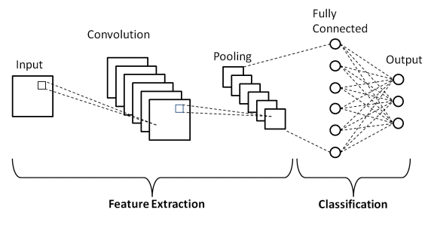
In the convolution layer, images are split into small pieces and extract features from each small block. The kernel uses a specific set of weights to communicate with images by multiplying their elements by the receptive region corresponding elements
The pooling layer aims to reduce the number of parameters when the image is too large and limit the over fitting risk and also minimizes the computational load, memory usage.
The fully connected layer classifies the input image into various groups based on the dataset. In a fully connected layer, SoftMax is used as an activation function.

Slide 50
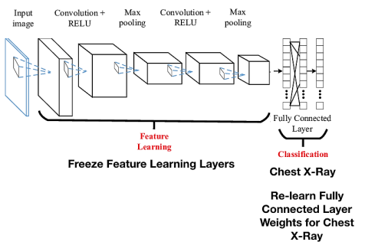
TRANSFER LEARNING:
A pretrained model was employed for feature extraction the model used in this method is ResNet152V2. This model was trained using the ImageNet dataset.
The above figure shows the transfer learning architecture which is used in Residual networks are made up of several well-chosen components, each of which may be represented as a module.

Slide 51
The first thing we notice is that there is a direct link that bypasses several levels (which may vary depending on the model). This link is known as the ‘skip connection' and it lies at the heart of residual blocks. Because of this skip link, the layer's output is no longer the same. Without this skip link, the input 'x' is multiplied by the layer weights before being multiplied by a bias term.
H(x)= f (wx + b) or H(x)=f(x)
The skip connections in ResNet alleviate the problem of disappearing gradient in deep neural networks by enabling the gradient to flow along an additional shortcut channel. Another benefit of these connections is that they allow the model to learn the identity functions, ensuring that the upper layer performs at least as well as the lower layer. Some parameters are involved in calculating the performance measurements of each machine learning and deep learning algorithm.

Slide 52
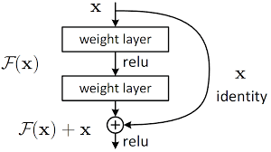
From the below figure when the new pixel was encountered then the given input pixel has any type of weight that was assigned to it, if so, it was assigned to the weight layer, otherwise it directly executes the relu function. Finetuning was also done for the current model, which is nothing more than adding layers or retraining the data on the specific model to get better outcomes.

Slide 53
Prediction methods for diseases:
Random forest (RF):
The Random forest is mostly used in classification and regression problems .The decision trees are developed by using the majority voting classification technique and the average method for regression. The method employs ensemble techniques such as bagging, maximum voting, and averaging.
This Random forest mostly depends on self-learning decision trees .In Random Forest from k number of records n number of records are taken .After that individual decision trees are constructed for each sample .
As each decision tree will generate an output and the final output is considered based on the majority voting or average for classification and regression respectively.

Slide 54
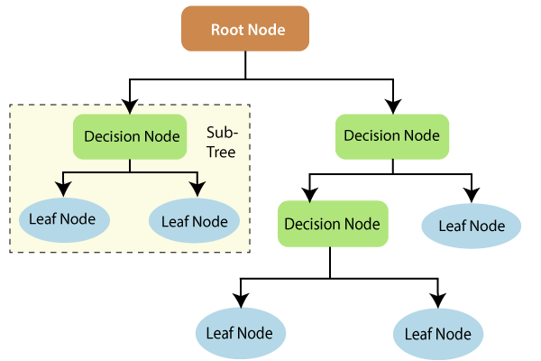

Slide 55
Decision tree(DT):
Decision tree is a flow chart like tree structure in which it contains root node ,branches, internal nodes and leaf nodes.
Decision tree learning uses a divide and conquer technique in which to search and find the ideal split points inside a tree.
When most or all of the records have been classified under distinct class labels, this splitting procedure is then repeated in a top-down, recursive fashion. The intricacy of the decision tree plays a significant role in determining whether or not all data points are categorized as homogenous sets.
The biggest challenge that arises while developing a Decision tree is how to select the best attribute for the root node and subnodes.The attributes can be selected by Information Gain and gini Index.

Slide 56
Naive Bayes (NB):
Naive Bayes algorithm is a supervised learning method for classification problems that is based on the Bayes theorem. It is called Naive because it assumes that each input variable is independent.
Naive Bayes is a probabilistic algorithm which predicts the outcome based on the probability. It uses conditional probability to calculate a product of individual probabilities of components. This means that the algorithm assumes the presence or absence of a specific feature of a class which is not related to the presence or absence of any other feature (absolute independence of features), given the class variable.
There were three naive bayes algorithms are Multinomial, Bernoulli, Gaussian .
P(B|A).P(A)
P(A|B) =
_________________________
P(B)

Slide 57
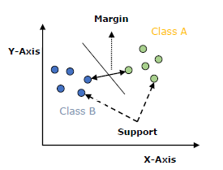
Support Vector Machine(SVM):
Support vector machine works by making a straight line between two classes. That means all of the data points on one side of the line will represent a category and the data points on the other side of the line will be put into a different category.
The straight line can be called as the decision boundary and also this decision boundary may not be the straight line all the time.
The SVM algorithm is implemented with a kernel that converts an input data space into the desired shape. SVM employs a technique known as the kernel trick, in which the kernel transforms a low-dimensional input space into a higher-dimensional space.

Slide 58
K Nearest Neighbors:
K-Nearest Neighbor is a supervised machine learning technique that can be used for classification and regression. Here the K represents the number of points that are to be taken as consideration.
It predicts the values of new data points using 'feature similarity,' which implies that the new data point will be assigned a value depending on how closely it resembles the points in the training set.
In order to avoid either overfitting or underfitting, different values of k must be considered when defining it. Larger values of k may result in high bias and low variance, while lower values of k may have high variance but low bias.
Various Ensemble techniques are used to aggregate all of the machine learning algorithms that provide accurate illness prediction. These techniques include max voting, averaging, and weighted average.

Slide 59
Ensemble Techniques:
Various Ensemble Techniques like Max Voting, Min Voting, Averaging, Weighted Average are been used.
Max Voting:
Based on voting algorithms, the maximum voting was carried out. It was comparable to taking 5 algorithms and guessing the results of each one. It will use the predicted value that yields the greatest number of predictions based on the binary output that was generated.
Min Voting:
Based on voting algorithms, the maximum voting was carried out. It was comparable to taking 5 algorithms and guessing the results of each one. It will use the predicted value that yields the lowest number of predictions based on the binary output that was generated.

Slide 60
Averaging:
The averaging was if the predicted value was not in the binary form or continuous variable then based on the predicted value it will do mean on for all the values and produces the output. it will be the predicted value for the averaging.
Weighted Average:
The weighted average is for each algorithm we are assigning some weight based on the weight the value that was predicted and it was multiplied and the mean was been calculated the result was the predicted output.

Slide 61
RESULTS AND DISCUSSION
Heart disease result
SNO | name | accuracy | f1_score | precision | recall
1 | descision_tree_validation | 76.356772 | 0.336449 | 0.315789 | 0.367347
2 | descision_tree_validation_result_2 | 78.220859 | 0.337079 | 0.379310 | 0.306122
4 | kneighbors_classifier_result | 83.199622 | 0.206897 | 0.666667 | 0.140000
5 | random_forest_classifier_result | 84.591789 | 0.237288 | 0.777778 | 0.140000
6 | Cross_validation_2 | 84.261444 | 0.225806 | 0.583333 | 0.140000
7 | naive_bayes_classifier_result | 82.043417 | 0.365854 | 0.468750 | 0.320000
8 | logistic_classifier_result | 82.043417 | 0.365854 | 0.468750 | 0.320000

Slide 62
Monkey Pox disease result
S.No | Name | Accuracy
1 | CNN | 79.93
2 | Efficient Net B3 | 89.34
3 | Efficient Net B5 | 95.80
Lungs disease result
S.No | Name | Accuracy
1 | CNN | 96.61
2 | Transfer learning | 90.28
Liver disease result
S.No | Name | Accuracy
1 | Random Forest | 99.3
2 | Decision Tress | 98.5
3 | K-NN | 90.9
4 | XG Boost | 89.5
5 | AdaBoost | 80.6

Slide 63
Doctor Prescription :
S.NO | NAME | ACCURACY
1 | CNN | 95.894
2 | PyTorch | 90
3 | Text OCR | 94.32

Slide 64
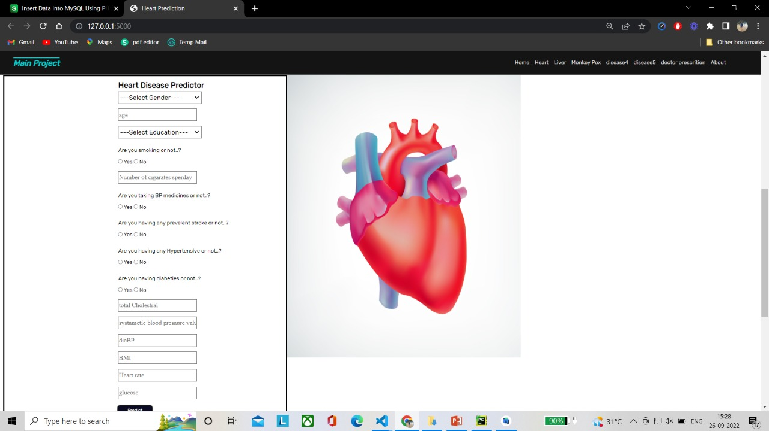
OUTPUT
HEART DISEASE OUTPUT

Slide 65
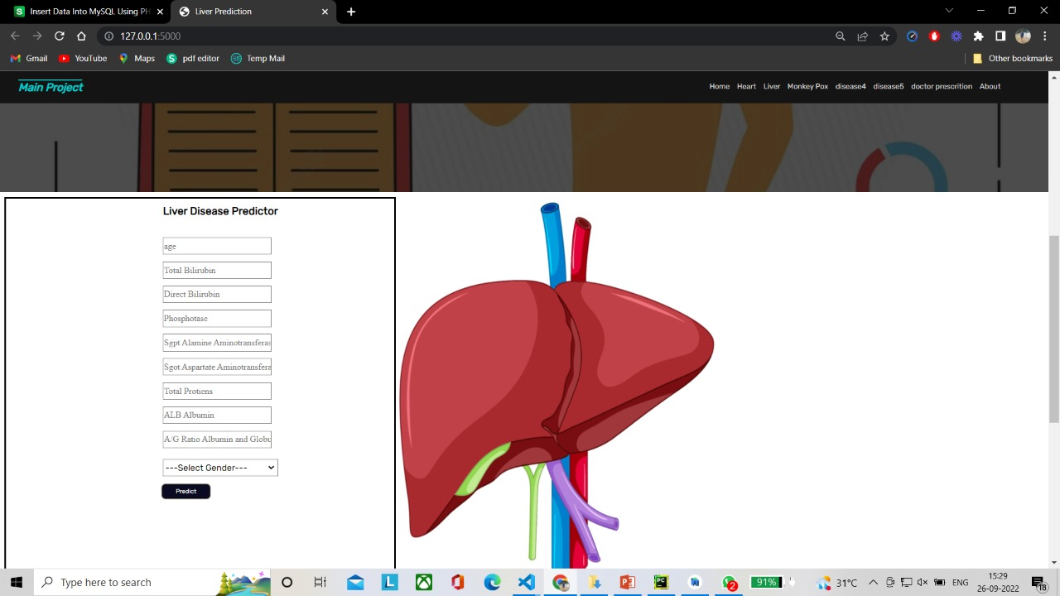
LIVER DISEASE OUTPUT

Slide 66
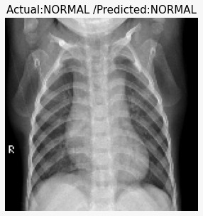
LUNG DISEASE OUTPUT

Slide 67
CONCLUSION
To bring our discussion to a close, we examined other articles in which researchers had finished their work on various models, as well as with related technologies and their accuracy., we reviewed various diseases like Heart, Lung, Monkeypox, Vector Borne and Malaria and various machine learning algorithms are been used by the researchers such as support vector machine, naive bayes, K-nearest neighbor, random forest, decision tree, and some deep learning algorithms such as convolution neural network, artificial neural network. The most current publications were chosen for the study, which will be published in Science Direct, IEEE Xplore, Elsevier, and ResearchGate indexed journals and conferences until June 2020.Most of the studies undertaken for illness prediction used datasets from Cleveland, UCI repository, Lister Hill National Center for Biomedical Communications, and very few used their own datasets. Analyzing the existing methodologies used for illness prediction reveals that, while certain methods have made a substantial increase in results with high sensitivity or less FP, there are still numerous issues to be solved. As a result, an optimum approach for predicting these diseases as early as feasible is still required, and this review study article will be useful for researchers and professionals. While some strategies have significantly improved findings with high sensitivity or less FP, an analysis of the current methodologies used for sickness prediction demonstrates that there are still many problems to be resolved. This review study article will be helpful for researchers and professionals in finding the best strategy for identifying these diseases as early as possible.

Slide 68
References
[1]. Xie, H., Fang, S., Zha, Z. J., Yang, Y., Li, Y., & Zhang, Y. (2019). Convolutional attention networks for scene text recognition. ACM Transactions on Multimedia Computing, Communications, and Applications (TOMM), 15(1s), 1-17.
[2]. PatientCare: Patient Assistive Tool Zith Automatic Hand-written Prescription Reader , 2020 2nd International Conference on Advancements in CoImputing (ICAC) | 978-1-7281-8412-8/20 -2020 IEEE | DOI: 10.1109/ICAC51239.2020.9357136.
[3]. Doctor’s Cursive Handwriting Recognition System Using Deep Learning, Lovely Joy Fajardo1 , Niño Joshua Sorillo1 , Jaycel Garlit1 , Cia Dennise Tomines1 , Mideth B. Abisado2 , Joseph Marvin R. Imperial1 , Ramon L. Rodriguez1 ,Bernie S. Fabito1 978-1-7281-3044-6/19 2019 IEEE
[4]. Hybrid Training Data for Historical Text OCR , Ladislav Lenc, Pavel Kral, and Anguelos Nicolaou, and Vincent Christlein , 2019 International Conference on Document Analysis and Recognition (ICDAR).
[5]. Medical Prescription Recognition using Machine Learning , Esraa Hassan, Habiba Tarek, Mai Hazem, Shaza Bahnacy, Lobna Shaheen, Walaa H. Elashmwai, 0973 2021 IEEE 11th Annual Computing and Communication Workshop and Conference (CCWC) | 978-1-6654-1490-2021 IEEE | DOI: 10.1109/CCWC51732.2021.9376141.

Slide 69
[6]. Handwritten Character Recognition using Deep Neural Networks, DSMLAI , Sparsh Kotriwal, Nitesh Pradhan, Vijaypal Singh Dhaka August 9–12, 2021, Windhoek, Namibia, 2020 Association for Computing Machinery. ACM ISBN 978-1-4503-8763-7/20/06.
[7]. Intelligent Prescription Reader: A Smart Health Tracking Application , Diganta Baishya, Pradip K Das, Dipsikha Phukan , Fourth International Conference on Electronics, Communication and Aerospace Technology (ICECA-2020) IEEE Xplore Part Number: CFP20J88-ART; ISBN: 978-1-7281-6387-1, 2020 IEEE.
[8 ]. Handwritten Digits Recognition Based on Deep Learning4j, Zareen Sakhawat, Saqib Al , Liu Hongzhi , AIPR 2018, August 18–20, 2018, Beijing, China 2018 Association for Computing Machinery. ACM ISBN 978-1-4503-6524-6/18/08.
[9]. A Novel Deep-Learning-Based Model for Medical Text Classification , Zhengfei Shen , Shaohua Zhang , ICCPR 2020, October 30-November 1, 2020, Xiamen, China 2020 Association for Computing Machinery. ACM ISBN 978-1-4503-8783-5/20/10.
[10]. Handwritten Character Recognition System using a Simple Feature , Bindu S Moni , Raju G , International Conference on Advances in Computing, Communications and Informatics (ICACCI-2012) , ICACCI 12, August 03 - 05 2012, CHENNAI, India.

Slide 70
[11]. Sharma, S., & Parmar, M. (2020). Heart diseases prediction using deep learning neural network model. Interna-tional Journal of Innovative Technology and Exploring Engineering (IJITEE), 9(3), 124-137.
[12]. Karn, S., Sangole, S., Gawde, A., & Joshi, J. (2019, May). Prediction and Classification Of Vector-Borne and Communicable Diseases through Artificial Neural Networks. In 2019 International Conference on Intelligent Computing and Control Systems (ICCS) (pp. 1011-1015). IEEE.
[13]. Abdur Rehman, N., Saif, U., & Chunara, R. (2019). Deep landscape features for improving vector-borne disease prediction. In Proceedings of the IEEE/CVF Conference on Computer Vision and Pattern Recognition Workshops (pp. 44-51).
[14]. Shimpi, P., Shah, S., Shroff, M., & Godbole, A. (2017, July). An artificial neural network approach for classification of vector-borne diseases. In 2017 International Conference on Computing Methodologies and Communication (ICCMC) (pp. 412-415). IEEE.
[15]. Shen, Z., & Zhang, S. (2020, October). A Novel Deep-Learning-Based Model for Medical Text Classification. In Proceedings of the 2020 9th International Conference on Computing and Pattern Recognition (pp. 267-273).
[16]. Moni, B. S., & Raju, G. (2012, August). Handwritten character recognition system using a simple feature. In Proceedings of the International Conference on Advances in Computing, Communications and Informatics (pp. 728-734).

Slide 71
[18]. Pham, L., Phan, H., Palaniappan, R., Mertins, A., & McLoughlin, I. (2021). Cnn-moe based framework for classification of respiratory anomalies and lung disease detection. IEEE journal of biomedical and health informatics, 25(8), 2938-2947.
[19]. Li, J. P., Haq, A. U., Din, S. U., Khan, J., Khan, A., & Saboor, A. (2020). Heart disease identification method using machine learning classification in e-healthcare. IEEE Access, 8, 107562-107582.
[20]. Abdur Rehman, N., Saif, U., & Chunara, R. (2019). Deep landscape features for improving vector-borne disease prediction. In Proceedings of the IEEE/CVF Conference on Computer Vision and Pattern Recognition Workshops (pp. 44-51).
[21]. Kumar, N. K., Sindhu, G. S., Prashanthi, D. K., & Sulthana, A. S. (2020, March). Analysis and prediction of cardio vascular disease using machine learning classifiers. In 2020 6th International Conference on Advanced Computing and Communication Systems (ICACCS) (pp. 15-21). IEEE.
[22]. Nagavelli, U., Samanta, D., & Chakraborty, P. (2022). Machine Learning Technology-Based Heart Disease Detection Models.Journal of Healthcare Engineering, 2022.
[23]. Louridi, N., Amar, M., & El Ouahidi, B. (2019, October). Identification of cardiovascular diseases using machine learning.In 2019 7th mediterranean congress of telecommunications (CMT) (pp. 1-6). IEEE.

Slide 72
[24]. Tariq, Z., Shah, S. K., & Lee, Y. (2019, November). Lung disease classification using deep convolutional neural network. In 2019 IEEE international conference on bioinformatics and biomedicine (BIBM) (pp. 732-735). IEEE.
[25]. Pham, L., Phan, H., Palaniappan, R., Mertins, A., & McLoughlin, I. (2021). Cnn-moe based framework for classification of respiratory anomalies and lung disease detection. IEEE journal of biomedical and health informatics, 25(8), 2938-2947.

Slide 73


