Slide 1
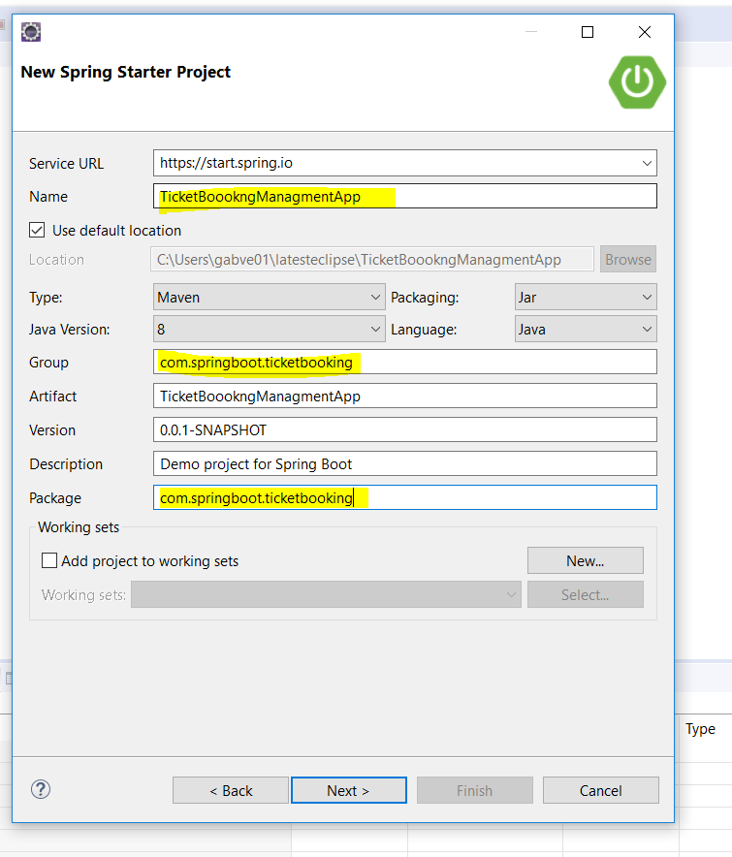

Slide 2
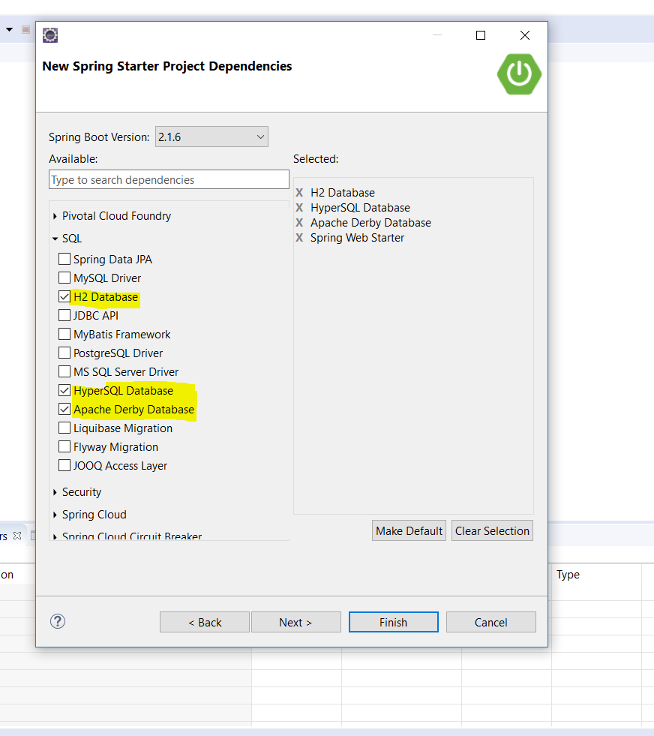
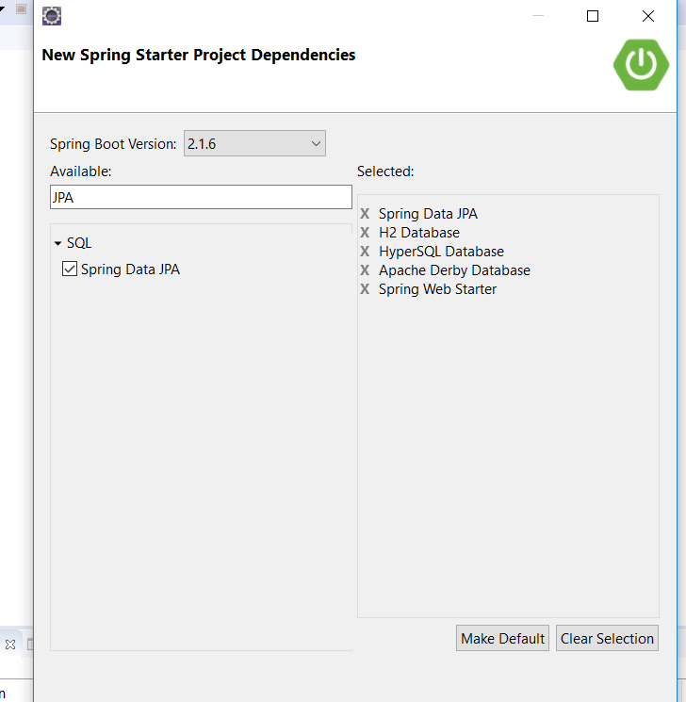

Slide 3
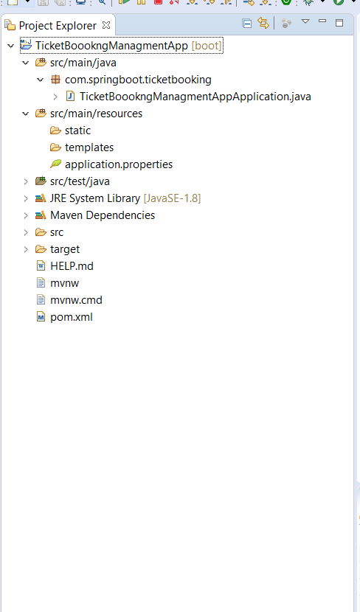
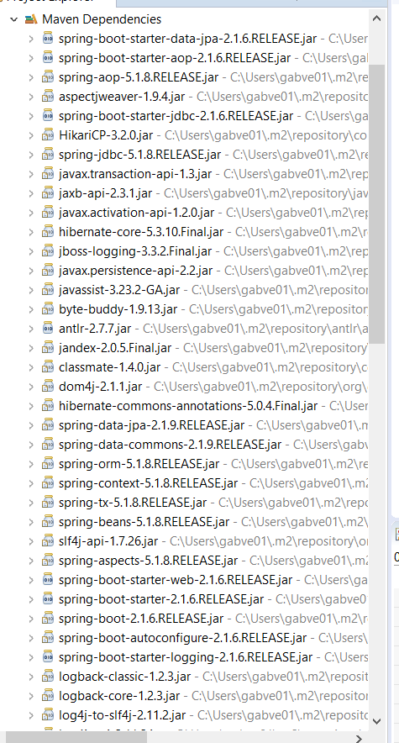

Slide 4
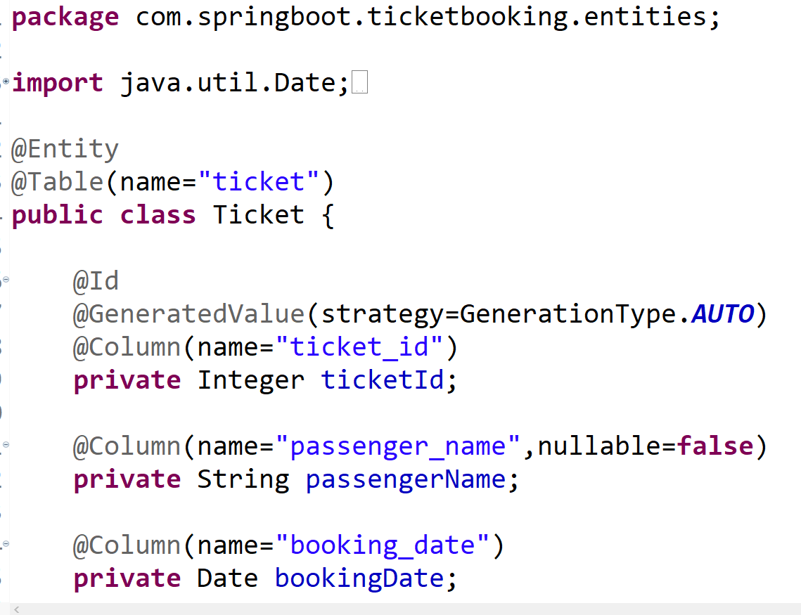

Slide 5
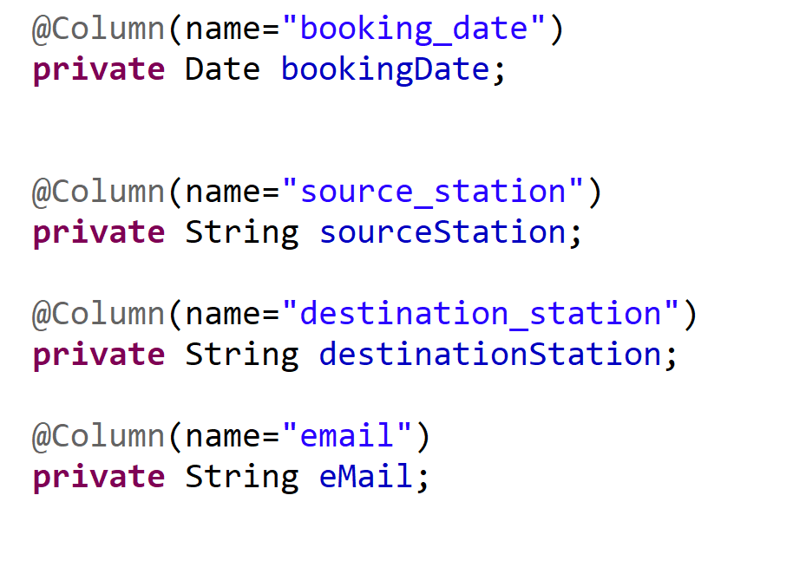

Slide 6
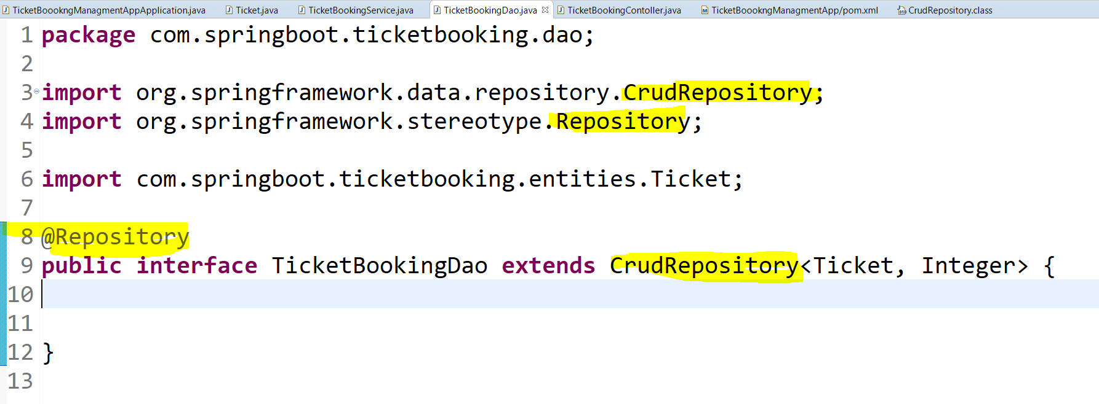

Slide 7
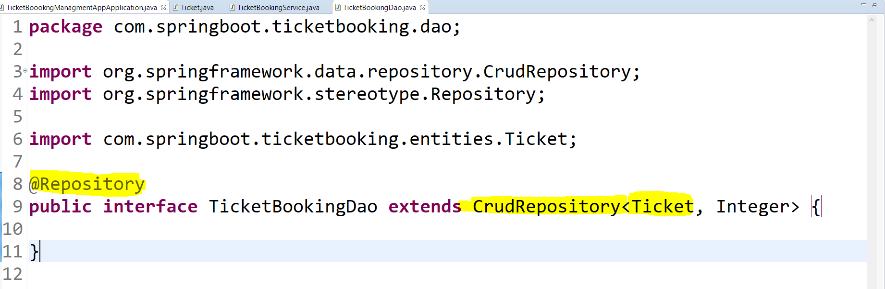

Slide 8
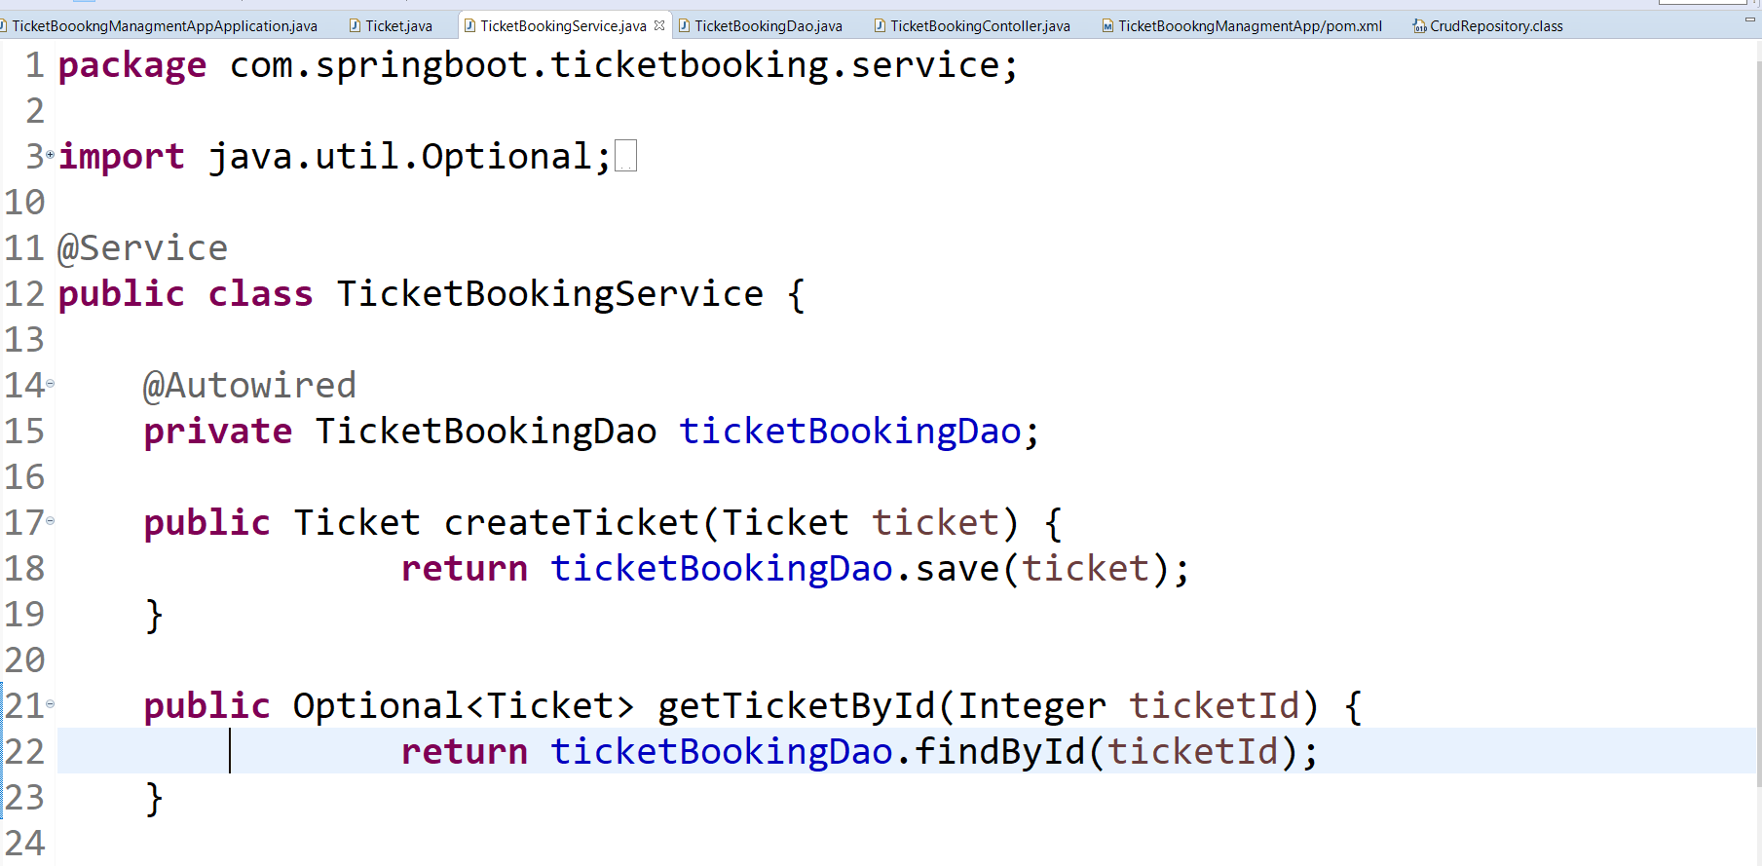

Slide 9
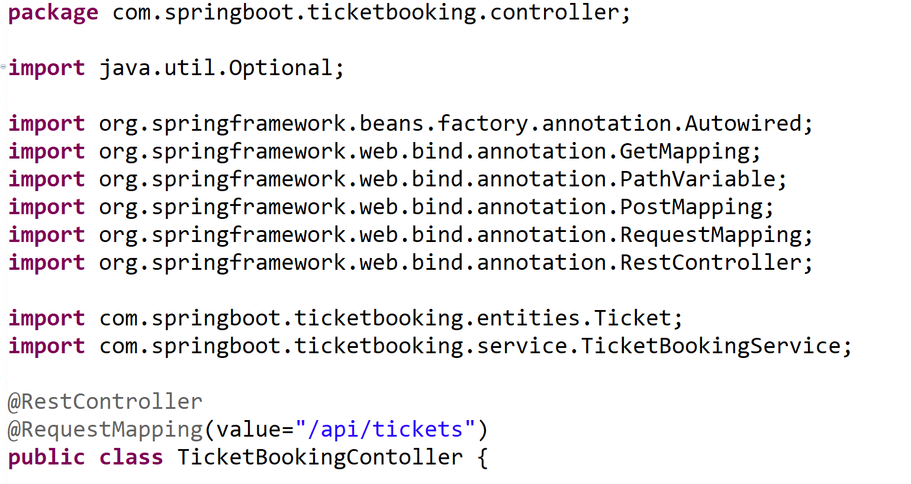

Slide 10
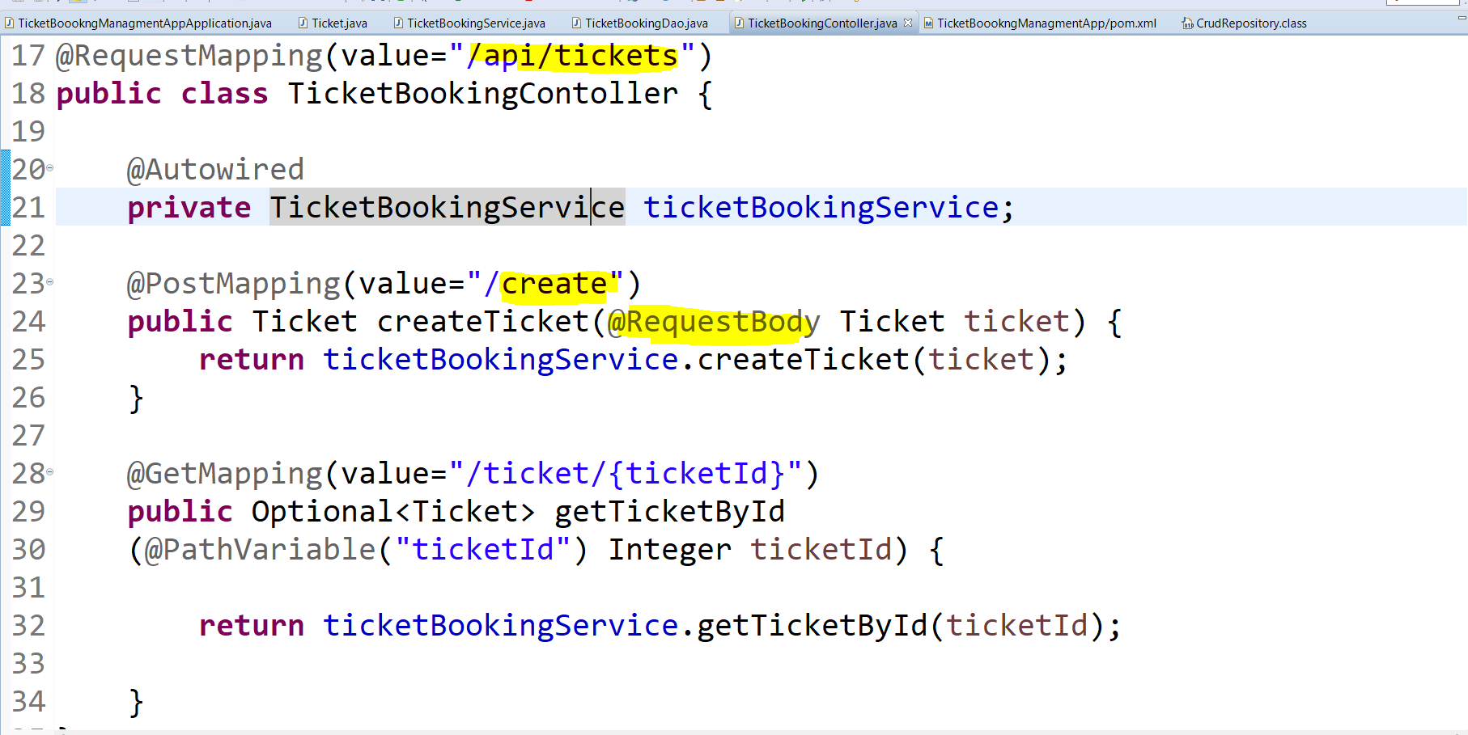

Slide 11
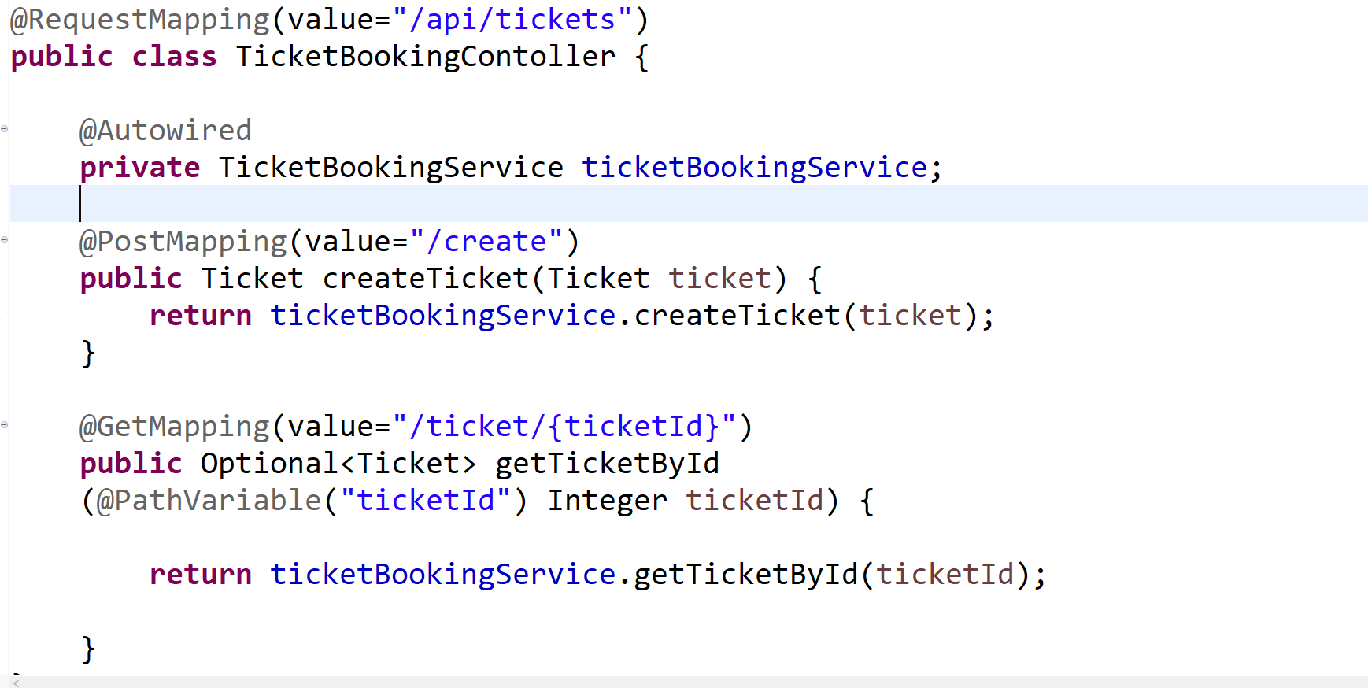

Slide 12
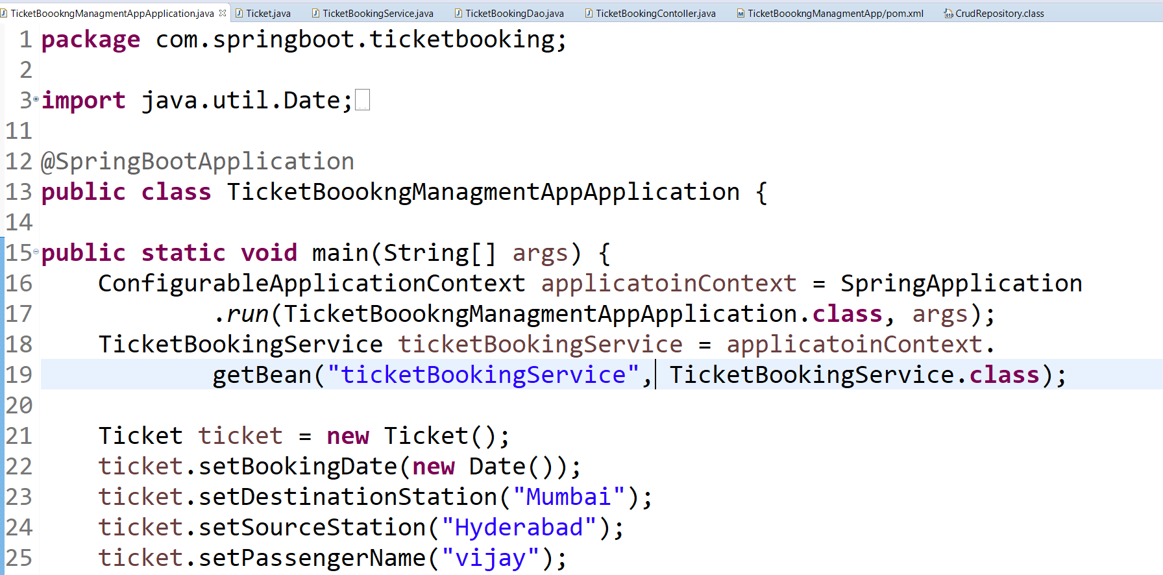
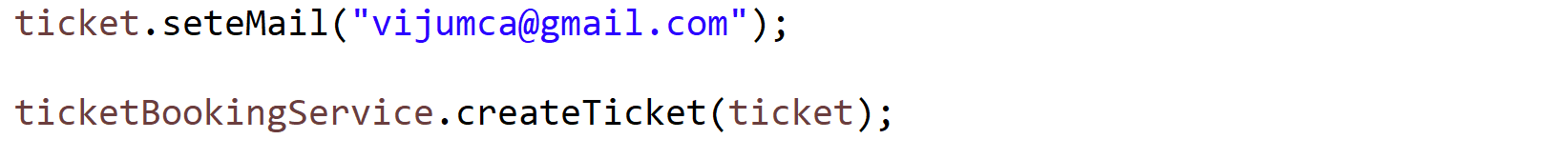

Slide 13
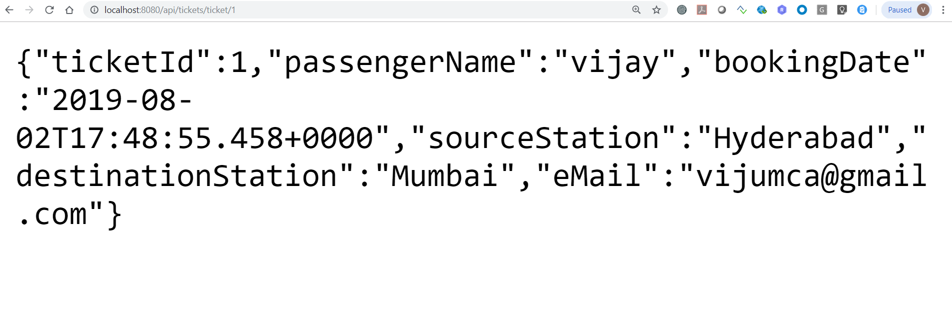

Slide 14
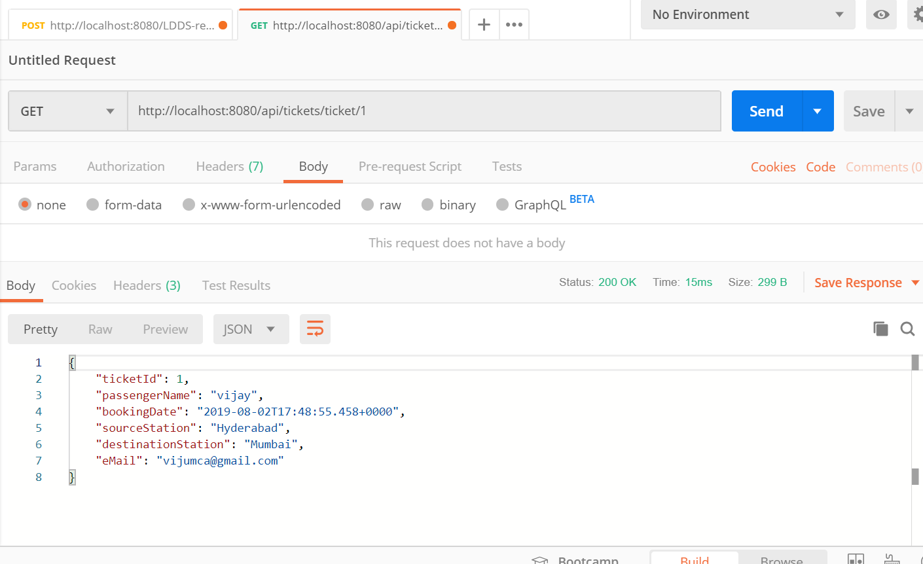

Slide 15
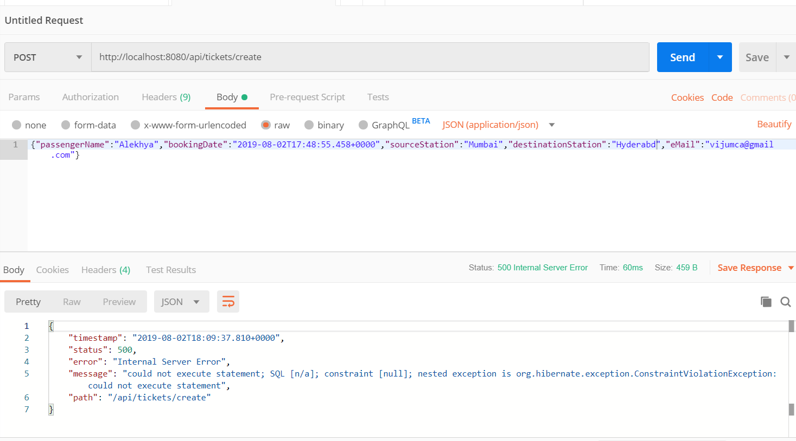

Slide 16
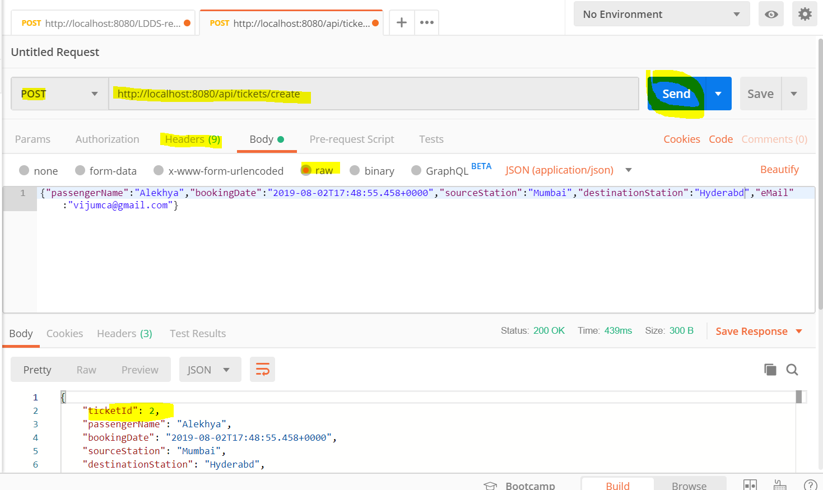

Slide 17
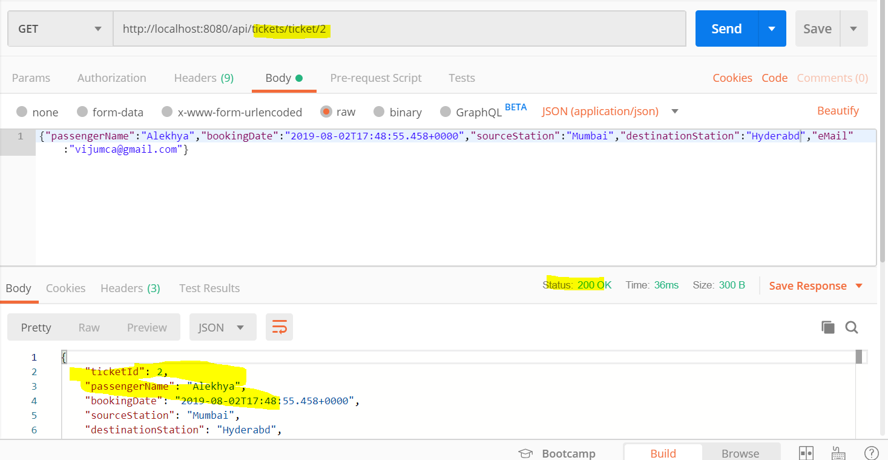

Slide 18
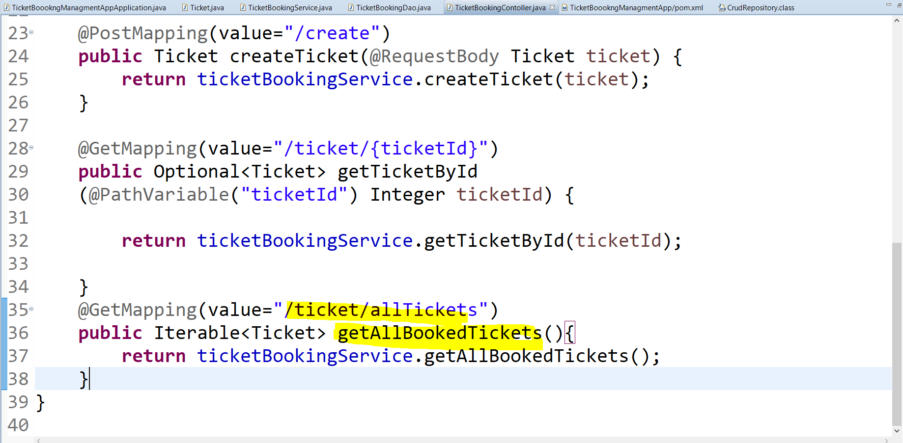

Slide 19
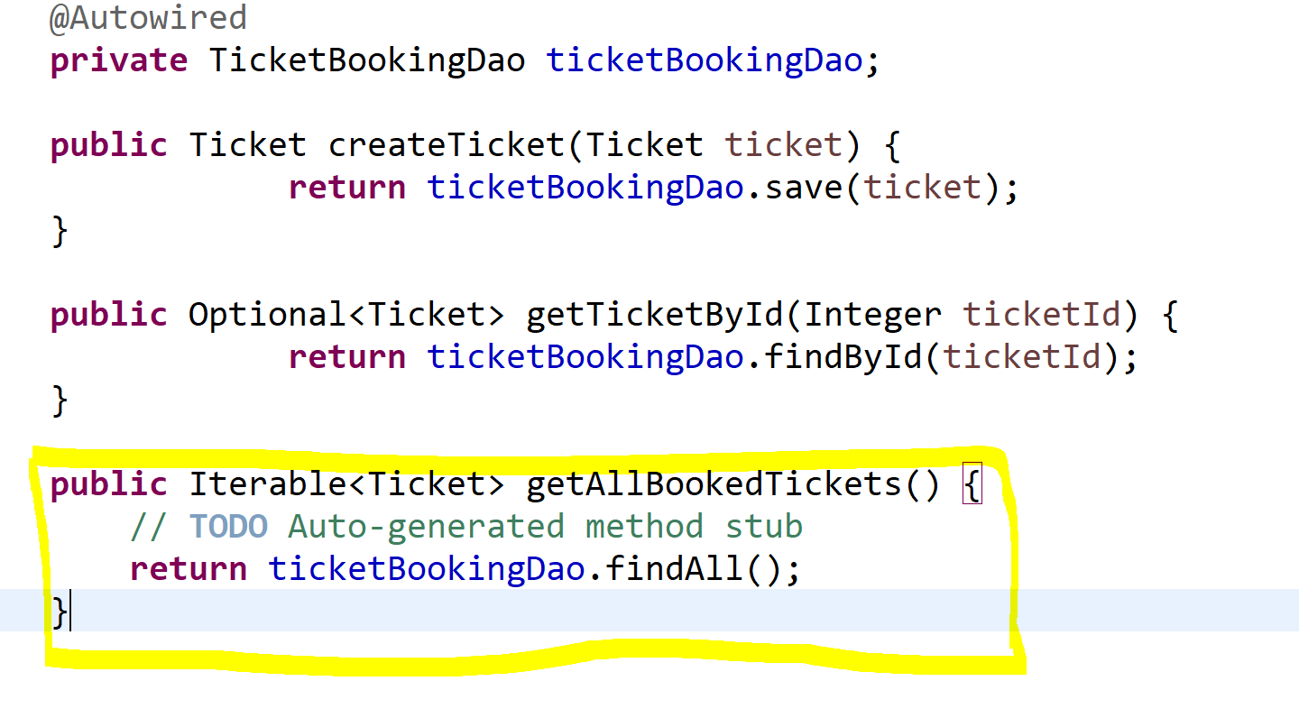

Slide 20
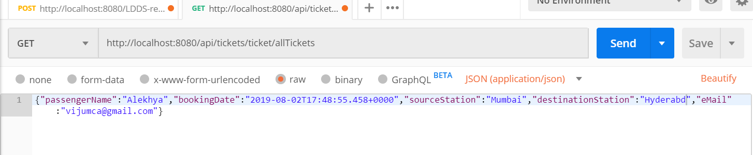
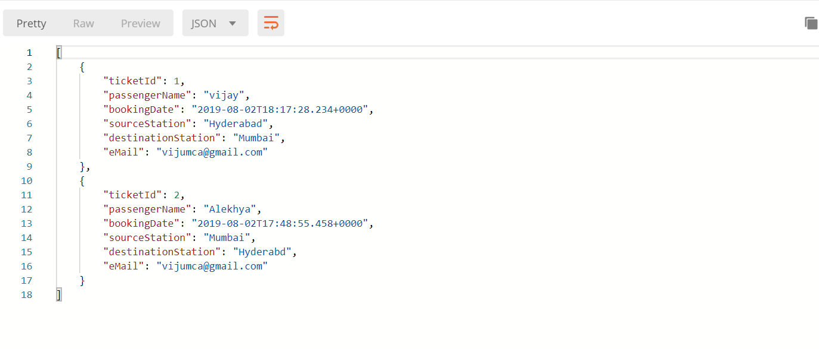

Slide 21
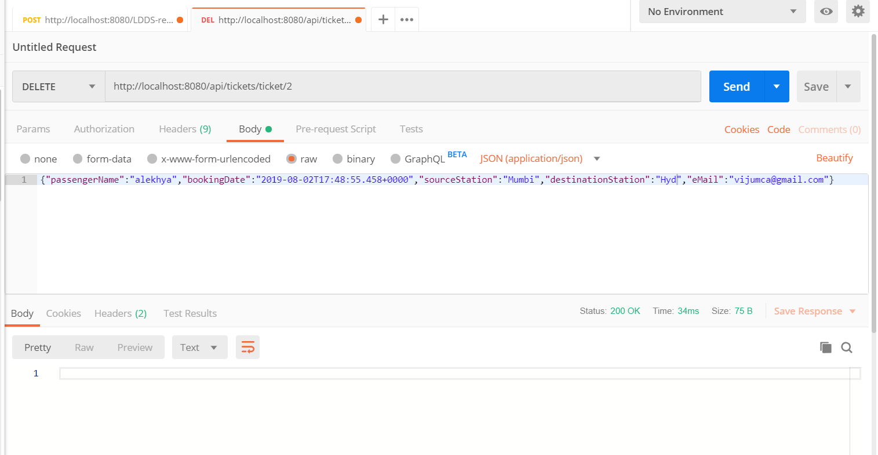

Slide 22
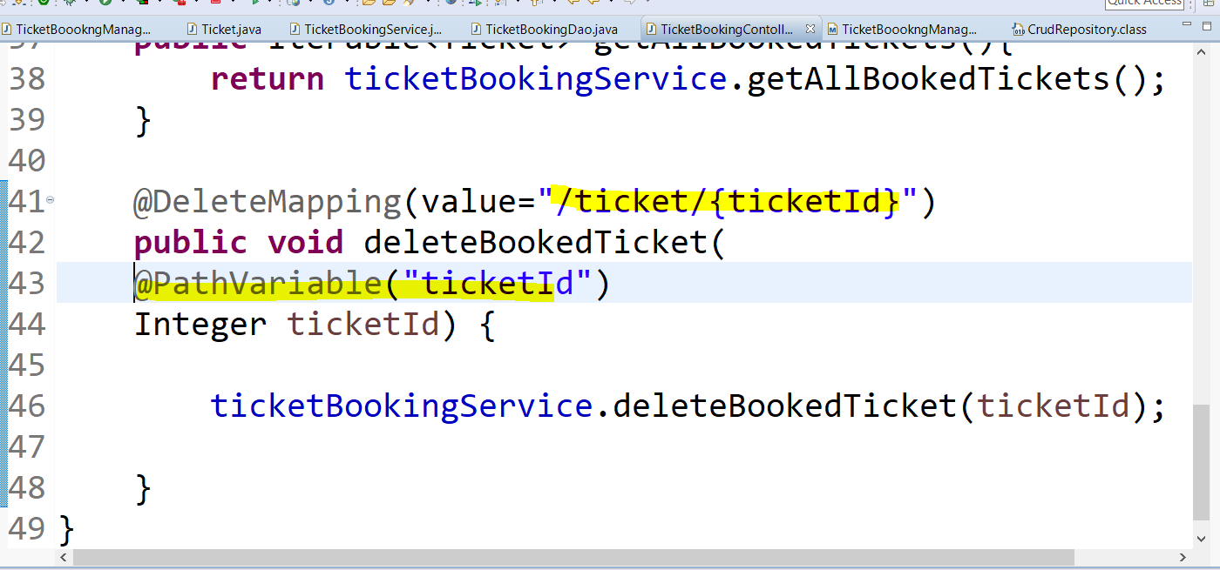

Slide 23
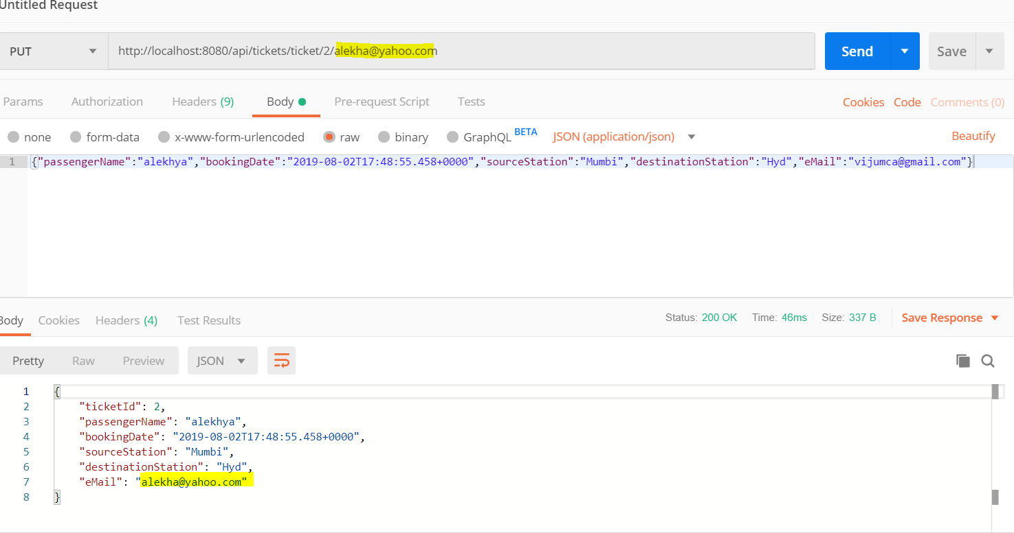

Slide 24
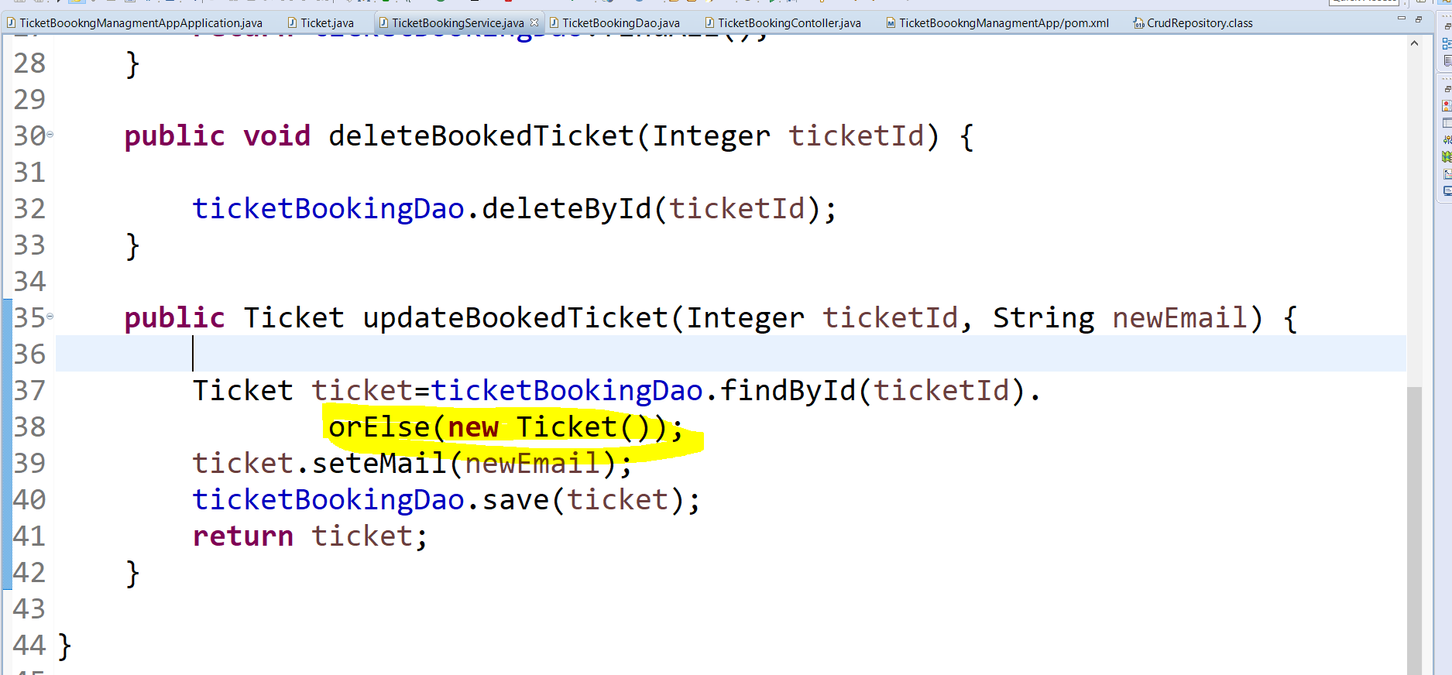

Slide 25
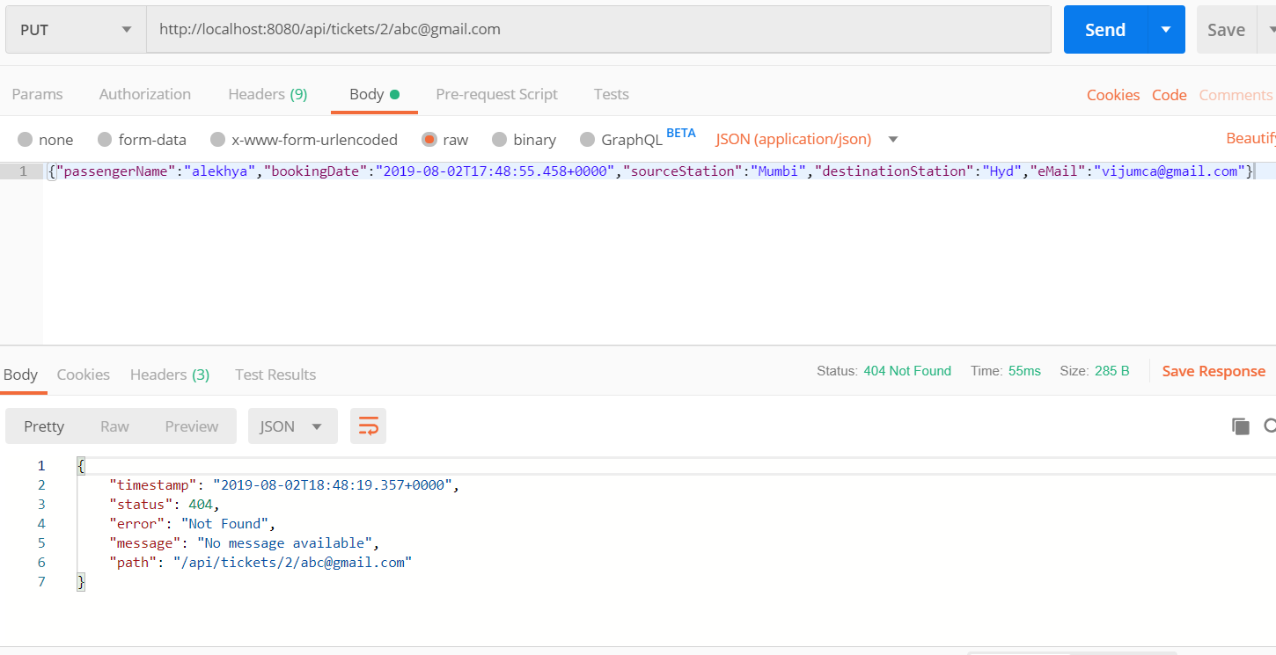

Slide 26
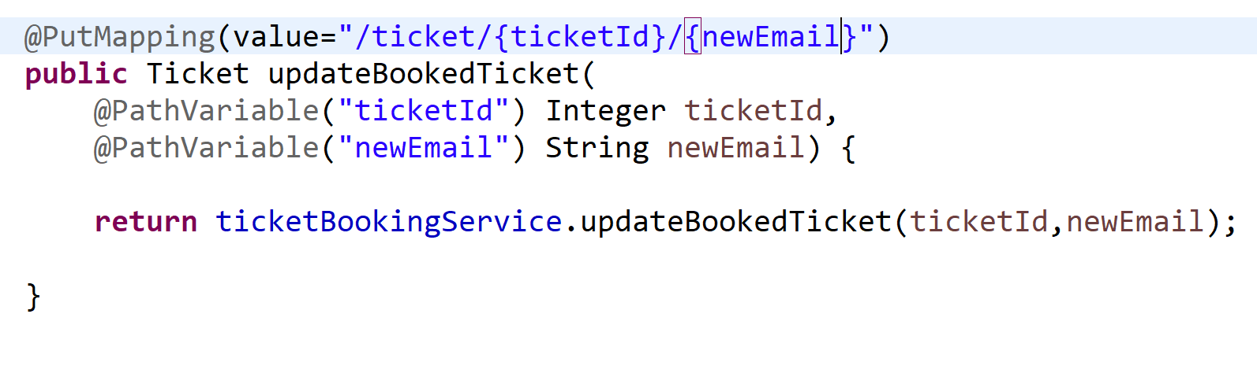
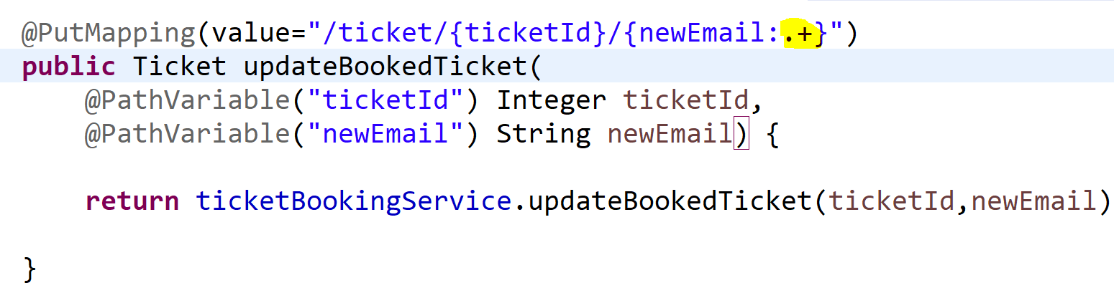

Slide 27
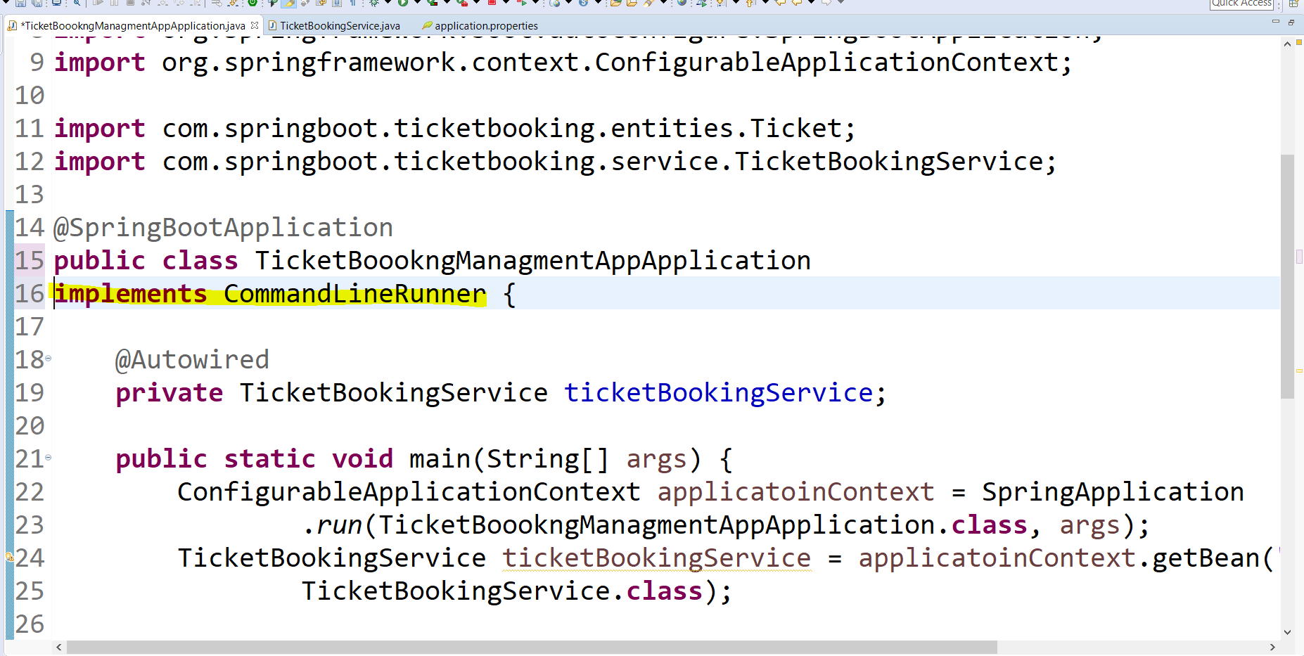

Slide 28
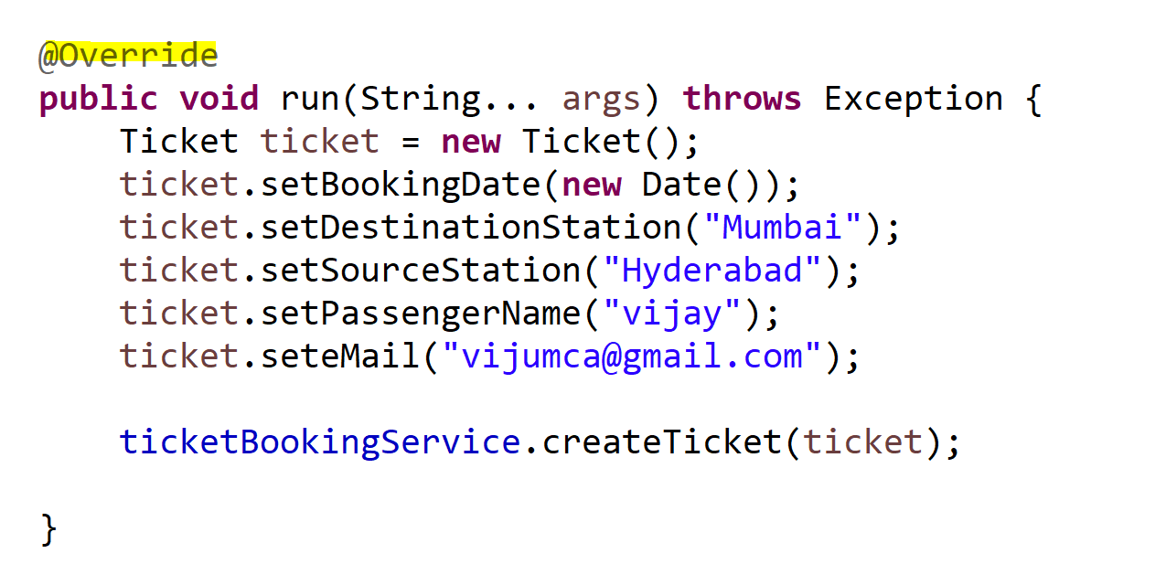

Slide 29
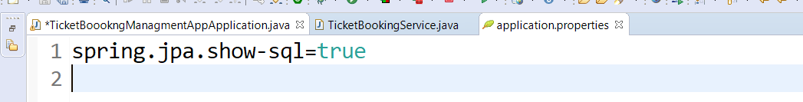
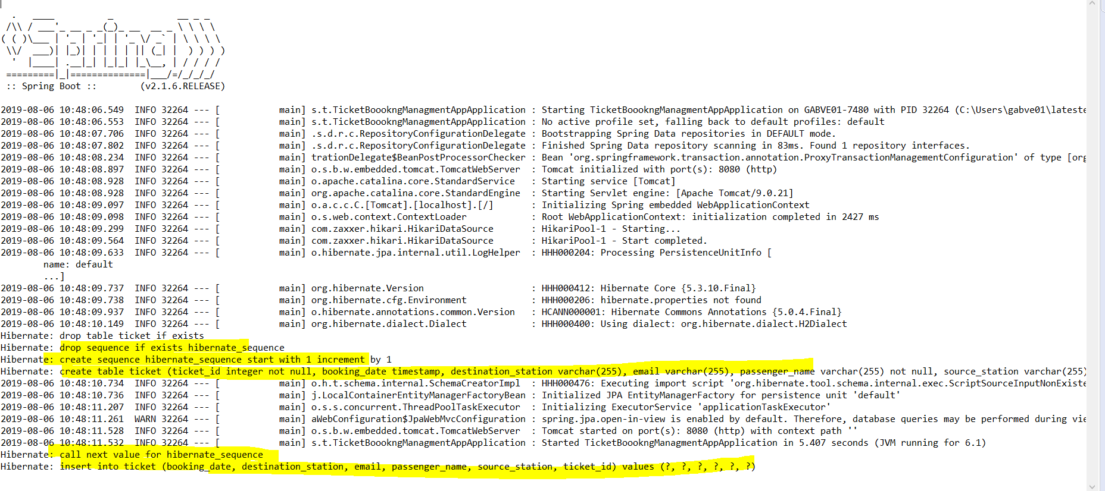

Slide 30
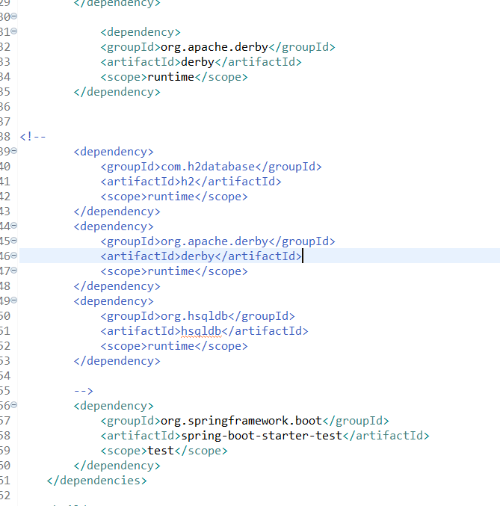

Slide 31
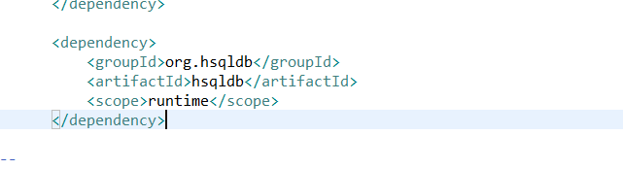

Slide 32
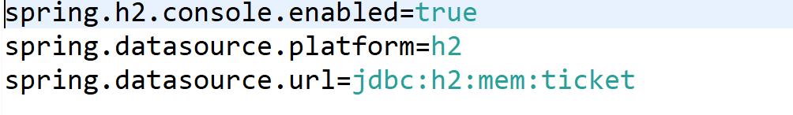

Slide 33
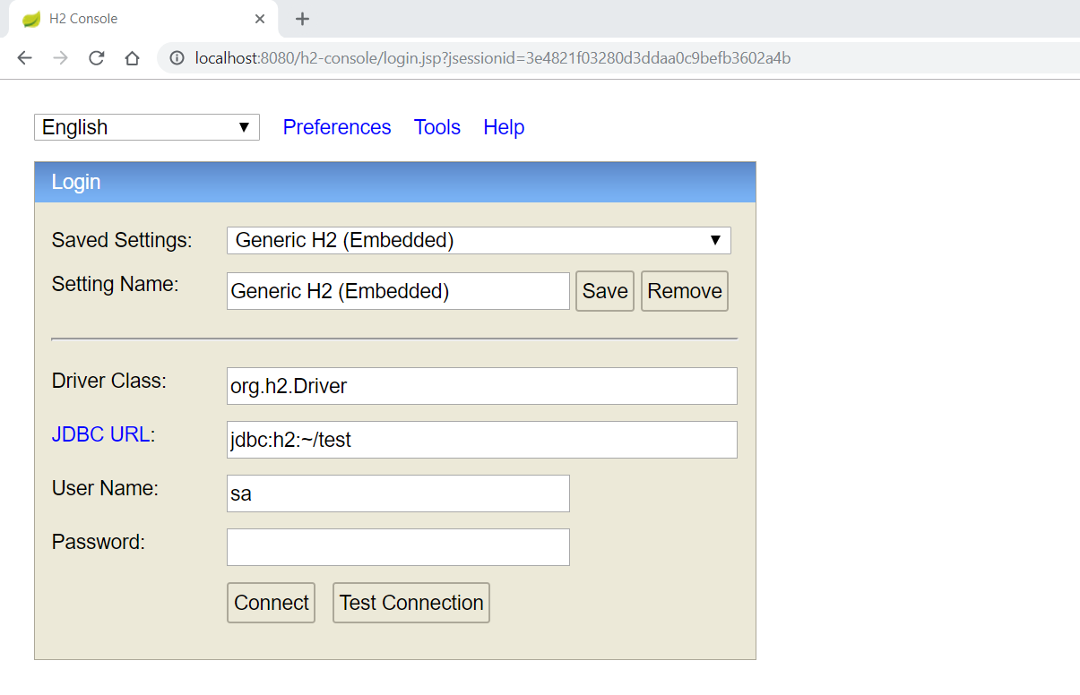

Slide 34
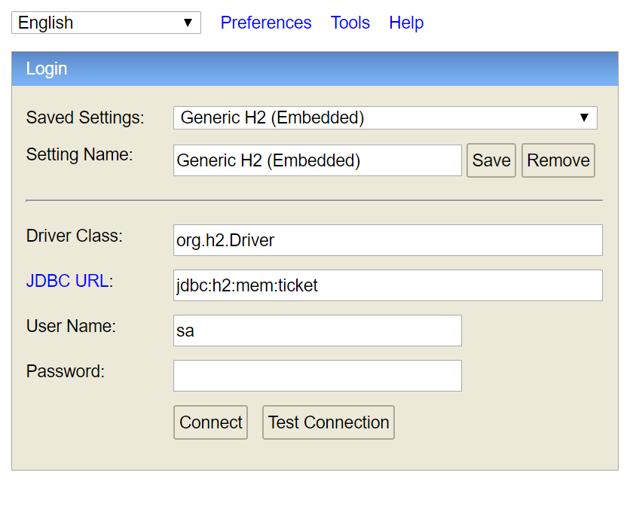

Slide 35
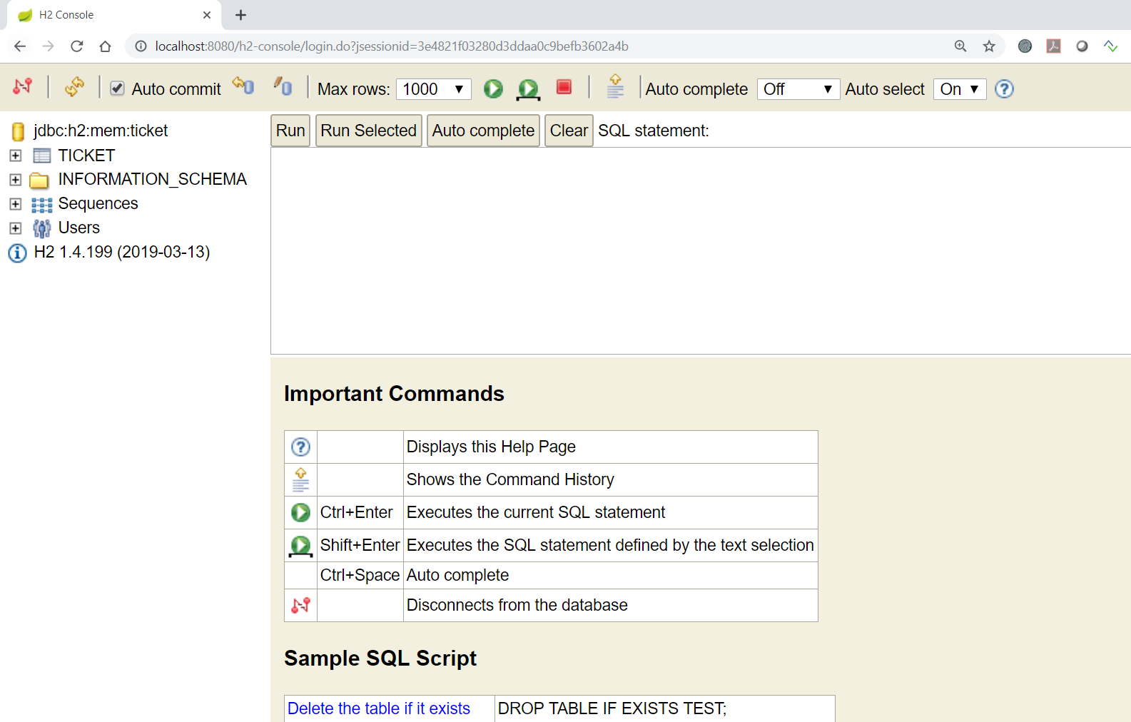
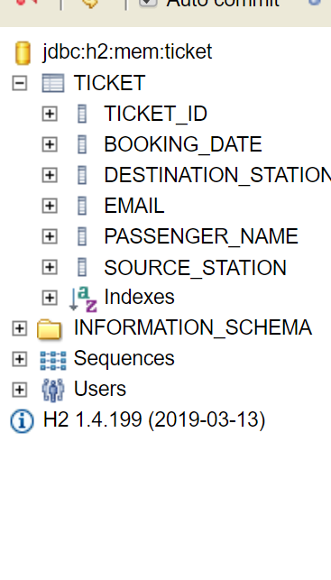

Slide 36
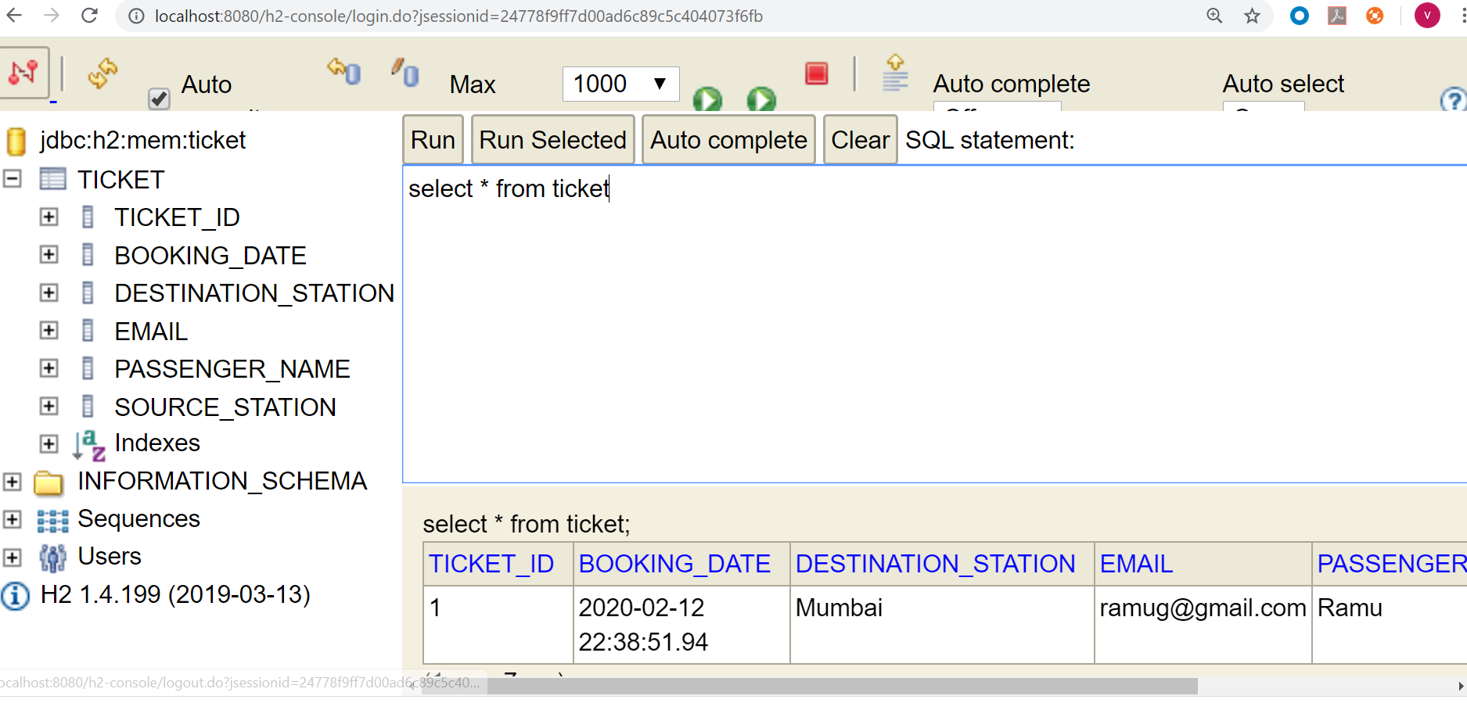

Slide 37
Sybase - Spring boot configuration
<dependency>
<groupId>com.sybase.jconnect</groupId>
<artifactId>jconn4</artifactId>
<version>7.07</version>
<scope>provided</scope>
</dependency>
<dependency>
<groupId>sybase</groupId>
<artifactId>jconn</artifactId>
<version>4_RELEASE</version>
</dependency>
POM.XML
ICONN jar
mvn install:install-file -Dfile="path-to\jconn4.jar" -DgroupId=sybase -DartifactId=jconn -Dversion=4_RELEASE -Dpackaging=jar

Slide 38
Sybase - Spring boot configuration
spring.datasource.url=jdbc:sybase:Tds:HOST:PORT/DB_NAME
spring.datasource.username=USER
spring.datasource.password=PASS
spring.jpa.properties.hibernate.default_schema=SCHEMA
spring.datasource.driverClassName=com.sybase.jdbc4.jdbc.SybDriver
spring.datasource.type=com.zaxxer.hikari.HikariDataSource
spring.jpa.hibernate.ddl-auto=none
spring.jpa.databasePlatform=org.hibernate.dialect.SybaseDialect
spring.datasource.connectionTestQuery=select 1
spring.jpa.show-sql=true
spring.jpa.hibernate.ddl-auto=create
Application Properties File

Slide 39
Oracle Configuration
<dependency>
<groupId>com.oracle.ojdbc</groupId>
<artifactId>ojdbc8</artifactId>
<version>19.3.0.0</version>
</dependency>
POM.XML
Application Properties
spring.datasource.username=student16-pim128
spring.datasource.password=N0tall0wed
spring.datasource.driver.class=oracle.jdbc.driver.OracleDriver
spring.jpa.properties.hibernate.dialect=org.hibernate.dialect.Oracle12cDialect
spring.datasource.driver.class=oracle.jdbc.driver.OracleDriver
spring.jpa.hibernate.ddl-auto=create

Slide 40
SQL SERVER
<dependency>
<groupId>com.microsoft.sqlserver</groupId>
<artifactId>mssql-jdbc</artifactId>
<scope>runtime</scope>
</dependency>
POM.XML
Application Properties
spring.datasource.url=jdbc:sqlserver://10.17.47.225;databaseName=pim128db
spring.datasource.username=sa
spring.datasource.password=N0tall0wed
spring.datasource.driverClassName=com.microsoft.sqlserver.jdbc.SQLServerDriver
spring.jpa.hibernate.dialect=org.hibernate.dialect.SQLServer2012Dialect
spring.jpa.hibernate.ddl-auto=create

Slide 41
MYSQL
<dependency>
<groupId>mysql</groupId>
<artifactId>mysql-connector-java</artifactId>
<scope>runtime</scope>
</dependency>
POM.XML
Application Properties
spring.datasource.url=jdbc:mysql://localhost:3306/ticket8to9batch
spring.datasource.username=root
spring.datasource.password=N0tall0wed
spring.datasource.driver-class-name=com.mysql.cj.jdbc.Driver
spring.jpa.properties.hibernate.dialect=org.hibernate.dialect.MySQL8Dialect
spring.jpa.hibernate.ddl-auto=create

Slide 42
Memory Configuration

