Slide 1
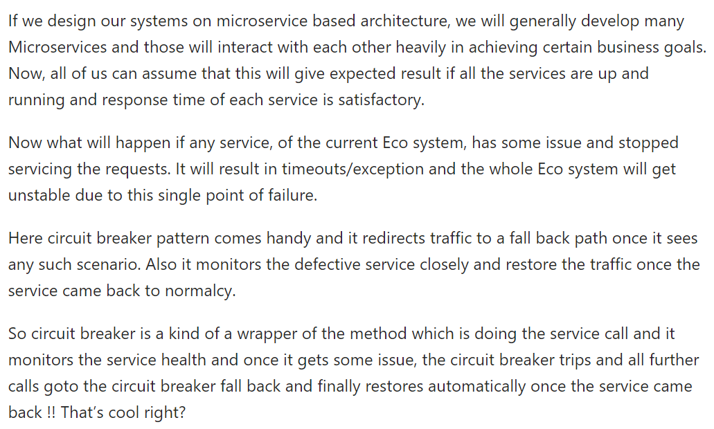
Hystrix Circuit Breaker

Slide 2
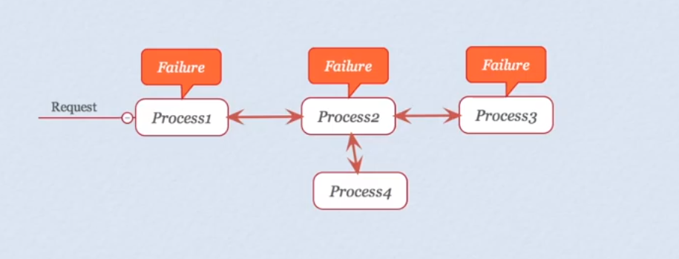
Spring Boot Hystrix

Slide 3
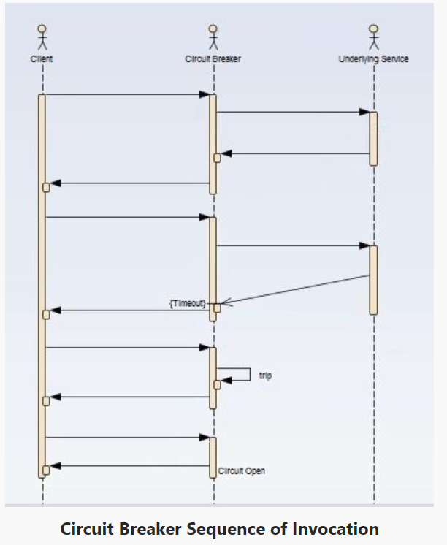
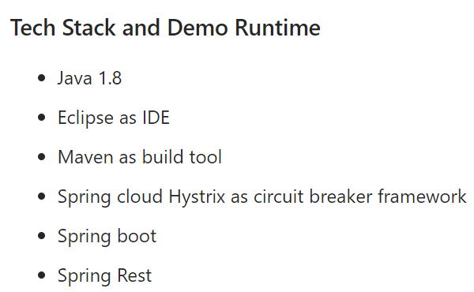
Spring Boot Hystrix

Slide 4
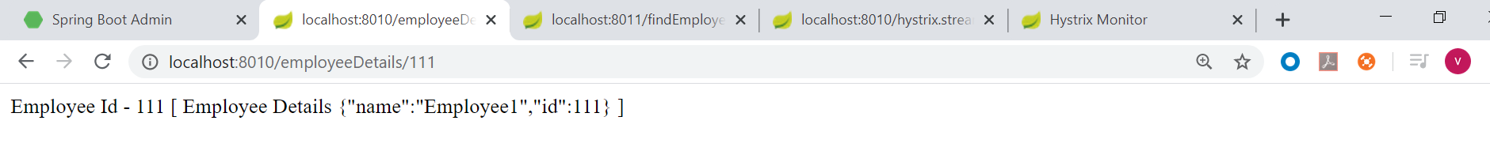
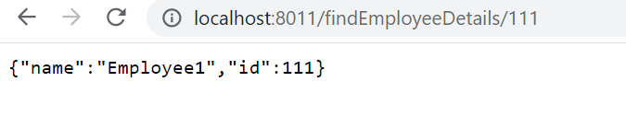
Spring Boot Hystrix

Slide 5
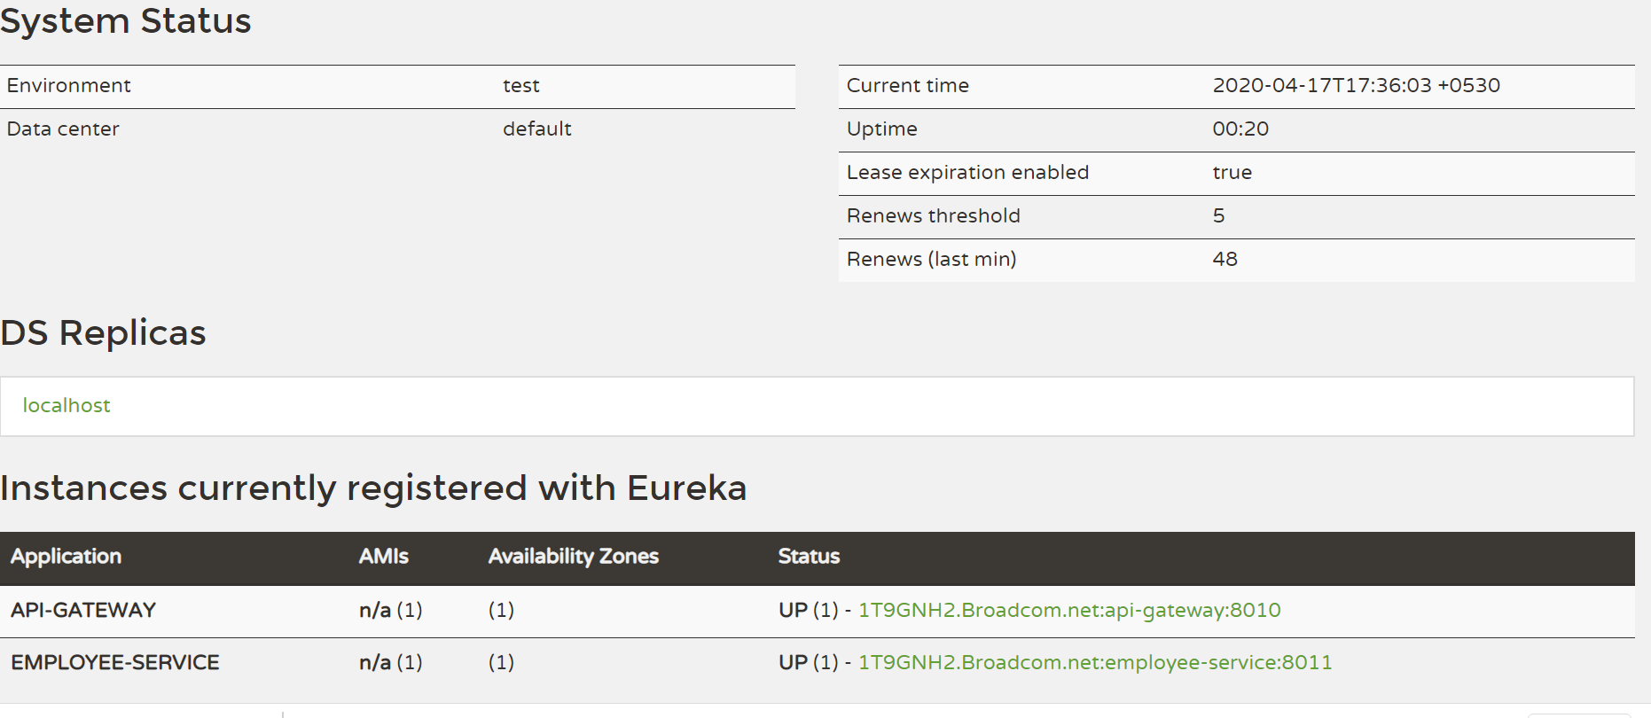

Spring Boot Hystrix

Slide 6
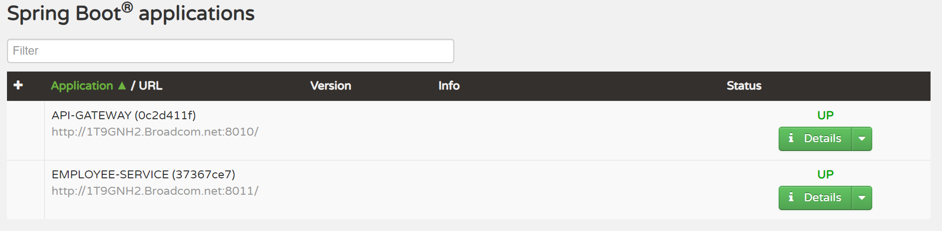
Spring Boot Hystrix

Slide 7
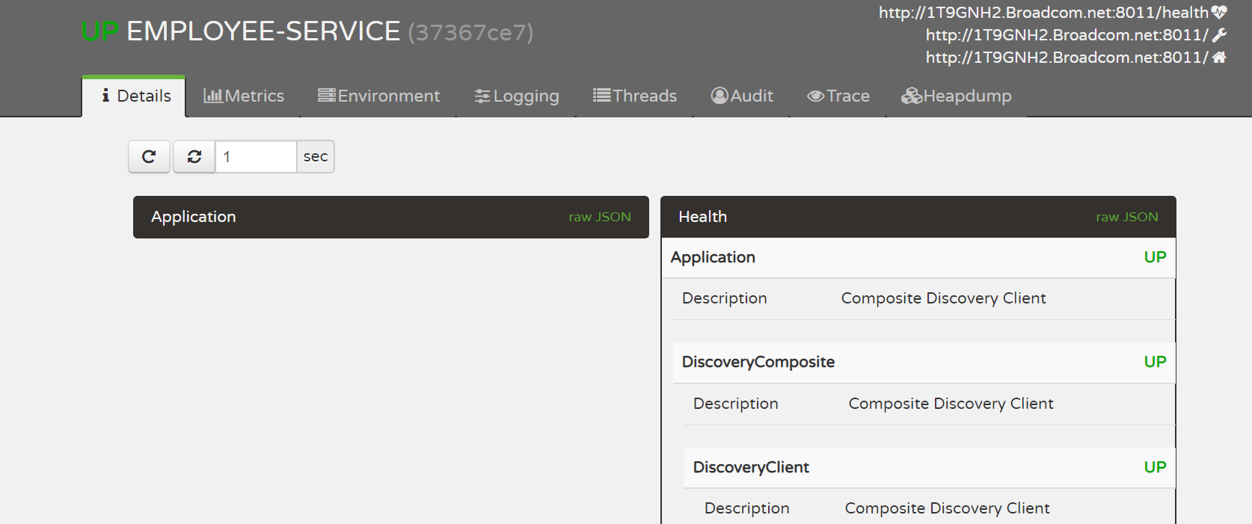
Spring Boot Hystrix

Slide 8

Spring Boot Hystrix

Slide 9

Spring Boot Hystrix

Slide 10
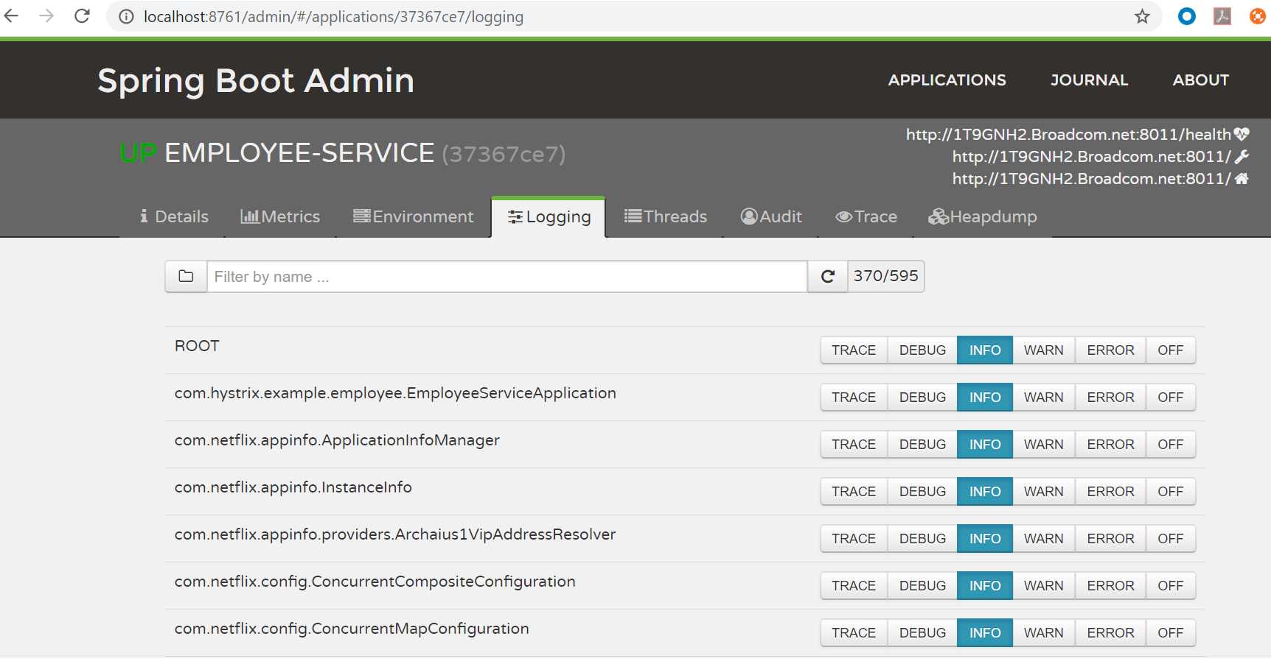
Spring Boot Hystrix

Slide 11
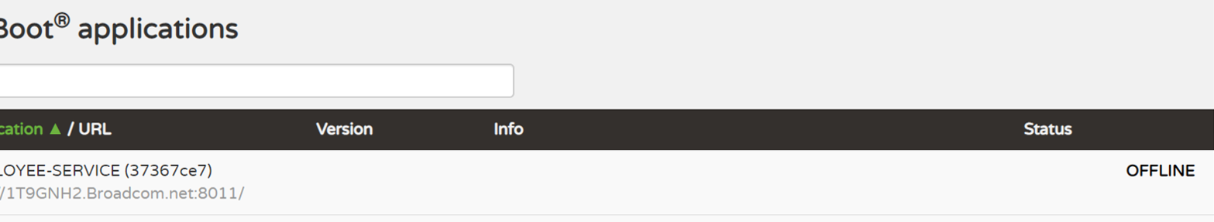
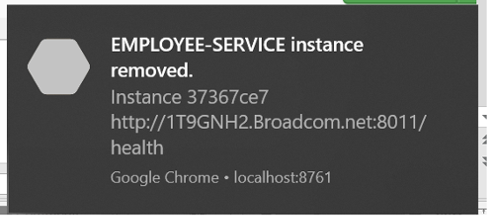
Spring Boot Hystrix

Slide 12



Spring Boot Hystrix

Slide 13
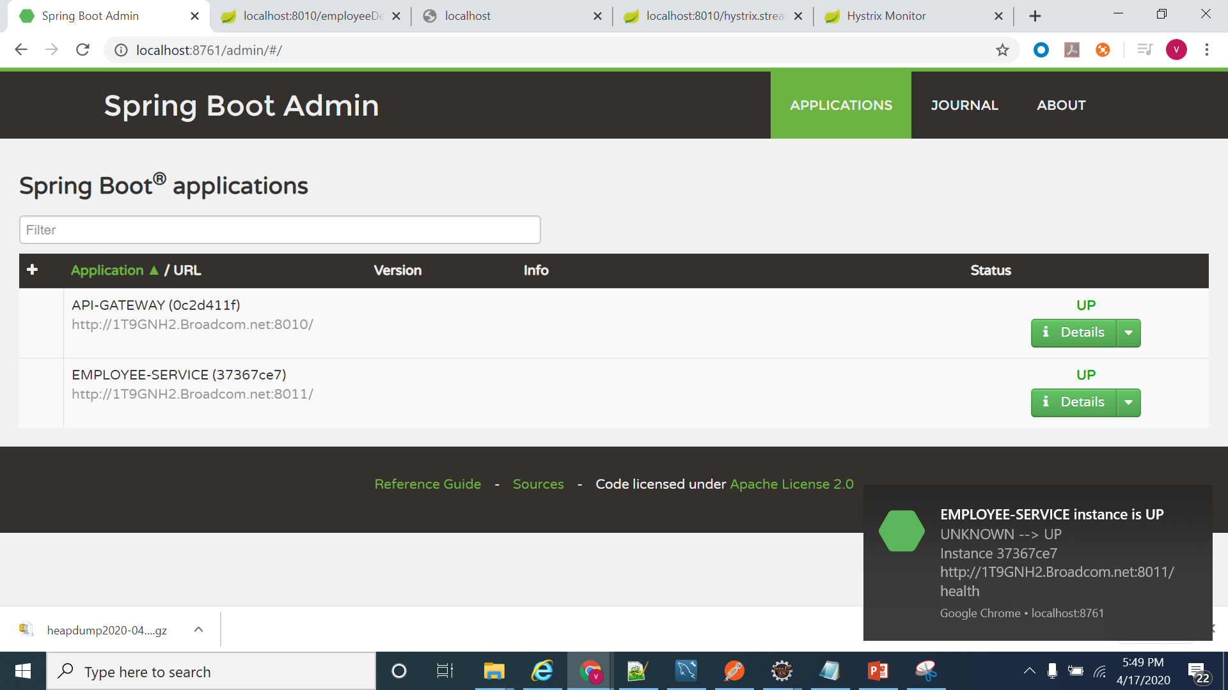
Spring Boot Hystrix

Slide 14
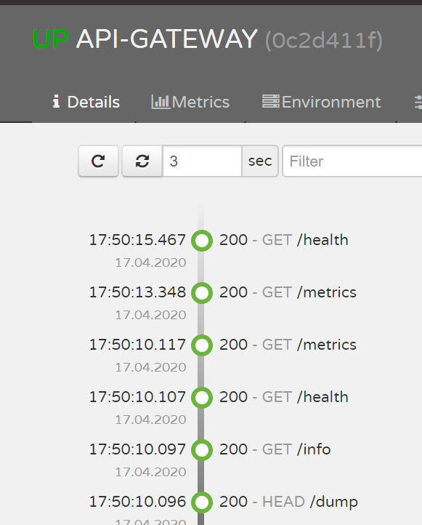
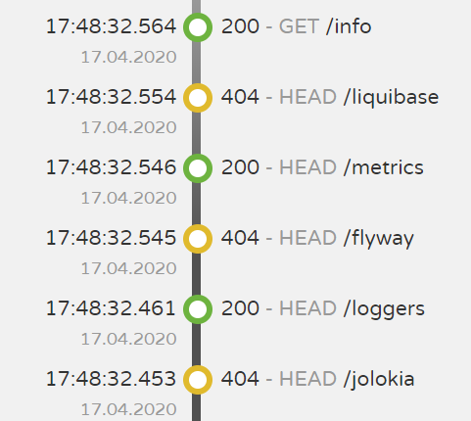
Spring Boot Hystrix

Slide 15
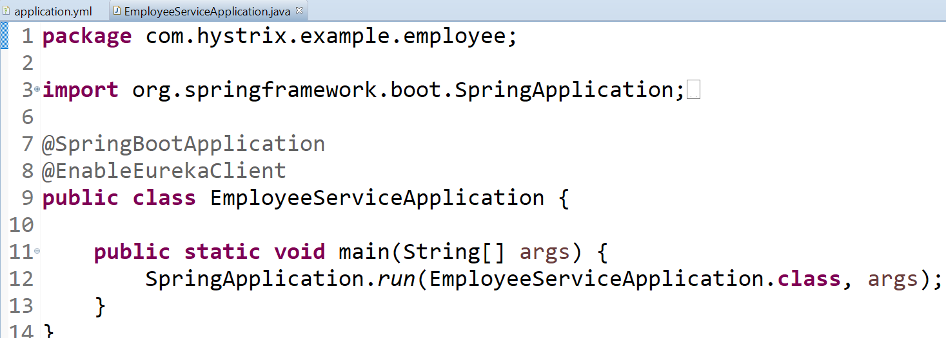
Spring Boot Hystrix

Slide 16
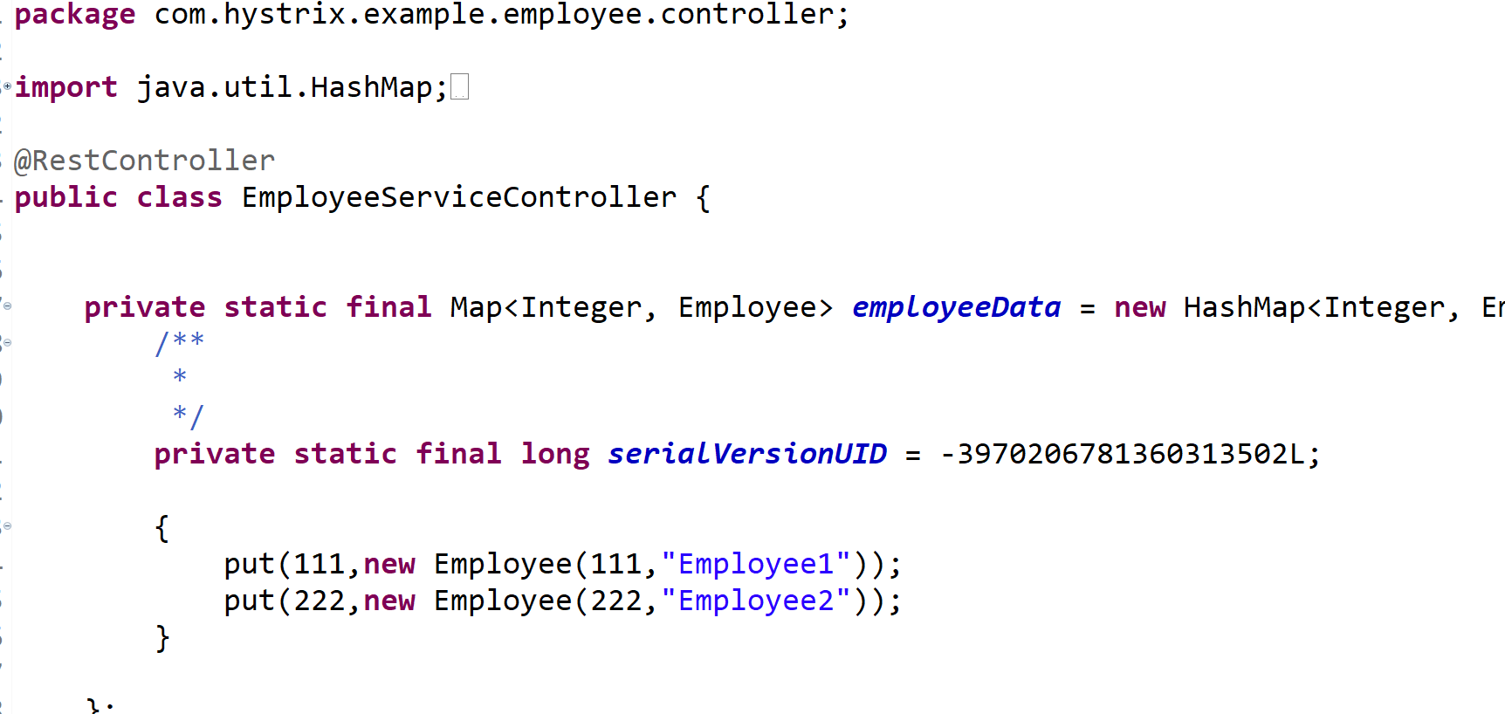
Spring Boot Hystrix

Slide 17
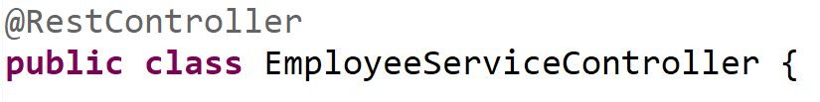
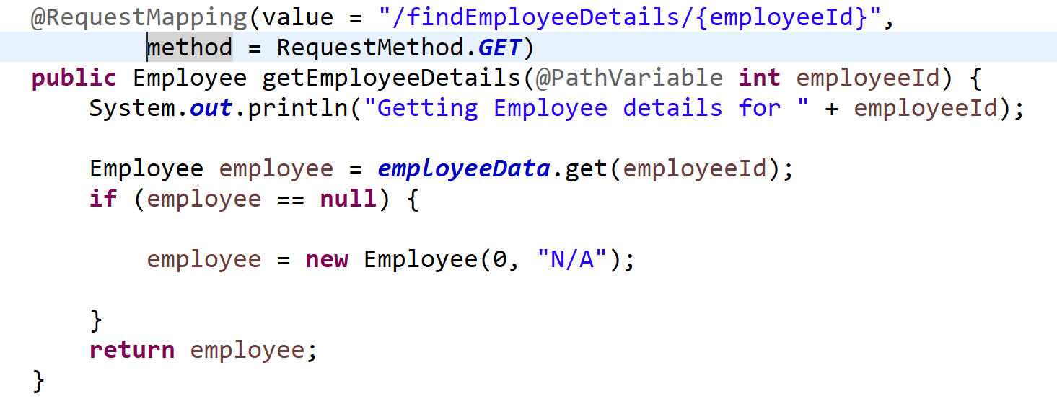
Spring Boot Hystrix

Slide 18
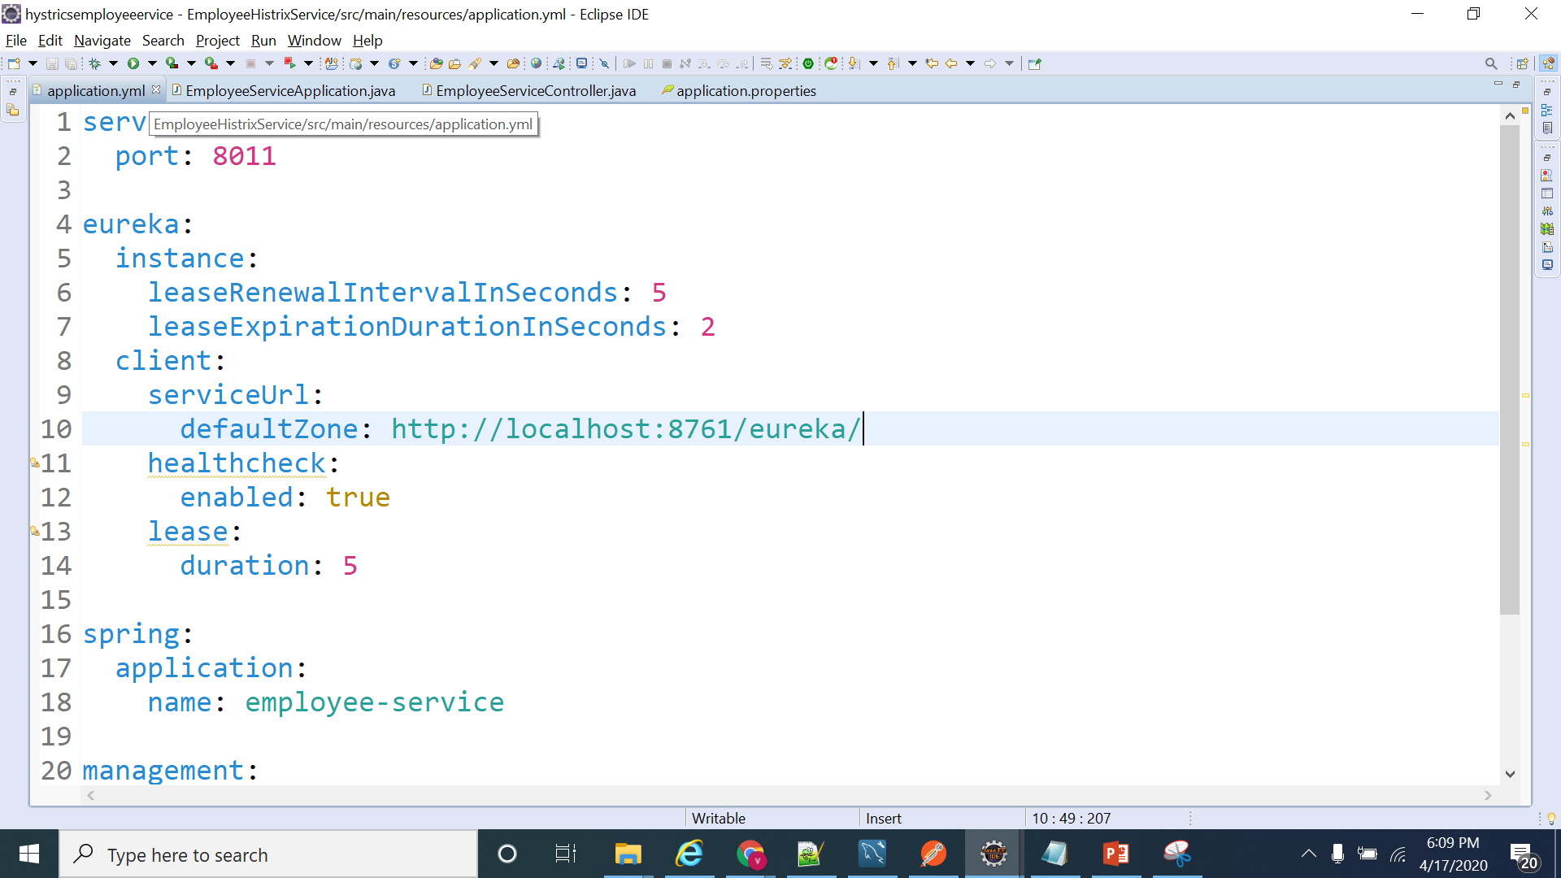
Spring Boot Hystrix

Slide 19
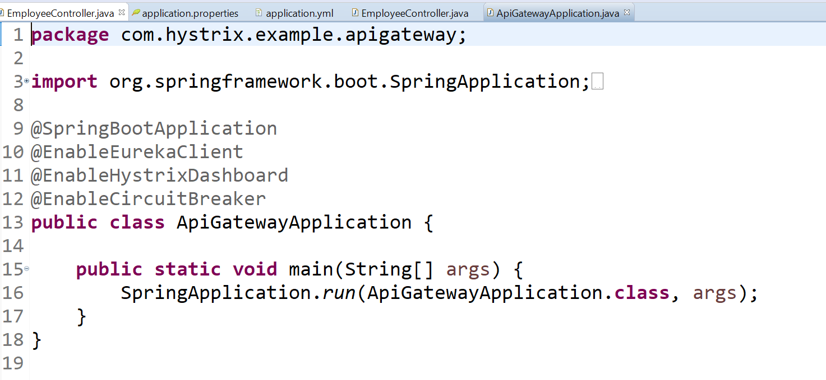
Spring Boot Hystrix

Slide 20
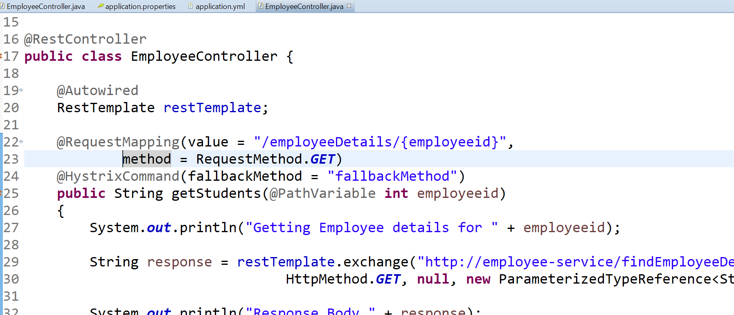
Spring Boot Hystrix

Slide 21
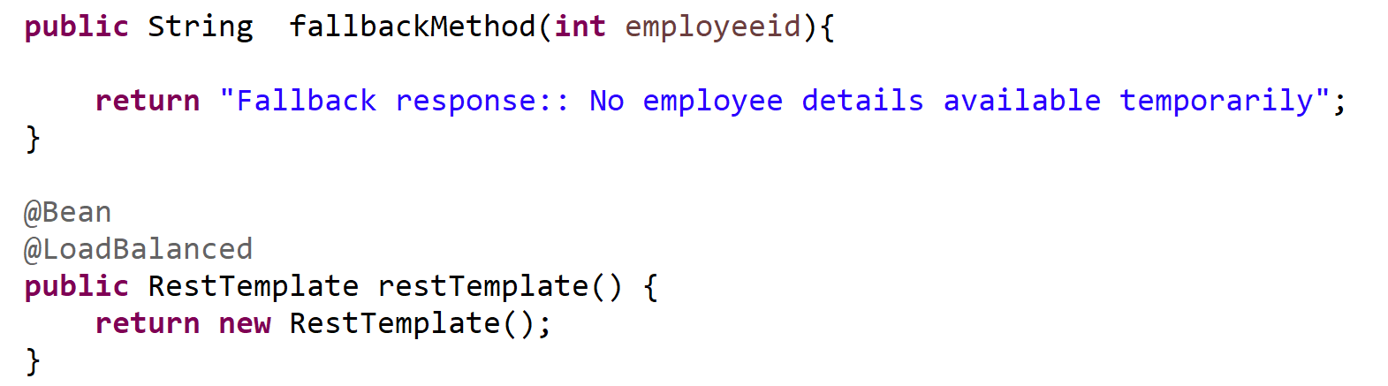
Spring Boot Hystrix

Slide 22
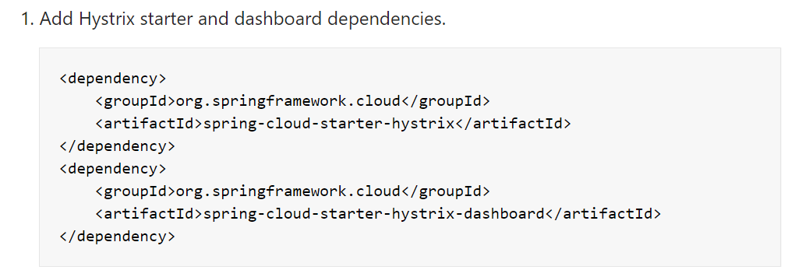
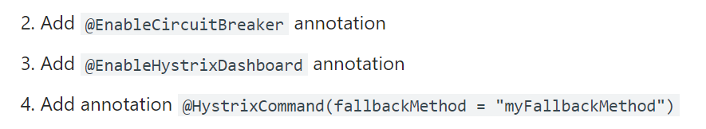
Spring Boot Hystrix

Slide 23
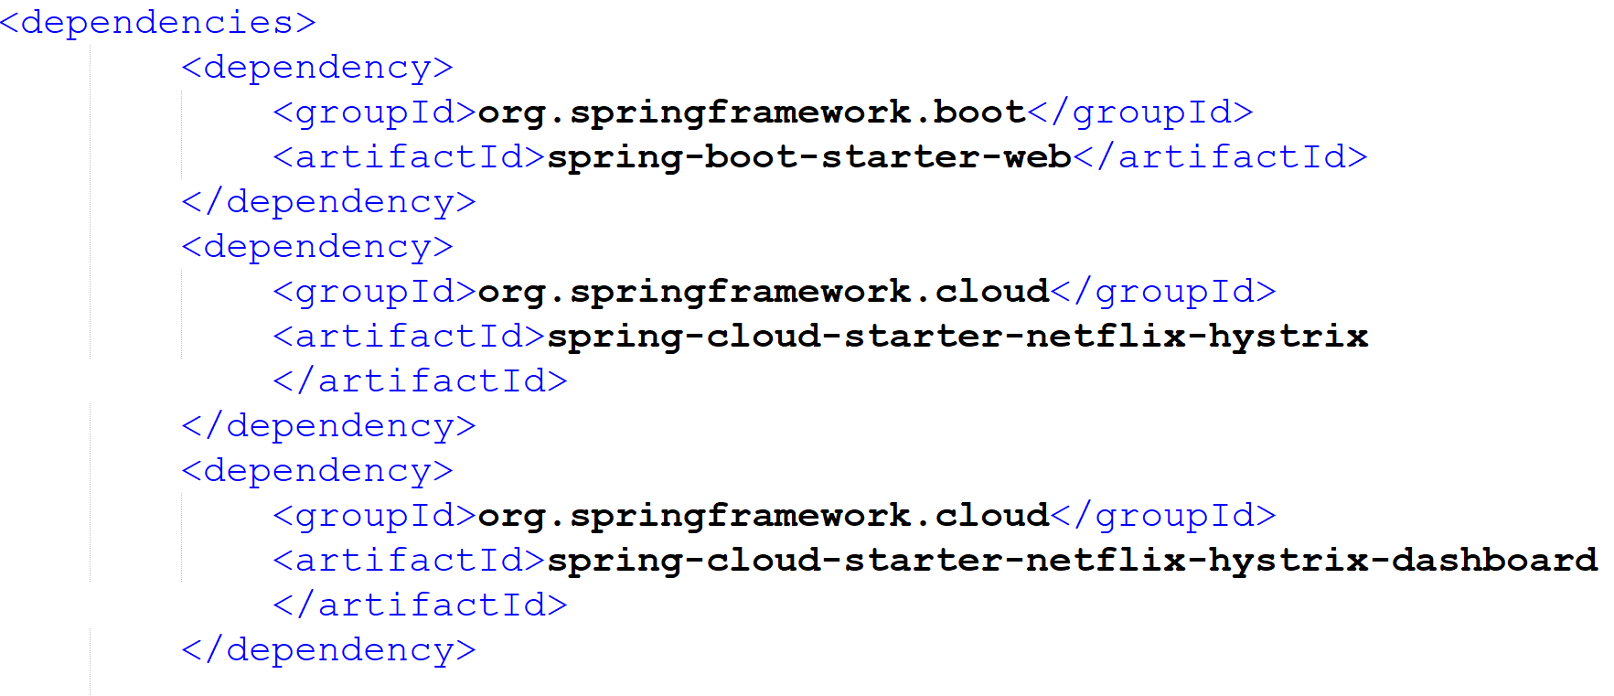
Spring Boot Hystrix

Slide 24
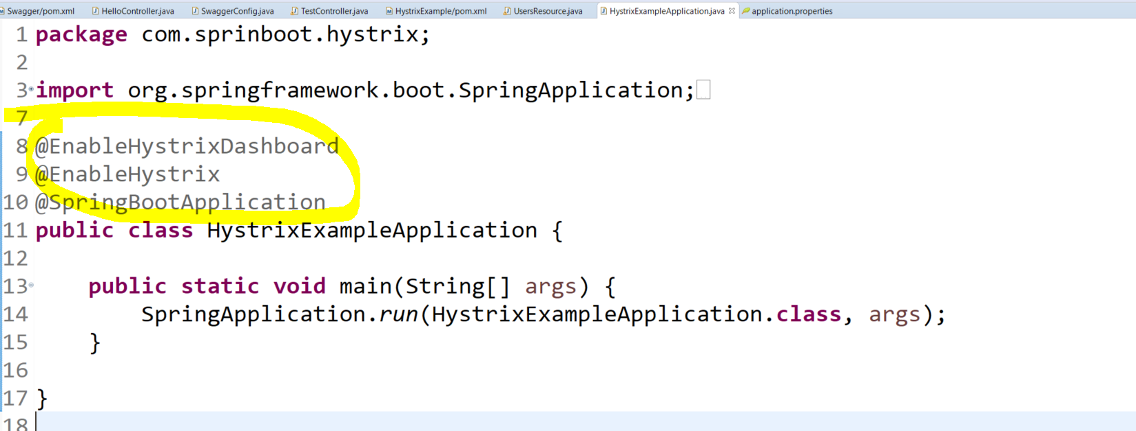
Spring Boot Hystrix

Slide 25
Spring Boot Hystrix

Slide 26
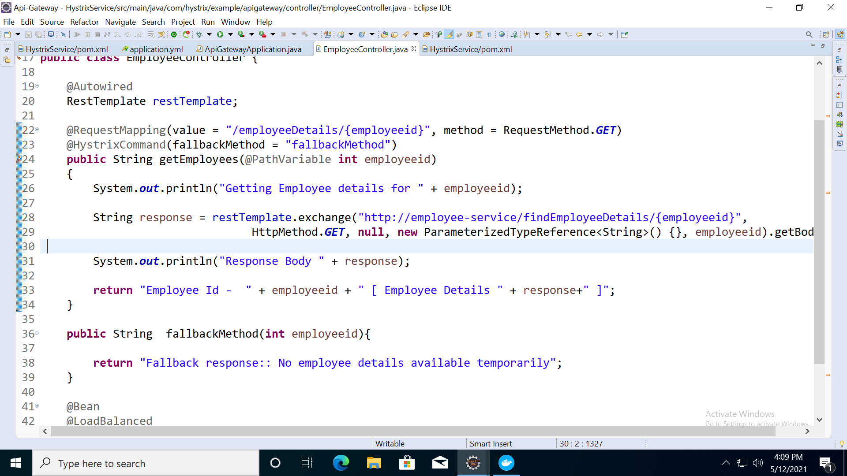
Spring Boot Hystrix

