Slide 1
Cancer Mortality Rates
Presented By: Faith Dempsey, Kaitlyn Beck, Brittany Foster, Anil Shinde, Sai Nadella

Slide 2


Issue
Patients with lung/bronchus cancer have a higher mortality rate than breast cancer.
Notes:
Sai

Slide 3
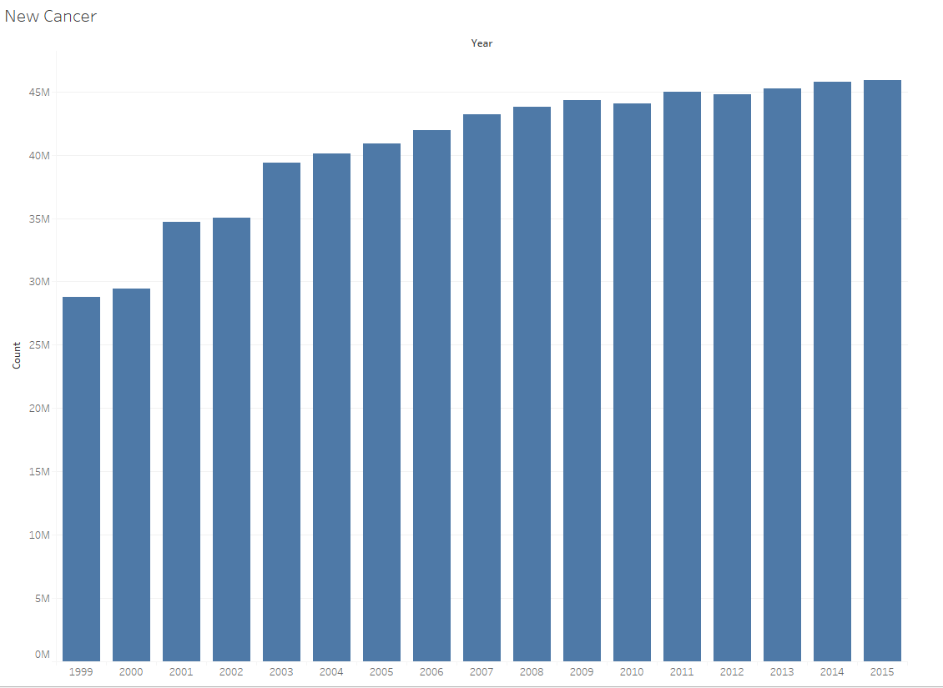
All New Cancer Cases
The number of new cancer patients increased between 1999 and 2015.
Notes:
Anil

Slide 4
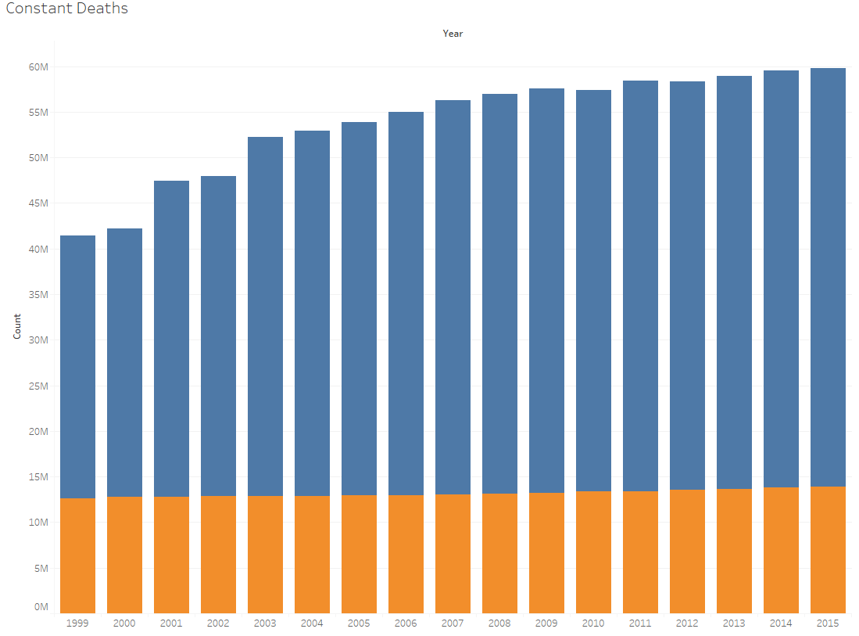
New Cases vs. Mortality
New cancer cases increased while mortality remained constant.
Notes:
Kaitlyn

Slide 5
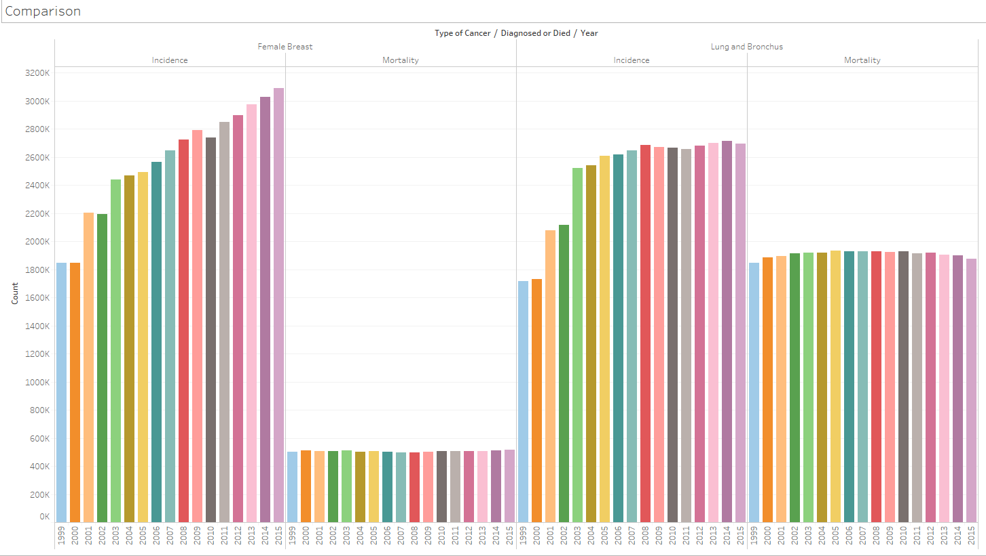
Breast Cancer
Lung & Bronchus
Notes:
Faith

Slide 6
Conclusion
Our findings support our issue: Patients with lung and bronchus cancer have a higher mortality rate than breast cancer.
Notes:
Brittany

Slide 7
Questions?

