Slide 1
A thesis WORK ON
TWITTER SENTIMENT ANALYSIS

Slide 2
CONTENTS:-
Introduction
Objectives
Use of Sentiment Analysis
Methodology
Twitter API
Used library
Feature Extraction
Result and Analysis
Conclusion

Slide 3
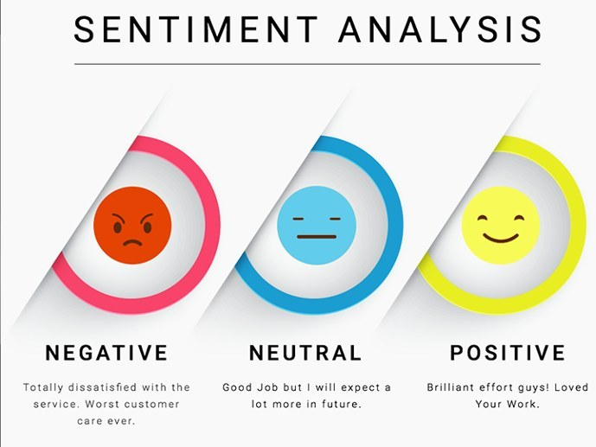
INTRODUCTION
Sentiment Analysis is process of collecting and analyzing data based upon the person feelings, reviews and thoughts.
Sentimental analysis often called as opinion mining as it mines the important feature from people opinions. Analysis is done by using various machine learning techniques, deep learning techniques, statistical models and Natural Language Processing (NLP) for the extraction of feature from a large data. It is used to generate opinions for people of social media by analyzing their feelings or thoughts which they provide in form of text. Sentiment Analysis is domain centered, i.e., results of one domain cannot be applied to another domain. Sentimental Analysis is used in many real-life scenarios, to get reviews. It is the process of accessing tweets for a particular topic and predicts the sentiment of these tweets as positive, negative or neutral with the help of different deep learning algorithm.

Slide 4
OBJECTIVES
The main objectives of this thesis work is to perform the sentiment analysis on covid19 such that people opinions about the pandemic are extracted from Twitter.
Thus, to achieve this objective we build a classifier based on deep learning methods and perform live sentiment analysis on collected data.

Slide 5

USE OF SENTIMENT ANALYSIS
Sentiment analysis is often performed on textual data to help businesses monitor brand and product sentiment in customer feedback and understand customer needs.
Since customers express their thoughts and feelings more openly, sentiment analysis is becoming an essential tool to monitor and understand that sentiment . Automatically analyzing customer feedback, such as opinions in survey responses and social media conversations, allows brands to learn what makes customers happy or frustrated, so that they can tailor products and services to meet their customers needs.

Slide 6
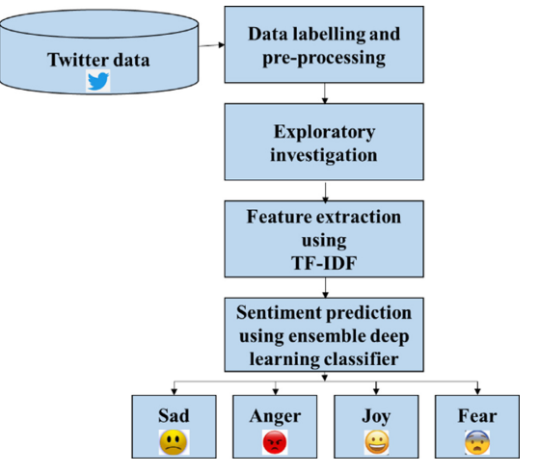


METHODOLOGY

Slide 7
TWITTER API(APPLICATION PROGRAMMING INTERFACE)
Twitter allows users to collect tweets with the help of Twitter API.
It provides two kinds of APIs: REST API and Streaming API.
The differences between these are: REST APIs support connections for short time interval and only limited data can be collected as a time, whereas Streaming API provides tweets in real-time and connection for long time.

Slide 8
USED LIBRARY
Tweepy:- It is an open-source python package that gives us a very convenient way to access the Twitter API with python. Which includes a set of classes and methods that represent twitters models and API endpoints.
NLTK:- Natural Language Toolkit (NLTK) is library in Python, which provides a base for building programs and classification of data, and It is also a collection of resources for Python that can be used for text processing, classification, tagging and tokenization.
Tensorflow:- TensorFlow is an open-sourced end-to-end platform, a library for multiple machine learning tasks.
Keras:- Keras is a high-level neural network library that runs on top of TensorFlow.
Pandas:- pandas is a fast, powerful, flexible and easy to use open-source data analysis and manipulation tool, built on top of the Python programming language.

Slide 9
FEATURE EXTRACTION
As feature extraction carried out using word embedding techniques. We have round 500 reviews each for positive and negative class. We take first 500 reviews as training set and remaining 500 as testing set.
Both the training and testing data must be represented in same order for learning. One of the ways that data can be represented is feature-based. By features, it is meant that some attributes that are thought to capture the pattern of the data are first selected, and the entire dataset must be represented in terms of them before it is fed to a deep learning algorithm.

Slide 10
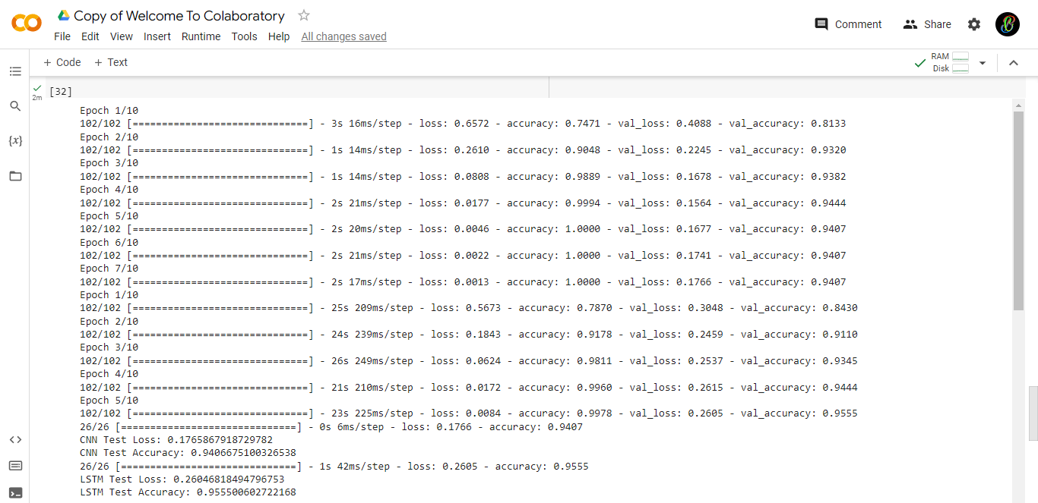
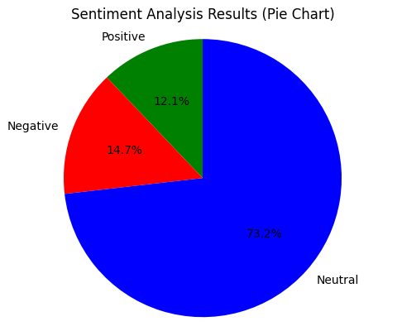
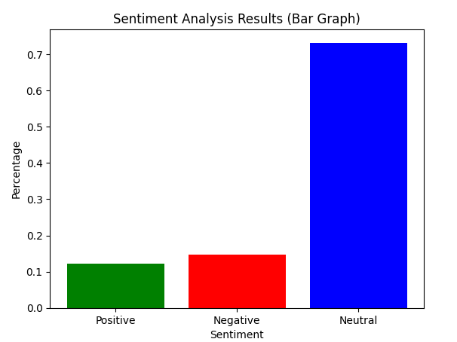
RESULT AND ANALYSIS

Slide 11
CONCLUSION
Sentiment analysis is used to identifying people’s opinion, attitude and emotional states. The views of the people can be positive or negative. Commonly, parts of speech are used as feature to extract the sentiment of the text. An adjective plays a crucial role in identifying sentiment from parts of speech. Sometimes words having adjective and adverb are used together then it is difficult to identify sentiment and opinion.
To do the sentiment analysis of tweets, the proposed system first extracts the twitter posts from twitter by user. The system can also compute the frequency of each term in tweet. Using deep learning approach help to obtain the results.

Slide 12
THANK YOU

