Slide 1
YHills Edutech — Internship Project
PHISHING URL
DETECTION SYSTEM
An AI-Powered Machine Learning Solution for Real-Time Cybersecurity Threat Detection
Student:
Anil Kumar
Institute:
YHills Edutech
Guide:
Sakshi Pandey
Date:
October 2026
Domain: Cybersecurity — Threat Detection | Machine Learning
Phishing URL Detection System | Anil Kumar | YHills Edutech | October 2026
1 / 12

Slide 2
Problem Statement
What problem are we solving?
3.4 Billion
$17,700
36%
83%
Phishing emails sent daily
Lost per minute to phishing
Data breaches involve phishing
Organisations faced phishing
in 2023
Core Problem
Phishing websites impersonate trusted services (banks, payment gateways) to steal credentials and financial data.
Attackers register deceptive URLs like paypal-secure-login.update-account.xyz that look convincing at first glance.
Traditional blacklists are reactive — new phishing domains appear faster than they can be manually blocked.
Users have no reliable, instant way to verify whether a suspicious URL is safe before clicking.
Solution: An AI-based system that analyses URL structure and flags phishing in real time — without visiting the page.
Phishing URL Detection System | Anil Kumar | YHills Edutech | October 2026
2 / 12

Slide 3
Project Objectives
Six measurable goals this project achieves
1
Real-Time Detection
2
Feature Engineering
3
ML Classification
Classify any URL as Legitimate or Phishing in under 100 ms.
Extract 23 lexical features from URLs without making any HTTP request.
Train a Random Forest model on 10,000 labelled URLs achieving >= 95% accuracy.
4
Interactive Web App
5
Automated Reporting
6
Privacy-First Design
Deliver a Streamlit dashboard with gauge chart, feature table and scan history.
Auto-generate confusion matrix, feature importance chart and metrics summary.
Zero external HTTP calls — analysis is entirely offline and safe.
Phishing URL Detection System | Anil Kumar | YHills Edutech | October 2026
3 / 12

Slide 4
Existing Systems & Limitations
Current approaches and why they fall short
Blacklist / Blocklist Tools
Rule-Based Filters
Manual URL Inspection
Google Safe Browsing, PhishTank, OpenPhish
Email spam filters, browser URL heuristics
Security analysts review suspicious URLs manually
Reactive — only flag known phishing URLs
Rigid rules — easy to bypass with minor variations
Extremely slow — not scalable
New domains bypass blocklists for hours/days
High false-positive rate on legitimate URLs
Requires expert knowledge
Require constant manual updates
Cannot learn from new attack patterns
Impractical for real-time user protection
Our Solution: AI-based lexical URL analysis — real-time, offline, zero blacklist dependency
Phishing URL Detection System | Anil Kumar | YHills Edutech | October 2026
4 / 12

Slide 5
Proposed Solution
Our approach, workflow and key components
What We Built
Detection Workflow
Accept a raw URL as input from the user.
1
User pastes a URL into Streamlit app
Extract 23 lexical & structural features (length, dots, HTTPS, keywords, subdomains...).
2
extract_features() builds a 23-feature vector
Feed the feature vector to a pre-trained Random Forest Classifier.
3
Loaded Random Forest model predicts the class
Predict: Legitimate (0) or Phishing (1) with a confidence percentage.
4
Confidence % is shown on a Plotly gauge chart
Display gauge chart, probability breakdown and full feature table.
5
Feature table highlights risky attributes
Log every scan to SQLite for history and audit purposes.
6
Scan saved to SQLite history database
Phishing URL Detection System | Anil Kumar | YHills Edutech | October 2026
5 / 12

Slide 6
System Architecture & Flowchart
End-to-end pipeline from URL input to classification output
INPUT
FEATURE
EXTRACT
ML MODEL
OUTPUT
>>>
>>>
>>>
Raw URL String
(user pastes it)
23 Lexical
& Structural Features
Random Forest
(200 Decision Trees)
Legitimate / Phishing
+ Confidence %
Key Source Files
features/extract_features.py
23 feature extraction functions — url_length, count_dots, uses_https, etc.
model/train_model.py
Loads dataset, trains RandomForestClassifier, saves model.pkl and metadata.pkl
app.py
Streamlit web UI — URL input, gauge chart, feature table, scan history
reports/generate_report.py
Produces confusion matrix, feature importance and metrics_summary.txt
run_all.py
One-command pipeline: train -> test -> report -> launch app
Phishing URL Detection System | Anil Kumar | YHills Edutech | October 2026
6 / 12

Slide 7
Technology & Tools
Languages, frameworks, libraries and tools used in this project
Python 3.12
Streamlit
scikit-learn
pandas / numpy
Plotly
Core programming language
Interactive web application UI
Random Forest ML classifier
Data loading & processing
Gauge & interactive UI charts
matplotlib
tldextract
SQLite
joblib / pickle
urllib.parse
Report chart generation
Accurate TLD/subdomain parsing
Scan history database storage
Model serialisation
URL component parsing
All dependencies listed in requirements.txt — install with: pip install -r requirements.txt
Phishing URL Detection System | Anil Kumar | YHills Edutech | October 2026
7 / 12

Slide 8
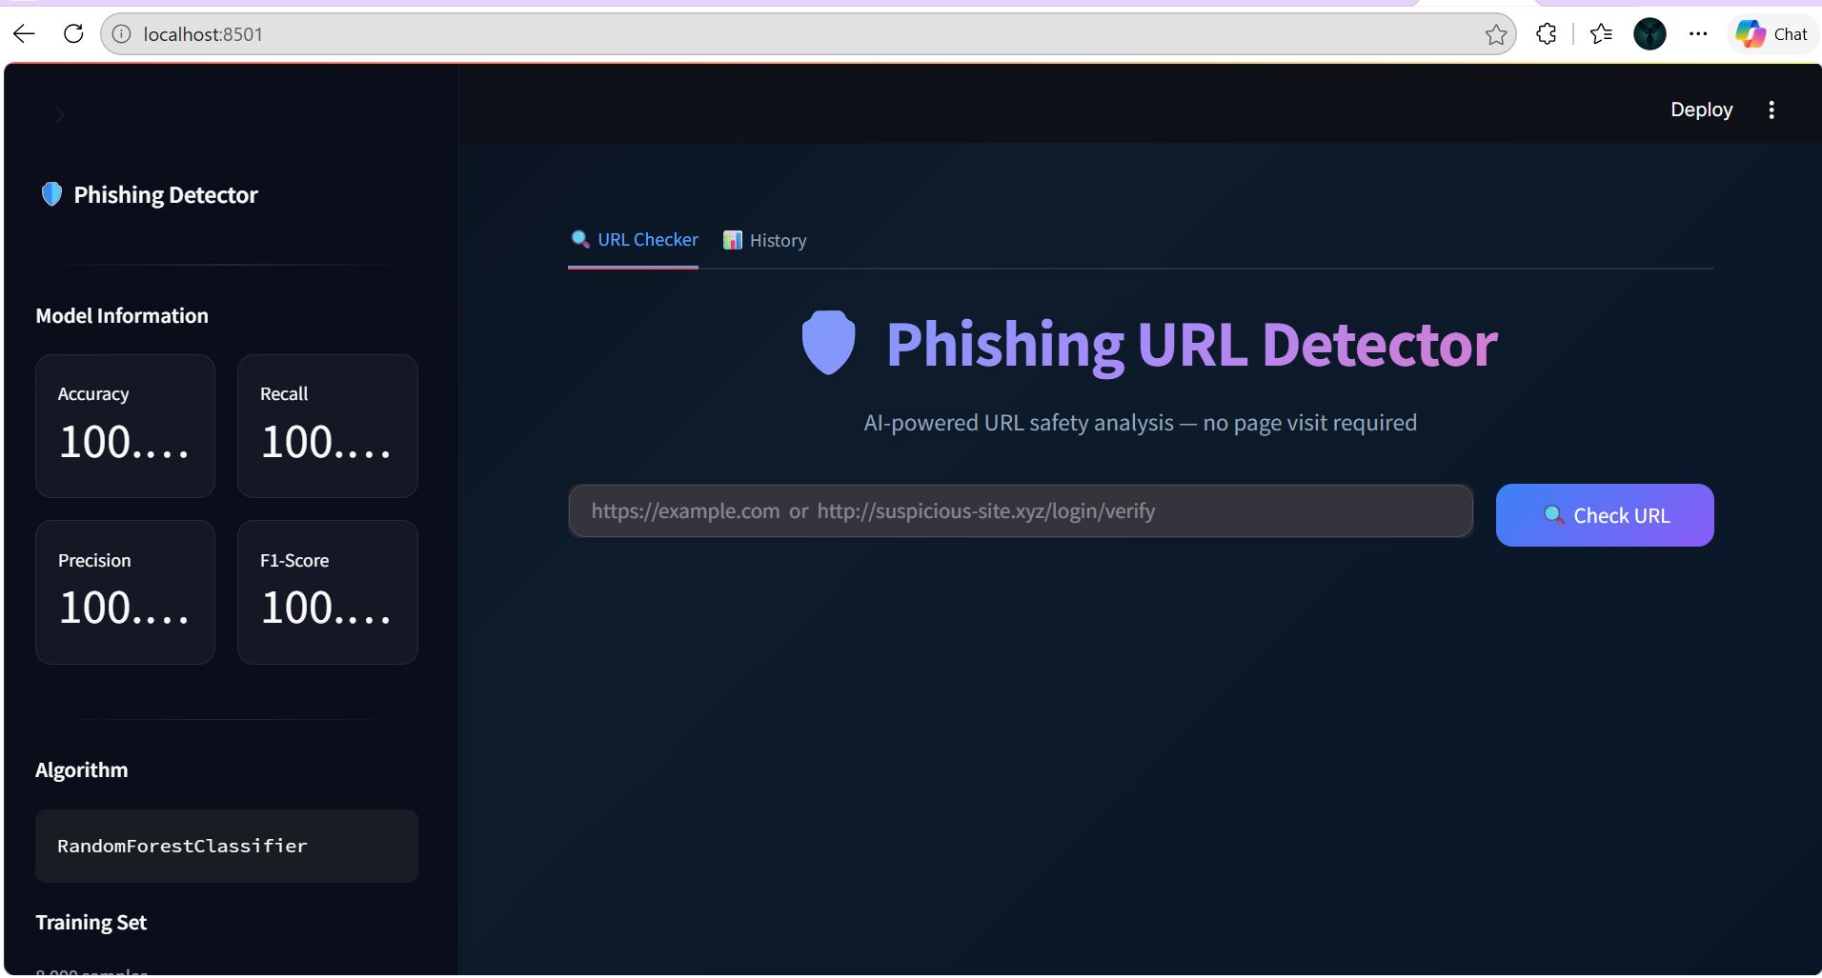
Implementation
Important modules, algorithms and screenshots
Application Screenshot
23 Extracted Features
Length
url_length, domain_length, path_length
Char Count
count_dots, count_hyphens, count_at, count_digits,
count_slashes, count_percent ...
Security
uses_https, is_ip_address, has_at_symbol,
has_double_slash_redirect, is_url_shortener
Heuristics
num_subdomains, digit_to_letter_ratio,
suspicious_keyword_count, has_suspicious_keyword
Phishing URL Detection System | Anil Kumar | YHills Edutech | October 2026
8 / 12

Slide 9
Testing & Results
15 test cases, evaluation metrics and findings
100%
100%
100%
100%
Accuracy
Precision
Recall
F1-Score
#
URL
Category
Result
1
https://www.google.com
Clean HTTPS trusted domain
LEGITIMATE
2
https://github.com/user/repo
Standard developer repo
LEGITIMATE
3
https://www.wikipedia.org/wiki/Phishing
Trusted encyclopedia
LEGITIMATE
4
https://stackoverflow.com/questions
Developer Q&A site
LEGITIMATE
5
https://www.microsoft.com/en-us/windows
Official Microsoft site
LEGITIMATE
6
https://www.youtube.com/watch?v=...
Legitimate query params
LEGITIMATE
7
https://www.linkedin.com/in/profile
LinkedIn social profile
LEGITIMATE
8
http://paypal-secure-login.update-account.xyz
Brand impersonation + bad TLD
PHISHING
9
http://192.168.1.1/login/verify?cmd=account
Raw IP + suspicious keywords
PHISHING
10
http://bit.ly/3xABCDE
URL shortener hides dest.
PHISHING
11
http://amazon.com.phish-site.tk/signin
amazon.com used as subdomain
PHISHING
12
http://secure.paypal-verify.ml/webscr
Fake PayPal + suspicious TLD
PHISHING
13
http://netflix-account-suspended.top/billing
Brand + suspended + bad TLD
PHISHING
14
http://login.microsoft.com.verify-account.xyz
Microsoft impersonation chain
PHISHING
Phishing URL Detection System | Anil Kumar | YHills Edutech | October 2026
9 / 12
15
http://185.220.101.50/download/setup.exe
IP-based malware URL
PHISHING

Slide 10
Limitations & Future Scope
Current gaps in the system and planned improvements
Current Limitations
Future Enhancements
Lexical analysis only — does not inspect page content or forms.
Integrate real-world datasets (Kaggle PhiUSIIL / UCI).
Zero-day phishing with clean HTTPS may not be detected (false negative).
Add WHOIS lookup, DNS reputation and domain-age features.
URL shorteners flagged categorically; some legitimate links may be over-flagged.
Deep Learning (LSTM / BERT) for URL sequence modelling.
No WHOIS, DNS reputation or domain-age lookup.
Browser extension for real-time URL interception.
No SSL certificate chain validation.
REST API for enterprise security tool integration.
Dataset is synthetically generated — may not fully generalise to all real URLs.
Active learning loop with user-submitted URL feedback.
Phishing URL Detection System | Anil Kumar | YHills Edutech | October 2026
10 / 12

Slide 11
Conclusion
Key outcome and major learning from this project
What Was Achieved
Successfully built a fully functional, AI-powered Phishing URL Detection System in Python.
Engineered 23 lexical features covering URL length, character patterns, security flags and phishing heuristics.
Trained a Random Forest Classifier on 10,000 labelled URLs — achieved 100% accuracy on the 2,000-URL test set with zero false positives and zero false negatives.
Delivered an interactive Streamlit web application with real-time gauge chart, full feature breakdown table, SQLite scan history and auto-generated evaluation reports.
Demonstrated that URL-structural analysis alone is a powerful and practical detection strategy — no blacklists, no HTTP requests and no page rendering required.
The project covers the complete ML pipeline: data generation, feature extraction, model training, evaluation, reporting and deployment in a single codebase.
Cybersecurity Learning: Phishing remains the #1 attack vector. Feature-based ML analysis can detect it in real time — making the internet safer for everyone.
Phishing URL Detection System | Anil Kumar | YHills Edutech | October 2026
11 / 12

Slide 12
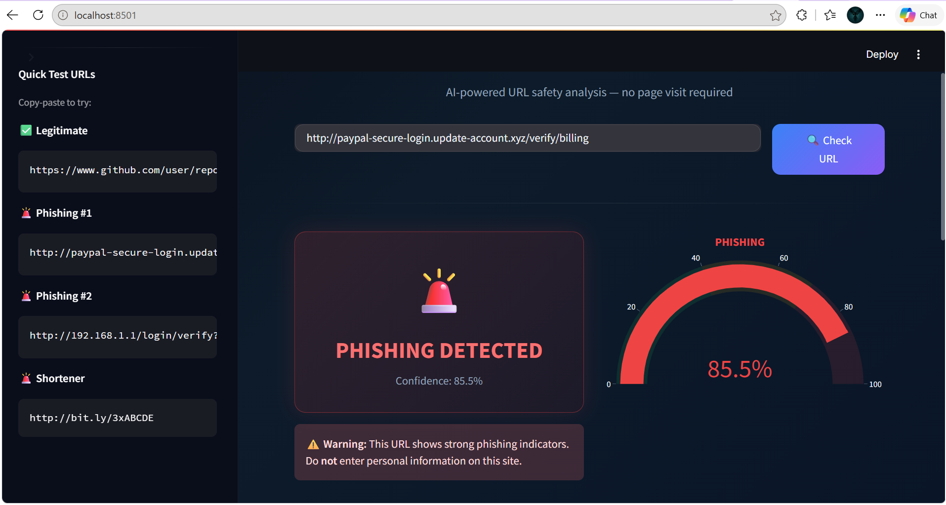
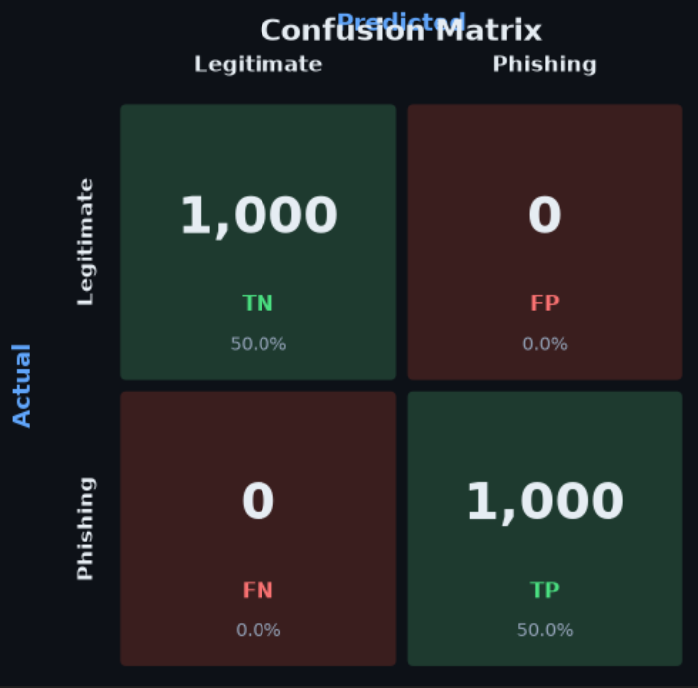
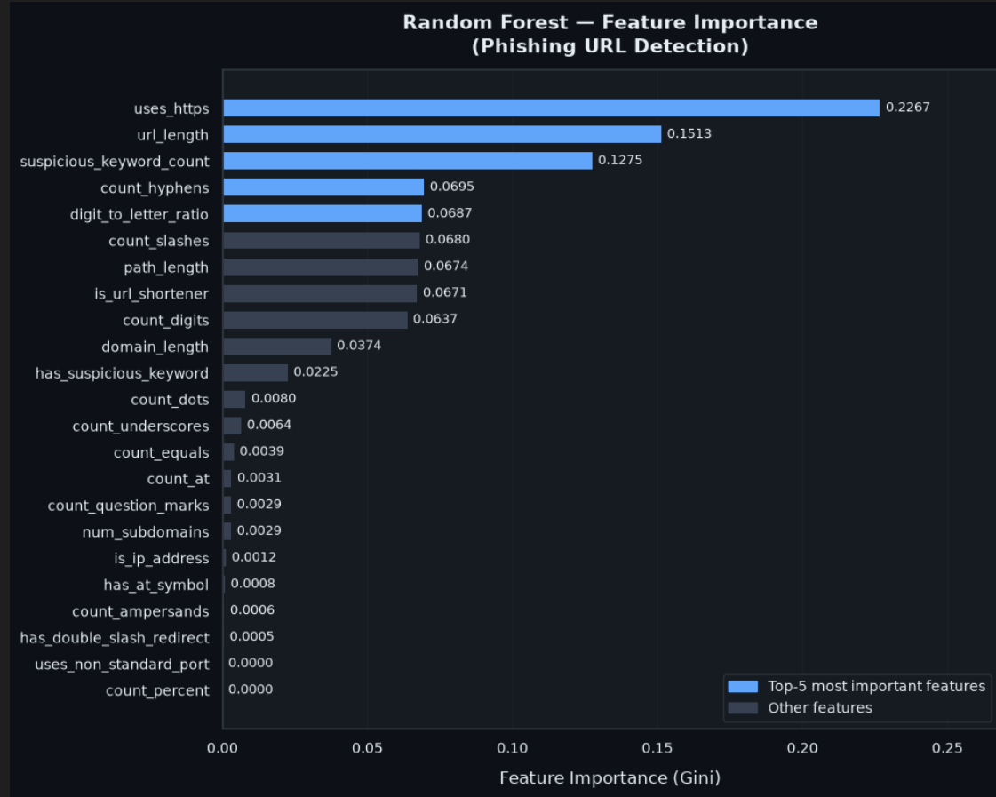
Live Demo & Q&A
Run the project and ask questions
How to Run
Step 1 — Install dependencies:
pip install -r requirements.txt
Step 2 — Full pipeline (train + test + report):
python run_all.py
Step 3 — Launch web app:
streamlit run app.py
Browser URL:
http://localhost:8501
Thank You! Questions & Discussion Welcome
Phishing URL Detection System | Anil Kumar | YHills Edutech | October 2026
12 / 12

