Slide 1
Analytical CRM Development for a Bank
By Anil r

Slide 2
PROBLEM STATEMENT
You are an analytical CRM (Customer Relationship Management) specialist hired by a bank to extract meaningful insights from various customer-related datasets.
The bank aims to reduce customer churn, improve service delivery, and enhance customer satisfaction. They have provided you with datasets including customer demographics, transaction details, customer exit information, and active customer profiles

Slide 3
OBJECTIVES
Identifying unique customers by year
Analyzing the distribution of balance
Identifying the correlation between salary and non-active customers
Credit card ownership across age groups
Analyzing tenure for each age segment
Ranking credit score segments based on churn
Analyzing the impact of credit card
Analyzing the number of products used by customers
Analyzing male and female churn rate
Analyzing the credit score for exited and retained categories
Analyzing Gender Distribution, Average Income, and Customer Count by Country
Reports

Slide 4
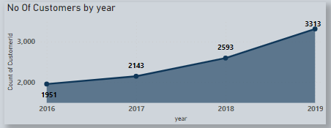
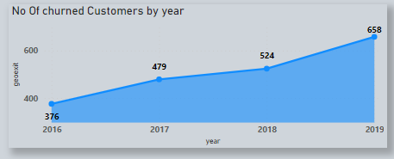
ANALYSING THE customers pattern
The trend of new customers joining bank increasing year on year, in 2019 the maximum number of customers can be observed
Customer churn slightly increased year on year, in 2019 The high number of customers churned can be observed

Slide 5
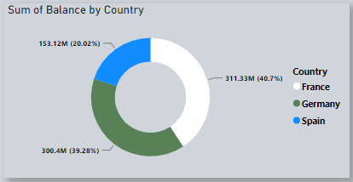
Analyzing the distribution of balance
The account balance distribution across regions reveals France with the highest balance at 311.33 million and Spain with the lowest at 153.12 million.

Slide 6

Analyzing correlation between salary and non-active customers
In the female category, there is a notably higher average estimated salary, despite having fewer active accounts compared to the male category. This suggests that the average estimated salary for females is not correlated with the number of active accounts, indicating potential gender-based disparities in account activity and earnings.

Slide 7
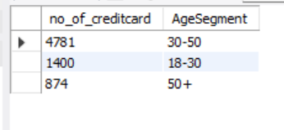
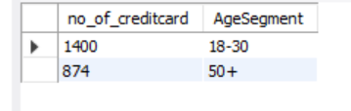
Credit card ownership across age groups
Customers aged between 30-50 exhibit a higher prevalence of credit card ownership, while those above 50 tend to have fewer credit card holders. This age-based analysis suggests a correlation between age demographics and credit card ownership patterns.
Age groups between 18-30 and 50+ demonstrate lower credit card ownership compared to the average credit card holder

Slide 8
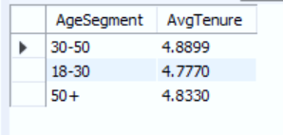
Analyzing tenure for each age segment
Among customer age segments, those aged between 30-50 exhibit the highest average tenure, while customers aged over 50 have a lower average tenure, indicating potential differences in long-term engagement and loyalty across age demographics.

Slide 9
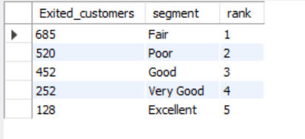
Ranking credit score segments based on churn
The credit score segments are ranked according to customer churn, with the Fair segment experiencing the highest churn rate and thus ranked first. Conversely, the Excellent segment demonstrates the lowest number of customer churn, securing the last rank. This ranking offers insights into the relationship between credit score segments and customer retention rates.

Slide 10
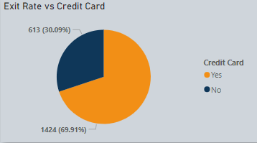
Analyzing the impact of credit card
The chart reveals that customers with a credit card are more prone to leaving the bank compared to those without one. This indicates potential dissatisfaction related to our credit card services. Thus, targeted improvements in this area are recommended.

Slide 11
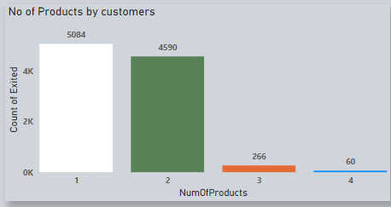
Analyzing the number of products used by customers
Customers heavily utilize Product Number 1, while Product Number 4 sees the least usage among customers, highlighting varying levels of popularity among different products.

Slide 12
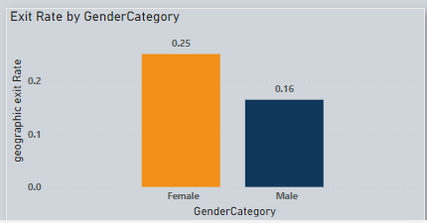
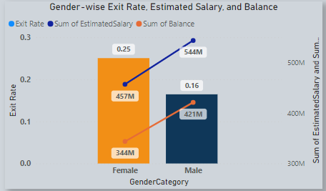
Analyzing male and female churn rate
The female churn rate is more than the male churn rate
Analysis reveals a trend of higher female customer attrition, accompanied by lower estimated salaries and account balances compared to males, suggesting increased financial risk associated with the female demographic for the bank.

Slide 13
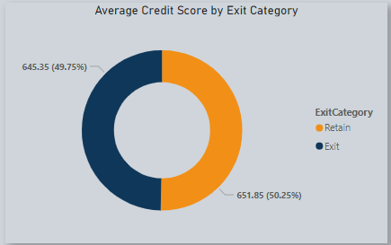
Analyzing the credit score for exited and retained categories
customers who have exited exhibit a lower average credit score in contrast to those who remain, underscoring the significance of creditworthiness in customer retention strategies.

Slide 14
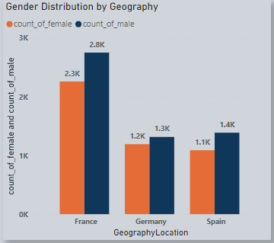
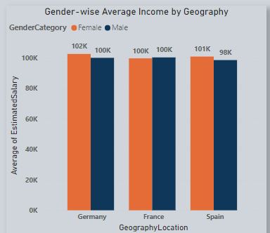
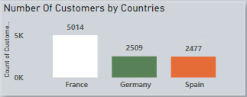
Analyzing Gender Distribution, Average Income, and Customer Count by Country
Male customers outnumber female customers across various countries, indicating a gender disparity in customer demographics on a global scale.
Female customers demonstrate a higher average income compared to male customers in every country analyzed.
France boasts the highest number of customers, while Spain has the lowest customer count among the countries examined.

Slide 15
reports

Slide 16

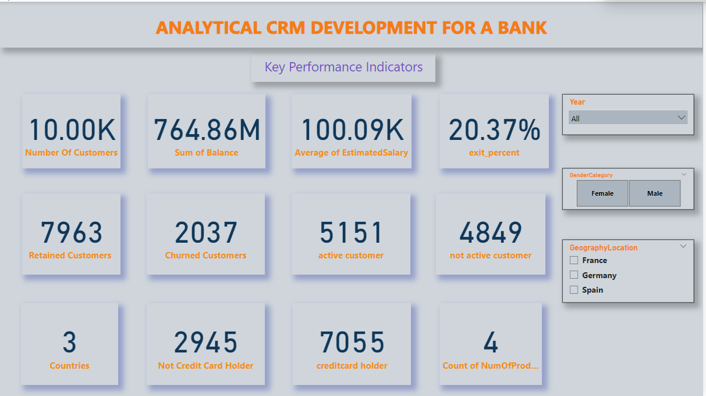

Slide 17
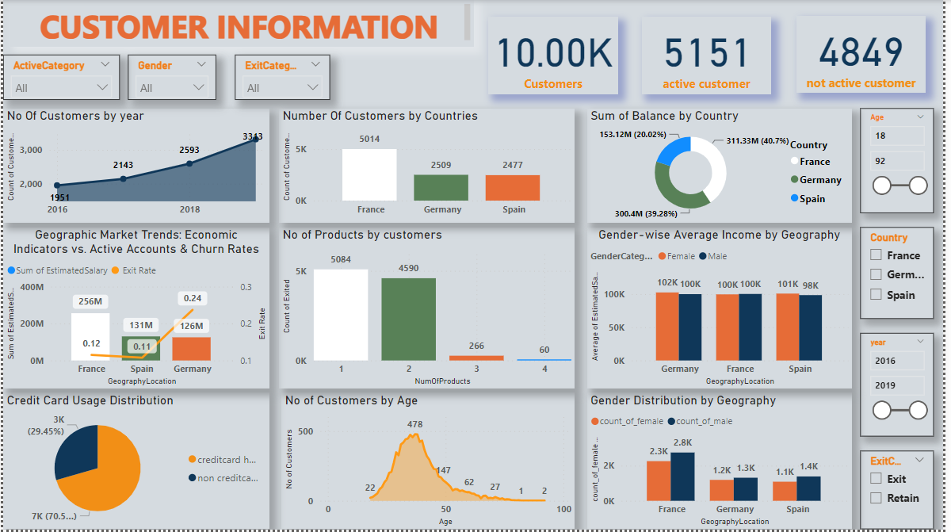

Slide 18
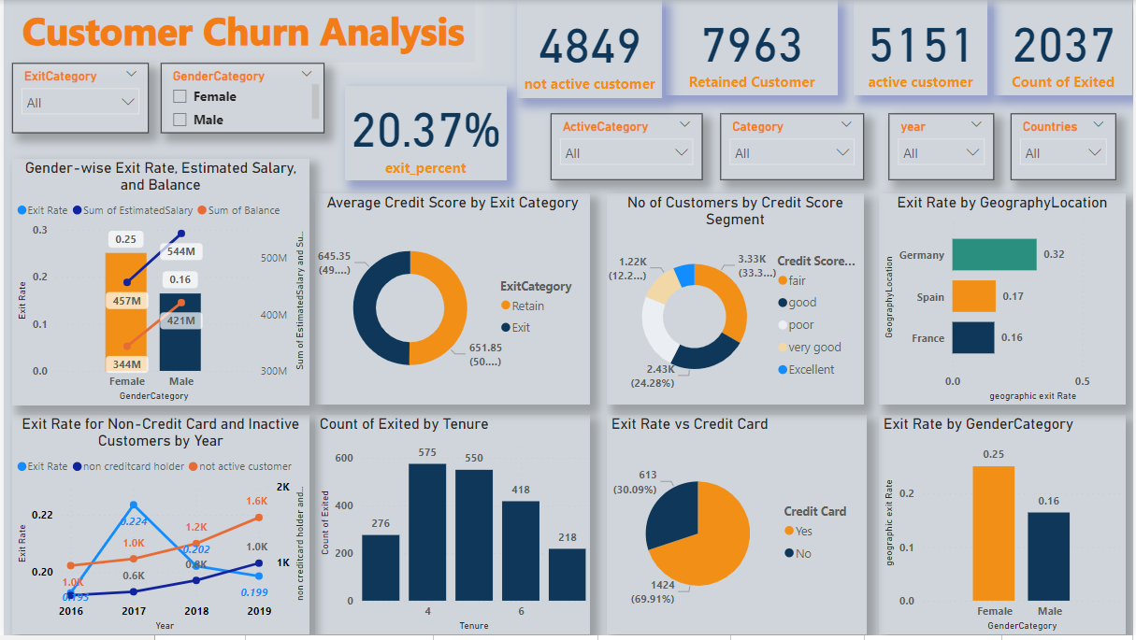

Slide 19
conclusion
In 2019, the bank saw its peak in new customer acquisitions but also experienced increased churn. France leads in customer numbers, with Spain trailing. Despite females having higher incomes, they exhibit higher churn rates and lower balances than males. Customers aged 30-50 own the most credit cards and have the longest tenure. Lower credit scores correlate with higher churn rates. Credit card holders are more likely to leave, suggesting dissatisfaction. Product usage varies, with Product Number 1 being the most popular. Gender disparities persist, with males outnumbering females globally despite their higher income. The bank should focus on retention strategies, especially for females, and address credit card service issues.

Slide 20
Thank you

