Slide 1


Resume Parsing System
This presentation will explore the workings of a resume parsing system, leveraging Natural Language Processing (NLP) techniques to analyze and extract valuable information from resumes.
by J Chiranjevi Anil
192210426

Slide 2
Natural Language Processing (NLP) Techniques
1
Tokenization
2
Part-of-Speech Tagging
The process of breaking down text into individual words or units, known as tokens.
Assigning grammatical categories (e.g., noun, verb, adjective) to each token in the text.
3
Named Entity Recognition
4
Sentiment Analysis
Identifying and classifying entities like names, locations, and organizations within the text.
Determining the emotional tone and subjective opinions expressed in the resume.

Slide 3
Data Preprocessing and Extraction
Data Cleaning
Data Transformation
Feature Extraction
Removing noise, inconsistencies, and irrelevant information from the resume data.
Converting the raw text data into a structured format suitable for analysis and processing.
Identifying and extracting relevant features from the resume data, such as skills, experience, and education.
This may involve handling formatting issues, removing special characters, and standardizing the data.
This may involve converting dates, addresses, and other relevant information into standardized formats.
These features will be used for further analysis and matching.

Slide 4
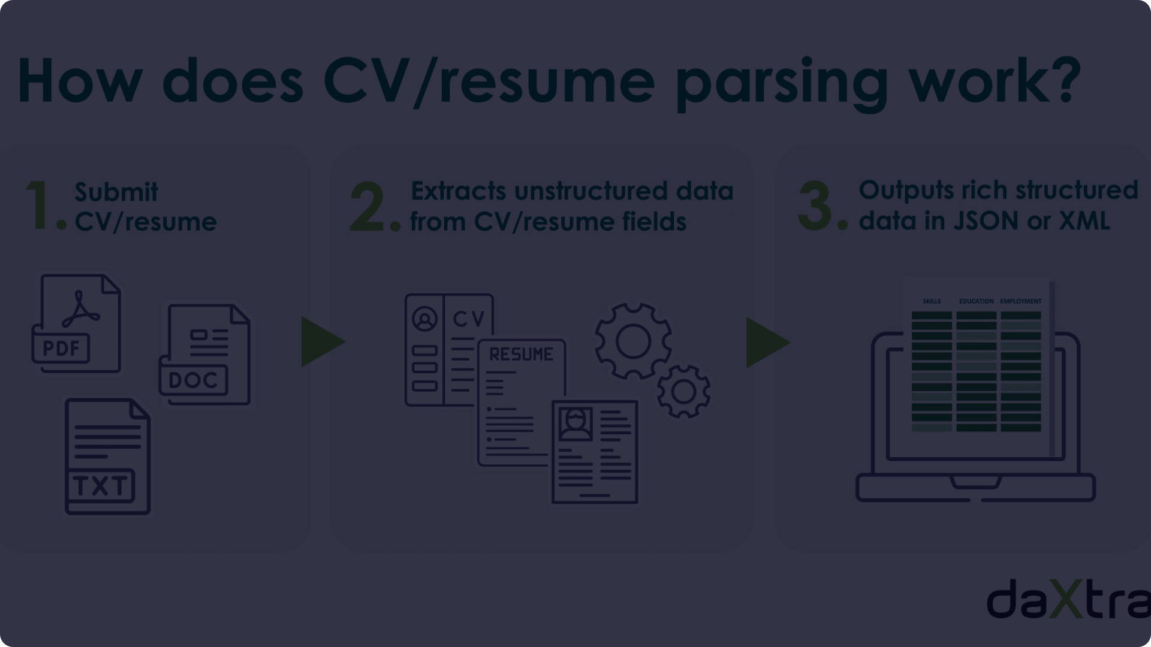



Resume Parsing Algorithms
Rule-Based Parsing
Machine Learning
Deep Learning
Utilizing predefined rules and patterns to identify and extract information from resumes.
Training models on a labeled dataset of resumes to learn patterns and predict information.
Employing neural networks to process and understand complex language structures in resumes.

Slide 5
Skill Extraction and Matching
Keyword Extraction
Identifying relevant keywords and skills from the resume text.
Skill Matching
Comparing extracted skills with job requirements to find suitable candidates.
Semantic Similarity
Determining the degree of similarity between extracted skills and job requirements, taking into account synonyms and related concepts.

Slide 6

Resume Scoring and Ranking
1
Candidate Scoring
Assigning numerical scores to each candidate based on their skills, experience, and other factors.
2
Ranking
Sorting candidates based on their scores to identify the most qualified candidates for the job.
3
Shortlisting
Creating a shortlist of the top-ranked candidates for further review and consideration.

Slide 7



Recruitment Processes
Interview Scheduling
Feedback Collection
Offer Generation
Automating the scheduling of interviews with shortlisted candidates.
Gathering feedback from interviewers on candidates' performance.
Generating personalized job offers based on candidates' qualifications and expectations.

Slide 8
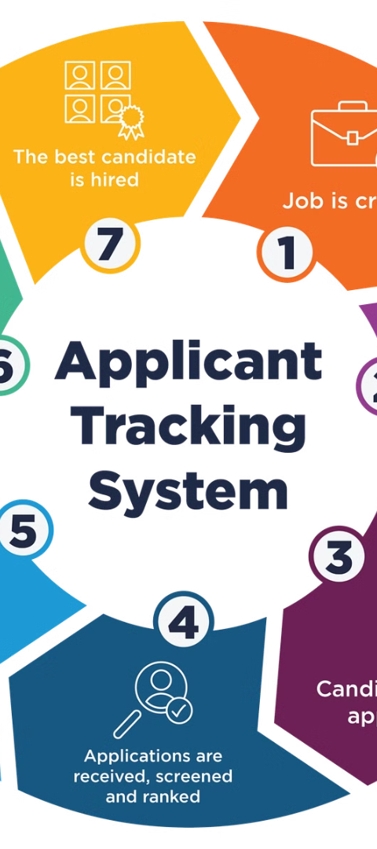
Applicant Tracking and Reporting
Applicant Database
Progress Tracking
Maintaining a centralized database of all applicants, including their resumes and application status.
Monitoring the progress of candidates through the recruitment process.
Reporting
Generating reports on recruitment metrics, such as time-to-hire and candidate flow.

Slide 9


Conclusion and Future Enhancements
Resume parsing systems are continuously evolving with advancements in NLP and AI. Future enhancements may include incorporating advanced language models, improved skill extraction techniques, and integration with other recruitment technologies.

Slide 10


