Slide 1
Cannon’s Algorithm

Slide 2
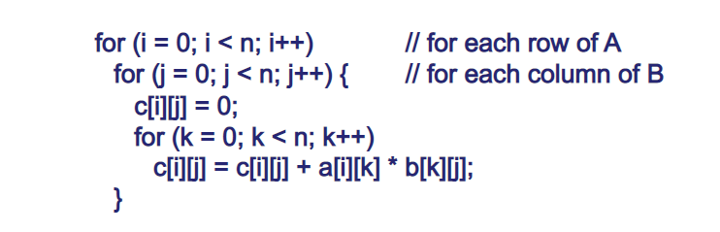

Sequential Matrix Multiplication
Assume throughout that matrices square (NxN)
Sequential code to compute AxB could be like this;
Requires $n^{3}$ multiplications and $n^{3}$ additions
Time complexity O($n^{3}$)

Slide 3
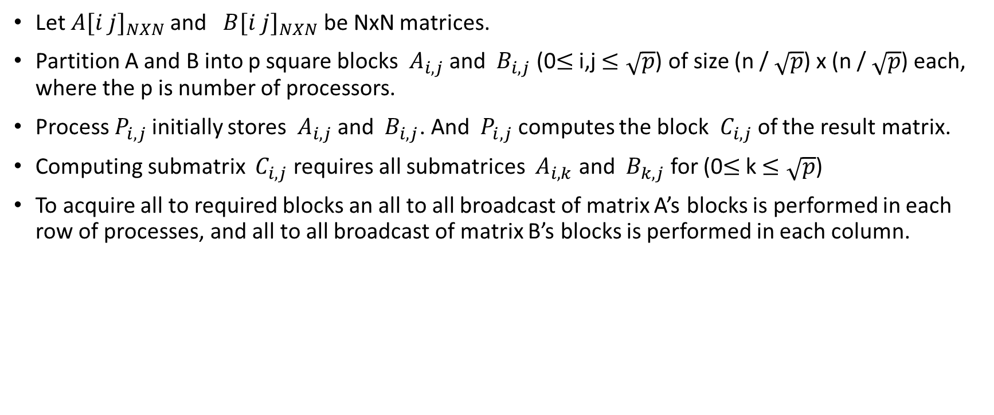
Simple Parallel Algorithm
Let${ A[i j]}_{NXN}$ and ${ B[i j]}_{NXN}$ be NxN matrices.
Partition A and B into p square blocks ${ A}_{i,j}$ and ${ B}_{i,j}$ (0$≤$ i,j $≤\sqrt{p}$) of size (n / $\sqrt{p}$) x (n / $\sqrt{p}$) each, where the p is number of processors.
Process${ P}_{i,j}$ initially stores ${ A}_{i,j}$ and ${ B}_{i,j}$. And ${ P}_{i,j}$ computes the block ${ C}_{i,j}$ of the result matrix.
Computing submatrix ${ C}_{i,j}$ requires all submatrices ${ A}_{i,k}$ and ${ B}_{k,j}$ for (0$≤$ k $≤\sqrt{p}$)
To acquire all to required blocks an all to all broadcast of matrix A’s blocks is performed in each row of processes, and all to all broadcast of matrix B’s blocks is performed in each column.

Slide 4
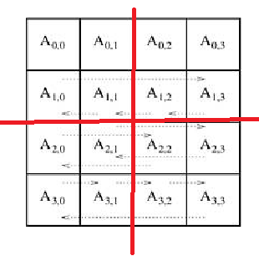
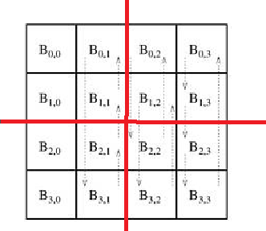
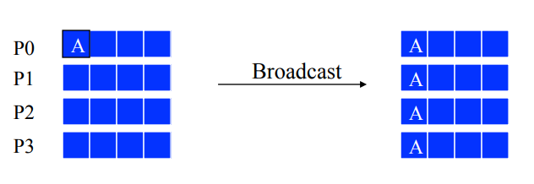

Simple Parallel Algorithm
Let A and B be 4x4 matrices. And let the number of precessor is 4
${ C}_{0,0}$ = ${ A}_{0,0}$ . ${ B}_{0,0}$ + ${ A}_{0,1}$ . ${ B}_{1,0}$ + ${ A}_{0,2}$ . ${ B}_{2,0}$ + ${ A}_{0,3}$ . ${ B}_{3,0}$ (we need other blocks)
All to All Broadcast

Slide 5

Disadvantages of Simple Parallel Algorithm
Not memory efficient
- Each process ${ P}_{i,j}$ has $2\sqrt{p}$ blocks of ${ A}_{i,k}$ and ${ B}_{k,j}$ at the end of communication phase
- Each process needs O$(n^{2}$/$\sqrt{p}$) memory
- Total memory over all the processes is O$(n^{2} x \sqrt{p}$), which is $\sqrt{p}$ times of the sequential algorithm

Slide 6
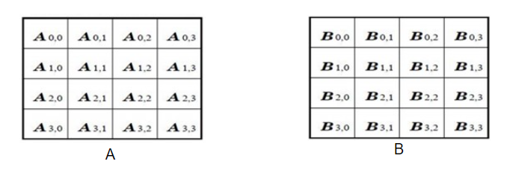
Cannon’s Algorithm
Cannon’s algorithm is a distributed algorithm for matrix multiplication for two-dimensional meshes first described in 1969 by Lynn Elliot Cannon.
It is especially suitable for NxN meshs. Cannon’s algorithm works well in homogeneus 2D grids.
Memory efficient algorithm.

Slide 7
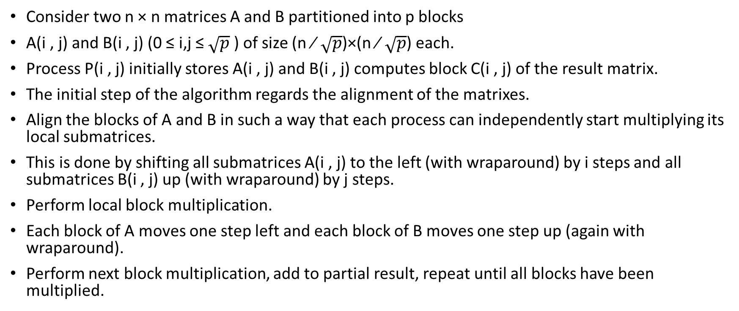
Cannon’s Algorithm
Consider two n × n matrices A and B partitioned into p blocks
A(i , j) and B(i , j) (0 ≤ i,j ≤ $\sqrt{p}$ ) of size (n ∕ $\sqrt{p}$)×(n ∕ $\sqrt{p}$) each.
Process P(i , j) initially stores A(i , j) and B(i , j) computes block C(i , j) of the result matrix.
The initial step of the algorithm regards the alignment of the matrixes.
Align the blocks of A and B in such a way that each process can independently start multiplying its local submatrices.
This is done by shifting all submatrices A(i , j) to the left (with wraparound) by i steps and all submatrices B(i , j) up (with wraparound) by j steps.
Perform local block multiplication.
Each block of A moves one step left and each block of B moves one step up (again with wraparound).
Perform next block multiplication, add to partial result, repeat until all blocks have been multiplied.

Slide 8
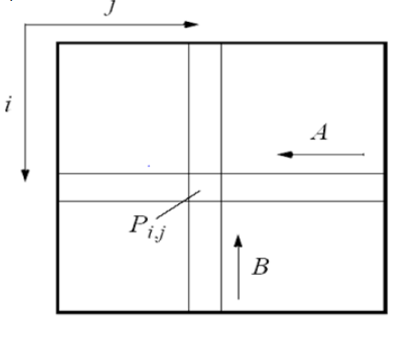

Cannon’s Algorithm - Initialization
Initially processor ${ P}_{i,j}$ has elements $A_{i,j}$ and $B_{i,j}$

Slide 9
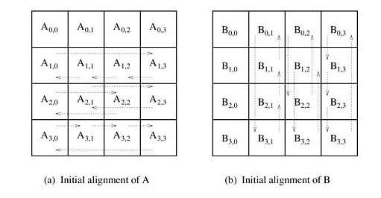
Cannon’s Algorithm - Initialization
The communication steps in Cannon's algorithm on 16 processes.

Slide 10
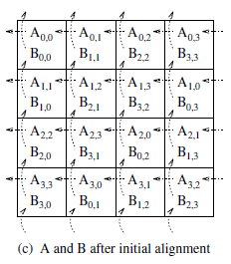
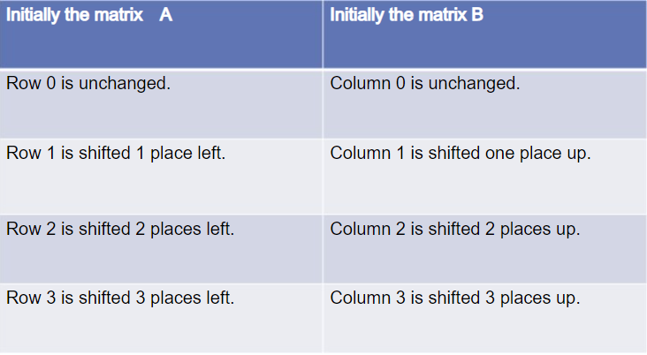
Cannon’s Algorithm – Initial Alignment
Alignment Rule
=>

Slide 11
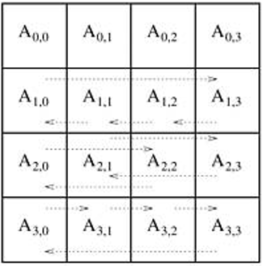
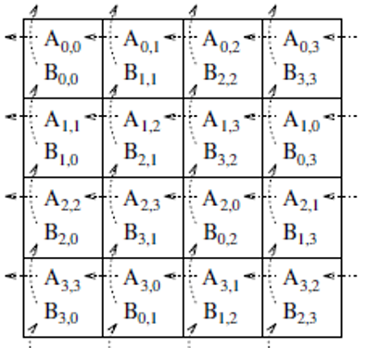
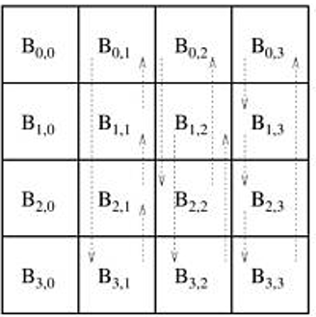
Cannon’s Algorithm – Initial Alignment
Comparision positions of initializaiton and alignment.
=>

Slide 12
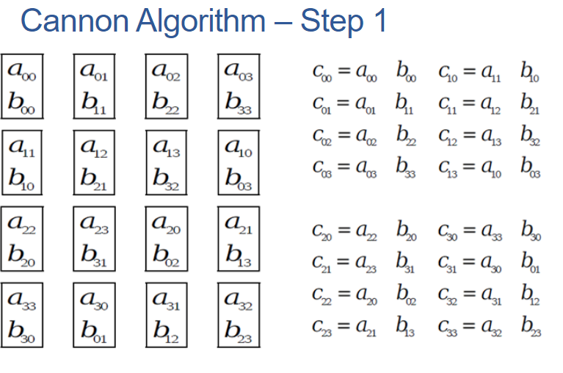
Cannon’s Algorithm – Initial Alignment
=>

Slide 13
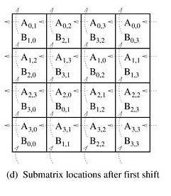
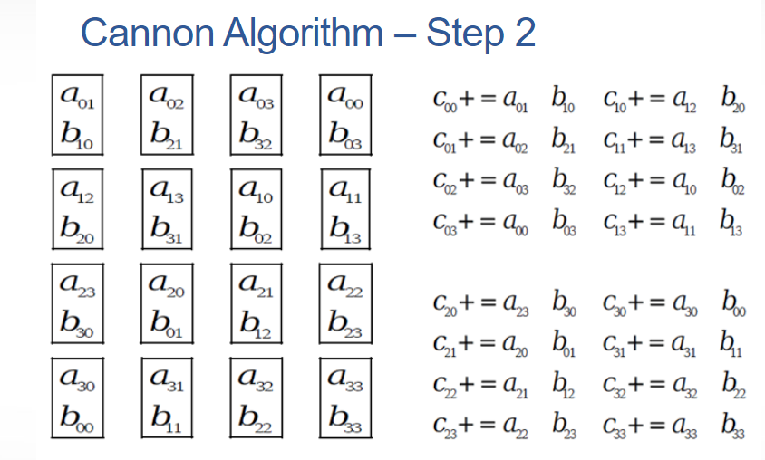
Cannon’s Algorithm – First Shift
Each block of A moves one step left and each block of B moves one step up
=>

Slide 14
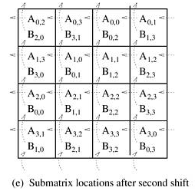
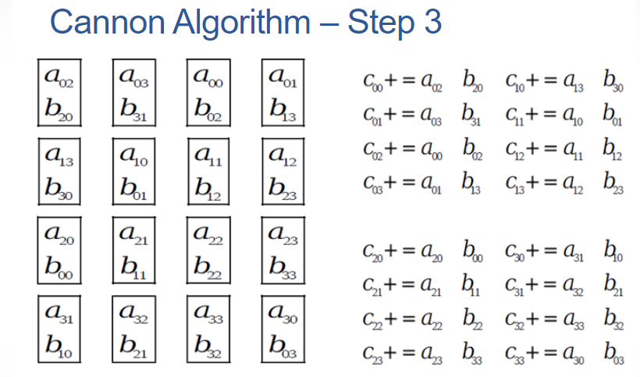
Cannon’s Algorithm – Second Shift
Each block of A moves one step left and each block of B moves one step up
=>

Slide 15
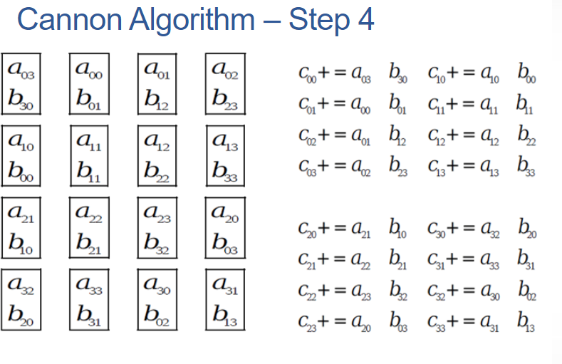
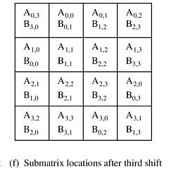
Cannon’s Algorithm – Third Shift
Each block of A moves one step left and each block of B moves one step up
=>

Slide 16
Analysis Of Cannon’s Algorithm
It’s especially suitable for NxN mesh.
The main advantage of the algorithm is that its storage requirements remain constant and are independent of the number of processors.
A disadvantage of the algorithm is that there are many connection setups with small message sizes. It would be better to able to transmit more data in each message.

Slide 17
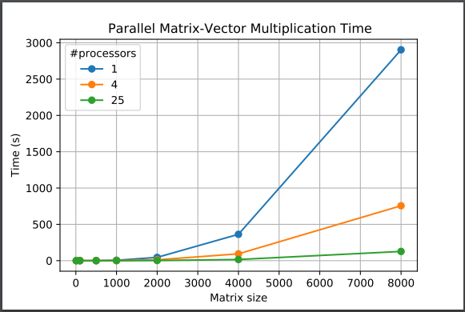
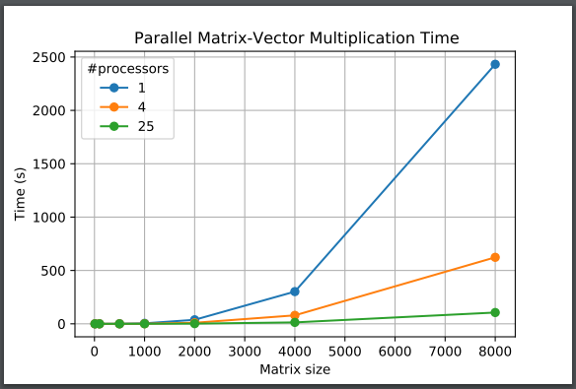
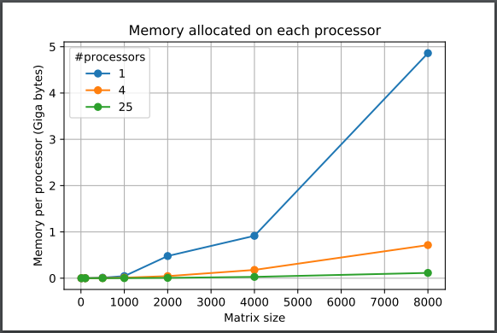
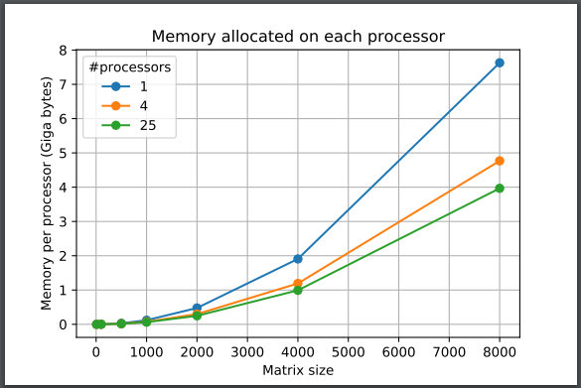
Cannon Parallel

