Slide 1
International Cricket Player Performance Analysis
BY : Yogesh, pranay,NagulMeera

Slide 2

Introduction
The goal of this endeavor is to find the best cricketers who can promote a company's goods as brand ambassadors. the project will employ a dataset of performance parameters for many cricketers, including batting average, strike rate, total runs scored, number of boundaries, and span. to rate the cricketers according to their performance, the analysis will use exploratory data analysis, and data cleaning and preparation. the report will provide a thorough discussion of the methodology utilized, the performance indicators chosen, and the top five cricketers' final rankings. the organization will use the findings to improve its marketing approach and brand image.

Slide 3


Problem definition
A company is seeking to identify the top-performing cricketers who can serve as brand ambassadors for their products. To achieve this objective, the company has provided a dataset that includes a range of performance metrics for many cricketers, including batting average, strike rate, total runs scored, number of boundaries, and span. The analysis project aims to identify the top 5 cricketers based on their overall performance, as determined by a weighted combination of their batting statistics.
The project will involve a multi-step analysis approach, starting with data cleaning and preprocessing to ensure that the data is consistent, complete, and accurate. Exploratory data analysis will be performed to identify any trends or relationships that can inform the weighting scheme used to rank the cricketers. Next, machine learning algorithms will be used to rank the cricketers based on their performance, considering both batting and bowling statistics.
The limitations of the analysis include the availability and completeness of the data, as well as the potential for bias in the selection of performance metrics and the weighting scheme used. The analysis will focus on cricketers who have played in at least five international matches across all formats. The results of the analysis will be used by the company to identify the cricketers with the highest potential to endorse their products and enhance their brand image.
The project will deliver a comprehensive report detailing the methodology used, the performance metrics selected, the weighting scheme used, and the final ranking of the top five cricketers. The report will also highlight any insights or trends identified during the analysis, as well as any limitations or areas for future improvement. The report will serve as a valuable tool for the company to make informed decisions about their marketing strategy and product endorsement deals.

Slide 4
Data set
I am using three datasets related to cricket players, countries, and batting statistics. Here's a brief explanation of each dataset:
The player dataset contains information about individual cricket players, including their name, gender, batting and bowling styles, playing role, and the country they represent.
The country dataset contains information about the countries represented in international cricket, including their unique identifier and name.
The batting statistics dataset contains information about the performance of individual cricket players with respect to their batting, including the number of matches and innings played, total runs scored, highest score, batting average, strike rate, number of centuries, half-centuries, and ducks (i.e., Dismissed without scoring any runs), as well as the number of fours and sixes scored.
Together, these datasets can be used to analyze the performance of cricket players across different countries and identify the top performers in terms of their batting statistics.
Reference: https://www.Kaggle.Com/datasets/ijajdatanerd/intl-cricketer-stats-odi-t20-tests

Slide 5
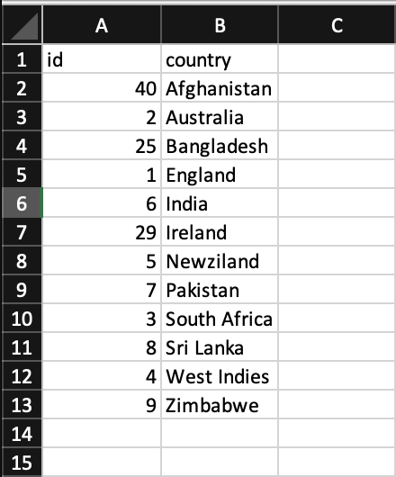
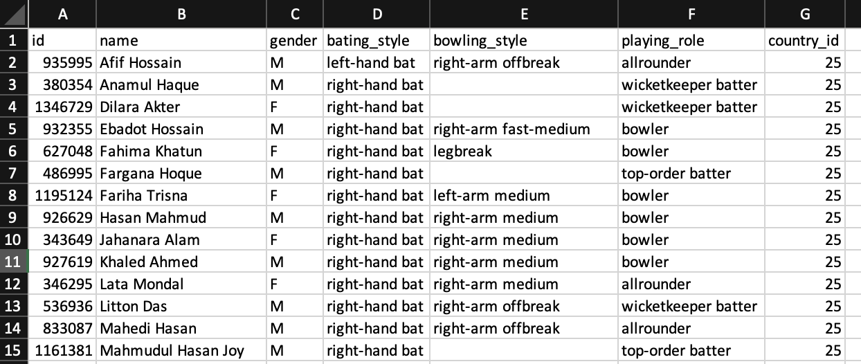
Sample data ( Country & Players ) - Structured

Slide 6
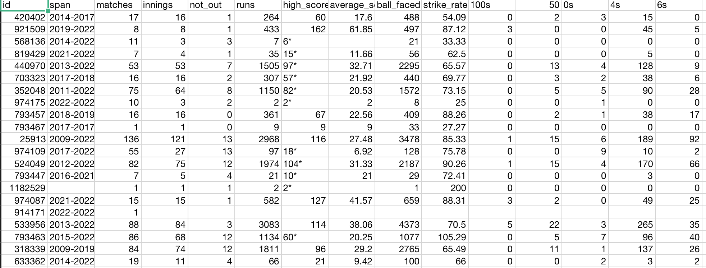
Sample data ( Player’s batting stats )- Structured

Slide 7
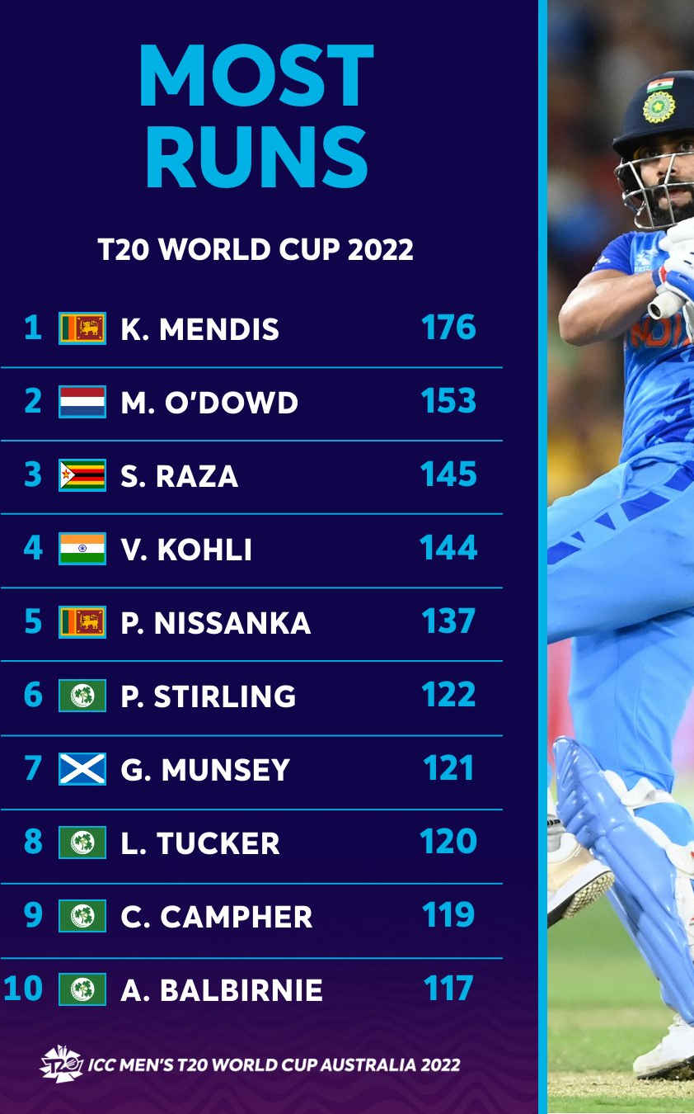
Sample data Text file & Image
Ishan Kishan IND 498.0 t20
Hazratullah AFG 537.0 t20
Afif Hossain BAN 486.0 t20
Jos Buttler ENG 670.0 t20
Moeen Ali ENG 498.0 t20
Matthew Wade AUS 448.0 t20
Virat Kohli IND 612.0 t20
Babar Azam PAK 778.0 t20
Kane Williamson NZ 513.0 t20

Slide 8
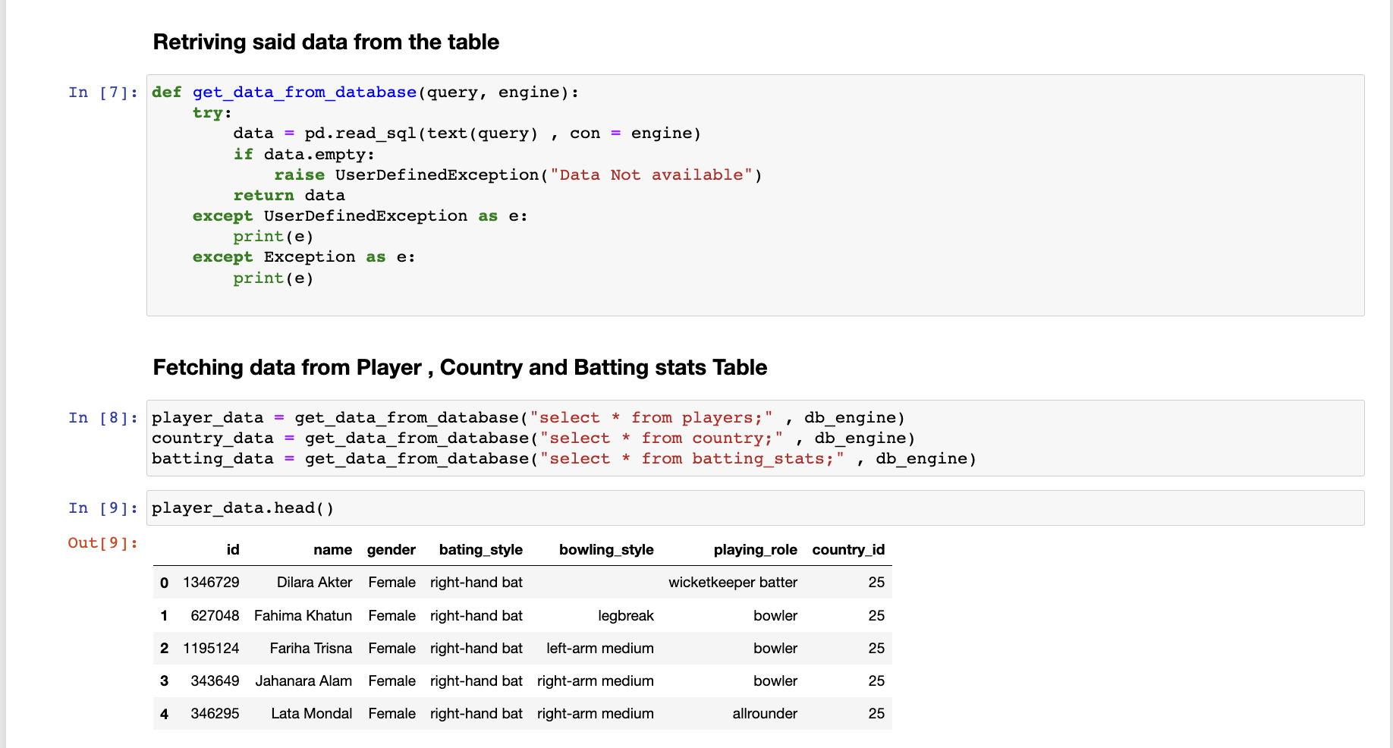
Retrieving data from data base

Slide 9
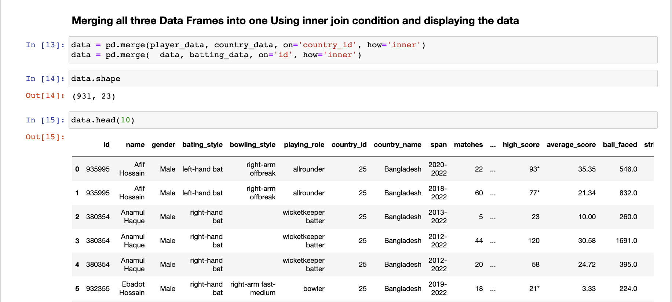
Merging all the data frames

Slide 10
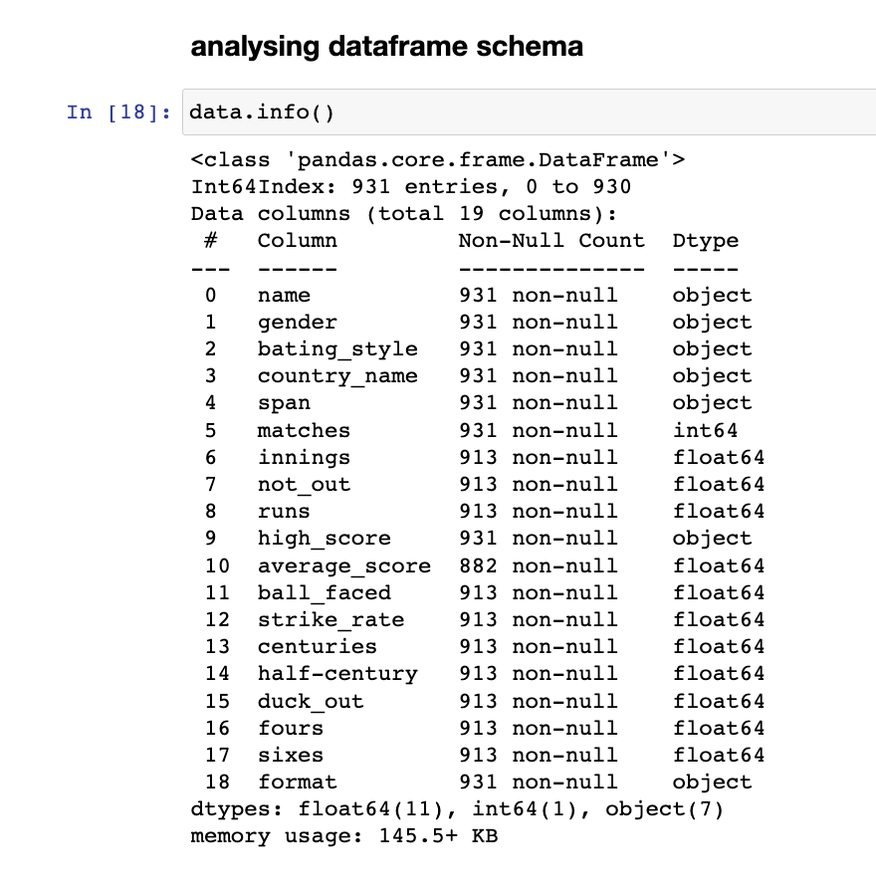
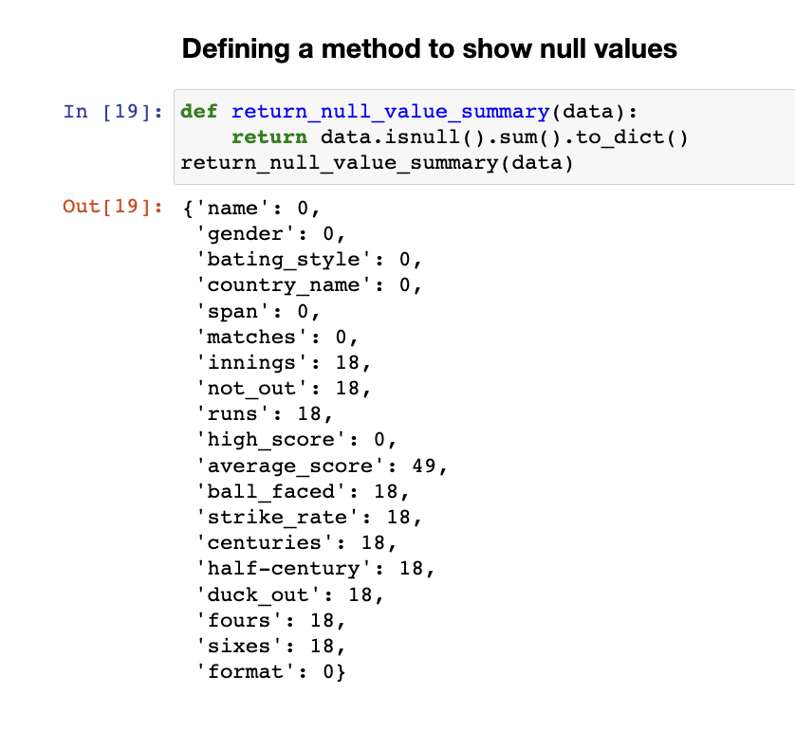
Analyzing data frame

Slide 11
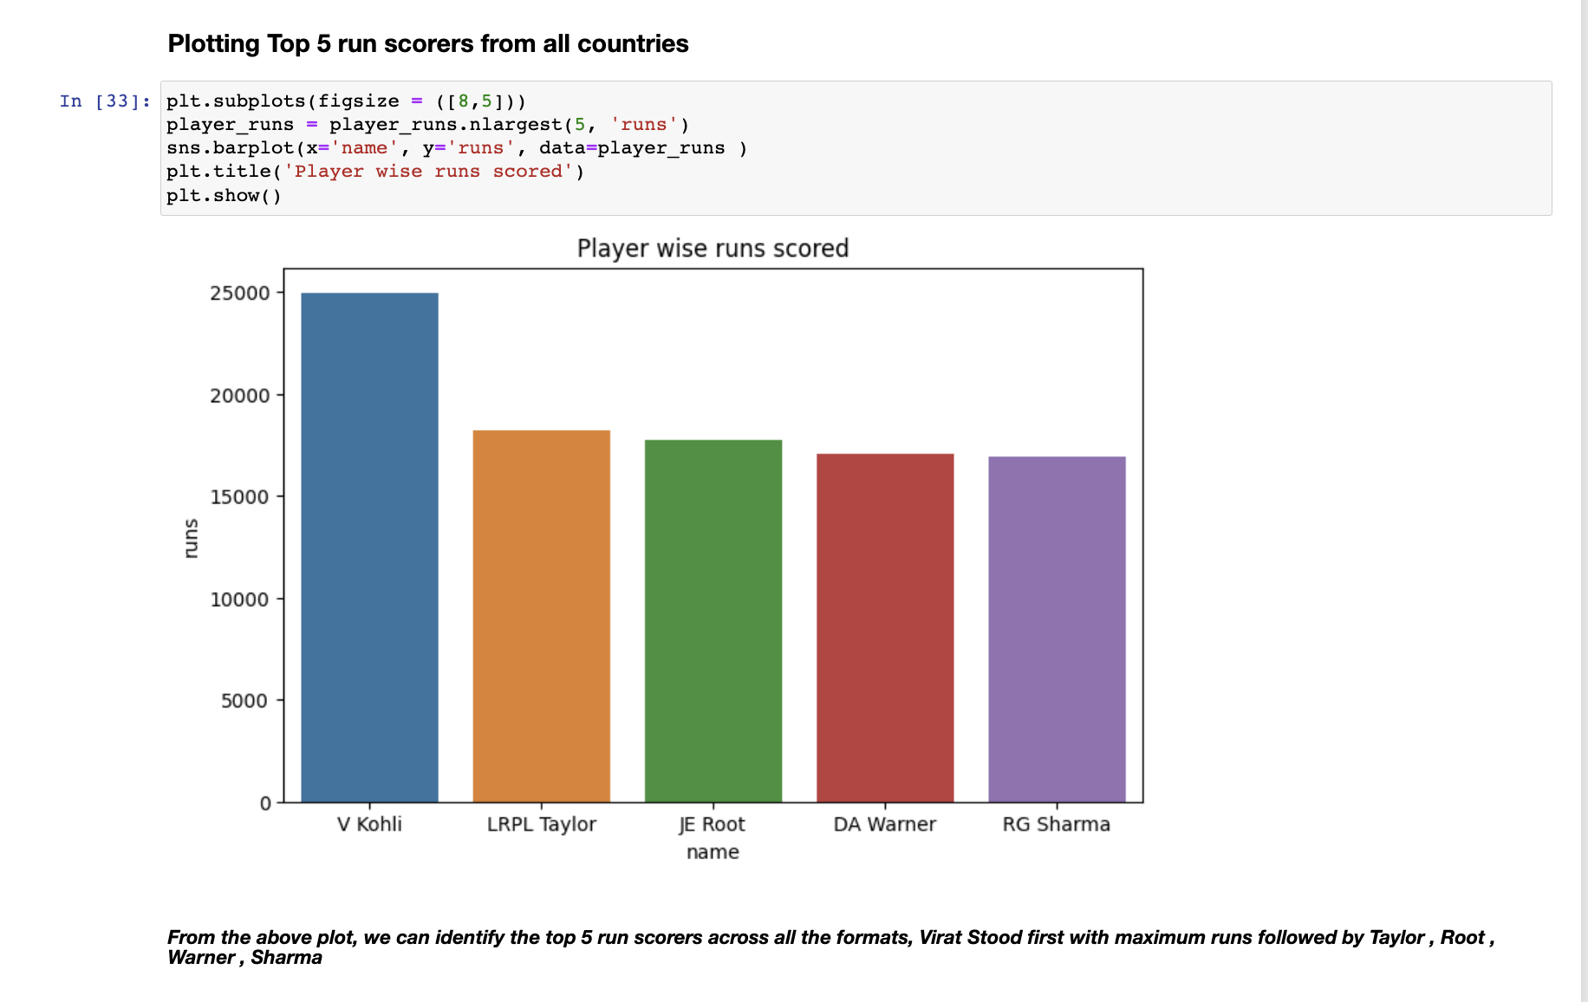
Visualizing TOP-5 Run Getters (ALL formats)

Slide 12
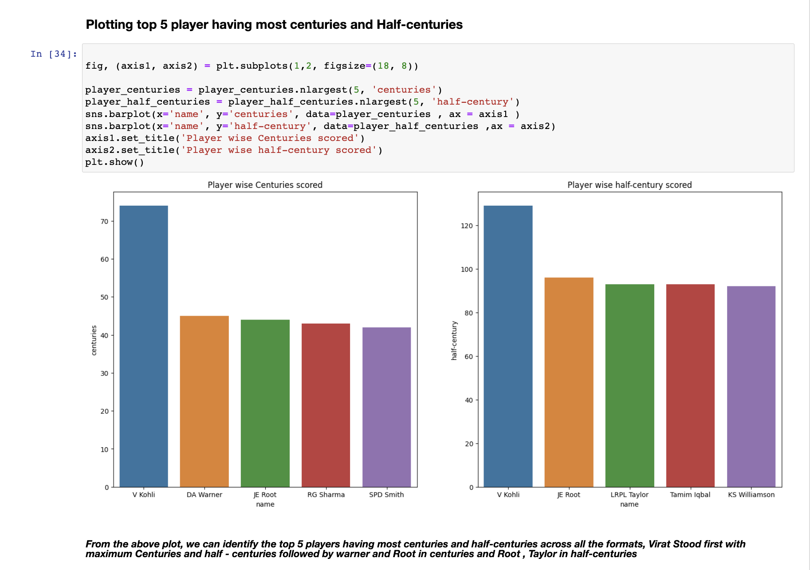
Visualizing TOP-5 100’s & 50’s (ALL formats)

Slide 13
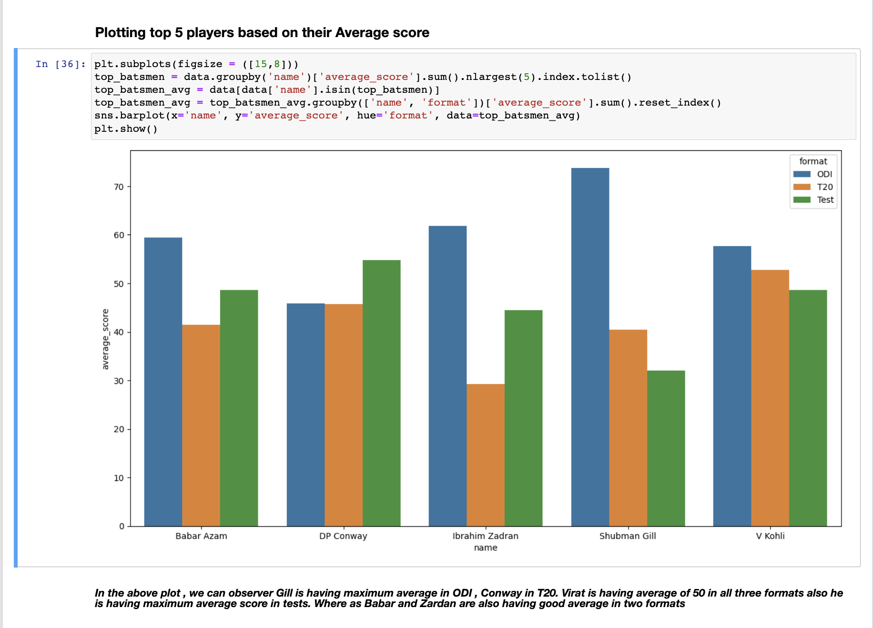
Visualizing Best Avg Scores ( Format wise)

Slide 14
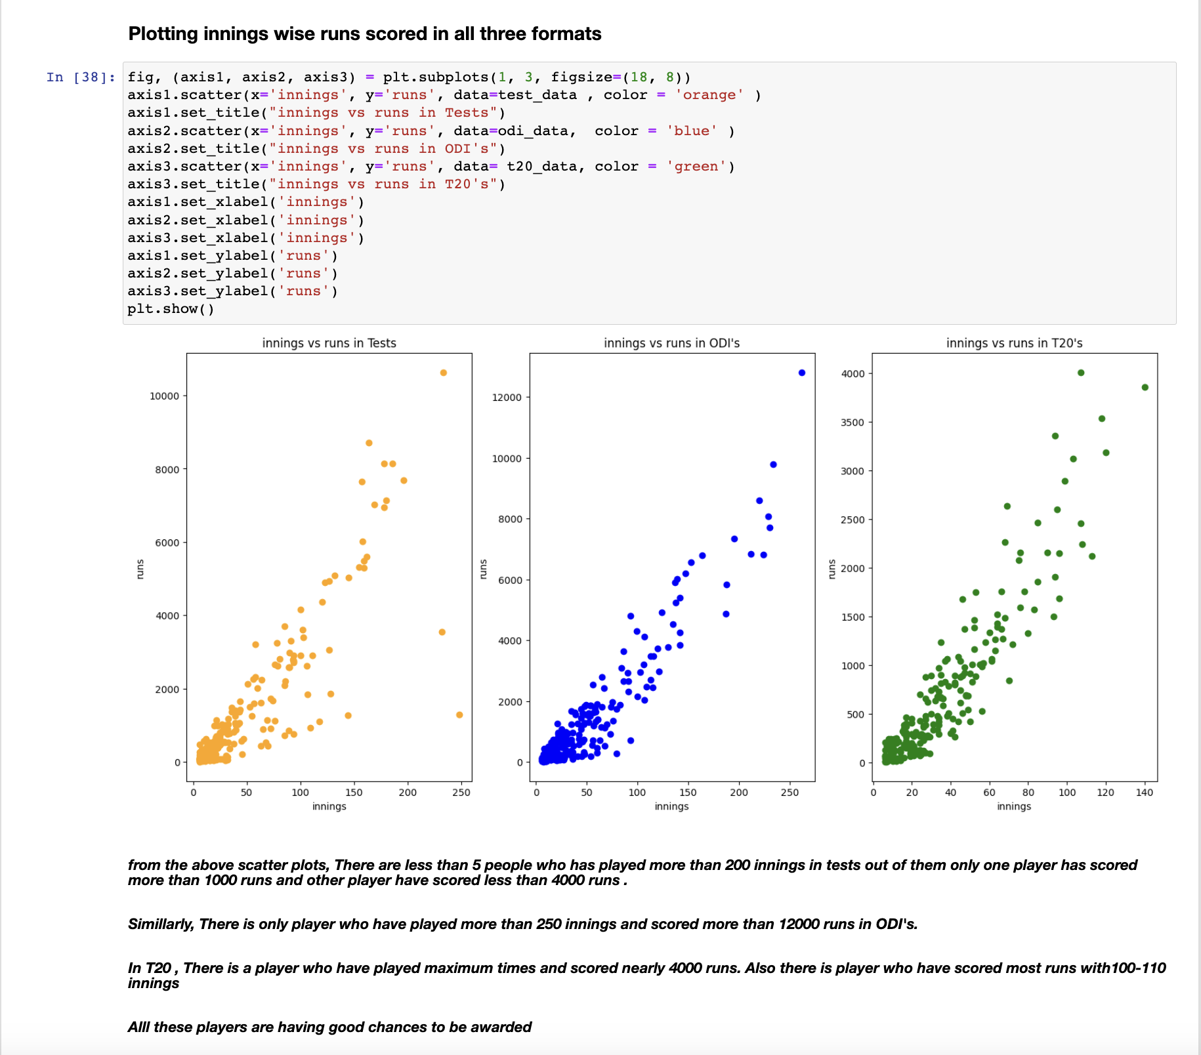
Visualizing Runs vs Innings ( Format wise)

Slide 15
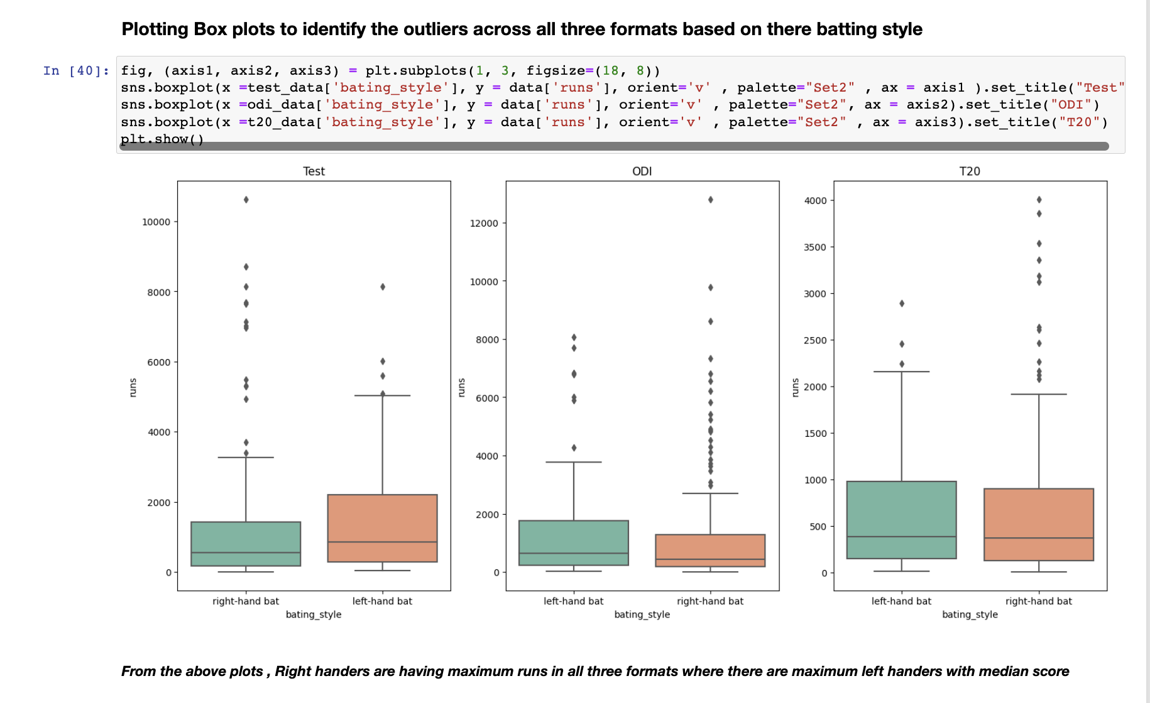
Plotting Batting Style vs Runs ( Format wise)

Slide 16
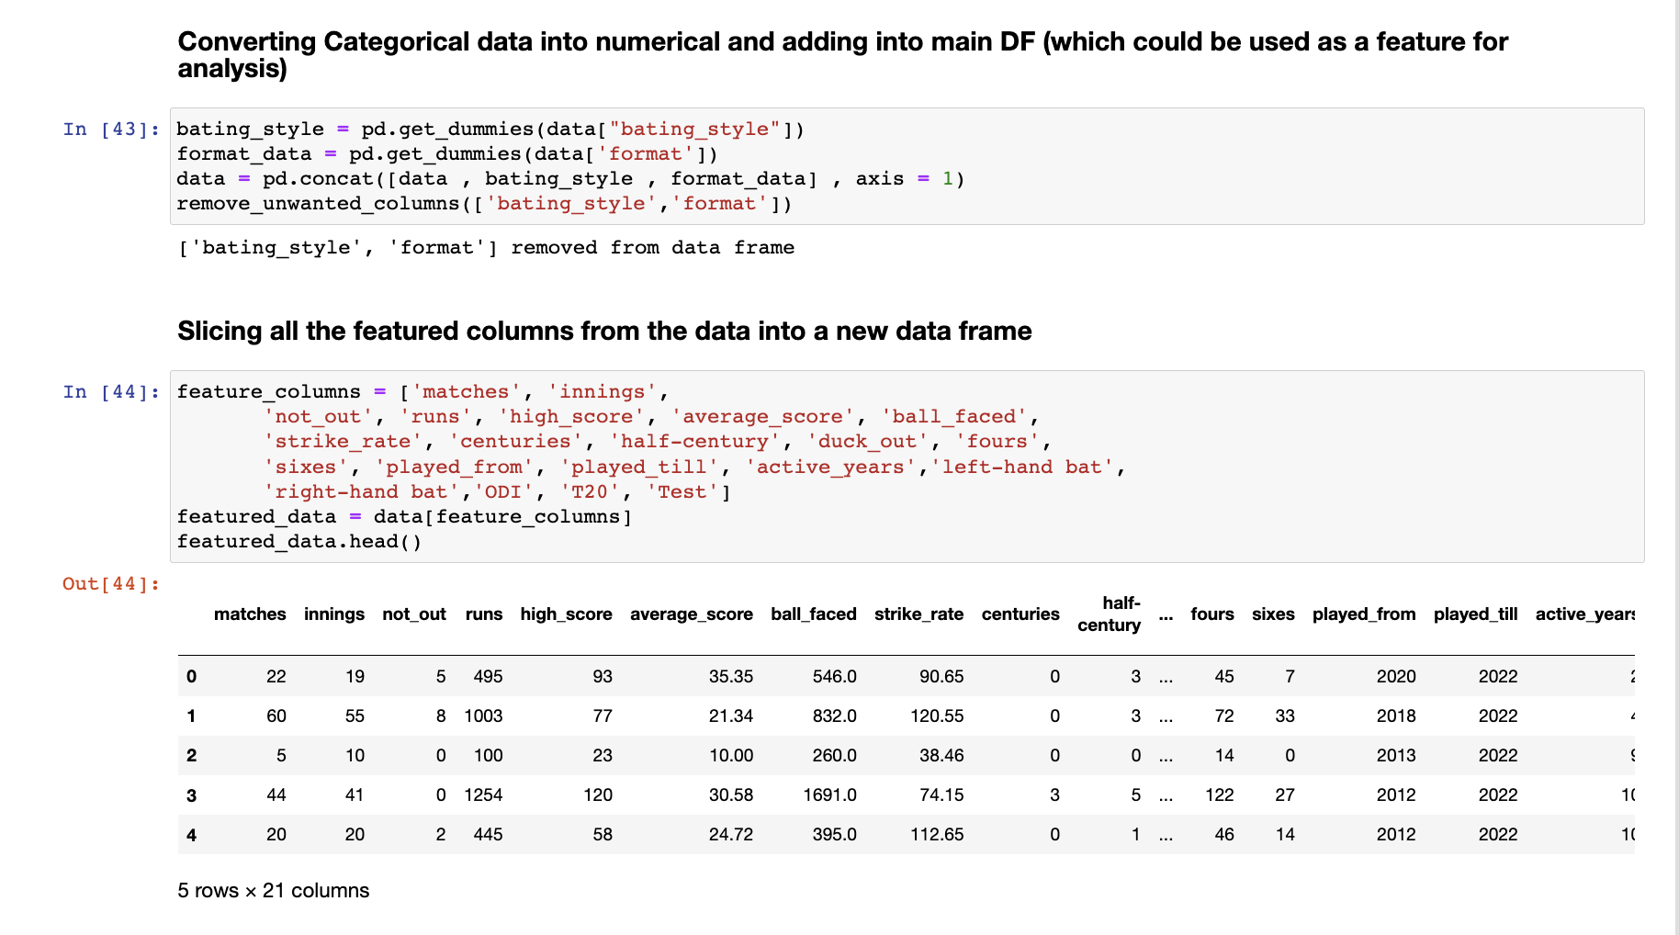
Data Pre-processing

Slide 17
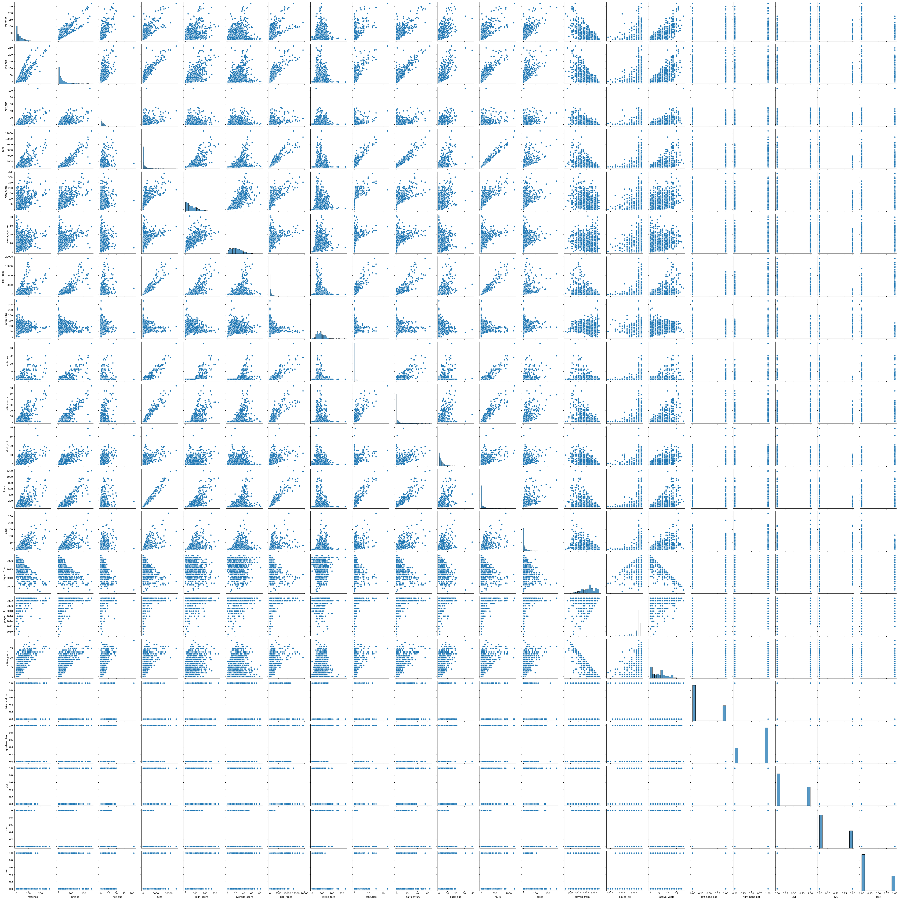
Pair Plot – To find relation b/w features

Slide 18
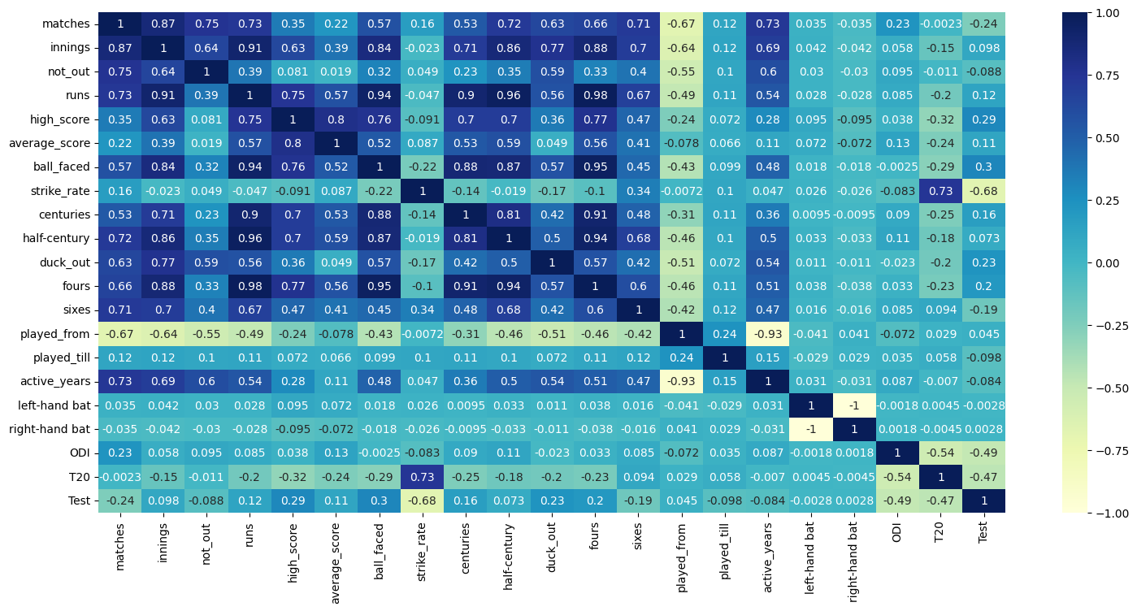
Heat Map – To find Co-relation b/w features

Slide 19
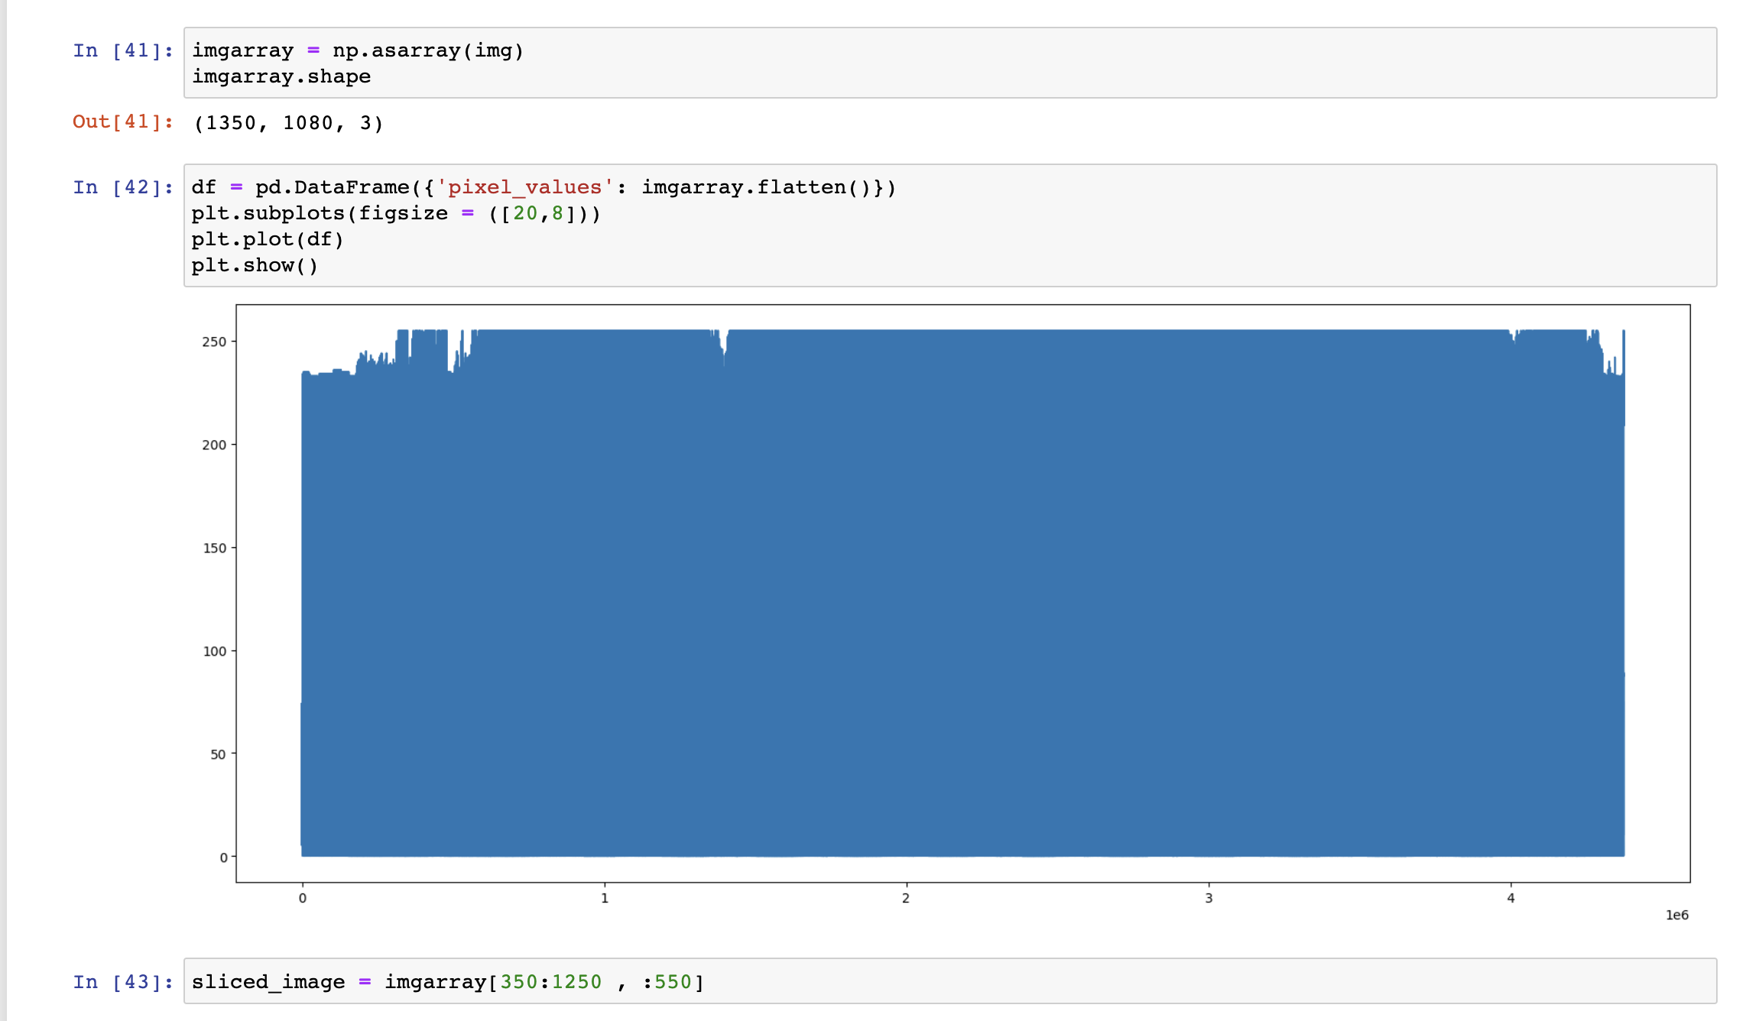
Reading Image Data and plotting it

Slide 20
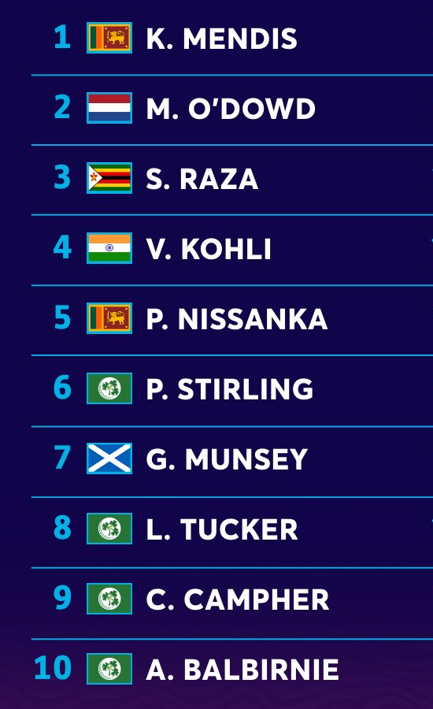
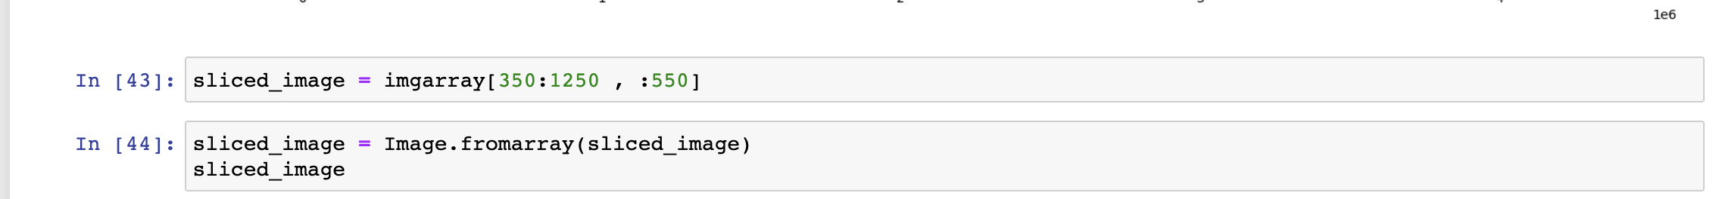
Slicing Data from array

Slide 21
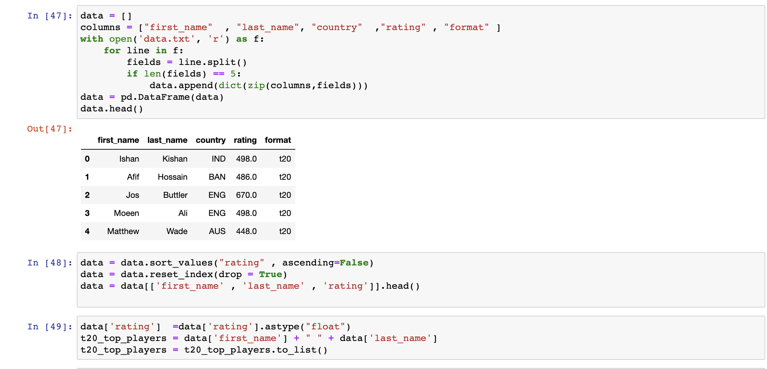
Loading Unstructred data and cleaning

Slide 22
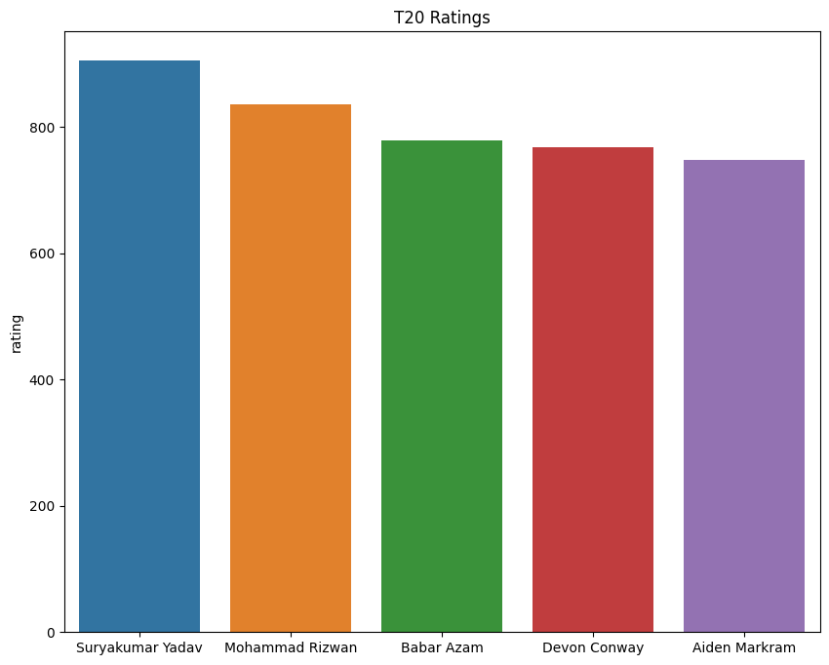
Visualizing Top Ranked Players

Slide 23
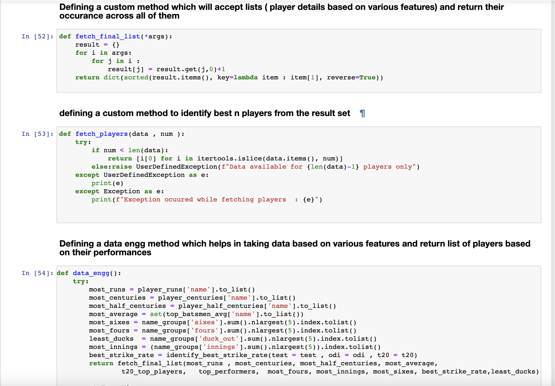
Identifying Top players

Slide 24
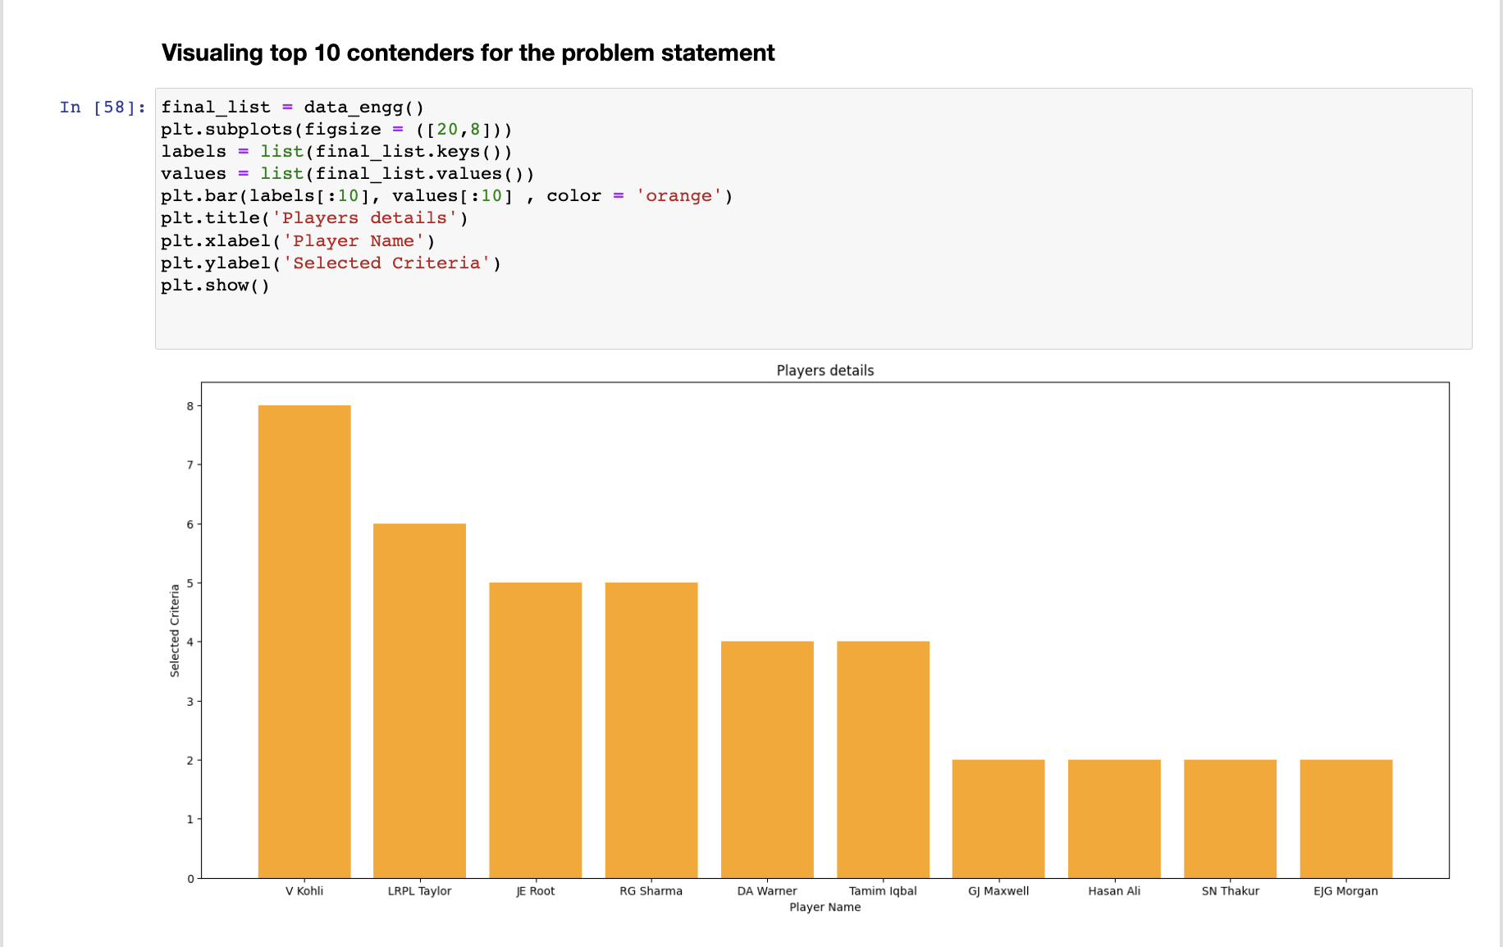
Visualizing Top Players

Slide 25
Conclusion
From the above analysis we have successfully identified the top 5 performing cricketers based on a range of performance metrics, including batting average, strike rate, total runs scored, boundaries, innings played and years active. The final ranking was based on a weighted combination of batting, which were determined through exploratory data analysis.
The top 5 cricketers identified through the analysis were V Kohli, LRPL Taylor, JE Root, RG Sharma, and DA Warner, who demonstrated consistent and exceptional performance in batting. These cricketers have the potential to serve as strong brand ambassadors for the company's products and can significantly enhance their brand image.
The limitations of the analysis included the availability and completeness of the data, as well as the potential for bias in the selection of performance metrics and the weighting scheme used. However, the analysis approach employed was robust and rigorous, taking into account a range of factors to arrive at the final ranking.
Overall, this analysis provides valuable insights and recommendations for the company to make informed decisions about its marketing strategy and product endorsement deals. The report serves as a valuable tool for future reference and can be used to inform future analyses or updates to the ranking criteria.

Slide 26
Thank You…!!!
BY : Yogesh, pranay,NagulMeera

