Slide 1

Analyzing Real-time Cryptocurrencies
By:
Venkata Anil Kumar Poka
Neha
Usha

Slide 2

Abstract
The issue definition for Crypto-currency data warehousing, processing, and analysis entails constructing a centralized repository of Crypto-currency data, cleaning and transforming the data, and doing data analysis to acquire insights into the Crypto market. The project's goal is to enhance decision making, optimize trading techniques, and anticipate future Crypto-currency market patterns.

Slide 3













Tools and Technologies used

Slide 4
Architecture flow charts

Slide 5
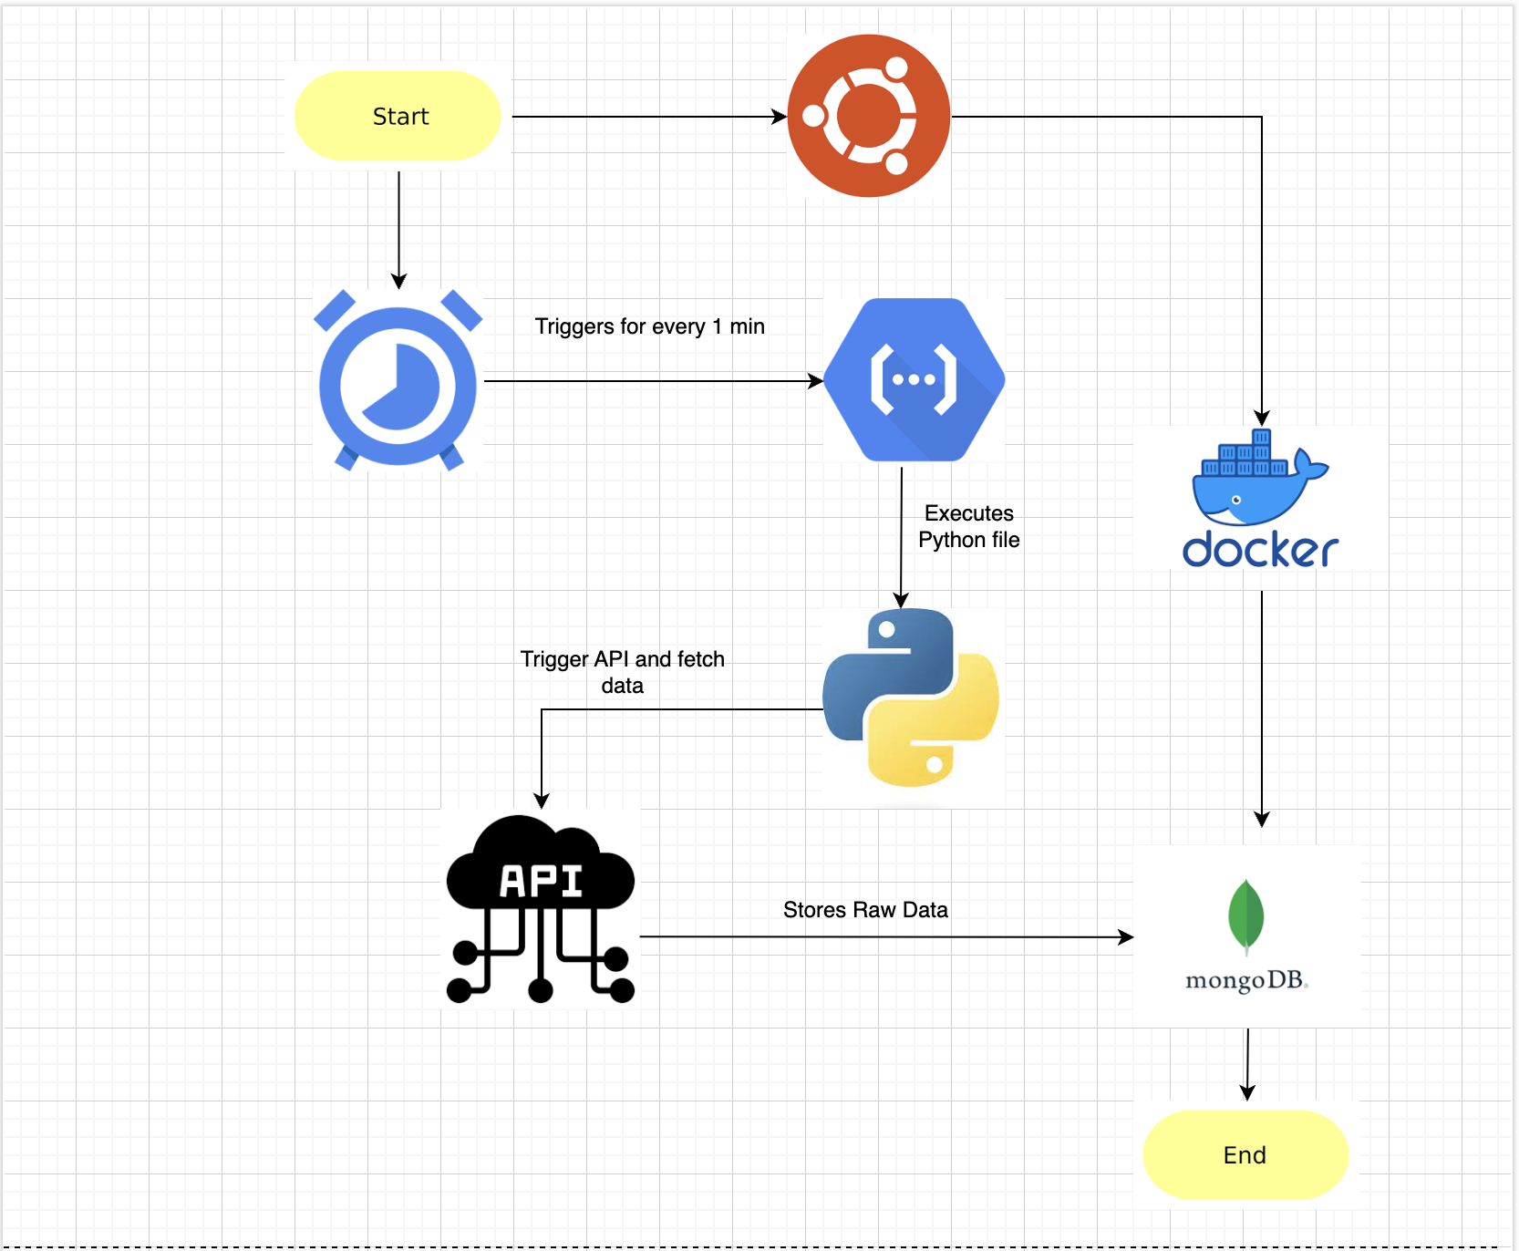

Slide 6
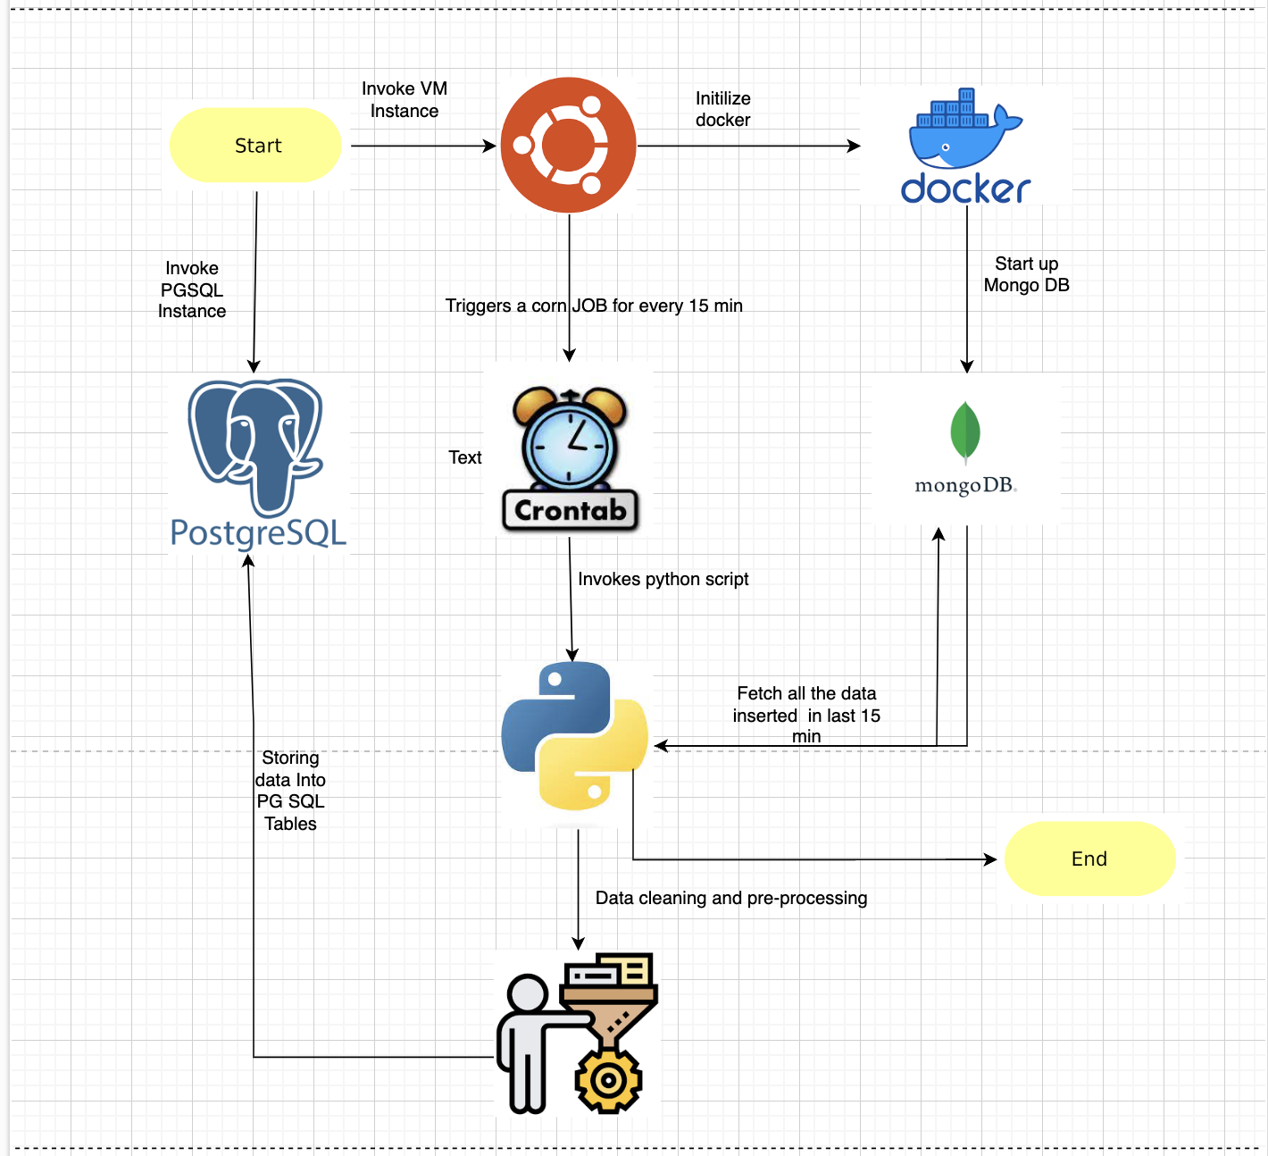

Slide 7
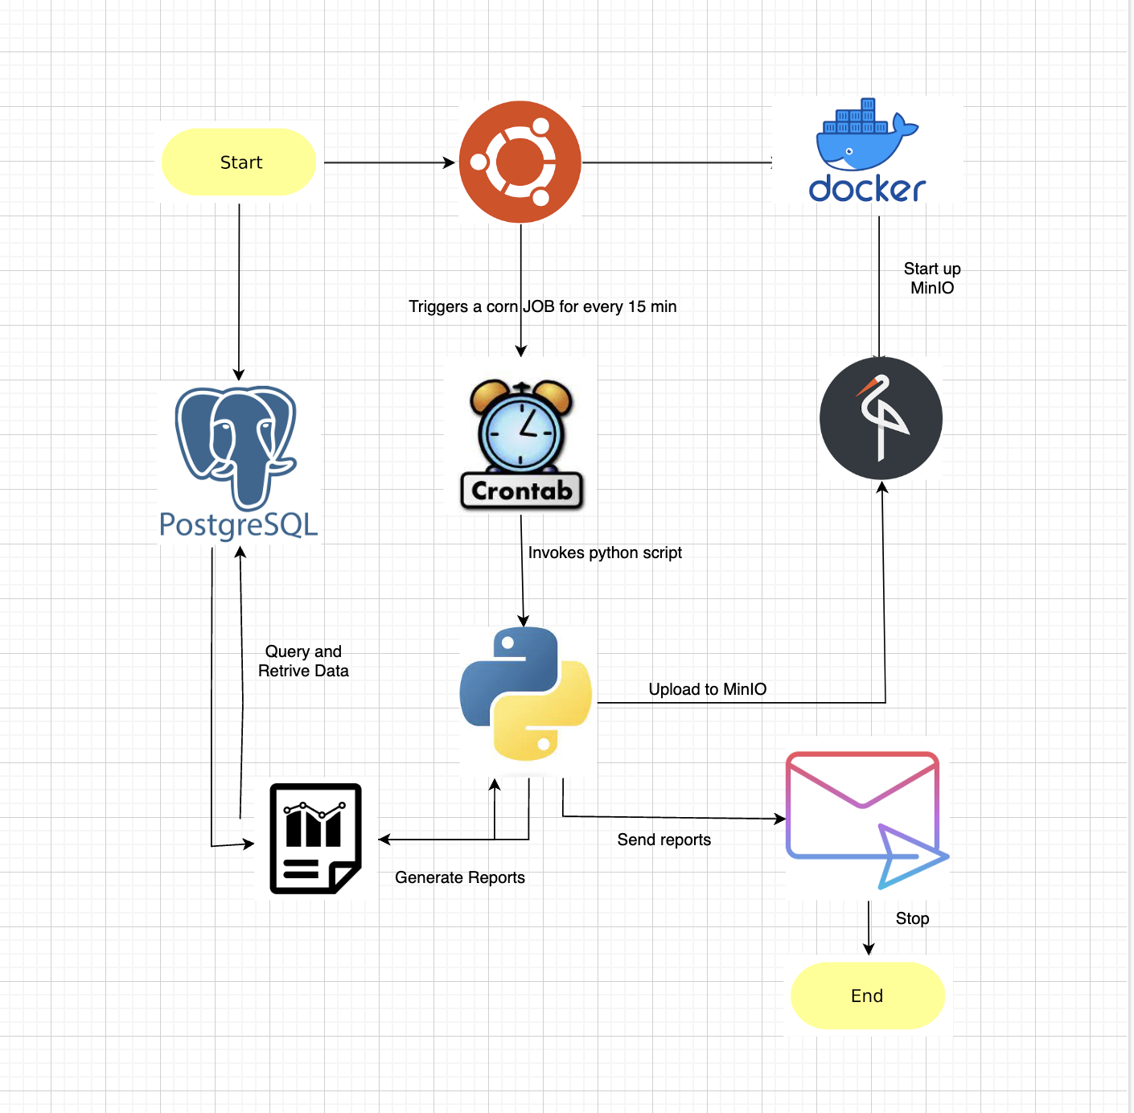

Slide 8
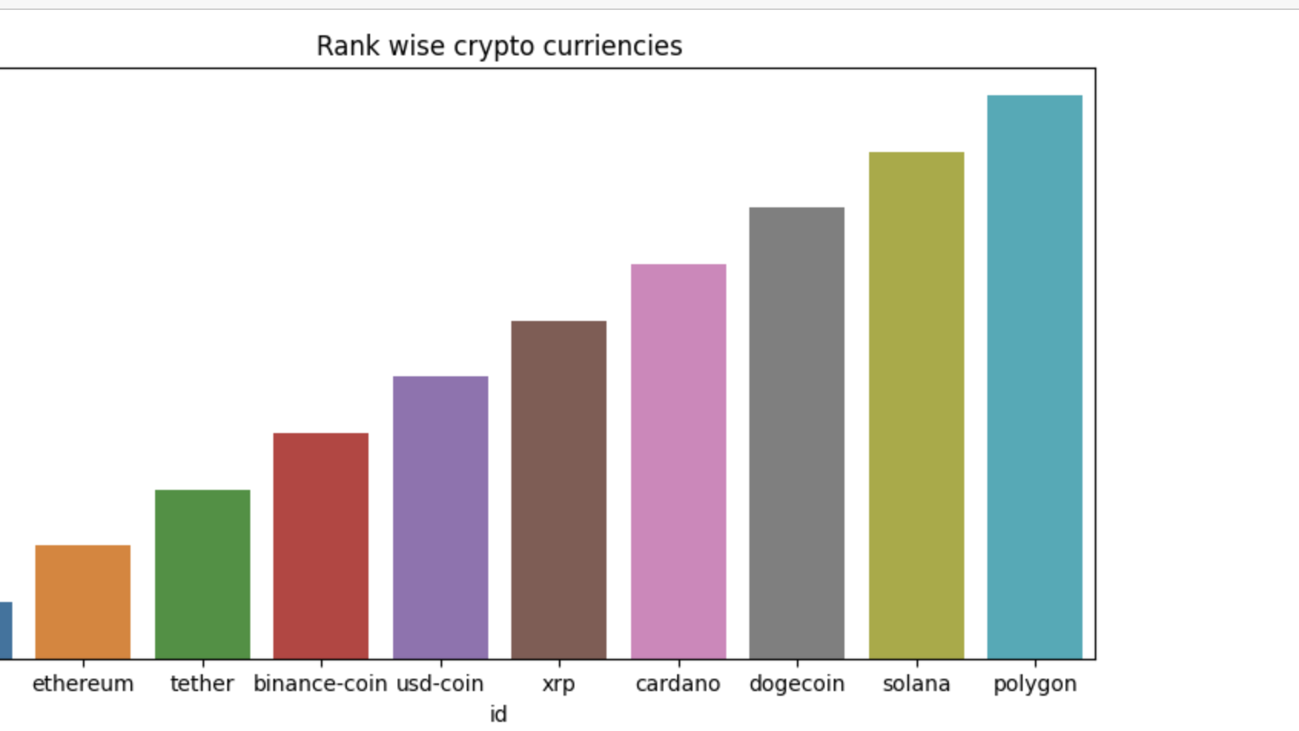
Top 10 Crypto currencies

Slide 9
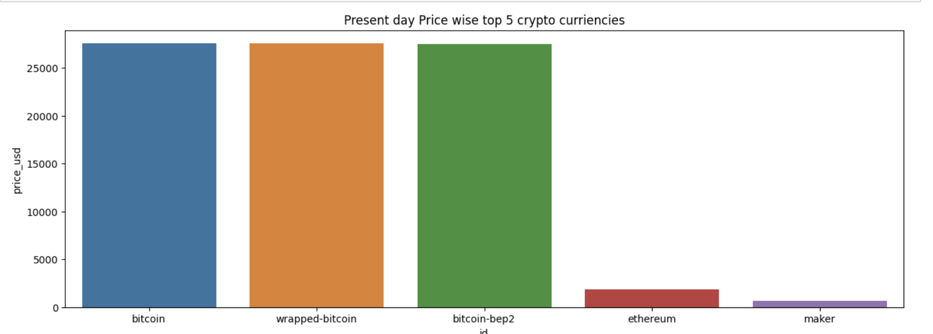
Most Expensive Currencies

Slide 10
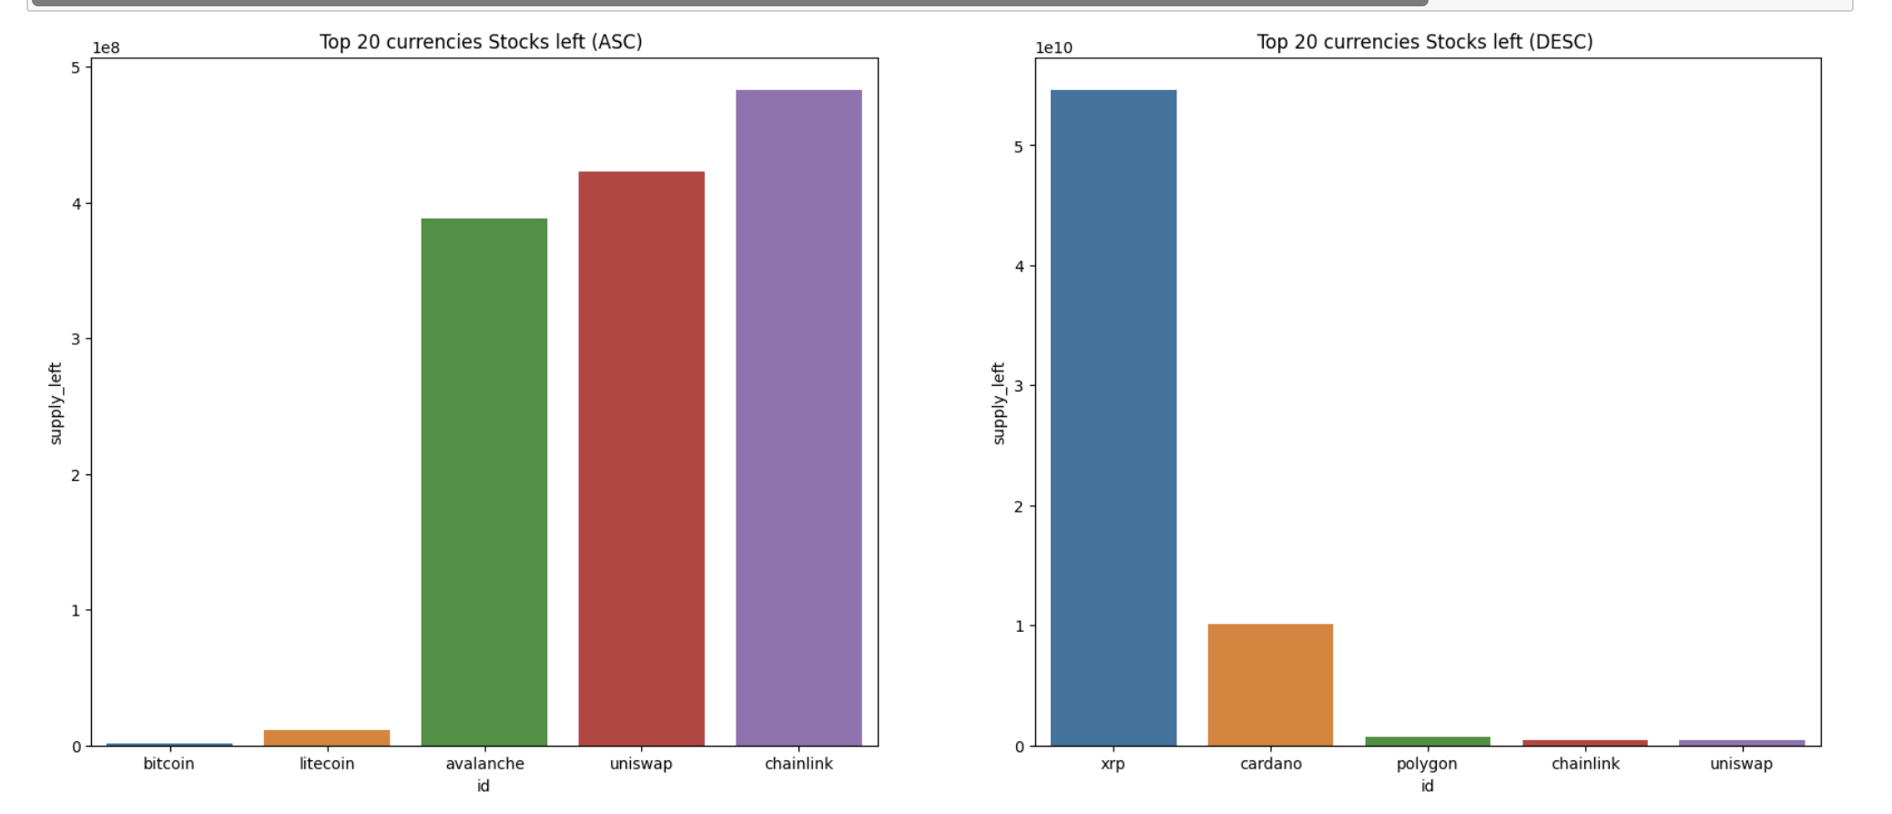
Availability of TOP 20 currencies

Slide 11
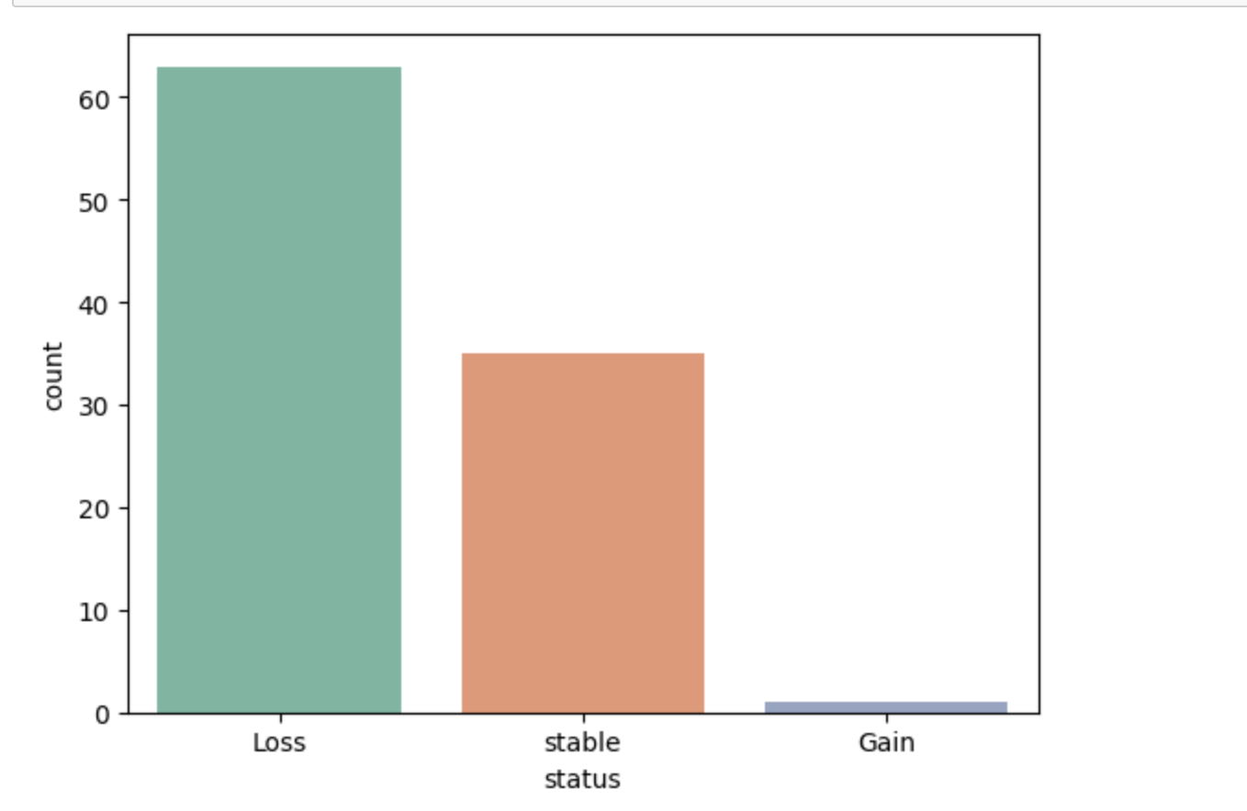
Stats of all 100 currencies for previous day

Slide 12
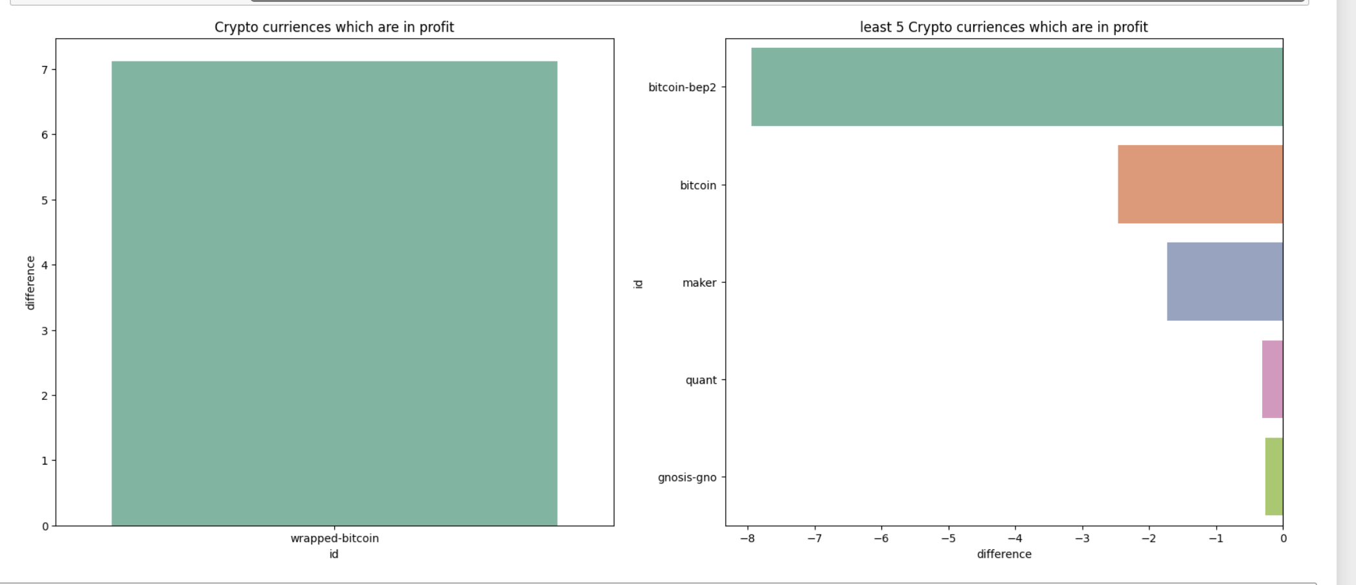
Displaying profit/losses

Slide 13
Model development – Use Cases
Predicting the price of the cryptocurrencies by passing necessary parameters
Predicting the rank of the cryptocurrencies by passing necessary parameters
Risk Assessment

Slide 14
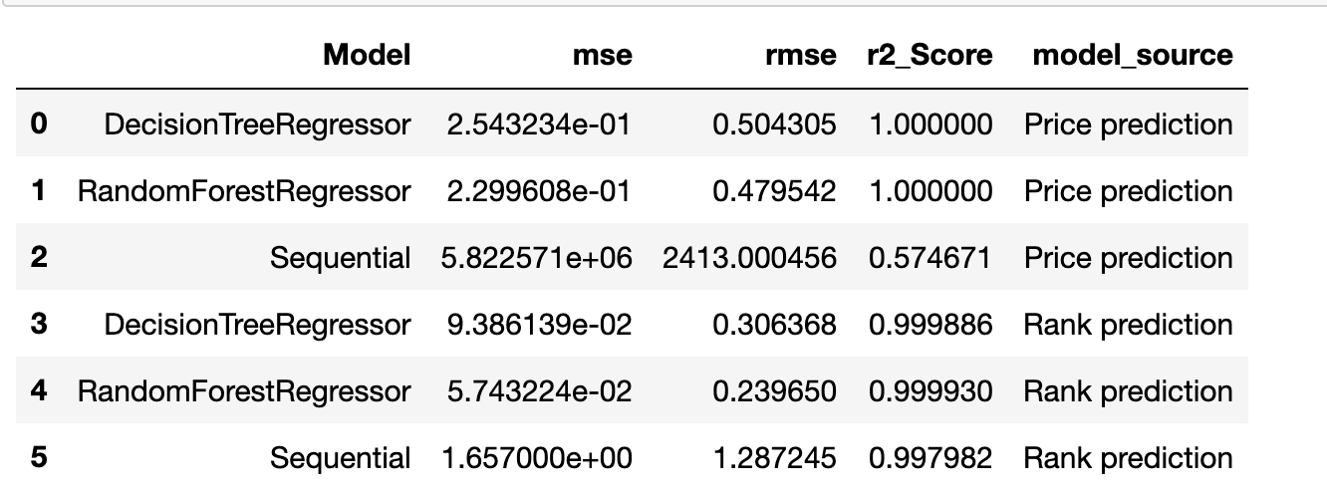
Model stats summary

Slide 15
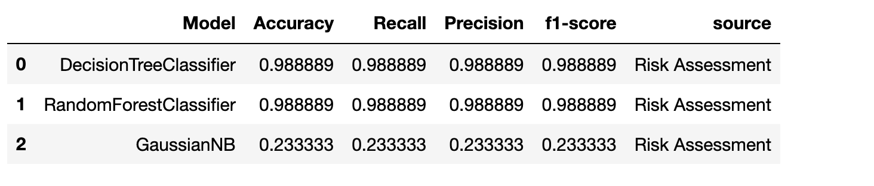
Risk Assessment Summary

Slide 16
Future Scope
We will automate all the reports from Visualization tools like Cognos , Qlik etc.
We will develop an interactive dashboard using tableau or Power BI
We will try to figure out /generate more Stats and reports which gives us clear picture about the market

