Slide 1
Segmentation and Paging
Operating System Concepts
Presentation

Slide 2
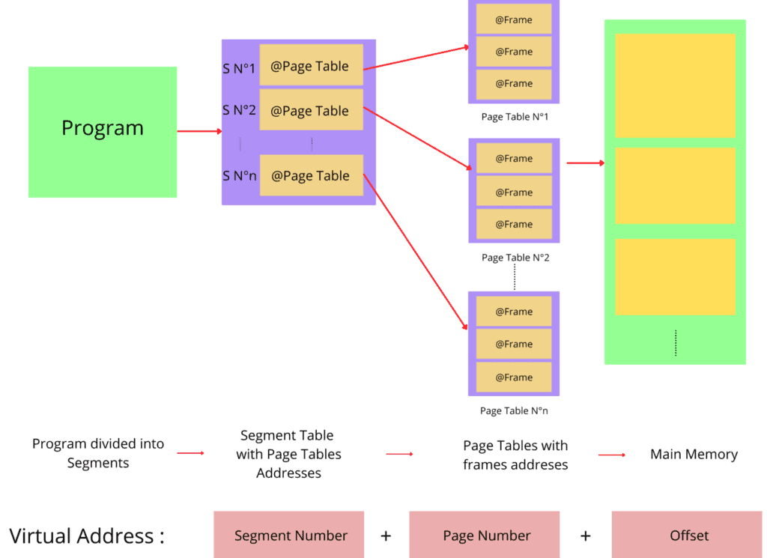
Segmentation vs. Paging: How OS Manages Memory

Slide 3
Why Memory Management?
- Programs require memory, but physical RAM is limited.
- OS must allocate, organize, and protect memory.

Slide 4
What is Segmentation
Split memory into segments (logical units such as code, data, stack).
- Example:
- Code Segment: Instructions of the program.
- Data Segment: Variables and constants.
- Stack Segment: Function calls and local variables.

Slide 5
Advantages of Segmentation
- Structure of Reasoning: Similar to the way programmers reason.
- Security: Segments can be allowed or denied permissions (read/write/execute).
- Debugging: Bugs are contained within their own segments.

Slide 6
Disadvantages of Segmentation
Most Important Issues:
- External Fragmentation: Space between segments is wasted.
- Irregular Sizes: Hardware has to deal with unusual segment sizes.
- Increased Page Tables: Increased overhead for segment tracking.

Slide 7
What is Paging ?
- Split memory into fixed-size pages (e.g., 4KB).
- Programs experience a virtual address space, translated into physical memory.

Slide 8
Advantages of Paging
Major Benefits:
-No Externally Fragmented Memory: Pages pack memory tightly.
- Hardware Support: Enables easier translation with TLBs (Translation Lookaside Buffers).
- Flexibility: Pages can be readily moved/swapped.

Slide 9
Disadvantages of Paging
Important Drawbacks:
- Internal Fragmentation: Last page might have unused space.
- Page Tables: Large programs require huge tables.
- Example: A 4KB page for a 500-byte file wastes 3.5KB.

Slide 10
Combined Approach: Segmentation + Paging
- How It Works:
- Divide code into segments, then segments into pages.
- Example: Code segment of a program is divided into 4KB pages.
- Pros: Trade-offs between logical structure (segments) and efficiency (pages).

Slide 11
Real-World Example
Modern OS:
- Windows/Linux: Use paging (4KB pages) with virtual memory.
- Segmentation: Legacy systems or specialized use (e.g., x86 real mode).

Slide 12
Why Paging Won?
- Key Reasons:
- Eliminates external fragmentation.
- Less complex hardware implementation.
- Accommodates contemporary hardware (caches, TLBs).

Slide 13
Future Trends
- Larger Pages: 2MB/1GB pages for large data.
- Huge Pages: Minimize TLB misses in cloud databases.
- Hybrid Models: Finding a balance between segmentation's logic and paging's efficiency.

Slide 14
Summary
- Segmentation: Logical, program-centric, but fragmented.
- Paging: Efficient, hardware-friendly, but abstract.
- Takeaway: OS memory management is like real estate—location (addressing) matters!

