Slide 1
Hurricane Ike (2008) & IRMA (2017) CASE LES INPUT VERIFICATIONS (Surface Wind Speed and Surface Pressure) HWRF Vs URMA

Slide 2
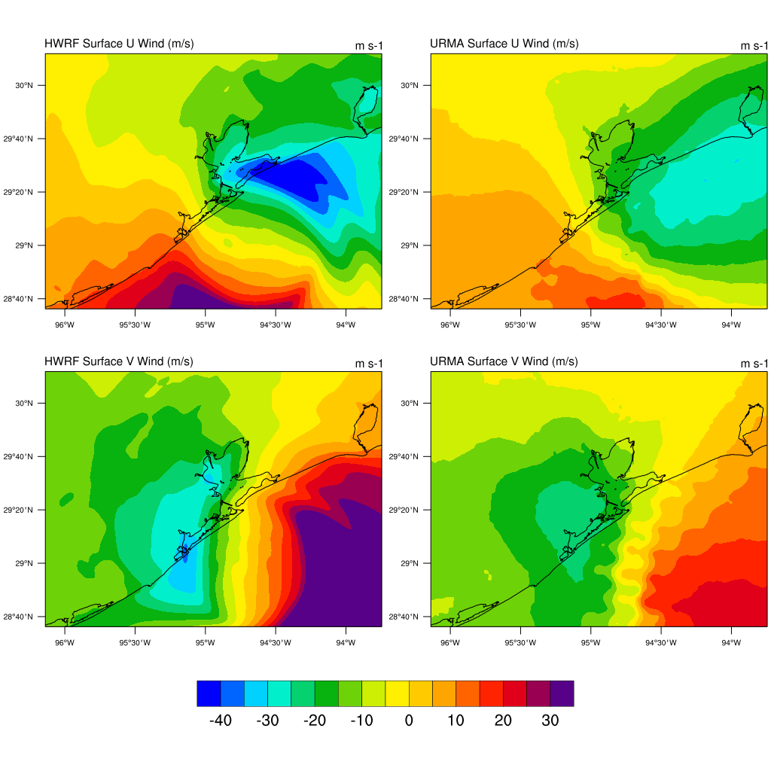
Hurricane Ike 2008 Case
HWRF U Wind
URMA U Wind
05 UTC 13 Sep 2008 (at landfall)
HWRF (left) shows strong U wind component than URMA (right) U wind component. (Top panel)
URMA surface winds are weak in strength
HWRF (First Column)
URMA (Second Column)
HWRF V Wind
URMA V Wind

Slide 3
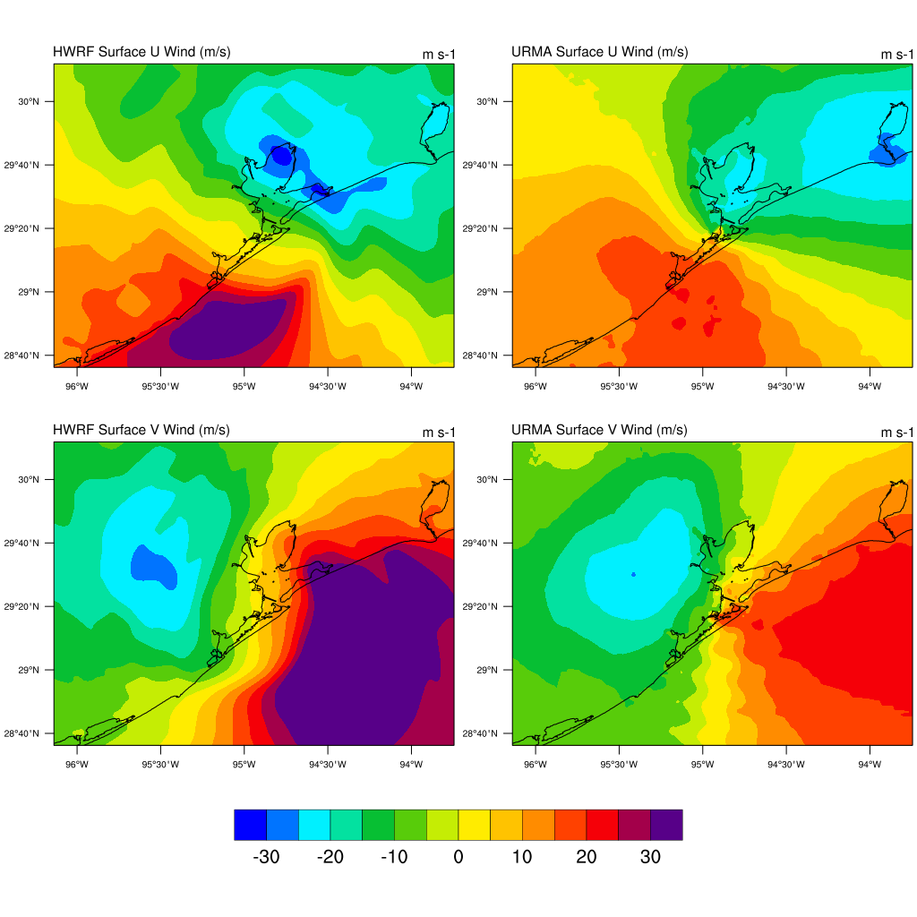
Hurricane Ike 2008 Case
HWRF U Wind
URMA U Wind
07 UTC 13 Sep 2008 (2 hours after landfall)
HWRF shows strong U wind component than URMA U wind component. (Top panel)
HWRF (First Column)
URMA (Second Column)
Top – U wind
Bottom – V wind
HWRF V Wind
URMA V Wind
URMA surface wind speed is much
Weaker than HWRF

Slide 4
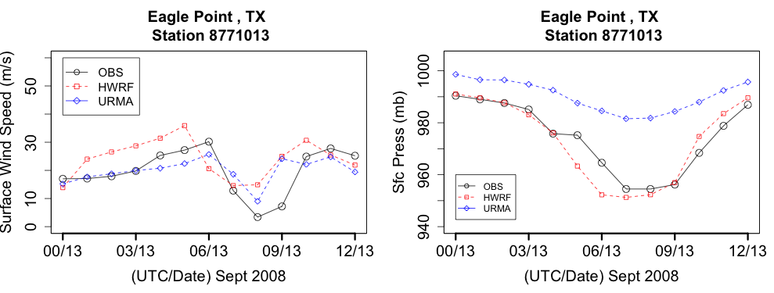
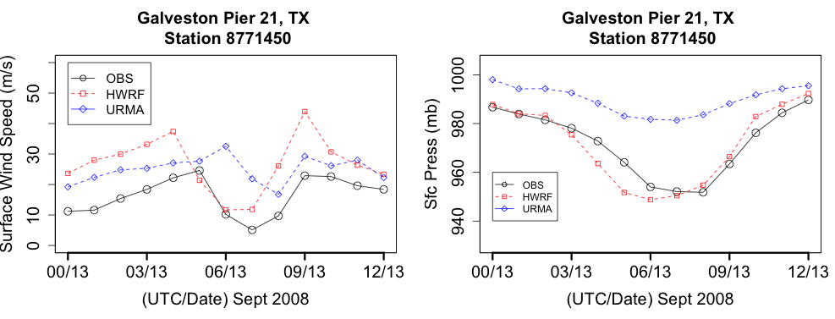
Comparison with observed wind speed & Sfc Pressure at two stations:
Surface Pressure captured accurately in HWRF.

Slide 5
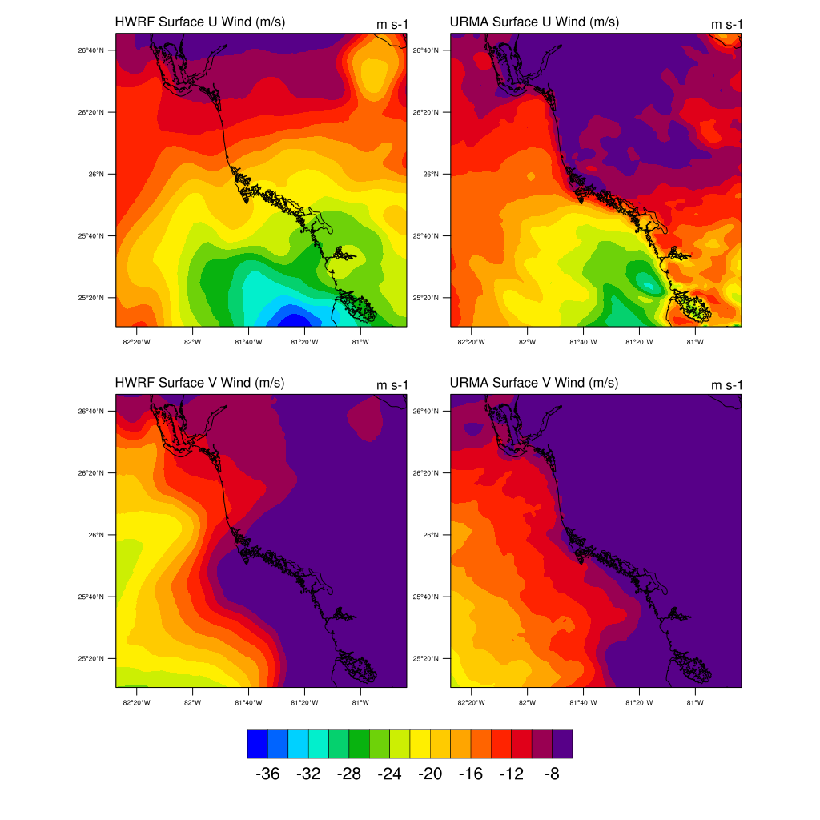
Hurricane Irma 2017 Case
12 UTC 10 Sep 2017 (6 hours before landfall)
HWRF shows strong U wind component than URMA U wind component. (Top panel)
V wind component is also have significant differences
Top – U wind
Bottom – V wind
HWRF (First Column)
URMA (Second Column)

Slide 6
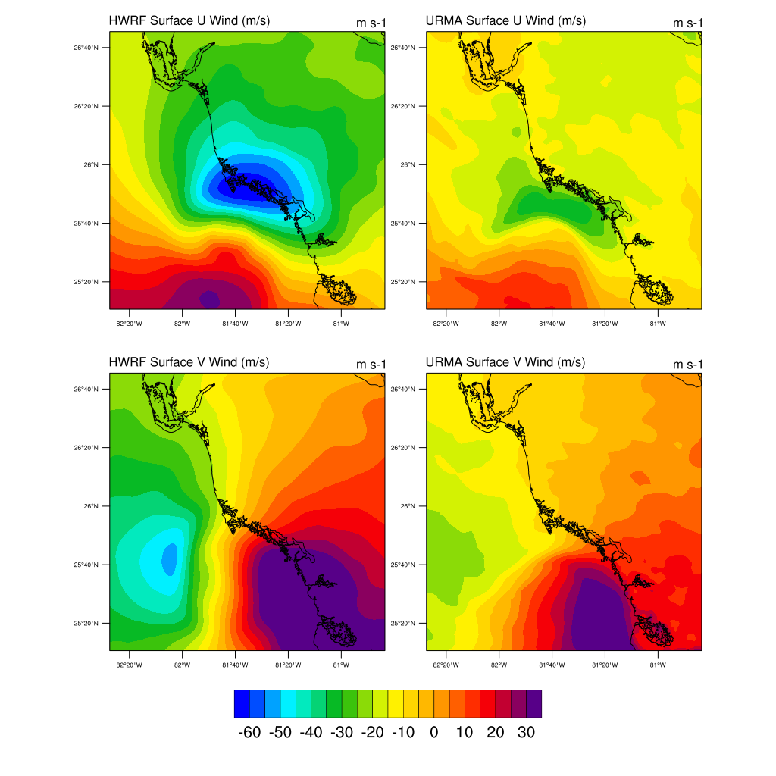
Hurricane Irma 2017 Case
12 UTC 10 Sep 2017 (at landfall)
HWRF (left) shows strong U wind component than URMA (right) U wind component. (Top panel)
URMA surface winds are weak in strength
HWRF (First Column)
URMA (Second Column)

Slide 7
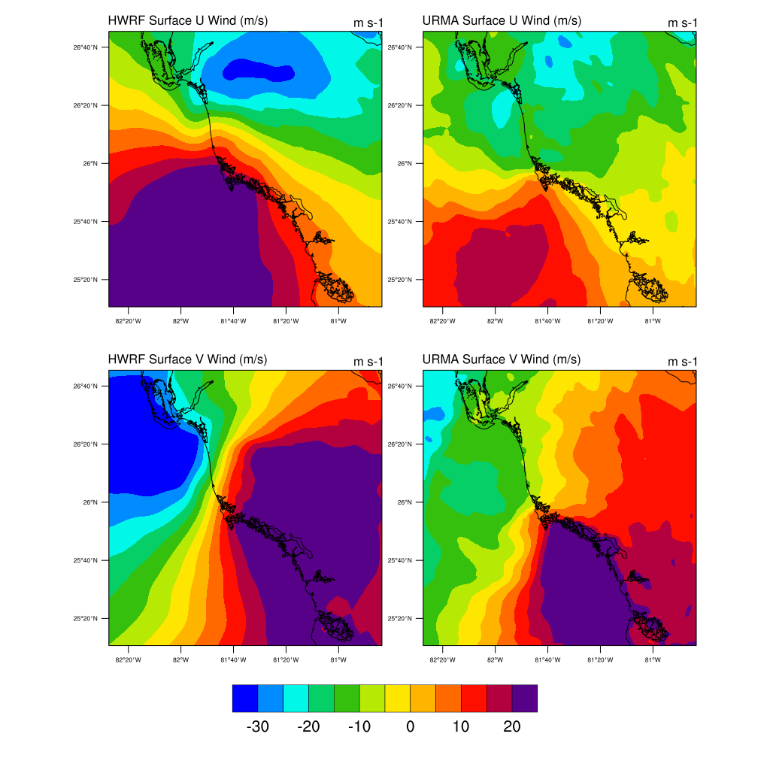
Hurricane Irma 2017 Case
21 UTC 10 Sep 2017 (3 hours after landfall)
HWRF shows strong U wind component than URMA U wind component. (Top panel)
HWRF (First Column)
URMA (Second Column)
Top – U wind
Bottom – V wind
URMA surface wind speed is much
Weaker than HWRF

Slide 8
Comparison with observed wind speed & Sfc Pressure at Naples, FL
HWRF surface winds are in good agreement with observation
And Surface Pressure is also captured accurately in HWRF.

Slide 9
REMARKS
HWRF (surface winds and Pressure) are much better than URMA for Hurricane Ike (2008) & IRMA 2017 case.
URMA winds are weak in strength and not captured very well in comparison with station observed surface wind speed.
URMA surface pressure is also weaker as seen in the comparison with observation during landfall time.
Our LES simulations are very sensitive to the forcing winds and URMA surface winds/psfc will impact our LES results.
Roshan and Geoff: URMA surface winds need to be investigated further and we need improvement over HWRF winds as per project objectives.
I cant use URMA surface winds in current stage as it will downgrade LES results. (??)
Before passing model data forcing, I encourage team to look their outputs and conduct basic analysis. Remember we need to address our main project objective goal i.e. 90% accuracy

