Slide 1

Classes Objects

Slide 2
Need for OOP
Integration of modules / applications
High level of flexibility
Illusion of simplicity
Extensibility of existing code
Challenges
Requirements
Modularity
Extendibility
Reusability
Interoperability
Security

Slide 3
OOP Terminologies
Object
Real world entities, which has two characteristics namely, state (attributes) and behavior (method).
Class
A description of what data is accessible through a particular kind of object, and how that data may be accessed.
It is an active entity
It is a passive entity
Method
The means by which an object's data is accessed, modified, or processed
Abstraction
Hides all but the relevant data about an object so as to reduce complexity and increase efficiency.
Focus on what the object does instead of how it does
Encapsulation
This wraps code and data into a single unit.
And separates what from the how.
Or implementation of abstraction
Inheritance
The way in which existing classes of object can be upgraded to provide additional data or methods
Polymorphism
The way that distinct objects can respond differently to the same message, depending on the class they belong to

Slide 4
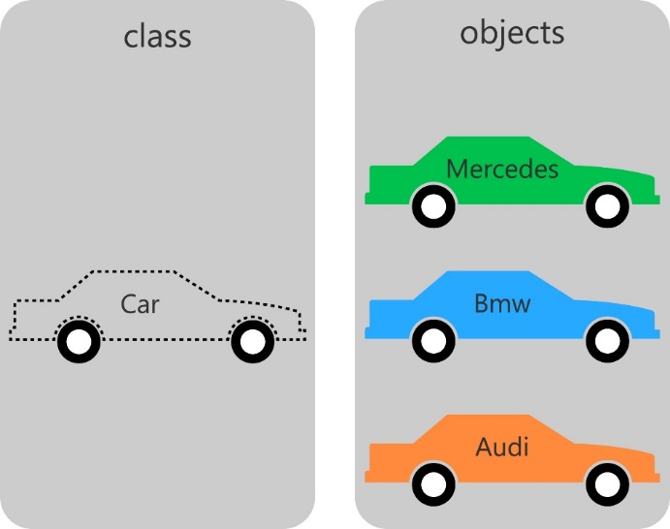
What is a class?
A class is a prototype / design that describes the common attributes (properties) and activities (behaviors) of objects
Attributes
• Example : Customer Id, Name, Telephone number and Address
Behaviour
• Activities(behavior) exhibited by the class to external world • Example: Purchasing items from the retail shop

Slide 5
What is an object?
When you are working with Python, always remember that everything i.e. variable, class, function, method etc. in Python is an object.
Thus Python embraces OOP at a fundamental level.
An object consists of:
A collection of related information i.e. attributes.
A set of operations to manipulate that information i.e. behaviors / methods.

Slide 6
OOP Benefits
Leads to development of smaller but stable subsystems.
The subsystems are resilient to change.
Reduces the risk factor in building large systems as they are built incrementally from subsystems which are stable.
Hence Object Orientation is suitable for developing extremely complex business systems

Slide 7
Creating a Class :
Classes are OOP tools/templates used to create objects.
Definition of a class starts with keyword class followed by classname and :. It contains attributes and methods.
An indented block of statements forms the body of the class.
Like functions and modules, classes are also python program units but they are more useful while building new objects.
Class classDemo:
pass #An empty block
P = classDemo()

Slide 8
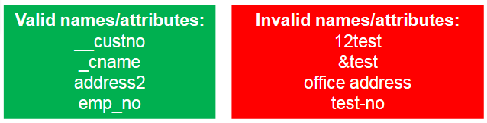
Creating a class: Access specifiers
Public
UML notation → +, python variable → name
These attributes can be freely used inside or outside of a class definition. A declaration that is accessible to all classes
Protected
UML notation → # , python variable → _name
Protected attributes are accessible only within the class in which it is declared and to its inherited sub-classes.
Private
UML notation → - , python variable → __name.
This kind of attribute is inaccessible and invisible. It's neither possible to read nor write to those attributes, except inside of the class definition itself. A declaration that is accessible only to the class in which it is declared

Slide 9
Methods
Methods define the behavior of an object.
All the methods should be defined inside the class with an access specifier.
Values that are passed to methods are known as arguments/parameters.
Value that is returned from a method is known as return value.
A method can return only one value at a time and it can be done using the return statement.
Implementation of a method requires the following:
Method
Method Header
Method Definition
Method invocator/Call
Access specifier

Slide 10
Creation of objects
Class is a blueprint for the creation of objects.
To realize a class, an object or an instance of the class needs to be created.
There can be many instances for a class and each instance will have its own data.
In Python, Class name with brackets allocates memory for objects during run time i.e. dynamic memory allocation.
Also one or more arguments could be passed for object creation. (Instantiation)

Slide 11
Importance of “self”
Explicit reference to refer the current object, i.e the object which invoked the method.
Used to create and initialize instance variables of a class i.e it creates the attribute for the class.
‘self’ reference must be used as a first parameter in all instance methods of a class otherwise the methods are known as simply “class methods”.
Moreover, “self” is not a keyword and has no special meaning in Python. We can use any name in that place.
However, it is recommended not to use any name other than “self” (merely a convention and for readability

Slide 12
__init__() method
__init__() method helps in initializing the variable during the creation of object.
Hence, it is also called as ‘initializer method’ or Default Constructor.
Before __init__() method, the object is been already constructed
Simple __init__() method
Parameterized __init__(argument 1, argument 2, ...) method

Slide 13
Relationships
Objects should collaborate each other for which relationships help in connecting to each other.
Few kinds of relationships between classes : – Generalization and specialization (is-a relationship) – Aggregation (has-a relationship)
- Composition (is composed of) – Association (uses-a relationship)

