Slide 1
Smart Home Prototype Anıl Peker Temirlan Bayeshov

Slide 2
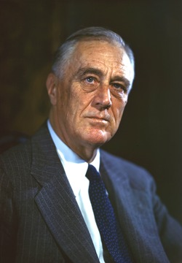
``Peace like charity, begins at home``
Franklin D. Roosevelt

Slide 3
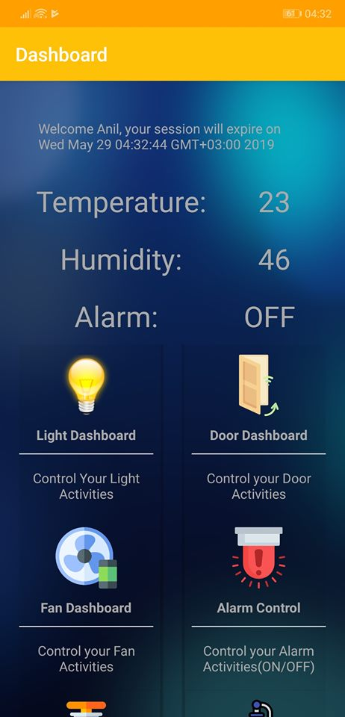
What is Smart Home?
Automated System
Easy of Use
Safety
Comfortability

Slide 4
OUR PROCESS IS EASY TO USE
Sensor Installation
1
Mobile Application Registration
2
Controlling and Monitoring Home
3

Slide 5
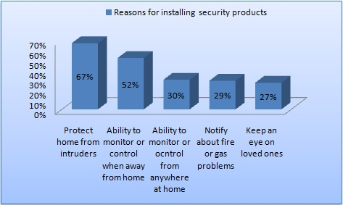
67% of people hold the reason that they buy home smart security products for protection 52% say that they want to get remote access to their homes/business when they are away from home. 30% want to monitor all rooms in their houses anywhere at home with security products.
Why we need
Smart Home?
home smart security product questionnaire statistics 2018/2019
[1]

Slide 6
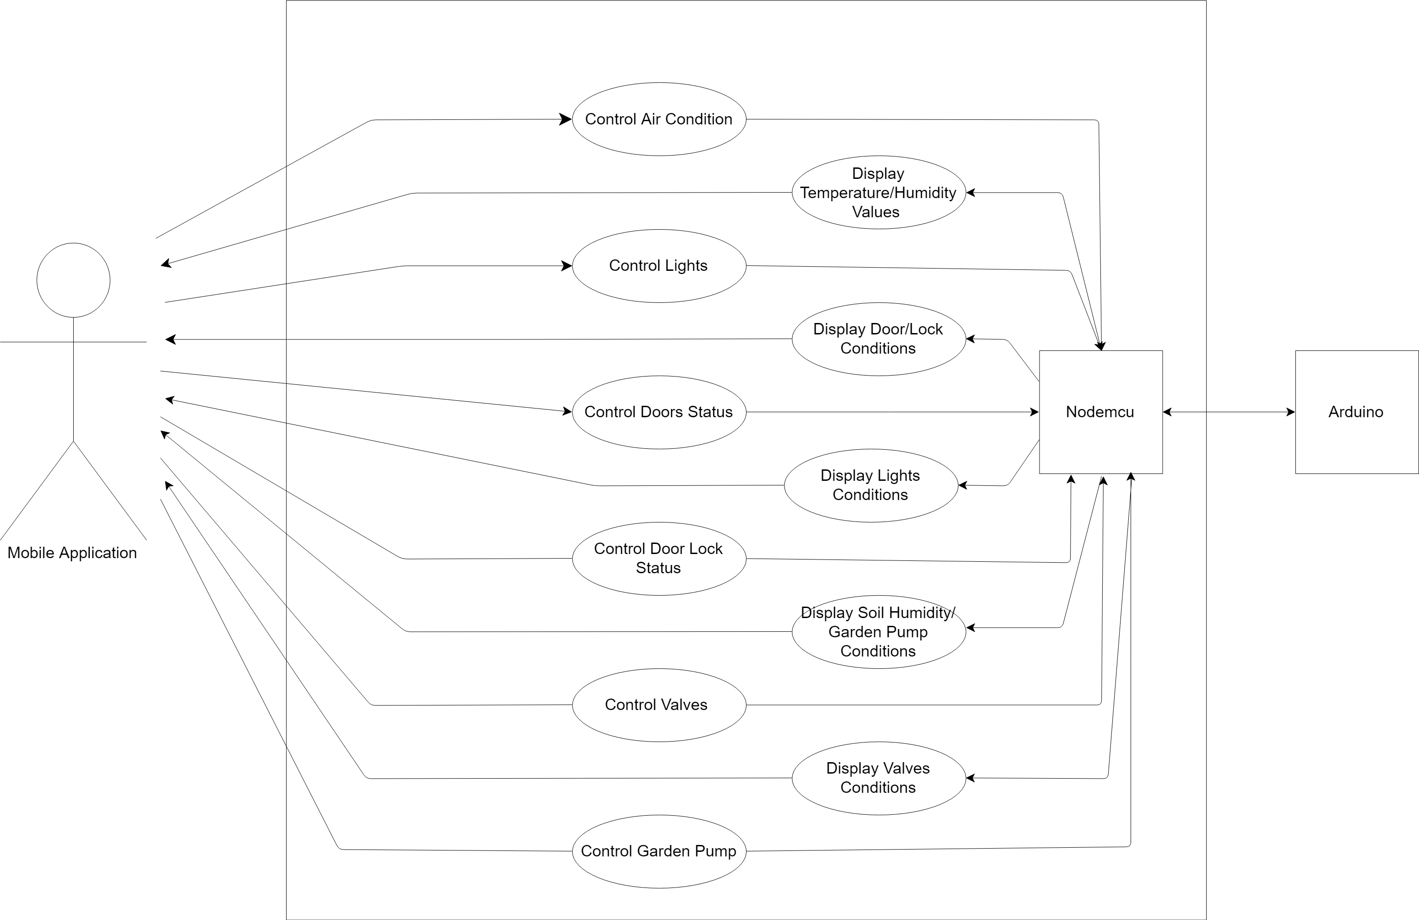

Slide 7
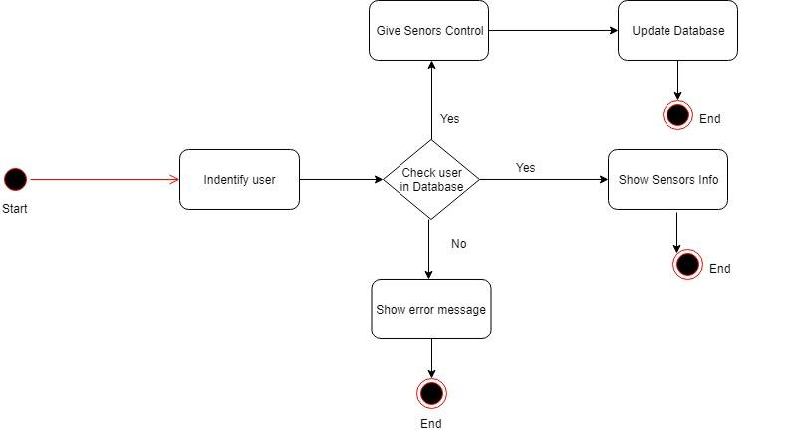

Slide 8
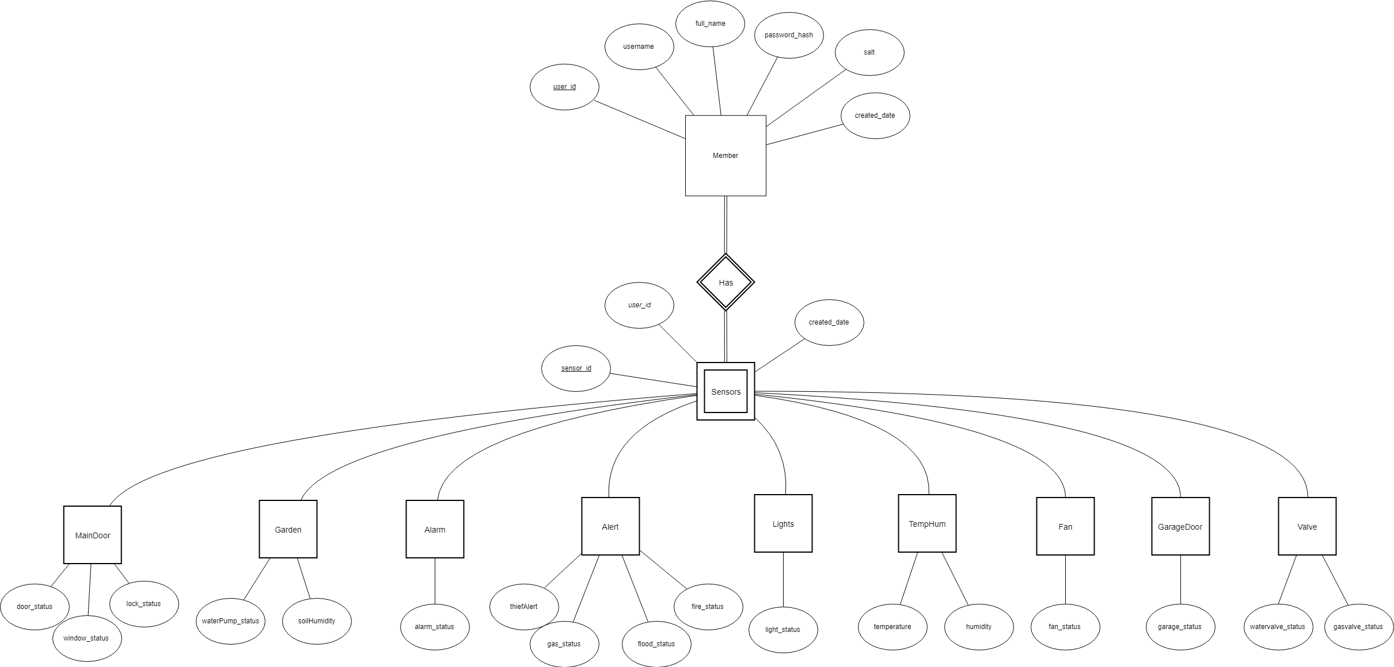

Slide 9
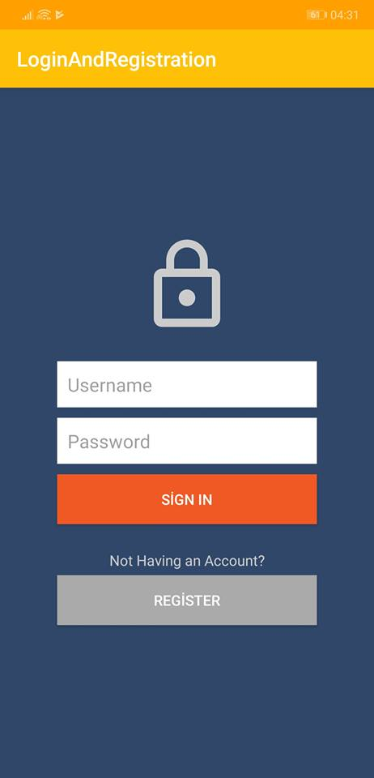
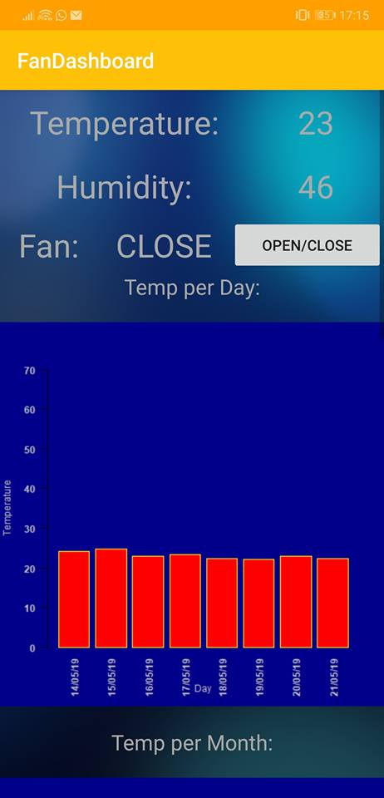
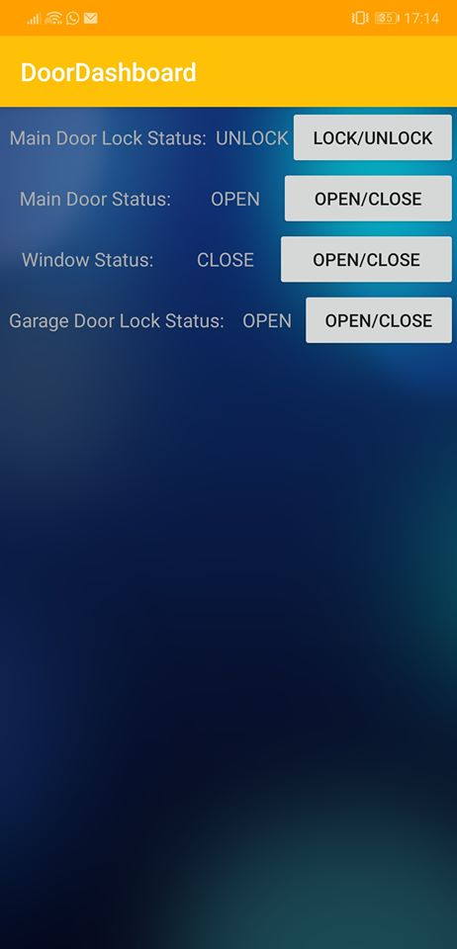

Slide 10
Main components
Arduino for sensors data collection
Nodemcu for Arduino data transmitting
Android Studio for mobile application
Wamp for local server and database
Rstudio for statistical performance

Slide 11
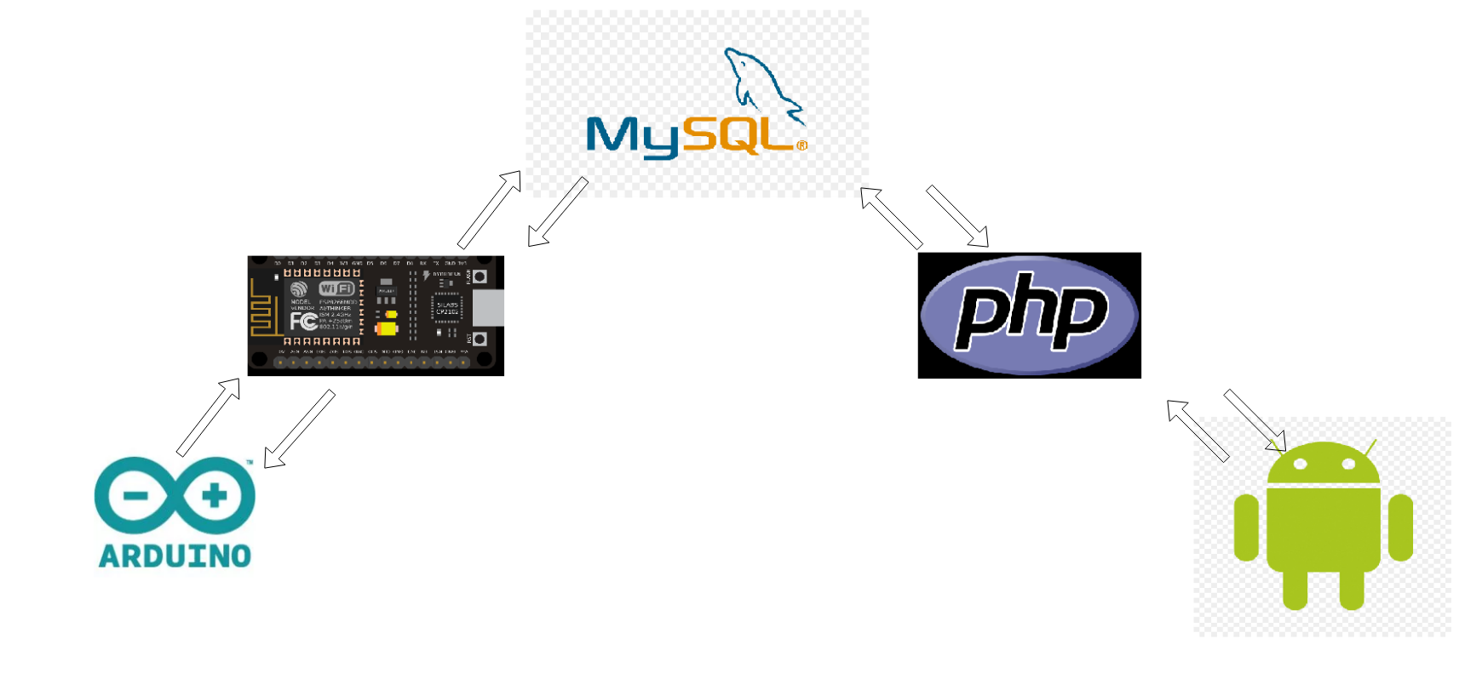
Components Connection

Slide 12
Arduino
Necessary libraries included for sensors
Circuit maded for sensors
Power supplied to all systems
Plug to Nodemcu card with Serial Communication
Data retrieved from Nodemcu
Data transmitted to Nodemcu

Slide 13
NodeMCU
Esp8266 WIFI Library included
MySQL Connector Library included
Sensor data retrieved from Arduino
Data transmitted to Database
Control data retrieved from Database
Control data transmitted to Arduino
Query processing for data flow

Slide 14
Android APP
Volley framework used for server communication
Session Handler for users
Sensor data retrieved from server
Control data transmitted to server
Dashboard design and explanation

Slide 15
Rstudio
Libraries and packages
Connection for a server
Retrieving data sets from database
Performing statistical calculations
Transmitting new data sets
Plotting a graphs

Slide 16
Wamp
For a localhost server
Local Database
PHP server for mobile application

Slide 17
Data transmitting Arduino to Database
 | Normal Condition (per day) | Unexpected Condition (per hour)
1 person | 7200 data sets | 900 data sets
10 person | 72000 data sets | 9000 data sets
100 person | 720000 data sets | 90000 data sets
Notes:
12 seconds= 1 data set (Normal condition)
4 seconds= 1 data set (Unexpected condition)

Slide 18
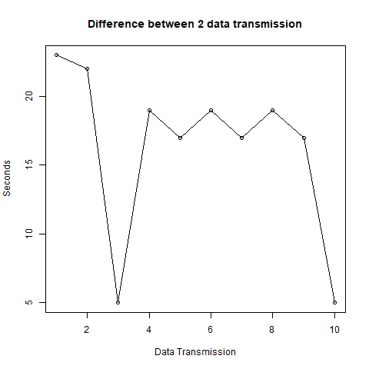
Difference between
two transmissions
In seconds
R line Graph

Slide 19
Control Data Response Time
Average Control Data Response time: 3 sec
Data gateway:
Android to Php Server
Server to Database
Database to NodeMCU
Nodemcu to Arduino

Slide 20
CREDITS
Special thanks to all the people who helped us during a project
Also we want to thank Cemal Can Balci for a big afford during a project

Slide 21
Reference List
https://reolink.com/home-smart-security-product-questionnaire-statistics/ [1]
https://www.statista.com/ [2]

Slide 22

THANKS!
Any questions?

