Slide 1
IBM HC 2020 – AI Recruiter
Team - Seizure
Nikhil JSK Prasanth Gelli Anil Raj Thota Maddula Raja Rahul
Lovely Professional University

Slide 2
Problem Statement
AI Recruiter
AI Enabled chatbot than can shortlist applicants.
Pain-Point
Resume-based shortlisting in HR Recruitment process
Automate

Slide 3
Our Solution
Chatbot that can provide analysis reports on
Resume Parsing
Chatbot Conversation
Work Profile
Social Profile
Provides an Overall Score based on all above parameters

Slide 4
Our Solution
Significance
Open – Source
Few commands to install (including Deployment)
End-to-end workflow setup to adapt

Slide 5
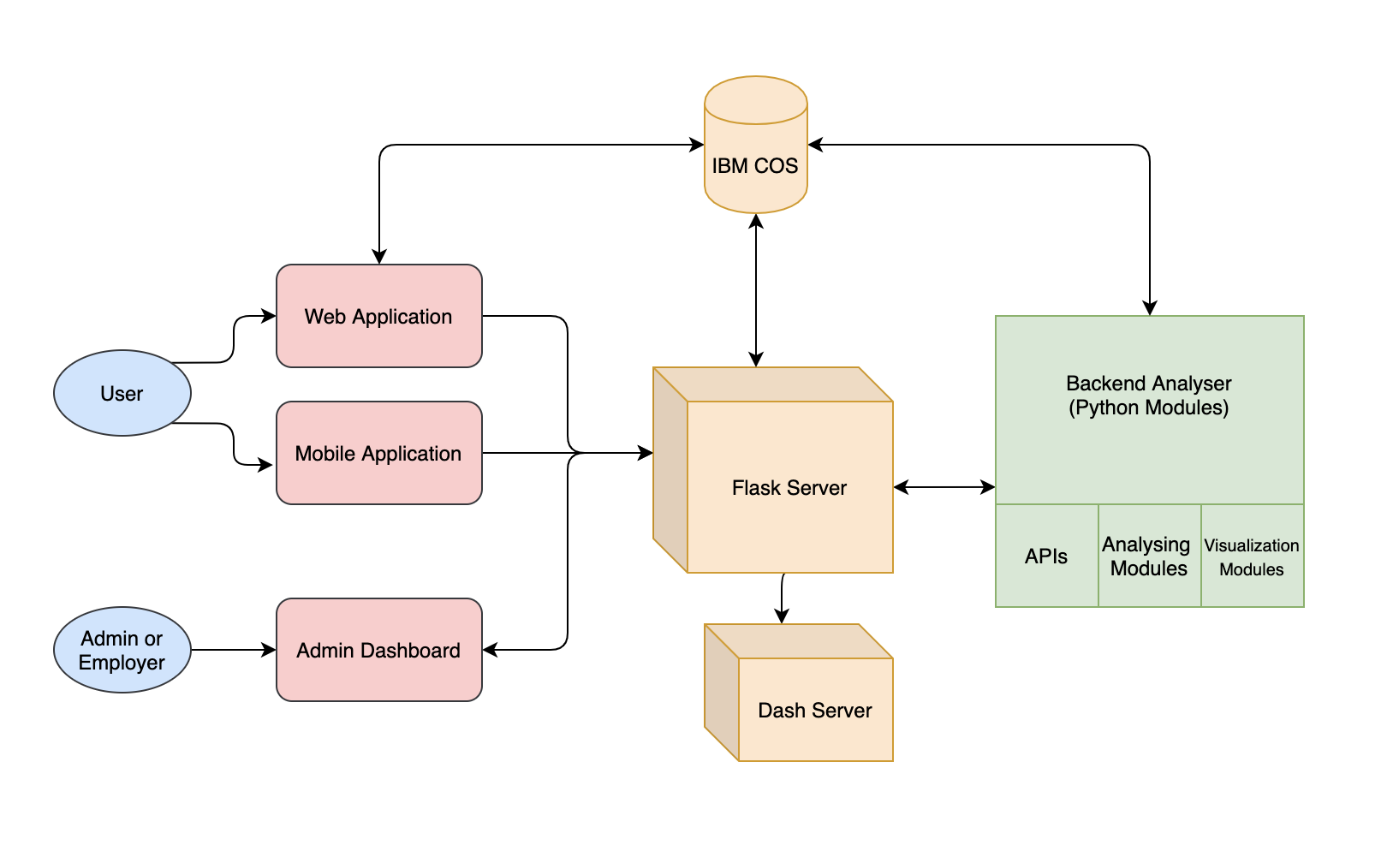
Architecture

Slide 6
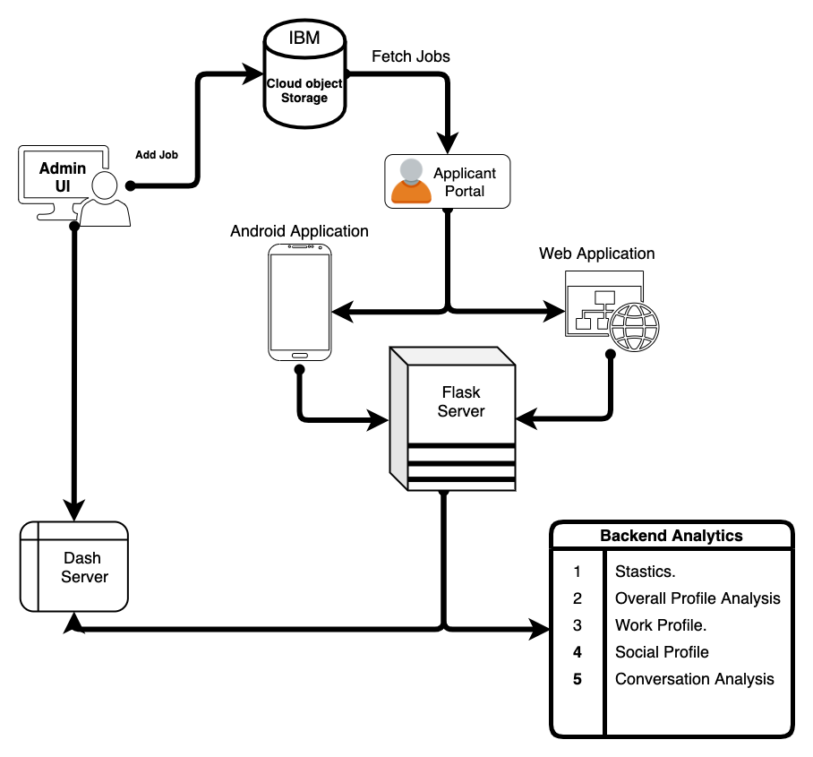
Process Flow

Slide 7
Backend Core Component
UI
React, React Router DOM
Ionic, Angular, TypeScript
CSS, Bootstrap
Flask & Dash
IBM Services
IBM COS
IBM Kubernetes
IBM Cloud
IBM Digital App Builder
IBM Watson Assistant
IBM Mobile Foundations
IBM Natural Language Understanding
IBM Personality Insights

Slide 8
Backend Core Component
Resume Parsing
Natural Language Processing
Spacy
Pyresparser
NLTK
Analysis & Visualization
Pandas, Numpy
Plotly
Seaborn
Matplotlib
Work Report Analysis
GitHub API
Social Report Analysis
Twitter API
LinkedIn API
Chatbot Conversation Analysis
TextBlob
PyWaffle
WordCloud
ProWriting Aid SDK
Kaggle Data for Peer-group Skill Analysis

Slide 9
Top Features
Web App, Android and iOS User Interface for Applicant
React App for Admin Dashboard
Flask, COS, Dash and Python Integration
Resume Parsing and Validations
Work Report, Social Profile Report and Peer-group Skill Scoring
Live Reload button for checking application status
Scoring Preferences with Admin
Generic Resume Format
End-to-End application deployed on IBM Cloud using Kubernetes
UI: http://159.122.187.28:30195/home
Flask Server: http://173.193.106.20:32327/

Slide 10
Thanks!
Team - Seizure
Nikhil JSK Prasanth Gelli Anil Raj Thota Maddula Raja Rahul
Lovely Professional University

Slide 11
UI
React, React Router DOM
Ionic, Angular, TypeScript
CSS, Bootstrap
Flask & Dash
IBM Services
IBM COS
IBM Kubernetes
IBM Cloud
IBM Digital App Builder
IBM Watson Assistant
IBM Mobile Foundations
IBM Natural Language Understanding
IBM Personality Insights
Resume Parsing
Natural Language Processing
Spacy
Pyresparser
NLTK
Analysis & Visualization
Pandas, Numpy
Plotly
Seaborn
Matplotlib
Work Report Analysis
GitHub API
Social Report Analysis
Twitter API
LinkedIn API
Chatbot Conversation Analysis
TextBlob
PyWaffle
WordCloud
ProWriting Aid SDK
Kaggle Data for Peer-group Skill Analysis

