Slide 1
Whisper S/w Dependencies How to Run OpenAI’s Whisper Speech Recognition Model

Slide 2
How to Run OpenAI’s Whisper Speech Recognition Model
Is Word Error Rate Useful?
How to evaluate Speech Recognition models

Slide 3
Whisper Model Requirements.
Install PyTorch, Whisper, and dependencies.
Works well with Python 3.8+.
Optimized Model Versions
Convert Whisper to ONNX or TensorFlow Lite (TFLite) for embedded deployment.
Use quantized versions of the model (e.g., 8-bit precision) to reduce memory and compute load.

Slide 4
Hardware Requirements
Memory (RAM)
Storage
Power Requirements
S/W Requirements

Slide 5
Optimization Strategies for Embedded Deployment
Since embedded devices have limited resources, optimization is crucial:
Model Quantization
Convert Whisper to int8 or float16 precision to reduce memory and computation cost.
Use tools like TorchScript, ONNX, TFLite.
Efficient Inference Execution
Use batch processing to handle multiple requests efficiently.
Enable model pruning to remove unnecessary parameters.
Implement low-latency decoding.
Hardware Acceleration
Leverage TensorRT (Jetson), OpenVINO (Intel), or EdgeTPU acceleration.
Use Neural Processing Units (NPU) or Tensor Processing Units (TPU) if available.
Streaming and Edge Processing
Instead of processing entire audio files, use real-time streaming.
Process only critical portions of speech for low-latency applications.

Slide 6
Conclusion
Deploying Whisper on embedded systems is hardware-intensive but feasible with the right optimization strategies.
If using high-end embedded devices like Jetson Xavier NX, you can run full-scale Whisper.
For low-power edge devices, quantization and model conversion (to ONNX/TFLite) is necessary.

Slide 7
What is an Embedded System? (Simple Explanation for Presentation)
An embedded system is a specialized computer designed to perform a specific task. Unlike general-purpose computers (like laptops or desktops), embedded systems are built into devices to handle a dedicated function efficiently.
Examples of Embedded Systems in Everyday Life:
Smartphones – The processor inside your phone is an embedded system.
Smart TVs – The system that controls the TV’s interface and apps.
Microwave Ovens – A small computer inside controls heating and timing.
Cars – Modern cars use embedded systems for airbags, GPS, and engine control.

Slide 8
How Embedded Systems Work ?
An embedded system consists of:
Hardware (small computer chips, sensors, memory).
Software (a program that runs the system).
Input & Output (takes data from sensors, processes it, and gives output).
Example: A smartwatch
Input: It collects heart rate data from sensors.
Processing: The chip analyzes the heart rate.
4.Output: It displays the result on the screen or sends alerts.
Privacy-Sensitive Applications: Since data doesn’t leave the device, offline processing is ideal for applications where privacy is critical (e.g., confidential meetings).
Low-Latency Requirements: Offline processing avoids network delays, making it suitable for real-time applications like live transcription or voice assistants.
Remote or No-Internet Environments: Useful in areas with poor or no internet connectivity (e.g., rural areas, airplanes, or military operations).

Slide 9
How This Relates to Our Work
We are deploying OpenAI’s Whisper (speech-to-text model) on embedded devices.
This means making Whisper run efficiently on small, low-power systems, like Raspberry Pi, Jetson, or Edge AI devices.
The challenge is to optimize AI models for these devices with limited memory, power, and processing capacity.
Main Goal:
We are working on deploying Whisper (speech-to-text AI) on embedded devices, making it work efficiently in low-power environments.

Slide 10
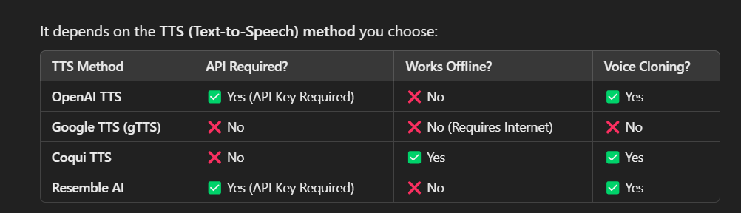
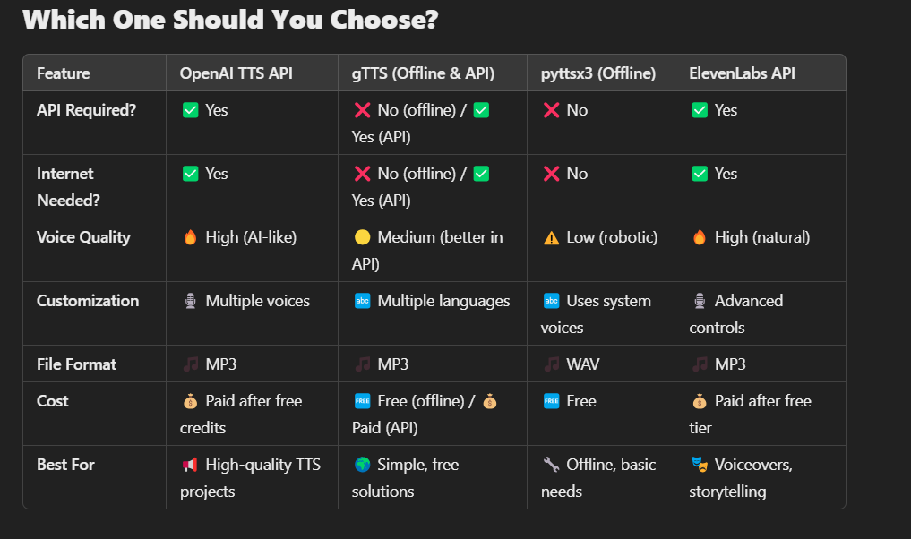

Slide 12
Title: Whisper AI & Google WaveNet for Speech Processing
Objective: Identify the right Matrices for AI processing in the Embedded devices have limited resources (CPU, GPU, RAM, power).

Slide 13
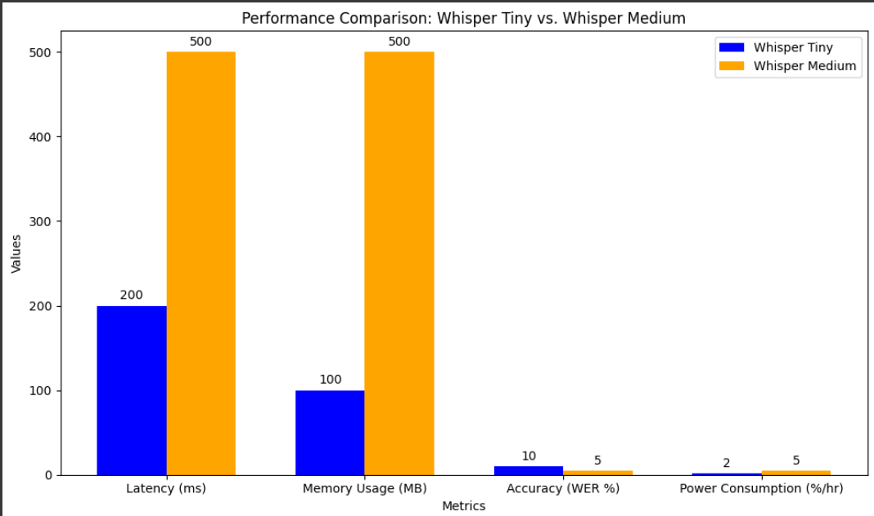
Matrices in Whisper AI
Whisper AI converts raw speech into text, but before that, it processes the audio in multiple steps.
Key reason: AI doesn’t "hear" like humans; it converts sound into mathematical representations (matrices) to understand speech.
Learning about these matrices helps optimize model performance on embedded devices.
Metric | Whisper Tiny | Whisper Medium | Trade-Off
Latency | 200ms | 500ms | Tiny is faster but less accurate.
Memory Usage | 100MB | 500MB | Tiny uses less memory.
Accuracy (WER) | 0.1 | 0.05 | Medium is more accurate.
Power Consumption | 2% battery/hour | 5% battery/hour | Tiny is more power-efficient.

Slide 14
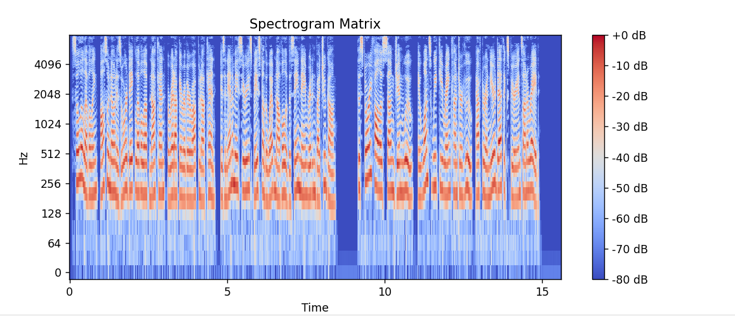
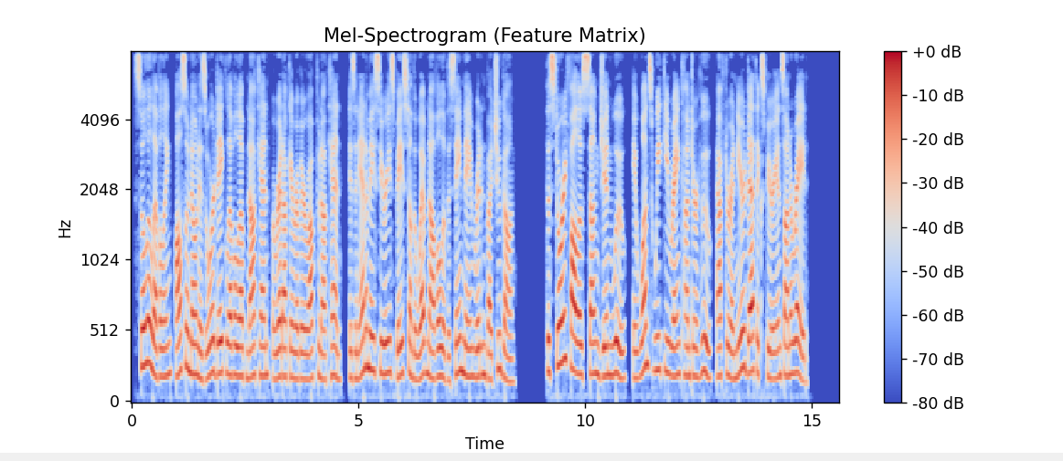
Spectrogram Matrix (Whisper STT)
Converts raw audio into a visual representation of frequency over time.
Example: 256 x 100 matrix (256 frequency bins, 100 time frames).
Why is it important?
Helps AI detect speech patterns.
Reduces noise interference.
Feature Matrix (Whisper STT)
Extracts linguistic features from the spectrogram.
It acts as a compressed version of important audio information for the model.
Example: Converts 256x100 Spectrogram to a smaller Feature Matrix for better processing.

Slide 15
Output Probability Matrix (Whisper STT)
Whisper predicts possible words based on extracted features.
Each word gets a probability score (likelihood of being correct).
Example:
"Hello" → 85%
"Hollow" → 10%
"Halo" → 5%
The word with the highest probability is chosen as output.

Slide 16
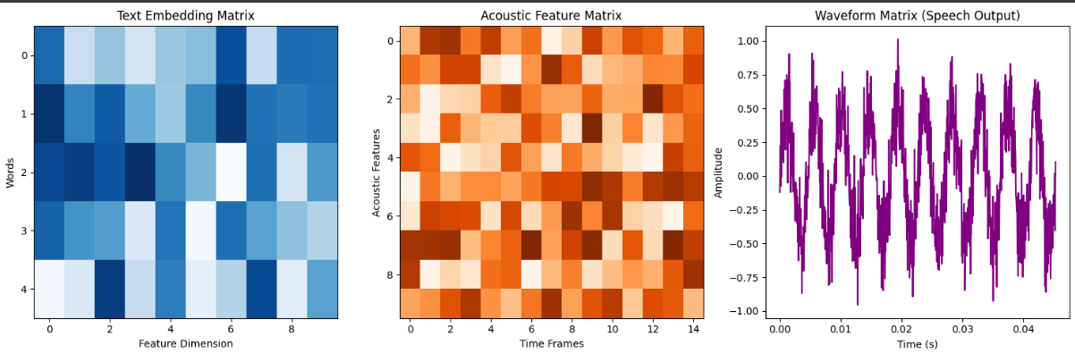
Google WaveNet for Text-to-Speech (TTS)
Text Embedding Matrix (Blue heatmap) → Converts text into numerical vectors.
Acoustic Feature Matrix (Orange heatmap) → Converts embeddings into speech features. Waveform Matrix (Purple waveform) → The final speech output generated by WaveNet.
It converts text into realistic speech (like a human voice).
It uses deep learning to generate natural sounds.
How does it work?
Text Embedding Matrix → Converts words into numbers (so the computer understands).
Acoustic Feature Matrix → Adds tone, pitch, and pronunciation.
Waveform Matrix → Creates the final sound that we hear.

Slide 17
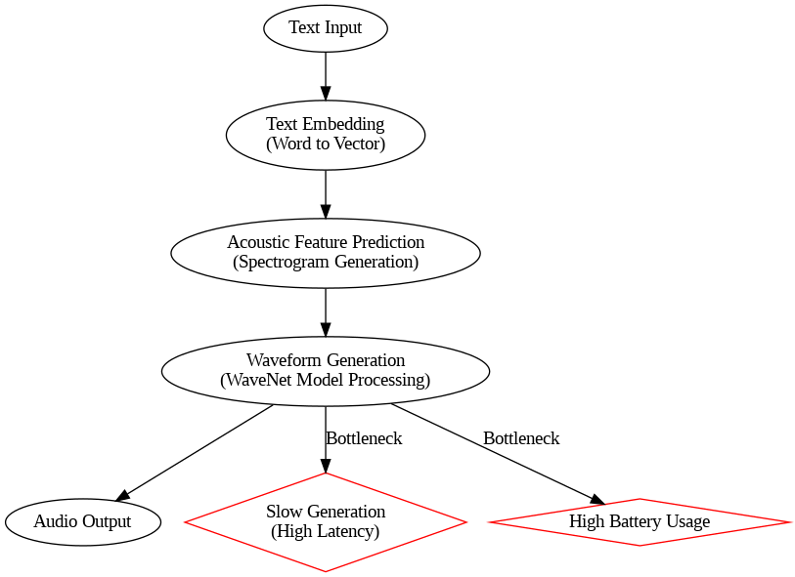
Performance Metrics for Embedded Devices
Why do we care about performance?
Phones (like iPhones) have limited memory & power.
If Whisper (speech-to-text) or WaveNet (text-to-speech) is too slow, the user experience will be bad.
Running a large AI model on a mobile device can cause high latency, battery drain, and memory issues.
Key Performance Factors:
Latency → How fast does it convert speech to text?
Memory Usage → How much RAM & storage does it need?
Accuracy → How correct are the transcriptions?
Power Consumption → How much battery does it drain?
Flowchart of WaveNet’s Text-to-Speech Process with bottlenecks (slow generation, battery usage).

Slide 18
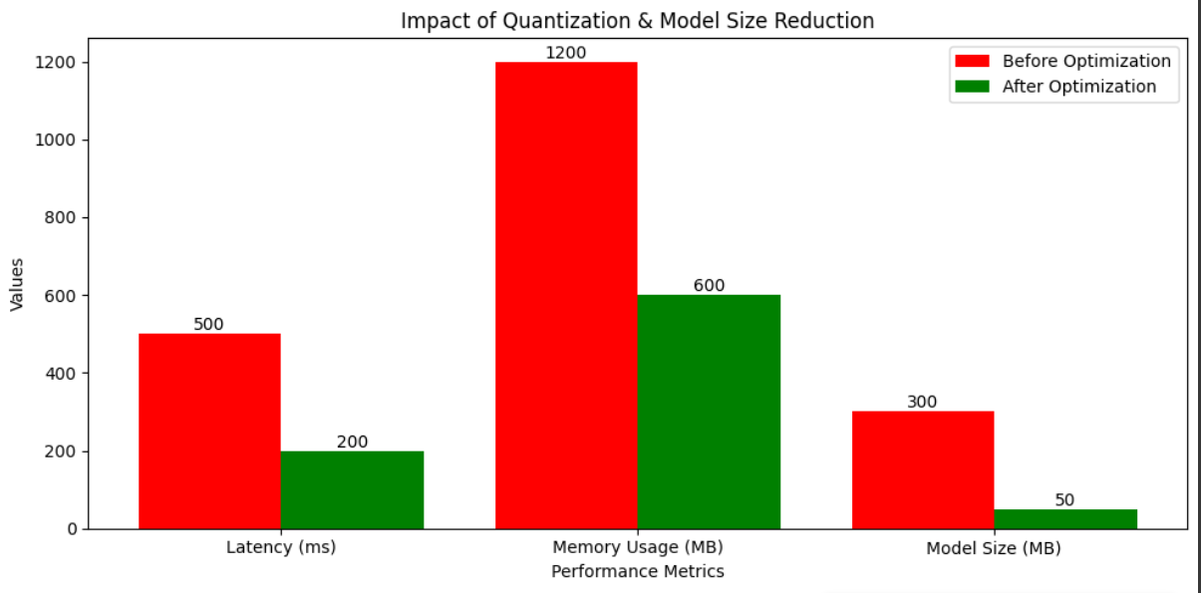
Challenges for iPhone Deployment
The Challenge:
iPhones are powerful but have limited resources compared to big computers.
Running Whisper AI as it is might drain battery & slow down the phone.
Google WaveNet Performance Challenges on iPhone
Slow Speech Generation – High latency in real-time speech.
Large Model Size – Consumes storage and memory.
High Battery Usage – Intensive computation drains power.
Needs Low Latency for Real-time Responses – Delay in voice assistants.
🔴 Before Optimization (Red Bars) → Higher latency, memory usage, and model size. 🟢 After Optimization (Green Bars) → Lower values due to quantization.

Slide 19
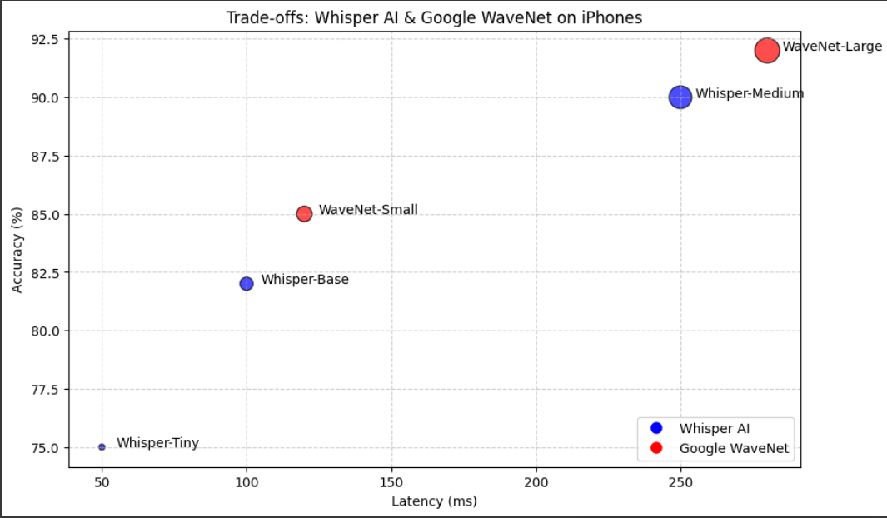
Optimization Approach for Whisper & WaveNet
Reduce Model Size – Use Tiny models & quantization. [Distilled WaveNet]
Utilize iPhone’s Hardware – Leverage GPU & Neural Engine for AI tasks.
Implement Low-Latency Streaming – Process data incrementally for real-time performance.
Balance Quality vs. Performance – Adjust sample rates, bitrate, and precision. i.e Generates speech word by word for real-time response.
Solutions to make it work on iPhone:
Use a smaller model → Instead of “medium,” try “tiny” or “base” for Whisper.
Quantization → Reduce model size without losing accuracy.
Memory Optimization → Adjust settings so it fits iPhone’s hardware.

Slide 20
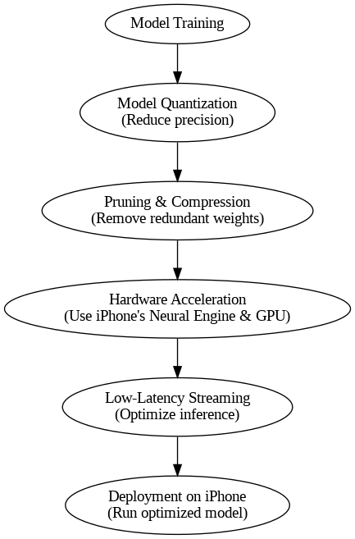
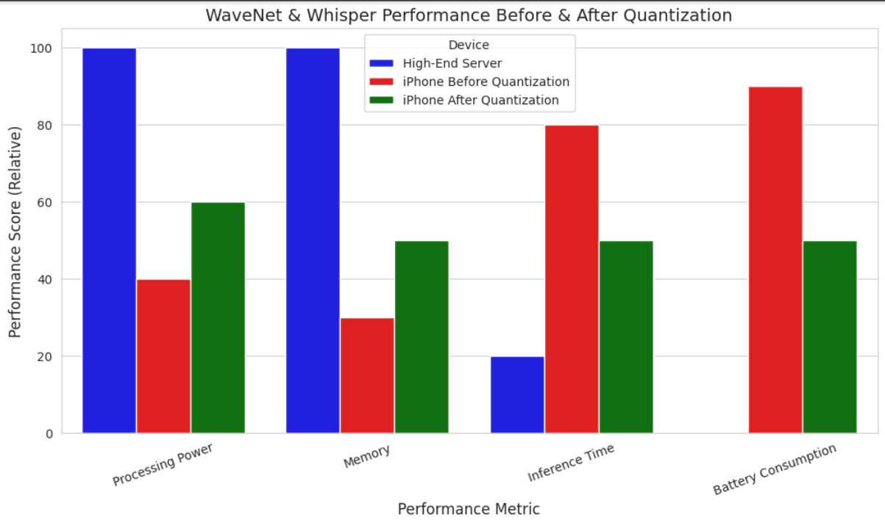
A Flowchart of Model Optimization Steps (Quantization, Acceleration, Low-Latency Streaming)
Key Insights from the Graph
Processing Power: Improved from 40% to 60% after quantization.
Memory Usage: Increased efficiency from 30% to 50%.
Inference Time: Reduced from 80ms to 50ms per sample.
Battery Consumption: Much lower, dropping from 90% to 50%.

Slide 21
Thank you!😊

Slide 22
Dataset | Language | Size | Link
LJSpeech | English | ~2.6 GB | LJSpeech
VCTK | English | ~10 GB | VCTK
Common Voice | Multilingual | Varies | Common Voice
LibriTTS | English | ~80 GB | LibriTTS
Thorsten | German | ~1.5 GB | Thorsten
CSS10 | Multilingual | Varies | CSS10
Baker | Chinese | ~5 GB | Baker
MAILABS | Multilingual | Varies | M-AILABS
Blizzard Challenge | English | Varies | Blizzard
OpenBible | African Languages | Varies | OpenBible
Nancy | French | ~1.5 GB | Nancy
SIWIS | Swiss French | ~5 GB | SIWIS
JSUT | Japanese | ~5 GB | JSUT
KSS | Korean | ~13 GB | KSS
Indic TTS | Indian Languages | Varies | Indic TTS
Arctic | English | ~5 GB | Arctic
TED-LIUM | English | ~30 GB | TED-LIUM
VoxCeleb | Multilingual | ~150 GB | VoxCeleb

Slide 23
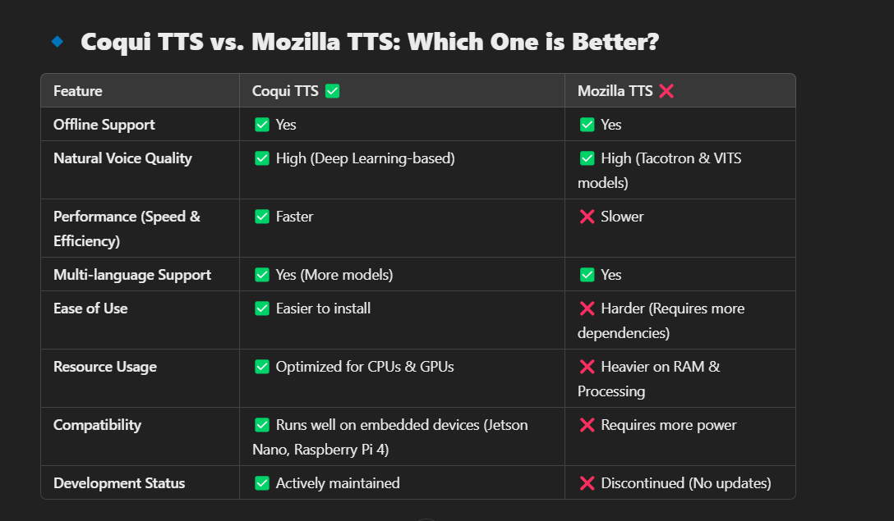
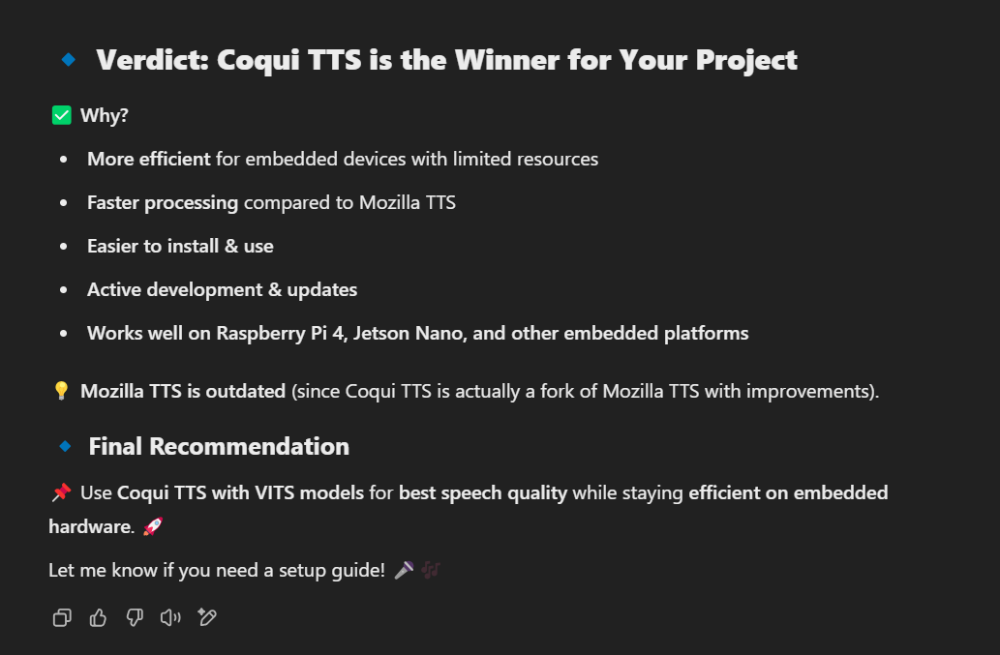

Slide 24
A. Coqui TTS
Coqui TTS is an open-source text-to-speech library with a wide range of pre-trained models.
It supports multiple languages, datasets, and model architectures.
Models are categorized into TTS models, vocoders, and voice conversion models.

Slide 25
Dataset | Language | Size | Link
LJSpeech | English | ~2.6 GB | LJSpeech
VCTK | English | ~10 GB | VCTK
Common Voice | Multilingual | Varies | Common Voice
LibriTTS | English | ~80 GB | LibriTTS
Thorsten | German | ~1.5 GB | Thorsten
CSS10 | Multilingual | Varies | CSS10
Baker | Chinese | ~5 GB | Baker
MAILABS | Multilingual | Varies | M-AILABS
Blizzard Challenge | English | Varies | Blizzard
OpenBible | African Languages | Varies | OpenBible
Nancy | French | ~1.5 GB | Nancy
SIWIS | Swiss French | ~5 GB | SIWIS
JSUT | Japanese | ~5 GB | JSUT
KSS | Korean | ~13 GB | KSS
Indic TTS | Indian Languages | Varies | Indic TTS
Arctic | English | ~5 GB | Arctic
TED-LIUM | English | ~30 GB | TED-LIUM
VoxCeleb | Multilingual | ~150 GB | VoxCeleb

Slide 26
Key TTS Models
English Models:
Tacotron 2: High-quality, slower.
Glow-TTS: Faster, lighter.
VITS: Natural prosody, end-to-end.
FastPitch: Control over pitch and duration.
Multi-Speaker (VCTK): Different voices for different characters.
Multilingual Models:
XTTS v2: Supports multiple languages.
YourTTS: Customizable for multilingual use.
Other Languages:
German, French, Spanish, Chinese, Japanese, and more.
Use Cases
Text-to-Speech for Applications:
Use tts_models/en/ljspeech/tacotron2-DDC for high-quality English speech.
Multilingual TTS:
Use tts_models/multilingual/multi-dataset/xtts_v2 for multilingual support.
Voice Cloning:
Use tts_models/en/vctk/vits for multi-speaker voice cloning.
Real-Time TTS:
Use lightweight models like tts_models/en/ljspeech/glow-tts.
1. English Models : These models are specifically trained for English text-to-speech synthesis. They are built on popular datasets like LJSpeech and VCTK.
2. Multilingual Models :These models support multiple languages and are trained on diverse datasets.
3. Models for Other Languages : Coqui TTS supports a wide range of languages beyond English. Here are some examples:

Slide 27
(base) PS C:\Users\anils\Music\Intern\TTS> tts --list_models
Name format: type/language/dataset/model
1: tts_models/multilingual/multi-dataset/xtts_v2
2: tts_models/multilingual/multi-dataset/xtts_v1.1
3: tts_models/multilingual/multi-dataset/your_tts [already downloaded]
4: tts_models/multilingual/multi-dataset/bark
5: tts_models/bg/cv/vits
6: tts_models/cs/cv/vits
7: tts_models/da/cv/vits
8: tts_models/et/cv/vits
9: tts_models/ga/cv/vits
10: tts_models/en/ek1/tacotron2
11: tts_models/en/ljspeech/tacotron2-DDC [already downloaded]
12: tts_models/en/ljspeech/tacotron2-DDC_ph
13: tts_models/en/ljspeech/glow-tts [already downloaded]
14: tts_models/en/ljspeech/speedy-speech
15: tts_models/en/ljspeech/tacotron2-DCA
16: tts_models/en/ljspeech/vits [already downloaded]
17: tts_models/en/ljspeech/vits--neon
18: tts_models/en/ljspeech/fast_pitch [already downloaded]
19: tts_models/en/ljspeech/overflow
20: tts_models/en/ljspeech/neural_hmm
21: tts_models/en/vctk/vits [already downloaded]
22: tts_models/en/vctk/fast_pitch
23: tts_models/en/sam/tacotron-DDC
24: tts_models/en/blizzard2013/capacitron-t2-c50
25: tts_models/en/blizzard2013/capacitron-t2-c150_v2
26: tts_models/en/multi-dataset/tortoise-v2
27: tts_models/en/jenny/jenny
28: tts_models/es/mai/tacotron2-DDC
29: tts_models/es/css10/vits
30: tts_models/fr/mai/tacotron2-DDC
31: tts_models/fr/css10/vits
32: tts_models/uk/mai/glow-tts

Slide 28
33: tts_models/uk/mai/vits
34: tts_models/zh-CN/baker/tacotron2-DDC-GST
35: tts_models/nl/mai/tacotron2-DDC
36: tts_models/nl/css10/vits
37: tts_models/de/thorsten/tacotron2-DCA
38: tts_models/de/thorsten/vits
39: tts_models/de/thorsten/tacotron2-DDC
40: tts_models/de/css10/vits-neon
41: tts_models/ja/kokoro/tacotron2-DDC
42: tts_models/tr/common-voice/glow-tts
43: tts_models/it/mai_female/glow-tts
44: tts_models/it/mai_female/vits
45: tts_models/it/mai_male/glow-tts
46: tts_models/it/mai_male/vits
47: tts_models/ewe/openbible/vits
48: tts_models/hau/openbible/vits
49: tts_models/lin/openbible/vits
50: tts_models/tw_akuapem/openbible/vits
51: tts_models/tw_asante/openbible/vits
52: tts_models/yor/openbible/vits
53: tts_models/hu/css10/vits
54: tts_models/el/cv/vits
55: tts_models/fi/css10/vits
56: tts_models/hr/cv/vits
57: tts_models/lt/cv/vits
58: tts_models/lv/cv/vits
59: tts_models/mt/cv/vits
60: tts_models/pl/mai_female/vits
61: tts_models/pt/cv/vits
62: tts_models/ro/cv/vits
63: tts_models/sk/cv/vits
64: tts_models/sl/cv/vits
65: tts_models/sv/cv/vits
66: tts_models/ca/custom/vits
67: tts_models/fa/custom/glow-tts
68: tts_models/bn/custom/vits-male
69: tts_models/bn/custom/vits-female
70: tts_models/be/common-voice/glow-tts

Slide 29
Name format: type/language/dataset/model
1: vocoder_models/universal/libri-tts/wavegrad
2: vocoder_models/universal/libri-tts/fullband-melgan
3: vocoder_models/en/ek1/wavegrad
4: vocoder_models/en/ljspeech/multiband-melgan [already downloaded]
5: vocoder_models/en/ljspeech/hifigan_v2 [already downloaded]
6: vocoder_models/en/ljspeech/univnet
7: vocoder_models/en/blizzard2013/hifigan_v2
8: vocoder_models/en/vctk/hifigan_v2
9: vocoder_models/en/sam/hifigan_v2
10: vocoder_models/nl/mai/parallel-wavegan
11: vocoder_models/de/thorsten/wavegrad
12: vocoder_models/de/thorsten/fullband-melgan
13: vocoder_models/de/thorsten/hifigan_v1
14: vocoder_models/ja/kokoro/hifigan_v1
15: vocoder_models/uk/mai/multiband-melgan
16: vocoder_models/tr/common-voice/hifigan
17: vocoder_models/be/common-voice/hifigan
Name format: type/language/dataset/model
1: voice_conversion_models/multilingual/vctk/freevc24 [already downloaded]

Slide 30
1. English (en)
LJSpeech Dataset:
tts_models/en/ljspeech/tacotron2-DDC
tts_models/en/ljspeech/glow-tts
tts_models/en/ljspeech/vits
tts_models/en/ljspeech/fast_pitch
tts_models/en/ljspeech/speedy-speech
tts_models/en/ljspeech/tacotron2-DCA
tts_models/en/ljspeech/neural_hmm
tts_models/en/ljspeech/overflow
tts_models/en/ljspeech/vits--neon
VCTK Dataset (Multi-Speaker):
tts_models/en/vctk/vits
tts_models/en/vctk/fast_pitch
Other English Datasets:
tts_models/en/ek1/tacotron2
tts_models/en/blizzard2013/capacitron-t2-c50
tts_models/en/blizzard2013/capacitron-t2-c150_v2
tts_models/en/multi-dataset/tortoise-v2
tts_models/en/sam/tacotron-DDC
tts_models/en/jenny/jenny
2. Multilingual
tts_models/multilingual/multi-dataset/xtts_v2
tts_models/multilingual/multi-dataset/xtts_v1.1
tts_models/multilingual/multi-dataset/your_tts
tts_models/multilingual/multi-dataset/bark

Slide 31
tts_models/uk/mai/vits (Ukrainian)
tts_models/tr/common-voice/glow-tts (Turkish)
tts_models/it/mai_female/glow-tts (Italian)
tts_models/it/mai_female/vits (Italian)
tts_models/it/mai_male/glow-tts (Italian)
tts_models/it/mai_male/vits (Italian)
tts_models/ewe/openbible/vits (Ewe)
tts_models/hau/openbible/vits (Hausa)
tts_models/lin/openbible/vits (Lingala)
tts_models/tw_akuapem/openbible/vits (Twi)
tts_models/tw_asante/openbible/vits (Twi)
tts_models/yor/openbible/vits (Yoruba)
tts_models/hu/css10/vits (Hungarian)
tts_models/el/cv/vits (Greek)
tts_models/fi/css10/vits (Finnish)
tts_models/hr/cv/vits (Croatian)
tts_models/lt/cv/vits (Lithuanian)
tts_models/lv/cv/vits (Latvian)
tts_models/mt/cv/vits (Maltese)
tts_models/pl/mai_female/vits (Polish)
tts_models/pt/cv/vits (Portuguese)
tts_models/ro/cv/vits (Romanian)
tts_models/sk/cv/vits (Slovak)
tts_models/sl/cv/vits (Slovenian)
tts_models/sv/cv/vits (Swedish)
tts_models/ca/custom/vits (Catalan)
tts_models/fa/custom/glow-tts (Persian)
tts_models/bn/custom/vits-male (Bengali)
tts_models/bn/custom/vits-female (Bengali)
tts_models/be/common-voice/glow-tts (Belarusian)
c. Other Languages
German (de):
tts_models/de/thorsten/tacotron2-DCA
tts_models/de/thorsten/vits
tts_models/de/thorsten/tacotron2-DDC
tts_models/de/css10/vits-neon
French (fr):
tts_models/fr/mai/tacotron2-DDC
tts_models/fr/css10/vits
Spanish (es):
tts_models/es/mai/tacotron2-DDC
tts_models/es/css10/vits
Chinese (zh-CN):
tts_models/zh-CN/baker/tacotron2-DDC-GST
Japanese (ja):
tts_models/ja/kokoro/tacotron2-DDC
Other Languages:
tts_models/bg/cv/vits (Bulgarian)
tts_models/cs/cv/vits (Czech)
tts_models/da/cv/vits (Danish)
tts_models/et/cv/vits (Estonian)
tts_models/ga/cv/vits (Irish)
tts_models/uk/mai/glow-tts (Ukrainian)

Slide 32

from TTS.api import TTS
# Step 1: Initialize the TTS model
tts = TTS(model_name="tts_models/en/ljspeech/tacotron2-DDC")
# Step 2: Provide input text
text = "Hello, how are you?"
# Step 3: Generate speech and save to a file
tts.tts_to_file(text=text, file_path="output.wav")
Output.wav

Slide 33
REAL-TIME TTS
A real-time TTS (Text-to-Speech) system is one that can generate speech instantly as the text is provided, with minimal delay. This is crucial for applications like virtual assistants, navigation systems, or live captioning, where the response needs to be immediate.
What is Real-Time TTS?
Real-time TTS means the system can convert text to speech with low latency (almost instantly).
The goal is to make the speech generation fast enough so that it feels natural and responsive to the user.
How Does Real-Time TTS Work?
Real-time TTS systems use lightweight models and optimized pipelines to minimize delay. Here’s how it works:
Step 1: Input Text
The user provides text input (e.g., "What’s the weather today?").
Step 2: Text Processing
The system processes the text to determine pronunciation, language, and tone.
Step 3: Speech Synthesis
A fast TTS model (e.g., Glow-TTS or FastSpeech) converts the text into a mel-spectrogram (an intermediate representation of speech).
A lightweight vocoder (e.g., HiFi-GAN or WaveRNN) converts the mel-spectrogram into audio waveforms (the actual sound).
Step 4: Output Audio
The system plays the audio immediately, with minimal delay.

Slide 34
Real-Time TTS Use Cases
Virtual Assistants:
Alexa, Google Assistant, and Siri use real-time TTS to respond to user queries instantly.
Navigation Systems:
GPS devices use real-time TTS to give turn-by-turn directions.
Live Captioning:
Real-time TTS is used to convert live speech into text and back into speech for accessibility.
Gaming:
Real-time TTS is used to generate character dialogues dynamically.

Slide 35
