Slide 1
Analysis of Air Tranportation Statistics Data to Discover the Potential Factors Behind Revenue Losses
Presented by: ANIL SENER

Slide 2
Agenda
Introduction
US Air Transportation Market in 2014
Insights Discovered via US Air Transportation Data Analysis
Recommendations & Next Actions

Slide 3
I. Introduction

Slide 4
Potential Drivers Revenue Losses in Air Transportation Sector
Decrease in Ticket Sales
Decrease in VAS Revenue
Ticket Fare & Demand Volatilities
Operational Inefficiencies
i. Flight Delays
ii. Flight Cancellations or Divertions

Slide 5
Potential Benefits of Air Transportation Data Analysis for Year 2014
Discovery of the most important Flight Routes
Understanding the impact of Flight Delays, Cancellations & Divertions on Ticket Sales Revenues
Observing Temporal Market Patterns in Flights by US Carriers
Benchmarking the position of your company with respect to other US carriers
Providing recommendations to guide you on opportunities to gain competitive advantage

Slide 6
II. US Air Transportation Market in 2014

Slide 7
Key Facts about US Air Transportation Market: Annual Passengers
761,003,553 Total Passengers with 83.43 % Load Factor
in 2014 by US Carriers.
There is 2.72 % growth in Total Passengers in 2014:
Domestic Flight Passengers increased by 2.66 %
International Flights Passengers increased by 3.15 %
Source: https://www.transtats.bts.gov/Data_Elements.aspx?Data=1

Slide 8
Key Facts about US Air Transportation Market: Operating Revenue
207,713,887,000 $ Operating Revenue is generated in 2014
by US Carriers: %70 from Domestic Flights
There is 3.73 % growth in Operating Revenue in 2014:
Domestic Flight Passengers increased by 4.83 %
International Flights Passengers decreased by -14.82 %
Source: https://www.transtats.bts.gov/Data_Elements.aspx?Data=7

Slide 9
III. Insights Discovered via US Air Transportation Data Analysis

Slide 10



Initial Dataset Exploration
Those features with missing fields are encountered in Cancelled & Diverted flights!
Flown Flights required in Q1 & Q2 correspond to the flights which are not cancelled: 5,692,827 in 2014
Diverted Flight | A flight that is required to land at a destination other than the original scheduled destination for reasons beyond the control of the pilot/company. ( Airline On-Time Performance Data )
Cancelled Flight | A flight that was listed in a carrier's computer reservation system during the seven calendar days prior to scheduled departure but was not operated. ( Airline On-Time Performance Data)
ARR_DELAY_NEW | ARR_DELAY_NEW Difference in minutes between scheduled and actual arrival time. Early arrivals set to 0.
DEP_DELAY_NEW | Difference in minutes between scheduled and actual departure time. Early departures set to 0.
Adjusted fields are selected to calculate actual delays, since they early arrivals or departures might not diminish the negative impacts of delays.
Duplicate Codes in Carrier Lookup due to changing carrier names over time 14 Unique Carriers available
Unique Codes in Airport Lookup , it includes both domestic & non-domestic airport
Source:https://www.transtats.bts.gov/Glossary.asp?index=D

Slide 11
Most Important Flight Routes
5,678,378 Flights were flown for 4717 Flight Routes by US air carriers
Atlanta -> Orlando Route has 7 times as much as Flights over the Average Flights Flown
Eliminated both Cancelled & Diverted Flights. Diverted Flights are eliminated because the destination of the route is not reached in reality!
RANK | ORIGIN CITY NAME | DESTINATION CITY NAME | ROUTE | FLOWN FLIGHT | PERCENTAGE
15 | Atlanta, GA | Orlando, FL | ATL->MCO | 8,356 | 0.1472%

Slide 12
Most Important Flight Routes
Top Flying Routes are followed by their round trips, it is a sign that airlines are retuning to their original airport for high traffic routes.
Revenue maximization on high traffic routes with high ratio of roundtrip might be an effective strategy which has potential contribution in increased Load Factor, however the no of flights should be allocated considering the competition created by the other carriers.
Answer to Q1!

Slide 13
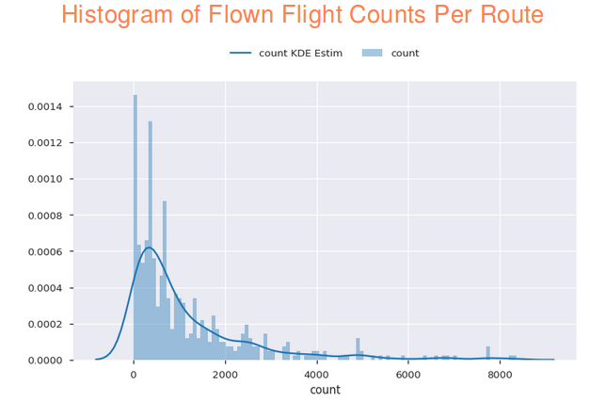
Most Important Flight Routes
The distribution of flights over Routes is rightward skewed (with a long tail on right).
There might be market expansion opportunities for your company for the flights in this long tail but you should take into account:
the economic feasibility of launching a new route from long tail,
characteristics of these route like distance, brand recognition & demand volumes accross time

Slide 14
Benchmarking with respect to other carriers
ExpressJet has flown 1.6 times as much as Average Flights Flown per Carrier
Eliminated only Cancelled Flights
This may provide an idea Market Share of Carriers in terms of Bulk Flight Volume in 2014, but it is hard to reach any conclusion on the actual revenues & losses during 2014 based on this output.
There are many other indicators that we should explore like the overall market trend, operational inefficiencies, changes in market focus and business model.
Answer to Q2!

Slide 15
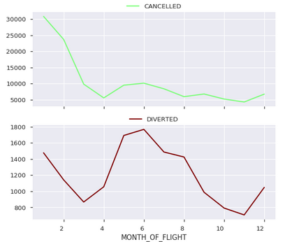
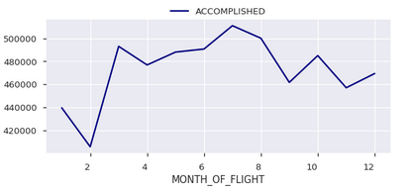
Temporal Patterns of Flight Delays, Cancellations & Divertions
When we visualized US carrier market flown flight trends, we observed cycles in Accomplished & Diverten flights, so we decided to decompose the seasonality from trend.

Slide 16
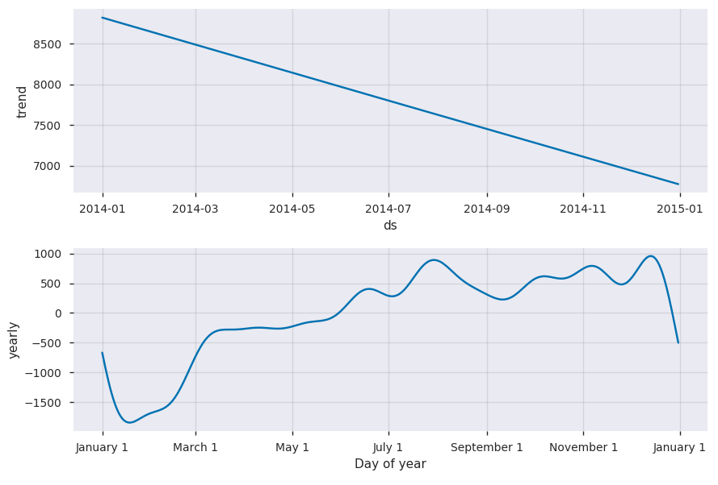
Temporal Market Patterns in Flights: Monthly Patterns for Flown Flight Counts
There seems to be a downward Market Flown Flight Trend during 2014(It is the flight Trends not passenger Trends)
This might be a signal of response from all US carriers, as a response to changing market demand.
Answer to Q5!
Note: Only Cancelled Flights are eliminated to calculate trend

Slide 17
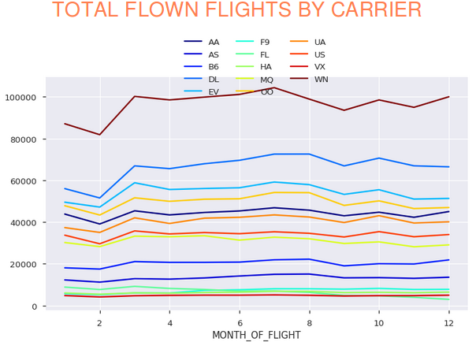
Bechmarking The Carriers
Flight Count Yearly Seasonality Component in the previous slide shows that high season for travelling with US Carriers is the second half of the year, however majority of carriers didn’t launch as much as flights as market trend is negative.
US carries seems to cluster in 3 different groups, SouthWest Airlines (WN) with high volume alone in the top cluster, ExpressJet (EV) in the middle cluster with a significant decrease in the flights flown in the second half of the year.
Answer to Q5!

Slide 18
Temporal Market Patterns in Flights: Monthly Patterns for Passenger Counts
This downward trend in Flown Flights, might be driven by decrease in Passenger after 6th month of the year, however this market level picture doesn’t provide much clue about the motivators behind the significant reduction in ExpressJet flights in the second half of the year.
Source: https://www.transtats.bts.gov/Data_Elements.aspx?Data=1

Slide 19
Carrier Level Summary Statistics
ExpressJet Airlines Inc. seems to have worse performance than its competitors in terms of Cancelled & Diverted Flights in 2014, this might be an indicator of revenue loss.
ExpressJet Airlines Inc. focused on shorter-distance flights relative to its competitors
ExpressJet Airlines Inc. has an average flight trend in flown flights relative to its competitors in 2014
High Cancellation rate in ExpressJet Airlines Inc. might not be totally attributed to Delays (Southwest has high delay as well), during 2014 ExpressJet reaches a peak in Cancellation Ratio.
(Note: Cancelled Flights are eliminated to calculate trend changes)
Answer to Q5!

Slide 20
ExpressJet Passenger Volume Profile
30,950,071 Total Passengers with 81.21 % Load Factor in 2014
by ExpressJet.
There is -6.09 % loss in Total Passengers in 2014:
Domestic Flight Passengers decreased by -6.43 %
International Flights Passengers decreased by -2.7 %
127,194,550 Total Passengers with 82.52 % Load Factor in 2014
by SouthWest.
There is 10.29 % growth in Total Passengers in 2014:
Domestic Flight Passengers increased by 9.86 %
International Flights in SouthWest started in 2014!!!
Source: https://www.transtats.bts.gov/Data_Elements.aspx?Data=1

Slide 21
ExpressJet Operating Revenue Profile
1,347,277,000 $ Operating Revenue is generated in 2014
by ExpressJet
There is -8.12% decline in Operating Revenue in 2014:
Domestic Flight Passengers decreased by -8.58%
Latin America Flights Passengers increased by 1.10%
18,605,116,000 $ Operating Revenue is generated in 2014
by SouthWest
There is 5.12% growth in Operating Revenue in 2014:
Domestic Flight Passengers increased by 5.10%
Latin America Flights Passengers increased by 6.73%
Source: https://www.transtats.bts.gov/Data_Elements.aspx?Data=7

Slide 22
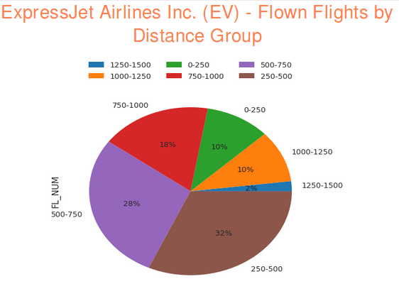
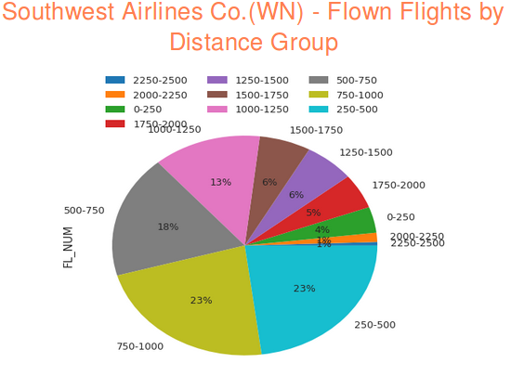
Opportunity: Longer Distance Routes?
ExpressJet Airlines benchmarked to Market Leader (in terms of flown flights) Southwest Airlines.
ExpressJet has no presence in flight routes longer than 1500 miles, %13 percent of overall flights of Southwest is in flight routes longer than 1500 miles
The previous slides show that the revenue growth in Southwest Airlines might be mostly because of long distance Domestic Flights & with a fair contribution of Latin America long distance flights.
Answer to Q5!

Slide 23
The Impact of Flight Delays, Cancellations & Divertions
ARR_DELAY_NEW field is used to calculate the TOTAL ARRIVAL DELAY
DEP_DELAY_NEW field is used to calculate the TOTAL DEPARTURE DELAY
TOTAL DELAY = TOTAL ARRIVAL DELAY + TOTAL DEPARTURE DELAY
The risk & cost of delays (departure penalties, utilization loss per airplane) should be calculated for these top delay airports as they might be congested hubs. (Verified that these airports have also the inbound & outbound traffic in US)
Answer to Q3!

Slide 24
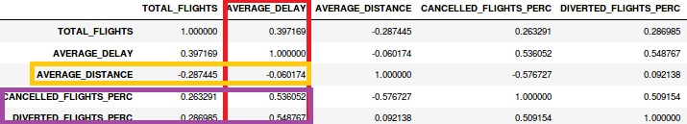
The Impact of Flight Delays, Cancellations & Divertions on Ticket Sales Revenues
We calculated correlations between some of the statistics in Carrier Level Summary Statistics:
Average Distance per Carrier doesn’t have viable correlation with Average Delay per Carrier. This might be evaluated as an encouraging indicator for our recommendation for your to conduct a feasibility study for long-distance flights markets expansion.
Average Delay per Carrier is also high in the carriers which have ahigh Cancelled & Diverted Flights Percentage. This gives a hint to focus on an optimization in flight planning & routes optimization to reduce Cancelled & Diverted Flights Rate by reducing Total Delay. (This should be supported with Hypothesis Testing)
Answer to Q5!

Slide 25
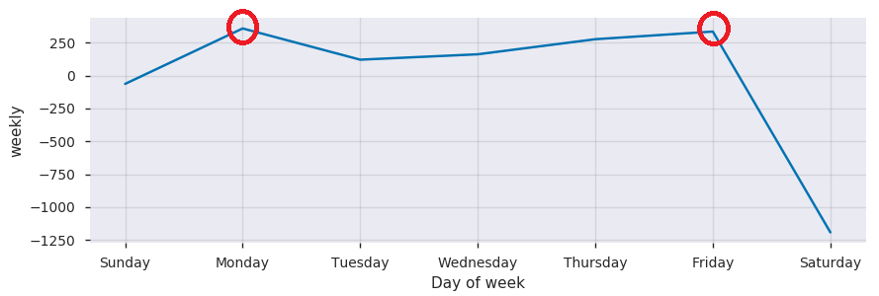
Temporal Market Patterns in Flights: Weekly Patterns for Flown Flights
Friday is discovered as the second day of week with highest no of Flown Flights (excluding only cancelled flights)
Weekly Seasonality Component
A secondary output of our Temporal Flight Analysis revealed that Monday & Friday was the peak points of Weekly Seasonality Component.
Answer to Q4!

Slide 26
Why Friday is 2nd most popular for travelling?
Weekly Roundtrip pattern might be the reason for the popularity of Friday.
We constructed a graph of potential paths of roundtrips for different days of the same week (<7 days). It is discovered that maximum no of Weekly Roundtrip Paths is Friday <-> Monday. So Friday might be great for departure for a weekend trip!
It is also important to mention second maximum no of Roundtrip Paths is available for Thursday <-> Friday
This observation directed us to a more scientific representation of the Popularity/Rank of the Days when we approach the first summary as a weighted directed network. As a result, we can observe Friday has the highest Rank (eigenvector centrality) in terms of weighted connections with other days.
Answer to Q4!

Slide 27
IV. Recommendations & Next Actions
Acknowledging that there is a high competition for these high traffic routes with high probability of roundtrip, it might be favorable to forecast the opportunity cost of scheduling the flight to these routes or dynamic pricing to be competitive.
Top weekly seasonality roundtrip patterns like Friday<->Monday has a high demand & potentially lower price elasticity especially for the return trips. This can be exploited to boost the revenues.
Executing an economic feasibility analysis for Long Distance Domestic & Latin American Flight Routes which are located in the long tail.
Testing the impact of Delays on High Cancellation & Divertion Rates is necessary. If significant improvement potential is available, executing a process control study to reduce Delays in flight departures & arrivals.
The risk & cost of delays should be calculated for the top delay airports as they are likely to be congested hubs. To avoid delays offering cheap flights in less congested hours or focusing on alternative hubs might evaluated.

Slide 28
Appendix:
Data Analysis Notebook

