Slide 1
Spark Cookbook - III
External Data Sources

Slide 2
Agenda
SparkContext & RDD
Loading data from local file system
Loading data from HDFS
Loading data from HDFS using custom InputFormat
Loading data from Amazon S3
Loading data from Cassandra
Loading data from relational database

Slide 3
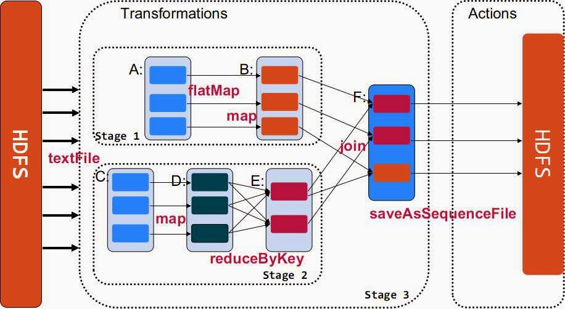
SparkContext & RDD
複習一隻spark程式的長相

Slide 4
SparkContext & RDD
Word Count (Scala)
val textFile = sc.textFile("hdfs://...")
val counts = textFile.flatMap(line => line.split(" "))
.map(word => (word, 1))
.reduceByKey(_ + _)
counts.saveAsTextFile("hdfs://...")

Slide 5

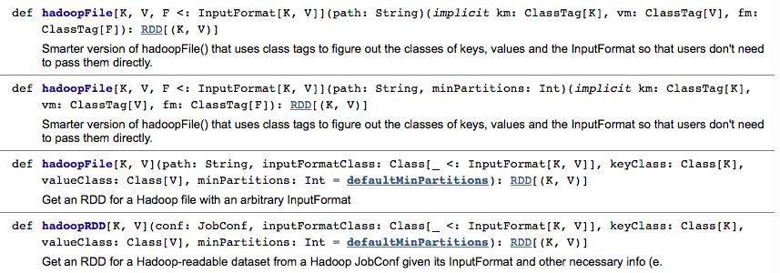
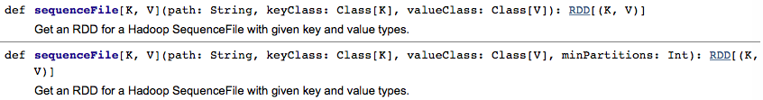

SparkContext support content format
http://spark.apache.org/docs/latest/api/scala/index.html#org.apache.spark.SparkContext

Slide 6
Loading data from Local File System
Word Count (Scala)
sc.textFile(“file:///home/hduser/words”)
.flatMap(_.split(”\\W+”))
.map( w => (w,1))
.reduceByKey((a,b) => (a+b))
.foreach(println)

Slide 7
Loading data from HDFS
Word Count (Scala)
sc.textFile(“hdfs://localhost:9000/user/hduser/words”)
.flatMap(_.split(”\\W+”))
.map( w => (w,1))
.reduceByKey((a,b) => (a+b))
.foreach(println)

Slide 8
Loading data from HDFS with custom InputFormat
Spark提供兩個讀取Hadoop file的method
sparkContext.hadoopFile
SparkContext.newAPIHadoopFile

Slide 9
Loading data from Amazon S3
Amazon S3 (Amazon Simple Storage Service)
val words = sc.textFile(“s3n://com.infoojects.wordcount/words”)

Slide 10
Loading data from RDB
Spark-shell –jar {mysql-connector-path}
JdbcRDD: A Spark feature that allows relational tables to be loaded as RDDs.
JdbcRDD( SparkContext, getConnection: () => Connection, sql: String, lowerBound: Long, upperBound: Long, numPartitions: Int, mapRow: (ResultSet) => T = JdbcRDD.resultSetToObjectArray)
Example: MySQL

Slide 11
Loading data from Apache Cassandra
私心:換成看MongoDB吧!

Slide 12
Loading data from MongoDB
安裝 MongoDB , 在test 下面建立 persons
下載 MongoDB 的 Spark connector
https://docs.mongodb.com/spark-connector/getting-started/

Slide 13
Loading data from MongoDB
參考RDB的範例執行, 並傳入參數
spark-shell
--packages org.mongodb.spark:mongo-spark-connector_2.10:1.0.0 (選擇 connector)
--conf (設定 mongodb 連線資訊, 及要存取的collection) "spark.mongodb.input.uri=mongodb://127.0.0.1/test.persons?readPreference=primaryPreferred"

Slide 14
Loading data from MongoDB
import com.mongodb.spark._
val rdd = MongoSpark.load(sc)
rdd.count
rdd.first.toJson

