Slide 1
BANGALORE HOUSE PRICE PREDICTION
Anila Peter

Slide 2
Objective
To develop a machine learning Regression model that predicts the prices of houses in Bangolore based on various features.

Slide 3
The real estate market in Bangalore is dynamic and rapidly evolving. With a growing population and increasing demand for housing, accurately predicting house prices has become essential for both buyers and sellers.
By developing house price prediction model, our goal is to empower stakeholders with valuable insights into the real estate market, enabling informed decision-making and facilitating smoother transactions.

Slide 4
Data Dictionary
Area_Type: The Type of Area of Property
Availability: Earliest time to move in the property, availability for possession.
Location: Locality or Area in the city
Size: Property Type (Like 3BHK, 4BHK)
Society: Name of the society
Total Sqft area: Area of property
Bathroom Nos: No of Bathroom in that particular Property
Balcony: No of Balcony
Price: Price of the property (target Column)

Slide 5
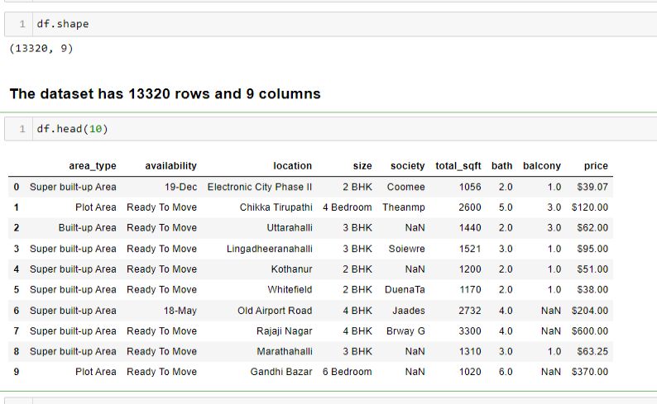
Shape and first few rows of the data set

Slide 6
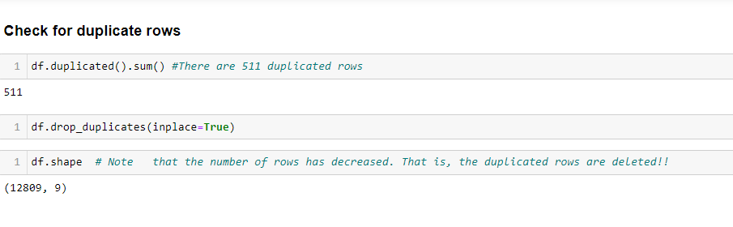
The duplicated rows are dropped

Slide 7
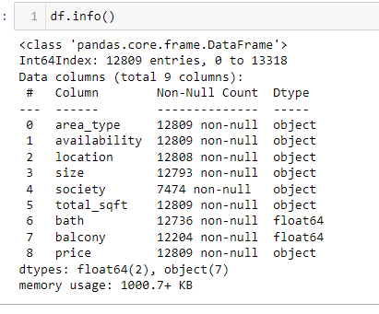
The columns size, totalsqft, and price are given as object data type. These columns can be are numerical columns and so we will convert them to either int or float data type.

Slide 8
To make the 'size' column numeric, we will remove terms BHK, Bedroom, RK... and just consider the number of rooms.
Changed the data type of column ‘size’ to ‘int’

Slide 9
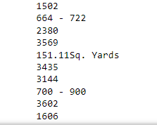
Cleaning values in column ‘total_sqft’
Looking through the values of column ‘total_sqft’ we found some of the values are given with units Sq. Meter, Sq. Yards, Acres, Grounds, Guntha, Perch and cents. These values should be converted to the unit of the column 'sqft'. Also some of the values are given as a range. We will find the average value for those given as a range.

Slide 10
Convert units using the following and then data type changed to float
1 Sq. Meter=10.764 sqft
1Sq. Yards=9 sqft
1Acre=43560 sqft
1Ground=2400 sqft
1Perch=272.25 sqft
1Cent=435.56 sqft
1 Guntha=1089 sqft

Slide 11
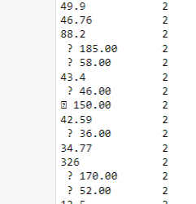
Cleaning values in column ‘price’
Looking through the values of column ‘price’ we found some of the values with special characters and some given as a range.
We removed the special characters and found average for those given as ranges.
Then changed the data type to ‘float’

Slide 12
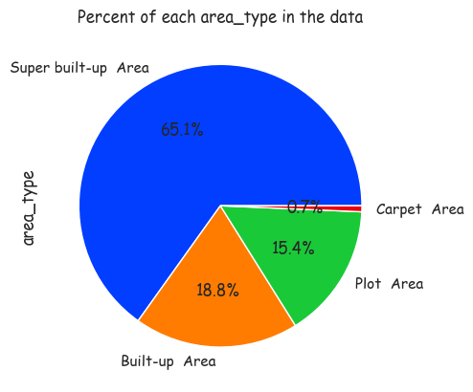
EDA
Majority of the records are of area type 'Super build_up area'. Only 0.7% of the records are of area_type 'Carpet area'.

Slide 13
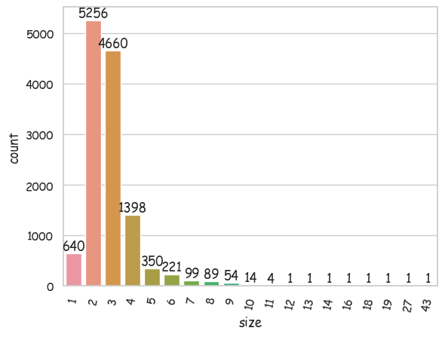
Count plot of column ‘size’
Most of the houses included in the data are either 2BHK or 3BHK

Slide 14
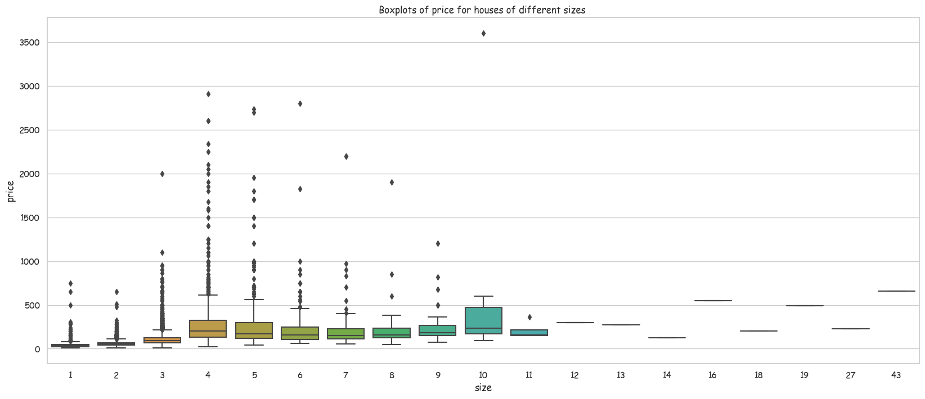
There are many outliers in the price values. The prices for same sized houses can vary based on the locations. So the outliers in prices can occur.

Slide 15
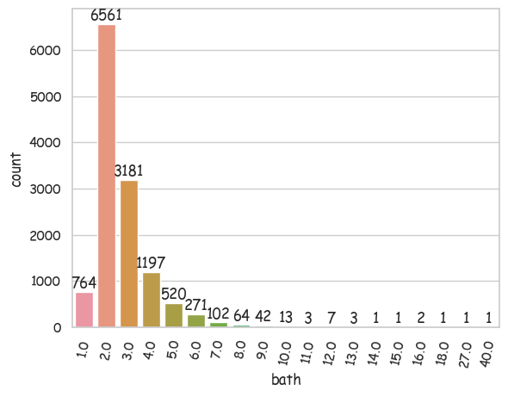
Count plot of column ‘bath’
Majority of the houses has two bathrooms

Slide 16
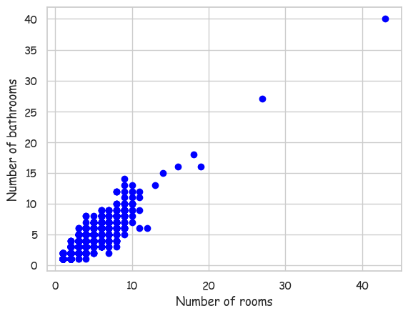
Scatter plot of ‘size’ versus ‘bath’
There is a strong positive correlation between the 'size' and 'bath' features. But strangely for some records, the number of bath rooms is more than number of rooms. These values might be due to some error and has to be treated.

Slide 17
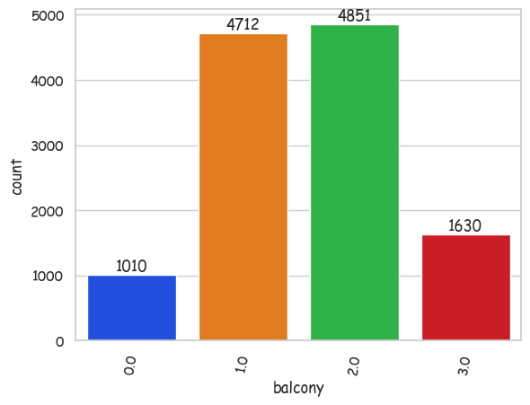
Count plot of column ‘balcony’
Most of the houses included in the data has 2 or 3 balconies.

Slide 18
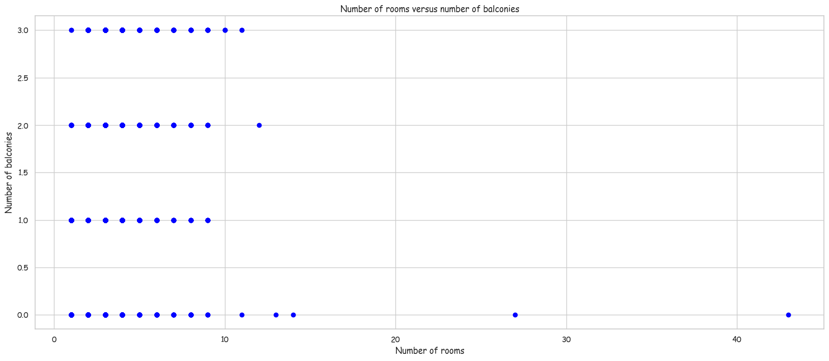
Scatter plot of ‘size’ versus ‘balcony’
There is no correlation between number of rooms and number of balconies. Also some houses with very large 'size' has no balconies.

Slide 19
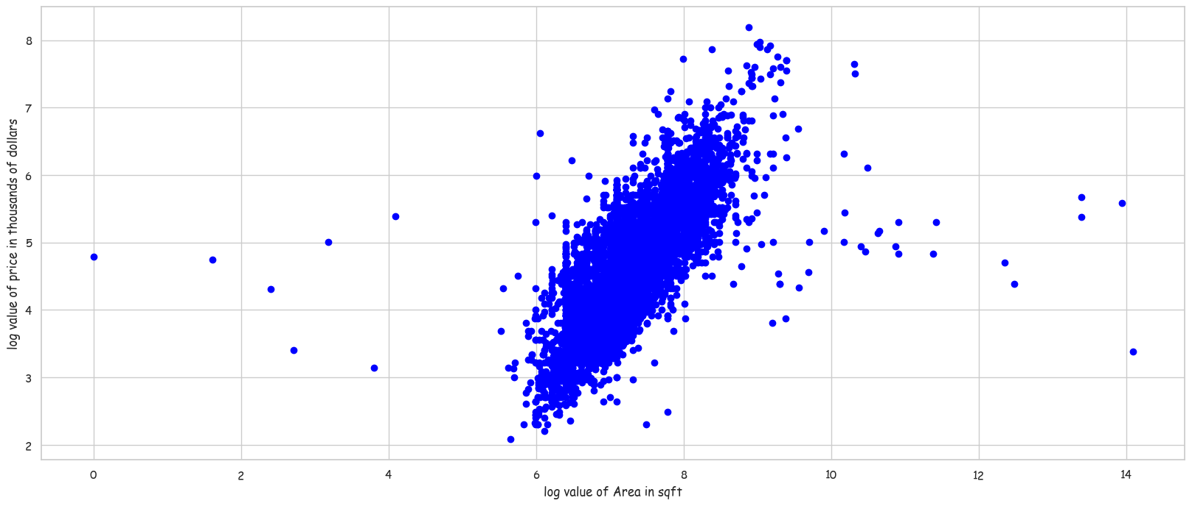
Scatter plot of log value of ‘total_sqft’ versus log value of ‘price’
There is positive correlation between 'total_sqft' and 'price'. There are some outliers which should be treated.

Slide 20
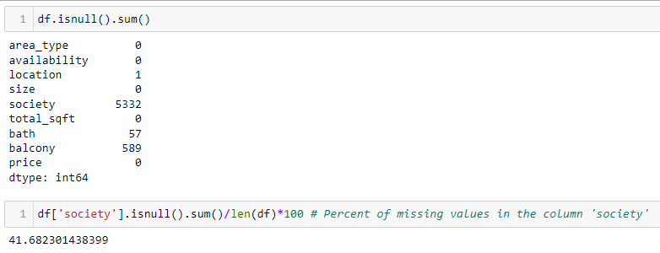
Handling Missing values
There are more than 40% missing values in the column 'society'. We will drop this column.
There are 589 missing values in the column 'balcony'. But in certain locations having balcony might influence the price. So we will keep the the column.

Slide 21
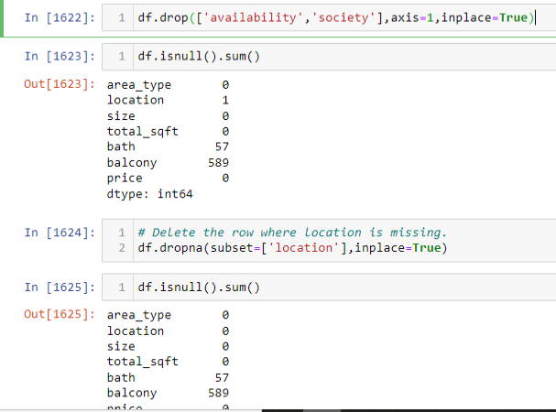
Drop the columns 'availability', 'society'
The column 'availability' does not affect the price prediction.
So drop it.
Also drop the record where location is missing

Slide 22
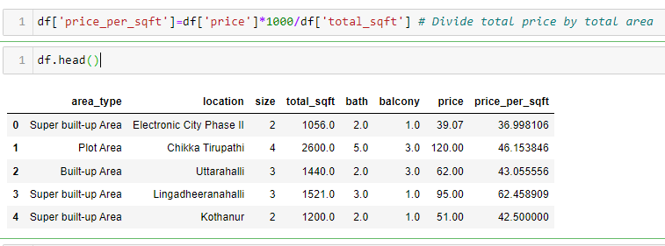
Outlier treatment
For each location price per sqft area will not vary much. Introduce a new column price per sqft, which can be used to find outliers.

Slide 23
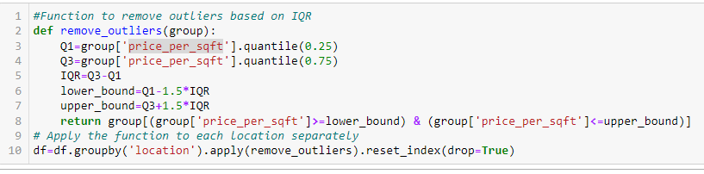
Outlier treatment
We will remove outliers based on column 'price per sqft' for each location, using IQR approach

Slide 24
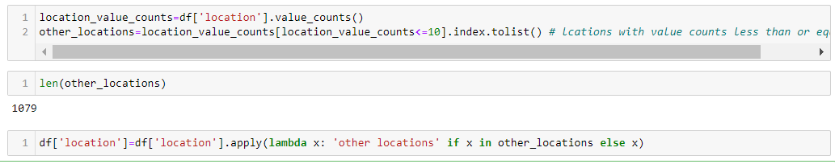
Dimensionality Reduction
There are 1304 unique values in the column 'location'. The number should be reduced before applying encoding otherwise one hot encoding will result in high dimensionality and high sparsity.
The locations with very few value counts may be unpopular locations and all these can be grouped together as 'other locations'. We will label locations with less than or equal to 10 value counts as 'other locations'.

Slide 25
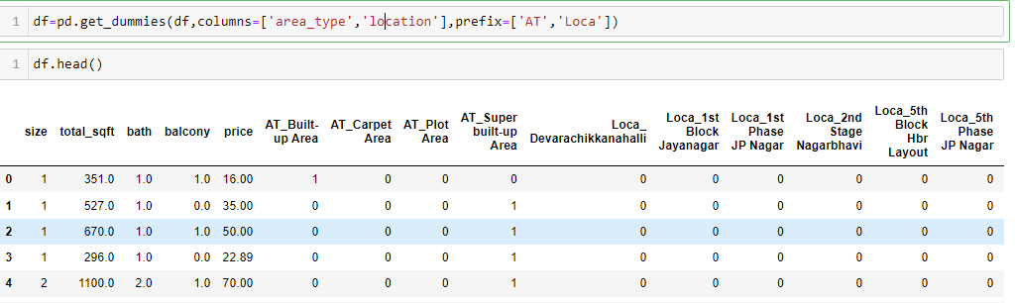
Encoding
Apply one hot encoding for the categorical columns ‘area_type’ and ‘location’

Slide 26

KNN Imputation
Apply KNN imputation for filling missing values in the columns ‘bath’ and ‘balcony’

Slide 27
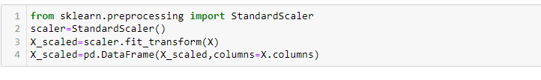
Separating the dependent variable (Target) and independent variables (Features)
Scaling the data

Slide 28

Train-test split
Importing regression models and evaluation metrics

Slide 29
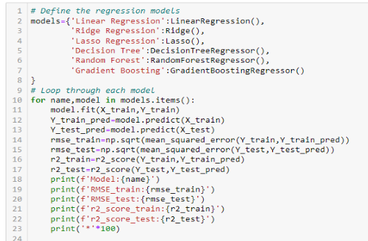
Loop through different models and find r2score

Slide 30
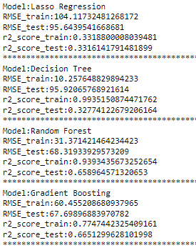
Random Forest regressor is giving r2 score for train is about 0.93 and for test is only 0.65. So, there is overfitting.

Slide 31
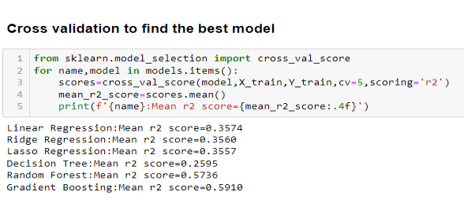
Random Forest and Gradient Boosting are giving the best mean r2 scores

Slide 32
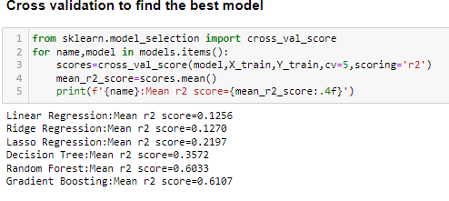
Random Forest and Gradient Boosting are giving the best mean r2 scores

Slide 33
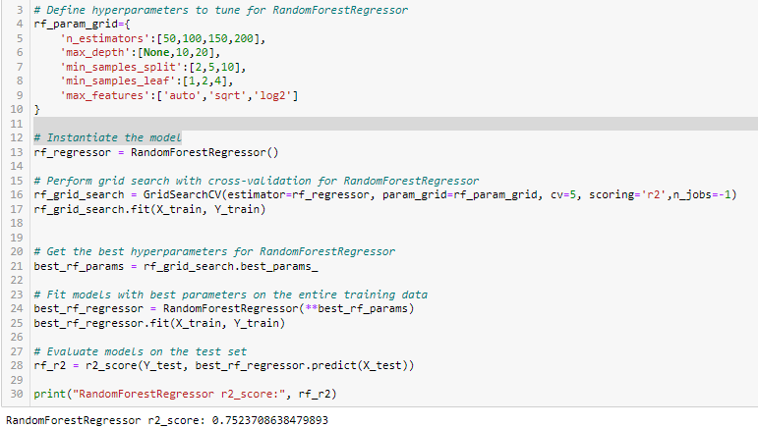
Hyperparameter tuning for Random Forest Regressor

Slide 34
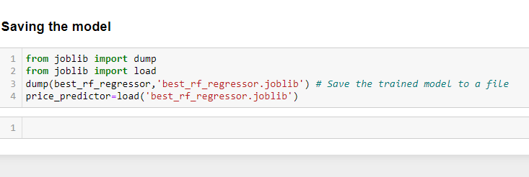
R2score has improved to about 0.75

Slide 35
Conclusion
Through this machine learning project, we aimed to develop a predictive model for house prices in Bangolore using various machine learning techniques.
We explored multiple regression models , including Linear Regression, Random Forest Regression, and Gradient Boosting Regression. After hyperparameter tuning and evaluation, the Random Forest Regression model achieved the best performance based on r2score.

Slide 36
Thank You

