Slide 1
Improving Model Performance: Hyperparameter Tuning
Deep Learning

Slide 2
Hyperparameters
Achieving optimal model performance is not always straightforward. It requires careful consideration and fine-tuning of various factors, including hyperparameters.
Hyperparameters are the configuration settings that are not learned from the training data but are set before the model training process begins.
They define the behavior and architecture of the model and directly influence its performance.
Hyperparameters are typically set by the data scientists or machine learning engineers and are tuned to optimize the model’s performance on a specific task.

Slide 3
Examples of hyperparameters
Learning Rate: The step size used in gradient-based optimization algorithms.
Batch Size: The number of training examples used in each iteration of the model training process.
Regularization Strength: The parameter that controls the amount of regularization applied to prevent overfitting.
Number of Hidden Units: The number of neurons or units in the hidden layers of a neural network.
Activation Function: The non-linear function applied to the output of each neuron in a neural network.

Slide 4
Impact of Hyperparameters on Model Performance
Hyperparameters directly influence the behavior and performance of machine learning models.
Choosing appropriate values for hyperparameters is critical to achieve optimal performance.
Improper settings can lead to underfitting or overfitting of the model, resulting in poor generalization and inaccurate predictions.
ex: a learning rate that is too large can cause the model to diverge during training,
while a learning rate that is too small may result in slow convergence or getting stuck in local optima.
Similarly, the choice of activation function can impact the model’s ability to capture complex patterns in the data.

Slide 5
How to identify hyperparameters?
Unfortunately, there are no set rules on which hyperparameters work best nor their optimal or default values.
You need to experiment to find the optimum hyperparameter set.
This activity is known as hyperparameter tuning or hyperparameter optimization.

Slide 6
How does hyperparameter tuning work?
The process of hyperparameter tuning is iterative, and you try out different combinations of parameters and values.
You generally start by defining a target variable such as accuracy as the primary metric, and you intend to maximize or minimize this variable.
It’s a good idea to use cross-validation techniques, so your model isn't centered on a single portion of your data.

Slide 7
Hyperparameter Tuning Techniques
1. Grid Search
Grid search is one of the simplest and most commonly used techniques for hyperparameter tuning. It involves defining a grid of possible hyperparameter values and exhaustively searching through all combinations to find the best set of hyperparameters.
The process of grid search can be summarized as follows:
Define the hyperparameter grid: Specify the range or list of values for each hyperparameter of interest.
Create a set of all possible hyperparameter combinations: Generate all possible combinations by taking one value from each hyperparameter’s range.
Evaluate models for each combination: Train and evaluate a model for each hyperparameter combination using a predefined evaluation metric.
Select the best hyperparameters: Choose the hyperparameter combination that yields the best performance on the evaluation metric.
Grid search provides a systematic approach to explore the hyperparameter space, ensuring that no combination is missed. However, it can be computationally expensive when dealing with a large number of hyperparameters or a wide range of values.

Slide 8
2. Random Search
Instead of examining every possible combination, random search samples hyperparameters randomly from predefined distributions or ranges.
The process of random search can be summarized as follows:
Define the hyperparameter distributions: Specify the distributions or ranges for each hyperparameter of interest.
Sample random hyperparameter combinations: Draw random samples from the defined distributions or ranges.
Evaluate models for each combination: Train and evaluate a model for each hyperparameter combination using a predefined evaluation metric.
Select the best hyperparameters: Choose the hyperparameter combination that yields the best performance on the evaluation metric.
Random search offers several advantages over grid search. It allows for a more diverse exploration of the hyperparameter space and can often discover good hyperparameter configurations more efficiently, especially when the impact of individual hyperparameters is unknown.

Slide 9
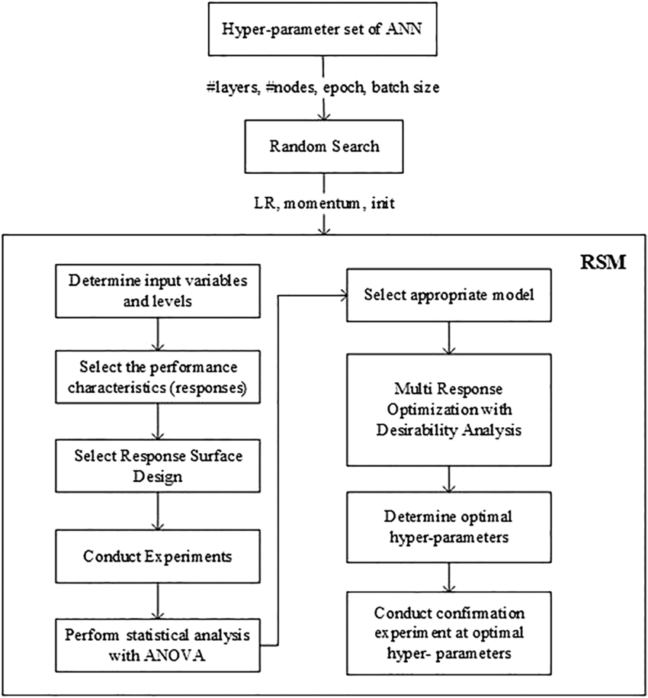

Slide 10
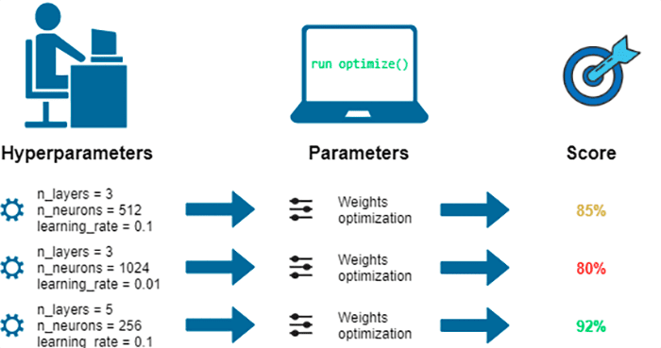

Slide 11
Explore more techniques that help hyperparameter optimization and prepare a report(minimum of 10)
Dataset Name | Hyperparameters | Values | Metric name | score

