Slide 1
Autoencoders Regularization Data Augmentation Early Stopping
Deep Learning

Slide 2
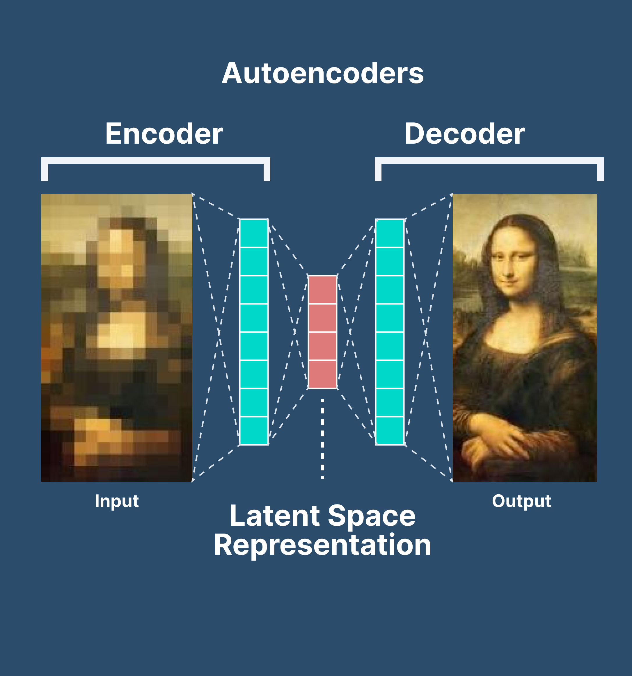

Slide 3
Autoencoders
Autoencoders provide outputs that are the same or similar to the input data—only compressed. In the case of variational autoencoders, often discussed in the context of large language models, the output is newly generated content

Slide 4
Autoencoders
Autoencoders are neural network-based models that are used for unsupervised learning purposes to discover underlying correlations among data and represent data in a smaller dimension.
The autoencoders frame unsupervised learning problems as supervised learning problems to train a neural network model.
The input only is passed as the output.
The input is squeezed down to a lower encoded representation using an encoder network, then a decoder network decodes the encoding to recreate back the input.

Slide 5
encoder
The encoding produced by the encoder layer has a lower-dimensional representation of the data and shows several interesting complex relationships among data.

Slide 6
An Autoencoder contains
Encoder: The encoder is the part of the network which takes in the input and produces a lower Dimensional encoding
Bottleneck: It is the lower dimensional hidden layer where the encoding is produced. The bottleneck layer has a lower number of nodes and the number of nodes in the bottleneck layer also gives the dimension of the encoding of the input.
Decoder: The decoder takes in the encoding and recreates back the input.

Slide 7
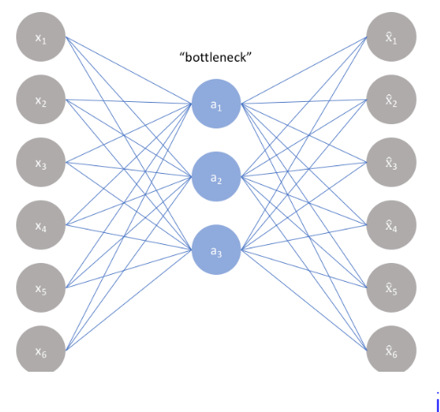

Slide 8
Encoder
The encoder is a set of convolutional blocks followed by pooling modules that compress the input to the model into a compact section called the bottleneck.
The bottleneck is followed by the decoder that consists of a series of upsampling modules to bring the compressed feature back into the form of an image.
In case of simple autoencoders, the output is expected to be the same as the input data with reduced noise.
However, for variational autoencoders it is a completely new image, formed with information the model has been provided as input.

Slide 9
Bottleneck
The most important part of the neural network
The bottleneck exists to restrict the flow of information to the decoder from the encoder, thus, allowing only the most vital information to pass through.
Since the bottleneck is designed in such a way that the maximum information possessed by an image is captured in it, we can say that the bottleneck helps us form a knowledge-representation of the input.
Thus, the encoder-decoder structure helps us extract the most from an image in the form of data and establish useful correlations between various inputs within the network.
A bottleneck as a compressed representation of the input further prevents the neural network from memorizing the input and over-fitting on the data.

Slide 10
Bottleneck
The smaller the bottleneck, the lower the risk of overfitting.
Very small bottlenecks would restrict the amount of information storable, which increases the chances of important information slipping out through the pooling layers of the encoder.

Slide 11
Decoder
the decoder is a set of upsampling and convolutional blocks that reconstructs the bottleneck's output.
Since the input to the decoder is a compressed knowledge representation, the decoder serves as a “decompressor” and builds back the image from its latent attributes.

Slide 12
set 4 hyperparameters before training an autoencoder
Code size: The code size or the size of the bottleneck is the most important hyperparameter used to tune the autoencoder. The bottleneck size decides how much the data has to be compressed. This can also act as a regularisation term.
Number of layers: Like all neural networks, an important hyperparameter to tune autoencoders is the depth of the encoder and the decoder. While a higher depth increases model complexity, a lower depth is faster to process.
Number of nodes per layer: The number of nodes per layer defines the weights we use per layer. Typically, the number of nodes decreases with each subsequent layer in the autoencoder as the input to each of these layers becomes smaller across the layers.
Reconstruction Loss: The loss function we use to train the autoencoder is highly dependent on the type of input and output we want the autoencoder to adapt to. If we are working with image data, the most popular loss functions for reconstruction are MSE Loss and L1 Loss. In case the inputs and outputs are within the range [0,1], as in MNIST, we can also make use of Binary Cross Entropy as the reconstruction loss.

Slide 13
Types of autoencoders
Undercomplete autoencoders
Sparse autoencoders
Contractive autoencoders
Denoising autoencoders
Variational Autoencoders (for generative modelling)

Slide 14
1. Undercomplete autoencoders
Undercomplete autoencoder takes in an image and tries to predict the same image as output, thus reconstructing the image from the compressed bottleneck region.
UAE are unsupervised as they do not take any form of label, the target being the same as the input.
The primary use of autoencoders : generation of the latent space or the bottleneck, which forms a compressed substitute of the input data and can be easily de-compressed back with the help of the network when needed.

Slide 15
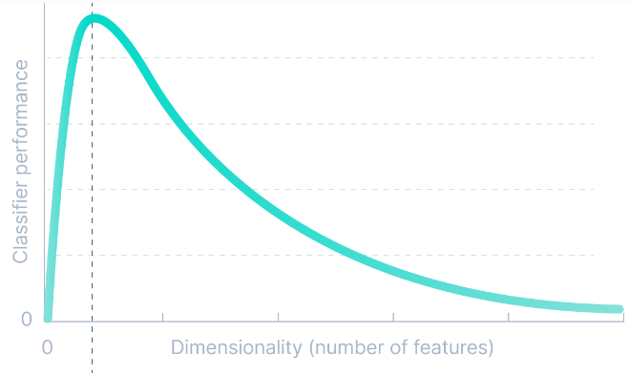
1. Undercomplete autoencoders

Slide 16
Undercomplete autoencoders
PCA can only build linear relationships
autoencoders can learn non-linear relationships and, therefore, perform better in dimensionality reduction
This form of nonlinear dimensionality reduction where the autoencoder learns a non-linear manifold is also termed as manifold learning.
NOTE: if we remove all non-linear activations from an undercomplete autoencoder and use only linear layers, we reduce the undercomplete autoencoder into something that works as an PCA.

Slide 17
The loss function
The loss function used to train an undercomplete autoencoder is called reconstruction loss, as it is a measure to check ‘how well the image has been reconstructed’ from the input data.
Although the reconstruction loss can be anything depending on the input and output, we will use an L1 loss to depict the term (also called the norm loss) represented by:
‍L=x-x^
‍Where x^ represents the predicted output and x represents the ground truth.
Notes:
As the loss function has no explicit regularisation term, the only method to ensure that the model is not memorising the input data is by regulating the size of the bottleneck and the number of hidden layers within this part of the network—the architecture.

Slide 18
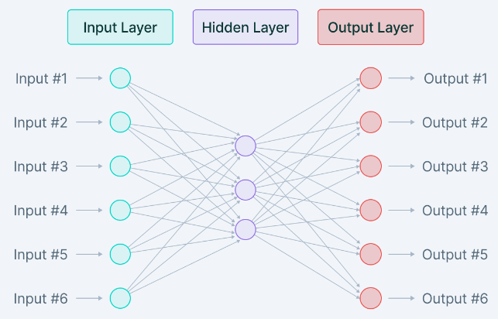
2. Sparse autoencoders
Sparse autoencoders are similar to the undercomplete autoencoders in that they use the same image as input. However, The medium through which encoding of information is regulated is significantly different.

Slide 19
2. Sparse autoencoders
While undercomplete autoencoders are regulated and fine-tuned by regulating the size of the bottleneck, the sparse autoencoder is regulated by changing the number of nodes at each hidden layer.
Since it is not possible to design a neural network that has a flexible number of nodes at its hidden layers, sparse autoencoders work by penalizing the activation of some neurons in hidden layers.
the loss function has a term that calculates the number of neurons that have been activated and provides a penalty that is directly proportional to that.
This penalty, called the sparsity function, prevents the neural network from activating more neurons and serves as a regularizer.

Slide 20
2. Sparse autoencoders
This form of regularization allows the network to have nodes in hidden layers dedicated to find specific features in images during training and treating the regularization problem as a problem separate from the latent space problem.
We can thus set latent space dimensionality at the bottleneck without worrying about regularization.

Slide 21

2. Sparse autoencoders
sparsity regularizer term can be incorporated into the loss function in two ways:
L1 Loss: In here, we add the magnitude of the sparsity regularizer as we do for general regularizers:
Where ‘h’ represents the hidden layer, ‘I’ represents the image in the minibatch, and ‘a’ represents the activation.
KL-Divergence: In this case, we consider the activations over a collection of samples at once rather than summing them as in the L1 Loss method.
Notes:
Kullback–Leibler (KL) divergence (also called relative entropy and I-divergence)

Slide 22


2. Sparse autoencoders
Considering the ideal distribution as a Bernoulli distribution, we include KL divergence within the loss to reduce the difference between the current distribution of the activations and the ideal (Bernoulli) distribution:
Where
and j denote the specific neuron for layer h and a collection of m samples is being made here, each denoted as x.

Slide 23
3. Contractive autoencoders
perform task of learning a representation of the image while passing it through a bottleneck and reconstructing it in the decoder.
The contractive autoencoder also has a regularization term to prevent the network from learning the identity function and mapping input into the output.
Contractive autoencoders work on the basis that similar inputs should have similar encodings and a similar latent space representation.
means that the latent space should not vary by a huge amount for minor variations in the input.

Slide 24
3. Contractive autoencoders
To train a model that works along with this constraint, we have to ensure that the derivatives of the hidden layer activations are small with respect to the input data.
Mathematically:
δh/δx
‍Where h represents the hidden layer and x represents the input.
An important thing to note in the loss function (formed from the norm of the derivatives and the reconstruction loss) is that the two terms contradict each other.

Slide 25

3. Contractive autoencoders
While the reconstruction loss wants the model to record differences between two inputs and observe variations in the data, the frobenius norm(also called the Euclidean norm ) of the derivatives says that the model should be able to ignore variations in the input data.
Putting these two contradictory conditions into one loss function enables us to train a network where the hidden layers now capture only the most essential information. This information is necessary to separate images and ignore information that is non-discriminatory in nature, and therefore, not important.
total loss function :
Where h is the hidden layer for which a gradient is calculated and represented with respect to the input x as ∇xai(h)(x).
The gradient is summed over all training samples, and a frobenius norm of the same is taken.

Slide 26
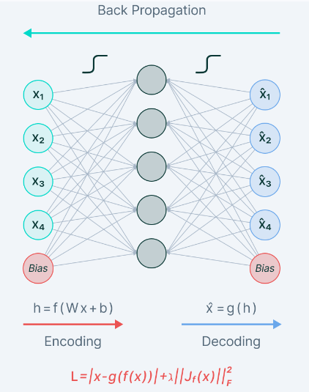

Slide 27
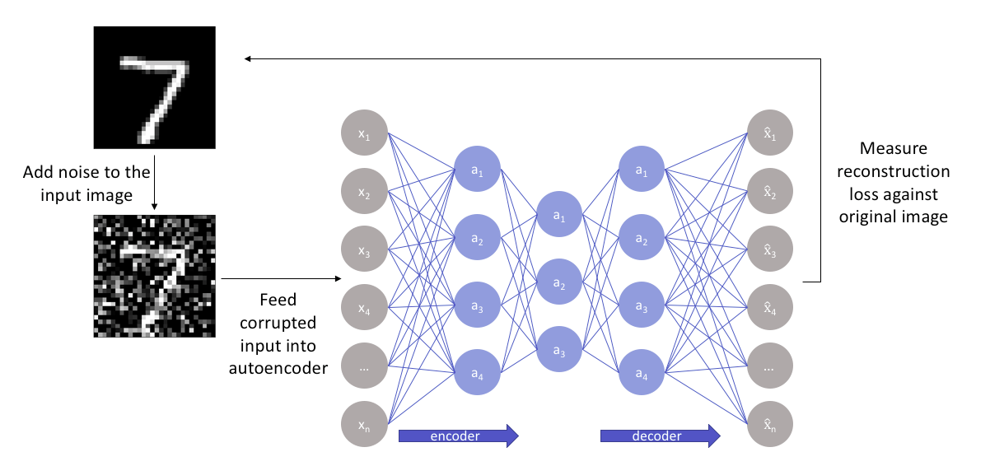
4. Denoising autoencoders
autoencoders that remove noise from an image. we feed a noisy version of the image, where noise has been added via digital alterations. The noisy image is fed to the encoder-decoder architecture, and the output is compared with the ground truth image.

Slide 28
4. Denoising autoencoders
gets rid of noise by learning a representation of the input where the noise can be filtered out easily.
While removing noise directly from the image seems difficult, the autoencoder performs this by mapping the input data into a lower-dimensional manifold (like in undercomplete autoencoders), where filtering of noise becomes much easier.
These work with the help of non-linear dimensionality reduction. The loss function generally used in these types of networks is L2 or L1 loss.

Slide 29
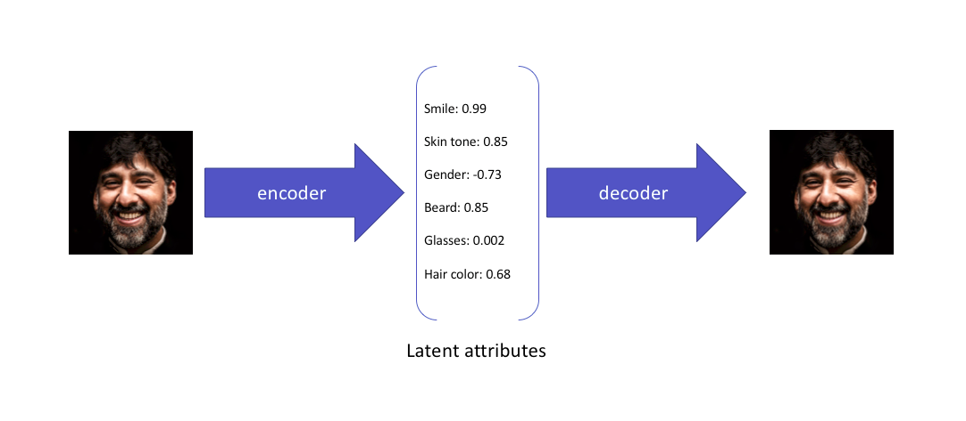
5. Variational autoencoders
Standard and variational autoencoders learn to represent the input just in a compressed form called the latent space or the bottleneck.
Therefore, the latent space formed after training the model is not necessarily continuous and, in effect, might not be easy to interpolate.

Slide 30
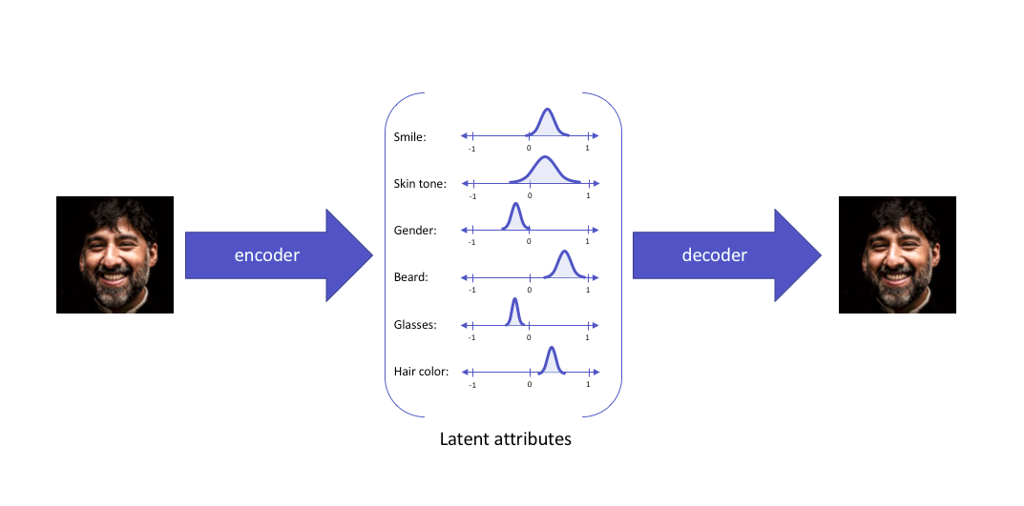
5. Variational autoencoders
While these attributes explain the image and can be used in reconstructing the image from the compressed latent space, they do not allow the latent attributes to be expressed in a probabilistic fashion.
They express their latent attributes as a probability distribution, leading to the formation of a continuous latent space that can be easily sampled and interpolated.When fed the same input, a variational autoencoder would construct latent attributes in the following manner:

Slide 31
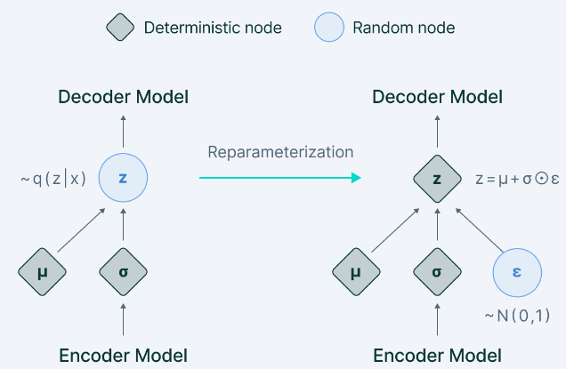
5. Variational autoencoders
reparameterization trick—a cleverly defined way to bypass the sampling process from the neural network.
Randomly sample a valueε from a unit Gaussian and then scale this by the latent distribution varianceσ and shift it by the mean μ of the same.
Now, we have left behind the sampling process as something done outside what the backpropagation pipeline handles, and the sampled value ε acts just like another input to the model, that is fed at the bottleneck.

Slide 32
5. Variational autoencoders
The variational autoencoder thus allows us to learn smooth latent state representations of the input data.
To train a VAE, we use two loss functions: the reconstruction loss and the other being the KL divergence.
While reconstruction loss enables the distribution to correctly describe the input, by focusing only on minimizing the reconstruction loss, the network learns very narrow distributions—akin to discrete latent attributes.
The KL divergence loss prevents the network from learning narrow distributions and tries to bring the distribution closer to a unit normal distribution.

Slide 33

5. Variational autoencoders
summarised loss function :
Where N denotes the normal unit distribution and β denotes a weighting factor.
The primary use of variational autoencoders can be seen in generative modeling.
Sampling from the latent distribution trained and feeding the result to the decoder can lead to data being generated in the autoencoder.

Slide 34
Applications of autoencoders
1. Dimensionality reduction
2. Image denoising
3. Generation of image and time series data
4. Anomaly detection

Slide 35
Anomaly detection
Undercomplete autoencoders can also be used for anomaly detection.
For example—consider an autoencoder that has been trained on a specific dataset P. For any image sampled for the training dataset, the autoencoder is bound to give a low reconstruction loss and is supposed to reconstruct the image as is.
For any image which is not present in the training dataset, however, the autoencoder cannot perform the reconstruction, as the latent attributes are not adapted for the specific image that has never been seen by the network.
As a result, the outlier image gives off a very high reconstruction loss and can easily be identified as an anomaly with the help of a proper threshold.

Slide 36
To be Noted
loss function of autoencoder is composed of two different parts. The first part is the loss function (e.g. mean squared error loss) calculating the difference between input data and output data while the second term would act as regularization term which prevents autoencoder from overfitting.
SGD and some other gradient descent based. optimization methods can be used to optimize this loss function.

Slide 37
Type of AE???
if a man claims to be an expert in mathematics, computer science, psychology, and classical music, he might be just learning some quite shallow knowledge in these subjects.
However, if he only claims to be devoted to mathematics, we would like to anticipate some useful insights from him.
And it’s the same for autoencoders we’re training — fewer nodes activating while still keeping its performance would guarantee that the autoencoder is actually learning latent representations instead of redundant information in our input data.

Slide 38
L1 Regularization Sparse
L1 regularization adds “absolute value of magnitude” of coefficients as penalty term while L2 regularization adds “squared magnitude” of coefficient as a penalty term.
Although L1 and L2 can both be used as regularization term, the key difference between them is that:
L1 regularization tends to shrink the penalty coefficient to zero
while L2 regularization would move coefficients towards zero but they will never reach.
Thus L1 regularization is often used as a method of feature extraction.
But sometimes L1 regularization leads to sparsity!!!

Slide 39
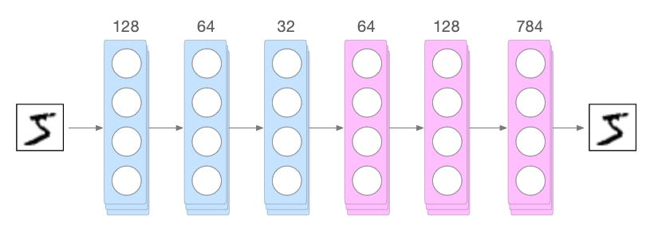
Example-Application
deep autoencoder and train it on MNIST dataset without L1 regularization and with regularization. The structure of this deep autoencoder is plotted as below:
The structure of autoencoder

Slide 40
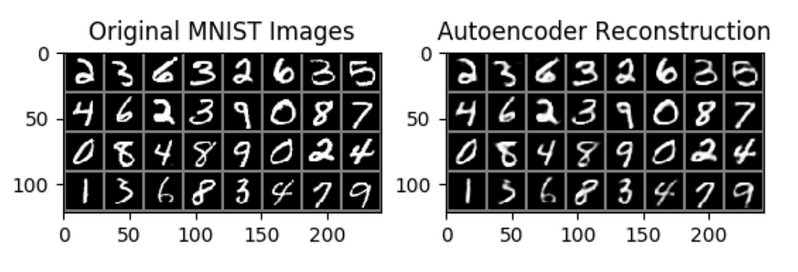
Example
And after 100 epochs of training using 128 batch size and Adam as the optimizer, below are the results:

Slide 41
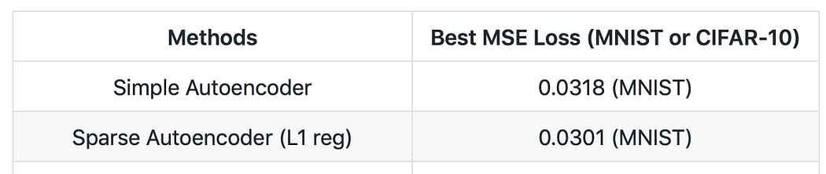
Example
Results: sparse autoencoder with L1 regularization with best mse loss 0.0301 actually performs better than autoencoder with best mse loss 0.0318. Although it’s just a slight improvement, it comes out that the sparse autoencoder actually learns better representation than autoencoder.

Slide 42
Example2
And what about sparsity? We can simply extract the weights in the first hidden layer and reshape them for visualizations to check if the activations of sparse autoencoder are actually more “sparse” than original autoencoder.

Slide 43
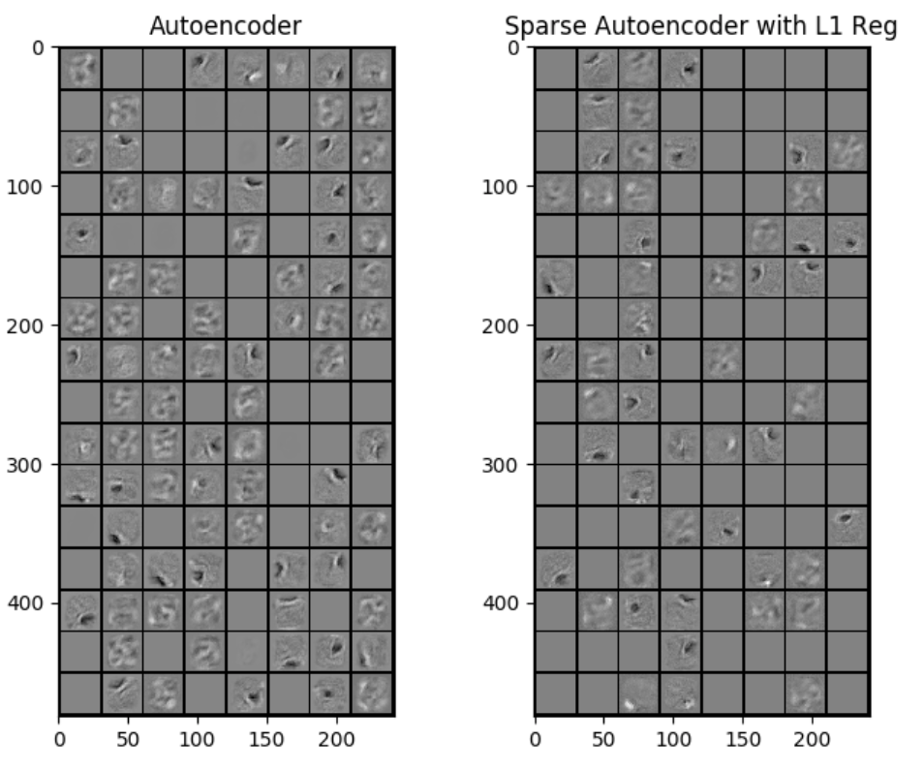
Notes:
due to the sparsity of L1 regularization, sparse autoencoder actually learns better representations and its activations are more sparse which makes it perform better than original autoencoder without L1 regularization.

Slide 44
Data Augmentation
technique to enhance your training dataset without the need for additional data collection, which can be both costly and time-consuming.

Slide 45
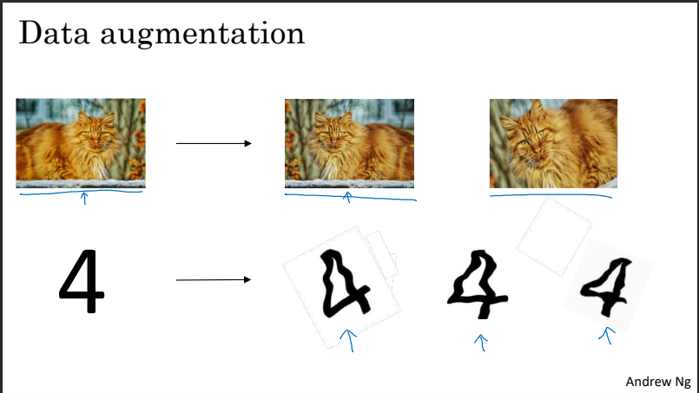
Notes:
Imagine you’re training a model to classify images of cats. If your model is overfitting, obtaining more training data might help, but what if that’s not feasible? This is where data augmentation comes in handy. By applying simple transformations to existing images — like flipping them horizontally, cropping, rotating, or zooming in — you can effectively double or even triple your dataset.

Slide 46
Data Augmentation
if you flip the images horizontally, you can basically make your training set twice as big. It’s not as great as having a completely new set of examples, but it still helps.
By making random distortions and translations of the image, you can expand your data set and create more training examples.

Slide 47
Data Augmentation - Application
These transformations generate new, “fake” training examples that still represent the original data.
While these augmented images might not provide entirely new information, they do offer fresh, independent examples that help the model learn.
The process is computationally inexpensive and helps teach your algorithm that a horizontally flipped cat is still a cat.

Slide 48
Data Augmentation – Application2
For tasks like optical character recognition (OCR), you can apply similar techniques by rotating and distorting the digits in your dataset. Even slight distortions can create a more varied training set, helping the model become more robust.

Slide 49
Early stopping
Early stopping is a technique used in machine learning to stop training a model when its performance on a validation dataset starts to degrade.
The goal is to prevent overfitting and avoid wasting computational resources.
technique to prevent overfitting

Slide 50
Early stopping
As you train your neural network, you monitor the training error or cost function. Ideally, this should decrease steadily as training progresses. However, if you notice that the error on your development set starts to increase after a certain point, it may indicate overfitting.

Slide 51
Early stopping
Early stopping allows you to halt the training process at the point where the model performs best on the development set.
This prevents the model from becoming too specialized to the training data, effectively reducing overfitting.

Slide 52
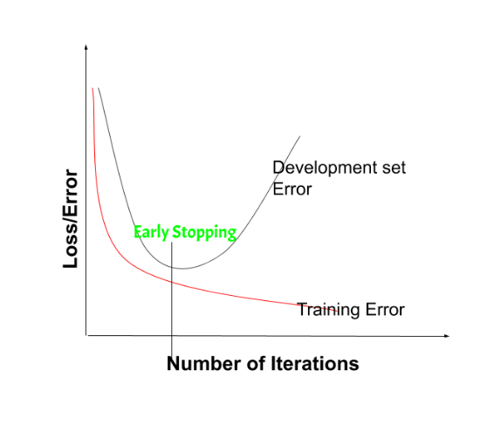
Stop…
early stopping is when you see that your neural network is performing its best around a certain point during training, so you just stop halfway and use the value that gave you the lowest error on the dev set.

Slide 53
how early stopping works:
Split data: Split your dataset into training and validation sets.
Train model: Train your model on the training set and evaluate its performance on the validation set at regular intervals (e.g., after each epoch).
Monitor performance: Monitor the model’s performance on the validation set and track its progress.
Stop training: When the model’s performance on the validation set starts to degrade (e.g., when the validation loss stops improving), stop training the model.

Slide 54
early stopping - advantages
Prevent overfitting
Save time
Improve model generalization: By stopping training when the model’s performance on the validation set starts to degrade, you can improve the model’s generalization to new, unseen data.

Slide 55
