Slide 1
Generative Adversarial Network
Deep Learning

Slide 2
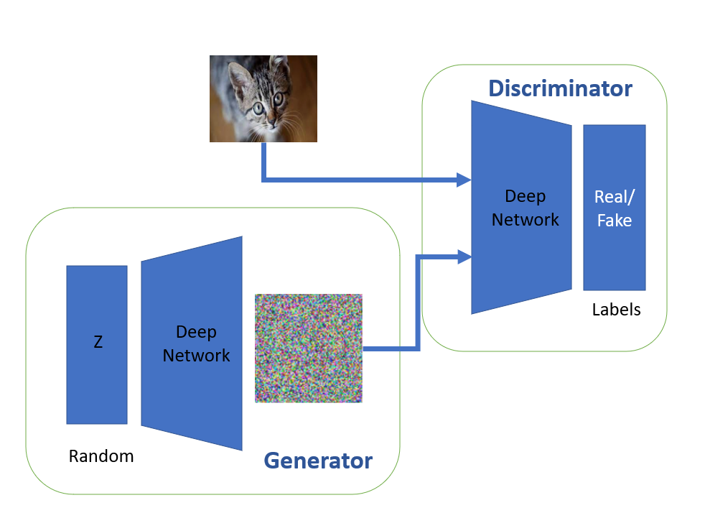

Slide 3
GAN
A generative adversarial network (GAN) is a deep learning architecture.
It trains two neural networks to compete against each other to generate more authentic new data from a given training dataset.
For instance, you can generate new images from an existing image database or original music from a database of songs.
A GAN is called adversarial because it trains two different networks and pits them against each other.

Slide 4
GAN can do
One network generates new data by taking an input data sample and modifying it as much as possible.
The other network tries to predict whether the generated data output belongs in the original dataset.
In other words, the predicting network determines whether the generated data is fake or real.
The system generates newer, improved versions of fake data values until the predicting network can no longer distinguish fake from original.

Slide 5
GAN applications across different industries
Generate images: create realistic images through text-based prompts or by modifying existing images, edit images.
Generate training data for other models: data aug
Complete missing information: accurately guess and complete some missing information in a dataset.
can train GAN to generate images of the surface below ground (sub-surface) by understanding the correlation between surface data and underground structures.
By studying known sub-surface images, it can create new ones using terrain maps for energy applications like geothermal mapping or carbon capture and storage.

Slide 6
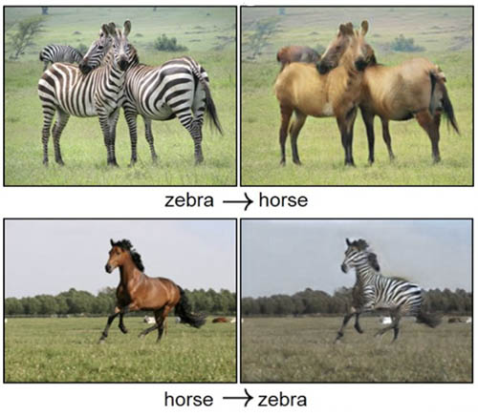
Generate 3D models from 2D data
GAN combines X-rays and other body scans to create realistic images of organs for surgical planning and simulation.

Slide 7
GAN: working
comprises two deep neural networks—the generator network and the discriminator network.
Both networks train in an adversarial game, where one tries to generate new data and the other attempts to predict if the output is fake or real data.

Slide 8
GAN: working
The generator neural network analyzes the training set and identifies data attributes
The discriminator neural network also analyzes the initial training data and distinguishes between the attributes independently
The generator modifies some data attributes by adding noise (or random changes) to certain attributes
The generator passes the modified data to the discriminator
The discriminator calculates the probability that the generated output belongs to the original dataset
The discriminator gives some guidance to the generator to reduce the noise vector randomization in the next cycle

Slide 9
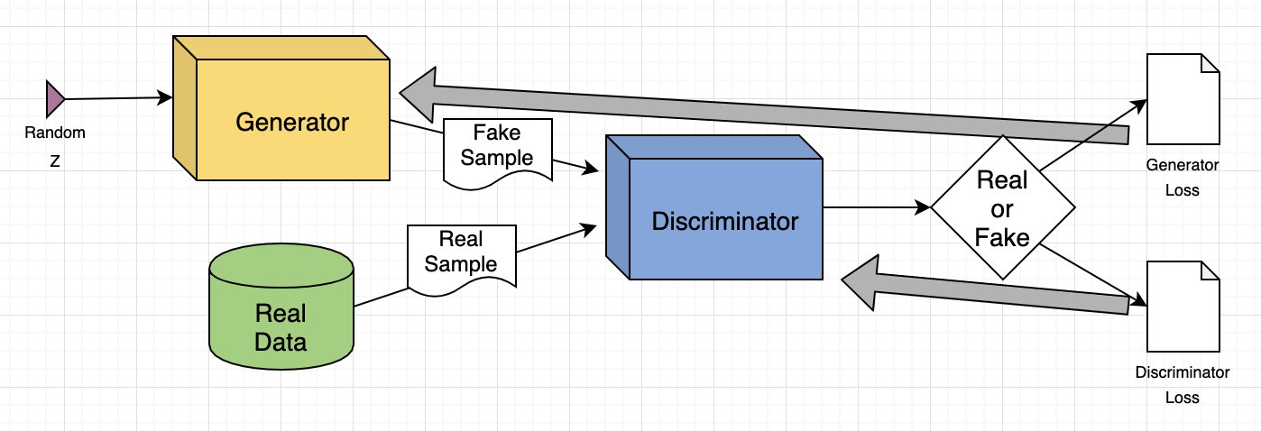
GAN: Architecture

Slide 10
GAN: working
The generator attempts to maximize the probability of mistake by the discriminator, but the discriminator attempts to minimize the probability of error.
In training iterations, both the generator and discriminator evolve and confront each other continuously until they reach an equilibrium state. In the equilibrium state, the discriminator can no longer recognize synthesized data.
At this point, the training process is over.

Slide 11
GAN: Example-image-to-image translations
Consider input image: human face
GAN attempts to modify.
Attributes: the shapes of eyes or ears.
The generator changes the real images by adding sunglasses to them.
The discriminator receives a set of images, some of real people with sunglasses and some generated images that were modified to include sunglasses.
If the discriminator can differentiate between fake and real, the generator updates its parameters to generate even better fake images.
If the generator produces images that fool the discriminator, the discriminator updates its parameters. Competition improves both networks until equilibrium is reached.

Slide 12
Types of GAN
Vanilla GAN
Conditional GAN
Deep convolutional GAN
Super-resolution GAN

Slide 13
Activation func in GANs
Leaky ReLU
Tanh
The ReLU activation (Nair & Hinton, 2010) is used in the generator with the exception of the output layer which uses the Tanh function.
It is observed that using a bounded activation allowed the model to learn more quickly to saturate and cover the color space of the training distribution.
Within the discriminator we found the leaky rectified activation (Maas et al., 2013) (Xu et al., 2015) to work well, especially for higher resolution modeling.

Slide 14
Loss function in GAN: BCE
Basic GAN loss function
The binary cross entropy loss, also known as log loss or logistic loss, is a commonly used loss function in binary classification tasks.
It measures the dissimilarity between predicted probabilities and true binary labels. The formula for binary cross entropy is as follows:
Binary Cross Entropy = -[y * log(p) + (1 — y) * log(1 — p)]
where:
y is the true binary label (0 or 1).
p is the predicted probability of the positive class.
In this formula, the first term (y * log(p)) represents the contribution to the loss when the true label is 1, and the second term ((1 — y) * log(1 — p)) represents the contribution when the true label is 0. The logarithm function is used to penalize large errors more severely, as the loss increases rapidly as the predicted probability deviates from the true label

Slide 15
Why BCE in GAN
The binary cross entropy loss is commonly used as the objective function in binary classification models, such as logistic regression or binary classifiers within neural networks.
The goal is to minimize the binary cross entropy loss, which leads to maximizing the likelihood of predicting the correct class probabilities.
It’s important to note that in practice, numerical stability techniques are often applied to prevent issues with taking the logarithm of zero or near-zero…

Slide 16
Conditional GAN
the generator generates images randomly, and we had no control over the class of image to be generated i.e while training GAN, the generator was generating a random digit each time i.e it may generate one, four, or six, we don't know what it will generate.
conditional GANs we can guide the generator to generate an image of one or six.
With conditional GAN you can generate images of the class of your choice.

Slide 17
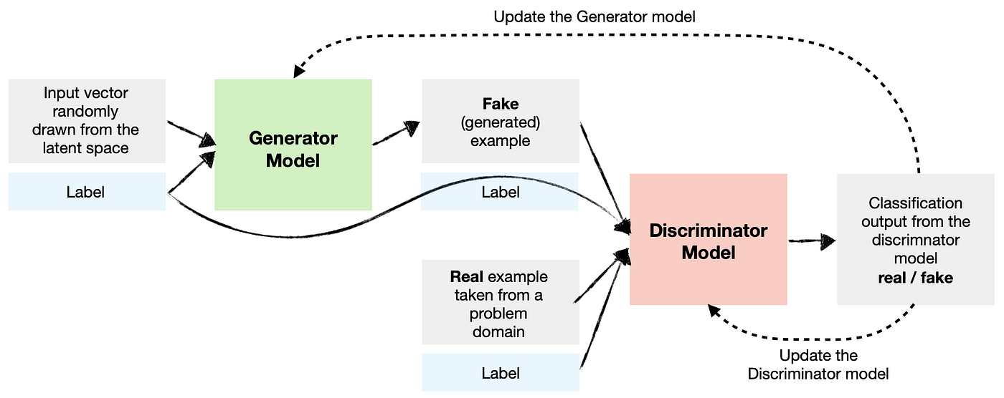
Conditional GAN

Slide 18
Working of Conditional GAN
For a GAN, we feed images as an only input to our generator and discriminator.
But for conditional GAN, we will be feeding class information to both the networks.
The generator takes random noise and a one-hot encoded class label as input. And outputs a fake image of a particular class.
The discriminator takes an image with one-hot labels added as depth to the image(channels) i.e if you have an image of 28 * 28 *1 size and one-hot vector of size n than image size will be 28 * 28 * (n+1).
Discriminator outputs whether the image belongs to that class or not i.e real or fake.

Slide 19
Controllable GANs
Conditional GANs help generate images of classes of our choice.
But we don’t have control over the content of the output image i.e what if we want a dog with RED HAT or Glasses.
this is where controllable GANs can help.
Controllable GANs are useful for getting features of choice in generated images

Slide 20
Controllable GANs
Example: generate an image of a person with black hair and green eyes, then you need to tweak the input noise.
When you feed a generator with a random noise vector, elements in this noise vector corresponds to some feature in the generated image.
When you change an element in the noise vector, it changes some features in the image, like some change in the vector may change the color of the hair or eyes of a person.
This can be done by mapping vectors with respected features in some vector space.
This can be performed by using a pre-trained classifier that tells if a particular feature is present in a generated image or not, like if a person’s eyes are green or not. This can be used to find noise vectors for different features.

Slide 21
Challenges to controllable GANs
Correlation b/w features: When we change an element of the noise vector in order to change one feature(like adding facial hair to an image of a female) leads to a change in other feature (like changing the gender of a person in an image). This may be because models have seen facial hair with a masculine face.
Vector space entanglement: When elements in noise vector are entangled while corresponding to features.

Slide 22
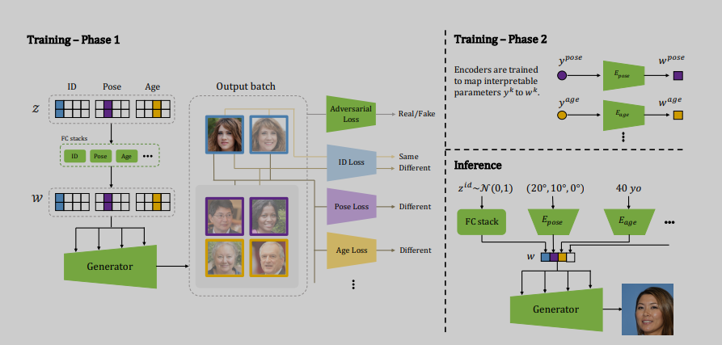
Architecture

Slide 23
Conditional and controllable GAN
Conditional GANs are used for generating images belonging to classes of our choice, while Controllable GANs are used for controlling features in images.

