Slide 1
Gradient Descent & its variants
Deep Learning

Slide 2
Gradient Descent
An optimization algorithm used to minimize a loss function by iteratively moving in the direction of the steepest descent as defined by the negative of the gradient.
which measures how well the model's predictions match the actual target values.

Slide 3
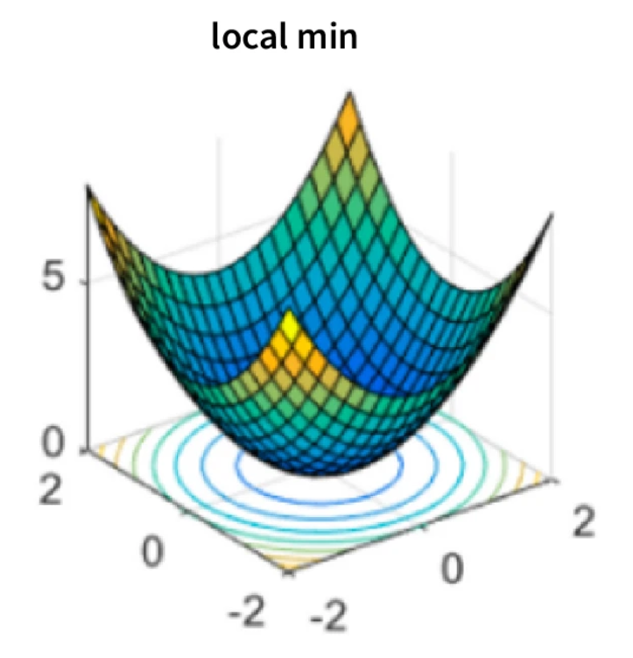
problems that can occur when using gradient descent:
1. Local Minima:
Gradient descent can get stuck in local minima, points that are not the global minimum of the cost function but are still lower than the surrounding points.
This can happen when the cost function has multiple valleys, and the algorithm gets stuck in one instead of reaching the global minimum.

Slide 4
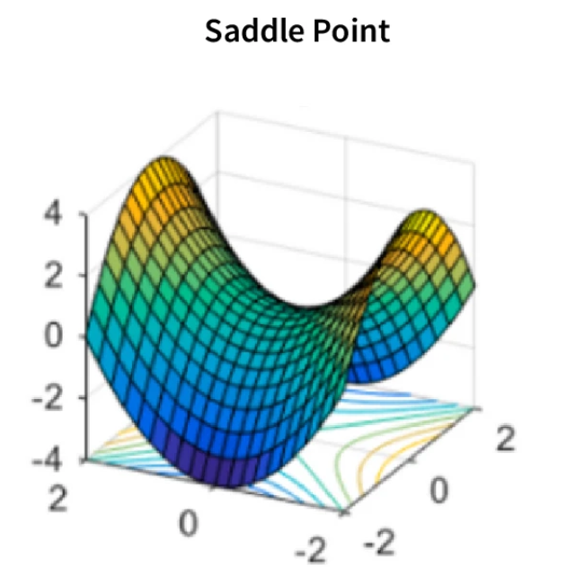
problems that can occur when using gradient descent:
2. Saddle Points:
A saddle point is a point in the cost function where one dimension has a higher value than the surrounding points, and the other has a lower value.
Gradient descent can get stuck at these points because the gradients in one direction point towards a lower value, while those in the other direction point towards a higher value.

Slide 5
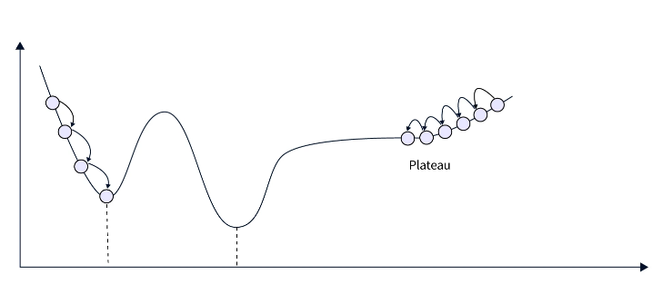
problems that can occur when using gradient descent:
3. Plateaus:
A plateau is a region in the cost function where the gradients are very small or close to zero. This can cause gradient descent to take a long time or not converge.

Slide 6
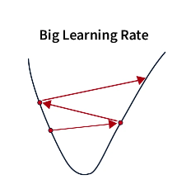
problems that can occur when using gradient descent:
4. Oscillations:
Oscillations occur when the learning rate is too high, causing the algorithm to overshoot the minimum and oscillate back and forth.

Slide 7
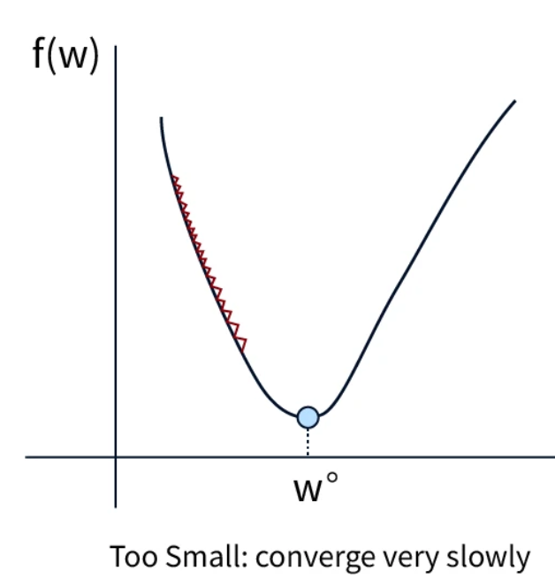
problems that can occur when using gradient descent:
5. Slow convergence:
Gradient descent can converge very slowly when the cost function is complex or has many local minima.
This means the algorithm may take a long time to find the global minimum.

Slide 8
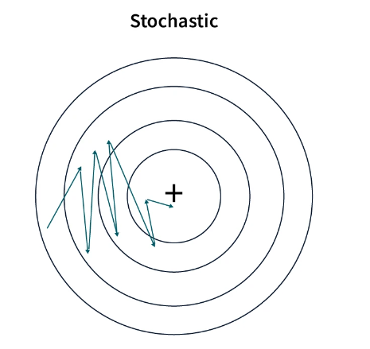
problems that can occur when using gradient descent:
6. Stochasticity:
In stochastic gradient descent, the cost function is evaluated at random samples from the data set.
This introduces randomness into the algorithm, making converging to a global minimum more difficult.

Slide 9
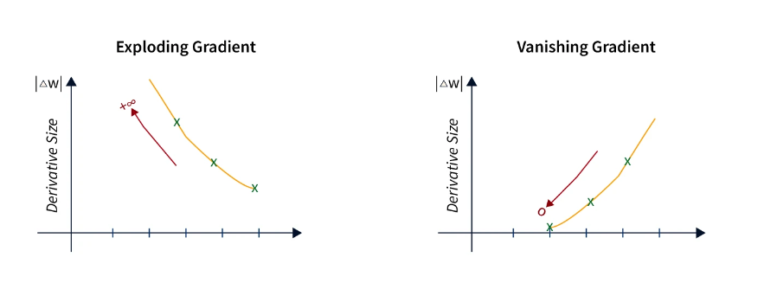
problems that can occur when using gradient descent:
7. Vanishing or Exploding Gradients:
Deep neural networks with many layers can suffer from vanishing or exploding gradients. This occurs when the gradients become very small or large, respectively, as they are backpropagated through the layers. This can make it difficult for the algorithm to update the weights and biases.

Slide 10
Process
Initialization: Start with initial values for the model parameters (weights and biases). These are often initialized randomly.
Forward Pass: Compute the model’s predictions by passing input data through the network.
Loss Calculation: Calculate the loss using the model’s predictions and the actual target values. The loss function quantifies the error or difference.
Backward Pass (Backpropagation): Compute the gradient of the loss function with respect to each model parameter. This involves calculating how changes in each parameter affect the loss.
Update Parameters: Adjust the parameters in the direction that reduces the loss. This is done using the gradients computed in the backward pass. The parameters are updated using the following formula:
p=p−alpha×gradient
Iteration: Repeat the process for a number of iterations or until convergence is achieved (i.e., the loss function does not significantly change).

Slide 11
Types of Gradient Descent
Batch Gradient Descent: Uses the entire dataset to compute the gradient and update the parameters. This can be computationally expensive for large datasets.
Stochastic Gradient Descent (SGD): Uses a single data point to compute the gradient and update the parameters. It’s much faster and can help escape local minima, but introduces more noise into the updates.
Mini-Batch Gradient Descent: Combines the benefits of both batch and stochastic gradient descent by using a subset of the dataset (mini-batch) to compute the gradient and update the parameters. It balances efficiency and convergence.

Slide 12
Variants of GD
Momentum: Helps accelerate gradient descent by considering the past gradients in the update. This can smooth out updates and help escape local minima.
Nesterov Accelerated Gradient (NAG): A variant of momentum that calculates gradients with a lookahead mechanism, potentially providing better convergence.
Adagrad: Adapts the learning rate for each parameter based on past gradients, which can be useful for dealing with sparse data.
RMSprop: Modifies Adagrad to use a moving average of the squared gradients, addressing the issue of a decreasing learning rate.
Adam (Adaptive Moment Estimation): Combines the benefits of momentum and RMSprop. It uses both the moving average of the gradients and their squared values to adaptively adjust the learning rate.

Slide 13
GD: An Example
We imagine a person who has lost his way in the mountains. Basically, it will be a matter of finding the way back by first looking for the direction with a steep downward slope. After having followed this direction for a certain distance, this method must be repeated until a valley is reached (the lowest value).
In machine learning, the gradient descent consists of repeating this method in a loop until finding a minimum for the cost function. This is why it is called an iterative algorithm and why it requires a lot of calculation.
Here is a 2-step strategy that will help you out if you are lost in the mountains:
1. From your current position, you look all around you for the direction of where the slope is going down the hardest.
2. Once you find that direction, you follow it for a distance (say you walk 300 meters) and repeat step 1.
By repeating steps 1 and 2 in a loop, you are sure to converge on the minimum of the valley. This strategy is nothing more or less than the gradient descent algorithm.

Slide 14
Steps in GD for finding min cost Function
Step 1: Compute the derivative of the cost function
We start from a random initial point (as if we were lost in the mountains) and then measure the value of the slope at that point. In mathematics, you measure a slope by calculating the derivative of the function.
Step 2: Updating the model parameters
We then progress by a certain distance d in the slope direction, which goes down, but not 300 meters this time. This distance is called the “learning rate”.
The result of this operation is to modify the value of the parameters of our model (our coordinates in the valley change when we move).

Slide 15
Implementation of GD
The general mathematical formula for gradient descent is
xt+1= xt- η∆xt,
with η representing the learning rate and ∆xt the direction of descent.
Gradient descent is an algorithm applicable to convex functions. Taking ƒ as a convex function to be minimized, the goal will be to obtain ƒ(xt+1) ≤ ƒ (xt) at each iteration.
use this algorithm which will gradually compute the minimum of a mathematical function

Slide 16
Implementation of GD
The application of gradient descent also uses the notion of learning rate.
It is a hyperparameter that allows control of the adjustment of the network weights with respect to the loss gradient.
It should be noted that an optimal learning rate is very important to obtain a minimum more quickly and efficiently.
It should be neither too high nor too low.
As the value goes down, it shows that one is gradually moving along the downward slope.
Several optimization methods use the gradient descent algorithm, such as RMSprop, Adam, and SGD.
In order not to make mistakes when using this algorithm, it is recommended to choose its parameters carefully.
One should also keep in mind that the minimum found might not be considered as a global minimum.

Slide 17
GD
the model will stop learning if the slope becomes zero. Mathematically speaking, a gradient could be described as a finite derivative with respect to its inputs.

Slide 18
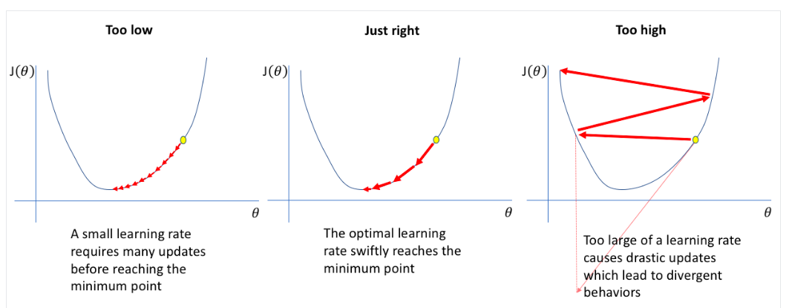
Learning Rate: the Role of the Hyper-parameter

Slide 19
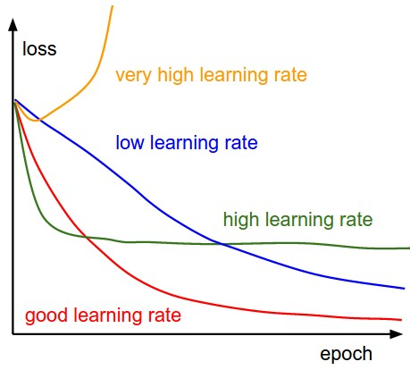
Effect of various learning rates on convergence

Slide 20
How to find the best learning rates?
Unfortunately, there is no magic formula to find the right learning rate.
Most of the time, you have to fumble around and try several values before you find the right one.
This is called hyperparameter tuning.

