Slide 1


The Convolutional Operation
Convolution is an operation on two function of a real valued argument.
The conv operation is usually denoted with an asterisk
In the case of indiscrete value:
In the case of discrete value:
w needs to be 0 for all negative arguments
x: input
w: kernel
s: feature map

Slide 2



The Convolutional Operation
For 2D input and 2D kernel:
It is commutative, so
Cross-correlation:
Many machine learning libraries implement cross correlations but call it covolution.
Any Neural Network algorithm that work with matrix multiplication and does not depend on specific properties of the matrix structure should work with convolution, without requiring any further changes to the neural network.

Slide 3
CNN-Motivation
Three advantages of convolution
Sparse interpretation
Parameter Sharing
Equivariant Representation
1. Sparse Interpretation
Traditional Matrix Multiplication: Every output unit interact with every input unit.
Convolution: Sparse connectivity
We need to store fewer parameters, which improves
Memory requirement
statistical efficiency

Slide 4
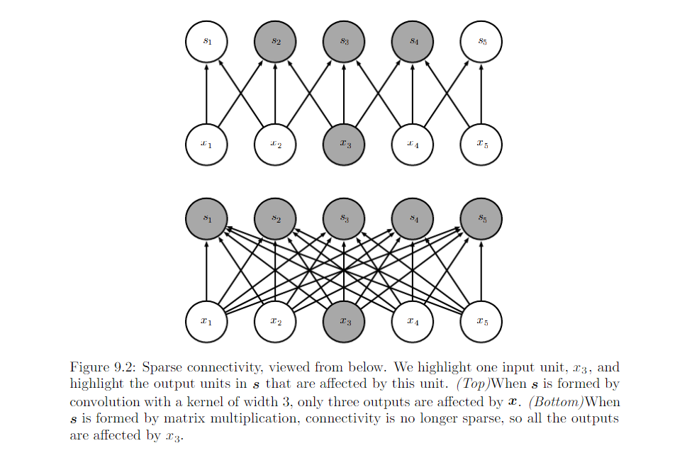
CNN-Motivation

Slide 5
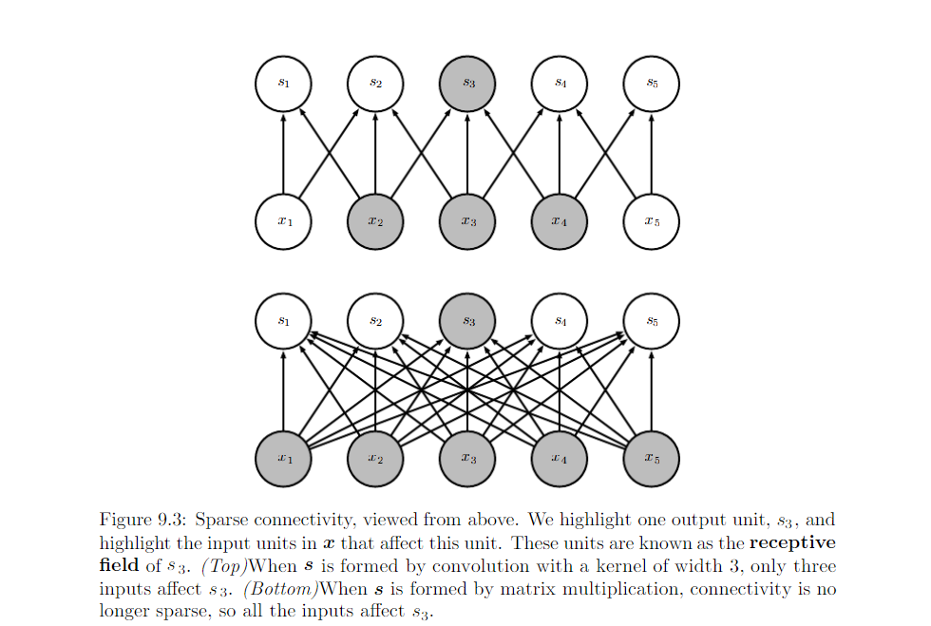

Slide 6
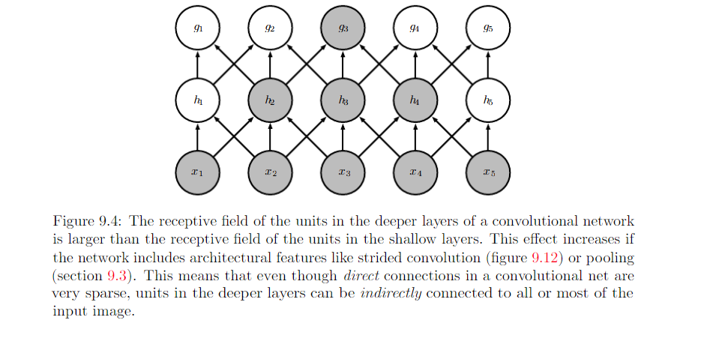
This allows the network to efficiently describe complicated interaction between many variables by construction such interaction from simple building blocks that each describe only sparse interaction.

Slide 7
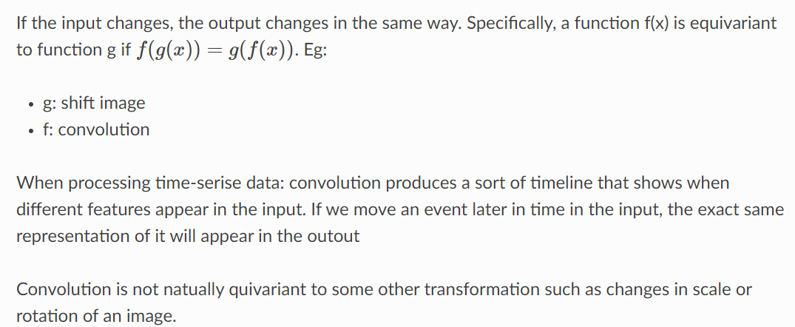
2. Parameter sharing(discussed) 3. Equivariance

Slide 8
Variants of the Basic Convolution
Function
Deep Learning

Slide 9
Topics in Convolutional Networks
Deep Learning
Overview
The Convolution Operation
Motivation
Pooling
Convolution and Pooling as an Infinitely Strong Prior
Variants of the Basic Convolution Function
Structured Outputs
Data Types
Efficient Convolution Algorithms
Random or Unsupervised Features
The Neuroscientific Basis for Convolutional Networks
2
11. Convolutional Networks and the History of Deep Learning

Slide 10
Topics in
Variants of Convolution Functions
Neural net convolution is not same as mathematical convolution
How convolution in neural networks is different
Multichannel convolution due to image color and batches
Convolution with a stride
Locally connected layers (unshared convolution)
Tiled convolution
Implementation of a convolutional network

Slide 11
Neural Net Convolution is Different
Deep Learning
Convolution in the context of neural networks does not refer exactly to the standard convolution operation in mathematics
The functions used differ slightly
Here we describe the differences in detail and highlight their useful propertied

Slide 12
Convolution Operation in Neural Networks
Deep Learning
It refers to an operation that consists of many applications of convolution in parallel
This is because convolution with a single kernel can only extract one
kind of feature, albeit at many locations
Usually we want to extract many kinds of features at many locations
Input is usually not a grid of real values
Rather it is a vector of observations
E.g., a color image has R ,G, B values at each pixel
Input to the next layer is the output of the first layer which has many different convolutions at each position
When working with images, input and output are 3-D tensors

Slide 13
Four indices with image software
Deep Learning
One index for Channel
Two indices for spatial coordinates of each channel
Fourth index for different samples in a batch
We omit the batch axis for simplicity of discussion

Slide 14
Multichannel Convolution
Deep Learning
Because we are dealing with multichannel convolution, linear operations are not usually commutative, even of kernel flipping is used
These multi-channel operations are only commutative if each operation has the same number of output channels as input channels.

Slide 15
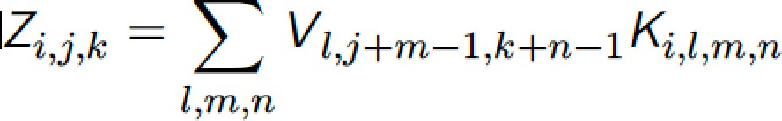
Definition of 4-D kernel tensor
Deep Learning
Assume we have a 4-D kernel tensor K with element
K_{i,j,k,l} giving the connection strength between
a unit in channel i of the output and
a unit in channel j of the input,
with an offset of k rows and l columns between output and input units
Assume our input consists of observed data V with element
V_{i,j,k} giving the value of the input unit
within channel i at row j and column k.
Assume our output consists of Z with the same format as V.
If Z is produced by convolving K across V without flipping K, then

Slide 16
Convolution with a stride: Definition
We may want to skip over some positions in the kernel to reduce computational cost
At the cost of not extracting fine features
We can think of this as down-sampling the output of the full convolution function
If we want to sample only every s pixels in each direction of output, then we can define a down-sampled convolution function c such that
We refer to s as the stride. It is possible to define a different
stride for each direction
9

Slide 17
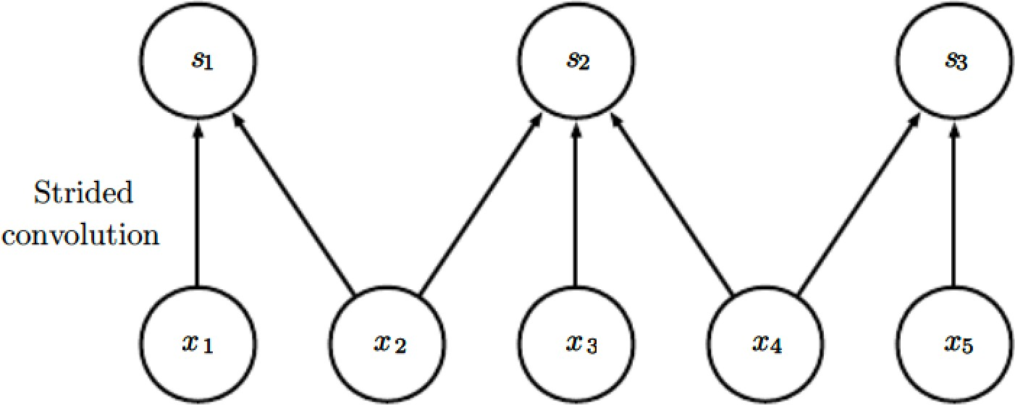
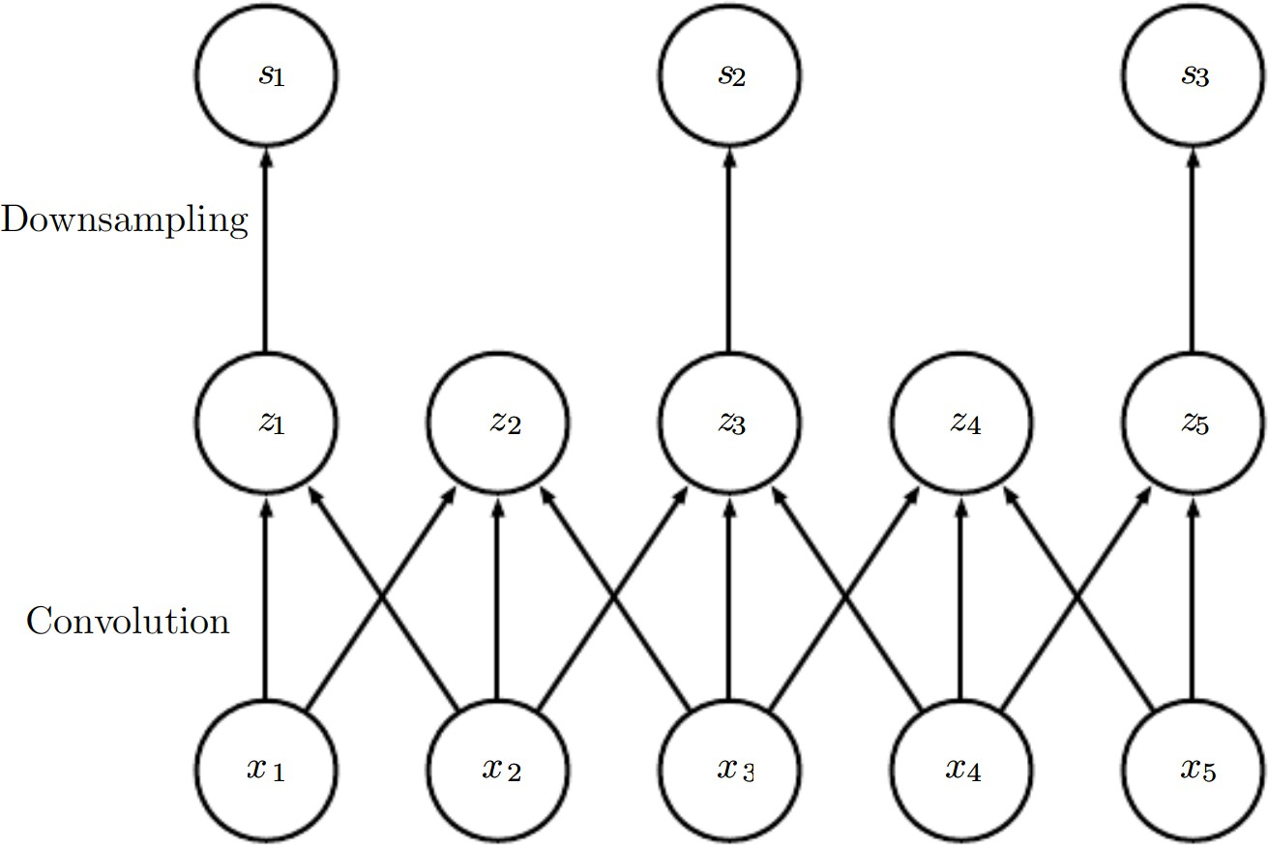
Convolution with a stride: Implementation
Here we use a stride of 2
Convolution with a stride of length two implemented in a single operation
Convolution with a stride greater than one pixel is mathematically equivalent to convolution with a unit stride followed by down-sampling.
Two-step approach is computationally wasteful, because it discard many values that are discarded
10

Slide 18
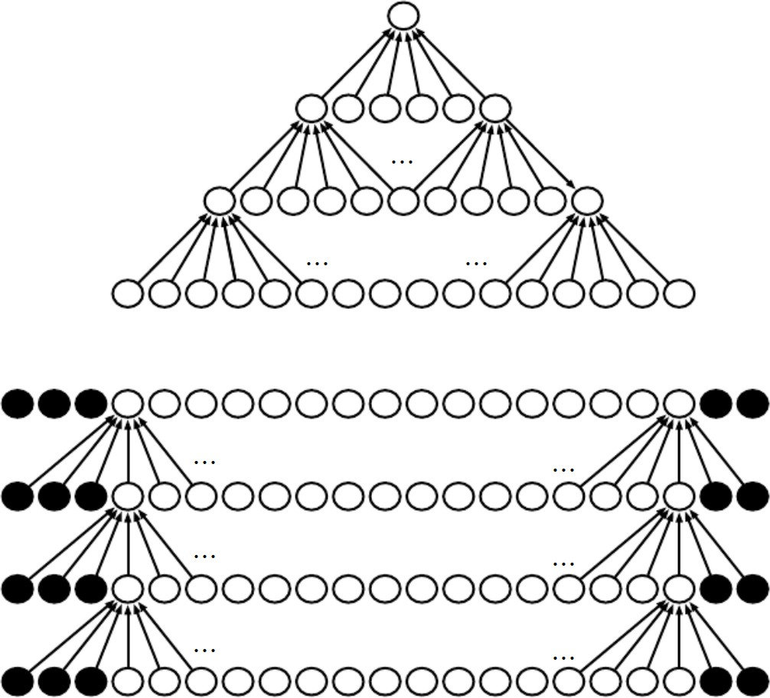
Effect of Zero-padding on network size
Deep Learning
Convolutional net with a kernel of width 6 at every layer No pooling, so only convolution shrinks network size
We do not use any implicit zero padding
Causes representation to shrink by five pixels at each layer
Starting from an input of 16 pixels
we are only able to have 3
convolutional layers and the last layer does not ever move the kernel, so only two layers are convolutional
By adding 5 implicit zeroes to Each layer, we prevent the Representation from shrinking with depth
This allows us to make an arbitrarily deep convolutional network
11

Slide 19
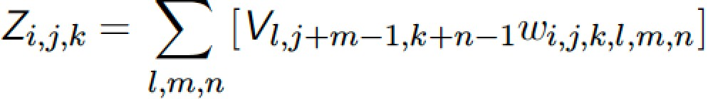
Locally connected layer
Deep Learning
In some cases, we do not actually want to use convolution, but rather locally connected layers
adjacency matrix in the graph of our MLP is the same, but every connection has its own weight, specified by a 6-D tensor W.
The indices into W are respectively:
i, the output channel,
j, the output row,
k, the output column,
l, the input channel,
m, the row offset within the input, and
n, the column offset within the input.
The linear part of a locally connected layer is then given by
12
Also called unshared convolution

Slide 20
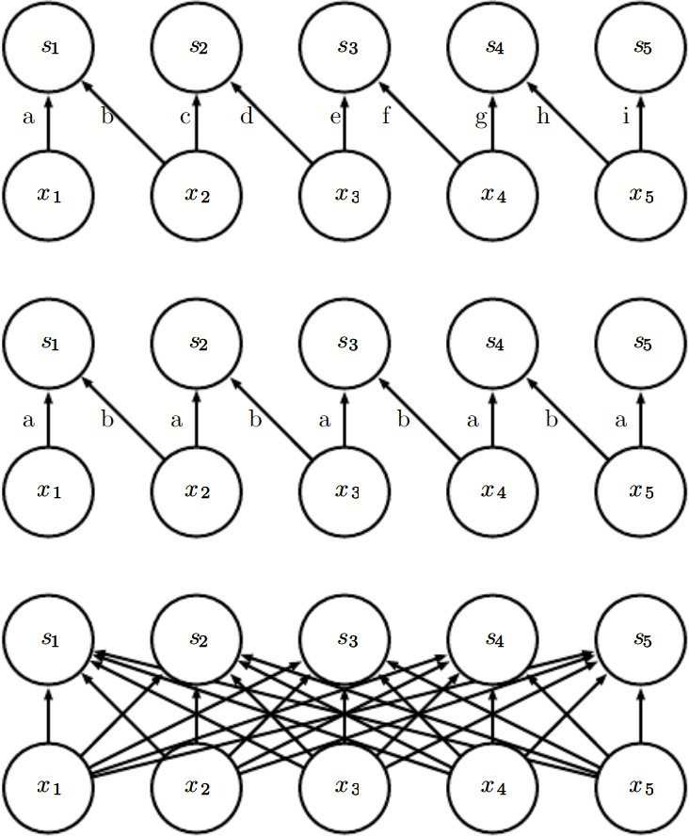
Local connections, convolution, full connections

Slide 21
Use of locally connected layers
Deep Learning
Locally connected layers are useful when
we know that each feature should be a function of a small part of space, but there is no reason to think that the same feature should occur across all of space
Ex: if we want to tell if an image is a picture of a face, we only need to look for the mouth in the bottom half of the image

Slide 22
Constraining Outputs
Deep Learning
Constrain each output channel i to be a function of only a subset of the input channels l
Make the first m output channels connect to only the first n input channels,
The second m output channels connect to only the second n input channels, etc
Modeling interactions between few channels allows fewer parameters to:
Reduce memory, increase statistical efficiency, reduce computation for forward/back-propagation.
It accomplishes these goals without reducing no₁₅ .of hidden units.

Slide 23
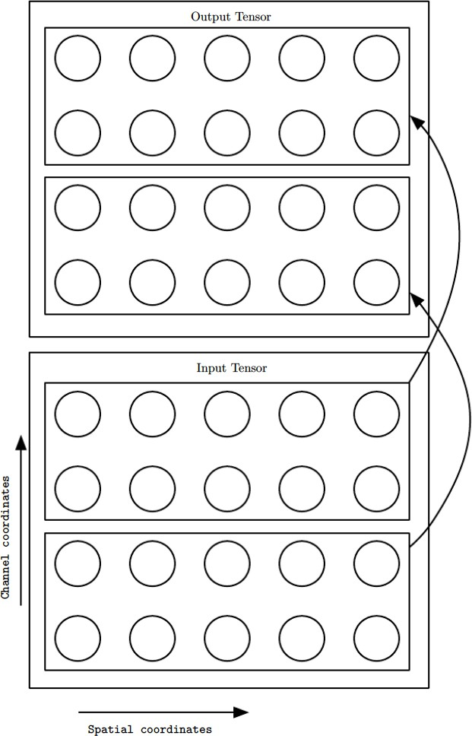
Network with further restricted connectivity
Deep Learning

Slide 24
Tiled Convolution
Deep Learning
Compromise between a convolutional layer and a locally connected layer.
Rather than learning a separate set of weights at every spatial location, we learn a set of kernels that we rotate through as we move through space.
This means that immediately neighboring locations will have different filters, like in a locally connected layer,
but the memory requirements for storing the parameters will increase only by a factor of the size of this set of kernels
rather than the size of the entire output feature map.

Slide 25
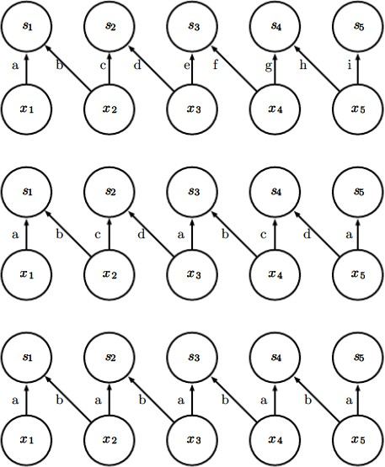
Comparison of locally connected layers, tiled convolution and standard convolution
Deep Learning
A locally connected layer Has no sharing at all
Each connection has its own weight
Tiled convolution
Has a set of different kernels With t=2
Traditional convolution Equivalent to tiled convolution with t=1
There is only one kernel and18it is applied everywhere

Slide 26
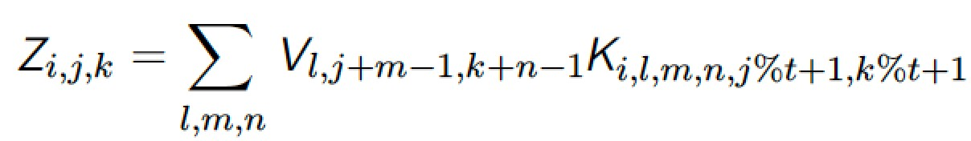
Defining Tiled Convolution Algebraically
Deep Learning
Let k be a 6-D tensor, where two of the dimensions correspond to different locations in the output map.
Rather than having a separate index for each location in the output map, output locations cycle through a set of t different choices of kernel stack in each direction.
If t is equal to the output width, this is the same as a locally connected layer
where % is the modulo operation, with t%t = 0, (t + 1)%t = 1, etc

Slide 27
Operations to implement convolutional nets
Deep Learning
Besides convolution, other operations are necessary to implement a convolutional network.
To perform learning, need to compute gradient wrt the kernel, given the gradient with respect to the outputs.
In some simple cases, this operation can be performed using the convolution operation, but when stride greater than 1, do not have this property.

Slide 28
Implementation of Convolution
Deep Learning
Convolution is a linear operation and can thus be described as a matrix multiplication
if we first reshape the input tensor into a flat vector
Matrix involved is a function of the convolution kernel
Matrix is sparse and each element of the kernel is copied to several elements of the matrix.
This view helps us to derive some of the other operations needed to implement a convolutional network

