Slide 1
CNN
Deep Learning
Dr Anila M/2024-25

Slide 2


The Convolutional Operation
Convolution is an operation on two function of a real valued argument.
The conv operation is usually denoted with an asterisk
In the case of indiscrete value:
In the case of discrete value:
w needs to be 0 for all negative arguments
x: input
w: kernel
s: feature map

Slide 3



The Convolutional Operation
For 2D input and 2D kernel:
It is commutative, so
Cross-correlation:
Many machine learning libraries implement cross correlations but call it covolution.
Any Neural Network algorithm that work with matrix multiplication and does not depend on specific properties of the matrix structure should work with convolution, without requiring any further changes to the neural network.

Slide 4
CNN-Motivation
Three advantages of convolution
Sparse interpretation
Parameter Sharing
Equivariant Representation
1. Sparse Interpretation
Traditional Matrix Multiplication: Every output unit interact with every input unit.
Convolution: Sparse connectivity
We need to store fewer parameters, which improves
Memory requirement
statistical efficiency

Slide 5
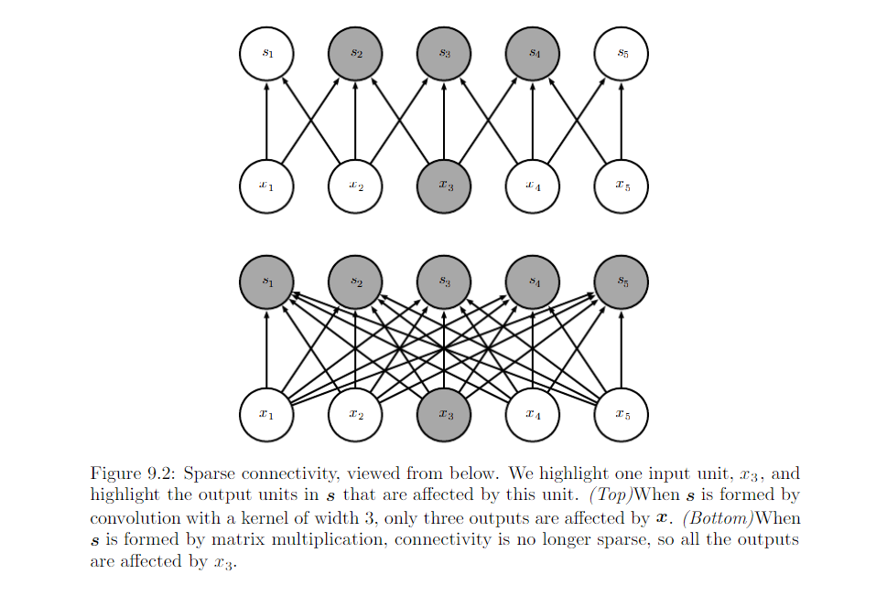
CNN-Motivation

Slide 6
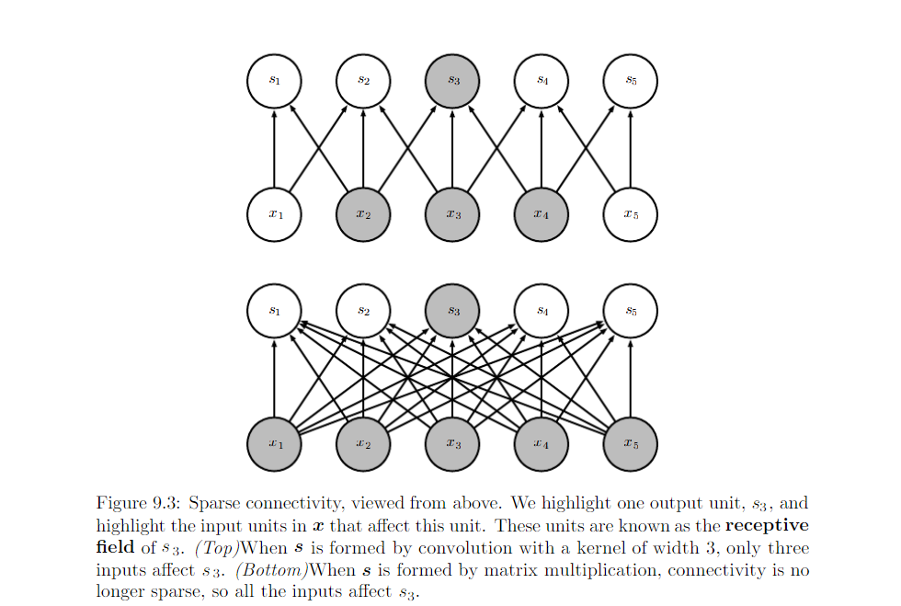

Slide 7
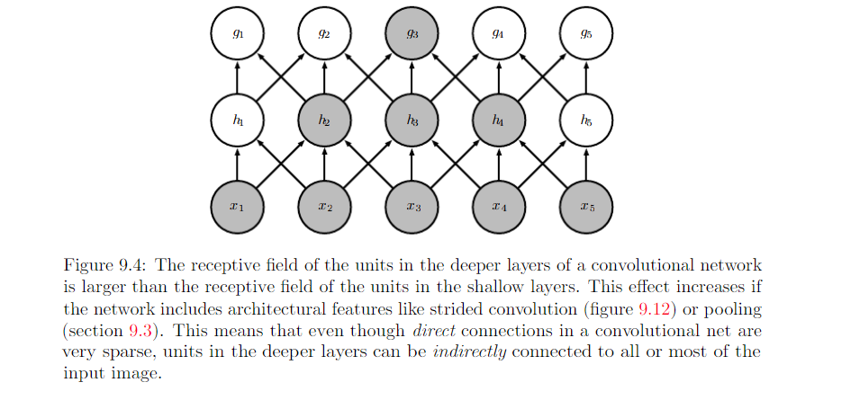
This allows the network to efficiently describe complicated interaction between many variables by construction such interaction from simple building blocks that each describe only sparse interaction.

