Slide 1
Recurrent NN
Deep Learning

Slide 2
The Inception of RNN
ANN that do not have looping nodes and are called feed forward neural networks.
all information is only passed forward, also referred as a multi-layer neural network.
appropriate for image classification tasks, for example, where input and output are independent
inability to retain previous inputs automatically renders them less useful for “sequential data analysis”
RNN Suitable for Datasets: Time-Series data and text data.

Slide 3
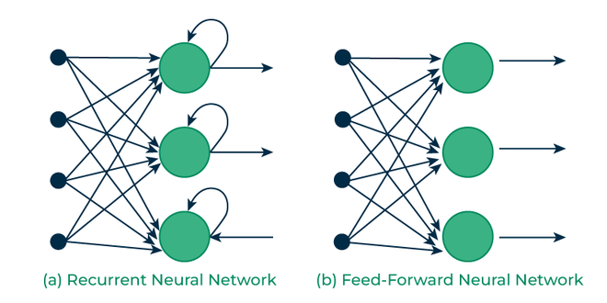
RNN Vs FFNN

Slide 4
RNN
An RNN is a neural network that is specialized for processing a sequence of data x(t)= x(1), . . . , x(τ) with the time step index t ranging from 1 to τ.
output from the previous step is fed as input to the current step
Ex: it is required to predict the next word of a sentence; the previous words are required and hence there is a need to remember the previous words.
most important feature of RNN is its Hidden state, which remembers some information about a sequence.
The state is also referred to as Memory State since it remembers the previous input to the network.
It uses the same parameters for each input as it performs the same task on all the inputs or hidden layers to produce the output. And so are called recurrent (because they perform the same task for every element of a sequence)
This reduces the complexity of parameters, unlike other neural networks.

Slide 5
RNN
For tasks that involve sequential inputs, such as speech and language, it is often better to use RNNs.
In an NLP problem, if you want to predict the next word in a sentence it is important to know the words before it.
they have a “memory” which captures information about what has been calculated so far.

Slide 6
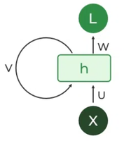
Recurrent Neuron
The fundamental processing unit in a Recurrent Neural Network (RNN) is a Recurrent Unit.
This unit has the unique ability to maintain a hidden state, allowing the network to capture sequential dependencies by remembering previous inputs while processing.
Long Short-Term Memory (LSTM) and Gated Recurrent Unit (GRU) versions improved the RNN’s ability to handle long-term dependencies.

Slide 7
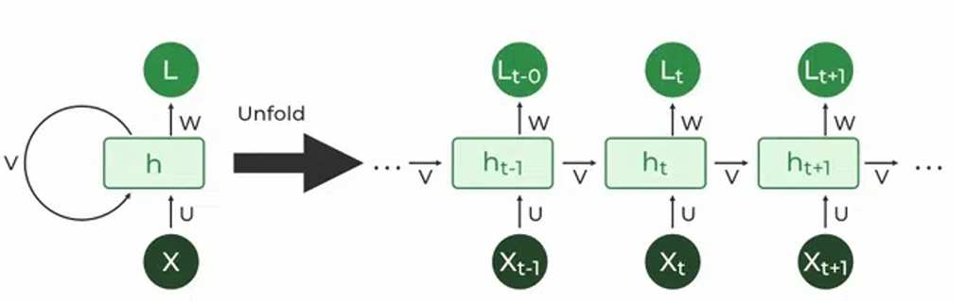
Unfold RNN

Slide 8
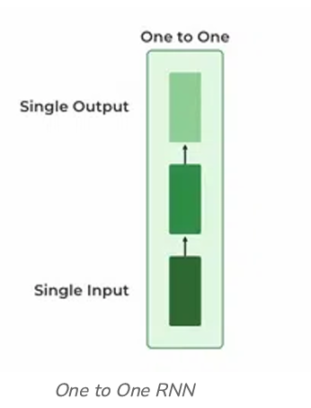
Types Of RNN
a) One to One :
Behaves the same as any simple Neural network, known as Vanilla Neural Network.
only one input and one output.
Ex: Feed-forward Network

Slide 9
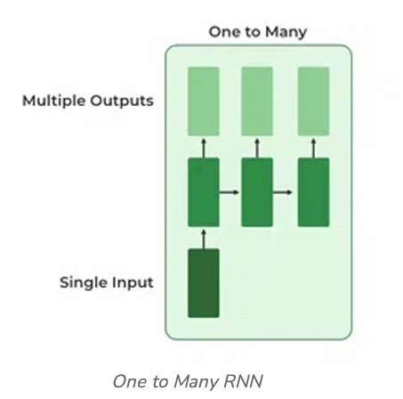
Types Of RNN
b) One To Many :
one input and many outputs associated with it.
examples of this network: Image captioning (given an image we predict a sentence having Multiple words).

Slide 10
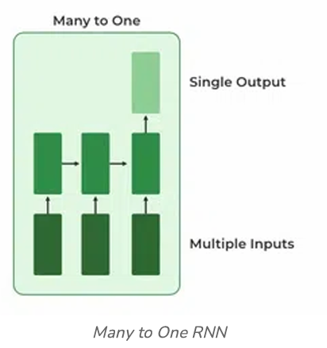
Types Of RNN
c) Many to One:
used in the problems like sentimental analysis.
Ex: multiple words as input and predict only the sentiment of the sentence as output.

Slide 11
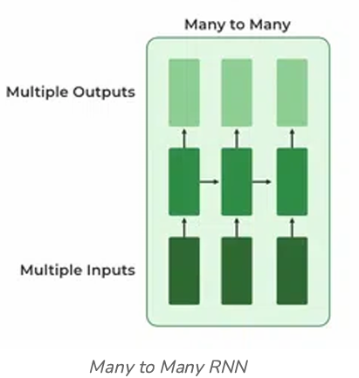
Types Of RNN
d) Many to Many:
multiple inputs and multiple outputs corresponding to a problem.
Example :language translation
In language translation, we provide multiple words from one language as input and predict multiple words from the second language as output.

Slide 12
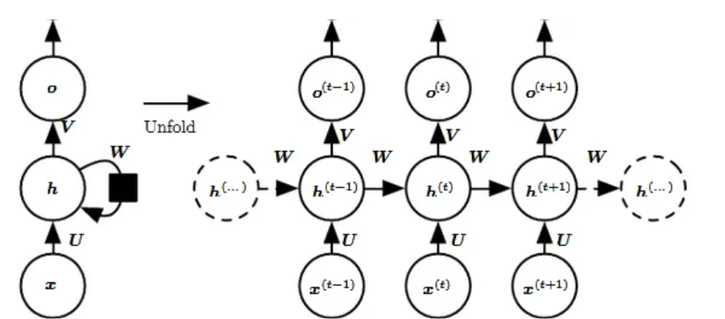
RNN Architecture
For example, if the sequence we care about is a sentence of 3 words, the network would be unrolled into a 3-layer neural network, one layer for each word.
Notes:
The left side of the above diagram shows a notation of an RNN and on the right side an RNN being unrolled (or unfolded) into a full network. By unrolling we mean that we write out the network for the complete sequence.

Slide 13
RNN
Input: x(t)​ is taken as the input to the network at time step t. For example, x1,could be a one-hot vector corresponding to a word of a sentence.
Hidden state: h(t)​ represents a hidden state at time t and acts as “memory” of the network. h(t)​ is calculated based on the current input and the previous time step’s hidden state:
h(t)​ = f(U x(t)​ + W h(t−1)​)
The function f is taken to be a non-linear transformation such as tanh, ReLU.

Slide 14
RNN
Weights: The RNN has input to hidden connections parameterized by a weight matrix U, hidden-to-hidden recurrent connections parameterized by a weight matrix W, and hidden-to-output connections parameterized by a weight matrix V and all these weights (U,V,W) are shared across time. (weights same)
Output: o(t)​ illustrates the output of the network. In the figure I just put an arrow after o(t) which is also often subjected to non-linearity, especially when the network contains further layers downstream.

Slide 15
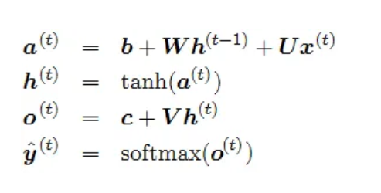
RNN: Forward Pass
We assume that the output is discrete, as if the RNN is used to predict words or characters.
A natural way to represent discrete variables is to regard the output o as giving the un-normalized log probabilities of each possible value of the discrete variable.
We can then apply the softmax operation as a post-processing step to obtain a vector ŷof normalized probabilities over the output.

Slide 16
Example: RNN Fwd pass
Assume , recurrent network that maps an input sequence to an output sequence of the same length.
The total loss for a given sequence of x values paired with a sequence of y values would then be just the sum of the losses over all the time steps.
We assume that the outputs o(t)are used as the argument to the softmax function to obtain the vector ŷ of probabilities over the output.
We also assume that the loss L is the negative log-likelihood of the true target y(t)given the input so far.
NOTE: log-likelihood→used to derive the maximum likelihood estimator of the parameter

Slide 17
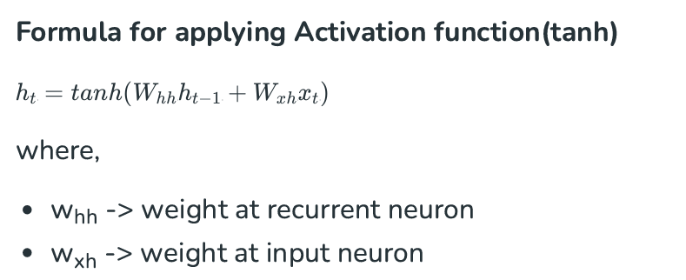
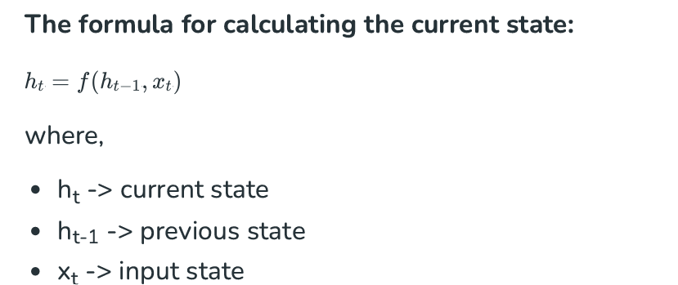
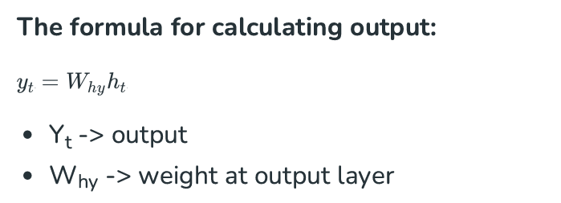
RNN
These parameters are updated using Backpropagation. However, since RNN works on sequential data here we use an updated backpropagation which is known as Backpropagation through time.

Slide 18
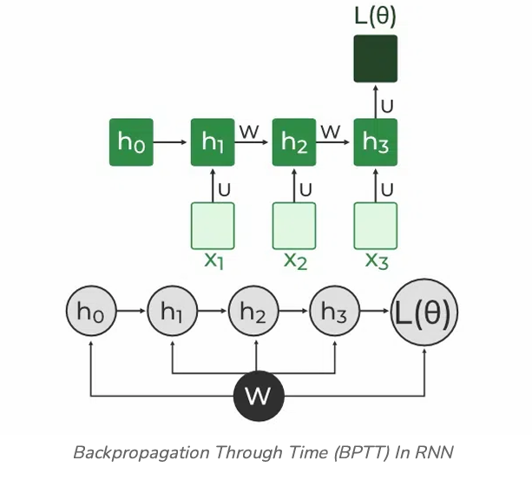
RNN: Backpropagation Through Time (BPTT)
In RNN the neural network is in an ordered fashion and since in the ordered network each variable is computed one at a time in a specified order like first h1 then h2 then h3 so on.
Hence we will apply backpropagation throughout all these hidden time states sequentially
L( θ )(loss function) depends on h3 h3 in turn depends on h2 and W h2 in turn depends on h1 and W h1 in turn depends on h0 and W where h0 is a constant starting state

Slide 19
Summary
Recurrent Neural Networks take the previous output or hidden states as inputs.
The composite input at time t has some historical information about the happenings at time T < t
RNNs are useful as their intermediate values (state) can store information about past inputs for a time that is not fixed a priori

Slide 20
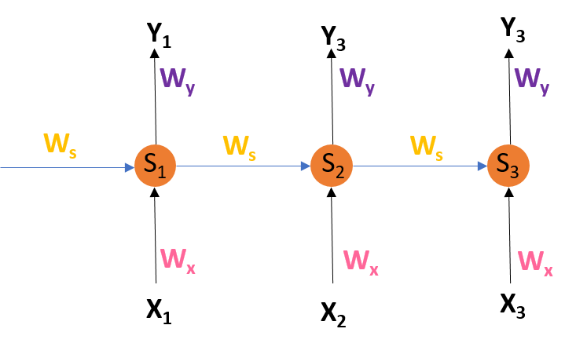
RNN: BPTT
We don’t independently train the system at a specific time “t”. We train it at a specific time “t” as well as all that has happened before time “t” like t-1, t-2, t-3. Consider the following representation of a RNN:
S1, S2, S3 are the hidden states or memory units at time t1, t2, t3 respectively,
and Ws is the weight matrix associated with it.
X1, X2, X3 are the inputs at time t1, t2, t3 respectively, and Wx is the weight matrix associated with it. Y1, Y2, Y3 are the outputs at time t1, t2, t3 respectively, and Wy is the weight matrix associated with it.

Slide 21



RNN: BPTT
For any time, t, we have the following two equations
where g1 and g2 are activation functions. Let us now perform back propagation at time t = 3
Let the error function be:
We are using the squared error here, where d3 is the desired output at time t = 3.
To perform back propagation, we have to adjust the weights associated with inputs, the memory units and the outputs.
so at t =3,

Slide 22
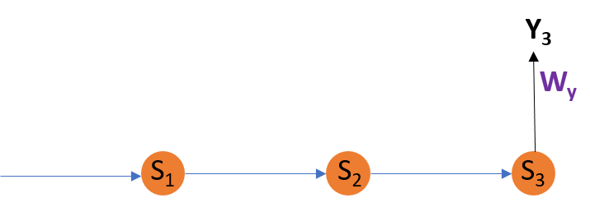
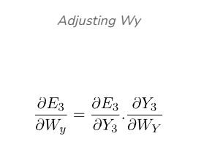
RNN: BPTT
Adjusting Wy For better understanding, let us consider the following representation:
E3 is a function of Y3.
Hence, we differentiate E3 w.r.t Y3. Y3 is a function of WY.
Hence, we differentiate Y3 w.r.t WY

Slide 23
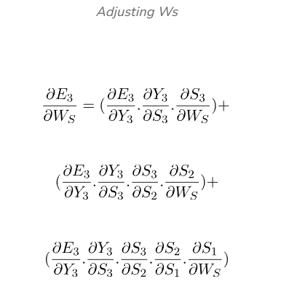
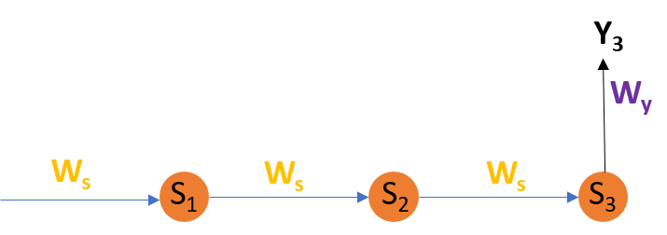
RNN: BPTT
Adjusting Ws : let us consider the following representation:
E3 is a function of Y3.
Hence, we differentiate E3 w.r.t Y3. Y3 is a function of S3.
Hence, we differentiate Y3 w.r.t S3. S3 is a function of WS.
Hence, we differentiate S3 w.r.t WS

Slide 24
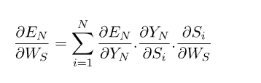
RNN: BPTT
So, we differentiate (partially) the Error function with respect to memory units S2 as well as S1 taking into consideration the weight matrix WS. We have to keep in mind that a memory unit, say S_{t} is a function of its previous memory unit S_{t-1}.
Hence, we differentiate S3 with S2 and S2 with S1.

Slide 25
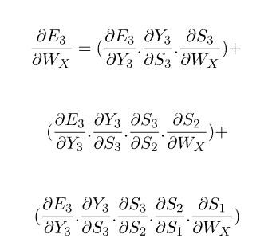
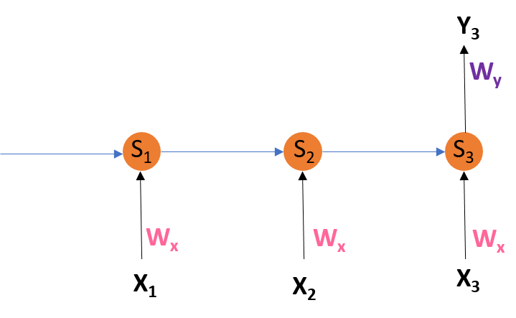
RNN:BPTT
Adjusting WX
E3 is a function of Y3.
Hence, we differentiate E3 w.r.t Y3. Y3 is a function of S3. Hence, we differentiate Y3 w.r.t S3. S3 is a function of WX. Hence, we differentiate S3 w.r.t WX

Slide 26
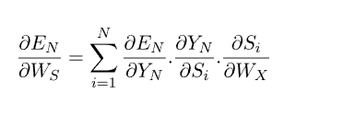
RNN:BPTT
can’t stop with this; we also have to take into consideration, the previous time steps. So, we differentiate (partially) the Error function with respect to memory units S2 as well as S1 taking into consideration the weight matrix WX.

Slide 27
Limitations of BPTT
can be used up to a limited number of time steps like 8 or 10. If we back propagate further, the gradient i.e delta becomes too small.
This problem is called the “Vanishing gradient” problem.
The problem is that the contribution of information decays geometrically over time.
So, if the number of time steps is >10 (Let’s say), that information will effectively be discarded
Going Beyond RNNs: One of the famous solutions to this problem is by using what is called Long Short-Term Memory (LSTM for short) cells instead of the traditional RNN cells.
But there might arise yet another problem here, called the exploding gradient problem, where the gradient grows uncontrollably large.
Solution: A popular method called gradient clipping can be used where in each time step, we can check if the gradient i.e delta> threshold.
If yes, then normalize it.

