Slide 1
Structured Query Language Unit-II: Part-2
SQL Data Types,
SQL Queries,
Data Manipulation Language
Set Operations,
Aggregate Functions,
Data Definition Language,
Integrity Constraints,
Null Values, Views, Join Expression.
Index Definition in SQL

Slide 2
SQL Data Types
SQL data types can be broadly divided into the following categories.
Numeric data types : INT, TINYINT, BIGINT, FLOAT, REAL, etc.
Date and Time data types : DATE, TIME, DATETIME, etc.
Character and String data types : CHAR, VARCHAR, TEXT, etc.
Unicode character string data types : NCHAR, NVARCHAR, NTEXT, etc.
Binary data types : BINARY, VARBINARY, etc.
Miscellaneous data types - CLOB, BLOB, XML, CURSOR, TABLE, etc.

Slide 3
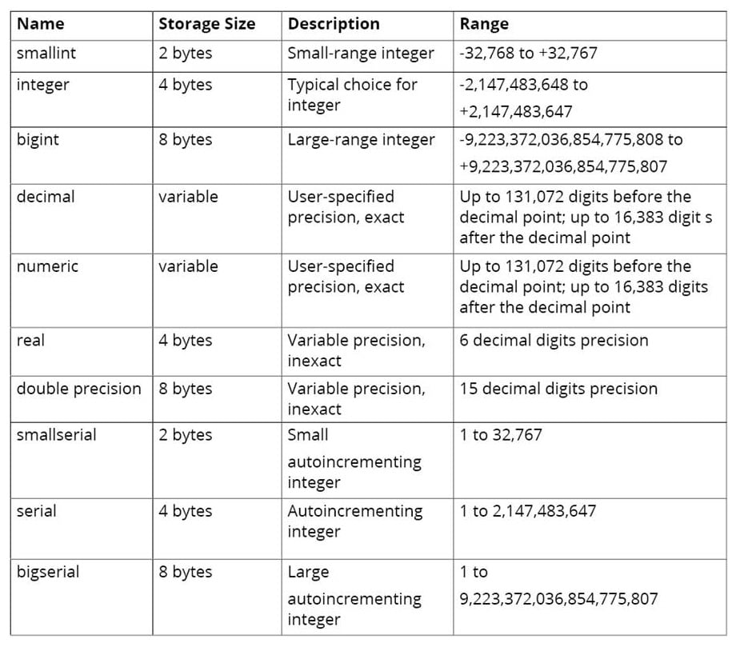
SQL Numeric Data Types

Slide 4
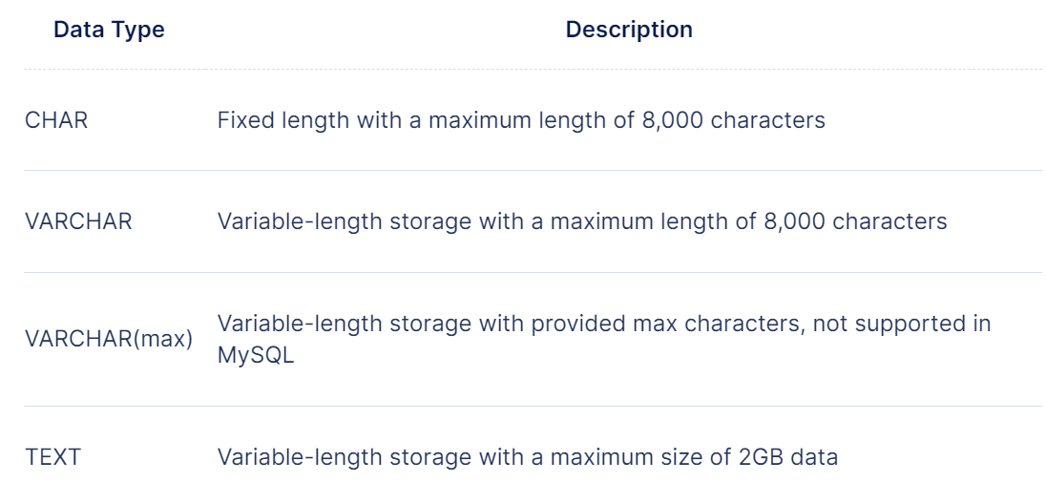
SQL Character and String Data Types

Slide 5

Boolean data types
Booleans are a data type used to represent True or False.

Slide 6
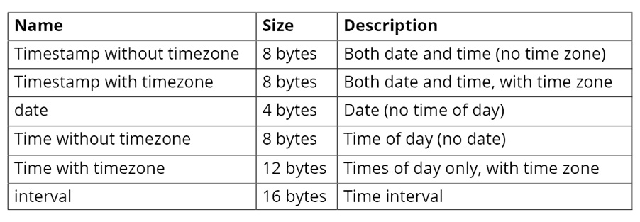
Date Time data types
The datetime data type is used to store time-based information such as dates and times

