Slide 1
Data Modeling for
Database Design
ER Modeling

Slide 2
Objectives
Understand concepts of data modeling and its purpose
Learn how relationships between entities are defined and refined, and how such relationships are incorporated into the database design process
Learn how ERD components affect database design and implementation
Learn how to interpret the modeling symbols

Slide 3
Data Model
Model: an abstraction of a real-world object or event
  Useful in understanding complexities of the real-world environment
Data model
  A diagram that displays a set of tables and the relationships between them
  Next Slide: “Restaurant” Access data model using Entity Relationship Diagram (ERD)

Slide 4
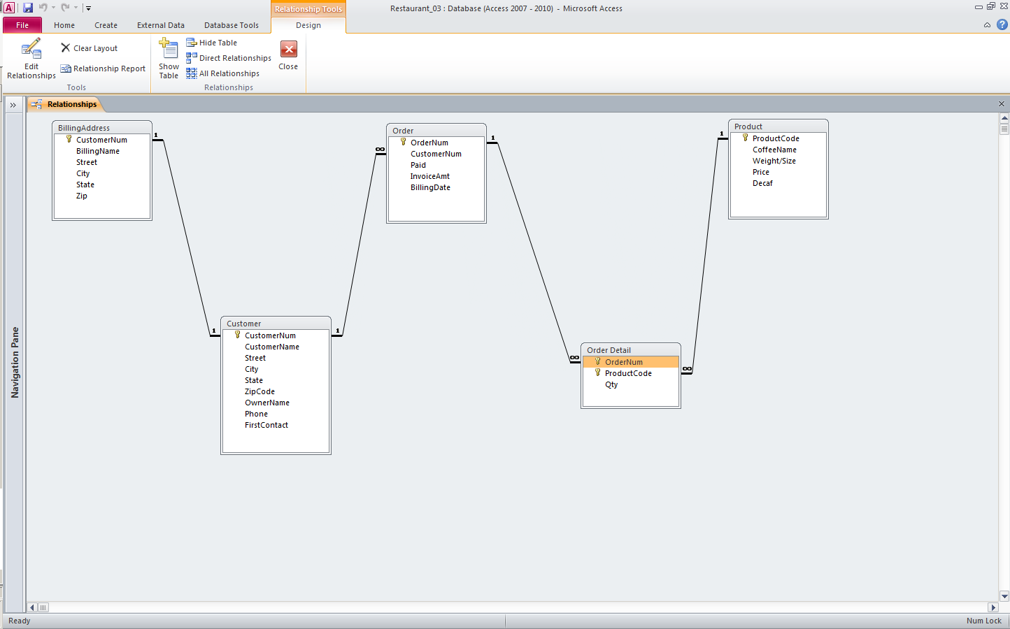
Access Data Model using ERD

Slide 5
What is an Entity Relationship Diagram (ERD)?
ERD is a data modeling technique used in software engineering to produce a conceptual data model of an information system.
So, ERDs illustrate the logical structure of databases.
ERD development using a CASE tool
  Data Modeler by Orcale

Slide 6
The Importance of Data Model
Blue print: official documentation
  Blue print of house
Employee’s w/o DB knowledge can understand
  a data model diagram vs. a list of tables
  Used as an effective Communication Tool
  Improve interaction among the managers, the designers, and the end users
Independence from a particular DBMS
  Network DB, Object-oriented DB, etc.

Slide 7
Data Model (con’t)
The data modeling revolves around discovering and analyzing organizational and users data requirements.
Requirements based on policies, meetings, procedures, system specifications, etc.
  Identify what data is important
  Identify what data should be maintained
Notes:
7

Slide 8
ERD
The major activity of this phase is identifying entities, attributes, and their relationships to construct model using the Entity Relationship Diagram.
  Entity → table
  Attribute → column
  Relationship → line
Basics of Data Modeling Video
  Until business rules # 3 (9:20)
Notes:
7

Slide 9
Characteristics of E-R Model
Semantic data model
Express the logical properties of an enterprise database
Design tools and documentation for data base structure
No physical DBMS
Proposed by Dr. Peter Chen
Unified Modeling Language (UML)

Slide 10
How to find entities?
Entity:
  "...anything (people, places, objects, events, etc.) about which we store information (e.g. supplier, machine tool, employee, utility pole, airline seat, etc.).”
  Tangible: customer, product
  Intangible: order, accounting receivable
  Look for singular nouns (beginner)
  BUT a proper noun is not a good candidate….

Slide 11
Entity Instance
Entity instance: a single occurrence of an entity.
  6 instances
Entity: student
Student ID | Last Name | First Name
2144 | Arnold | Betty
3122 | Taylor | John
3843 | Simmons | Lisa
9844 | Macy | Bill
2837 | Leath | Heather
2293 | Wrench | Tim
instance

Slide 12
How to find attributes?
Attribute:
  Attributes are data objects that either identify or describe entities (property of an entity).
  In other words, it is a descriptor whose values are associated with individual entities of a specific entity type
    The process for identifying attributes is similar except now you want to look for and extract those names that appear to be descriptive noun phrases.

Slide 13
How to find relationships?
Relationship:
  Relationships are associations between entities.
  Typically, a relationship is indicated by a verb connecting two or more entities.
  Employees are assigned to projects
  Relationships should be classified in terms of cardinality.
    One-to-one, one-to-many, etc.

Slide 14
How to find cardinalities?
Cardinality:
  The cardinality is the number of occurrences in one entity which are associated to the number of occurrences in another.
  There are three basic cardinalities (degrees of relationship).
  one-to-one (1:1), one-to-many (1:M), and many-to-many (M:N)

Slide 15
Identifier
“attributes that uniquely identify entity instances”
Becomes a PK in RDS
Composite identifiers are identifiers that consist of two or more attributes
Identifiers are represented by underlying the name of the attribute(s)
  Employee (Employee_ID), student (Student_ID)
Notes:
18

Slide 16
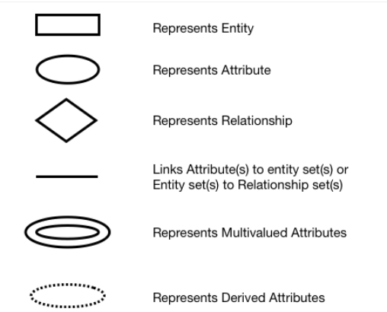
Symbols used in ER Diagrams
Slide 3- <number>

Slide 17
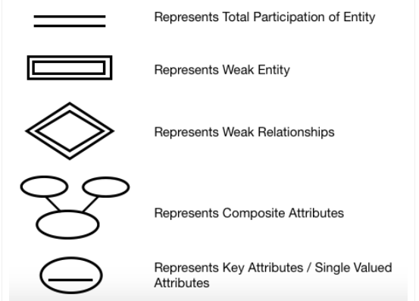
Slide 3- <number>

Slide 18
Example COMPANY Database
We need to create a database schema design based on the following (simplified) requirements of the COMPANY Database:
  The company is organized into DEPARTMENTs. Each department has a name, number and an employee who manages the department. We keep track of the start date of the department manager. A department may have several locations.
  Each department controls a number of PROJECTs. Each project has a unique name, unique number and is located at a single location.
Slide 3- <number>

Slide 19
Example COMPANY Database (Contd.)
  We store each EMPLOYEE’s social security number, address, salary, sex, and birthdate.
    Each employee works for one department but may work on several projects.
    We keep track of the number of hours per week that an employee currently works on each project.
    We also keep track of the direct supervisor of each employee.
  Each employee may have a number of DEPENDENTs.
    For each dependent, we keep track of their name, sex, birthdate, and relationship to the employee.
Slide 3- <number>

Slide 20

Initial Design of Entity Types:
EMPLOYEE, DEPARTMENT, PROJECT, DEPENDENT
Slide 3- <number>

Slide 21

ER DIAGRAM – Relationship Types are:
WORKS_FOR, MANAGES, WORKS_ON, CONTROLS, SUPERVISION, DEPENDENTS_OF
Slide 3- <number>

Slide 22
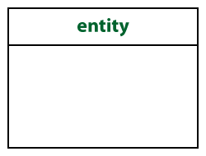
Crow’s Foot Notation
Known as IE notation (most popular)
Entity:
  Represented by a rectangle, with its name on the top. The name is singular (entity) rather than plural (entities).

Slide 23
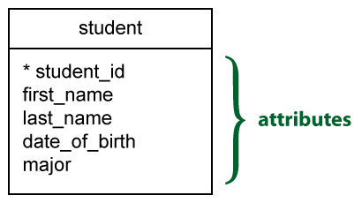
Attributes
Identifiers are represented by underlying the name of the attribute(s)

Slide 24



Basic Cardinality Type
1-to-1 relationship
1-to-M relationship
M-to-N relationship

Slide 25
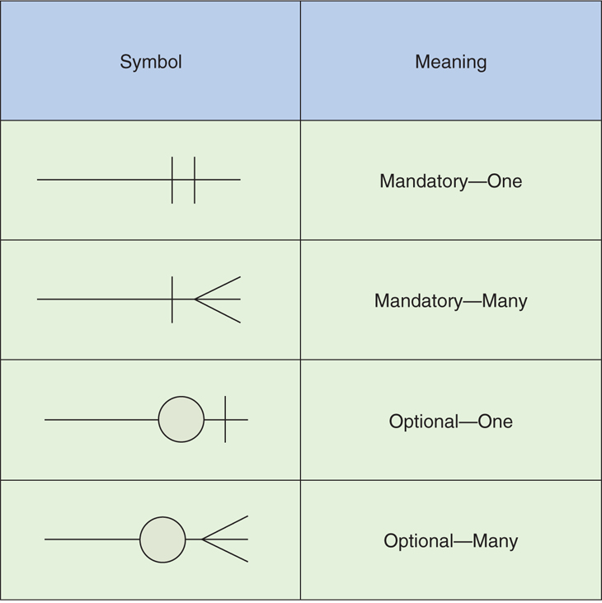
Cardinality con’t

Slide 26
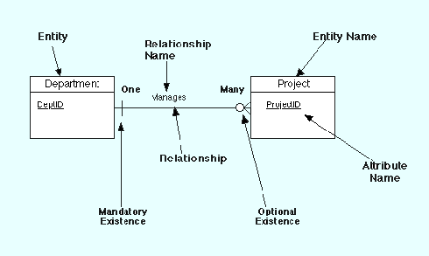
Example Model

Slide 27
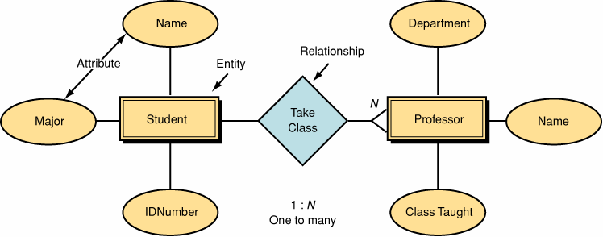
Data Model by Peter Chen’ Notation (first - original)

Slide 28
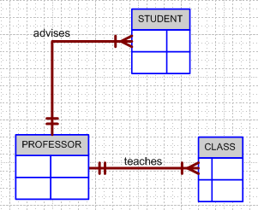
Business Rule Example 1
Finalized business rules must be bi-directional.
  Draft: one sentence
  Finalized: two sentences
A professor advises many students (professor to student). Each student is advised by one professor (student to professor).
A professor must teach many classes. Each class must be taught by one professor.

Slide 29
Business Rule 1
Business Rules are used to define entities, attributes, relationships and constraints.
Usually, they are used for the organization that stores or uses data to be an explanation of a policy, procedure, or principle.
The data can be considered significant only after business rules are defined.
  W/o them it cannot be considered as data for RDS but just records.

Slide 30
Business Rule 2
When creating business rules, keep them simple, easy to understand, and keep them broad.
  so that everyone can have a similar understanding and interpretation.
Sources of business rules:
  Direct interviews with internal & external stakeholders
  Site visitations (collect data) and observation of the work process or procedure
  Review and study of documents (Policies, Procedures, Forms, Operation manuals, etc..)

Slide 31
Discovering Business Rules
Real world example on the class website
  After reviewing and studying the interview and various forms, develop a draft business rules - does not need to be bi-directional and less precise wording…
  Keep on going until “optimized”
  Then, finalize Business Rules: bi-directional.

Slide 32
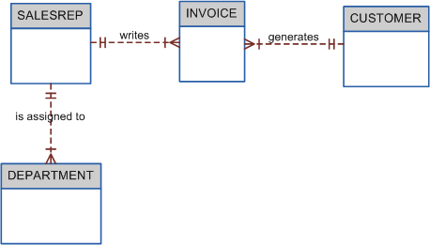
Business Rule Example 2
A sales representative must write many invoices. Each invoice has to be written by one sales representative.
Each sales representative must be assigned to many department. Each department has only one sales representative.
A customer has to generate many invoices. An invoice is generated by only one customer.

Slide 33
Attributes
“Describe detail information about an entity ”
Entity: Employee
Attributes:
  Employee-Name
  Address (composite)
  Phone Extension
  Date-Of-Hire
  Job-Skill-Code
  Salary
Notes:
18

Slide 34
Classes of attributes
Simple attribute
Composite attribute
Derived attributes
Single-valued attribute
Multi-valued attribute
Notes:
5

Slide 35
Simple, Composite attribute
A simple attribute cannot be subdivided.
  Examples: Age, Gender, and Marital status
A composite attribute can be further subdivided to yield additional attributes.
  Examples:
    ADDRESS --→ Street, City, State, Zip
    PHONE NUMBER --→ Area code, Exchange number
Notes:
22

Slide 36
Derived attribute
is not physically stored within the database
instead, it is derived by using an algorithm.
  Example 1: Late Charge of 2%
    MS Access: InvoiceAmt * 0.02
  Example 2: AGE can be derived from the date of birth and the current date.
    MS Access: int(Date() – Emp_Dob)/365)
Notes:
22

Slide 37
Single-valued attribute
can have only a single (atomic) value.
  Examples:
    A person can have only one social security number.
    A manufactured part can have only one serial number.
  A single-valued attribute is not necessarily a simple attribute.
    Part No: CA-08-02-189935
    Location: CA, Factory#:08, shift#: 02, part#: 189935
Notes:
23

Slide 38
Multi-valued attributes
can have many values.
  Examples:
    A person may have several college degrees.
    A household may have several phones with different numbers
    A car color
Notes:
23

Slide 39
Example - “Movie Database”
Entity:
  Movie Star
Attributes:
  SS#: “123-45-6789” (single-valued)
  Cell Phone: “(661)123-4567, (661)234-5678” (multi-valued)
  Name: “Harrison Ford” (composite)
  Address: “123 Main Str., LA, CA” (composite)
  Gender: “Female” (simple)
  Age: 24 (derived)

Slide 40
Procedure of ERD
Relatively simple representations of complex real-world data structures
Data modeling is iterative process.
“complete” and “100% error free” model is not possible!
Only “Optimized” model is possible….

