Slide 1
Chapter 11: Indexing and Hashing

Slide 2
Chapter 12: Indexing and Hashing
Basic Concepts
Dense and sparse Index
Secondary Indices
Ordered Indices
Tree-Structure Indexing: B⁺-Tree Index Files

Slide 3
Basic Concepts
Indexing mechanisms used to speed up access to desired data.
  E.g., author catalog in library
Search Key - attribute to set of attributes used to look up records in a file.
An index file consists of records (called index entries) of the form
Index files are typically much smaller than the original file
Two basic kinds of indices:
  Ordered indices: search keys are stored in sorted order
  Hash indices: search keys are distributed uniformly across “buckets” using a “hash function”.
search-key
pointer

Slide 4
Index Evaluation Metrics
Access types supported efficiently. E.g.,
  records with a specified value in the attribute
  or records with an attribute value falling in a specified range of values.
Access time
Insertion time
Deletion time
Space overhead

Slide 5
Ordered Indices
In an ordered index, index entries are stored and sorted on the search key value. E.g., author catalog in library.
Primary index: in a sequentially ordered file, the index whose search key specifies the sequential order of the file.
  Also called clustering index
  The search key of a primary index is usually but not necessarily the primary key.
Secondary index: an index whose search key specifies an order different from the sequential order of the file. Also called
non-clustering index.
Index-sequential file: ordered sequential file with a primary index.

Slide 6

Dense Index Files
Dense index — Index record appears for every search-key value in the file.
E.g. index on ID attribute of instructor relation

Slide 7

Dense Index Files (Cont.)
Dense index on dept_name, with instructor file sorted on dept_name

Slide 8

Sparse Index Files
Sparse Index: contains index records for only some search-key values.
  Applicable when records are sequentially ordered on search-key
To locate a record with search-key value K we:
  Find index record with largest search-key value < K
  Search file sequentially starting at the record to which the index record points

Slide 9

Sparse Index Files (Cont.)
Compared to dense indices:
  Less space and less maintenance overhead for insertions and deletions.
  Generally slower than dense index for locating records.
Good tradeoff: sparse index with an index entry for every block in file, corresponding to least search-key value in the block.

Slide 10

Secondary Indices Example
Secondary index on salary field of instructor
Index record points to a bucket that contains pointers to all the actual records with that particular search-key value.
Secondary indices have to be dense

Slide 11
Primary and Secondary Indices
Indices offer substantial benefits when searching for records.
BUT: Updating indices imposes overhead on database modification --when a file is modified, every index on the file must be updated,
Sequential scan using primary index is efficient, but a sequential scan using a secondary index is expensive
  Each record access may fetch a new block from disk
  Block fetch requires about 5 to 10 milliseconds, versus about 100 nanoseconds for memory access

Slide 12
Multilevel Index
If primary index does not fit in memory, access becomes expensive.
Solution: treat primary index kept on disk as a sequential file and construct a sparse index on it.
  outer index – a sparse index of primary index
  inner index – the primary index file
If even outer index is too large to fit in main memory, yet another level of index can be created, and so on.
Indices at all levels must be updated on insertion or deletion from the file.

Slide 13
Multilevel Index (Cont.)

Slide 14
Index Update: Deletion
If deleted record was the only record in the file with its particular search-key value, the search-key is deleted from the index also.
Single-level index entry deletion:
  Dense indices – deletion of search-key is similar to file record deletion.
  Sparse indices –
    if an entry for the search key exists in the index, it is deleted by replacing the entry in the index with the next search-key value(may be of next block/row) in the file (in search-key order).
    If the next search-key value already has an index entry, the entry is deleted instead of being replaced.

Slide 15
Index Update: Insertion
Single-level index insertion:
  Perform a lookup using the search-key value appearing in the record to be inserted.
  Dense indices – if the search-key value does not appear in the index, insert it.
  Sparse indices – if index stores an entry for each block of the file, no change needs to be made to the index unless a new block is created.
    If a new block is created, the first search-key value appearing in the new block is inserted into the index.

Slide 16
Secondary Indices
Frequently, one wants to find all the records whose values in a certain field (which is not the search-key of the primary index) satisfy some condition.
  Example 1: In the instructor relation stored sequentially by ID, we may want to find all instructors in a particular department
  Example 2: as above, but where we want to find all instructors with a specified salary or with salary in a specified range of values
We can have a secondary index with an index record for each search-key value

Slide 17
B⁺-Tree Index Files
B⁺-tree indices are an alternative to indexed-sequential files.
Disadvantage of indexed-sequential files
  performance degrades as file grows, since many overflow blocks get created.
  Periodic re-organization of entire file is required.
Advantage of B⁺-tree index files:
  automatically reorganizes itself with small, local, changes, in the face of insertions and deletions.
  Reorganization of entire file is not required to maintain performance.
(Minor) disadvantage of B⁺-trees:
  extra insertion and deletion overhead, space overhead.
Advantages of B⁺-trees outweigh disadvantages
  B⁺-trees are used extensively

Slide 18

Example of B⁺-Tree

Slide 19
B⁺-Tree Index Files (Cont.)
A B⁺-tree is a rooted tree satisfying the following properties:
All paths from root to leaf are of the same length
Each node that is not a root or a leaf has between ⎡n/2⎤ and n children.
A leaf node has between ⎡(n–1)/2⎤ and n–1 values
Special cases:
  If the root is not a leaf, it has at least 2 children.
  If the root is a leaf (that is, there are no other nodes in the tree), it can have between 0 and (n–1) values.

Slide 20
B⁺-Tree Node Structure
Typical node
  K_{i} are the search-key values
  P_{i} are pointers to children (for non-leaf nodes) or pointers to records or buckets of records (for leaf nodes).
The search-keys in a node are ordered
K₁ < K₂ < K₃ < . . . < K_{n–1}
(Initially assume no duplicate keys, address duplicates later)

Slide 21

Leaf Nodes in B⁺-Trees
Properties of a leaf node:
For i = 1, 2, . . ., n–1, pointer P_{i} points to a file record with search-key value K_{i},
If L_{i}, L_{j} are leaf nodes and i < j, L_{i}’s search-key values are less than or equal to L_{j}’s search-key values
P_{n} points to next leaf node in search-key order

Slide 22
Non-Leaf Nodes in B⁺-Trees
Non leaf nodes form a multi-level sparse index on the leaf nodes. For a non-leaf node with m pointers:
  All the search-keys in the subtree to which P₁ points are less than K₁
  For 2 ≤ i ≤ n – 1, all the search-keys in the subtree to which P_{i} points have values greater than or equal to K_{i–1} and less than K_{i}
  All the search-keys in the subtree to which P_{n} points have values greater than or equal to K_{n–1}

Slide 23

Example of B⁺-tree
B⁺-tree for instructor file (n = 6)
Leaf nodes must have between 3 and 5 values
(⎡(n–1)/2⎤ and n –1, with n = 6).
Non-leaf nodes other than root must have between 3 and 6 children (⎡(n/2⎤ and n with n =6).
Root must have at least 2 children.

Slide 24
Observations about B⁺-trees
Since the inter-node connections are done by pointers, “logically” close blocks need not be “physically” close.
The non-leaf levels of the B⁺-tree form a hierarchy of sparse indices.
The B⁺-tree contains a relatively small number of levels
    Level below root has at least 2* ⎡n/2⎤ values
    Next level has at least 2* ⎡n/2⎤ * ⎡n/2⎤ values
    .. etc.
  If there are K search-key values in the file, the tree height is no more than ⎡ log_{⎡n/2⎤}(K)⎤
  thus searches can be conducted efficiently.
Insertions and deletions to the main file can be handled efficiently, as the index can be restructured in logarithmic time (as we shall see).

Slide 25

Queries on B⁺-Trees
Find record with search-key value V.
  C=root
  While C is not a leaf node {
    Let i be least value s.t. V ≤ K_{i}.
    If no such exists, set C = last non-null pointer in C
    Else { if (V= K_{i} ) Set C = P_{i +1} else set C = P_{i}}
    }
  Let i be least value s.t. K_{i} = V
  If there is such a value i, follow pointer P_{i} to the desired record.
  Else no record with search-key value k exists.

Slide 26
Handling Duplicates
With duplicate search keys
  In both leaf and internal nodes,
    we cannot guarantee that K₁ < K₂ < K₃ < . . . < K_{n–1}
    but can guarantee K₁ ≤ K₂ ≤ K₃ ≤ . . . ≤ K_{n–1}
  Search-keys in the subtree to which P_{i} points
    are ≤ K_{i,}, but not necessarily < K_{i,}
    To see why, suppose same search key value V is present in two leaf node L_{i} and L_{i+1}. Then in parent node K_{i} must be equal to V

Slide 27
Handling Duplicates
We modify find procedure as follows
  traverse P_{i} even if V = K_{i}
  As soon as we reach a leaf node C check if C has only search key values less than V
    if so set C = right sibling of C before checking whether C contains V
Procedure printAll
  uses modified find procedure to find first occurrence of V
  Traverse through consecutive leaves to find all occurrences of V
** Errata note: modified find procedure missing in first printing of 6th edition

Slide 28
Queries on B⁺⁻Trees (Cont.)
If there are K search-key values in the file, the height of the tree is no more than ⎡log_{⎡n/2⎤}(K)⎤.
A node is generally the same size as a disk block, typically 4 kilobytes
  and n is typically around 100 (40 bytes per index entry).
With 1 million search key values and n = 100
  at most log₅₀(1,000,000) = 4 nodes are accessed in a lookup.
Contrast this with a balanced binary tree with 1 million search key values — around 20 nodes are accessed in a lookup
  above difference is significant since every node access may need a disk I/O, costing around 20 milliseconds

Slide 29
Updates on B⁺-Trees: Insertion
Find the leaf node in which the search-key value would appear
If the search-key value is already present in the leaf node
  Add record to the file
  If necessary add a pointer to the bucket.
If the search-key value is not present, then
  add the record to the main file (and create a bucket if necessary)
  If there is room in the leaf node, insert (key-value, pointer) pair in the leaf node
  Otherwise, split the node (along with the new (key-value, pointer) entry) as discussed in the next slide.

Slide 30
Updates on B⁺-Trees: Insertion (Cont.)
Splitting a leaf node:
  take the n (search-key value, pointer) pairs (including the one being inserted) in sorted order. Place the first ⎡n/2⎤ in the original node, and the rest in a new node.
  let the new node be p, and let k be the least key value in p. Insert (k,p) in the parent of the node being split.
  If the parent is full, split it and propagate the split further up.
Splitting of nodes proceeds upwards till a node that is not full is found.
  In the worst case the root node may be split increasing the height of the tree by 1.
Result of splitting node containing Brandt, Califieri and Crick on inserting Adams
Next step: insert entry with (Califieri,pointer-to-new-node) into parent

Slide 31
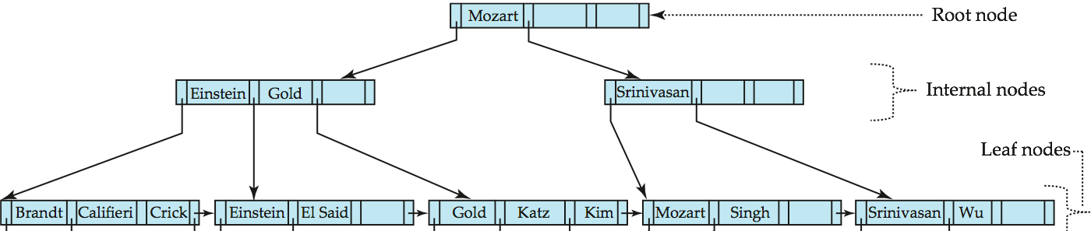
B⁺-Tree Insertion
B⁺-Tree before and after insertion of “Adams”

Slide 32
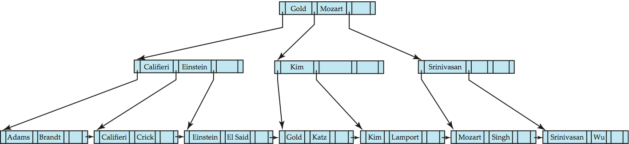
B⁺-Tree Insertion
B⁺-Tree before and after insertion of “Lamport”

Slide 33
Insertion in B⁺-Trees (Cont.)
Splitting a non-leaf node: when inserting (k,p) into an already full internal node N
  Copy N to an in-memory area M with space for n+1 pointers and n keys
  Insert (k,p) into M
  Copy P₁,K₁, …, K _{⎡n/2⎤-1},P _{⎡n/2⎤} from M back into node N
  Copy P_{⎡n/2⎤+1},K _{⎡n/2⎤+1},…,K_{n},P_{n+1} from M into newly allocated node N’
  Insert (K _{⎡n/2⎤},N’) into parent N
Read pseudocode in book!
Califieri
Adams Brandt Califieri Crick
Adams Brandt
Crick

Slide 34
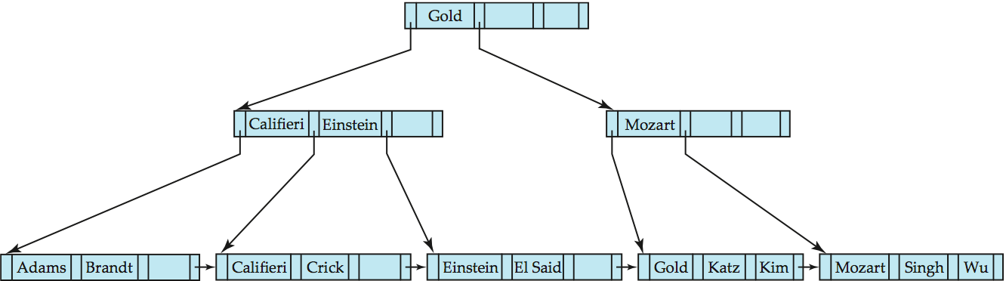
Examples of B⁺-Tree Deletion
Before and after deleting “Srinivasan”
Deleting “Srinivasan” causes merging of under-full leaves

Slide 35
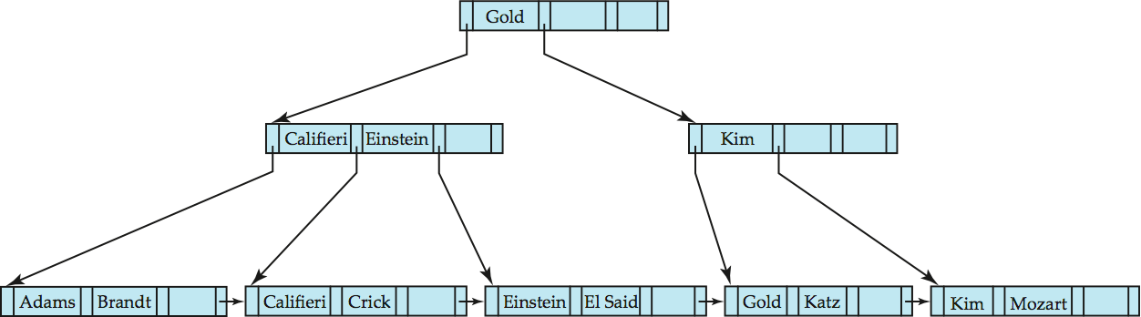
Examples of B⁺-Tree Deletion (Cont.)
Deletion of “Singh” and “Wu” from result of previous example
Leaf containing Singh and Wu became underfull, and borrowed a value Kim from its left sibling
Search-key value in the parent changes as a result

Slide 36
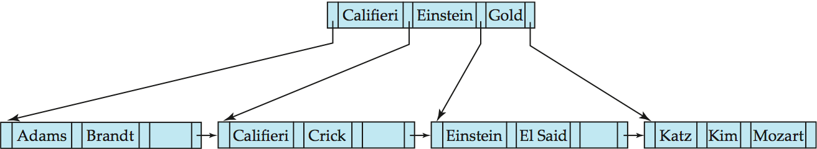
Example of B⁺-tree Deletion (Cont.)
Before and after deletion of “Gold” from earlier example
Node with Gold and Katz became underfull, and was merged with its sibling
Parent node becomes underfull, and is merged with its sibling
  Value separating two nodes (at the parent) is pulled down when merging
Root node then has only one child, and is deleted

Slide 37
Updates on B⁺-Trees: Deletion
Find the record to be deleted, and remove it from the main file and from the bucket (if present)
Remove (search-key value, pointer) from the leaf node if there is no bucket or if the bucket has become empty
If the node has too few entries due to the removal, and the entries in the node and a sibling fit into a single node, then merge siblings:
  Insert all the search-key values in the two nodes into a single node (the one on the left), and delete the other node.
  Delete the pair (K_{i–1}, P_{i}), where P_{i} is the pointer to the deleted node, from its parent, recursively using the above procedure.

Slide 38
Updates on B⁺-Trees: Deletion
Otherwise, if the node has too few entries due to the removal, but the entries in the node and a sibling do not fit into a single node, then redistribute pointers:
  Redistribute the pointers between the node and a sibling such that both have more than the minimum number of entries.
  Update the corresponding search-key value in the parent of the node.
The node deletions may cascade upwards till a node which has ⎡n/2⎤ or more pointers is found.
If the root node has only one pointer after deletion, it is deleted and the sole child becomes the root.

Slide 39
Non-Unique Search Keys
Alternatives to scheme described earlier
  Buckets on separate block (bad idea)
  List of tuple pointers with each key
    Extra code to handle long lists
    Deletion of a tuple can be expensive if there are many duplicates on search key (why?)
    Low space overhead, no extra cost for queries
  Make search key unique by adding a record-identifier
    Extra storage overhead for keys
    Simpler code for insertion/deletion
    Widely used

Slide 40
B⁺-Tree File Organization
Index file degradation problem is solved by using B⁺-Tree indices.
Data file degradation problem is solved by using B⁺-Tree File Organization.
The leaf nodes in a B⁺-tree file organization store records, instead of pointers.
Leaf nodes are still required to be half full
  Since records are larger than pointers, the maximum number of records that can be stored in a leaf node is less than the number of pointers in a nonleaf node.
Insertion and deletion are handled in the same way as insertion and deletion of entries in a B⁺-tree index.

Slide 41
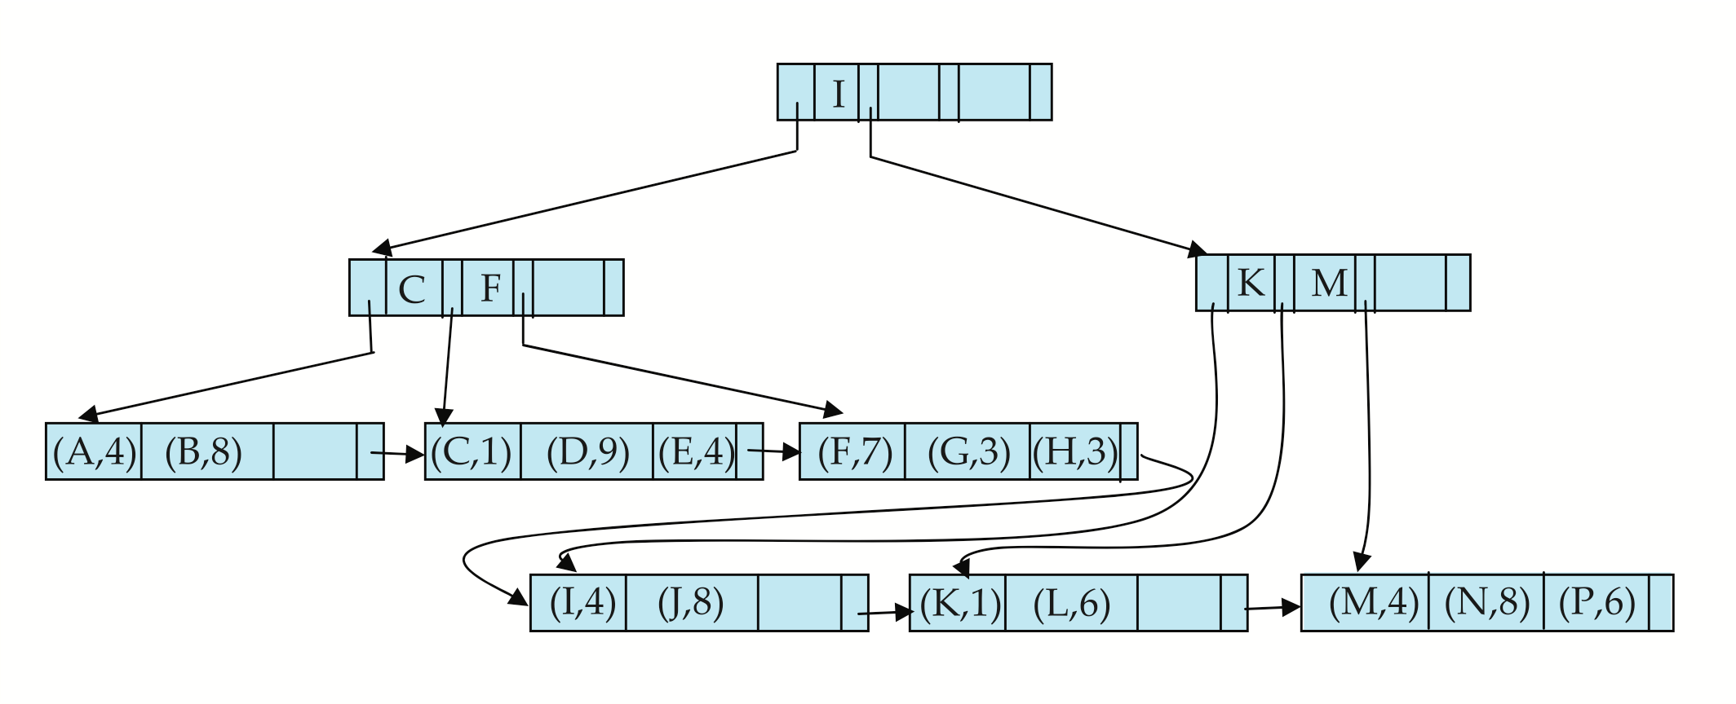

B⁺-Tree File Organization (Cont.)
Example of B⁺-tree File Organization
Good space utilization important since records use more space than pointers.
To improve space utilization, involve more sibling nodes in redistribution during splits and merges
  Involving 2 siblings in redistribution (to avoid split / merge where possible) results in each node having at least entries

Slide 42
Other Issues in Indexing
Record relocation and secondary indices
  If a record moves, all secondary indices that store record pointers have to be updated
  Node splits in B⁺-tree file organizations become very expensive
  Solution: use primary-index search key instead of record pointer in secondary index
    Extra traversal of primary index to locate record
      Higher cost for queries, but node splits are cheap
    Add record-id if primary-index search key is non-unique

