Slide 1
Sequential circuits

Slide 2
Counter Design Block
4-bit synchronous up counter.
Active high, synchronous reset.
Active high enable.

Slide 3
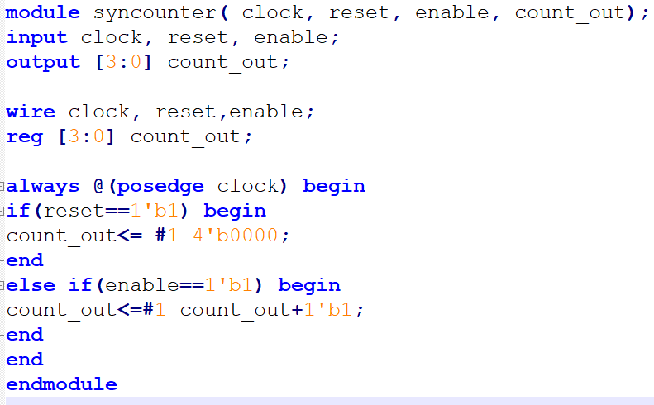
Simple Up Counter

Slide 4
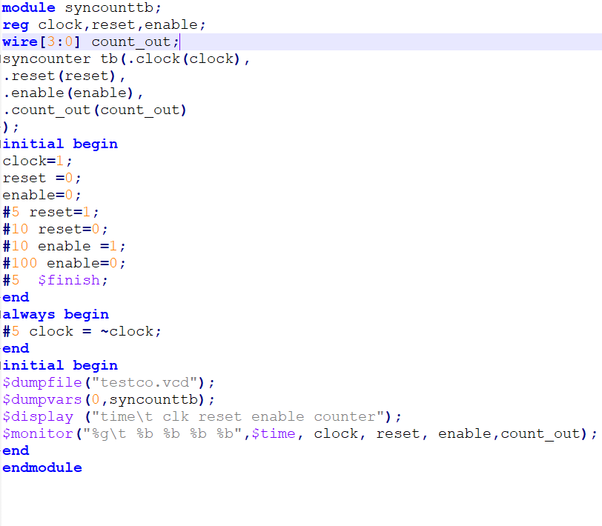
Up Counter Testbed

Slide 5
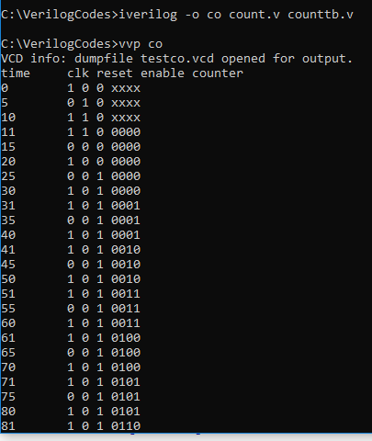
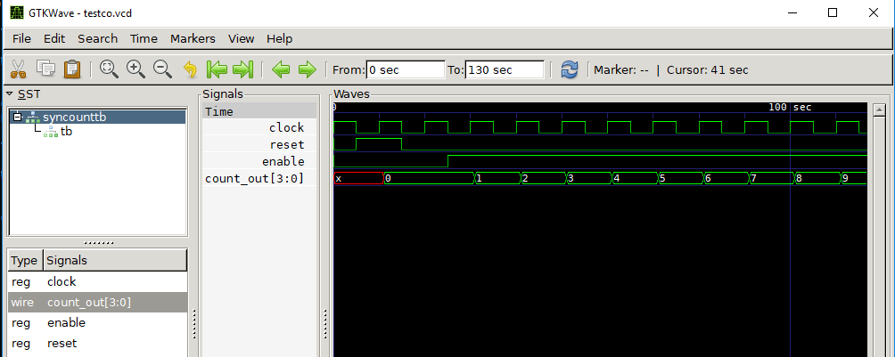
Output

Slide 6
Today LAB Assignments
Design a 8-Bit Up-Down Counter
Design all flip-flop (T, S-R,JK)
Design JK master-slave
Design a Divide by 2 Counter

