Slide 1


FDP on Artificial Intelligence and It’s Applications - Session on Unsupervised Learning and Natural Language Processing Date:03-12-2020
Dr.Subalalitha C.N
Associate Professor, Department of Computer Science and Engineering
SRM Institute of Science and Technology , Kattankulathur Campus,Chennai
Email: subalaln@srmist.edu.in
https://www.subalalitha.in/

Slide 2
Targets of the day !
Unsupervised Machine Learning
K-Means Clustering
Hands-on Session on K-Means
Natural Language Processing (NLP)- A sub domain of Artificial Intelligence
Hands-on session on NLP

Slide 3
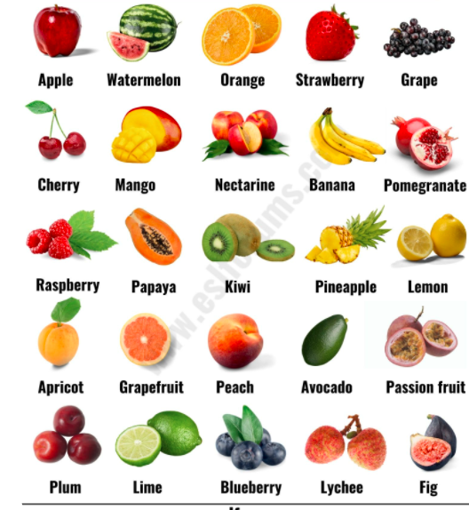
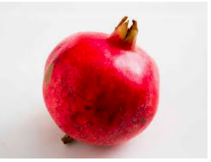
Labelled Fruits for Training
A Supervised ML Algorithm
Supervised Machine Learning Algorithm
(Training)
Test Fruit
Machine Learning Classifier Model
The Fruit is Pomegranate

Slide 4
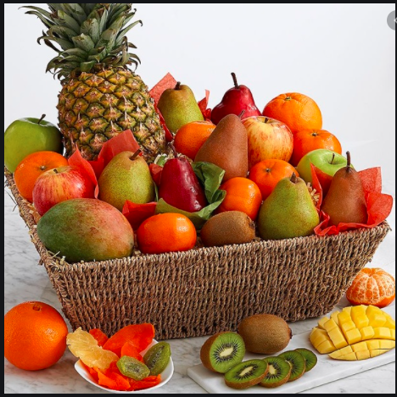

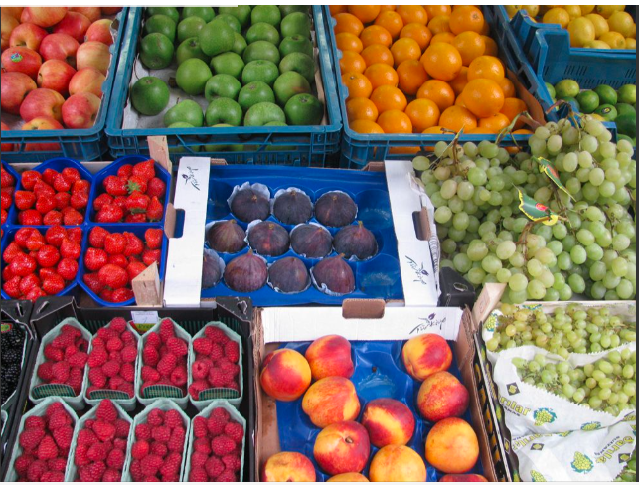
Unlabelled Fruits for Training
An Unsupervised ML Algorithm
Unsupervised Machine Learning Algorithm
(Training)
Test Fruit
To which tray I should put this Fruit?
Put in Tray-3

Slide 5
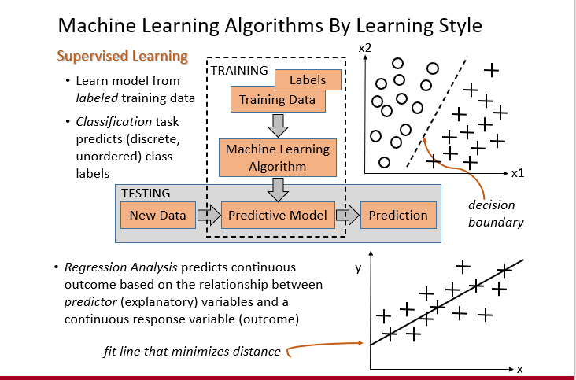

Slide 6
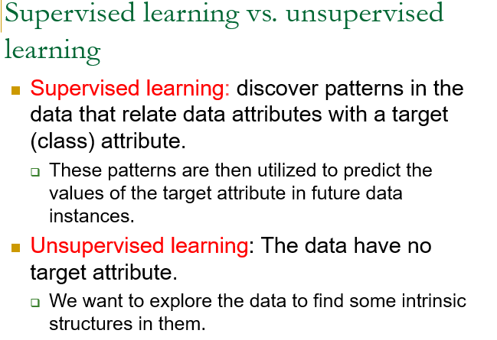

Slide 7
Those intrinsic structures are similar groups called Clusters.
The Process is called Clustering
Note:
Classification – Supervised Learning
Clustering- Unsupervised Learning

Slide 8
More on Clustering
Clustering is a technique for finding similarity groups in data, called clusters. I.e.,
it groups data instances that are similar to (near) each other in one cluster and data instances that are very different (far away) from each other into different clusters.
Real Time Scenarios
groups people of similar sizes together to make “small”, “medium” and “large” T-Shirts.
Tailor-made for each person: too expensive
One-size-fits-all: does not fit all.
In marketing, group customers according to their shopping habits .
Customers who buy Rice, Wheat, Dhal
Customers who buy Pasta, Noodles , burger buns

Slide 9
Types of Clustering – Dimension #1
Hard Clustering: In hard clustering, each data point either belongs to only one cluster
Soft Clustering: In soft clustering, instead of putting each data point into many cluster based on a probability or likelihood of that data point to be in those clusters is assigned.

Slide 10
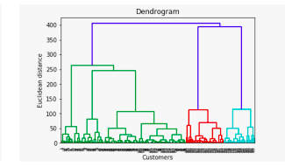
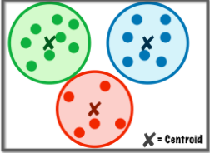
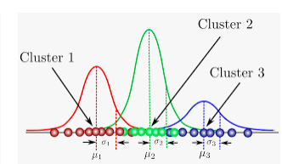
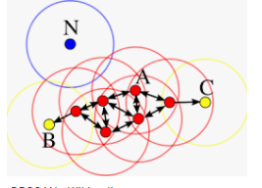
Types of Clustering – Dimension #2
Connectivity models: Centroid models:
Distribution Based models: Density Models
.

Slide 11
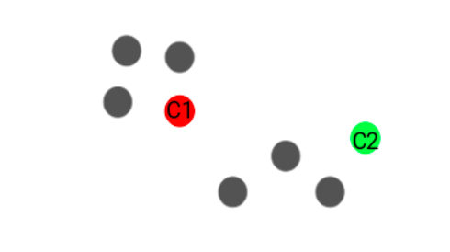
K- Means Clustering
Step 1: Choose the number of clusters k
Step 2: Select k random points from the data as centroids

Slide 12

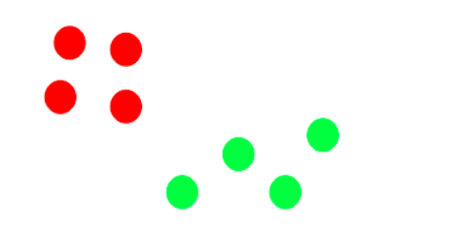
Step 4: Recompute the centroids of newly formed clusters
Now, once we have assigned all of the points to either cluster, the next step is to compute the centroids of newly formed clusters:
Step 5: Repeat steps 3 and 4

Slide 13
When to Stop ?
Centroids of newly formed clusters do not change
Points remain in the same cluster
Maximum number of iterations are reached

Slide 14
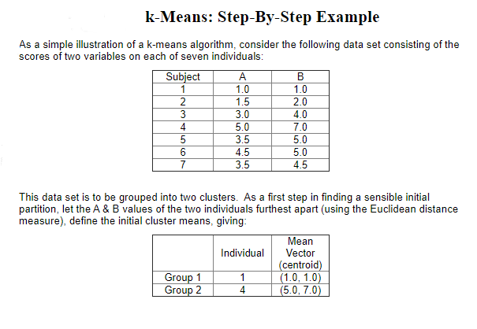

Slide 15
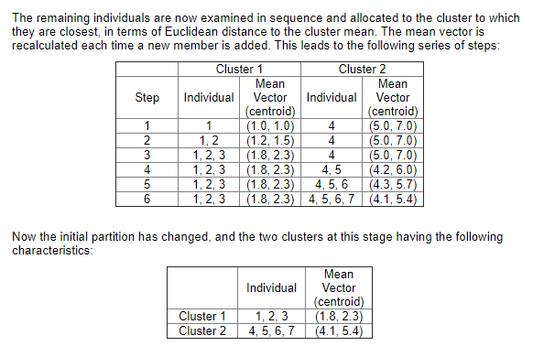

Slide 16
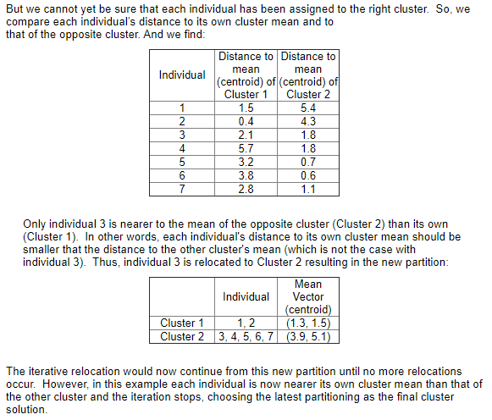

Slide 17
Evaluation: Did you guess the right number of clusters?
Elbow Method
Silhouette Coefficient

Slide 18
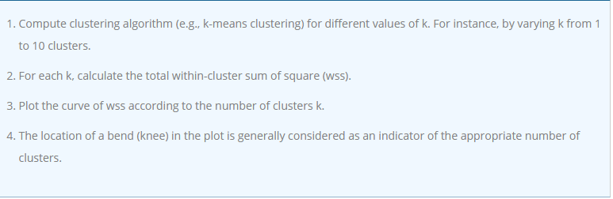
Elbow Method

Slide 19
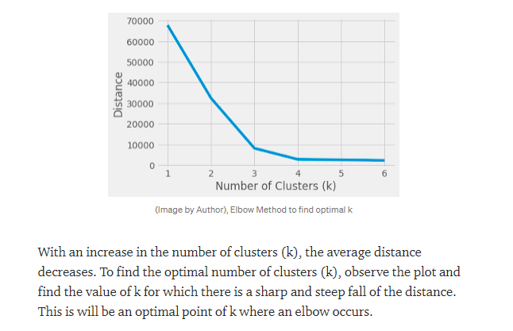

Slide 20
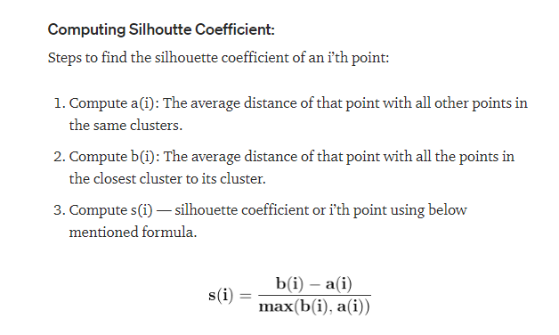
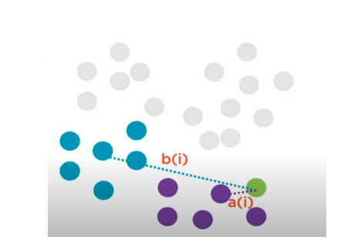

Slide 21
Let us Code K-Means !

Slide 22
A Session on Natural Language Processing

Slide 23
What is Natural Language Processing (NLP)?
Natural Language Processing is all about automatic processing of human languages by the computers either in the form of Text or Speech!
NLP helps us to interact with computers using human languages, the same way we do with humans !
It rooted out from the field of Linguistics along with the development in Computer Science !
So, this field is roughly 50 years old, already!

Slide 24
NLP applications are closely coupled with our lives

Slide 25
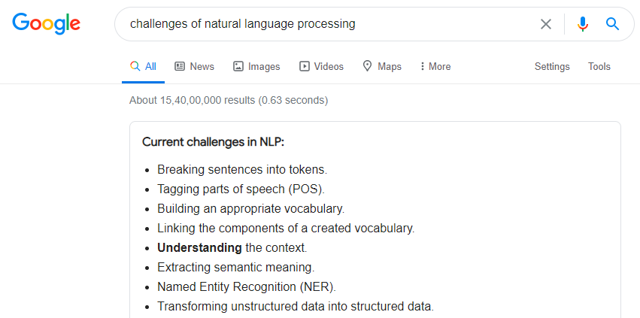

Slide 26
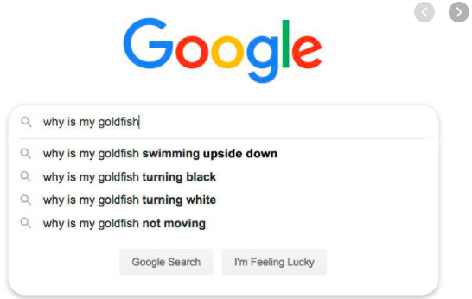

Slide 27
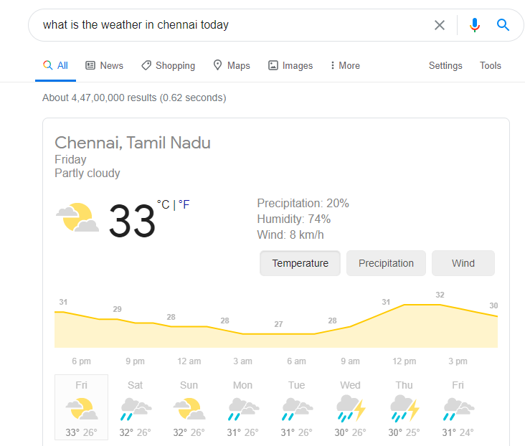

Slide 28
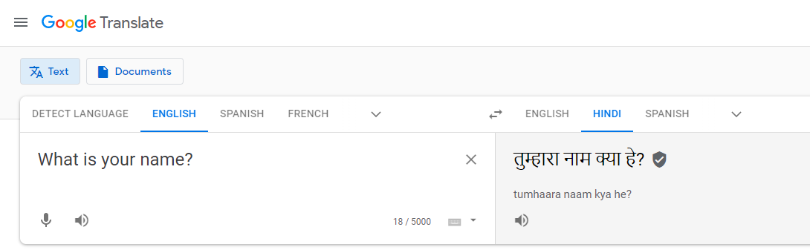
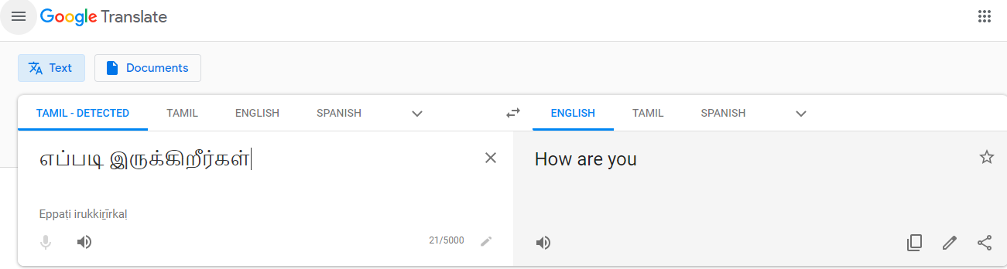

Slide 29
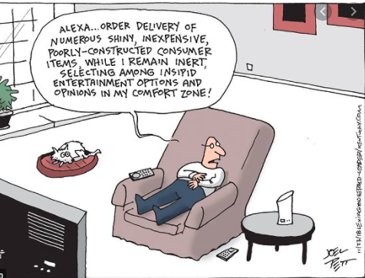

Slide 30


Slide 31
Expectations from NLP Applications
NLP Applications can understand our text input
The word , “understand” means so deep!
Understand grammar
Understand Meaning
Understand Spelling
Understand Intent
Understand Location
NLP Applications can understand our Speech Input
Speech to Text
Text to Speech
NLP Applications can Translate from one Language to another
Machine Translation
NLP Applications can retrieve information relevant to our query
Search Engines (Information Retrieval Systems)

Slide 32
Expectations from NLP Applications
NLP Applications can extract information relevant to our query
Information Extraction Systems
Remember the Query ?: “what is the temperature in Chennai ?”
NLP applications can give Map locations
Google Maps
NLP applications can do tasks for us
Google Assistant, Alexa
NLP Applications can summarize, give statistics .
NLP Applications can analyze and give Suggestions
Movie Reviews, Product Reviews
NLP Applications can Chat with us
Chatbots
WHAT NOT ?

Slide 33

So how do NLP Applications are built How intelligence is fed into them? Are they more powerful than humans?

Slide 34
NLP Application tries to understand Human Languages at different Levels.
Do you remember how we learnt our mother tongue and other languages ?
The Same Way …
So What are those Levels ?
Meanwhile you recollect how you learnt languages…

Slide 35
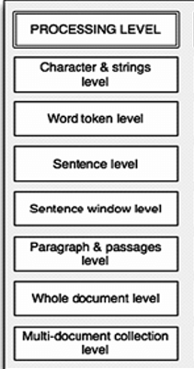
Levels of NLP -Dimension #1
Spell Checkers – both character and Word level
Search Engines - Word and sentence levels
Machine Translation system- Word ,sentence, paragraph and document levels.
Multi-document Level – Summary Generation .

Slide 36
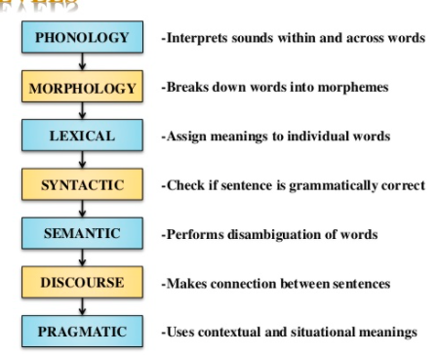
Levels of NLP -Dimension #2

Slide 37
Morphology
Morphology is the study of morphemes and their arrangements in forming words.
the, free, desk, eat--cannot be divided further
Mosquito- cannot be divided into mos and quito
Boys, girls –can be divided into boy, girl and -s

Slide 38
Morphemes
Morphemes (Smallest meaningful unit)
Free Morphs Bound Morphs
E.g.: girl, time E.g.: -s, -ive

Slide 39
Morphology
Inflection Derivation
arrive arrived arrival
Dispose disposed disposal
Improve improved *improval

Slide 40
Morphology
Circumfixes
A prefix and a suffix act together to surround a base
German:
film-en ‘to film’ ge-film-t ‘filmed
Think of an example for our Indian language word

Slide 41
Morphology
Infixes
Infixes create discontinuous bases.
Charau, a language of Vietnam
sulat ‘write’
s-um--ulat ‘wrote
s-in-ulat ‘was written’

Slide 42
Morphology
Reduplication
Using some part of the base (which may be the entire base) more than once in a word.
If the entire base is reduplicated, reduplication resembles compounding.
Indonasian Languages (complete reduplication)
kursi ‘chair - kursikursi ‘chairs’
lalat ‘house-fly’ - lalatlalat ‘house-flies’
ibu ‘mother’ - ibuibu ‘mothers’
Tagalog language (partial reduplication)
bill ‘buy’ - bibill ‘he will buy’
inom ‘drink’ - ininom ‘he will drink’
sulut ‘write’ - susulat ‘he will write’

Slide 43
Morphology for Indian Languages
Indian Languages are rich in Morphology
படிக்கிறாள்= படி < Verb > க்கிறு < Present Tense Marker > ஆள் < Third Person Feminine Singular Suffix >
<படி+க்கிறு+ஆள்>

Slide 44
Stemming and Lemmatization
A preliminary Process for Morphological Processing
Stemming usually refers to a crude heuristic process that chops off the ends of words in the hope of achieving this goal correctly most of the time, and often includes the removal of derivational affixes.
Input : Smiling – Stem : Smil
Lemmatization usually refers to doing things properly with the use of a vocabulary and morphological analysis of words, normally aiming to remove inflectional endings only and to return the base or dictionary form of a word, which is known as the lemma .
Input : Smiling –Lemma : Smile

Slide 45
Part Of Speech Tagging
Annotate each word in a sentence with a part-of-speech marker.
Lowest level of syntactic analysis.
Useful for subsequent syntactic parsing and word sense disambiguation.
John saw the saw and decided to take it to the table.
NNP VBD DT NN CC VBD TO VB PRP IN DT NN

Slide 46
English POS Tagsets
Original Brown corpus used a large set of 87 POS tags.
Most common in NLP today is the Penn Treebank set of 45 tags.
Tagset used in these slides.
Reduced from the Brown set for use in the context of a parsed corpus (i.e. treebank).
The C5 tagset used for the British National Corpus (BNC) has 61 tags.

Slide 47
English Parts of Speech
Noun (person, place or thing)
Singular (NN): dog, fork
Plural (NNS): dogs, forks
Proper (NNP, NNPS): John, Springfields
Personal pronoun (PRP): I, you, he, she, it
Wh-pronoun (WP): who, what
Verb (actions and processes)
Base, infinitive (VB): eat
Past tense (VBD): ate
Gerund (VBG): eating
Past participle (VBN): eaten
Non 3rd person singular present tense (VBP): eat
3rd person singular present tense: (VBZ): eats
Modal (MD): should, can
To (TO): to (to eat)

Slide 48
English Parts of Speech(cont.)
Adjective (modify nouns)
Basic (JJ): red, tall
Comparative (JJR): redder, taller
Superlative (JJS): reddest, tallest
Adverb (modify verbs)
Basic (RB): quickly
Comparative (RBR): quicker
Superlative (RBS): quickest
Preposition (IN): on, in, by, to, with
Determiner:
Basic (DT) a, an, the
WH-determiner (WDT): which, that
Coordinating Conjunction (CC): and, but, or,
Particle (RP): off (took off), up (put up)

Slide 49
Closed vs. Open Class
Closed class categories are composed of a small, fixed set of grammatical function words for a given language.
Pronouns, Prepositions, Modals, Determiners, Particles, Conjunctions
Open class categories have large number of words and new ones are easily invented.
Nouns (Googler, textlish), Verbs (Google), Adjectives (geeky), Abverb (automagically)

Slide 50
Ambiguity in POS Tagging
“Like” can be a verb or a preposition
I like/VBP candy.
Time flies like/IN an arrow.
“Around” can be a preposition, particle, or adverb
I bought it at the shop around/IN the corner.
I never got around/RP to getting a car.
A new Prius costs around/RB $25K.

Slide 51
POS Tagging Approaches
Rule-Based: Human crafted rules based on lexical and other linguistic knowledge.
Learning-Based: Trained on human annotated corpora like the Penn Treebank.
Statistical models: Hidden Markov Model (HMM), Maximum Entropy Markov Model (MEMM), Conditional Random Field (CRF)
Rule learning: Transformation Based Learning (TBL)
Neural networks: Recurrent networks like Long Short Term Memory (LSTMs)
Generally, learning-based approaches have been found to be more effective overall, taking into account the total amount of human expertise and effort involved.

Slide 52
Classification Learning
Typical machine learning addresses the problem of classifying a feature-vector description into a fixed number of classes.
There are many standard learning methods for this task:
Decision Trees and Rule Learning
Naïve Bayes and Bayesian Networks
Logistic Regression / Maximum Entropy (MaxEnt)
Perceptron and Neural Networks
Support Vector Machines (SVMs)
Nearest-Neighbor / Instance-Based

Slide 53
Probabilistic Sequence Models
Probabilistic sequence models allow integrating uncertainty over multiple, interdependent classifications and collectively determine the most likely global assignment.
Two standard models
Hidden Markov Model (HMM)
Conditional Random Field (CRF)

Slide 54
Hidden Markov Model
Probabilistic generative model for sequences.
Assume an underlying set of hidden (unobserved, latent) states in which the model can be (e.g. parts of speech).
Assume probabilistic transitions between states over time (e.g. transition from POS to another POS as sequence is generated).
Assume a probabilistic generation of tokens from states (e.g. words generated for each POS).

Slide 55
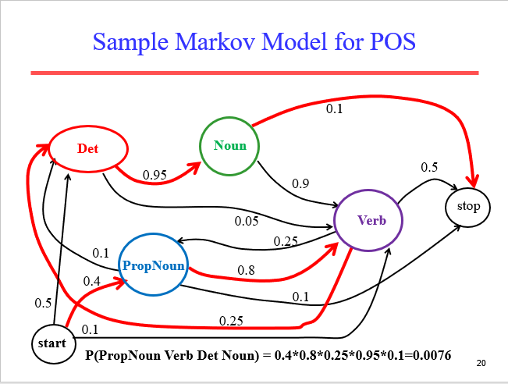

Slide 56
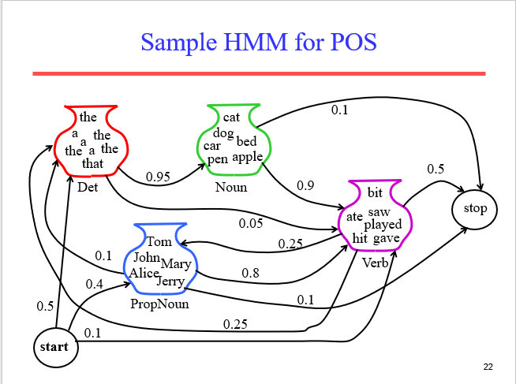

Slide 57
Three Useful HMM Tasks
Observation Likelihood: To classify and order sequences.
Most likely state sequence (Decoding): To tag each token in a sequence with a label.
Maximum likelihood training (Learning): To train models to fit empirical training data.

Slide 58
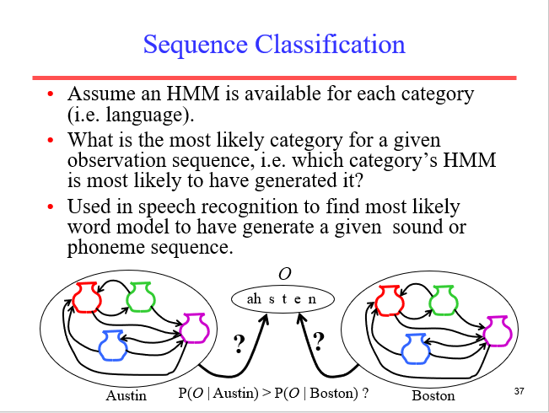

Slide 59
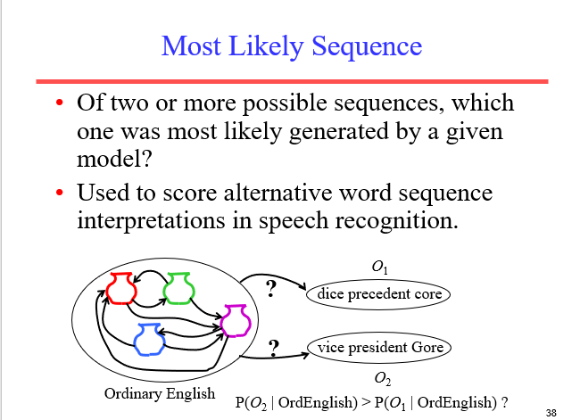

Slide 60
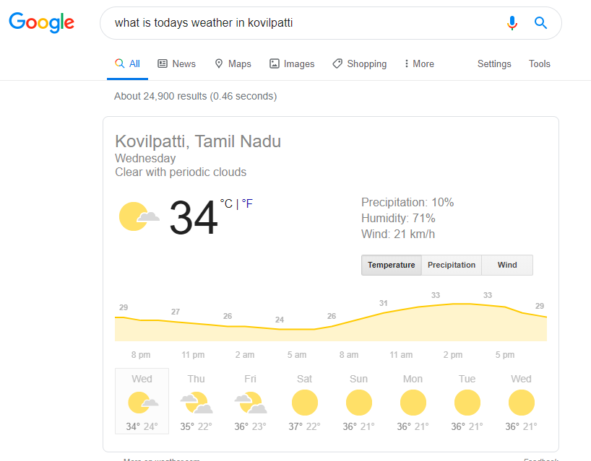
Information Extraction
Information Extraction (IE) systems
Produce a structured representation of relevant information:
May be relation between the extracted elements .
Notes:
Now let's define information extraction! a more general task
Goal: get semantic information out of documents, esp. web pages
Defined as a dumbing-down of more lofty goal of Natural Language Understanding -- more technologically manageable
we're often interested in learning about particular relations (in DB sense)
e.g. scouring financial news for movements of executives
e.g. [person] [assumes/loses] [role] at [company]
I want to scour through text, find relation instances, suck out, put in DB
you're allowed to do domain- and problem-specific customization
lots of potential applications
- business/financial context
- biomedical context, clinical medicine
there's all this unstructured text data about research and patients -- you'd like to be able to get structured information out of it
could lead to other automated information finding: trends, correlations, drug interactions, impact of some protein on expression of a gene, ...

Slide 61
Information Extraction and It’s Connect with Named Entity Extraction
Named Entity Recognition is a key part of Information Extraction system
Robust handling of proper names essential for many applications such as Summarization, IR, Anaphora etc
Pre-processing for different classification levels
Information filtering
Information linking

Slide 62
What is NER ?
NER involves identification of proper names in texts, and classification into a set of predefined categories of interest.
Three universally accepted categories:
Person, location and organisation
Other common tasks: recognition of date/time expressions, measures (percent, money, weight etc), email addresses etc.
Other domain-specific entities: names of Drugs, Genes, medical conditions, names of ships, bibliographic references etc.

Slide 63
What is not NER?
NER is not event recognition.
NER does not create templates,
NER does not perform co-reference or entity linking,
though these processes are often implemented alongside NER as part of a larger IE system.
NER is not just matching text strings with pre-defined lists of names.
It recognises entities which are being used as entities in a given context.
NER is not an easy task!

Slide 64
Ambiguity Examples
Person vs Location
Sir C. P Ramaswamy was the Divan of Travancore (Per)
Sir C.P Ramaswamy Road is in Chennai (Loc)
Person vs Organization
Anil Ambani opened Reliance Fresh (Per)
Reliance Fresh is under Anil Amabani Group Ltd (Org)

Slide 65
More complex problems in NER
Issues of style, structure, domain, genre etc.
Punctuation, spelling, spacing, formatting, ….all have an impact
Dept. of Computing and Information Science
Manchester Metropolitan University
Manchester
United Kingdom
> Tell me more about Leonardo
> Da Vinci

Slide 66
Problems in NE Task Definition
Category definitions are intuitively quite clear, but there are many grey areas.
Many of these grey area are caused by metonymy.
Person vs. Artefact
Organisation vs. Location
Company vs. Artefact
Location vs. Organisation

Slide 67
Entity Types

Slide 68
Approaches in Named Entity Resolution
Dictionary Look-up
Rule based ( Using lexical, contextual and morphological information)
Hidden Markov Model
Machine Learning Model
Hybrid methods (Statistical+ Linguistics)

Slide 69
Challenges of NER in Indian Languages
Following are the major challenges encountering in Indian Languages.
Agglutination
Ambiguity
Between Proper and common nouns
Between named entities
Lack of Capitalization

Slide 70
Challenges of NER in Indian Languages
Agglutination
In Dravidian languages, words consist of a lexical root to which one or more
affixes are attached.
Example in Tamil:
1) ராமனைத்தவிர (otherthan Raman)
2) செவ்வாயன்று (On Tuesday)
3) இந்தியாவிலுள்ள (In India)
4) கண்ணனைப் பற்றிக் கொண்டு (hold onto Kannan)

Slide 71
Challenges of NER in Indian Languages
Ambiguity
Comparatively Indian languages suffer more due to the ambiguity that exists between common & proper nouns and between named entities itself. In some cases same word can refer to different named entity types. Those instances can recognized by contextual information.
Examples:
Hi: Akash - Person name and Sky
Hi: Sooraj - Person name and Sun
Hi: Chaanth – Moon and Silver
Hi: Aam – Mango and Common
Ml: Roopa – Person name and Rupee
Ml: Madhu – Person name and Honey
Ml: Mala – Person name and Garland

Slide 72
Challenges of NER in Indian Languages
திங்கள் - Day and Month
மலர் - Person name and Flower
செவ்வாய் - Day and planet
சக்தி – Person name and Power
மாலை – Evening and Garland
வெள்ளி– Silver, Planet, Day

Slide 73
Challenges of NER in Indian Languages
Spell Variation: Due to the different writing styles same entity is represented in various word forms. In Tamil, sanskirit letters such as “ja”, “sha”, “sri” “Ha” are replaced by “sa”,“ciri”, “ka”
Example:
Roja can be written as Rosa
Srimathi - cirimathi
Raja - rasa
ShajahAn - sajakAn

Slide 74
Challenges of NER in Indian Languages
Lack of Capitalization
In English and some other European languages capitalization is considered as the important feature to identify proper noun.
It plays a major role in NE identification.
Unlike English capitalization concept is not found in Indian languages.

Slide 75
Let us Code Few NLP Stuffs !

