Slide 1

WhyCode
Why The Code Is Like This
Evidence-backed repository understanding
Read the code. Trace the change.
Understand the decision.
WhyCode / HackFront India 01
Notes:
Selected theme: AI and Developer Tools. Selected problem: Why The Code Is Like This. Live: https://whycode-76qv.onrender.com ; source: https://github.com/Anilcodee/whycode . Branding asset: repository docs/WhyCode-GitHub-App-Logo.png.

Slide 2
The context is scattered
“What changed?” is easier to answer
than “Why did it change?”
A developer must connect source files, commits,
pull requests and issues to reconstruct the context.
For onboarding developers, contributors and maintainers
WhyCode / HackFront India 02
Notes:
Problem framing from the project README. No measured productivity statistics or customer research claims are made. Historical intent may not be recorded.

Slide 3
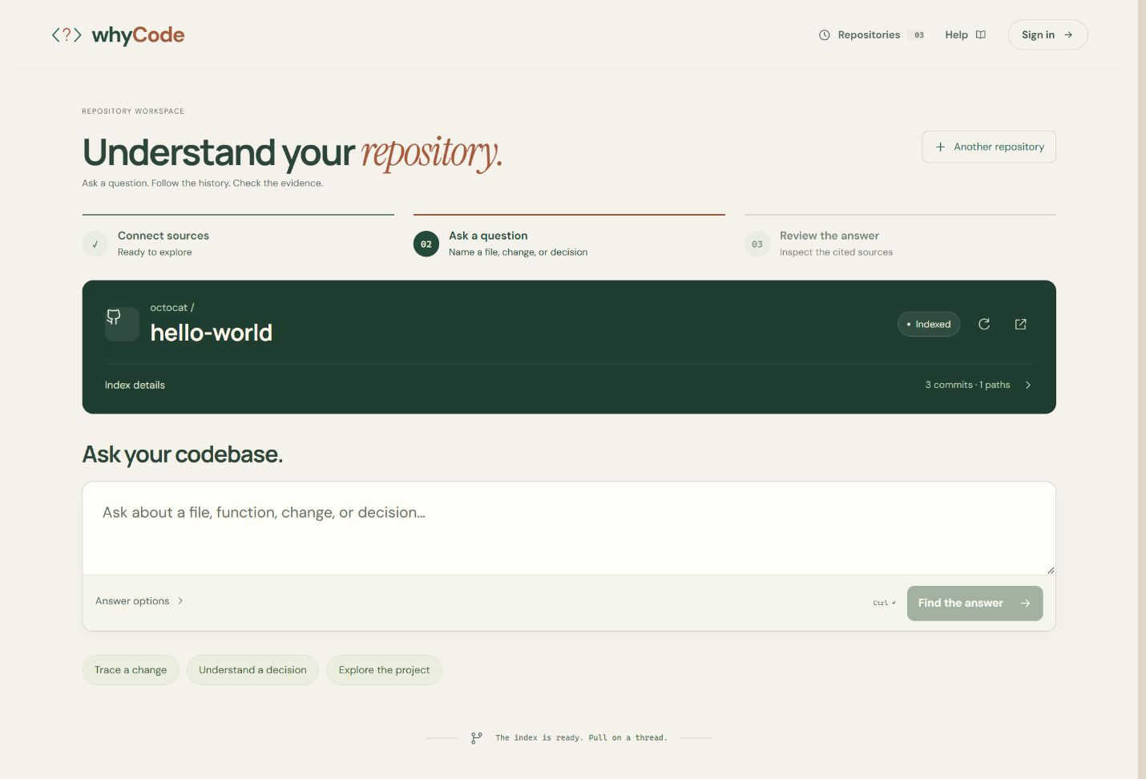
Connect a repository. Ask a focused question.
Public exploration works without an account. Coverage is bounded.
WhyCode / HackFront India 03
Notes:
Existing prototype screenshot: docs/whycode-workspace-ready.jpg. Source: README user journey and coverage limits. Current source is pinned to a revision; not every file, branch or commit is indexed.

Slide 4
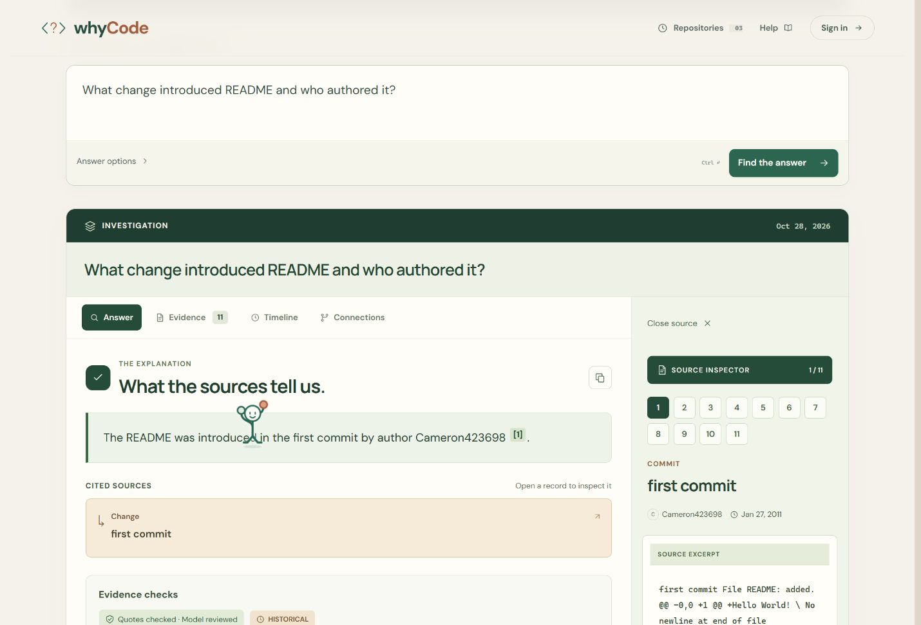
Inspect the evidence behind the answer
01 Ask about a change
02 Open the citation
03 Read the source
WhyCode / HackFront India 04
Notes:
Existing prototype screenshot: docs/whycode-answer-reading-panel.jpg. It demonstrates an authored README change, not recovery of undocumented architectural intent. Model output should be checked against original evidence.

Slide 5
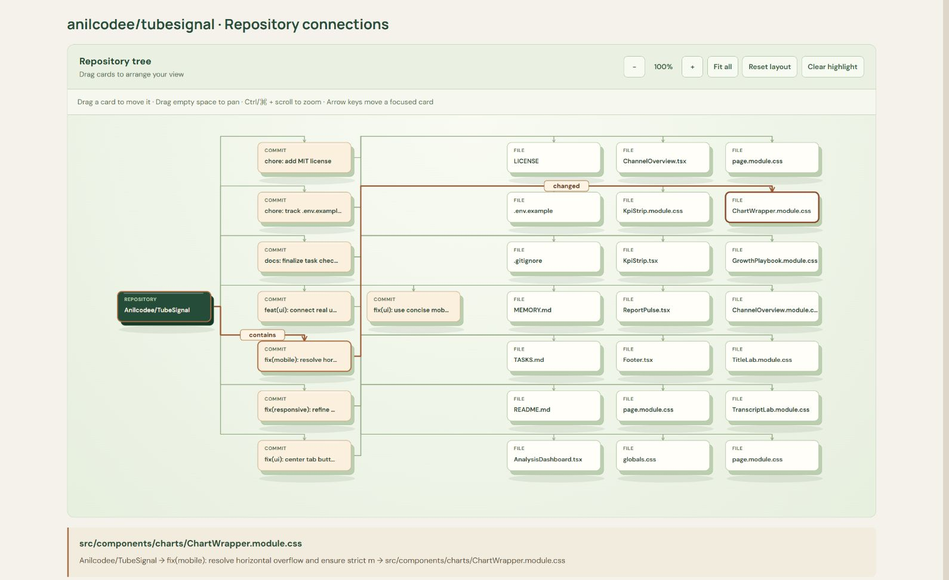
Follow connections back to their source
Zoom, drag nodes and highlight the path from the repository root.
WhyCode / HackFront India 05
Notes:
Existing prototype screenshot: docs/whycode-readable-relationship-labels.jpg. Repository graph is a navigable representation of indexed context, not a complete program dependency graph.

Slide 6
Evidence before explanation
Collect and retrieve
Validate and review
Pinned files and a selected window
of changes and discussions
Citations and exact quotations checked;
a separate model pass reviews claims
Answer with sources — or withhold when support is missing
Checks reduce risk; they do not guarantee semantic correctness.
WhyCode / HackFront India 06
Notes:
Implementation: apps/api/src/services/question-service.ts and claim-validation domain code. Model review is not independent human validation. No accuracy benchmark is claimed.

Slide 7
Technology with a clear responsibility
Neo4j Aura
Supabase + Upstash
Public evidence relationships
and related-context retrieval
Identity, saved work, encrypted runtime
records, job ownership and request limits
Gemini + Sarvam
React + Express + Docker
Answer generation and review; optional
Hindi/Hinglish for public explanations
Typed browser/API workflow, GitHub
collection and Render deployment
WhyCode / HackFront India 07
Notes:
Sources: README architecture, runtime configuration and source. SerpAPI adds optional public web context in a secondary lane. Private source snapshots are isolated from public Neo4j storage.

Slide 8
Clear ownership and tested boundaries
Guest → optional import → account workspace
Temporary guest records; account-owned saved investigations.
Private access requires separate read-only GitHub App permission.
109 tests in the latest documented verification run
API + frontend checks, plus both builds. Database integration checks
cover isolation, recovery and stale writes; no load/accuracy benchmark.
WhyCode / HackFront India 08
Notes:
Source: README verification (73 API + 36 frontend), qa-audit/FIX-REPORT.md and runtime integration scripts. Counts refer to the prior documented run, not a new test execution for this presentation. Deletion removes relevant saved work, not GitHub content or every public index. Private excerpts can go to the model after explicit consent.

Slide 9
Try WhyCode
whycode-76qv.onrender.com
github.com/Anilcodee/whycode
Demo: guest access or configured Google/GitHub login
Render Free may sleep. Public email delivery awaits custom SMTP.
Indexing and retrieval are bounded; model mistakes remain possible.
AI disclosure: Codex assisted development and documentation.
Gemini and Sarvam power the described runtime AI features.
WhyCode / HackFront India 09
Notes:
Next steps: labeled evidence-quality evaluation, measured developer task study, production email delivery, hosted acceptance/load testing, monitoring and restore checks. Sources: project README, docs/hackathon/submission-copy.md, Render deployment log supplied by user. No independent security certification or measured time savings claimed.

